Slide 1
Gunnery Brief C& D, 1/11 ACR Tank Gunnery
1-17 NOV 2011

Slide 2
1/11 ACR Mission & CDR’s Intent
1/11 ACR executes HBCT Level One M2A2 Gunnery from 05-20 OCT 11 and M1A1 Gunnery from 1-17 NOV 11 in order to qualify all crews and platoons on their combat platforms, increase proficiency in MOS skills and prepare units for success in Full Spectrum Operations.
CDR’s Intent
Purpose: IOT qualify lethal crews in a challenging and demanding training environment.
Key Tasks:
Prepare crews for PTDO and operational requirements
Conduct thorough and complete pre-gunnery requirements as per FM 3-20.21
Pass all gates to live fire exercises in AGTS/UCOFT prior to T-1 week to Troop/Company’s assigned gunnery
Complete Troop/Company led TCGST/BCGST for all firing crews prior to T-1 week to Troop/Company’s assigned gunnery
Qualify all crews
Conduct thorough after operations PMCS and after operations maintenance
End State: All crews qualified, detailed completion of PMCS completed on all vehicles and ancillary equipment, and all crews are qualified and prepared for future combat operations with no loss of personnel and equipment.

Slide 3
Training Objectives & Prep Tasks
Training Objectives
All Crews are capable of executing react to contact drills IOT engage and destroy enemy.
Develop leaders that understand and are capable of massing weapon system’s effects on the objective.
Leaders that understand a hybrid threat and operations on an asymmetrical battlefield.
Mechanized formation that is knowledgeable on crew served weapon systems and main gun weapon systems that matriculate to experts in engagement and target discrimination to mitigate collateral damage.
Platoons trained to “P” level in all identified critical crew tasks.
Gunnery Prep Tasks
TASK | D CO
GST | 03-20 OCT 11
GT I | 03-20 OCT 11
AGTS | JUL – NOV 11
VCE Cert. | 24-25 OCT 11
Reference: FM 3-20.21 (HBCT Gunnery)

Slide 4
Stabilized Platform Qualification Standards
GT II: Crew scores at least 70 points on at least 7 of 10 engagement and attain 700 or more points overall.
GT III: Crew scores at least 70 points on at least 3 of 5 engagements and attain 350 or more points overall.
GT IV: Crew scores at least 70 points on at least 3 of 5 engagements and more than 350 points overall.
NOTE: If GT III and GT IV are fire together the crew must score at least 70 points on at least 7 or 10 engagements and attain 700 or more points overall.
GT V: Crew scores at least 70 points on at least 7 of 10 engagements and attain 700 or more points overall.
GT VI: Crew scores at least 70 points on at least 7 of 10 engagements and attain 700 or more points overall.
Crew Qualification Criteria
Distinguished | Crew scored at least 70 points on at least 9 of 10 engagements AND more than 900 points overall.
Superior | Crew scored at least 70 points on at least 8 of 10 engagements AND more than 800 points overall.
Qualified | Crew scored at least 70 points on at least 7 of 10 engagements AND more than 700 points overall.
Unqualified | Crew failed to qualify on at least 7 engagements OR scored less than 700 points.
Note:
each target is scored separately and then averaged for the total engagement score. If a crew earns less than 70 points on a target within the engagement, then they fail the engagement, regardless of how many points they earn on the other target. Also, crews must qualify one engagement at night.
If a crew fails to qualify, that crew will re-fire for qualification. The highest rating that crew can ear when re-firing is “Qualified”. A crew re-fires only the engagement s with a score of 69 or fewer points. A crew re-fires only the number of engagements required to obtain a qualified rating (700 points and 7 qualified engagements).

Slide 5
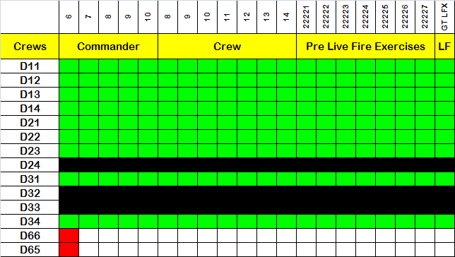
AGTS Statistics
Notes
11/14 crews firing (D24, D32, & D33 not firing)
19/11 crews complete w/ AGTS as of 25 OCT
D65 and D66 will complete AGTS during Week 6 (gunnery support window to C TRP)

Slide 6
GUNNERY SCHEDULE

Slide 7
1/11 ACR Bradley Gunnery – Oct. 2011
Week | Sunday | Monday | Tuesday | Wednesday | Thursday | Friday | Saturday
1 |  |  |  |  |  |  | 1
2 | 2 | 3 | 4 | 5 | 6 | 7 | 8
3 | 9 | 10 | 11 | 12 | 13 | 14 | 15
4 | 16 | 17 | 18 | 19 | 20 | 21 | 22
5 | 23/30 | 24/31 | 25 | 26 | 27 | 28 | 29
RSOI
B TRP Gunnery Support
A TRP: Boresight & GT II
A TRP: GT III/IV
A TRP: Make up /Maintenance
A TRP: GT V
Roll Out
RSOI
12-01 Training Days
B TRP Gunnery Support
A TRP Gunnery Support
A TRP: Make up /Maintenance
A TRP: RETRAIN
A TRP: GT VI
A TRP: GT VI Make up
B TRP: Boresight & GT II
B TRP: GT III/IV
B TRP: Make up /Maintenance
12-01 Training Days
A TRP Gunnery Support
B TRP: GT V
B TRP: Make up /Maintenance
B TRP: RETRAIN
B TRP: GT VI
B TRP: GT VI Make up
Clean Up
7

Slide 8
MANNING OVERVIEW

Slide 9
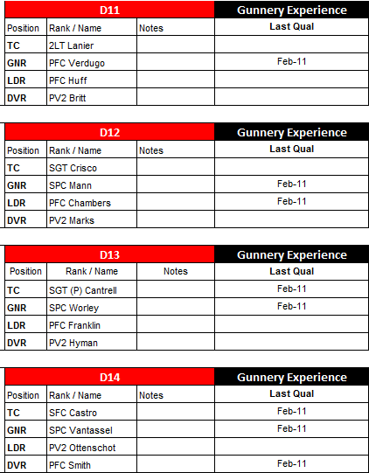
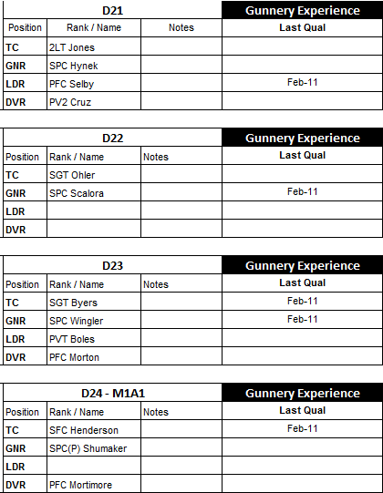
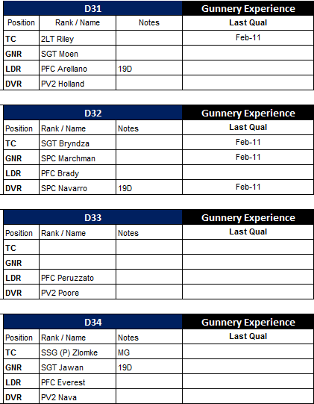
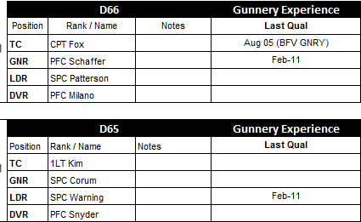
Crew Rosters
NOT FIRING
NOT FIRING
Note:
12/14 crews firing

Slide 10
LAND AND AMMO

Slide 11
Land & Ammo
M2A2 | Required
 | 7.62mm | AP | HE
GT II | Dry | Dry | Dry
GT III | 450
GT IV | 100 | 24 | 24
GT V | 600 | 40 | 24
GT VI | 450 | 32 | 48
Total | 1,650 | 104 | 104
Drawn | 40,000 | 7000 | 6000
Table | Range
GT II | RG 1
GT III/IV | RG 1
GT V | RG 1
GT VI | RG 1
Notes:
Land locked in
Ammo draw has 10% overage to account for refires

Slide 12
RANGE 1 OVERVIEW

Slide 13
Range 1
210
220
230
240
080
070
060
050
040

Slide 14
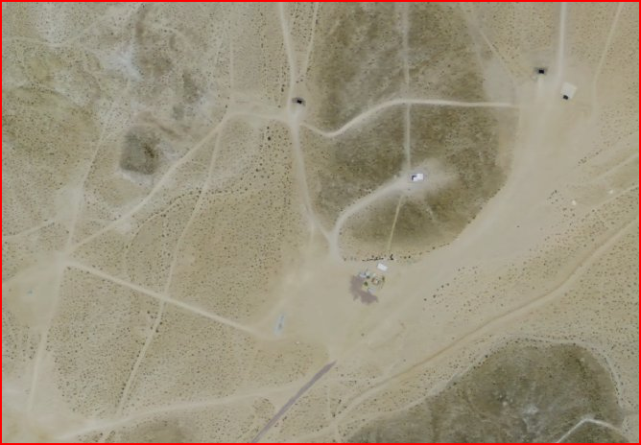
Overview
BP 1
RNG 1 Tower
Boresight/Zero Line
RSO’s Clearing Pit
Fire Line
CASEVAC Vehicle
Maintenance Area
Fire Line
CP
Ammo Pad
AAR Shack
Fuel Site
Ground Guide Area (2.5 Ton & Above)
Gate Guard

Slide 15
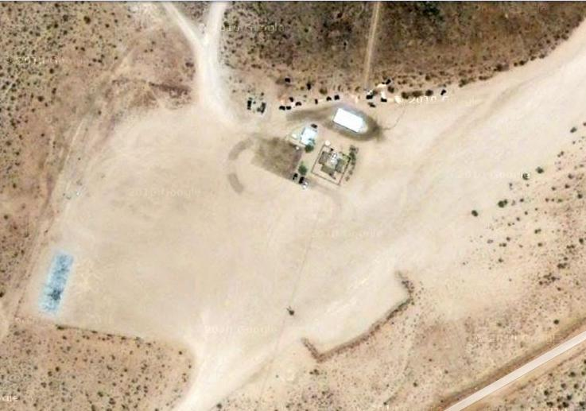
Detailed
CASEVAC
at Tower
To Left
Lane
Water Buff.
To Right
Lane
Chow
Area
AAR &
Warm Up
BLDG
BFVs
MAINT.
SITE
TACTICAL VEHICLES
FUEL
SITE
RETRAINING
To AMMO Point
To Goldstone Rd

Slide 16
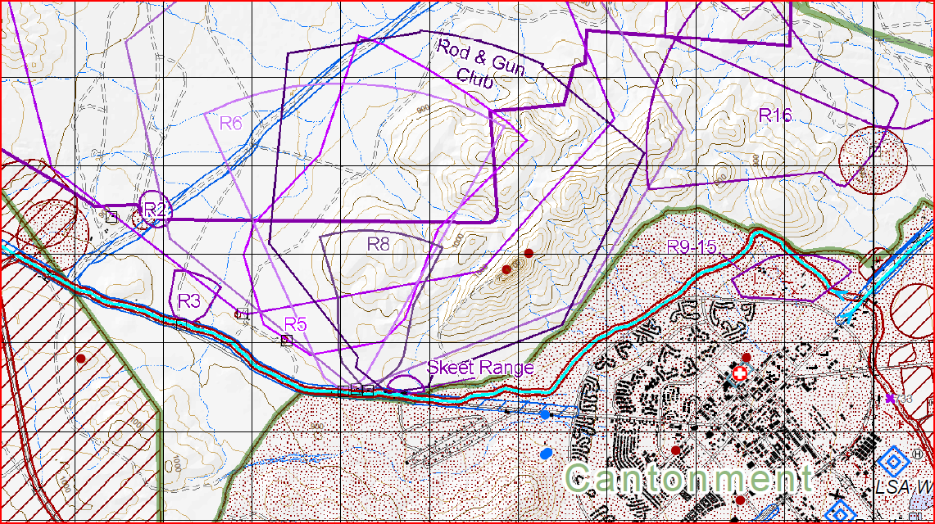
Movement Routes to Range 1
Wheeled Vehicles
Tracked Vehicles
Serial 1 (ADVON): D7, D5 (OIC & Ammo NCOIC)
Serial 2 (Tracks): D44, 4x M2, D77, D88, D6
Serial 3 (Wheels): D40, D8, D82

Slide 17
GT VI Scenario (T)

Slide 18
Range 1 - GT VI

