Slide 1
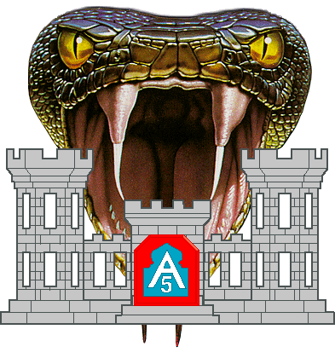

1-395th Engineer Battalion
Inside the Wire Threat
Awareness Brief
OCT 2012

Slide 2
Terminal Learning Objective
Action: | Receive an Inside the Wire Threat Awareness period of instruction.
Conditions: | You are given a classroom environment; period of instruction by a Trainer Mentor (TM) subject matter expert (SME) instructor; course materials.
Standards: | Develop an increased understanding and awareness of the inside the wire threat, warnings and indicators of such an attack and friendly best practices to mitigate their effectiveness. Understand how each of these topics impacts operations.

Slide 3
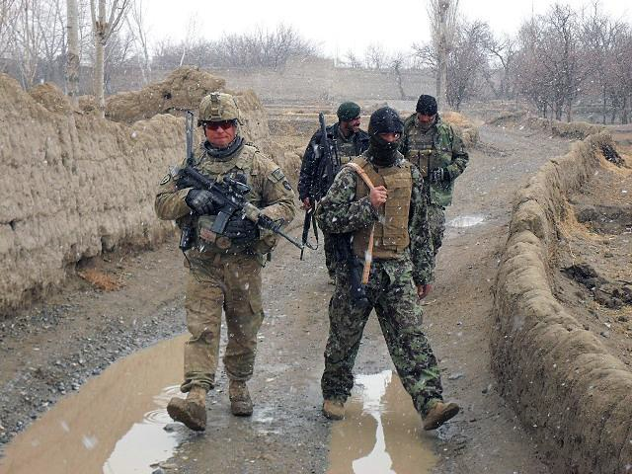
Enabling Learning Objectives
To inform deploying units, trainers, and scenario writers of the increase in inside the wire or “green on blue” attacks over the last several years in Afghanistan.
To identify the possible warning signs that an insider threat may exhibit prior to the execution of an attack.
To identify some observable indicators that may reduce the likelihood of a future insider attack.

Slide 4
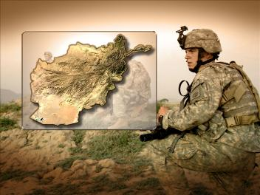
References
NATO Training Mission Afghanistan http://ntm-a.com/
ISAF NATO http://www.isaf.nato.int/
Asymmetric Warfare Group (AWG) Insider Threats in Partnering Environments Smart Card JUN 2011
COMISAF Advisory and Assistance Team Insider Threat Post Incident Mitigation Techniques, AUG 2012
Center for Army Lessons Learned (CALL) Publications
  GTA 90-01-033, FEB 2012
  GTA 90-01-036, MAR 2012

Slide 5
Inside the Wire Threat
“Green on Blue”
Insider attacks: An assault by an individual or group of individuals against coalition forces who were allowed to enter a secure area or work jointly with international forces.
Green (ANSF) on Blue (ISAF/U.S.): attacks by persons enrolled in or perceived to be Afghan National Security Force (ANSF), that could result in U.S, or NATO International Security Assistance Force (ISAF) injury or death
The ANSF (Green) includes, but is not limited to the following organizations:
  Afghan National Army (ANA)
  Afghan National Police (ANP)
  Afghan Uniformed Police (AUP)
  Afghan Local Police (ALP)
  Afghan Security Guard (ASG)

Slide 6
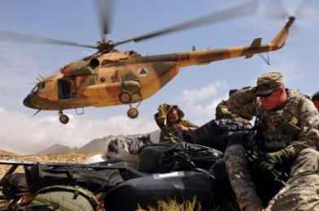
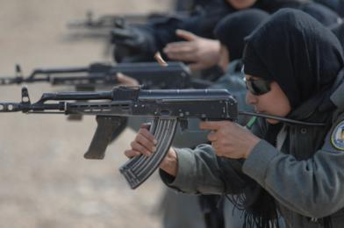
Background / Incident Trends
First incident reported in 2007 in Afghanistan
Attacks have doubled from 2010 to 2011
Attacks have doubled again in 2012 with four months of the year still remaining
Attacks alone in 2012 have accounted for half (50%) of all reported incidents since 2007
This increasing trend goes hand-in-hand with the increasing level of cooperation between coalition forces and the ANSF

Slide 7
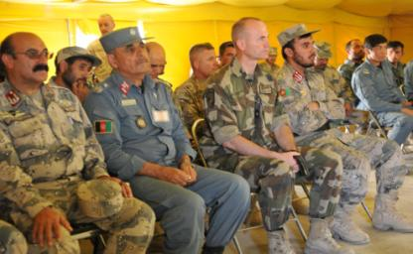
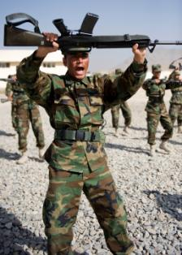
Background / Incident Trends
Roughly 20% of the Green-on-Blue events also included a
Green-on-Green aspect
Solely Green-on-Green incidents
actually outnumber the
Green-on-Blue ones
Slightly more than half of the
incidents occurred inside a secure area
The vast majority of the incidents occurred outdoors
Nearly 15% of the incidents happened after or during a pre-coordinated meeting with Afghan locals, such as a Key Leader Engagement (KLE) event or Shura.
Notes:
Our ANSF parA handful of the events involved drug use, or alledged drug use, by the shooter.
Occasionally, a non-ANSF shooter will dress in an ANSF uniform.
tners are also being victimized by these attacks

Slide 8

ISAF Grievances with ANSF
  Use drugs
  Are traitors, cannot be trusted
  Are dangerous / unstable
  Are incompetent but allowed to serve
  Poor fire control measures, fire all rounds right away
  Treat dogs poorly
  Practice poor hygiene
  Are lazy and refuse to work hard
  Fasting during Ramadan endangers themselves and others (light headed)
  Cannot be trusted to do thorough searches
  Corrupt

Slide 9

Top ANSF Grievances Against ISAF
ISAF conduct night raids
Perceived disrespect of Afghan women and their privacy
ISAF set-up of needless roadblocks
Civilian and ANSF casualties resulting from ISAF activities
ISAF personnel exhibiting extreme arrogance, and refusal to take advice from ANSF
Urinating in public, exposing selves to women
Failure to adequately protect civilians from harm
Failure to respect Islam, the Quran, or a mosque
Failure to respect Afghan elders
  Commit war crimes and atrocities, leaders fail to prosecute the Soldiers responsible
  Over promise and under deliver

Slide 10
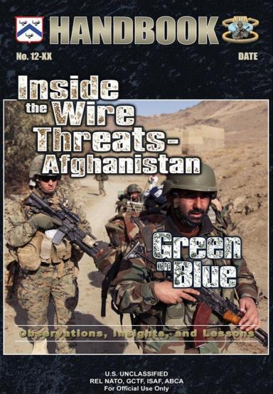
COMISAF INSIDER THREAT TACTICAL DIRECTIVE (2 MARCH 2012)
Underlying Motives
“The largest percentage of Green-on-Blue attacks started as personal disagreements between Afghan National Security Forces (ANSF) and US/Coalition Forces involving as many as 40% of known incidents.”
  Guard Post on Joint Base
  Joint Training
  ANA Compound
  2011 Kabul Air Base Briefing
Notes:
Definition/Issue
Identifying, understanding underlying motives, and rapidly reacting to inside the wire attacks in
Afghanistan is difficult in the this environment. Inside the wire threats are defined as “Green-on-Blue attacks by persons enrolled
or perceived to be Afghan Soldiers or Police resulting in U.S., International Security Force
Assistance (ISAF), or United Nations Assistance Mission in Afghanistan (UNAMA) bodily harm
or death.” Determining the origin, scope, and strategy to combat inside the wire threats within
the Afghan National Security Forces (ANSF) affects both current and future transition
operations. The focus of these next few slides is on preventing, defending against, and defeating both
the causes of and mitigating the effects of Green-on-Blue incidents.
Historical Context Inside the wire attack examples
It is important to recognize that not all Green-on-Blue attacks are alike. Every attack is different
and the circumstances vary. Some attacks were preceded with no warnings or provocation.
U.S. UNCLASSIFIED//FOR OFFICIAL USE ONLY
REL NATO, GCTF, ISAF, ABCA
However, vigilance is necessary, and there are important indicators and lessons that can be
derived in looking at the whole spectrum of incidents.
Below are examples based on recent past Green-on-Blue attacks.
Here are a few examples and some of you here may have experienced this type of threat before and have your own. These are included here for brief discussion and better understanding of the threat. There are no single factors or scenarios that explain all of the attacks but many are started as personal disagreements.
At a joint compound, an Afghan National Police (ANP) member was manning a post with his
U.S. service member partner. This was not first time that the U.S. service member had worked
with the ANP member, but the ANP member was acting sporadic and arguing. He asked the U.S.
service member to exchange some USD for rupees. The U.S. service member refused and
requested that ANP member stop asking. The ANP member became angry and began acting
careless with his weapon, pointing it in the sky and walking away from the post. The U.S.
service member called the ANP sergeant of the guard to report the ANP member’s behavior. The
ANP sergeant of the guard ordered the ANP member to return to his post. The ANP member
then claimed he would call the Taliban and continued his erratic actions. The U.S. service
member followed the proper escalation of force and ultimately shot the ANP member when he
turned his weapon on the U.S. service member.
Warning signs
• Erratic behavior
• Making exaggerated claims
• Leaving post and returning
• Careless with weapon and pointing it around
• Not obeying the orders of his Afghan leaders
Conducting joint training, a unit of U.S. service members and ANP members were walking to the
training range. One ANP member was acting erratic and began shooting blindly into the valley.
A U.S. service member ordered him to stop and reprimanded him for his behavior. The ANP
member became cocky but then kept to himself as they continued walking to the training range.
Once at the range, the U.S. service members took a break. The ANP member then opened fire on
the group and was killed by return fire.
Warning signs
• Attitude and demeanor changed following reprimand and correction
• Erratic behavior
• Careless with weapon
U.S. UNCLASSIFIED//FOR OFFICIAL USE ONLY
REL NATO, GCTF, ISAF, ABCA
• Soldier kept to himself following his reprimand
At an Afghan National Army (ANA) compound, U.S. service members entered to speak with
ANA leadership. As some of the U.S. service members waited outside, one asked an ANA
soldier for a lighter for his cigarette. The ANA soldier refused and rebuffed the U.S. service
member for wanting to smoke during Ramadan. The U.S. service member cursed the ANA
soldier and disparaged his religious beliefs. The argument quickly escalated and the ANA soldier
raised his weapon. Shots were fired, resulting in both of the individuals being wounded.
Warning signs
• Escalating argument
• Personal offense to cultural insensitivity

Slide 11
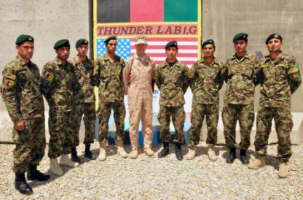
Types of GoB Actors
Personal:
Acts without guidance or pre-planning from external entities
Based on personal motivations, grievances, or emotions: ideological,
combat stress, unknown
May be spur-of-the-moment
Vast majority of GOB attacks are of this variety
Co-optees:
Existing ANSF member recruited to act on behalf of the insurgency.
Use ideology, money, intimidation, threats, and family/tribal ties
Infiltrators:
Existing insurgent joins ANSF
Impersonators:
Insurgent posing as ANSF
member
Use of counterfeit uniforms
and identification

Slide 12
Types of GoB Attacks

Slide 13
Insider Threat Categories
Category I Indicators
Complains about other nations or religions
Advocates violence beyond what is the accepted norm
Abrupt behavioral shift
Experiences personal crisis
Reclusive behavior
Category II Indicators
Verbally defends radical groups and/or ideologies
Speaks about seeking revenge
Cuts ties with unit, family, or friends
Attempts to recruit others to support the insurgents
Category III Indicators
Advocates violence as a solution to problems
Shows a sudden shift from “upset” to “normal”
Takes suspicious travel or unauthorized absences
Action: Closely monitor Situation and or discuss problems with individual
CAT I
Threat Indicator
CAT II
Action: Administrative action (such as counseling), refer to counterintelligence
CAT III
Action: Refer to counterintelligence & chain of command. Immediate actions, such as removing weapons or detention
Notes:
Early indicators of violent behavior are often displayed before an insider attack occurs. It is vitally important that you create bonds of trust and become comrades with partners.
There are often atmospherics, or warning signs, that in retrospect should have indicated to the victims that something was wrong. Survivors of the incidents often say that “something didn’t feel right“, or that something was out of the ordinary. In other words, situational awareness and intuition should play a role in preventing these events.
The shooter is often someone who displays psychological problems, such as erratic or withdrawn behavior, or undergoes an abrupt attitude or personality change. Drug use is also a possible indicator.
Complacency on the part of coalition security forces played a role in many of the incidents. Lax personal security measures and ignoring force protection protocols are recepies for disaster. This also holds true for allowing our ANSF partners to relax protocols as well, for example, when unauthorized individuals are allowed access to secure areas.
A lack of cultural sensitivity can erode a sense of mutual respect between coalition forces and the ANSF. Several cases arose out of ANSF feeling of a lack of respect by coalition force members.

Slide 14
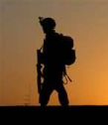
Key Considerations:
What are my Personal Security Habits?
Am I aware of our partner nation’s culture, customs , traditions and codes?
“Deliberate Demeanor”: Do I deliberately exercise proper demeanor to avoid friction points?
When in a “friction point” situation, how do I aim to diffuse it?
Am I aware that my action or inactions may affect others?
Me

Slide 15
Key Considerations cont…
What are our team’s security TTPs?
Are our physical areas suited to help reduce the threat?
What is our team attitude toward locals? Do we think it helps to reduce the threat?
Me
My Team

Slide 16
Key Considerations cont…
Do we treat our local national linguists (LNL) with dignity and respect to get them closer to us than the enemy?
Do we encourage our US hired linguists (USH) to develop LNLs as “sensors “and “friction reducers”?
Me
My Team
Our Interpreters

Slide 17
Key Considerations cont…
Do we utilize our USH as “sensors” and “friction reducers”?
Do we seek to reduce regional bias among LNLs by promoting teamwork?
Do we engage our partners in the “frank discussions” about the threat?
Does my team influence our partnered environment to help reduce the treat i.e.
  Sports and exercise as a pressure release,
  being respectful of prayer times,
  Developing a strong partnership to
  align our partners closer to us
Me
My Team
Our Interpreters
Our Partners

Slide 18
Key Considerations cont…
Do we review our ROE and “actions on” in anticipation of GoB / ITW threat?
Do we focus FP efforts inward in as well to the routine outward focus?
  Roving Guards,
  Guardian Angels,
  ISR focus inside our Tactical
  infrastructures
Do we have a well-detailed and
regularly refined and rehearsed
Base Defense plan?
Me
My Team
Our Interpreters
Our Partners
Our Force Protection

Slide 19
Deliberate Demeanor: Given a Soldier understands the partner nation’s culture, customs, traditions and codes, “Deliberate Demeanor” (D2) is the practice of constantly exerting a professional and controlled conduct, resistant to incitement to any “friction points” that may lead to incidents of personal disagreements. Patience, Courtesy and Restraint combined with Vigilance are commonly practiced in D2.
Unknown Motivations
Personal
Deliberate Demeanor
Me
Co-option
My Team
Interpreter / Partner Dev.
Impersonation
Our Interpreters
Biometrics
Infiltration
Our Partners
Base Defense Plan
Our Force Protection

Slide 20
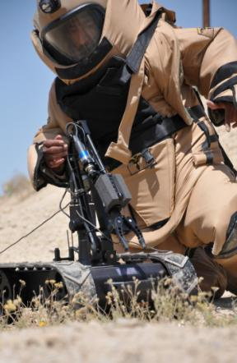
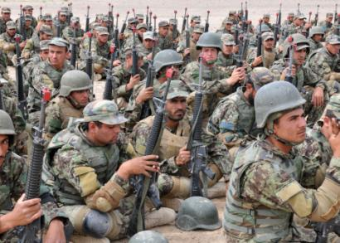
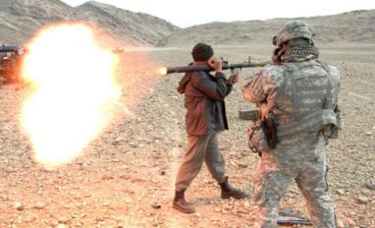
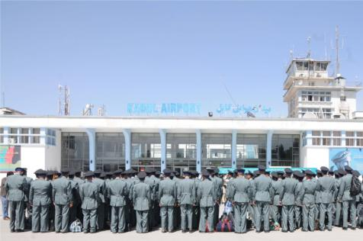
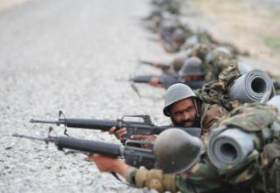
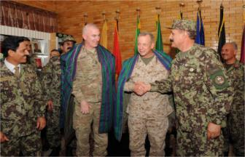
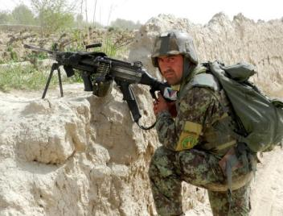
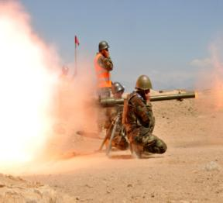
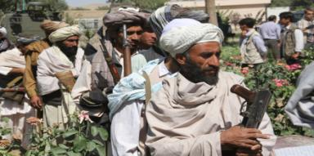
Friendly Best Practices

Slide 21
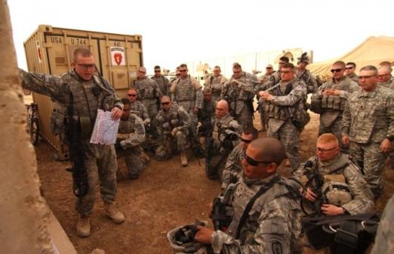
Unit Readiness
Commanders are to review Force Protection measures in locations where ISAF personnel cohabit or are co-located with ANSF
Develop Insider Threat focused SOPs
Integrate Insider Threat training at all levels
Incorporate scenarios and vignettes into rehearsals and pre-patrol / mission planning
Develop a well-detailed,
consistently refined, and
rehearsed Base Defense Plan
Develop atmospherics
and reporting procedures
Know and rehearse ROE,
EOF, and “Actions on”

Slide 22
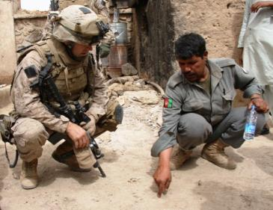
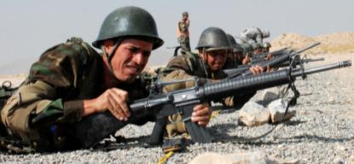
Situational Awareness and Personal Readiness
Guard Against Complacency! (carry your weapon at all times)
Relationships are important
Build bridges between ISAF and ANSF, not walls
Continually assess your training and force protection to counter threats
Promote trust
  Say what you mean (2nd & 3rd order of effects, think before you speak)
  Don’t promise what you cannot deliver
Treat all with Dignity and Respect
Be a good listener
Do a daily risk assessment
Vigilant observance by ISAF
Cover each other (Guardian Angel)
Notes:
To summarize.
Be vigilant. Ensure threat reporting and trend analysis is kept up to date and that all unit members have current information. Stay alert to possible threats inside the wire. Be prepared. Control your demeanor. Do not provoke personal confrontation. Seek to promote trust with all coalition partners. Green on blue incidents can interfere with the ongoing security transition by creating barriers to communication and trust. Leaders, Soldiers and units need to work to create an environment of confidence and trust and take active steps to prevent green on blue attacks.

Slide 23
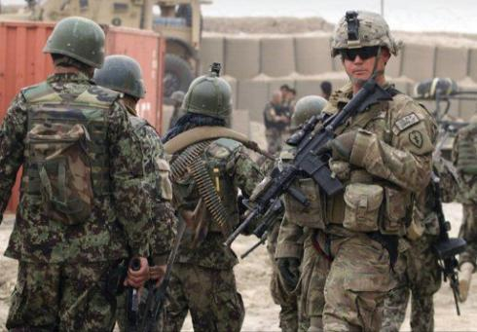
Force Protection (FP)
  Increase of level and maintain wear of PPE
  Maintain positive control of personal weapons and ammunition
  Establish armed over-watch inside compounds for training activities and command post
  ANSF prohibited from carrying weapons in specified areas
Establish a secure and defendable zone
  Establish an SOP, know the plan and execute it
  Increase FP posture during
    Host nation / civilian /
    coalition casualty
    Large gatherings / formations
    Significant global events
  Use the “Buddy” system;
  cover each other
  Use the “Guardian Angel” TTP
Increase of weapons posture
Utilize Roving Guards
Guardian Angel

Slide 24
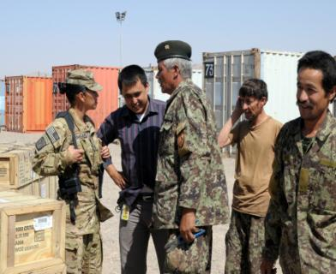
Interpreter/Linguist Considerations
“War in Afghanistan has always been marked by changing alliances. Today’s enemy may be tomorrow’s friend.”
Integral part of the Coalition
  Provide insight and
  perspective/GoB prevention
  Avoid derogatory language
  Be proactive to protect
  sensitive information
Vital Link with partnered unit
and population
Cultivate an environment of mutual respect
  Establish rapport early
  Maintain rapport throughout deployment
Be professional
Guard against over familiarity and complacency

Slide 25
“Actions On”
Execute rehearsed actions on contact (armed):
  Quickly attain positive identification of target(s).
  Rapidly adjust weapon status to address the threat ( green to red, amber to red)
  Return accurate direct fire.
  Suppress, neutralize, and/or destroy target(s) while minimizing threat to friendly forces and limiting collateral damage to civilians.
  Secure area – 360 degrees.
  Don’t rely on outside help such as quick reaction force (QRF), close air support (CAS), or indirect fire. Time is of the essence. Resolve situation with forces on hand.
Execute rehearsed actions on contact (unarmed):
  Escape if possible using cover and concealment, Have an escape route and plan in mind – hopefully two, Leave your belongings, Carry something to fight with
  Lock down or conceal yourself using the best cover possible, Barricade your hiding place, Lock the door, Silence your cell phone / radio, Use something to fight with
  Fight using environmental / found weapons, and good tactics such as ambush, Last resort; life in imminent danger, Look for right opportunity – magazine changes etc., Use violent action to eliminate the threat
  Wait for QRF arrival

Slide 26
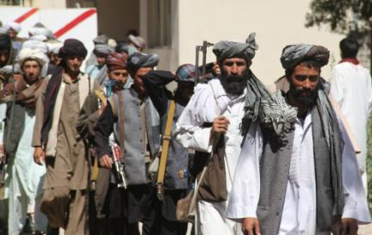
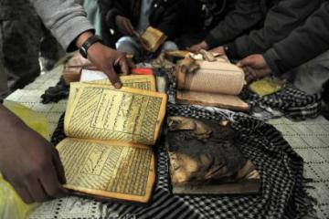
Culture Factors
DO NOT use derogatory terms in any language (even in friendly conversation), insults, or bullying
DO NOT slander host nation or coalition partners, avoid arrogance
DO NOT physically harm host nation or coalition partners (except in self defense)
DO NOT put down or slander any religion
ALWAYS be courteous and thankful for host nation and coalition partner hospitality
Study and understand ANSF unit command climate, the local Afghan community’s tribal culture and activities of daily living patterns
Be aware of cultural differences
Plan ahead to eliminate or mediate those actions that Afghans may find offensive
Educate both ISAF and ANSF about the other side’s culture
  Avoid public rebukes; counsel in private jointly with ANSF chain of command

Slide 27
Vignette
Vignette #1 (At a Combat Outpost with partnered coalition and ANSF units)
Incident Summary: On 01 March 2012, an ANA NCO and an Afghan interpreter engaged checkpoints and a mortar pit at a Combat Outpost with RPG and small arms. A combined Afghan-coalition force suppressed the attack, causing them to flee.
Location and Background: Combat Outpost (COP), Northern Afghanistan. A combined Afghan-US unit had been working together for the last four months. One of the Afghan interpreters on the COP became familiar with some of the US soldiers. He spends time socializing with them and often brings them fruit from outside the COP. When he begins to ask probing questions about classified information, the soldiers distance themselves from him and notify their leadership. The interpreter is reprimanded, and then begins to act coldly to the US soldiers, spend less time with them and more time with one of the ANA NCOs on the COP. The US unit has trained on active shooter drills within the past three months.

Slide 28
Vignette cont…
Details: During static security operations, an ANA NCO approached the COP entry control point (ECP) and had an argument with the ANA guard at the ECP. The argument was witnessed by the US soldier who was also guarding the ECP. The ANA soldier then approached the ECP and shot the ANA guard in the shoulder then engaged the US soldier by shooting him in the chest (he was wearing his full personal protective equipment and received only minor injuries). The ANA shooter then fled back into the compound in an attempt to blend back into the ANA. The active shooter procedures were initiated, but the shooter could not be located.
Shortly after the initial engagement, the ANA NCO and the interpreter went into a tower from within the compound and killed the US soldier in the tower and began shooting into the COP with small arms and RPGs. Most of the assailants’ fires focused on the company command post and the mortar firing point. The combined unit began to engage the tower to suppress the assailants.
The two enemy combatants subsequently escaped out of the tower and moved away from the COP where they were followed by the aerostat camer and ultimately engaged and killed by close combat air support.

Slide 29
Vignette cont…
Learning Point 1: Atmospherics. The Afghan civilian interpreter exhibited signs of colluding with the enemy by asking about sensitive information after having become unduly familiar with the US soldiers. While they did the right thing by notifying their leadership, the interpreter should have been isolated and further investigated prior to being allowed back inside the COP.
Learning Point 2: Active Shooter Training. Active shooter training was crucial to quickly responding to the incident. Though the assailant could not be quickly located, the unit quickly adopted an alerted state and was able to quicly respond to the assailants when the follow-on attack occured. Units should not wait for or plan to rely on QRF or air support for insider threat incidents.
What Ifs:
What if the interpreter had been investigated further for links to the insurgency?
What if the unit had NOT conducted Active Shooter Training? What could have gone wrong?
What if the assailants had been detained instead of killed?

Slide 30

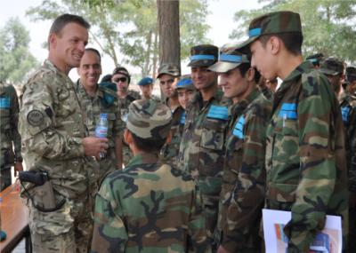
Summary
Insider threat is a shared coalition and ANSF problem.
PREVENTION IS THE KEY!
Listen to your intuition and maintain a heightened situational awareness
Complacency Kills
Mutual respect is borne out of a respect of each other’s cultures
Always attempt to understand cultural sensitivities of partnered nation personnel
Always ensure our partners know that we are providing security to their nation TOGETHER as one team
Maintain vigilant 360 degree security (applies to before, during, and after military operations)
Enroll all personnel into biometrics entering US and Coalition bases
Notes:
Conclusion
Inside the wire attacks provoke a lack of confidence and trust among ISAF and coalition forces
that partner and work with ANSF on a daily basis. ISAF must continue to maintain vigilance to prevent, defend against, and to
mitigate and ultimately defeat the Green-on-Blue threat. Units must leverage the capabilities of
fielded counterintelligence (CI) personnel to help combat the inside the wire threat. CI personnel
help monitor ANSF units and sensitize coalition forces and ANSF junior leaders on signs to
watch for of a soldier at risk, or one whom is comprised. Prevention is the key to success.
The bottom line - units and individual Soldiers need to be aware and prepare for the possibility of this threat in their AO. By rehearsing scenarios a more preventative and prepared mindset is developed. Do not let your guard down.
A confrontation between an ANSF member and an ISAF Soldier precedes many of the attacks
Many confrontations come about because ISAF ignorance or lack of empathy toward Muslim and/or Afghan cultural norms:
Failure to respect Islam, the Koran, or a mosque
Failure to respect the privacy of Afghan women
Failure to respect Afghan elders
Ethnocentrism (belief in the superiority of one’s own culture) by ISAF members
Vigilant observance by ISAF and vetted ANSF forces may prevent future attacks
Mutual trust and respect between ISAF and ANSF remains key to the prevention of future insider attacks.

Slide 31
Check on Learning
1) Question: Name 5 grievances ANSF have with NATO ISAF
  Answer: ISAF-conducted night raids, Perceived disrespect of Afghan women and their privacy, ISAF set-up of needless roadblocks, Civilian and ANSF casualties resulting from ISAF activities, ISAF personnel exhibiting extreme arrogance, and refusal to take advice from ANSF, Urinating in public, exposing selves to women, Failure to adequately protect civilians from harm, Failure to respect Islam, the Quran, or a mosque, Failure to respect Afghan elders, Commit war crimes and atrocities, leaders fail to prosecute the Soldiers responsible, Over promise and under deliver
2) Question: What are the four different types of actors for insider threats?
Answer: Personal, Co-Option, Infiltrator, Impersonator
3) Question: How many threat indicator categories are there and what COAs should you take for each?
Action: Closely monitor Situation and or discuss problems with individual
CAT I
Threat Indicator
CAT II
Action: Administrative action (such as counseling), refer to counterintelligence
CAT III
Action: Refer to counterintelligence & chain of command. Immediate actions, such as removing weapons or detention

Slide 32
Back Up Slides

Slide 33
Key Considerations:
What are my Personal Security Habits?
Am I aware of our partner nation’s culture, customs , traditions and codes?
“Deliberate Demeanor”: Do I deliberately exercise proper demeanor to avoid friction points?
When in a “friction point” situation, how do I aim to diffuse it?
Am I aware that my action or inactions may affect others?
Me

Slide 34
Key Considerations cont…
What are our team’s security TTPs?
Are our physical areas suited to help reduce the threat?
What is our team attitude toward locals? Do we think it helps to reduce the threat?
Me
My Team

Slide 35
Key Considerations cont…
Do we treat our local national linguists (LNL) with dignity and respect to get them closer to us than the enemy?
Do we encourage our US hired linguists (USH) to develop LNLs as “sensors “and “friction reducers”?
Me
My Team
Our Interpreters

Slide 36
Key Considerations cont…
Do we utilize our USH as “sensors” and “friction reducers”?
Do we seek to reduce regional bias among LNLs by promoting teamwork?
Do we engage our partners in the “frank discussions” about the threat?
Does my team influence our partnered environment to help reduce the treat i.e.
  Sports and exercise as a pressure release,
  being respectful of prayer times,
  Developing a strong partnership to
  align our partners closer to us
Me
My Team
Our Interpreters
Our Partners

Slide 37
Key Considerations cont…
Do we review our ROE and “actions on” in anticipation of GoB / ITW threat?
Do we focus FP efforts inward in as well to the routine outward focus?
  Roving Guards,
  Guardian Angels,
  ISR focus inside our Tactical
  infrastructures
Do we have a well-detailed and
regularly refined and rehearsed
Base Defense plan?
Me
My Team
Our Interpreters
Our Partners
Our Force Protection

Slide 38
Deliberate Demeanor: Given a Soldier understands the partner nation’s culture, customs, traditions and codes, “Deliberate Demeanor” (D2) is the practice of constantly exerting a professional and controlled conduct, resistant to incitement to any “friction points” that may lead to incidents of personal disagreements. Patience, Courtesy and Restraint combined with Vigilance are commonly practiced in D2.
Unknown Motivations
Personal
Deliberate Demeanor
Me
Co-option
My Team
Interpreter / Partner Dev.
Impersonation
Our Interpreters
Biometrics
Infiltration
Our Partners
Base Defense Plan
Our Force Protection

Slide 39
Threat Reduction “5 Rings of Security”
Key Considerations cont…
Do we treat our local national linguists (LNL) with dignity and respect to get them closer to us than the enemy?
Do we encourage our US hired linguists (USH) to develop LNLs as “sensors” and “friction reducers”?
Key Considerations cont…
Do we review our ROE and “actions on” in anticipation of GoB / ITW threat?
Do we focus FP efforts inward in as well to the routine outward focus?
  Roving Guards
  Guardian Angels,
  ISR focus inside our tactical
  infrastructures
Do we have a well-detailed and
regularly refined and rehearsed
Base Defense plan?
Deliberate Demeanor: Given a Soldier understands the partner nation’s culture, customs, traditions and codes, “Deliberate Demeanor” (D2) is the practice of constantly exerting a professional and controlled conduct, resistant to incitement to any “friction points” that may lead to incidents of personal disagreements. Patience, Courtesy and Restraint combined with Vigilance are commonly practiced in D2.
Key Considerations cont…
What are our team’s security TTPs?
Are our physical areas suited to help reduce the threat?
What is our team attitude toward locals? Do we think it helps to reduce the threat?
Key Considerations:
What are my Personal Security Habits?
Am I aware of our partner nation’s culture, customs , traditions and codes?
“Deliberate Demeanor”: Do I deliberately exercise proper demeanor to avoid friction points?
When in a “friction point” situation, how do I aim to diffuse it?
Am I aware that my action or inactions may affect others?
Key Considerations cont…
Do we utilize our USH as “sensors” and “friction reducers”?
Do we seek to reduce regional bias among LNLs by promoting teamwork?
Do we engage our partners in the “frank discussions” about the threat?
Does my team influence our partnered environment to help reduce the treat i.e.
  Sports and exercise as a pressure release,
  being respectful of prayer times
  Developing a strong partnership to
  align our partners closer to us
Unknown Motivations
Personal
Me
Me
Me
Me
Me
Deliberate Demeanor
Me
Co-optees
My Team
My Team
My Team
My Team
My Team
Interpreter / Partner Dev.
Impersonators
Our Interpreters
Our Interpreters
Our Interpreters
Our Interpreters
Biometrics
Infiltrators
Our Partners
Our Partners
Our Partners
Base Defense Plan
Our Force Protection
Our Force Protection

