Slide 1
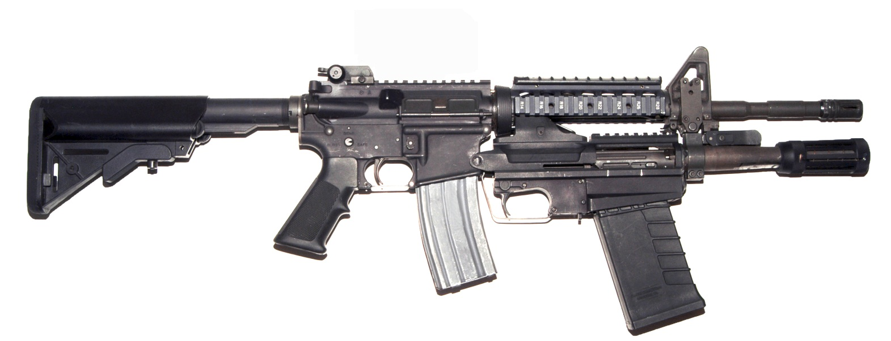
UNCLASSIFIED//FOUO
M26 MASS
Modular Accessory Shotgun System (MASS)
New Equipment training
OPERATOR
STUDENT HANDOUT
Version 2.6
As of 1000 on 10 Dec 2011
FOR TRAINING USE ONLY
UNCLASSIFIED//FOUO

Slide 2
Safety
Always THINK Safety
Treat every weapon as if it is loaded.
Handle every weapon with care.
Identify the target before you fire.
Never point the muzzle at anything you don’t intend to shoot.
Keep the weapon on safe and your finger off the trigger, until you intend to fire.

Slide 3
Welcome
On behalf of TACOM, we would like to welcome you to the M26 Modular
Accessory Shotgun System (MASS) NET Operator course.
The purpose of this course is to familiarize you with the proper operating
procedures specific with the M26 MASS. You will be instructed how to
perform operator tasks for the M26 IAW the applicable Technical
Manuals.
Given the information in a classroom you will receive instruction on the
administrative policies and an overview of entire course in accordance
with (IAW) the POI.
This is a train the trainer course. You will be responsible to train others in
your unit.

Slide 4
Training Overview
ADMINISTRATION
SAFETY
CHARACTERISTICS
CLEARING
STAND ALONE INSTALLATION
HOST WEAPON INSTALLATION
OPERATION
FIELD STRIPPING
FUNCTION CHECK
PMCS
TROUBLESHOOTING
PRACTICAL EXERCISE
REVIEW

Slide 5
Administration
Hand outs/Disks: Yours to keep and copy.
Smoke only in designated areas.
Cell phones, on vibrate. If you need to take a call, move to the hallway.
Uniform. Class leader’s discretion.
Sign in sheet. PRINT LEGIBLY!

Slide 6
Classroom Safety (Con’t)
Classroom Safety
Follow instructions and do not work ahead of instructor.
Ask questions to prevent damage to equipment or lost parts.
Army approved eye protection is required for most operation procedures.
Jewelry and other “snag” hazards should be removed prior to performing operator tasks.
Observe the proper use of tools.
Use each tool how it was intended.
Use the right tool for the job.

Slide 7
Warnings, Cautions, & Notes
Safety Icons: WARNINGS, CAUTIONS, and NOTES are always found in the first pages of the 10 and 23 manuals.
WARNINGS: Identifies a clear danger to the person performing that specific procedure.
CAUTIONS: Identifies risk of damage to equipment if the task is not performed properly.
NOTES: Used to highlight essential procedures, conditions, statements, or convey important instructional data to the user.

Slide 8
Safety Warning Icons
EYE PROTECTION: Person will goggles shows that material will injure the eyes.
EXPLOSION: Rapidly expanding symbol shows that the material may explode if subjected to high temperatures, sources of ignition, or high pressure.
HOT AREA: Hand over object radiating heat shows hot surfaces that can burn unprotected flesh.
CHEMICAL: Drops of liquid on hand shows that material can cause burns or irritation to hands or tissue.

Slide 9
Safety Warning Icons (Con’t)
EAR PROTECTION: Headphones over ears shows that noise level will harm hearing.
POISON: Skull and crossbones shows that material is poisonous or a danger to life.
VAPOR: Human figure in a cloud shows that material vapors present a danger to life or health.
LASER LIGHT: Laser light hazard symbol indicates extreme danger for eyes from laser beams and reflections.

Slide 10
References
MASS Operator manual: TM 9-1005-341-10
MASS Maintenance and Parts TM 9-1005-341-23&P
Rifle Marksmanship FM 3-22.9

Slide 11

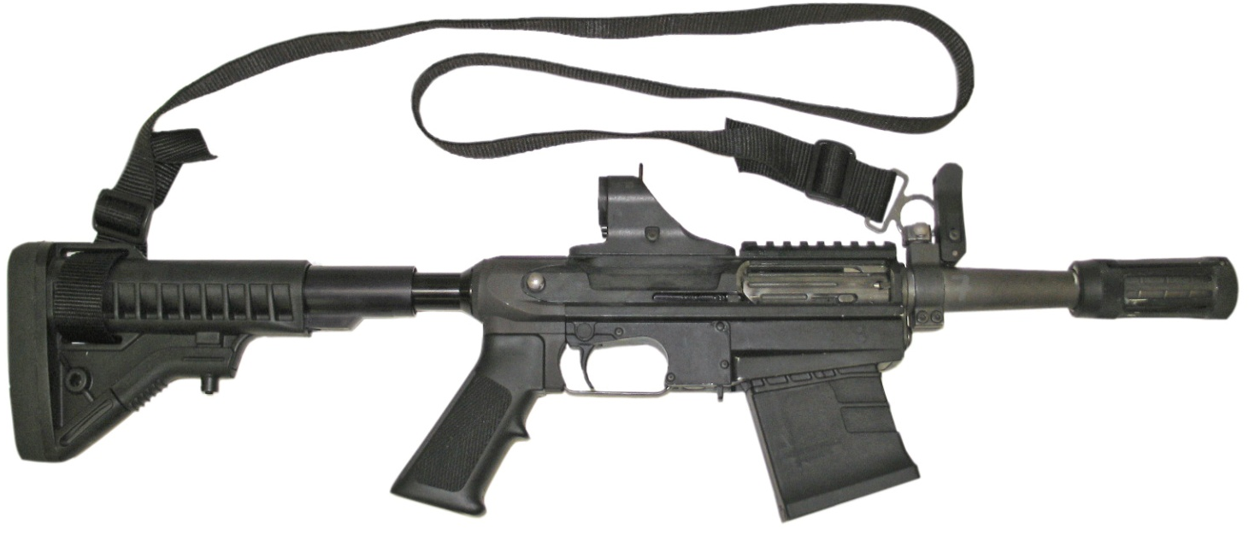
Configurations
M26 ATTACHED
M26 STAND ALONE

Slide 12
M26 MASS Characteristics
Multi-shot 12 gauge Shotgun, 3” Chamber
Straight push-pull action, with ambidextrous charging handle
Attaches under the barrel of the M4 series carbine
Box magazine-fed, 5 Round Box Magazine (3 RBM AAL)
Air-cooled, and manually-operated
Stand-Alone Configuration with integral fold up iron sights
Utilizes M4 sighting system when mounted under the barrel
Retractable accessory standoff device for ballistic breaching
Integral Mil Std 1913 rail
M26 MASS OPNET

Slide 13
Physical Characteristics
Attached Mode
Stand Alone Mode
Caliber- 12Gauge
Weight- 3.5lbs (1.6Kg)
Length- 16.5 in. (41.9 cm)
Mechanical Features- Improved
Cylinder Bore
Caliber- 12Gauge
Weight- 5.3 (2.4Kg)
Length- 26.5 in. (67.3 cm)
Mechanical Features- Improved
Cylinder Bore
M26 MASS OPNET

Slide 14
Firing Characteristics
Velocity………………………………. Ammunition specific
Maximum effective Rate of Fire…….Operator dependent
Maximum effective Range-
Less Lethal 66 ft. (20m)
Buckshot 131 ft. (40m)
Breaching 0 to 3 in. (0 to 7.6 cm)
Maximum Range……………………. Ammunition specific
Safety Mechanism…………………...Safe-Fire (cross-bolt)
M26 MASS OPNET

Slide 15
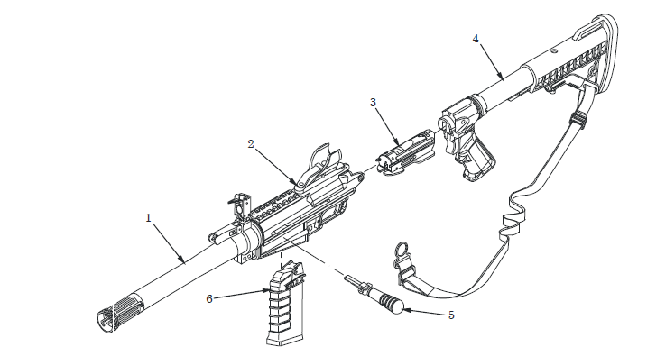
Location of Major Components
Barrel Assembly (1) Chambers the shot shell for firing and guides the projectile.
Receiver Assembly (2) Provides support for the bolt/bolt carrier assembly and houses the moving parts of the weapon.
Bolt/Bolt Carrier Assembly (3) Provides feeding,
chambering, firing, extraction, and ejection
of cartridges using manual
action for power.

Slide 16
Location of Major Components (Cont.)
Stand Alone Module (4). Provides capability to use weapon without mounting to host weapon. Includes pistol grip, adjustable hydraulic butt stock, and sling.
Charging Handle (5). Provides charging of the MASS. The charging handle can be folded down and locks in the forward position when a round is chambered. It can be installed on either side of the weapon to accommodate
both left-handed and right-handed firers.
M26 MASS OPNET

Slide 17
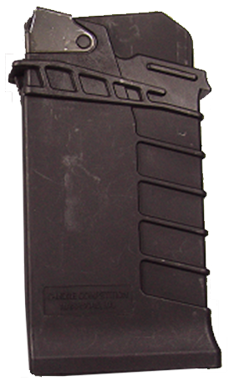
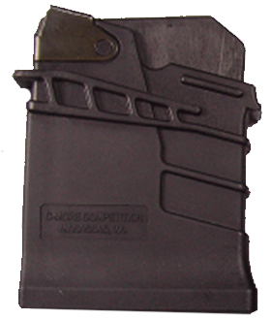
Location of Major Components (Cont.)
Magazine Assembly (6). Holds up to five cartridges for feeding and provides a quick reload capability for sustained firing. A three round magazine is also available.
M26 MASS OPNET

Slide 18
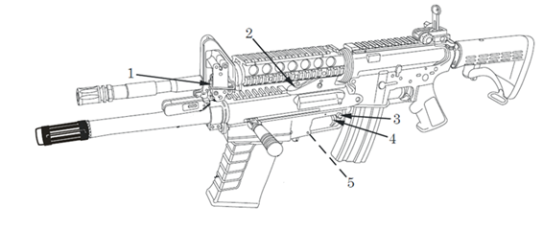
Controls and Indicators
Sling Swivel (1) Allows operator to attach sling to host weapon.
Rear Mount Bracket (2) Provides an interface between MASS and barrel nut of host weapon. Acts as rear sight in stand-alone mode.
Safety Mechanism (3) Has two positions, safe and fire. When the red stripe is visible, the weapon can be fired. The safety mechanism can be installed on either side of the receiver by field maintenance for ambidextrous operation. The safety can not be moved to safe unless the hammer is cocked.
M26 MASS OPNET

Slide 19
Controls and Indicators
Trigger (4) When squeezed it initiates the firing sequence.
Action Lock Release (5) Secures the action to forward position and prevents the bolt from moving out of battery when a round is chambered. It also allows the bolt and action to be unlocked and cycled to the rear to accomplish weapon clearing without firing a chambered cartridge. It is located on the underside of the weapon just to the rear of the magazine release.
M26 MASS OPNET

Slide 20
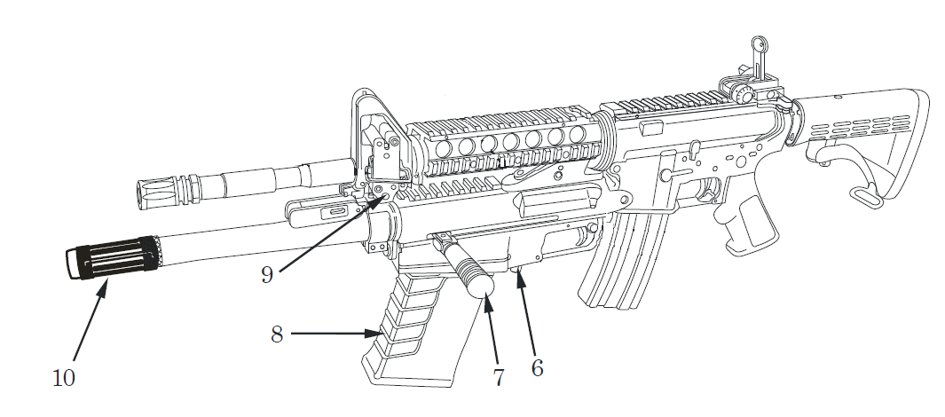
Controls and Indicators
Magazine Release (6) Holds the magazine in place in the magazine well and allows the operator to release the magazine and remove it from the weapon.
Charging Handle (7) Provides charging of the MASS. The charging handle can be folded down and locks in the forward position when a round is chambered. It can be installed on either side of the weapon for ambidextrous operation.
M26 MASS OPNET

Slide 21
Controls and Indicators
Magazine (8) Holds up to five cartridges for feeding and provides a quick reload capability for sustained firing.
Takedown Pin (9) Secures MASS to host weapon.
Standoff Device (10) Provides internal choke tube and is used for breaching techniques.
M26 MASS OPNET

Slide 22
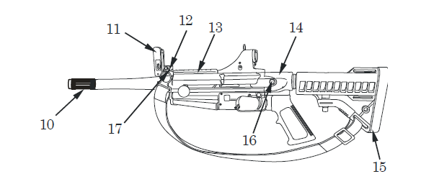
Controls and Indicators
Front Sight (11). Allows operator to adjust strike of round.
Elevation Block (12). Provides a means to attach the MASS to a M4 carbine.
Adapter Rail (13). Provides location for mounting of accessories.
M26 MASS OPNET

Slide 23
Controls and Indicators
Pistol Grip Adapter (14). Integrates pistol grip and butt stock tube. Mounts to rear of MASS receiver.
Butt Stock Assembly (15). Adjustable hydraulic butt stock is adjusted by depressing lock release lever located underneath butt stock.
Adapter Mounting Pin and Coiled Wire Ring (16). Secures pistol grip adapter to MASS receiver.
Elevation Block Pin and Coiled Wire Ring (17). Secures sling bracket to elevation block.
M26 MASS OPNET

Slide 24
Ammunition
The M26 MASS is capable of firing the following 2 ¾ in. and 3 in. cartridge.
LETHAL NONLETHAL
M162, #00 Buckshot M1012, Point Control
Birdshot, #4, #6, #7-1/2, M1013, Crowd Dispersal
#8, and #9
MK242 MOD 0, Dummy
Slug, Foster style
M1030 Breaching cartridge
M26 MASS OPNET

Slide 25
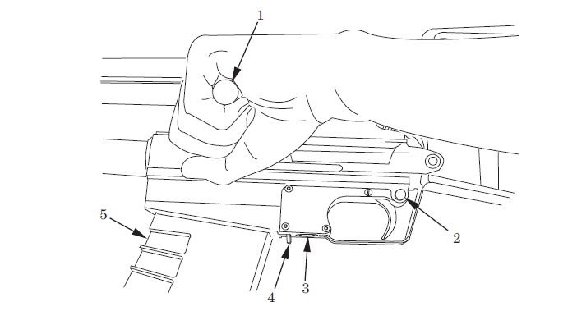
Clearing Procedures
NOTE
A round may or may not be present in the chamber.
1) Remove the magazine (5) by depressing magazine release (4).
2) Place safety mechanism (2) in safe position (no red visible) and
continue with step 3. If unable to place in safe position (no red visible),
pull charging handle (1) rearwards to eject chambered round. Place
safety mechanism in safe position (no red visible) and proceed to step 4.
M26 MASS OPNET

Slide 26
Clearing Procedures
Press action lock release (3) and pull charging handle (1) rearwards to
eject chambered round if present.
4) Inspect receiver and chamber to ensure areas contain no ammunition.
5) Return bolt to forward and locked position.
M26 MASS OPNET

Slide 27
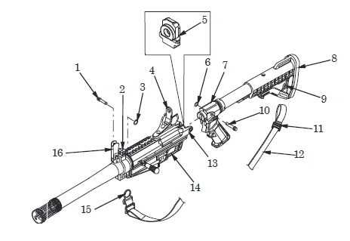
Stand Alone Module Installation
Clear weapons. (M4 and M26 MASS)
Push takedown pin (1) from upper bracket assembly (2).
Support MASS with one hand and slide MASS forward along the barrel of host weapon until it comes free of the barrel.
Remove rubber receiver plug (5) from rear of upper receiver (13) and store plug.
Remove coiled wire ring
(6) from mounting pin (10).
Remove mounting pin (10) from
pistol grip adapter (7).
M26 MASS OPNET

Slide 28
Stand Alone Module Installation (Con’t)
5) Install pistol grip adapter (7) into rear of upper receiver (13). Ensure that trigger guard (14) is captured by pistol grip adapter.
Firmly seat pistol grip adapter (7) into rear of upper receiver (13) and install mounting pin (10) and coiled wire ring (6).
7) Insure the elevation block (2) is set at lowest setting.
M26 MASS OPNET

Slide 29
Stand Alone Module Installation (Con’t)
8) Install end of sling strap (12) through slot of butt stock (8) and secure by threading strap through sling slide (11).
9) Remove coiled wire ring (3), elevation block pin (1), and sling bracket (15) from hole (9) in butt stock (8).
10) Secure sling bracket (15) to elevation block pin (1) with coiled wire ring (3) or to mounting pin (10) with coiled wire ring (6).
M26 MASS OPNET

Slide 30
Stand Alone Module Installation (Con’t)
11) Place rear sight (4) and front sight (16) in upright locked position.
WARNING
For the stand-alone configuration of the M26 MASS, shooter should be limited to 200 rounds of either 2-3/4 in. 00-buckshot or the M1030 breaching rounds per day to reduce risk of musculoskeletal trauma.
M26 MASS OPNET

Slide 31
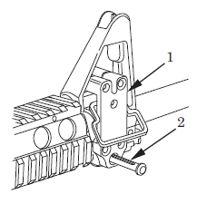
Host Weapon Installation
NOTE
Upper bracket assembly must be installed on host weapon by field maintenance prior to attachment of MASS to weapon.
Clear weapons.(M4 and M26 MASS)
Remove lower adapter rail from host weapon. Refer to TM 9-1005-319-10.
Push takedown pin (2) from upper bracket
assembly (1).
M26 MASS OPNET

Slide 32
Host Weapon Installation
Remove the coil ring(6) from the mounting pin (10)
Remove the mounting pin (10) from the pistol grip adapter (7)
Remove the pistol grip adapter(7) from the receiver (13)
Install plug (5) into the
receiver (13)
M26 MASS OPNET

Slide 33
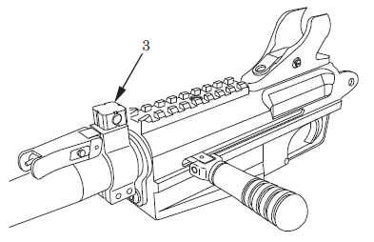
Host Weapon Installation
8) Insure the elevation block (3) is at the lowest setting.
CAUTION
No adjustment should be made to the elevation block. Firing MASS with elevation block not at the lowest setting will cause damage to the MASS
M26 MASS OPNET

Slide 34
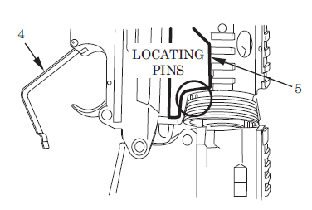
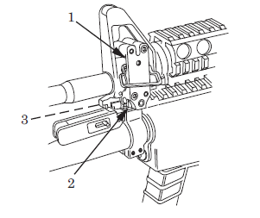
Host Weapon Installation
Position trigger guard (4) so it is open and free from retention by the magazine well of the host weapon.
Ensure rubber receiver plug is seated in
MASS. Insert rear bracket (5) in barrel nut
of host weapon. Ensure that two locating
pins are seated within teeth spaces of
barrel nut of host weapon. If locating pins
do not align within teeth of barrel nut,
notify field maintenance. Apply downward
pressure to seat, until hole in elevation
block (3) is aligned with takedown pin (2).
Push takedown pin (2) through
elevation block.
M26 MASS OPNET

Slide 35
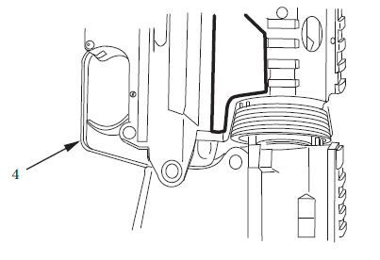
Host Weapon Installation
NOTE
If upper bracket assembly and lower bracket assembly do not align, return both host weapon and MASS to field maintenance for alignment.
12) Position trigger guard (4) between MASS and magazine well of host weapon. Trigger guard will be properly aligned when it is retained by magazine well.
M26 MASS OPNET

Slide 36
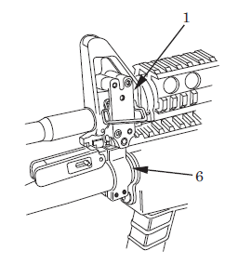
Host Weapon Installation
13) Grasp upper bracket assembly (1) and lower bracket assembly (6) and check for movement. If movement is detected, notify maintenance.
M26 MASS OPNET

Slide 37
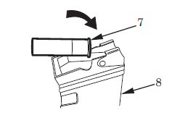
Loading the Magazine
Manually check the follower for freedom of movement.
Load rounds in magazine (8) by inserting cartridge (7) rim first. Push down and toward rear of magazine.
Repeat until magazine (8) is full.
M26 MASS OPNET

Slide 38

Loading and Firing
WARNING
To avoid injury or death, ensure muzzle is pointed in a safe direction.
Do not fire any rounds without the standoff device/cylinder choke firmly screwed in place. If the weapon is fired without the standoff device/ cylinder choke in place it will result in damage to the barrel and/or injury to the operator. The operator should conduct periodical checks to ensure the standoff device/ cylinder choke is tight.
NOTE
The magazine may be inserted with bolt assembly open or closed.
M26 MASS OPNET

Slide 39
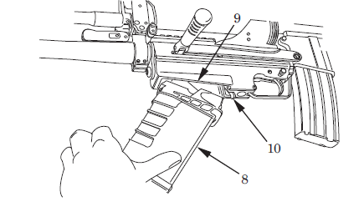
Loading and Firing
Clear the weapon.
Insert fully loaded magazine (8) into magazine well (9) by seating front lip
first and then rotating rear upwards until it snaps in place secured by magazine release (10).
Grasp magazine (8) and pull down to ensure magazine is seated securely
in magazine well (9).
M26 MASS OPNET

Slide 40
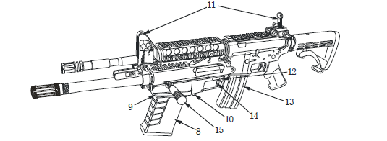
Loading and Firing
4) Pull the charging handle (15) to rear and then push forward with enough force to ensure round is inserted into the chamber and the bolt is locked.
5) Remove magazine (8) by depressing magazine release (10). Insert another round to fully load the magazine.
6) Insert fully loaded magazine (8) into magazine well (9) by seating front lip first and then rotating rear and upwards until it snaps in place secured by the magazine release (10).
M26 MASS OPNET

Slide 41
Loading and Firing
7) Face target, place weapon against shoulder, and grip host weapon magazine (13) with firing hand.
8) Align optic or front and rear sights (11) of host weapon.
Move safety mechanism (12) from safe position to fire position.
Squeeze trigger (14) of the MASS.
Pull charging handle (15) to the rear to eject spent round, then push it forward to chamber the next round.
M26 MASS OPNET

Slide 42
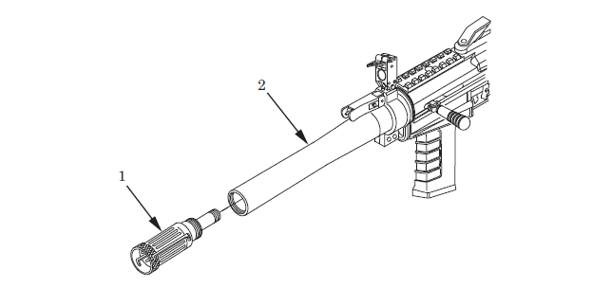
Deploy the Standoff Device
Pull out on standoff device (1) and rotate counterclockwise 1/8 turn. Slide standoff device forward until end of travel is reached. Rotate standoff device clockwise 1/8 turn to lock.
When breeching insure the standoff device is extended and in contact with the surface being breeched.
M26 MASS OPNET

Slide 43
Deploy the Standoff Device
During breeching operation the operator should maintain charging handle to hand contact at all times.
When breeching locks the recommended technique is surface to surface contact, 45 degrees down and 45 degrees towards the lock set.
When breeching visible hinges the recommended technique is surface to surface contact 45 degrees towards the door frame.
During breeching operations the standoff device can be flush to the surface being breeched.
During all breeching operations the operator should insure they are wearing the proper protective equipment.
To stow standoff device, reverse the above steps.
M26 MASS OPNET

Slide 44
Misfire Procedures
IMMEDIATE ACTION
Pull charging handle rearward by depressing action lock button.
Check ejection port. If a cartridge is ejected, push charging handle forward and attempt to fire again.
If MASS still fails to fire, perform Remedial Action.
M26 MASS OPNET

Slide 45
Misfire Procedures
REMEDIAL ACTION
Clear weapon
Check chamber and remove any type of obstruction caused by an empty or ruptured case, live round, or foreign matter.
Reload MASS magazine
Chamber a cartridge
Attempt to fire
Perform troubleshooting procedures if remedial action fails to correct the problem.
M26 MASS OPNET

Slide 46
Misfire Procedures
Common causes and corrections of malfunctions;
Failure to feed (Short Cycle)
Operator must pull the charging handle completely to the rear when charging.
Failure to feed (loose magazine)
Operator must insure the magazine in fully seated by pulling down on the magazine after loading.
Failure to fire
Left-handed operator may inadvertently move the safety to SAFE while charging the weapon. Field Maintenance can reverse the safety for left- handed fires.
Failure to fire
Operators must release the trigger during charging to re-cock the hammer.
M26 MASS OPNET

Slide 47

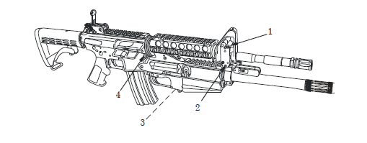
Field Stripping (Disassembly)
WARNING
To avoid injury or death, ensure that both MASS and host weapon are cleared of ammunition.
Push takedown pin (2) from upper bracket assembly (1).
Support MASS with one hand and slide MASS forward along barrel of host
weapon until it comes free of barrel.
M26 MASS OPNET

Slide 48
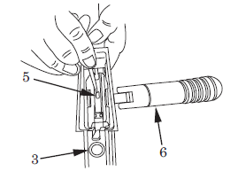
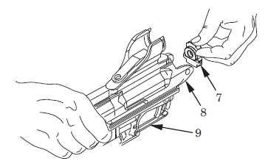
Field Stripping (Disassembly)
3) Press action lock release (3). Pull bolt all the way rearward and then forward to charge the weapon. Move safety mechanism to safe position (no red visible).
Press action lock release (3). Pull bolt rearward halfway. Retract charging handle retaining plunger (5) with thin end of T-handle in cleaning kit or a pointed object and remove charging handle (6).
5) Rotate trigger guard (9) downward. Remove receiver plug (7) from MASS receiver (8) by hand.
M26 MASS OPNET

Slide 49
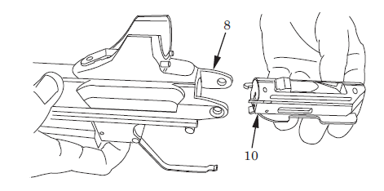
Field Stripping (Disassembly)
6) Remove bolt/bolt carrier assembly (10) from rear of MASS receiver (8).
M26 MASS OPNET

Slide 50
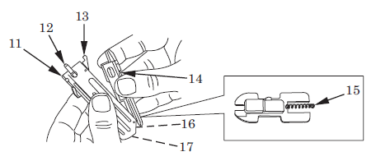
Field Stripping (Disassembly)
CAUTION
Do not bend, twist, or crimp bolt carrier spring (15) located at rear of bolt carrier when disassembling bolt from bolt carrier. If spring is crimped, twisted, or bent, report this condition to armorer (field maintenance) and do not use the weapon.
M26 MASS OPNET

Slide 51
Field Stripping (Disassembly)
7) Separate bolt (11) from bolt carrier (14) by lifting bolt off carrier.
8) Visually inspect bolt (11) for broken or missing cartridge guide (13) and extractor(s) (12).
9) Visually inspect for presence of firing pin (16) and firing pin spring (17).
M26 MASS OPNET

Slide 52
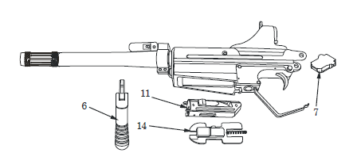
Field Stripping (Disassembly)
10) Operator field stripping is complete when charging handle (6), receiver plug (7), bolt (11), and bolt carrier (14) are removed from weapon.
M26 MASS OPNET

Slide 53
Field Stripping (Disassembly)
CAUTION
Do not pull trigger or allow hammer to fall if bolt and bolt carrier are not in MASS, as doing so may render MASS inoperable.
The procedure to reset the hammer if it is allowed to fall without the bolt/bolt carrier in place is;
Pull and hold the trigger to the rear. Using the index finger through the magazine well, depress the hammer to the rear. Once the hammer is fully depressed, release the trigger. This will reset the hammer allowing the bolt/bolt carrier to be inserted back into the receiver.
M26 MASS OPNET

Slide 54
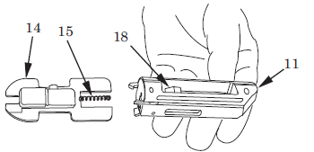
Field Stripping (Assembly)
CAUTION
Use great care when repositioning bolt carrier spring, located at rear of bolt carrier, into hole in rear of bolt. Do not bend, twist, or crimp spring when installing it, as this may render MASS inoperable.
Carefully assemble bolt (11) onto bolt carrier (14), ensuring that bolt carrier spring (15) is inserted into hole in rear of bolt.
Slide bolt (11) forward on bolt carrier (14), allowing locking bar (18) to drop down.
M26 MASS OPNET

Slide 55
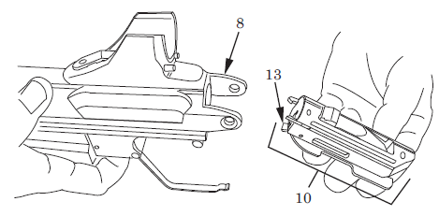
Field Stripping (Assembly)
With bolt/bolt carrier assembly (10) inclined slightly downward at the rear, insert bolt/bolt carrier assembly into rear of MASS receiver (8) while compressing cartridge guide (13). Ensure that cartridge guide enters receiver opening first.
4) Slide bolt/carrier assembly (10) forward until it is forward and locked.
M26 MASS OPNET

Slide 56
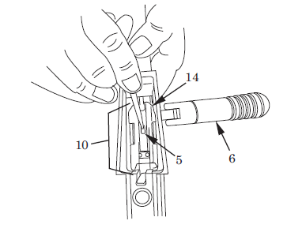
Field Stripping (Assembly)
NOTE
Charging handle can be installed on right side of weapon to accommodate left-handed firers. Ensure that charging handle folds toward magazine well.
5) Retract charging handle retaining plunger (5) with thin end of T-handle in cleaning kit (WP 0019, item 1) or a pointed object and, at the same time, install charging handle (6), with cutouts facing toward magazine well, into bolt/bolt carrier assembly (10).
M26 MASS OPNET

Slide 57
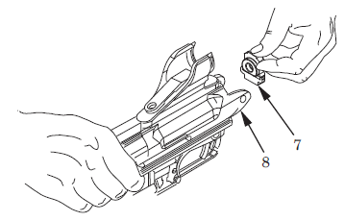
Field Stripping (Assembly)
6) Install receiver plug (7) into rear of MASS receiver (8).
M26 MASS OPNET

Slide 58
M26 Function Check
WARNING
To avoid injury or death, ensure that MASS and host weapon are cleared.
Be sure weapon is unloaded and pointed in a safe direction.
Depress action lock release and pull charging handle rearward.
Place safety mechanism in safe position (no red visible).
Return bolt to forward and locked position. Attempt to pull charging handle rearward to ensure action lock has engaged.
Leave safety mechanism in safe position (no red visible). Attempt to pull trigger.
The hammer should not fall.
Remove finger from trigger. Move safety mechanism to fire position (red visible).
Pull trigger. The hammer should fall.
Charge weapon and place safety mechanism in safe position (no red visible).
M26 MASS OPNET

Slide 59
PMCS
Preventive Maintenance Checks and Services (PMCS) must be performed by the operator to be sure the M26 Modular Accessory Shotgun System (MASS) is in good operating condition and ready for its primary mission.
To ensure maximum operational readiness, it is necessary that the MASS be inspected at regular intervals so that any defects can be discovered and corrected before serious damage or failure occurs. An inactive weapon is a weapon, whether assigned or not assigned to an individual, which is stored in an arms room for a period of 90 days. Normal cleaning (PMCS) of an inactive weapon will be performed every 90 days. Any maintenance problems that are beyond your authorization will be referred to field maintenance for correction.
M26 MASS OPNET

Slide 60
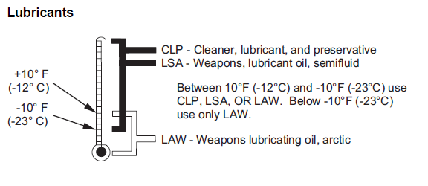
Lubrication Instructions
Intervals :
When operating the weapon, clean and lubricate MASS daily after operation.
Periodic lubrication can be performed without disassembling. Keep the weapon clean and lubricated even when it is not used for awhile.
Lube after 160 rounds
Fully clean and lubricate the MASS at 320 round intervals.
When in inactive storage, clean and lubricate MASS quarterly or when corrosion appears.
M26 MASS OPNET

Slide 61
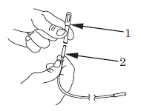
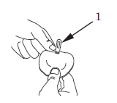
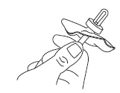
Cleaning the M26
WARNING
To avoid injury or death, ensure that MASS and host weapon are cleared.
Screw slotted shotgun tip (1) onto cleaning cable (2).
2) Place shotgun tip (1) into one of the slots on the patch.
3) Slide a patch saver onto tip, over the patch.
M26 MASS OPNET

Slide 62
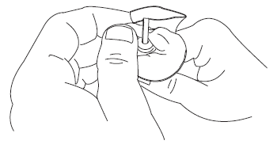
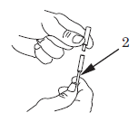
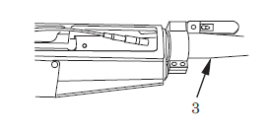
Cleaning the M26
4) Pinch patch and place it through slot in the tip.
Attach obstruction remover to opposite end of cleaning
cable (2).
6) Open the action and push the cleaning cable, obstruction remover first, down the barrel (3) from breech to muzzle.
M26 MASS OPNET

Slide 63
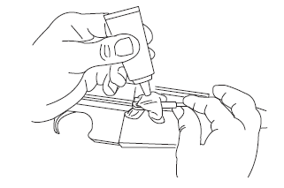
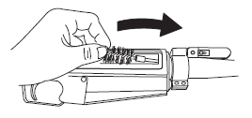
Cleaning the M26
CAUTION
Run first patch through bore only one time. Any abrasive material collected by the patch could damage the bore if the patch were used again.
7) Apply cleaner, lubricant, and preservative (CLP) or semi-fluid weapons lubricating oil (LSA) to first patch through barrel. This lubricates bore and prevents residue or dirt from scratching bore.
8) Screw on brush and run it through in the same manner. Twist brush in counterclockwise direction, from gunner's viewpoint, to clean chamber.
9) Disassemble patch, insert shotgun tip into an unused inner slot on the patch, and create another swab. Use new swab to run from breech to muzzle.
10) Repeat previous steps until bore is clean and carbon is removed.
M26 MASS OPNET

Slide 64
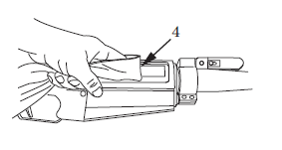
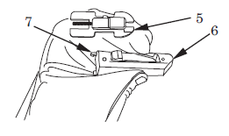
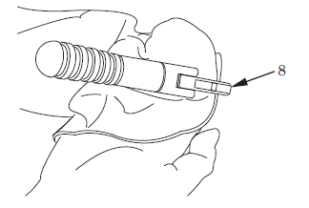
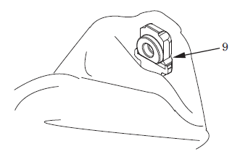
Cleaning the M26
11)Wipe interior of receiver (4) with wiping rag moistened with CLP or LSA until clean.
12) Wipe bolt (6) and bolt carrier (5) with wiping rag moistened with CLP or LSA until clean. Use cleaning brush to clean extractors (7) on bolt.
13) Wipe charging handle (8) with wiping moistened with CLP or LSA and ensure it is clean.
14) Wipe receiver plug (9) with dry wiping rag, ensuring it is clean.
M26 MASS OPNET

Slide 65
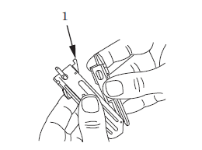
Troubleshooting
FAILURE TO FEED.
Step 1. Inspect for dirty or corroded ammunition.
Clean or replace ammunition as required
Step 2. Inspect magazine for cleanliness and serviceability.
Clean or replace magazine as required.
Step 3. Inspect for obstruction in chamber.
Remove obstruction.
Step 4. Inspect for broken or missing cartridge guide (1).
If cartridge guide is broken or missing, notify field maintenance.
M26 MASS OPNET

Slide 66
Troubleshooting
FAILURE TO CHAMBER.
Step 1. Inspect for dirty or corroded ammunition.
Clean or replace ammunition as required.
Step 2. Inspect for dirt and/or corrosion build up in chamber.
Clean as required.
Step 3. Inspect magazine for dirt, broken or missing parts.
Clean as required.
Step 4. If problem persists, notify field maintenance.
M26 MASS OPNET

Slide 67
Troubleshooting
FAILURE TO LOCK.
Step 1. Inspect for dirt and/or corrosion build up in chamber.
Clean as required.
Step 2. If problem persists, notify field maintenance.
FAILURE TO FIRE.
Step 1. Inspect to see if weapon is on safe (no red visible).
Place safety mechanism in fire position (red visible) and attempt to fire.
Step 2. Inspect to see if weapon is loaded. Point in a safe direction. Remove magazine and pull charging handle to the rear. Place safety in safe position (no red visible), if not already in safe position.
If not loaded, see WP 0006 or WP 0008 for loading instructions.
M26 MASS OPNET

Slide 68
Troubleshooting
FAILURE TO FIRE.
Step 3. Inspect for faulty ammunition.
Replace ammunition as necessary.
Step 4. Inspect magazine for cleanliness and serviceability.
Clean or replace magazine as required.
Step 5. Visually inspect for dirt or residue on firing pin and around firing pin hole.
Clean thoroughly.
Step 6. Visually inspect for broken or missing firing pin and firing pin spring.
If broken or missing, notify field maintenance.
M26 MASS OPNET

Slide 69
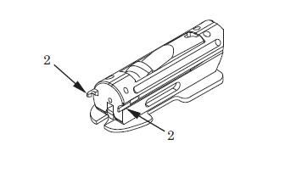
Troubleshooting
FAILURE TO EXTRACT.
Step 1. Inspect for dirt and/or corrosion build up in chamber and on both extractors (2).
Clean as required.
Step 2. Inspect for immovable or broken extractors.
If either extractor is immovable, clean and lubricate bolt.
If either extractor is broken, notify field maintenance.
M26 MASS OPNET

Slide 70
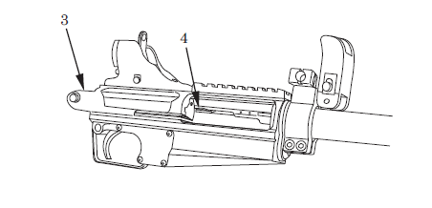
Troubleshooting
FAILURE TO EJECT.
Step 1. Inspect for dirt and/or corrosion build up in upper receiver (3).
Clean as required.
Step 2. Inspect for worn or broken ejector (4).
If ejector is worn or broken, notify field maintenance.
M26 MASS OPNET

Slide 71
PRACTICAL EXERCISE
TASK: Clear the M26 MASS
CONDITION: Given a M26 and student guide in a classroom environment.
STANDARD: Clear the M26 IAW the student guide without causing injury to personnel or damage to the weapon.
TASK: Mount the M26 MASS to a M4 rifle
CONDITION: Given a M26, a M4 rifle and student guide in a classroom environment.
STANDARD: Mount the M26 to a M4 rifle IAW the student guide without causing injury to personnel or damage to the weapon.
M26 MASS OPNET

Slide 72
PRACTICAL EXERCISE
TASK: Install the stand alone module on the M26 MASS
CONDITION: Given a M26, the stand alone module and student guide in a classroom environment.
STANDARD: Install the stand alone module to the M26 MASS IAW the student guide without causing injury to personnel or damage to the weapon.
TASK: Field strip the M26 MASS
CONDITION: Given a M26 and student guide in a classroom environment.
STANDARD: Field strip the M26 MASS IAW the student guide without causing injury to personnel or damage to the weapon.
M26 MASS OPNET

Slide 73
PRACTICAL EXERCISE
TASK: Perform a function check of the M26 MASS
CONDITION: Given a M26 and student guide in a classroom environment.
STANDARD: Perform a function check of the M26 MASS IAW the student guide without causing injury to personnel or damage to the weapon.
M26 MASS OPNET

Slide 74
Review
Questions
Comments
Critiques
Clean Up
Release to Unit
M26 MASS OPNET

Slide 75

Contact Information
NET – Small Arms Team, M26
Primary Instructor
Assistant Instructor
Jeremy Danielson
(810) 278-6341
Jeremy.p.danielson.civ@mail.mil
AI
586-467-6682
heath.r.mcnelly.civ@mail.mil
Small Arms Team Lead
Small Arms Supervisor
Heath McNelly
586-467-6682
heath.r.mcnelly.civ@mail.mil
Jeffrey Kilburn
586-467-6493
jeffrey.s.kilburn.civ@mail.mil
M26 MASS OPNET

Slide 76
Contact Information
Jeremy Danielson
(810) 278-6341
Jeremy.p.danielson.civ@mail.mil
NET Manager
Jason Ellis
jason.r.ellis1.civ@mail.mil
Equipment Specialist
M26 MASS OPNET

