Slide 1
milSuite Workstyle
Changing the way we work using milSuite

Slide 2

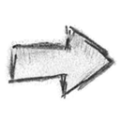
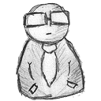
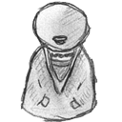



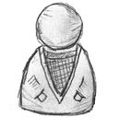
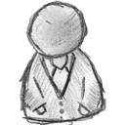
Let’s all work separately
Leadership wants a weekly status update from all division leads
That cycle repeats until one person consolidates all entries and makes a final version for leadership
An email is sent to all division leads with the task and an attachment to fill out
More emails are sent with the attached document to team members asking the same
Everybody downloads the documents and makes their changes and then sends them back via email

Slide 3
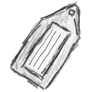
Let’s all work collaboratively
Reviewers and team members all work collaboratively on the document and eventually mark it as final and tag leadership on the document
Leadership wants a weekly status update for their department
A status update is posted tagging all division leads
All division leads see it in their activity feed and a virtual document is created to capture the updates and team members are tagged
Team members update the virtual document and mark it for action and review

Slide 4
Let’s all work socially
Team members, including leadership, want to know what is happening in their department
Follow people, places, and content of interest
View updates in streams, inbox, or via email notifications
All team members “narrate” their work, tagging it based on predefined taxonomy or self selected concepts

Slide 5
milSuite Workstyle
Team is the focus over Structured Top-Down management
Transparency is key to providing an unfiltered view of what is happening
All ideas, requirements, thoughts are shared publicly or privately depending on the context.
Team members blog and share with customers and the community
Social tools are used in every business process along with traditional business tools

Slide 6
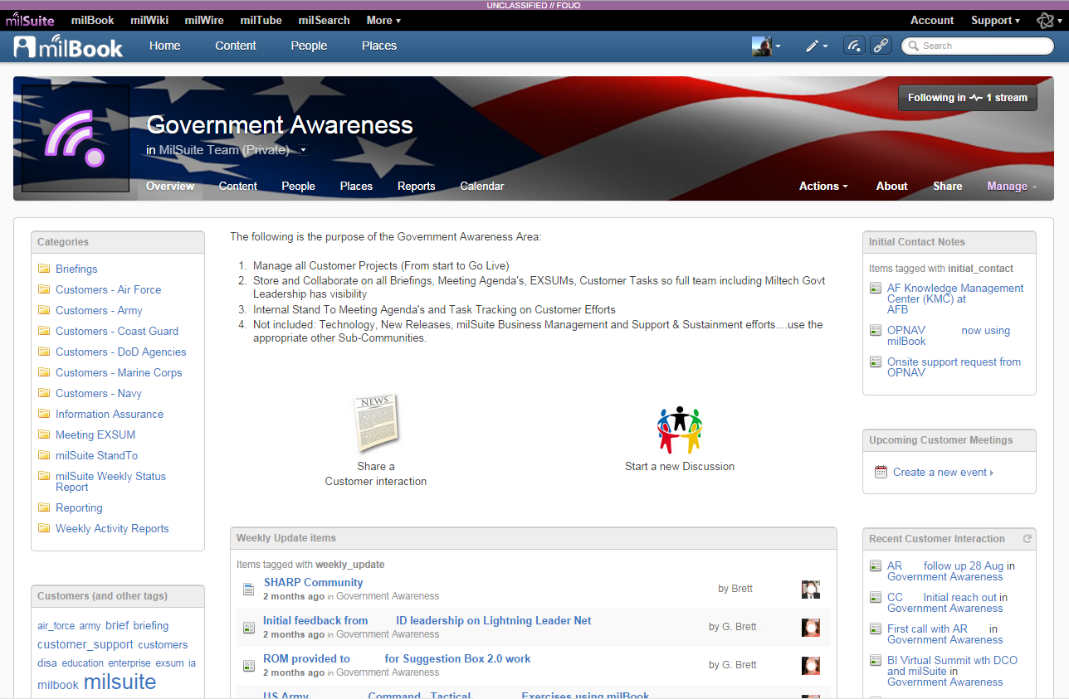
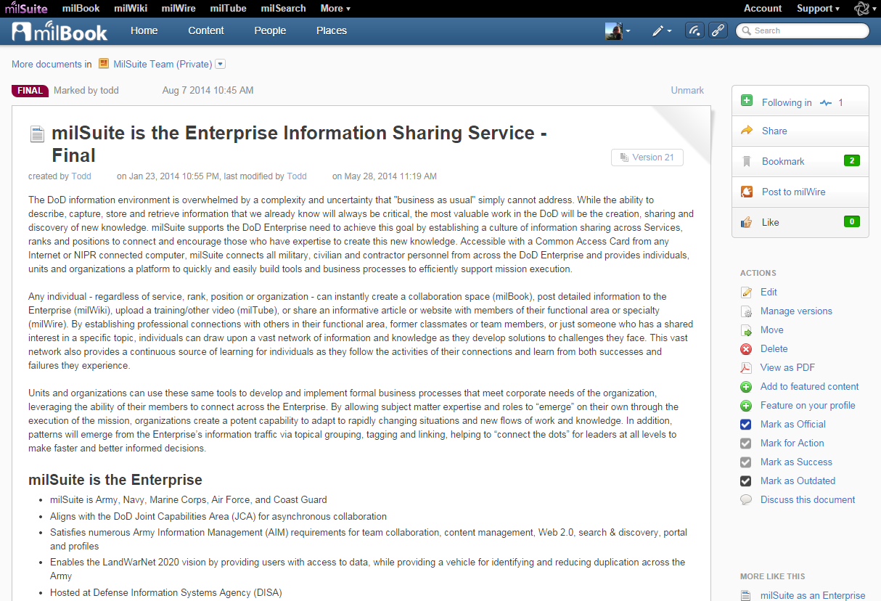
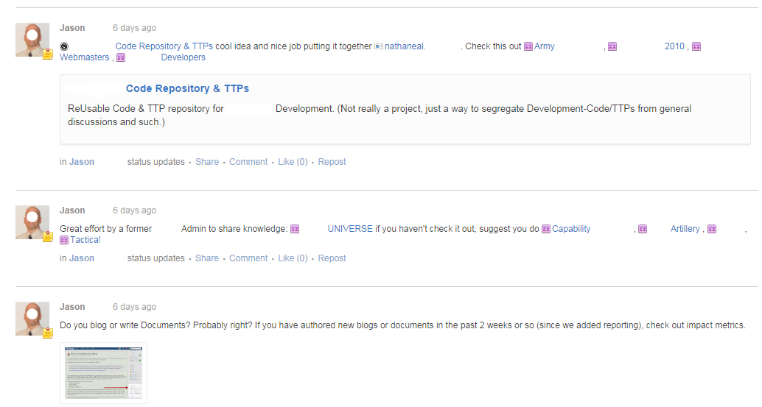
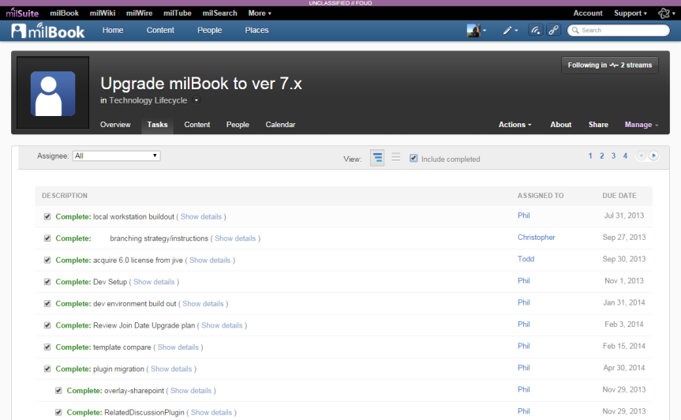
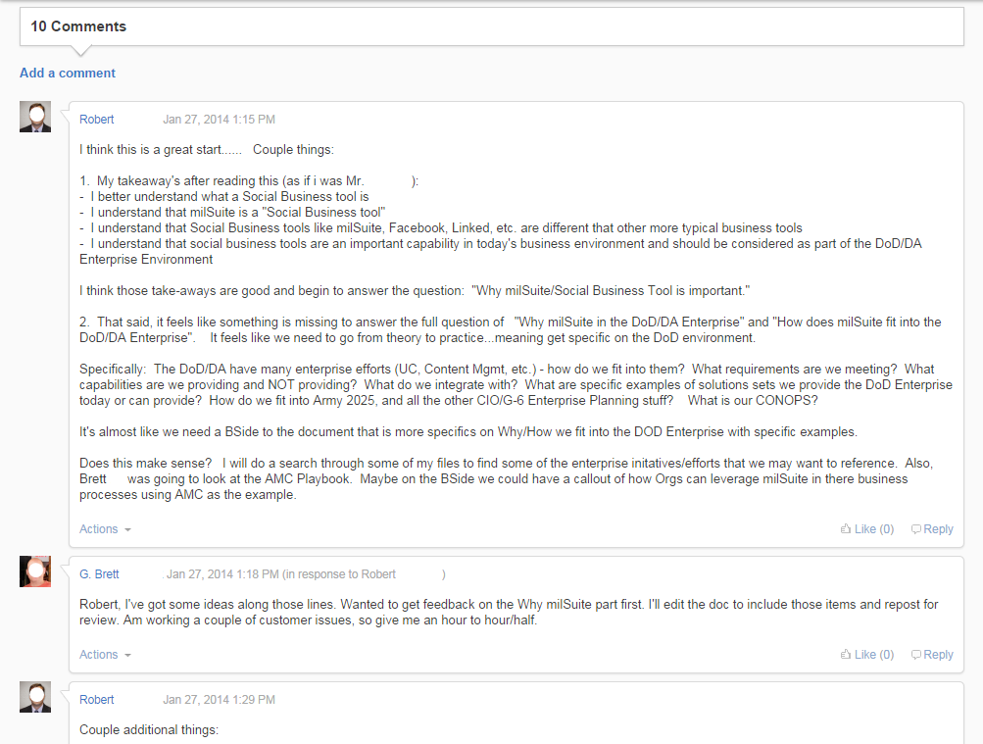
milSuite Workstyle Examples
Groups and Communities for various efforts
Virtual documents for team collaboration
Status updates linking out to groups and content educates others and updates connection streams
Discussions happen online and change happens instantly
Projects and tasks are transparent

Slide 7

Points of Contact
Visit milSuite at https://www.milsuite.mil
MilTech Solutions Director:
Claudia DeCarlo claudia.decarlo.civ@mail.mil
milSuite Product Director:
Tom Curran thomas.curran1.civ@mail.mil
milSuite Deputy Product Director:
Robert Wheeler robert.b.wheeler1.ctr@mail.mil
milSuite Operations Chief:
Todd Miller todd.f.miller10.ctr@mail.mil

