Slide 1
Assessing Security Cooperation as a Preventive Tool Preliminary Observations Angela O’Mahony, Derek Eaton, Michael McNerney, Tom Szayna
March 2012

Slide 2
Background and Project Objective
DoD policy documents assert that Security Cooperation (SC) can be used to prevent adverse security conditions in partner nations
SC missions can be used widely, for a small fraction of the cost of direct U.S. involvement
Preventive SC thesis is an important assumption in DoD policy, but:
Logic underlying the hypothesis remains underspecified
Data in support of it has not been examined thoroughly
Objective: Does SC help partners reduce state fragility, preventing adverse outcomes?

Slide 3
Outline
Approach and methodology
What we found out
Conclusions and way forward

Slide 4
How We Operationalized the Research Question
Specified the preventive thesis/assertion
Formulated two main hypotheses
SC lowers the probability of domestic instability
Effect of SC is conditional (regime type, other aid, type of aid)
Compiled data on preventive-oriented SC
Concessionary programs only, funds spent
Normalized the expenditures across countries by using SC per/10,000 people
Used fragility as a measure of probability of political instability
Database: State Fragility Index (SFI)

Slide 5
Preventive SC Hypothesis Has Two Components
Weak states pose threaten U.S. interests
Threats to U.S. Interests
Terrorist safe havens
Loss of control of WMD
Failed states
Regional spillovers
U.S. intervention
Weak State Institutions
Domestic Instability
Violence, Insurgencies
2. SC strengthens state institutions
Strengthens U.S. Interests
No terrorist havens
No loss of WMD
Strengthens state
Strengthens region
No U.S. intervention
SC
Strong State Institutions
Domestic Stability

Slide 6
Countries and Years Included in and Excluded from Our Analyses
We assessed the effect of SC on SFI for 107 countries from 1991 to 2008
We excluded countries where SC was less likely to be motivated by prevention
Wealthy countries (GDP per capita above $10,000)
NATO members
Afghanistan, Iraq, Israel, Egypt
We excluded periods in which countries experienced high levels of conflict in the three-year window surrounding SC provision
We assess the effect of SC on partner fragility five years after SC was provided
For example, we examine the impact of SC provided in 2001 on countries’ SFI scores in 2006

Slide 7
We Drew Data from 11 Programs to Measure SC
Program | 2005$mn spent 1991-2008
Foreign Military Financing Program | 80,082
Nonproliferation, Antiterrorism, Demining, and Related | 21,568
International Narcotics Control and Law Enforcement | 9,977
Drug Interdiction and Counter-Drug Activities | 3,457
Excess Defense Articles | 1,637
International Military Education and Training | 809
Building Partner Capacity of Foreign Militaries (Section 1206) | 546
Security and Stabilization Assistance (Section 1207) | 149
Regional Centers for Security Studies | 123
Global Peace Operations Initiative | 78
Regional Defense Combating Terrorism Fellowship Program | 68

Slide 8
Statistical Estimation Details
We used regression analyses including almost 1300 country-year observations
To account for the diversity of countries, we included controls for every country included in the analysis
To account for the improvement in SFI scores in the index as a whole over time, we included countries’ SFI scores from the previous year as a separate control variable
SC per 10,000 people was logged to account for the presence of a few, large amounts

Slide 9
Other Variables We Included in Our Analyses
U.S. development aid
Development aid from other developed countries
Conflict in neighboring countries
Government regime type

Slide 10
Outline
Approach and methodology
What we found out
Conclusions and way forward

Slide 11
Testing our Hypotheses
✓
SC lowers the probability of domestic instability
Effect of SC is conditional
SC more effective in
States with stronger institutions
Democratic regimes
Some regions
Countries that also receive development assistance
Some types of SC are more effective than others
✓
✓
✓
✗
✓
✓
✗
Supports hypothesis
Does not support hypothesis

Slide 12
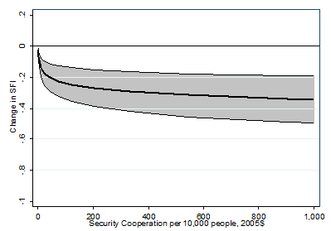
SC Appeared to Reduce State Fragility… (One year effect)
$1,000 SC per 10,000 people is associated
with 0.34 decline in SFI

Slide 13
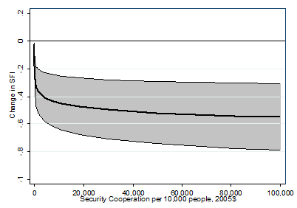
…Size of Impact Did Not Increase Greatly with Large Amounts of SC
$100,000 SC per 10,000 people is associated
with 0.55 decline in SFI

Slide 14
Testing our Hypotheses
✓
SC lowers the probability of domestic instability
Effect of SC is conditional
SC more effective in
States with stronger institutions
Democratic regimes
Some regions
Countries that also receive development assistance
Some types of SC are more effective than others
✓
✓
✓
✗
✓
✓
✗
Supports hypothesis
Does not support hypothesis

Slide 15
We Measure Strength of State Institutions Two Ways
We use SFI in the year in which SC was provided
We use State Reach, which measures governments’ capacity to penetrate its territory and mobilize resources
State Reach is an index comprised of:
Road Density (km of roads per 100 sq. km)
Telephone Density (telephone lines per 100 people)
Urbanization (urban population as % of total)

Slide 16
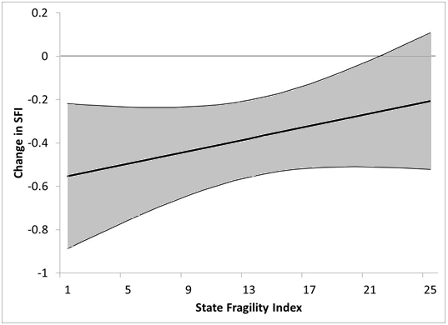
SC Was More Effective in Less Fragile Partner Nations in Our Set
e.g.
Uruguay
e.g.
Malaysia
e.g.
Honduras
e.g.
Djibouti
e.g.
Uganda
e.g.
Ethiopia
e.g.
Somalia
$1,000 SC per 10,000 people as SFI varies
Notes:
2010 SFI scores

Slide 17
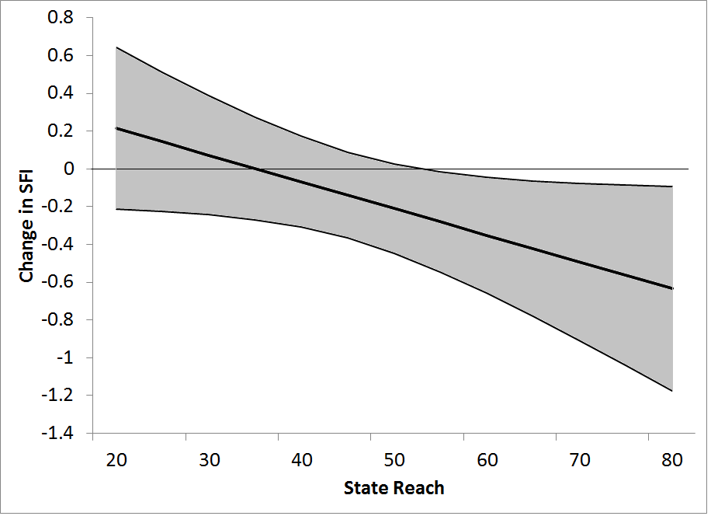
SC Was More Effective in Partner Nations with Greater State Reach
e.g.
Chad(24)
e.g.
Kenya (39)
e.g.
Bangladesh (53)
e.g.
Malaysia (69)
e.g.
Uruguay (82)
$1,000 SC per 10,000 people as State Reach varies
Notes:
2008 State Reach

Slide 18
Testing our Hypotheses
✓
SC lowers the probability of domestic instability
Effect of SC is conditional
SC more effective in
States with stronger institutions
Democratic regimes
Some regions
Countries that also receive development assistance
Some types of SC are more effective than others
✓
✓
✓
✗
✓
✓
✗
Supports hypothesis
Does not support hypothesis

Slide 19
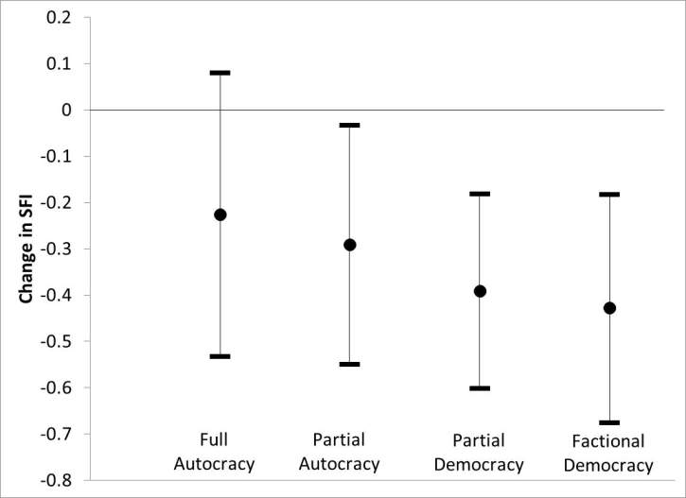
SC Was More Effective in More Democratic Partner Nations
$1,000 SC per 10,000 people as regime type varies

Slide 20
Testing our Hypotheses
✓
SC lowers the probability of domestic instability
Effect of SC is conditional
SC more effective in
States with stronger institutions
Democratic regimes
Some regions
Countries that also receive development assistance
Some types of SC are more effective than others
✓
✓
✓
✗
✓
✓
✗
Supports hypothesis
Does not support hypothesis

Slide 21
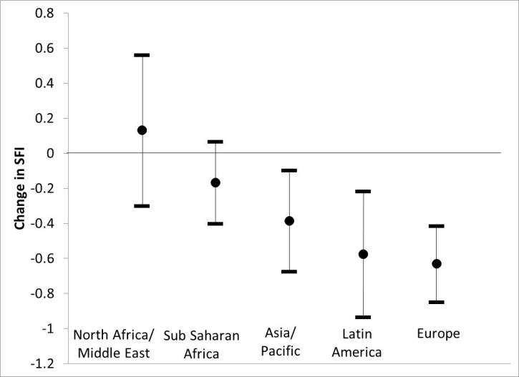
SC Was Less Effective in Middle East and Africa
$1,000 SC per 10,000 people as region varies

Slide 22
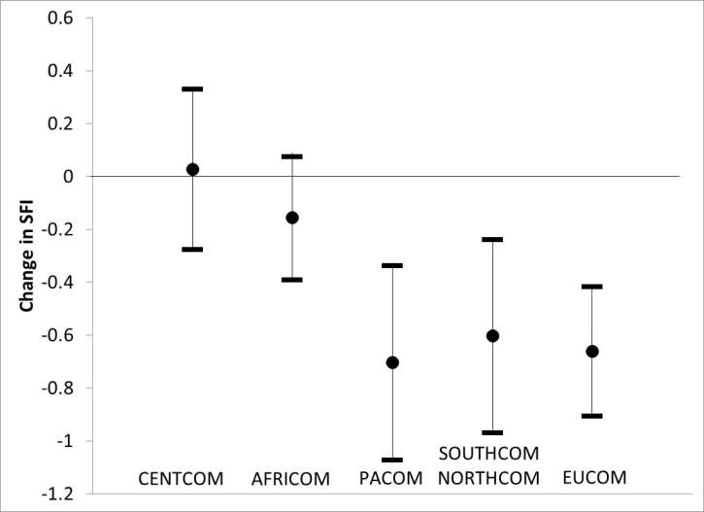
SC Was Less Effective in CENTCOM and AFRICOM
$1,000 SC per 10,000 people as COCOM varies

Slide 23
Testing our Hypotheses
✓
SC lowers the probability of domestic instability
Effect of SC is conditional
SC more effective in
States with stronger institutions
Democratic regimes
Some regions
Countries that also receive development assistance
Some types of SC are more effective than others
✓
✓
✓
✗
✓
✓
✗
Supports hypothesis
Does not support hypothesis

Slide 24
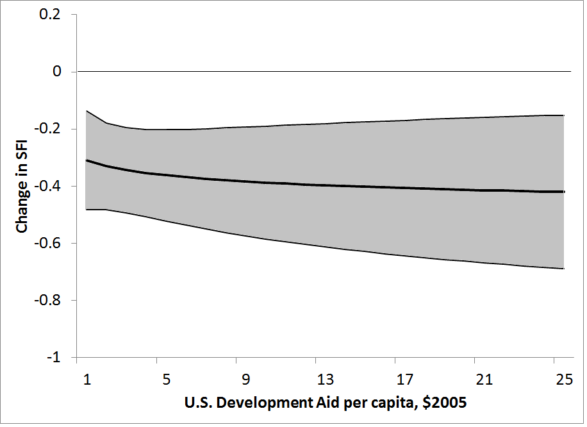
SC Effectiveness Did Not Depend on Concurrent U.S. Development Aid
$1,000 SC per 10,000 people as U.S. Development Aid varies

Slide 25
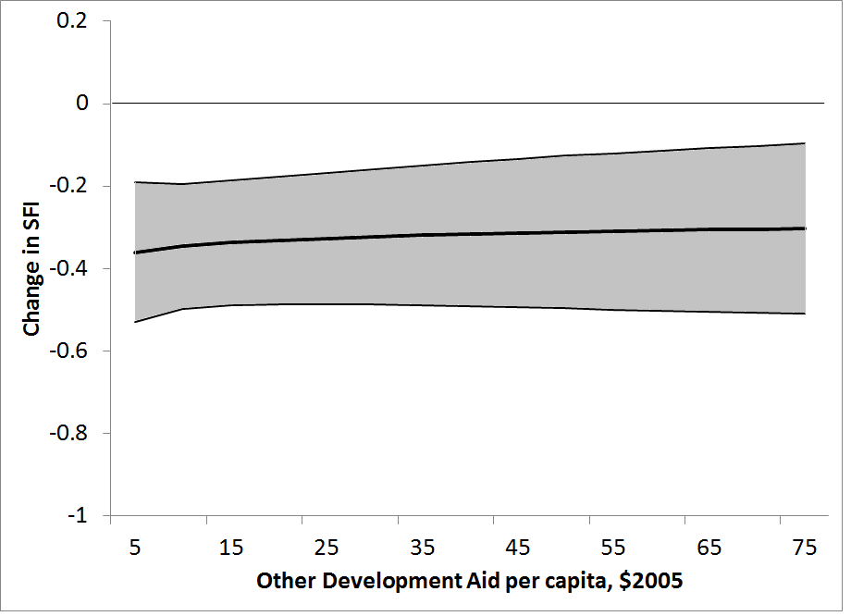
SC Effectiveness Did Not Depend on Development Aid from Other Developed Countries Either
$1,000 SC per 10,000 people as Other Development Aid varies

Slide 26
Testing our Hypotheses
✓
SC lowers the probability of domestic instability
Effect of SC is conditional
SC more effective in
States with stronger institutions
Democratic regimes
Some regions
Countries that also receive development assistance
Some types of SC are more effective than others
✓
✓
✓
✗
✓
✓
✗
Supports hypothesis
Does not support hypothesis

Slide 27
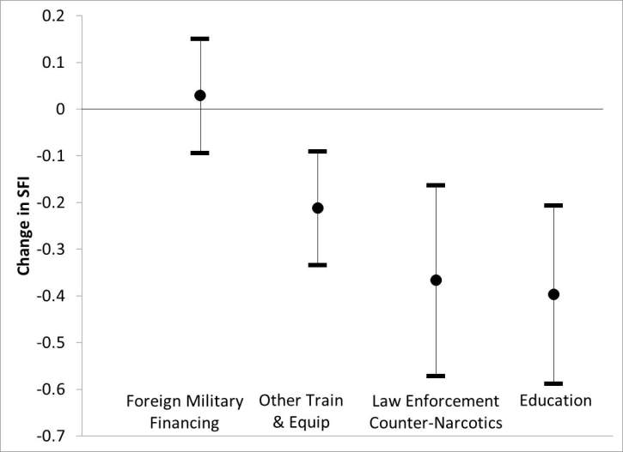
Foreign Military Financing Was Less Effective than Other Types of SC at Preventing State Fragility
$1,000 SC per 10,000 people as type of SC varies

Slide 28
Outline
Approach and methodology
What we found out
Conclusions and way forward

Slide 29
Overall Observations
Bottom line: SC has a small but statistically significant impact in preventing instability
So, the preventive thesis/assertion is correct but the effect is nuanced
Far more SC does not provide far more effect
More effect in states with strong institutions
More effect in democratic regimes
Non-materiel aid is especially effective
Little correlation of SC with development aid

Slide 30
Implications
For countries that lack state reach, focus on institution building
But development assistance - with its long term focus - may be a better tool than SC
In already bad situations, SC is not sufficient
This highlights the importance of prevention
Small amounts of SC have the most return on investment
This may reflect the fact of U.S. involvement rather than its form or size
To the extent that type of SC matters, training and education may be most effective for preventive reasons
FMF does not appear effective for preventive reasons; it may play an important role for access and relationship building
Our results suggest that Army trainers may be effective for prevention and is in line with greater focus of GPF on SFA

Slide 31
We are conducting case studies to add context to our quantitative analysis
We are analyzing 13 countries in depth
Top SC recipient from each GCC
States that showed strong or weak correlation between SC investments and SFI change
Philippines, Bangladesh, Jordan, Yemen, Georgia, Azerbaijan, Armenia, Morocco, Mali, Niger, Colombia, Honduras, Guatemala
We will conduct pairwise comparisons for several of these countries to further explore differences in SFI outcomes

Slide 32
Next Steps
Discussions with Army community Complete case studies and integrate quantitative and qualitative analysis | March 2012 April/May 2012
Draft final report Final report and discussions with extended security cooperation community | June 2012 September 2012

Slide 33
BACKUPS: Methodology

Slide 34
To Accomplish Our Objective, We Defined Three Tasks
Task 1: Fully specify the preventive hypothesis
Task 2: Assess empirical validity of the preventive hypothesis
Quantitative analysis
Develop a database that combines information on past SC efforts and political stability of partner nations
Measure the correlations between SC efforts and political stability of partner nations
Identify factors that condition the relationship between SC efforts and political stability of partner nations
Qualitative analysis
Analyze 10-15 countries based on quantitative results
Assess potential causal linkages between SC efforts and political stability of partner nations
Task 3: Identify key insights and implications for the Army

Slide 35
Government Documents, Discussion and Literature Review Gave Us Insight to the Hypothesis
Examined main policy documents and statements that outline the Preventive SC Thesis
Quadrennial Defense Review (2006)
BPC QDR Execution roadmap (2006)
Military Contribution to Cooperative Security (CS) Joint Operating Concept (2008)
SecDef Foreign Affairs article (2009)
Quadrennial Defense Review (2010)
National Security Strategy (2010)
National Military Strategy (2011)
Verified the meaning with former policy participants
Conducted literature review

Slide 36
We Excluded Some Programs
Programs for which we have limited usable data
Some training programs, military to military programs, and classified programs
Programs to countries we exclude from our analyses
Wealthy countries (GDP per capita above $10,000), NATO members, Afghanistan, Iraq, Israel, Egypt
Programs that are not SC in our measure
Non-concessional sales of military training and equipment, economic development assistance, and peacekeeping operations

Slide 37
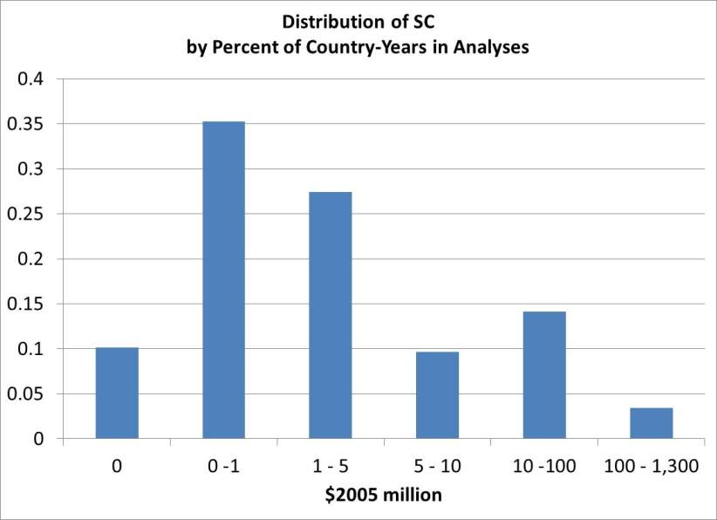
Distribution of SC Is Uneven: Many States Get a Little Aid, a Few Get a Lot

Slide 38
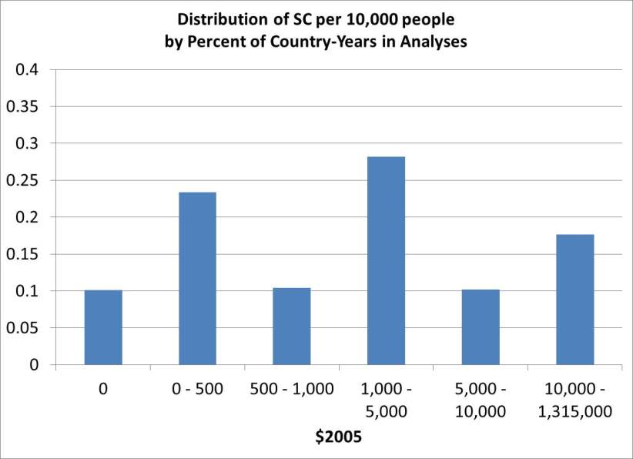
We Use SC per 10,000 People to Account for Differences in Country Size

Slide 39
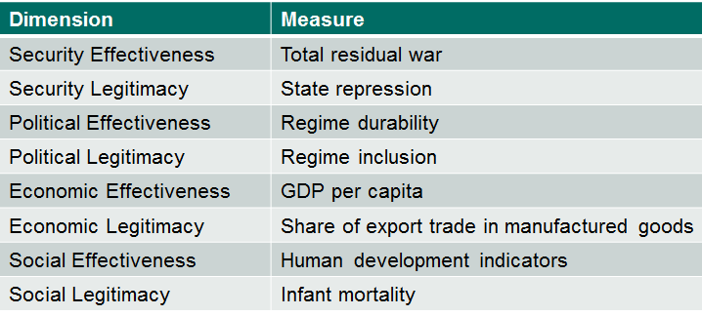
We Use the State Fragility Index (SFI) to Measure Probability of Domestic Instability
SFI is an annual measure of state fragility produced by the Center for Systemic Peace & Polity IV Project and frequently used by the conflict and development communities.
SFI scores are based on eight dimensions
SFI ranges from 0 (no fragility) to 25 (extreme fragility)
SFI includes scores for 168 countries, 1995-2010
E.g. for 2010: Somalia 25, Haiti 18, Bangladesh 12, Peru 7, Finland 0

Slide 40
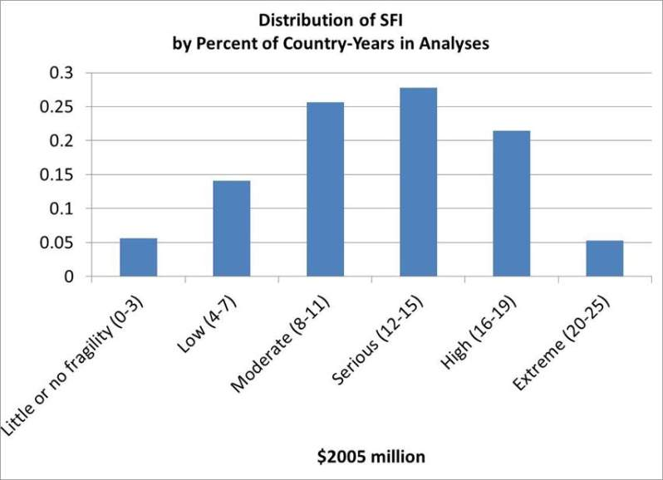
Distribution of SFI: Most States Experience Moderate to High Fragility

Slide 41
BACKUPS: Model Results

Slide 42
Model 1: Effect of SC on SFI
Variable | Coefficient | Standard Error | Significance
SFI, 1 year prior | 0.70 | 0.03 | 99%
SC per 10,000 people, 5 years prior | -0.04 | 0.01 | 99%
U.S. development aid per capita, 5 years prior | -0.02 | 0.05 | 26%
Other aid per capita, 5 years prior | 0.13 | 0.05 | 99%
Conflict in neighboring countries | 0.28 | 0.18 | 86%
Full autocracy | 0.57 | 0.40 | 84%
Partial autocracy | 0.93 | 0.40 | 98%
Partial democracy | 0.28 | 0.35 | 58%
Factional democracy | 1.01 | 0.37 | 99%
Constant | 2.69 | 0.44 | 99%
R2 | 0.58
# of Observations | 1262

Slide 43
Model 2: Effect of SC on SFI as SFI 5 Years Prior Varies
Variable | Coefficient | Standard Error | Significance
SFI, 1 year prior | 0.59 | 0.04 | 99%
SFI, 5 years prior | 0.04 | 0.03 | 81%
SC per 10,000 people, 5 years prior (SC) | -0.07 | 0.03 | 99%
SC * SFI, 5 years prior | 0.002 | 0.002 | 70%
U.S. development aid per capita, 5 years prior | -0.14 | 0.06 | 97%
Other aid per capita, 5 years prior | 0.18 | 0.09 | 96%
Conflict in neighboring countries | 0.43 | 0.29 | 85%
Full autocracy | -0.05 | 0.25 | 14%
Partial autocracy | 0.36 | 0.25 | 85%
Partial democracy | -0.28 | 0.09 | 99%
Factional democracy | 0.40 | 0.19 | 96%
Constant | 3.97 | 0.53 | 99%
R2 | 0.48
# of Observations | 875

Slide 44
Model 3: Effect of SC on SFI as State Reach Varies
Variable | Coefficient | Standard Error | Significance
SFI, 1 year prior | 0.54 | 0.04 | 99%
SC per 10,000 people, 5 years prior (SC) | 0.07 | 0.05 | 77%
State Reach | -0.11 | 0.03 | 99%
SC * State Reach | -0.002 | 0.001 | 90%
U.S. development aid per capita, 5 years prior | -0.10 | 0.07 | 87%
Other aid per capita, 5 years prior | 0.11 | 0.11 | 70%
Conflict in neighboring countries | 0.37 | 0.32 | 75%
Full autocracy | 0.04 | 0.28 | 12%
Partial autocracy | 0.51 | 0.23 | 97%
Partial democracy | -0.22 | 0.06 | 99%
Factional democracy | 0.60 | 0.16 | 99%
Constant | 10.63 | 2.14 | 99%
R2 | 0.45
# of Observations | 753

Slide 45
Model 4: Effect of SC on SFI as Regime Type Varies
Variable | Coefficient | Standard Error | Significance
SFI, 1 year prior | 0.70 | 0.03 | 99%
SC per 10,000 people, 5 years prior (SC) | -0.03 | 0.02 | 78%
Partial autocracy | 0.40 | 0.24 | 89%
SC * Partial autocracy | -0.01 | 0.03 | 22%
Partial democracy | -0.17 | 0.23 | 55%
SC * Partial democracy | -0.02 | 0.03 | 56%
Factional democracy | 0.59 | 0.23 | 99%
SC * Factional democracy | -0.03 | 0.03 | 62%
U.S. development aid per capita, 5 years prior | -0.03 | 0.05 | 43%
Other aid per capita, 5 years prior | 0.14 | 0.06 | 99%
Conflict in neighboring countries | 0.25 | 0.18 | 82%
Constant | 3.30 | 0.38 | 99%
R2 | 0.58
# of Observations | 1187

Slide 46
Model 5: Effect of SC on SFI as Region Varies
Variable | Coefficient | Standard Error | Significance
SFI, 1 year prior | 0.69 | 0.03 | 99%
SC per 10,000 people, 5 years prior (SC) | -0.08 | 0.03 | 99%
SC * Europe | -0.01 | 0.03 | 17%
SC * Sub Saharan Africa | 0.05 | 0.03 | 88%
SC * North Africa & Middle East | 0.09 | 0.04 | 96%
SC * Asia and Pacific | 0.02 | 0.04 | 50%
U.S. development aid pc, 5 years prior | -0.01 | 0.05 | 33%
Other aid per capita, 5 years prior | 0.16 | 0.06 | 99%
Conflict in neighboring countries | 0.24 | 0.18 | 82%
Full autocracy | 0.53 | 0.41 | 80%
Partial autocracy | 0.93 | 0.42 | 97%
Partial democracy | 0.27 | 0.36 | 54%
Factional democracy | 1.01 | 0.38 | 99%
Constant | 2.68 | 0.44 | 99%
R2 | 0.58
# of Observations | 1262

Slide 47
Model 6: Effect of SC on SFI as COCOM Varies
Variable | Coefficient | Standard Error | Significance
SFI, 1 year prior | 0.68 | 0.03 | 99%
SC per 10,000 people, 5 years prior (SC) | -0.02 | 0.02 | 73%
SC * CENTCOM | 0.02 | 0.03 | 60%
SC * EUCOM | -0.07 | 0.03 | 99%
SC * PACOM | -0.07 | 0.03 | 96%
SC * SOUTHCOM & NORTHCOM | -0.06 | 0.03 | 91%
U.S. development aid pc, 5 years prior | -0.01 | 0.05 | 9%
Other aid per capita, 5 years prior | 0.14 | 0.06 | 98%
Conflict in neighboring countries | 0.27 | 0.17 | 88%
Full autocracy | 0.63 | 0.41 | 87%
Partial autocracy | 1.04 | 0.41 | 99%
Partial democracy | 0.29 | 0.36 | 58%
Factional democracy | 1.09 | 0.38 | 99%
Constant | 2.85 | 0.45 | 99%
R2 | 0.58
# of Observations | 1240

Slide 48
Model 7: Effect of SC on SFI as U.S. Development Aid Varies
Variable | Coefficient | Standard Error | Significance
SFI, 1 year prior | 0.70 | 0.03 | 99%
SC per 10,000 people, 5 years prior (SC) | -0.04 | 0.02 | 95%
U.S. development aid per capita, 5 years prior | 0.01 | 0.08 | 15%
SC * U.S. development aid per capita, 5 years prior | -0.005 | 0.01 | 44%
Other aid per capita, 5 years prior | 0.14 | 0.05 | 99%
Conflict in neighboring countries | 0.28 | 0.19 | 87%
Full autocracy | 0.57 | 0.40 | 85%
Partial autocracy | 0.93 | 0.40 | 98%
Partial democracy | 0.28 | 0.35 | 58%
Factional democracy | 1.01 | 0.37 | 99%
Constant | 2.63 | 0.44 | 99%
R2 | 0.58
# of Observations | 1262

Slide 49
Model 8: Effect of SC on SFI as Other Development Aid Varies
Variable | Coefficient | Standard Error | Significance
SFI, 1 year prior | 0.70 | 0.03 | 99%
SC per 10,000 people, 5 years prior (SC) | -0.05 | 0.02 | 97%
Other aid per capita, 5 years prior | 0.12 | 0.06 | 95%
SC * Other aid per capita, 5 years prior | 0.003 | 0.01 | 44%
U.S. Development aid per capita, 5 years prior | -0.01 | 0.05 | 33%
Conflict in neighboring countries | 0.27 | 0.19 | 85%
Full autocracy | 0.56 | 0.40 | 83%
Partial autocracy | 0.92 | 0.41 | 97%
Partial democracy | 0.28 | 0.35 | 57%
Factional democracy | 1.01 | 0.38 | 99%
Constant | 2.73 | 0.44 | 99%
R2 | 0.58
# of Observations | 1262

Slide 50
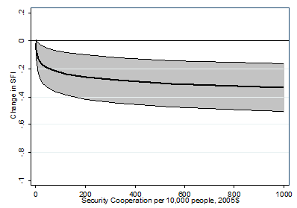
We Included SC Squared to Assess Nonlinearity
$1,000 SC per 10,000 people is associated
with 0.33 decline in SFI

Slide 51
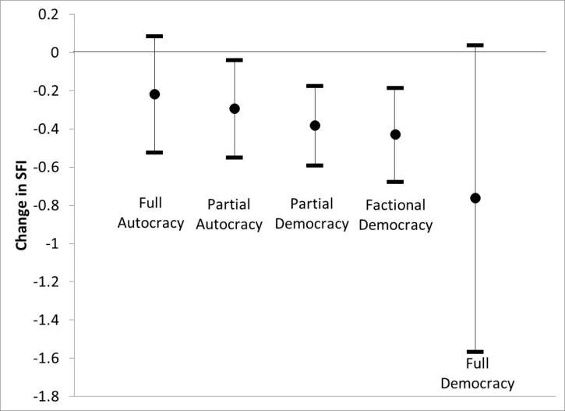
SC Was More Effective in More Democratic PNs
$1,000 SC per 10,000 people as regime type varies

