Slide 1
WOLFHOUND Tactical Radio Direction Finding System
Provided by:
Intelligence & Information Warfare Directorate
Mr. John Lynch, PM (732) 427-5534 john.lynch4@us.army.mil
Praemittias Systems LLC Mr. Reid Clayton, CEO (720) 937-5735 reidc@praemittias.com

Slide 2
This WOLFHOUND Training
is classified
UNCLASSIFIED // For Official Use Only
References to specific:
Equipment capabilities
Radio frequencies
Mission information and/or
Related reporting
May increase the security classification

Slide 3
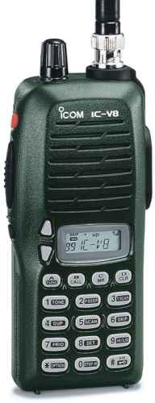
WOLFHOUND Concept of Operation
WOLFHOUND :
A ground-based direction-finding (DF) tool
Used for Early Warning / Force Protection
Designed to target Very High Frequency (VHF) and low-range Ultra-High Frequency (UHF) push-to-talk (PTT) radios (i.e., the ICOM IC-V8)
ICOM IC-V8

Slide 4
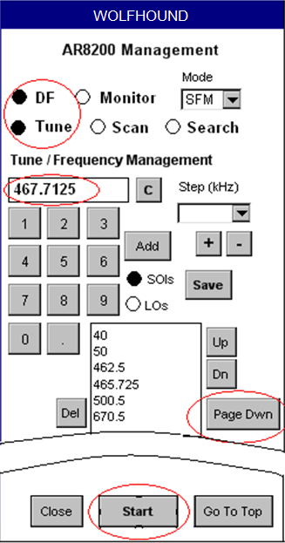
WOLFHOUND Concept of Operation
WOLFHOUND is:
Modular
Lightweight
Versatile
Direction Finding
Monitor and Record voice communications
Allows native speakers or translators to monitor voice traffic to aid in Target ID and/or Location

Slide 5
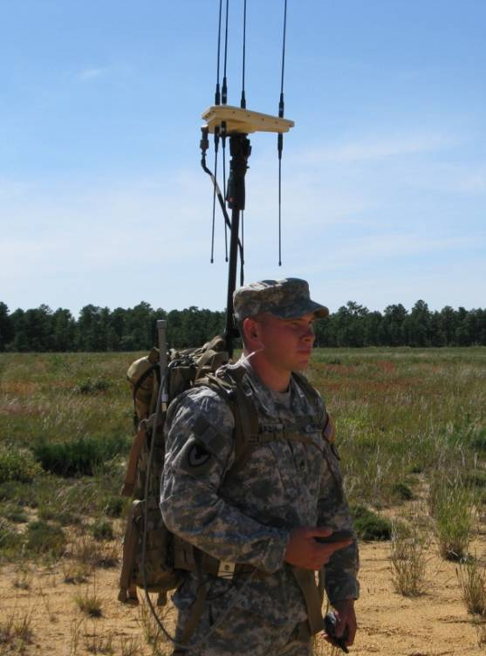
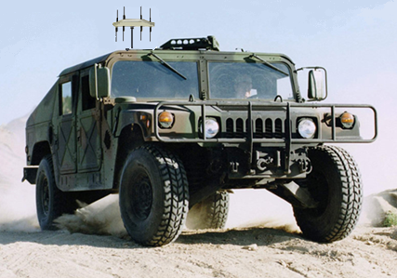
WOLFHOUND Concept of Operation
Two Modes of Operation
Stand-alone Mode
Cooperative Mode
Four Deployment Configurations
(Defined by Remote Antenna usage)
Custom Backpack (Hands-free &
weapon-ready operations)
Vehicle-mounted (Mobile operations)
Fixed Site (Static operations;
I&W and Force Protection)
Hand-held

Slide 6
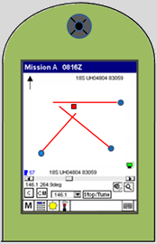
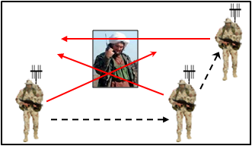
WOLFHOUND
Concept of Operation
Stand-Alone Mode
A lone Operator detects an emitter and vectors around it
WOLFHOUND generates a line-of-bearing (LOB) toward the
emitter and displays it on the touch-screen Display Head
As the operator vectors and the emitter continues to
transmit, more LOBs are generated & displayed
LOBs will start to cross
one another on the
Display Head
The intersection of the
LOBs represents the
location of the emitter
WOLFHOUND Display Head

Slide 7
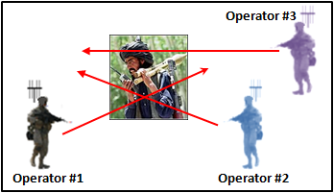
WOLFHOUND
Concept of Operation
Cooperative Mode
Three WOLFHOUND Operators are networked together using small Wireless Routers
They position themselves around an emitter
With a single transmission from the emitter, three LOBs are generated simultaneously, one from each WOLFHOUND unit
Three LOBs are generated at the same time by a single radio transmission
All three LOBs appear on each Operator’s
Display Head
Cooperative Mode

Slide 8
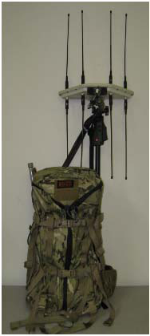
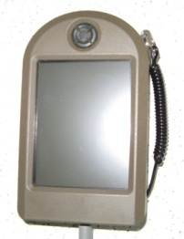
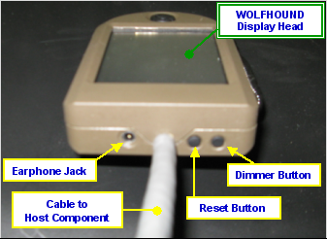
WOLFHOUND
Deployment Configurations
Custom Backpack
Display Head is worn on the operator’s forearm or attached to backpack shoulder strap
Remote Antenna is secured to an adjustable mast attached to the frame of the backpack
Hands free and weapon ready
Custom Backpack
for
Dismounted Operations

Slide 9
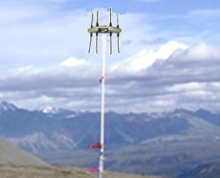
WOLFHOUND
Deployment Configurations
Fixed Site
Remote Antenna has Pica tinny-style rail to facilitate user-originated mission solution
Designated listening post and I&W
Early Warning / Force Protection
Vehicle Mount
Early detection and warning in support of mobile operations
Remote Antenna attaches to user-originated vehicle mount

Slide 10
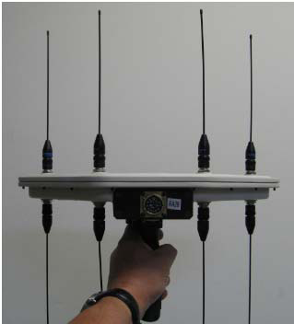
WOLFHOUND
Deployment Configurations
Hand-held
The Remote Antenna is hand-carried
Either Stand-Alone or Cooperative Mode
The Hand-held deployment configuration should be considered only in instances that do not impair:
Mobility of the WOLFHOUND Operator
Weapons deployment capability

Slide 11
Key Points for Leaders

Slide 12
Key Points for Leaders:
WOLFHOUND should be briefed as a Force Protection system
Why?
Because WOLFHOUND has an audio recording capability, this could lead to the system being classified as signals.
Post-Mission processing requires analyst involvement, especially for post-mission audio.
System classification is FOUO, but processed post-mission files are higher.
Destruction Plan - destroy the thumb drive.

Slide 13
Key Points for Leaders:
Ground-based Direction Finding (DF) is very difficult!
Basic understanding of movement techniques and signal
theory is a must.
Mission Considerations:
Pre-mission preparation (frequencies, movement, targeting)
. WOLFHOUND is not a “magic” box, it should be used as part of an overall CONOP
Proper spacing and movement during operation
(sometimes “boxing” around a target)
4. Jammers render WOLFHOUND ineffective, i.e., if WOLFHOUND is within the jamming “bubble”
5. Voice confirmation of target (by linguists / interpreters)

