Slide 1
UNCLASSIFIED
2-101 SFAAT Operational Experiences
PURPOSE:
Share lessons learned from OEF SFAAT Mission
Share information with the broader Army3
Duration: 6 MAR 2013
Location: Fort Drum, NY
Proponent: 3rd BDE, 10th MTN DIV
Chair: Spartan 6
Attendees: Spartan Leaders
INPUTS:
Strike AAR Comments
Strike Vignettes
OUTPUTS:
Share Best Practices and Lessons Learned
AGENDA:
Opening Comments (LTC Davis/MAJ Kuhlman)
Transition continuum
Conceptual Framework
Organization (TM Strike/Tm Campbell)
Realignment Vignette
Base Transfer/Site Survey Vignette
Key Take Aways
As of 6 MAR 2013

Slide 2
Transition Continuum
SFA
Activities:
Transition
Generate
Employ
Sustain
CF
CF
CF
CF
ANSF
ANSF
ANSF
ANSF
CA
CA
Who is Fighting?
ANSF
ANSF
CF
CF
CA
ANSF
Who is in Charge?
CF
SUPPORTED
ANSF
SUPPORTED
SUPPORTING
SUPPORTING
ANSF
CF
Partnered
Operation
Combined
Operation
Enabled

Slide 3
TAC-1 Priorities for Advising ANSF
Endstate: ANSF capable of:
Planning, preparing, and executing an annual campaign plan and supporting operations to provide national defense and provincial security.
Projecting combat power as needed to conduct offensive operations (movements to contact) .
Maintaining freedom of movement throughout AO.
Overwatching and reinforcing AUP & ABP within Corps AO.
Sustaining, maintaining and training the force.
COMMAND & CONTROL
Battle staffs fuse information to answer CCIR in support of the Cdr's decision making process. (3)
Battle staffs control and synchronize current operations; plan future operations.
OCC coordinate planning and execution of combined operations between ANA, AUP, ABP, NDS, and Provincial Governors.
ENABLERS
Employ organic mortar and artillery fires ISO operations. (1)
Employ organic route clearance assets ISO C-IED fight. (2)
Employ MICO multi-functional teams ISO collecting PIR (3)
Allocate RW aviation assets ISO operations and sustainment. (5)
SUSTAINMENT
Receive transfer of tactical bases from CF. (4)
Establish and manage service contracts in support of garrisons and tactical bases. (4)
Maintain warfighting equipment. (1, 2, 5)
Distribute classes of supply (CLIII/V/VIII/IX priority) in support of anticipated demand. (1, 5)
Treat trauma and evacuate casualties to established medical facilities. (5)
1. Remove negative influencers; promote positive influencers.
2. Develop a professional, empowered NCO Corps; foster mutual trust between the Officer and NCO Corps.
Endstate: Competent ANA leaders that provide direction & resources to subordinate units and are accountable to HHQ and subordinate units.
02/1200AUG12

Slide 4
Focus Areas
Given the significant reductions in troops levels, future coalition forces will deploy to Afghanistan and focus on advising ANSF battalion and above organizations to assist them in solving their own problems and enable ANSF unilateral operations and eventual independence
ANA Big 5
Route Clearance and EOD
Garrison Operations
Intelligence/Operation Fusion
Brigade Level Logistics
Indirect Fires
ABP Big 4
Border Zone Operations
Border Management
Command and Control
Logistics
AUP PHQ Big 6
Command and Control of District
Conduct Community Policing
Provide Support to Investigations
Conduct Tactical Police Operations
Conduct Fixed Site Security
Provide Sustainment and Accountability
Develop systematically across all levels
Advise: ANA Battalion level organizations and above
Develop BDE mission command and organic enablers
Support ANSF independent operations with CF enablers
(ISR, CCA, CAS, IDF)
Develop top to bottom
Advise: Focus on zone level capacity
Enable capacity to secure the Border
Support ANSF independent operations with CF enablers
(ISR, CCA, CAS, IDF)
Develop top to bottom
Advise: Provincial and select districts
Develop and enable community based solution (COIN Effect)
Create unity of effort through the OCC construct
1/1500NOV12

Slide 5
UNCLASSIFIED // FOUO
NOK-SOK TASK ORGANIZATION
201 CORPS ADVISOR TEAM
 | 201 CORPS HQ FOB GAMBERI-COL Walrath
 | OCC-R CENTRAL FOB GAMBERI-COL Himsel
 | FOB GAMBERI-LTC Wagner
LAGHMAN AUP ADVISOR TEAM “PERFORMANCE”
 | PHQ LAGHMAN FOB MEHTAR LAM-LTC Hamby
2-502 | QARGHAH’i AUP COP XIO HAQ-CPT Rainey
 | OCC-P LAGHMAN FOB MEHTAR LAM-LTC Davis
KUNAR AUP ADVISOR TEAM “RAPTOR”
 | KUNAR PHQ FOB FIAZ-LTC Williams
1-75 | SAR KANI AUP FOB JOYCE-CPT McCain
1-502 | NARI AUP FOB BOSTICK-MAJ Faulkner
 | WATAPUR AUP COP H-M-CPT Henry
2-502 | BAR KUNAR AUP COP MONTI -CPT Andrews
 | OCC-P KUNAR FOB FIAZ-LTC Coulson
V
SHHC
V
BSTB
V
BSB
V
V
NoK OCC ADVISOR TEAM
 | OCC-P NURISTAN COP KALAGUSH-LTC Karr
V
NANGAHAR AUP ADVISOR TEAM
 | OCC-P NANGARHAR FOB HUGHIE-LTC Konczey
1-320 | KOT/DEH BALA AUP FOB SHINWAR-CPT Holler
1-320 | KHUGYANI AUP FOB CONNOLLY-CPT Askew
V
1/201 ADVISOR TEAM “FALCON”
2-502 | 1/201 IN BDE FOB GAMBERI-LTC Devarona
1-502 | 1/1/201 IN KDK COP KALAGUSH-CPT M. Morgan
1-502 | 2/1/201 IN KDK METHAR LAHM-CPT Small
 | 4/1/201 CS KDK COP XIO HAQ-CPT Chung
 | 5/1/201 CSS KDK FOB GAMBERI-CPT Lawrence
V
V
V
V
V
SOK ADVISOR TEAMS “WIDOWMAKER”
1-75 | 4/203 IN BDE FOB SHANK-LTC Cox
1-75 | 1/4/203 IN KDK FOB ALTIMUR -CPT Taetzsch
 | 4/4/203 CS KDK FOB SHANK-CPT Stutes
 | OCC-P LOGAR FOB PUL-E-ALAM PB-LTC Molina
 | OCC-P WARDAK OCCP WARDAK- LTC Parker
 | ABP ZONE-2 FOB GOODE-LTC Horn
V
ABP ADVISOR TEAM “TOP GUN”
1-320 | ABP ZONE-1 J-BAD GARRISON-LTC Wiseman
1-502 | 1/1 ABP KDK FOB BOSTICK-CPT T. Morgan
1-502 | 2/1 ABP KDK COP MONTI-CPT Carrier
1-75 | 3/1 ABP KDK FOB JOYCE-CPT Brancieri
1-320 | 5/1 ABP KDK FOB TORKHAM-CPT Knight
2-502 | 8/1 ABP KDK FOB Connolly-CPT Flowers
V
V
BSTB
V
V
V
BSB
V
V
BSB
2/201 ADVISOR TEAM “TALON”
1-502 | 2/201 IN BDE FOB HUGHIE-LTC POWER
2-502 | 3/1/201 IN KDK FOB Connolly-CPT Dortona
2-502 | 6/1/201 IN KDK FOB SHINWAR-CPT Wenger
 | 4/2/201 CS KDK FOB FORTRESS-CPT Krug
 | 5/2/201 CSS KDK FOB JOYCE-MAJ Slocum
V
V
V
V
V
V
V
V
BSTB
Legend:
INDICATES CHANGE FROM COA BRIEFED ON 27 APR 12
V
BSB
10 TMs NoK
6 TMs SoK
01 JUN LAD
As of 3 MAY 2012

Slide 6
UNCLASSIFIED
STRIKE BCT (-) FTCKY COMMAND
2BCT(-) FTCKY COMMAND
Cadre (95 Officers, 165 NCOs, 14 WO, 244 EM)=518
7 UICs = 1 x BCT UIC; 6 x BN UIC; 30 x CTB UIC
BCT (-) with Provisional Authorities
BCT = FG UCMJ/Chapter Authorities
BN = FG UCMJ Authority
C-T-B CDRs with CG UCMJ Authority
X
BCT Staff
BDE OPS SGM - MSG Marshall
Medical – CPT Forbush
Chaplain – MAJ Hodge
FMT – SSG Supernault
Retention – MSG Millner
PAO – MAJ Hopwood (female)
EO – SFC Mouton
BCT FRSA – Mrs. Logue
2
V
101
XO – MAJ Rowland
S1 – MAJ Thiesfeld / CPT Hollywood
S2 – CW2 Etzler
S3 – MAJ Kort, CPT Twamley
S4 – CPT Faber
S6 – CPT Pollak
PBO – CW2 Davis, WO1 Harcrow (females)
Legal –CPT Grimm
STRIKE (REAR)
CDR – LTC Hedrick (May 12)
CSM – CSM Haywood
1-502 IN
2-502 IN
1-75 CAV
2 BSTB
1-320 FA
526 BSB
V
V
V
V
STB
V
5
V
BSB
TALON
FALCON
WIDOWMAKER
RAPTOR
TOP GUNS
PERFORMANCE
OIC – MAJ Brown
CSM – TBD
OIC – MAJ Carroll
CSM – 1SG Harbour
OIC – MAJ Tavares
CSM – SGM Brelland
OIC – MAJ Spears
CSM – 1SG Taylor, G
OIC – MAJ Schotzko
CSM – CSM Tate
OIC – MAJ Post
CSM - Robertson
V
HHC
V
V
V
STB
V
V
BSB
HHC
OIC – CPT Morse
1SG – SFC Lopez
OIC – 1LT Portwood
1SG – SFC Burnard
HHC
OIC – CPT Calkins
1SG – SFC (P) Silva
OIC – CPT Motto
1SG – SFC Lyon
OIC – 1LT Ring
1SG – 1SG Sanders
OIC – 1LT Murphy
1SG – 1SG Meeks
HHT
HHB
HHC
“Regulators”
“Head Hunter”
“Warrior”
“Hell Raiser”
“Havoc”
“Stand Tall”
V
A
V
OIC – 1LT Meyer
1SG – 1SG Wilson
V
V
V
V
OIC – 1LT Calkins
1SG – 1SG Gabriel
A
OIC – 1LT Collini
1SG – SFC Peasgood
OIC – CPT Flores
1SG – 1SG Rico
A
OIC – 1LT Ficken
1SG – 1SG Rugerio
A
OIC – 1LT Gatewood
1SG – SFC Andrews
E
A
A
X
“Hardrock”
“Attack”
“Apache”
“Beast”
“Rock Hard”
“Road Warrior”
V
B
V
OIC – CPT Kastl
1SG – 1SG Fitzke
V
V
MI
OIC – 1LT Holmbeck
1SG – SFC(P) Totten
V
B
V
OIC – CPT Teter/
CPT Petrelli
1SG – 1SG Carter
B
OIC – 1LT Rezendes
1SG – 1SG Baca
B
OIC – 1LT Hammer
1SG – 1SG Jefferson
B
B
OIC – CPT McGuigan
1SG – 1SG Flynn
“Bulldog”
“Renegade”
“Bone Crusher”
“Nighthawk”
“Bulls”
“Mad Bull”
V
J
C
V
J
V
V
OIC – CPT Sparks
1SG – 1SG Taylor
V
FSC
C
V
OIC – CPT Glass/
CPT Wagner
1SG – 1SG Harris
C
OIC – 1LT McConaghy
1SG – 1SG Bryant
OIC – CPT Roush
1SG – 1SG Whitted
C
OIC – 1LT Walls
1SG – SFC Leach
C
G
OIC – CPT Snyder
1SG – 1SG Cana
“Charger”
“Chaos”
“Venom”
“Rider”
“Black Heart”
“Cobra”
(~445=96%)
(~439=92%)
D
OIC – CPT Payne
1SG – MSG Overway
V
FSC
HHC
BDE
V
OIC – CPT DeJesus
1SG – 1SG TBD
D
OIC – CPT Peck
1SG – 1SG Bond
D
OIC – 1LT Dickinson
1SG – SFC Fountain
“Wardog”
“Dog”
“Death Dealer”
“Hawk”
6 x BN STAFF
V
FSC
(~511=95%)
(~622=93%)
S1-1LT
S2-SFC/MSG
S3/XO- CPT/1LT
S4- 1LT
S6- SSG
UMT- CPT/1LT
PA- CPT/1LT
Maint Tech- WO1/CW2
Motor Sgt-SFC
BN FRSA-CIV
V
FSC
F
OIC – 1LT Malone
1SG – SFC Johnson
E
OIC – 1LT Collins
1SG – 1SG Thompson
“Easy”
“Fighter”
(~730=90%)
(~730=90%)

Slide 7
ANSF Performance Outputs
Command and Control:
Executing a realignment plan that consolidates combat power to project into contested areas
ANSF executing summer/spring campaign plan and have developed winter campaign and training plan.
Conducting complementary operations along seams and out-of-sector operations.
Weekly provincial security/intelligence targeting meetings.
Predictive analysis and intelligence fusion that resulted in successful defense of Kunar 2-3 Aug.
Successful employment of ANA MI MFTs in support of 10 ANA BDE and Kdk operations
Developed a comprehensive communications training plan which includes individual/collective training exercise at each echelon.
Sustainment & Medical:
96 CLPs in last 90 days; 42 effective patrols and 54 un-forecasted patrols delivering one commodity.
2/201 ANA BDE combined arms resupply to Nangalam delivering 90 DoS.
AMCM process that increased aircraft utilization to 100% over 24 AAF resupplies to remote ANSF sites.
Establish service contracts to maintain 9 x ANSF bases; transferring 11 additional CF to ANA by NOV.
181 ANA ground CASEVAC compared to 28 CF air MEDEVAC; a ratio of 8 ANA to 1 CF evacuation.
6 combined aid stations operational in AO.
Route Clearance & CIED:
81 route clearance patrols in last 30 days; 72 un-partnered and 9 partnered.
22 IEDs located and 19 cleared (86% success rate).
Conduct un-partnered RCPs (1/day/ANA Bde).
29 Soldiers attended IMT; 5 received certificates and 24 graduated course.
Next 201 Corps IMT courses scheduled for DEC 12
Anticipate increased CIED training with the arrival of additional civilian contractors in JAN 13
Fires:
Repositioning of howitzers to provide direct support to kandaks
24 indirect fire missions; 9 ISO deliberate operations and base defense
Certification for un-partnered ANA units to integrate CF joint fires successfully (5 TICs)
ANA combined arms live fires training exercises
BSO fire support training to increase proficiency of howitzers, mortars, forward observers, and FDCs
1/1500NOV12

Slide 8
TM TALON DEPLOYMENT AAR
Realigning an ANA BDE

Slide 9
 | STRIKE | SFAAT AAR | 6 MAR 13
UNCLASSIFIED
When you buy an elephant, before you bring it home, you must first determine if you have a big enough room to put it in. – Afghan Proverb

Slide 10
 | STRIKE | SFAAT AAR | 6 MAR 13
UNCLASSIFIED
Agenda
Challenges
Key Issues
Recommendations
Keys to Success

Slide 11
 | STRIKE | Challenges | 6 MAR 13
UNCLASSIFIED
Challenges:
The ANA initially disagreed with the move and actively sought to undermine it
The ANA initially refused to plan for the move
An ongoing MOD gas crisis during the midst of the realignment created challenges
The realignment moves all occurred while ‘in contact’ with a determined enemy
Facilities were often inadequate to receive additional Soldiers by desired timelines
No ANA Corps had ever attempted to put a ‘bridging contract’ solution in place prior
Afghans don’t view property hand-over in the same way Americans do…no checklists
Closing FOBs meant existing fire support procedures ISO the ANSF were no longer valid in some cases and required revalidation
Legal review timelines for contracts were rigid and could not be rushed
Kunar transitioned from CF BSO relationship to BSI during realignment - ANA C2 evolved
Some CF refuse to acknowledge Afghan cultural ‘red-lines’ and dismiss them

Slide 12
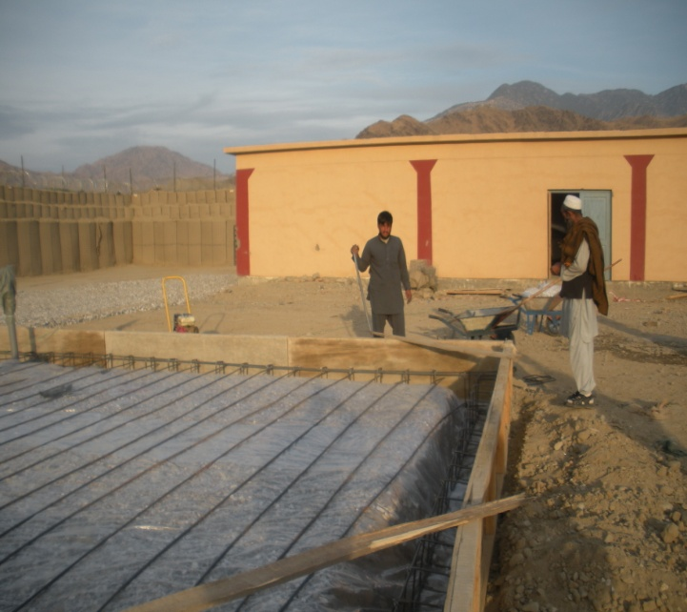
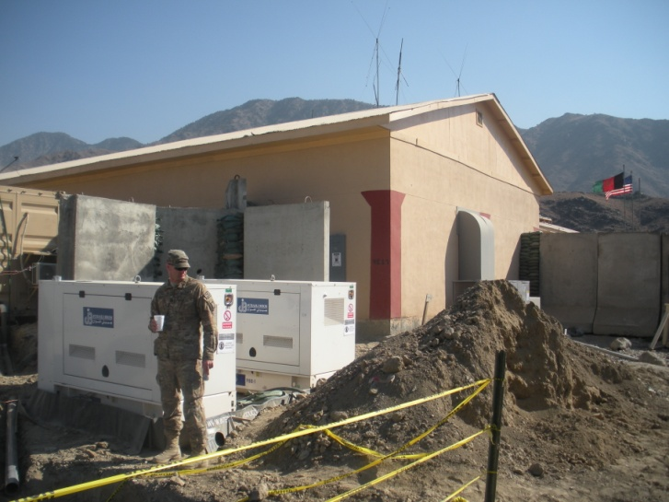
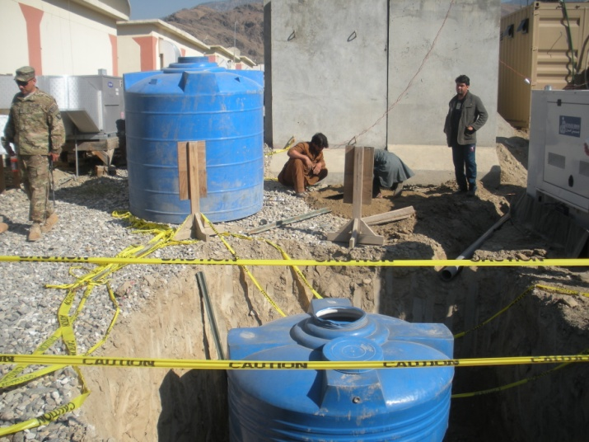
 | STRIKE | Key Issues | 6 MAR13
UNCLASSIFIED
2nd BDE 201st Corps Realignment
Key Issues:
Contracting
Cultural Issues
Logistical Considerations
Facilities
Combined Planning

Slide 13
 | STRIKE | Key Issues | 6 MAR 13
UNCLASSIFIED
2nd BDE 201st Corps Realignment
Issue: Contracting –The need arose for an extensive amount of “bridging contracts” to allow for the continued service of life support necessities required for the ANA to continue to function. These contracts were critical in the realignment process because the ANA’s contracting system would not come on-line until DEC 12, after the realignment and into the winter months and cold weather.
Discussion: Previously these contracts had serviced exclusively CF forces at CF locations. During this process, TM Talon had one logistics officer who had assumed responsibility for both the BDE S-4 and the Garrison Support Unit. TM Talon’s Signal Officer and Assistant S3 were responsible for paying contractors upon completion. The duties of COR were all-consuming and left little time for anything else. During the contracting process red tape was abundant at NTM-A/ISAF/RC levels. Success depended upon close coordination with all agencies involved, especially the FOB Fenty contracting Officer and the 4-4 BDE Engineering Officer.

Slide 14
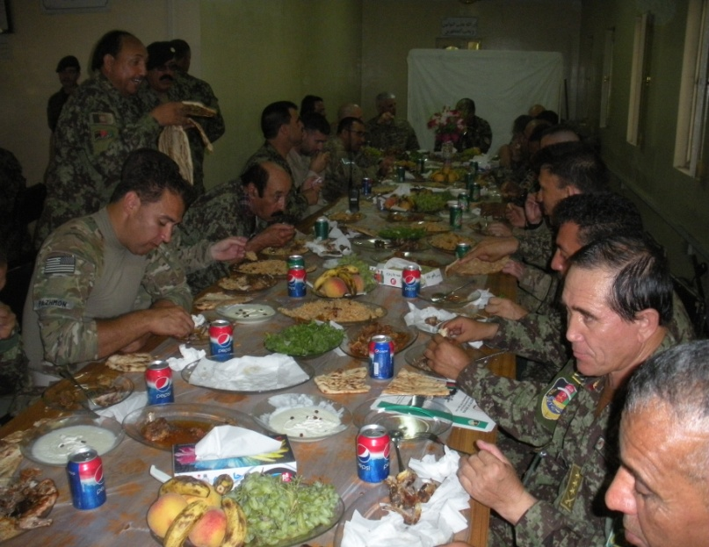
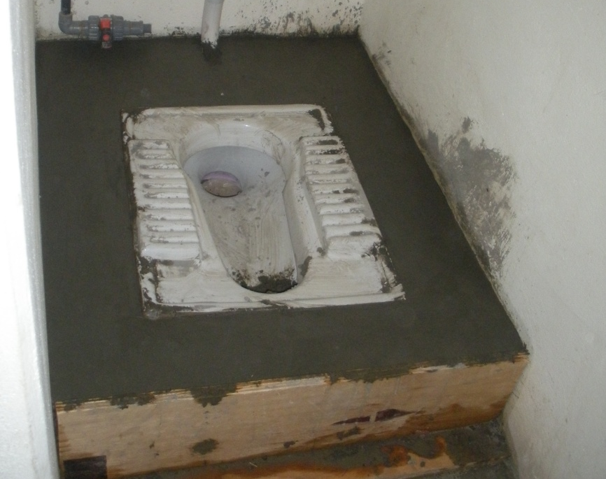
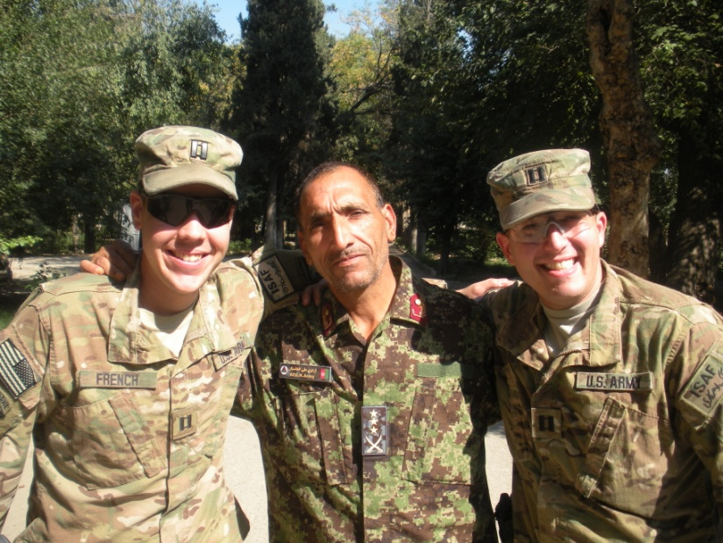
 | STRIKE | Key Issues | 6 MAR 13
UNCLASSIFIED
2nd BDE 201st Corps Realignment
Issue: Cultural Issues – During the course of the 2nd ANA BDEs realignment, TM Talon encountered several cultural issues and only through careful negotiation of these issues and working closely with the Afghans to develop solutions were we able to maintain rapport and accomplish the mission.
Discussion: During the realignment TM Talon encountered several issues that by American standards would be considered trivial, but by Afghan standards were “red lines” that they were unable to budge on. It was not uncommon for an Afghan planning meeting to be somewhat disjointed and very consensus oriented. Commanders would seek consensus from everyone in the room, vice giving orders. This in an anathema to Western military leaders as a Commander’s word is law, but when taken in the cultural context, one can see that by seeking consensus in a public forum everyone will become a stake holder and not only share in success, but more importantly share the blame should failure occur.
“This sounds like a math problem to me” – Unnamed U.S. Officer

Slide 15
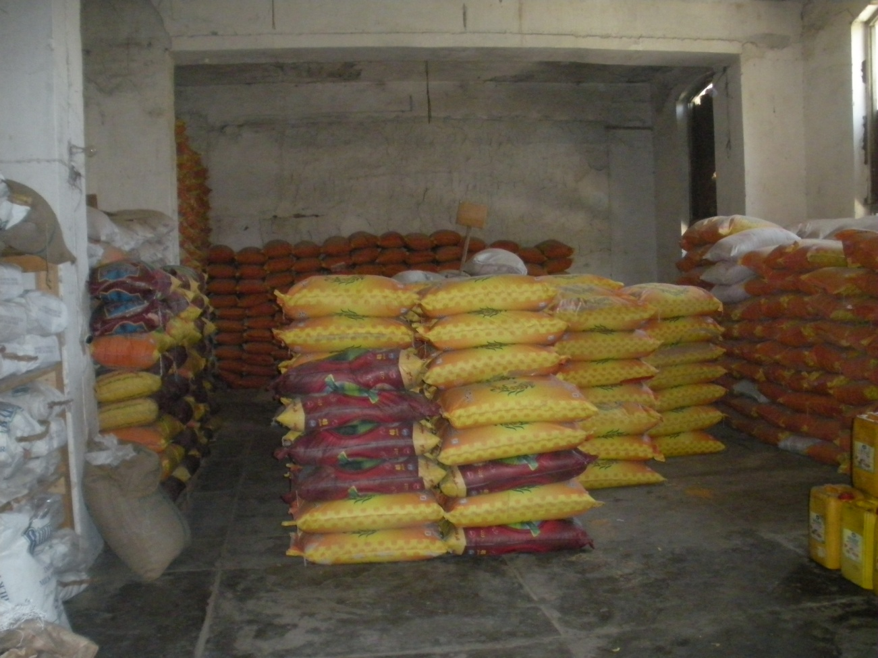
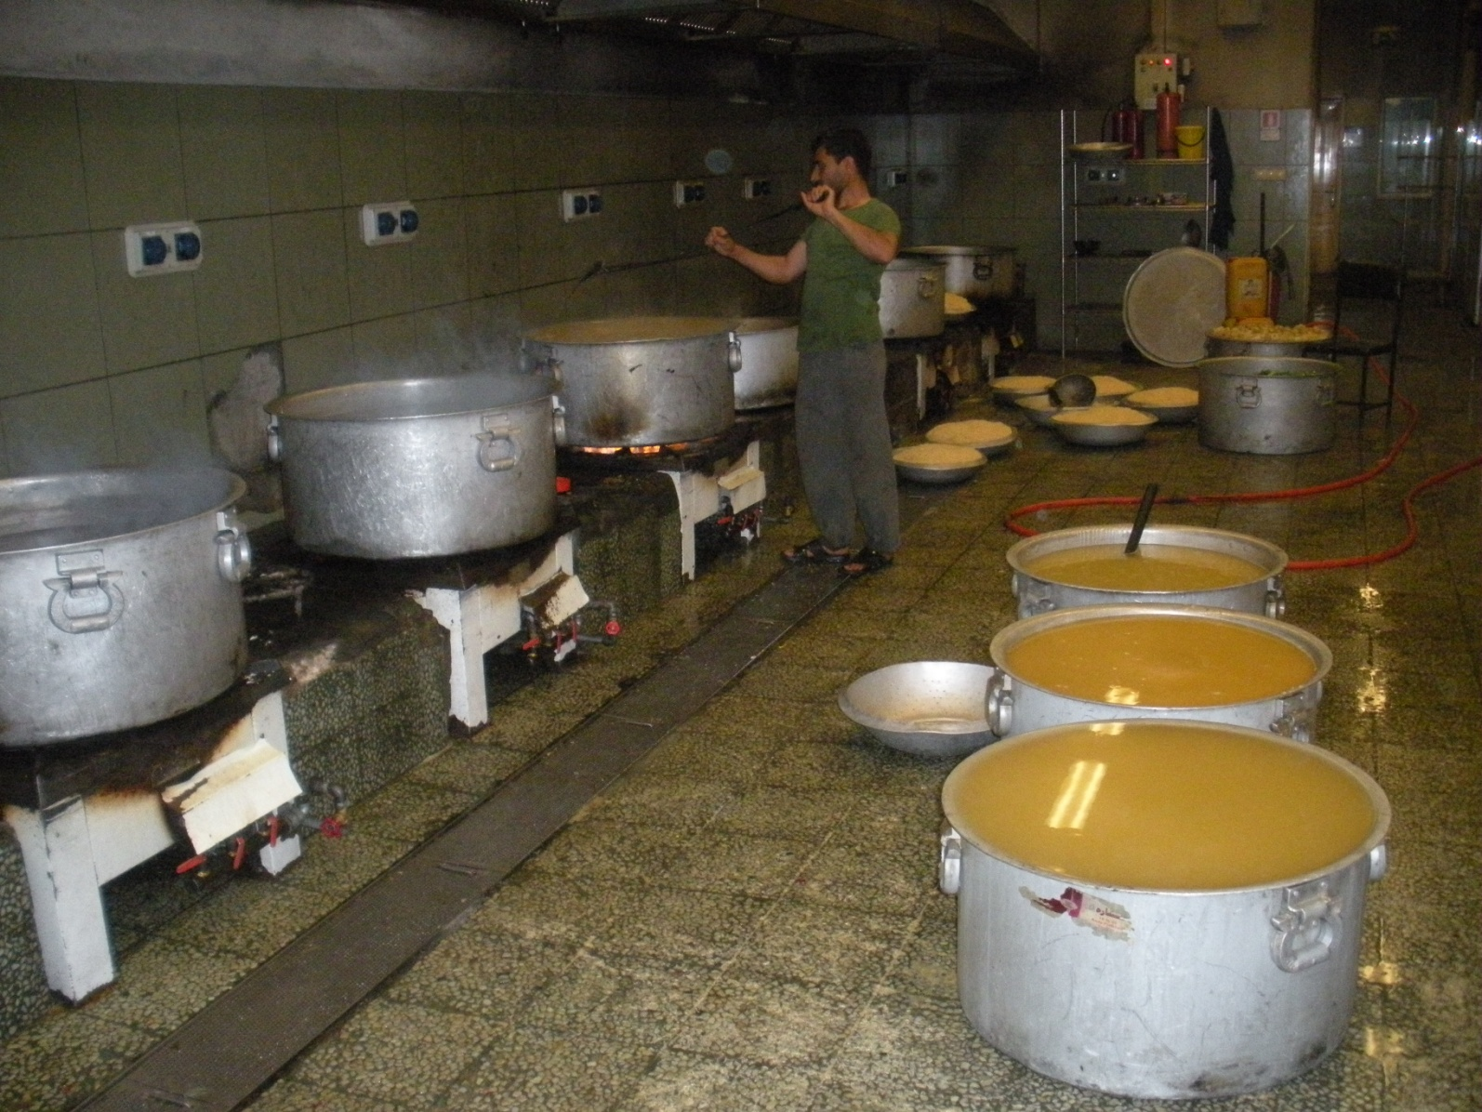
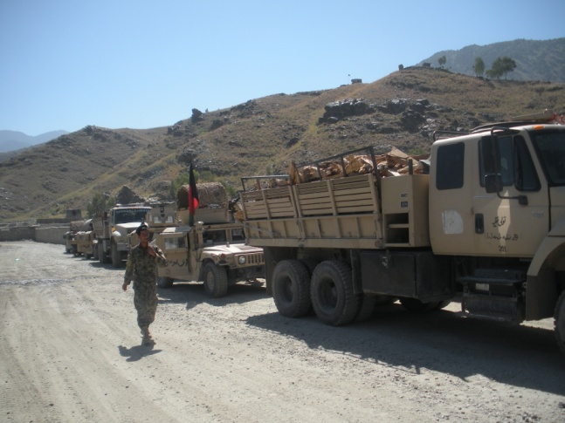
 | STRIKE | Key Issues | 6 MAR 13
UNCLASSIFIED
2nd BDE 201st Corps Realignment
Issue: Logistical Considerations – Declining direct CF support to ANSF logistics and unresponsiveness of organic ANA logistical capabilities.
Discussion: Because over the past 10 years CF has supplied the ANSF with whatever they might need, the ANSF believe that this is natural and expect that this system will continue. During the realignment, CF was looked at to provide everything including beds, building materials, food, and fuel. During the realignment, 6th Kandak, 1st BDE, was tasked with assuming the mouth of the Pech River Valley and make link up with 6th Kandak, 2nd BDE. During this movement, they requested building materials for newly planned COP sites as well as service contracts to maintain life support. During the BDE HQ realignment, the ANA BDE Commander and staff vocalized all of their needs to the advisor teams, and while they initially seemed outrageous, further consideration of their logistical system planning horizons and a lack of responsiveness in their system made their requests seem more realistic and necessary.

Slide 16
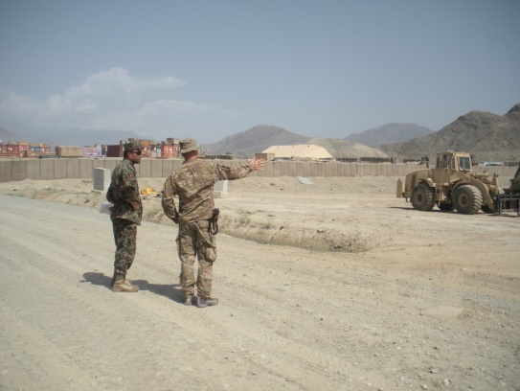
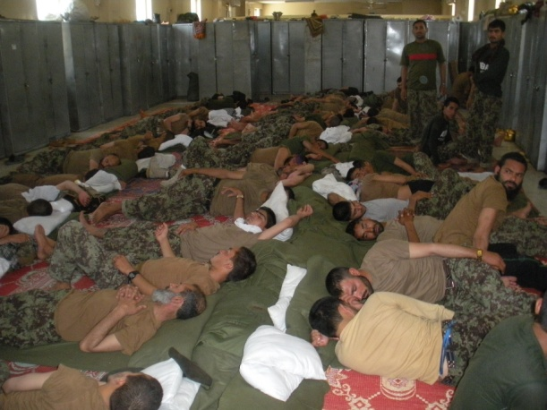
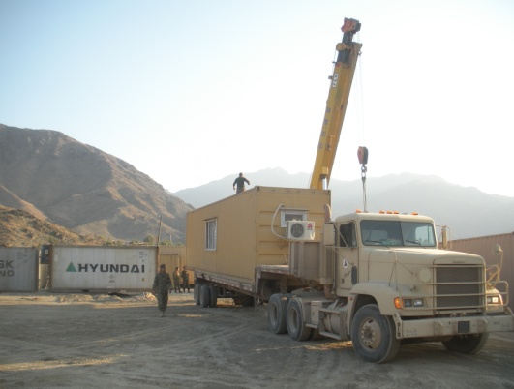
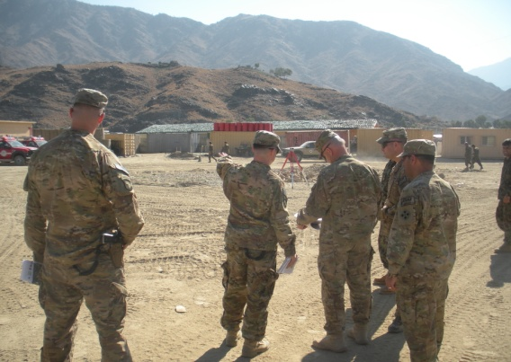
 | STRIKE | Key Issues | 6 MAR 13
UNCLASSIFIED
2nd BDE 201st Corps Realignment
Issue: Facilities: When realigning ANSF units into new locations, the CF advisors and the BSI higher HQ must ensure facilities at the receiving location can adequately support the number of newly arriving ANSF personnel. Considerations include (but are not limited to) sewage capacity, DFAC capacity, shower/latrine capacity, lodging capacity, medical facility capabilities, motorpool space, and mosque capacity.
Discussion: In some instances, ANA units were asked to move into locations prior to adequate facilities being available. It is imperative that both Afghan and CF leaders address facility shortfalls (to the extent possible) and work to address these issues. This may involve using ASFF funds for small project improvements, contracting in the event construction is necessary, or moving existing infrastructure from one location to another (i.e. CHUs from one FOB to another). Legal constraints, especially contracting timelines, can be rigid and inflexible, and often cannot be rushed. Adequate time must be built into the overall plan prior to executing a move to synchronize facility improvements/construction timelines with move timelines. The more ANA leadership can conduct battlefield circulation and see future unit locations and articulate concerns/expectations, the easier it is to manage their concerns and ultimately get their buy-in for the necessary moves. Cultural considerations must be addressed throughout as some are unforeseen “red-lines” that CF units will not anticipate.

Slide 17
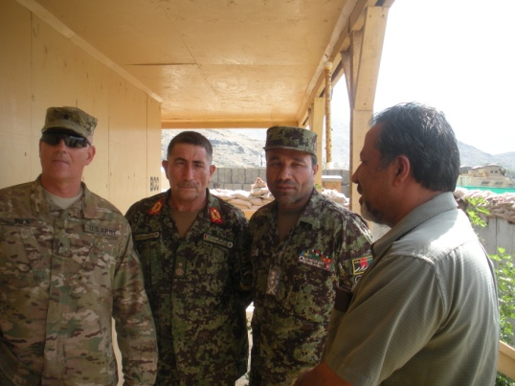
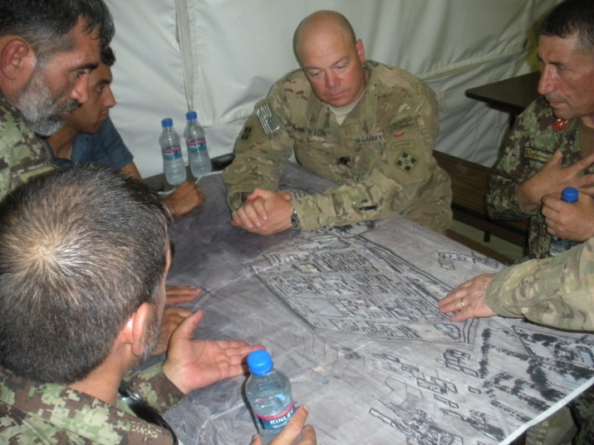
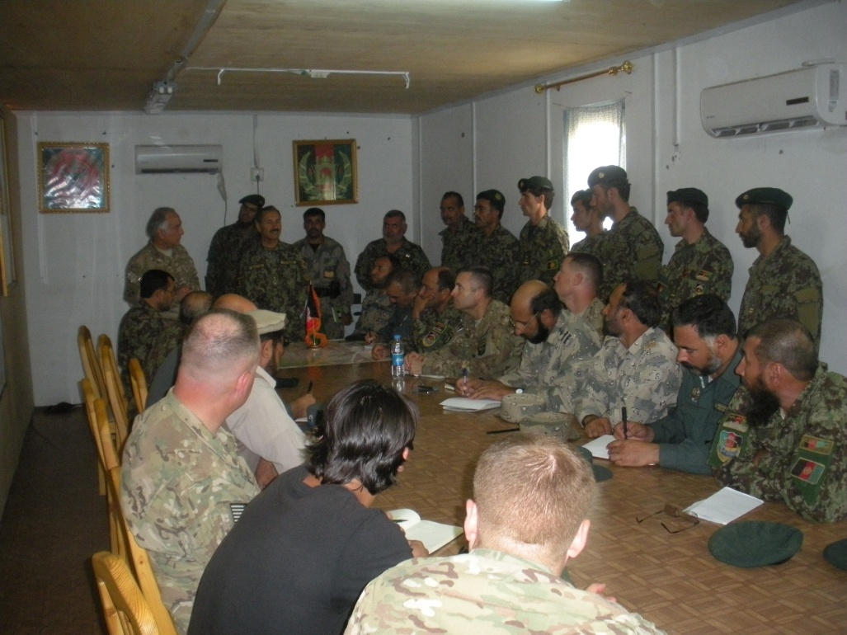
 | STRIKE | Key Issues | 6 MAR 13
UNCLASSIFIED
2nd BDE 201st Corps Realignment
Issue: Combined planning between the ANA and CF advisor teams is critical to success. During the course of the deployment, advisor teams parallel planned with their Afghan counterparts but the most productive sessions were combined sessions.
Discussion: CF/NATO style militaries will conduct in-depth MDMP and mission analysis, however the ANA will not. It was not uncommon to see a Kandak level order no longer than one page and BDE level orders no longer than 3 pages. The entire order for the realignment was 5 pages long with “annexes”. The ANA order read like a task list with very little room for deviation. They did not use a synch matrix, although it was helpful for CF advisors and BSOs to have a synch matrix to shadow the ANA’s timeline.

Slide 18
 | STRIKE | Recommendations | 6 MAR 13
UNCLASSIFIED
Recommendations:
LTP with Afghan role players at JRTC – force SFA staffs to work collaborative planning with ANSF role-players ….use a real world scenario like a BDE realignment/FOB closures to drive this exercise.
Visual planning with Afghans worked well – i.e. rock drills depicting units moving from FOBs in Nangarhar to FOBs in Kunar
Conduct regular battlefield circulation with ANSF leaders prior to conducting a realignment move. Ensure leaders understand facility limitations at each future location and seek to address their concerns. Determine what the ANSF are capable of fixing/improving and what will require CF assistance.
All BSI ‘retrograde’ briefs must have a component which addresses corresponding ANSF issues with facilities, contracts, and timeline synchronization
Bring the ANSF into combined retrograde/realignment briefings as early in the process as possible. Don’t plan in a vacuum or without an ANSF perspective.
Determine who the real ‘action officers ‘ will be – who has the intellectual capacity to actually draw up plans, etc. It may not be the principal staff officer. Delicately balance situation so the principals don’t lose face in public.
Maintain unity of effort and messaging across multiple echelons of command and influence.

Slide 19
 | STRIKE | Keys to Success | 6 MAR 13
UNCLASSIFIED
Keys to Success:
Relationships with Afghan counterparts was ultimately the key to convincing them to move
Key leader engagement strategy – ensured all advisors had similar message and prevented information fratricide
Both advisors and BSOs understood the endstate and worked together to accomplish
Coalition advisors conducted a quality mission analysis of the ANA’s move prior to advising the ANA on how to address challenges
Advisors at all levels (KDK, BDE, Corps) ensured a unity of effort on all messaging to Afghan counteparts
“Blue One” reports and regular VTC updates with key BSO/advisor leaders ensured situational awareness by all
Weekly BSO/Corps advisor/BDE advisor base closure meetings helped synch retrograde/realignment
Battlefield circulation – getting ANA leaders and CF leaders to see the future sites and give/receive guidance was critical. We conducted multiple walk-thrus of all sites
Conduct multiple combined IPRs with all involved parties (BSO, advisors, ANA)

Slide 20
Base Transfer Site Survey (Fly Away Advising)
Background:
-During 9th Month Deployment Strike Transfer 21 Bases to ANA Control
-Additionally, Strike oversaw the transfer of 5 provinces from Coalition BSO (4-4IN) to Afghan BSO (201st ANA Corps)
-The transfer of a base required detailed condition setting measures in all Warfighting Functions IOT facilitate smooth transfer
-ANA need to learn through an extended non-standard LS/RS RIP process how to:
-Run the base logistically
-Establish MoD Contracts (Big 3) to replace ASFF
-Request in extremis Fires Support
-Execute Fire Training Exercise
-COP Defense
-FEPP / FERP Property Transfer
Process:
Post Transfer Site Survey (ANA Bde / Corps Level)
T+60
Post Transfer Site Survey (ANA Bde Level)
T+30
Transfer Day (Ceremony Dependant)
T Day
Conditions Check / FEPP Signed
T-5
Combined BTSS #4 ANA Corps Leaves permanent party
T-15
T-30 Combined BTSS #3
T-50 Combined ANA/CAT BTSS #2
T-90 Combined ANA/CAT BTSS #1
T-180 ANA begins contracting process for Big 3
T-180 Base Transfer Targeted CAT informs Counterpart
Task Organization:
Security Element (First Lift) Toulay Size COP requires 30 Soldier Element (PLT)
Infrastructure Assessment Team
Corps G4 (With Counterpart)
Corps Eng (With Counterpart)
GSU DPW (With Counterpart)
Corps Surgeon (With Counterpart)
Interpreter
Fires Support Exercise White Cell
FSO
RTO
Interp
Lessons Learned:
Post Transfer Site Survey Requires a “First Lift” Security Element commensurate to size of FOB
Post Transfer Site Survey requires frequent Fire Support Exercise as a “demonstration”
ANA must own the process and must accept FEPP / FERP…With Concept of Support to maintain equipment and footprint
ANA contracting is like teaching Columbus how to get to the moon
It requires 90 days to train ANA Bde / Corps on their Contract Process
It takes 180 days from requirement generation to contract obligation in MOD System
ANA only need the big “3”
Internal Guardian Angel Teams required for both

Slide 21
UNCLASSIFIED
TTPs to Sustain
SITTEMP
Develop these prior to MRX and continue to refine and utilize them throughout the deployment. Huge benefits within the sustainment community; adopted in other RCs.
Maintenance over Supply advisory efforts
Focus on advising the ANSF to maintain equipment over relying on and overtaxing their supply system. Aligns with lower budget of ANSF and also with concept of ANSF as a homeland defense military and not a force projection military.
Measure success with Performance Based Outputs not by incalculable inputs
Utilize systems that show measures of effectiveness and measures of performance like command maintenance trackers and CLP trackers that show how effective they are at conducting their wartime mission VS input based measures that are hard to discern like how many RPGs they have, how much fuel can they store, how many miles/km have they driven.
Utilization of the 3 ‘I’s (Inform, Influence, Instigate)
Use of the process of informing the counterparts of what you know at various levels (via SITTEMP and higher, lower, adjacent advisors) to develop your reverent authority and further influencing them on what they could do to solve their own issues, and instigating them to proper action through various techniques (using higher advisor efforts to push ANSF efforts, withholding enablers until plans are developed properly, etc.)
Counterpart Meetings
Synchronized efforts across advisor channels (within different advisory TFs)
Staff Assisted Visits (higher staff visiting subordinate staff sections or units)
Increased the knowledge for counterparts in matters/events occurring within subordinate units and gave advisors additional opportunity to mentor counterparts in daily responsibilities, systems and sustainment operations
Conducting JRTC Style AARs
AMCMs and air missions became increasingly more successful (and ANSF took on more responsibility) as advisors utilized this AAR style of asking questions we already knew answers to and guided them to see the failure or missed opportunities from just completed missions.

Slide 22
Strike SFAAT AAR Summary
Task Organization:
Manning Team Campbell:
SFAB and SFAAT present challenges to prioritization when deployed manning conflicts with home station leadership requirements
Manning Team Strike:
Seek commander’s discretion when faced with directive manning documents
Carefully resource special skills for deployed advisor teams (CC-LOC/EFR/CREW, ETC…)
Talent management – weight the main effort (advising)
Timing:
Synch transition to SFAB task org with mission-specific training
Home Station Training/Pre -Deployment Training:
FORSCOM training requirements
72 days Home Station Training (HST)
Focus on the Big 5
Walk and Shoot
Advisor STX
Media Awareness
JRTC
Advisor Academy
STX/Force on Force
Deployed/sustainment Training
Mission Execution:
LOEs/Big 5/Big 6/ Big 4
Advisor Coordination Templates/Advisor Coordination Network
Relationships with the BSO/BSI
Paradigm shift in relationships between ANSF and Coalition Forces
Working yourself out of a job
TM Campbell Strike Mission Execution:
Training Progression - Platoon Collective STX
Legal Processing
Medical Processing
Coordination with Forward Commands
FRG/Family Support Issues

Slide 23
QUESTIONS

