Slide 1
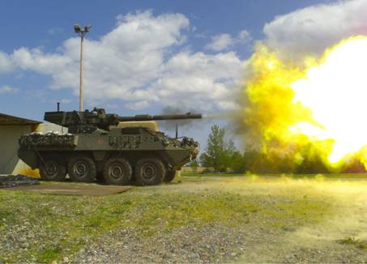
Mobile Gun System
(MGS)
Armament
M68A1E8 105mm Main Gun
with 18-Round Autoloader
M2 .50 Cal Cdr’s Weapon
M240C 7.62mm Coax MG
Fire Control System Similar to the M1 Abrams Series MBT
6 Aimed Main-gun Shots/ Min
Survivability
High Hard Steel Structure
Protection: 14.5mm
RPG w/ SLAT armor
Titanium Armor for
Critical Gunpod Areas
Spall Liners
Smoke Grenade Launchers
C2
SINCGARS
FBCB2
GPS
BFT
Mobility
Top Speed – 60 mph
50m Dash – 9 sec.
Wheel Clearance – 21 in
Vertical Climb – 23 in
Gap Crossing – 78 in
Range – 330 miles (Cbt Ops)
Deployability
C-130 – 1 ea
C-17 – 3 ea
C-5 – 4 ea
Key Characteristics
  Configuration: Combat (inches) Flying (inches)
Height: 130.44 105.67
  Width: 116.34 104.47
  Length: 300.53 300.53
  Weight: 46,995 lbs 40,482 lbs
  Engine: 350 hp JP-8/Diesel (Caterpillar)
  Transmission: Allison
  Brakes: 5 inch ABS
  Other: 8 Wheel Drive; 4 Wheel Steering
  Crew: 3 (19k)

Slide 2
