Slide 1
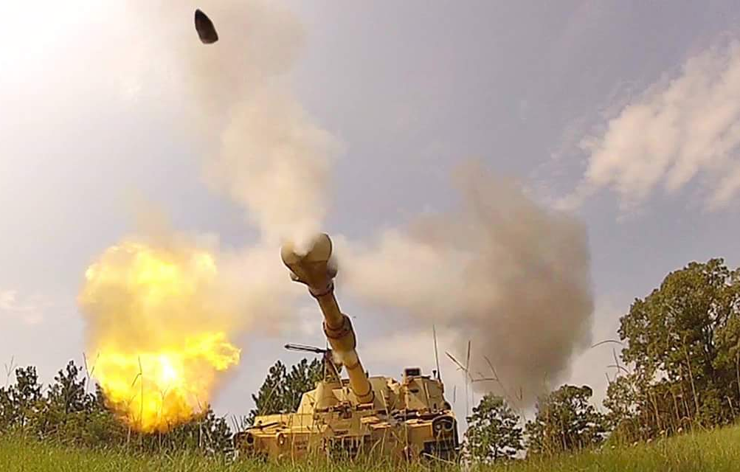
FIRES is
Your Profession
COL Heyward G. Hutson III
Assistant Commandant USAFAS
U.S. Army
Release of the information in this briefing does not imply any commitment or intent on the part of the U.S. Government to provide any additional information on any topic presented herein. This briefing is provided with the understanding that the recipient government will
make similar information available to the U.S. Government upon request.

Slide 2
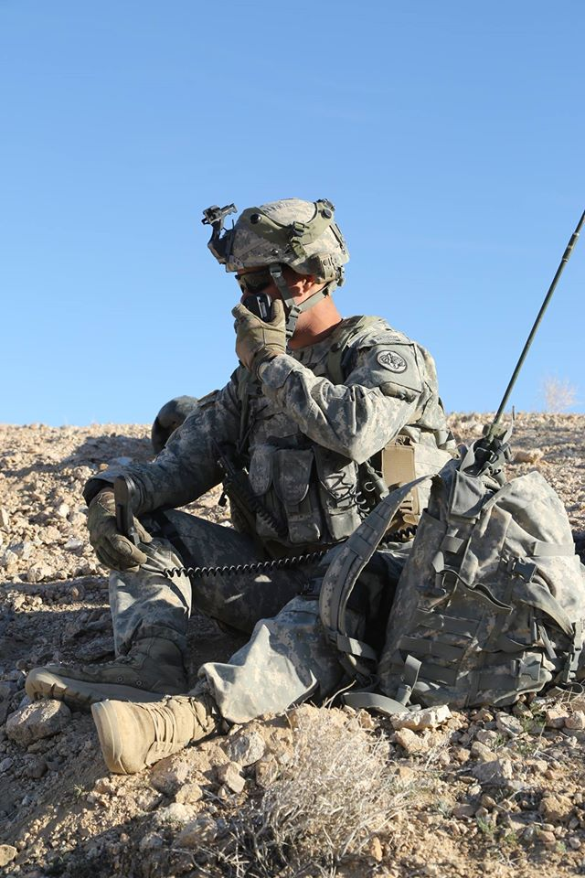

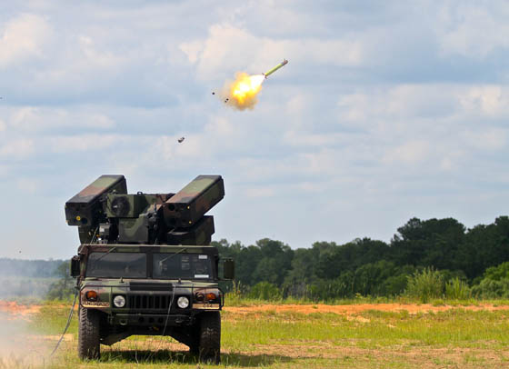
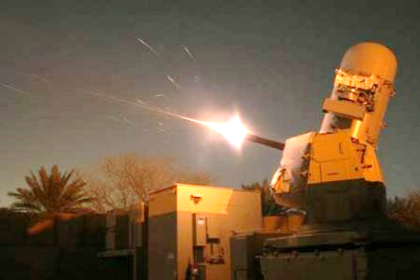
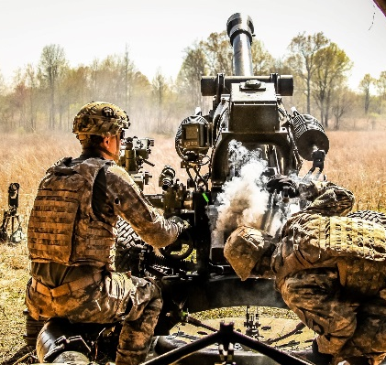
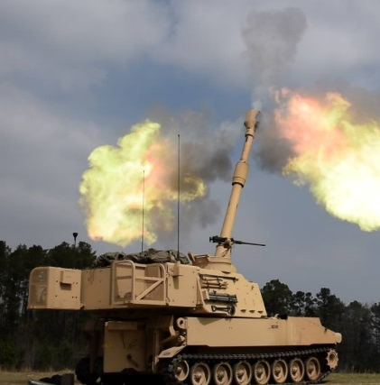
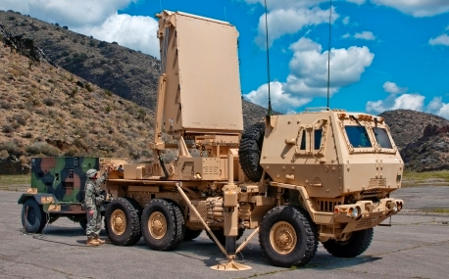
15 Years of War
Afghanistan
Balkans
Modularity/
Units of Action
Evolving
Threat
Horn of Africa
2002
Persian Gulf
High Sustained OPTEMPO
Korea
Loss of DIVARTY
Smaller Army
Loss of SHORAD
Iraq
Ukraine
Non-Standard Missions:
Maneuver Missions
PRT/Advisor Teams
Philippines
Syria
Homeland
Defense
High Global Demand…Still a Contested Environment
Notes:
Bill payer
Loss of force structure
Needs of the Army
Loss of senior leader mentorship

Slide 3
How Did We Get here?
Transformation
NLOS
SECFOR
ATACMS SLEP
DIVARTYS?
FA History and Relevancy Struggle
Crusader
EBO
Non-Lethal
Fires
Maneuver
Battalions
CENTCOM
FIB MSN
Precision Fires arrived too late to the Force to become a “Game Changer” (QRU, GMLRS, Excalibur)
FA Post Transformation
ADA Post Transformation
Required FIB/DIVARTY Capability
Sensor
Sensor
WAS
ISO
Theater
Precision
Fires
ISO BCTs
WAS
CAM
AAMDC
Shooter
Shooter
Decentralized Force Structure
Decentralized MSN CMD
Centralized Force Structure
Centralized MSN CMD
Decentralized Force Structure
Centralized MSN CMD

Slide 4
Defining the Problem
Senior leaders in the Division and the Operations Group “F” senior mentor believe that the establishment of a DIVARTY in the EAB Fires HQs FDU is a positive step for improving the integration and delivery of fires but that it does not go far enough in assigning the command and support relationships required for an effective fires structure in support of a Division. Senior leaders believe that the DIVARTY must have command authority of the DS FA BNs (DS FA BNs assigned to DIVARTY), and that the Division FSE must be part of the DIVARTY, not the Division HHC/HHBN.
MCTP after 8A WFX
“My intent is to develop a common construct that enables standardized training, fires unit certification and leader development while exemplifying effective mission command, and supporting seamless cross-attachment of units with common procedures and shared understanding of this essential warfighting capability.”
GEN Allyn
DA Trained
DIVARTY’s
Role
DA Trained
14 Years of COIN

Slide 5

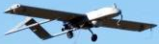
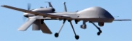
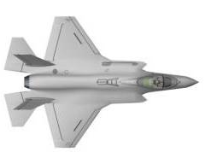
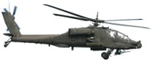
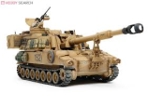
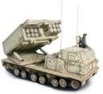
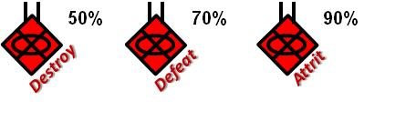


Learn the BCT DA Fight
BN Focus
BCT Focus
Next Fight
MC Nodes
BCT TAC
BCT Main
Sustainment
Information
Collection
BCT ASSETS
DIV ASSETS
OFF
DEF
BCT
PLANNING
STAB
Units
Maneuver
E
DEF
OFF
MDMP
Staff Estimates
Transitions
STAB
WARNO
WARNO
WARNO
Fires
STAB
FRAGO
OFF
OPORD
FRAGO
DEF
FRAGO
Enemy
Method
Provide Task and Purpose IAW CDR’s Intent
Integrate and Synchronize
Anticipate and Coordinate
S3
Sust RXL Fires RXL I.C. RXL BCT CAR
XO
Preparation
PCC/PCI PLT RXL CO RXL BN CAR
Collaboration
1-2 hrs
4-6 hrs
24-48 hrs
Time / Space
5 – 10 km
10 – 30 km
?? km
S3
XO
COMMANDER
Army leaders are responsible for clearly articulating their concept of operations in time, space, purpose, and resources.
ADRP 3-0, May 2012
Notes:
This slide depicts the Operational Framework as relates to the BN Fight, BCT Fight, and Next Fight and the emphasis for the BDE leaders on each. Working right to left, the XO and CDR should focus efforts on the Next Fight through the Plans Cell, looking out 24-48 hours to anticipate and coordinate.
The transitions between Offense, Defense, and Stability constructs occur between the Next Fight and the BDE Fight.
Using enablers, the BDE, through either its TAC or its Main, affects the enemy at a distance, to begin attrition and shape conditions prior to the BN Fight. The CAV SQDN then assists through both shaping fires and, when necessary, direct fires, to further attrite the enemy.
At this point, the BCT TAC picks up the primary effort, assisting in the management of the information resulting from the BN Fight against an enemy that is at well less than full strength due to the BDE’s earlier efforts.

Slide 6
CTC and My Observations
FA BN Commanders struggle defining FSCOORD responsibilities – increasing BN FG responsibilities.
Gunlines are not trained above the PLT level and cannot mass Fires.
FISTs and FSOs at all levels are not trained. TLE at or above 650m.
FIST do not want to come back to FA BNs. NCOs believe their careers peak at SFC.
Gun sections cannot shoot degraded (non-digital). TMDE of equipment, training, and not certified.
“FDOs and their chiefs don't understand troubleshooting when they are not accurate and often we see the Five RAF as a goal, not a requirement.”
“Integration and synchronization of fires continues to challenge BCTs.”
“[BCTs] underutilize or misallocate joint fires assets to include traditional surface to surface fires, CAS, CCA, and EW and rarely plan airspace or ground control measures.”
“Units treat targeting as a planning or problem solving process.” Not as an integrating process to integrate and synchronize fires into operations.
“Units are challenged developing and executing a coordinated and synchronized fires support plan to achieve the specific lethal and nonlethal effects required to support a COA.”

Slide 7
Core Competency Snapshot
(2014 Actual Testing Results)
FIST 10 Level Written Exam Pass / Fail
Rank | Score pecentage | Questions missed out of 44 | PASS | FAIL
CPT | 50% | 22 |  | X
2LT | 45% | 24 |  | X
2LT | 50% | 22 |  | X
2LT | 41% | 26 |  | X
2LT | 45% | 24 |  | X
SSG | 83% | 11 | X
SSG | 64% | 16 |  | X
SGT | 54% | 20 |  | X
SGT | 57% | 19 |  | X
PFC | 70% | 13 | X
PFC | 77% | 9.5 | X
SPC | 81% | 8.5 | X
PV2 | 69% | 13.5 |  | X
PFC | 49% | 22.5 |  | X
PFC | 54% | 20 |  | X
PFC | 66% | 15 |  | X
PV2 | 66% | 15 |  | X
PV2 | 64% | 16 |  | X
PFC | 66% | 15 |  | X
PFC | 57% | 19 |  | X
FIST 20 Level Written Exam Pass/ Fail
Rank | Score pecentage | Questions missed out of 54 | PASS | FAIL
CPT | 52% | 25.5 |  | X
2LT | 44% | 30 |  | X
2LT | 46% | 29 |  | X
2LT | 47% | 28.5 |  | X
2LT | 41% | 31.5 |  | X
SSG | 64% | 19 |  | X
SSG | 60% | 21.5 |  | X
SGT | 62% | 20 |  | X
SGT | 51% | 26 |  | X
FIST 30 Level Written Exam Pass/ Fail
Rank | Score pecentage | Questions missed out of 67 | PASS | FAIL
CPT | 50% | 33.5 |  | X
2LT | 40% | 40 |  | X
2LT | 46% | 36 |  | X
2LT | 51% | 32.5 |  | X
2LT | 36% | 42.5 |  | X
SSG | 55% | 30 |  | X
SSG | 52% | 32 |  | X
SGT | 58% | 27.5 |  | X
SGT | 44% | 37.5 |  | X

Slide 8
FA Officer Talent Management Facts
The Infantry’s promotion rate to LTC was 78% compared to 48% for FA officers
FA Branch PZ selection rate decreased from 31.9% (FY14) to 26.1% (FY15)
No FA O6/COLs were selected for an O6 Immaterial Command on the FY17 CSL
There were 12 Former BN Commanders not selected for O6
FA Officers serving in FABs were selected for promotion at a higher rate than officers who served in BCTs (68% vs 47%)
70% of FA officers selected for promotion did not serve as BDE FSOs
77% of all BDE FSOs received COM reports
Serving as a BDE FSO puts officers at severe risk for promotion
The BDE FSO billet is a key position preparing officers to be FSCOORDs

Slide 9
Primary Zone Promotion Statistics
FA Branch
 | 2011 | 2012 | 2013 | 2014 | 2015 | 2016
FA | 44.6% | 47.3% | 36.2% | 31.9% | 26.1%
MFE | 38.3% | 41.0% | 42.9% | 42.5% | 40.7%
ARMY | 36.2% | 37.3% | 41.9% | 40.5% | 39.4%
FA | 94.8% | 81.9% | 66.3% | 63.4% | 61.6% | 48.9
MFE | 92.9% | 84.6% | 71.8% | 63.1 | 60.5% | 59.6
Army | 86.8% | 82.5% | 71.9% | 63.0 | 60.4% | 59.6
FA | 87.1% | 83.9% | 78.3% | 71.1% | 77.9%
MFE | 92.2% | 88.2% | 83.4% | 66.4 | 70.3%
Army | 93.3% | 88.6% | 83.5% | 65.6 | 69.6%
AD Branch
 | 2011 | 2012 | 2013 | 2014 | 2015 | 2016
AD | 33.3% | 34.8% | 52.2% | 17.6% | 29.6%
MFE | 38.3% | 41.0% | 42.9% | 42.5% | 40.7%
ARMY | 36.2% | 37.3% | 41.9% | 40.5% | 39.4%
AD | 100% | 76.7% | 58% | 56.3% | 63.6% | 54.5
MFE | 92.9% | 84.6% | 71.8% | 63.1 | 60.5% | 59.6
Army | 86.8% | 82.5% | 71.9% | 63.0 | 60.4% | 59.6
AD | 84.8% | 77.1% | 81.5% | 56.3% | 54.9%
MFE | 92.2% | 88.2% | 83.4% | 66.4 | 70.3%
Army | 93.3% | 88.6% | 83.5% | 65.6 | 69.6%
COL
COL
LTC
LTC
MAJ
MAJ
Denotes less percentage than MFE as a whole
AR Branch
 | 2011 | 2012 | 2013 | 2014 | 2015 | 2016
AR | 55% | 48% | 56.9% | 41.6% | 46.3%
MFE | 38.3% | 41.0% | 42.9% | 42.5% | 40.7%
ARMY | 36.2% | 37.3% | 41.9% | 40.5% | 39.4%
AR | 91.7% | 84.3 | 77.0% | 73.2% | 66.7% | 69.4%
MFE | 92.9% | 84.6% | 71.8% | 63.1 | 60.5% | 59.6
Army | 86.8% | 82.5% | 71.9% | 63.0 | 60.4% | 59.6
AR | 64.1% | 93.8% | 82.1% | 73.2% | 79.6%
MFE | 92.2% | 88.2% | 83.4% | 66.4 | 70.3%
Army | 93.3% | 88.6% | 83.5% | 65.6 | 69.6%
COL
Denotes a decrease of greater than 5%
LTC
MAJ

Slide 10








AC DIVARTYs
25th IN DIV | 2nd IN DIV | 1st AR DIV | 82nd ABN DIV | 101st ABN DIV | 3rd IN DIV | 1st CAV DIV | 4th IN DIV | 1st IN DIV | 10th MTN DIV
Schofield Barracks | Korea | Fort Bliss | Fort Bragg | Fort Campbell | Fort Stewart | Fort Hood | Fort Carson | Fort Riley | Fort Drum
FORSCOM BCT FA BNS DIRECTED FOR ATTACHMENT TO THE DIVARTY RESPECTIVELY REMAIN IN EFFECT IAW GUIDANCE PER:
U.S. ARMY FORCES COMMAND (FORSCOM) DIVISION ARTILLERY (DIVARTY) IMPLEMENTATION ORDER, April 2014
USARPAC
FA BNS REMAIN UNDER FULL COMMAND AUTHORITY OF BCT COMMANDER TO INCLUDE RATER RESPONSIBILITIES FOR THE FA BN COMMANDER, SENIOR RATER RESPONSIBILITIES FOR THE BATTERY AND FORWARD SUPPORT COMPANY COMMANDERS AND REVIEWER RESPONSIBILITIES FOR SENIOR NON-COMMISSIONED OFFICERS.
I CORPs
III CORPs
XVIII CORPs
8A
A
I
R
B
O
R
N
E
17th FAB | 75th FAB | 18th FAB | 210th FAB
Fort Lewis | Fort Sill | Fort Bragg | Korea
AC FAB Organizations
Distribution A. Approved for Public Release.

Slide 11
1CD, 1 ID, 4 ID, 10th MTN
The BCT Fires Bns remain assigned to the BCTs. DIVARTY maintains oversight of training and certifications of Field Artillery battalions.
BCT Commander
DIVARTY Commander
+ Enable Mission Command
+ Coach, mentor and develop artillery commanders and leaders
+ Provide training guidance and approve training plans and programs
+ ICW the Division CG, responsible for the Mission Training Brief
+ Approve the Commander’s USR
+ Assess the state of training and provide training direction
+ Assess manpower, equipment, and training resource requirements; coordinate the obtaining of needed resources
+ Provide readiness assessment
+ Approve and assess METL
+ Manage military personnel, equipment and command supply discipline
+ Responsible for the Organization Inspection Program
+ Special Court Martial Convening Authority and Field Grade Appellate Authority.
+ Responsible for leader development and organizational training
+ Enable Mission Command
+ Provide training guidance input to the BCT CDR for organizational training and unit readiness
+ ICW the BCT CDR, assess training and provide training recommendations to the BCT and FA BN CDR
+ Execute fires training and certifications (fires batteries, FDC, FIST, Artillery leader, radar section, survey section, etc.)
+ Conduct unit certifications (artillery tables for battery and battalion level)
+ ICW the BCT CDR, provide FA leader development
Organic
ll
Oversight
DS
No Transfer of BCT commander authority
x
RATER: BCT CDR
SR RATER: Division CDR
HHB

Slide 12
1AD, 3ID, 82nd ABN, 101st ABN
The BCT Fires Bns are “attached” to the Division Artillery (DIVARTY) for ADCON. The Fires Bn is DS to their BCT
BCT Commander
DIVARTY Commander
+ ICW the DIVARTY commander , provide input to METL development
+ Approve the Commander’s USR
+ ICW the DIVARTY commander, provide input to the unit training plan
+ Enable Mission Command
+ Oversee leader development, organizational training, and unit readiness
+ Provide training guidance and approve training plans and programs
+ ICW the BCT commander, provide METL guidance and approve unit METL
+ ICW the Division CG, responsible for the Mission Training Brief
+ Review the Commander’s USR
+ Assess the state of training and provide training direction
+ Assess manpower, equipment, and training resource requirements; coordinate the obtaining of needed resources
+ Manage military personnel, equipment and responsible for command supply discipline
+ Responsible for the Organization Inspection Program
+ Responsible for rating schemes (Rates the Bn CDR)
+ Special Court Martial Convening Authority and Field Grade Appellate Authority.
Organic
ll
DS
Attached
Transfer of BCT command authority to the DIVARTY CDR during the period of attachment
x
RATER: DIVARTY CDR
SR RATER: Division CDR
HHB
HHBn
12

Slide 13
Significant Points from 1AD DIVARTY
  The DIVARTY Commander:
    Manages the FA Field Grade slate on behalf of the Division Commander
    Approves the CPT command slate
    Manages junior officers and senior NCO’s (E7 and above) career management
    Rates FA Battalion Commanders
    Senior rates ALL FA Field Grades, FA Battery Commanders, and FSC Company Commanders
    BDE FSOs are rated by FA BN Cdrs and SR by the DIVARTY Cdr. No intermediate rater.
  The DIVARTY CSM manages ALL 13 series personnel across post. Low density MOSs go through the BCT CSMs.
  Consolidated all Fire Support personnel and all associated MTOE equipment into FA Battalions – integrated them in to the firing batteries – not in HHBs or a separate FIST Battery. This is to grow future Battery Commanders and First Sergeants and equalize the span of control.
  All Division FSE personnel and associated equipment answer to DIVARTY. DFSCOORD works for FSCOORD.

Slide 14
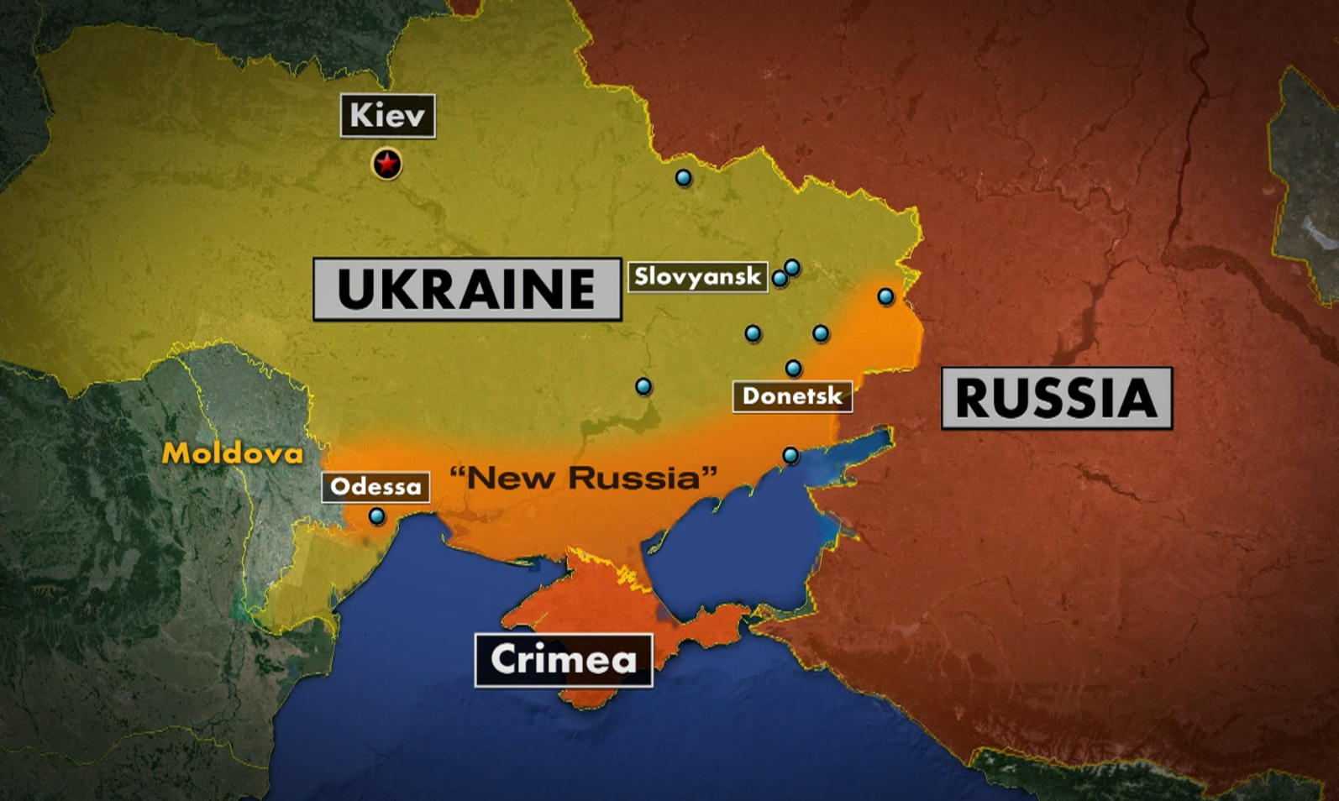
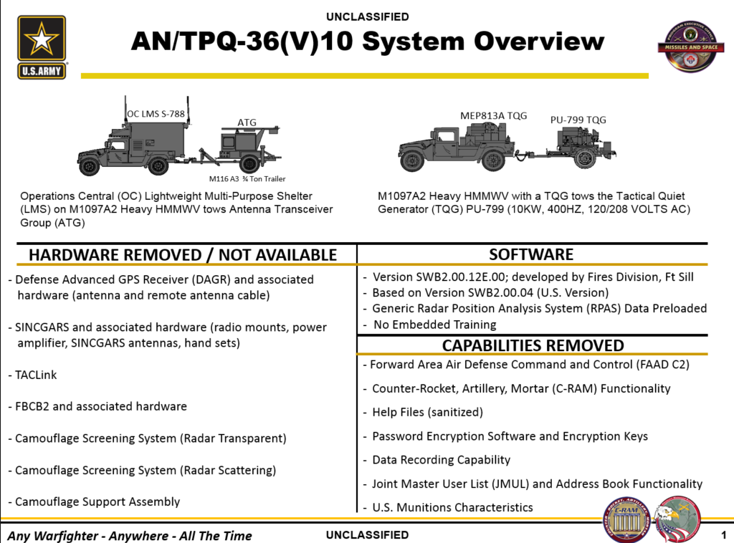
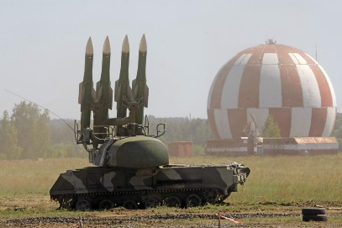
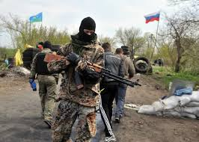
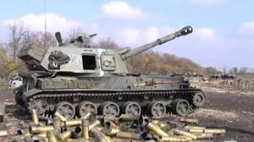


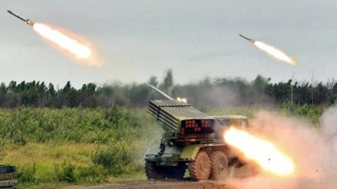

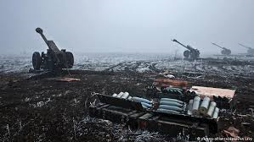
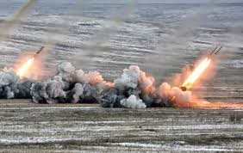
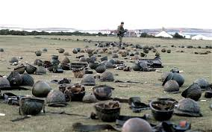
Ukraine’s Artillery Duel
RUSSIA
Ukraine
“when they [Ukrainians] see certain types of UAVs, they know in the next 10-15 minutes, there’re going to be rockets landing on top of them.” LTG Hodges
“In a three minute period….a Russian fire strike wipe out two mechanized battalions with a combination of top-attack munitions and thermobaric warheads.” Karber

Slide 15
VIDEO
The effects of DPICM

Slide 16
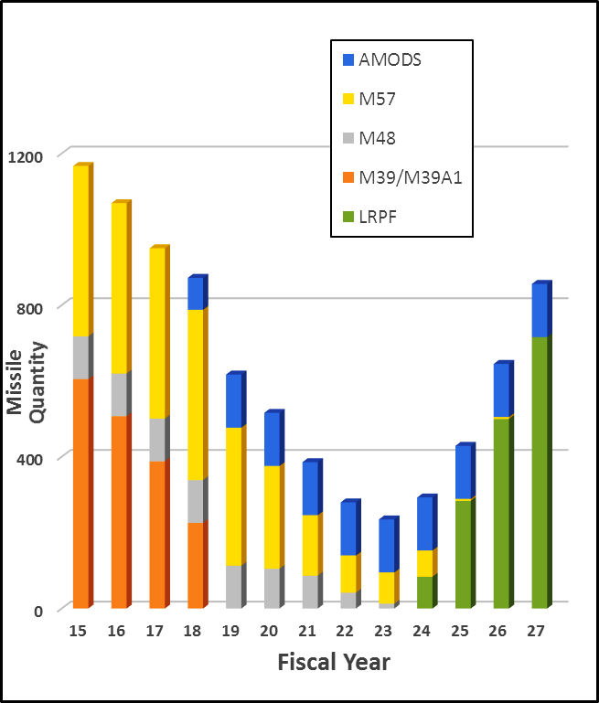
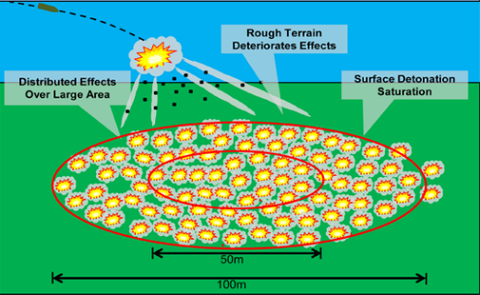
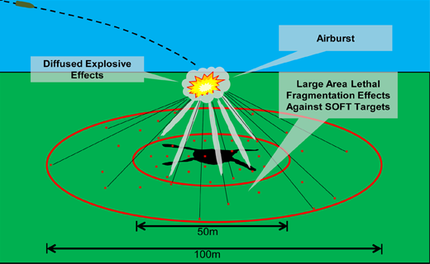
Loss of Capacity
Loss in FA Force Structure
FA Force Structure | 1989 | 1999 | 2004 | 2006 | 2008 | 2016
FA HQ [inc CORPS/DIV/FA BDE]: AC/RC | 31/31 | 19/26 | 19/26 | 19/17 | 6/7 | 14/8
Cannon BNs AC/RC (# Tubes) | 65/126 (1560/3024) | 39/80 (702/1440) | 38/67 (608/1072) | 40/47 (640/752) | 49/45 (784/720) | 32/43 (576/774)
GS Rockets BNs AC/RC (# Launchers) | 20/1 (540/27) | 16/13 (288/234) | 6/1 (108/18) | 19/18 (304/288) | 11/15 (176/240) | 11/14 (176/224)
4584
1350
567
400
Loss of ATACMS Capacity
1999 ATACMS Operational Requirements Document (ORD) established the ATACMS Unitary requirement
Resource Mgnt Directive (RMD) 700-A1 directed the Army to SLEP
  Limited quantity SLEP: 140
  No increase in total ATACMS quantity
  Reset missile shelf life to 10 years
Theater Specific Effort
ATACMS with SLEP and LRPF
Loss of Area Denial Capability
DPICM
High Explosive
1:5 ratio of effectiveness (1 Round DPICM to 5 rounds HE)
The bomblet is capable of penetrating approximately 2.75 in. (6.98 cm.) of homogenous armor plate
Anti-personnel effects are obtained by fragmentation of the bomblets
Notes:
1990 – DS 3x8 GS 3x9
1999 – DS 3x6 GS 3x6
2004 DS 2x8 GS 3x6
DS 2x8 GS 3x4 rocket 2x8
2016 DS 3x6 EAB cannon 3x4 rocket 2x8

Slide 17

BCT CDR’s Fires Orientation Course
As of 12 APR 16
 | DAY 1 / 26 APR 16 | DAY 2 / 27 APR 16 | DAY 3 / 28 APR 16
 |  | Lunch | Lunch
0830
CG Welcome
0830-0900 CG, FCoE (1)
BCT FIRES: D3A Through Joint Targeting
Targeting Overview & Capabilities
Integrating FIRES through Targeting
Precision Fires Program
0830-1045 FTC Director (1)
CTC FIRES Lessons Learned & Observations
FIRES Rehearsals
0830-1000 JRTC’s FOX 6 via VTC (1)
0900
FA CMDT Welcome
Role of the FSCOORD and the FFAHQ
D/A CDR – BCT CDR Relationships
0900-1000 FA CMDT (1)
1000
Break 1000-1015
The 5 Requirements for Accurate Fire:
Accurate Target Location
Accurate Computation Procedures
Accurate Ammunition Data
Accurate Meteorological Data
Accurate Firing Unit Location
1015-1230 428 FA BDE CDR (1)
Break 1000-1015
Maintaining Readiness:
Manning, Equipping & Leader Development
1015-1145 FA Asst CMDT (1)
1100
Break 1045-1100
CEMA Planning
1100-1200 EW Director (1)
1200
Travel 1145-1200
Lunch with ADA CMDT
1200-1300
Lunch with CG
1200-1300
1300
Lunch with FA CMDT
1230-1330
Travel 1300-1315
Travel 1300-1315
BCT Commander’s Role
Drafting Commanders Guidance for FIRES
CDR’s Role as BCT Engagement Authority
FA Organization for Combat
1315-1445 Senior FA Mentor (1)
Travel 1330-1400
Overview of Airspace Coordination
(ADAM / BAE, FIRES Cell)
FIRES ABCS systems and the FIRES COP
(AFATDS / AMDWS / TAIS)
1315-1445 30 ADA BDE / 428 FA BDE (3)
1400
Basics of Live Fire, Safety, &
FA Systems (Field Training)
FIRES Training Strategy
FA Tables I-VI
Artillery Skills Proficiency Test
Individual / Section
(FA Table Testing / Cert / Qual Discussion)
1400-1700 428 FA BDE CDR (2)
1500
ARTILLERY STRONG
FIRES Training Strategy
Digital Sustainment Training
FA Tables VII-XVIII & Combined Arms TNG
Red Books
1445-1545 1 AD DIVARTY CDR (3)
Break 1445-1500
KING OF BATTLE
Discussion with Senior Leaders
FORSCOM CG via VTC
Senior FIRES Leader via VTC
1500-1630 Senior Leaders (1)
1600
Travel 1545-1600
FIRES Training Strategy
CFFT and VBS3 Overview
JFO Phased Program & Certifications
1600-1700 FCOE G7 / 428 FA BDE CDR / FTC DIR (4)
FCoE Reachback Resources
1630-1700 AAR FA CMDT (1)
1700
Social with FA & ADA CCC Students 1730-UTC
Legend: (1) = Snow Hall, Rm 113; (2) = OP Moway / Firing PT 182; (3) = Hopkins Hall; (4) = Monti Hall

Slide 18
Going Back to the Force
Get over change. Change is a constant in our profession.
DIVARTYs are here to stay. Attached BNs are in question.
Don’t fear DIVARTYs. DIVARTY commanders know their stuff and will decide the future battalion commanders
Learn your profession. A COM/HQ represents your performance
DIVARTYs WILL professionally develop you
Remain closely nested and connected to your maneuver units
Expect and enforce only the highest standards
Your senior NCOs face the same challenges
Know that you are our legacy – you all will make this succeed or fail and prepare us for the next near-peer fight

Slide 19
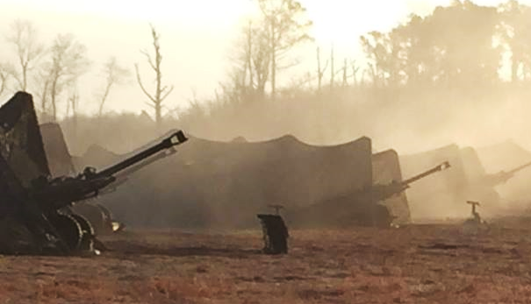
QUESTIONS
“If, After The Battle Is Over,
Your Infantry Don't Like You,
You Are A Poor Artilleryman.”
Captain Henry J. Reilly
The China Relief Expedition, 1900
F Battery, 5th US Field Artillery
The United States Army Field Artillery School

