Slide 1
Intro to EES
(Evaluation Entry System)
What YOU need to know,
Mixed with some Eval basics.

Slide 2
EES NOTE
Use of EES is MANDATORY for all NCOERs with a “THRU” date of 1 JAN 16 or later.
  NCOERs with a “THRU” date before 1 JAN 16, will be submitted through the proper S1 channels using the applicable form for that date.
Use of EES for OER submission has been mandatory for several years.
https://evaluations.hrc.army.mil/
This class will not cover the art of writing evaluations. For information on how to create and compile evaluations, see S1Net at;
www.milsuite.mil

Slide 3
Agenda
References
Navigating EES
Responsibilities
Creating an OER/NCOER Support Form
Creating an OER/NCOER
Evaluation Process
Assigning Delegates
“Profiling” and Rater/SR Profile
Types of Evaluations
Major Issues
Questions

Slide 4
References
EES Webstie: https://evaluations.hrc.army.mil/index.html
ADP 1, The Army
ADRP 1, The Army Profession
ADRP 6-22, Army Leadership
ADRP 7-0, Training Units and Developing Leaders
AR 27-10, Military Justice
AR 350-1, Army Training and Leader Development
AR 600-9, The Army Body Composition Program
AR 600-20, Army Command Policy
AR 623-3, Evaluation Reporting System
ATP 6-22.1, The Counseling Process
DA Pam 611-21, Military Occupational Classification and Structure
DA Pam 623-3, Evaluation Reporting System
FM 6-22, Army Leadership; Competent, Confident, and Agile
TC 7-22.7, Noncommissioned Officer Guide

Slide 5
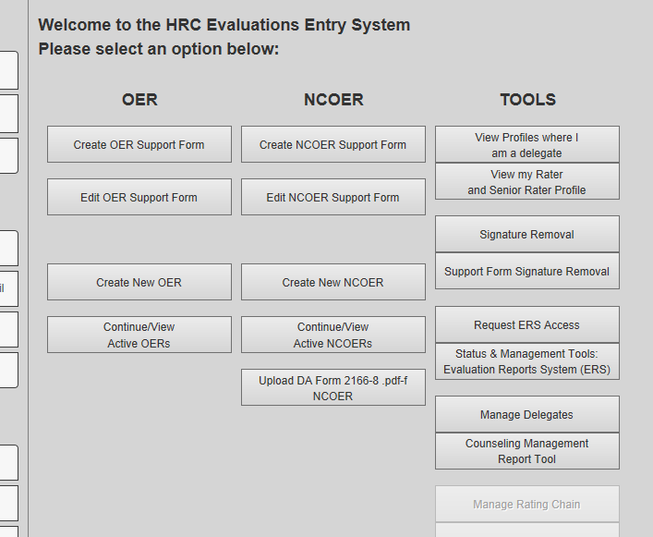
Navigating EES
Create / Continue Support Form:
Rated, Rater, SR or Delegates can create and edit support forms.
Create / Continue Evaluation:
ANYONE can create, but only Rater, SR or delegate can view or edit once saved.
Manage Delegates:
Go here to assign delegates.

Slide 6
Responsibilities
Commanders: Commander’s are ultimately responsible for the evaluations within their units.
Rater: Assesses PERFORMANCE. (AR 623-3, 2-12)
  Counsel Soldier. Initial is a face-to-face discussion of duties, responsibilities, and objectives
  Quarterly to assess a Soldier’s performance against the standards - the Army Leadership Requirements Model, the org’s mission, duties, responsibilities, tasks, and objectives.
  NOTE: Rater commenting on potential will result in in the evaluation being returned from HQDA.
Senior Rater: Assesses POTENTIAL. (AR 623-3, 2-14)
  Accurately assess POTENTIAL for greater responsibility measured against the above standards. Reviews for accuracy.
  NOTE: SR commenting on performance will result in the
  evaluation being returned from HQDA.

Slide 7
Responsibilities, cont.
Supplementary Reviewer (NCOERs only):
  Ensures Rater and Senior Rater meet minimum requirements and bullets/ narrative comments meet the standards.
  NCOERs do not need a Supplementary Reviewer if the Senior Rater is SGM/CSM, CW3-CW5, or CPT/higher
Rated Soldier: (AR 623-3, 2-10)
  Make sure your evaluation gets done, when it needs to be done (Annual vs. Change of Rater vs. Change of Duty, etc.)!
  IT’S YOUR CAREER!!
  Push for counseling and updates on performance.
  Update Support Form with accomplishments, even those accomplishments in civilian education, training, etc.

Slide 8
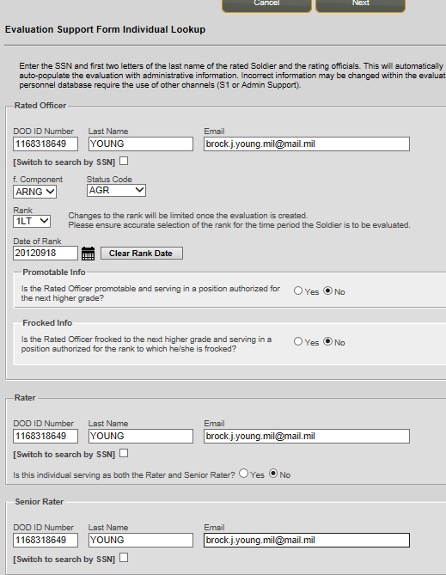
Creating a Support Form
Create Support Form:
Click on applicable button.
Enter applicable information for:
Rated NCO/OFFICER,
Senior Rater,
Reviewer (if applicable on NCOERs only)

Slide 9
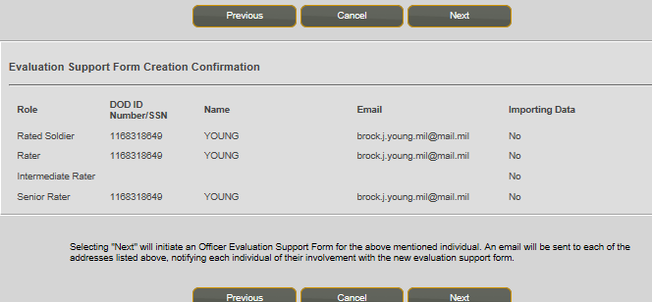
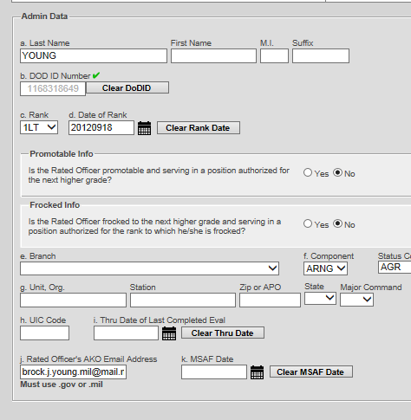
Creating a Support Form
Confirm applicable information is correct.
Click “NEXT”
Complete filling out the Section I Admin data.
Click “NEXT,” and complete Section II Authentication
(Rater/ Senior Rater/ Reviewer Info)

Slide 10
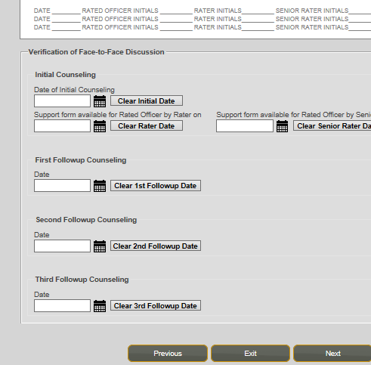
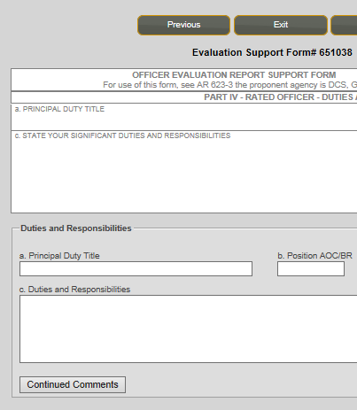
Creating a Support Form
Enter any applicable Counseling Dates.
Click “NEXT”
Begin filling out applicable sections.
How to fill out this information can be found in the PowerPoint class entitled “NCOER Support Form Class - v4 20150516”

Slide 11
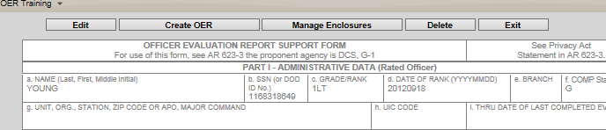
Create an Evaluation
2 ways to create an Evaluation:
1) Create an Evaluation From an active Support Form:
Click on “Create OER (or NCOER)” button. This way is PREFERRED because it will import all of the bullets from the Support Form.
NOTE: If you are the Rated Soldier, once you create the evaluation you will not have access to view it until it is ready for your signature.
2) Create an Evaluation From Scratch (no Support Form used):
Click on applicable button and begin form. You will need to enter all administrative data as well as duties, responsibilities, MOS/AOC, etc.
NOTE: If you are the Rated Soldier, you can create and input your own evaluation information, however once you EXIT the evaluation, you will not have access to view it again until it is ready for your signature.

Slide 12
Create an Evaluation
Once created, the Rater and Senior Rater will input the applicable information, bullets/narratives into the form.
OERs: Every box will be in narrative format.
NCOERs: Rater boxes will be in bullet format on SGT and SSG/MSG-1SG NCOERs(no change to old formatting); SGM/CSM NCOERs will be all narative. Senior Rater comments will be in a narrative format.
  A good TTP, Senior Rater should comment on; promotion potential (command, positons, assignments), school potential (both Mil and Civ), performance potential, and retention protential.
Once everything is good and the Enlisted Advisor has reviewed the evaluation (for NCOERs; see section on Assigning Delegates), the evaluation must be signed in order:
  Rater
  Senior Rater
  Rated Soldier.
  Reviewer (if applicable)

Slide 13
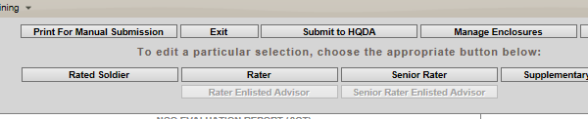
Completing an Evaluation
Once the evaluation is signed by the Rated Soldier, the Senior Rater submits the evaluation to HQDA for submission:
NOTE FOR ALL OERs: Senior Raters WILL NOT submit OERs until they have informed the BN S1 that the OER is complete and ready for submission. The BN S1 will inform the 49th MP BDE S1, who will review and code OERs prior to submission.
NCOERs can be submitted when complete.

Slide 14
Evaluation Process
Initial Counseling. Following this, the Rated Soldier should create their NCOER/OER Support Form if their Rater hasn’t done so already.
Follow-up Counseling: Quarterly at a minimum. Suggest that counseling also take place after a period of extended duty, e.g. AT, long ODT, etc. Updates are made to Support form and or 4856.
Evaluation Creation. Takes place at any time, but it is suggested to have the draft complete 30 days from the “THRU” date.
Signing the Evaluation. Evaluations can be signed up to 14 days before the “THRU” date.
Submission to HQDA. Once signed by the Rated Soldier, the Senior Rater will forward the evaluation to HQDA (except Officers in 49 MP BDE). Must be done after the “THRU” date.
Coding/PERMing. It’s taking roughly 3-4 months to process
an NCOER, and 1-3 months to process OERs. Once coded it
is placed in your IPERMS file.

Slide 15
Assigning Delegates
Assigning delegates allows visibility of evaluations and support form by Soldiers out side of the rating chain.
Mandatory delegates:
  All Officers: Assign BN S1 Officer and BDE S1 Warrant as delegates with the following permissions:
    View Rating Profile
    Edit Evaluations
    Submit Evaluations/ Remove Signatures
  All NCOs: Assign Company 1SG or DET SGT (at a minimum) as delegate with the “Enlisted Advisor” permissions.
  NCOs with BC as Senior Rater or Reviewer: Assign BN CSM as delegate with the “Enlisted Advisor” permissions.
Other delegates can be assigned at the unit level as appropriate. Suggested delegates include company XO, Platoon Sergeants, Training or Readiness NCOs, etc.

Slide 16
Assigning Delegates
How to assign a delegate:
1) Select “Manage Delegates”
2) If adding your first delegate your screen will look like this. Use the drop down to select
“Rater” or “Senior Rater” depending on what role you would like to assign.

Slide 17
Assigning Delegates
How to assign a delegate:
3) Enter the delegate’s DOD ID number or SSN and Last Name
4) When information populates, ensure delegate’s information is correct.
5) Select roles; an “Enlisted Advisor” will only be a delegate for Rater or Senior Rater.

Slide 18
Assigning Delegates
How to assign a delegate:
6) Check the applicable delegate permissions. Unless granting additional permissions, only select the “Enlisted Advisor” permission for the Enlisted Advisor.
7) Select “Update Permissions” to save work;
8) Use drop down to change the role you would like your delegate to have permissions (Note: only a delegate with “Submit Evaluations” permission in the Senior Rater role can submit completed evaluations).
9) Add any additional delegates you need to add. When complete, return to the HOME screen.

Slide 19
Profiling
What is a “Profile” with regards to evaluations?
A “Profile” is a management technique used to prevent Senior Raters/Raters from placing everyone in the top box.
  (if everyone is AWESOME, then no one is awesome)
It is designed to force Raters and Senior Raters to give better, more accurate assessments of their subordinates.
Profiling doesn’t mean good NCOs/Officers are harmed by the rating check, it just requires more succinct narrative and bullet comments.
OERs: BOTH the Rater and Senior Rater Profiles are CONSTRAINED, meaning EES/HQDA will not allow a Far Exceeds or Most Qualified if your profile doesn’t allow it (AR 623-3, ch 3-11).
NCOERs: Only Senior Rater Profiles are constrained, but
Rater profiles are tracked to check “tendency,” which will
effect how boards treat Rater bullets.

Slide 20
Profiling, cont.
What are the constraints?
NCOERs: Raters must maintain a credible RATER PROFILE. Your Rater Profile is UN-CONSTRAINED, meaning you can give as many “FAR EXCEEDS” ratings as you like. However, your “Rater Tendency,” or rating history for each grade they rate, is maintained within the EES. It follows a rater through their career and while not constrained, will affect how an evaluation is looked at; e.g. if a Rater only gives “FAR EXCEEDS” to certain grades (from SSG-CSM/SGM), it will give less weight to their comments on a particular evaluation.
NCOERs: Senior Rater Profile. Senior Rater Profile is CONSTRAINED, meaning you are limited to marking 24% of SSGs-CSM/SGM (, “MOST QUALIFIED.” There is a “Silver Bullet Exception,” meaning with immature profiles (under 5
evaluations) 1 of the first 4 NCOERs can be given the “MOST QUALIFIED” ranking. This is a ONE TIME USE per rank.

Slide 21
Profiling, cont.
OERs: Rater and Senior Rater Profiles are CONSTRAINED, meaning Officers are only allowed to grant 49% of each rank they rate with either an “EXCELS” (as Rater) or “MOST QUALIFIED” (as Senior Rater). HOWEVER, if you have an immature profile, and have only just begun rating/senior rating Officers of a certain rank, you are allowed a ONE TIME option of giving one of the first 4 evaluations you make at a particular grade, an “EXCELS” (as Rater) or “MOST QUALIFIED” (as Senior Rater).
Managing your Profile.
You can keep track of your profile through EES.
Managing profiles for the good of your subordinates requires forethought and planning.
Get a tracker. Here are two:
  https://www.milsuite.mil/book/message/574677
  https://www.milsuite.mil/book/docs/DOC-278659

Slide 22
Types of Evals
When is YOUR evaluation due?
(These are only the typical types of evaluations, see AR 623-3 for a complete list)
Annual: 365 rated days from last THRU or promotion to SGT/Commission; NO unrated time.
Extended Annual: 365 rated days with additional unrated time from last THRU or promotion to SGT/Commission. Typically, 1st time OERs for 2LTs will be Extended Annual.
Change of Rater: Mandatory when Rater changes but has been Rater for over 90 days.
Change of Duty: Changes duty while under same Rater (to include going into the ING).
Complete the Record (OERs only): Used to close out a rating period before an HQDA Board.
Relief for Cause: is required when an NCO or Officer is
relieved for cause. Must include counseling (or other
applicable documentation).

Slide 23
Major Issues
Major Issues that cause evaluations to be returned:
Formatting issues in Rater and Senior Rater’s comment sections on NCOERs
  DA PAM 623-3 para 3-6b, 3-11b - Raters of MSG and below will use bullet(s) for all blocks in Part IV
  DA PAM 623-3 para 3-16b - Raters of SGMs / CSMs will use narrative comments for Part IV blocks c, d and f
  DA PAM 623-3 para 3-7c, 3-12e, 3-17e - Senior Raters of all NCOs will use narrative comments
Raters comment on performance, NOT potential.
Senior Raters comment on potential, NOT performance.
Missing SHARP statement in Part IV block c (Character).
Unqualified Senior Rater (must be two pay grades above rated NCO)
Missing Required Supplementary Reviewer, e.g. NCOERs with Senior Raters in ranks of SFC–MSG, WO1–CW2, 2LT–1LT.
Improper use of “Extended Annual” report (wrong type of eval).
Senior Rater now uses NARRATIVE on NCOER, not bullets.

Slide 24
QUESTIONS?
For additional personal growth and development,
visit:
Army Professional Forums;
www.milsuite.mil
NCOER Bullet Guide;
https://www.milsuite.mil/book/docs/DOC-263142
NCOER (OER) Support Form Class;
https://www.milsuite.mil/book/docs/DOC-202566

