Slide 1
RC OD Training Locations
RTSM Cp Dodge, IA
RTSM Cp Ripley, MN
RTSM Ft McCoy, WI
RTSM Ft Custer, MI
91B10/30
91F10/30
91/94 SLC
ASI H8 (W)
ASI H8 (T)
91B10/30
91H10/30
91/94 SLC
ASI H8 (W)
ASI H8 (T)
89B10 *
91B10/30
91J10
91L10/30
91/94 SLC
ASI H2
ASI H8 (W)
91B10/30
91/94 SLC
ASI H8 (W)
ASI R1
RTSM Gowen Field, ID
RTSM Ft Indiantown Gap, PA
91A10/30
91B10/30
91F10/30
91H10/30
91/94 SLC
ASI H8 (W)
ASI H8 (T)
91B10/30
91D10/30
ASI H8 (W)
UIC: W7WPAA
UIC: W7XTAA
UIC: W7W3AA
UIC: W88DAA
UIC: W7XDAA
UIC: W7XGAA
RTSM Cp Edwards, MA
91B10/30
91C10
ASI H8(W)
UIC: W7RHAA
RTSM Ft Dix, NJ
91B10/30
91E10/30
91F30
91H10/30
91/94 SLC
ASI H8 (W)
ASI H8 (T)
UIC: W7W2AA
UIC: W7WLAA
TASS at ODS Ft Lee
RTSM Cp Roberts, CA
89A10
89B30/40
ASI H8(T)
91B10/30
91D10/30
91/94 SLC
ASI H8 (W)
ASI H8 (T)
RTSM Ft Bragg, NC
91B10/30
91F10
91/94 SLC
ASI H8 (W)
RTSM Pearl City, HI
91B10/30
91/94 SLC
ASI H8 (W)
UIC: W7WNAA
RTSM Ft Gordon, GA
UIC: W7XUAA
94E10
94F10
UIC: W7XFAA
UIC: WOU5AA
RTSM Salina, KS
91B10/30
91C10/30
91C(J)30
91E 10/30
91/94 SLC
ASI H8 (W)
RTSM Ft Stewart, GA
91B10/30
91D10/30
91E10/30
91P10/30
91/94 SLC
ASI H8 (W)
UIC: W8YEAA
UIC: W7LZAA
RTSM Cp Shelby, MS
RTSM Ft Hood, TX
91B10/30
91C10/30
91M10/30
91/94 SLC
ASI H8 (W)
ASI H8 (T)
UIC: W7XNAA
91B10/30
91H10/30
ASI H8 (W)
ASI H8 (T)
Cp Allen, Puerto Rico
Legend: RC Institution Locations by Compo
91B10
91D10
UIC: W92LAA
RTSM Ft Leonard Wood, MO
RTSM Cp Blanding, FL
91B10/30
91D10/30
91/94 SLC
ASI H8 (W)
91B10/30
91F10
91/94 SLC
ASI H8 (W)
ARNG Sites (13)
V 3.2
USAR Sites (7)
UIC: W7XSAA
UIC: W7W4AA
Notes:
RTS-M: Regional Training Site – Maintenance. A Reserve Component (RC), ARNG & USAR training institution comprised of full-time staff of instructors; Active Guard/Reserve (AGR) Soldiers, civilians, and contractors. RTS-Ms vary by organizational size (structure/instructor staff), mission, and facilities. RTS-Ms execute Ordnance MOS-T (MOS reclass training / 10 level), PME (ALC and SLC), and ASIs, plus other specialized training.
ARNG RTS-Ms are Mission Command to the individual National Guard States and some are aligned under a State Regional Training Institute (RTI). Communication channel to the NG RTS-Ms is through the NGB coordinating element; OD SME Cell located at Camp Dodge, IA.
USAR RTS-Ms are Mission Command to the 3d BDE (OD) / 94th DIV, 80th TC, USAR.
HT-RTSM: High-Tech RTSM. HT-RTSMs are Signal School RC Training Sites with the additional mission of executing maintainer training for OD 94CMF. The HT-RTSMs are Mission Command to the 2d BDE (SIG) / 100th DIV, USAR. For Ordnance, they currently execute 94E10 and 94F10 MOS-T (reclass).
TASS: The Army School System. USAR TASS training institutions are BN level organizations comprised of traditional Army Reserve Soldier Instructors whom execute training mission during their Annual Training (AT) periods. The TASS BNs conduct training at co-located facilities; select USAR RTS-Ms and at the US Army Ordnance School at Ft Lee, VA.
5th BDE (Multi Functional). This is a multifunctional (sustainment) TASS organization that conducts MOS-T (reclass) training in PR.

Slide 2
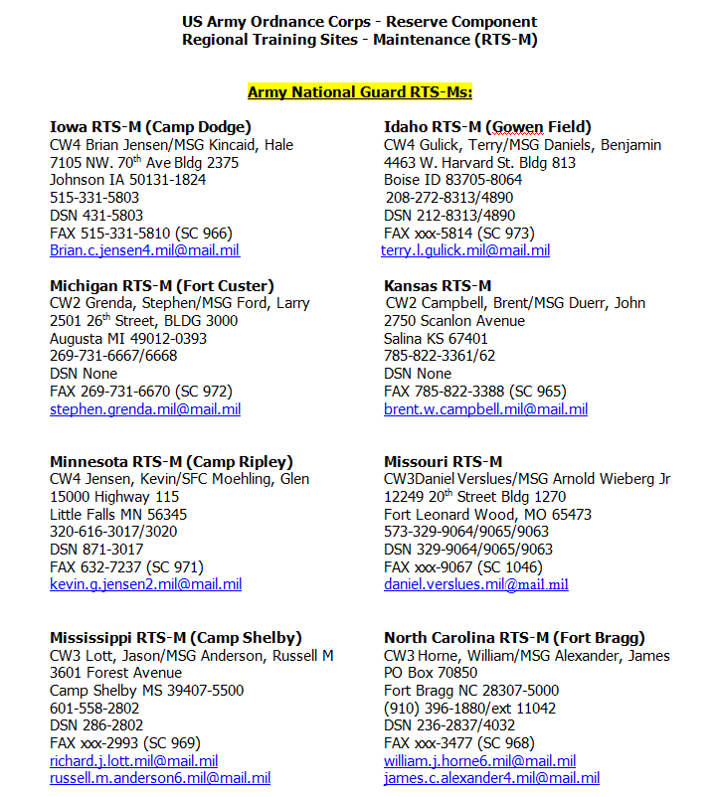
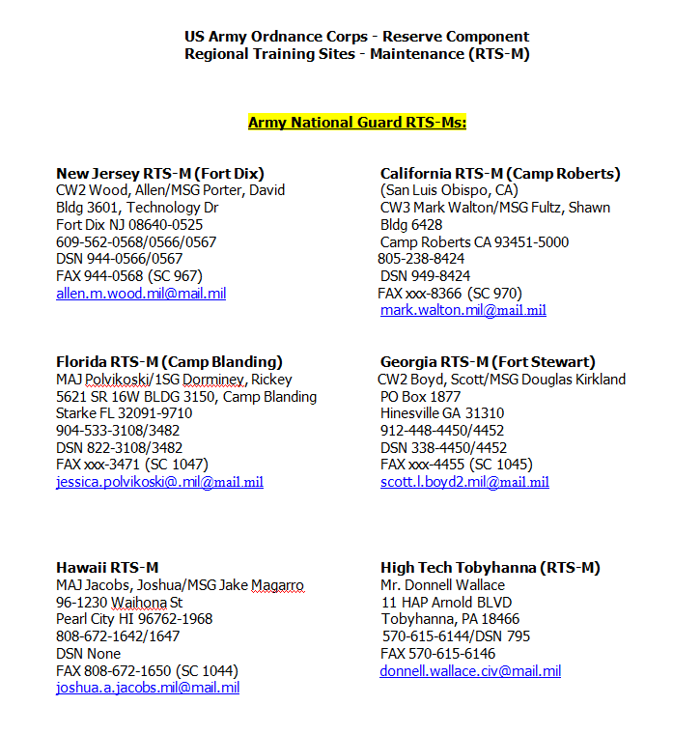
UIC: W7WPAA

Slide 3
