Slide 1
CAV Leader University CONOP 26-29 JAN 15
UNCLASSIFIED//FOUO
Mission. 1-4 CAV conducts CAV Leader University 26-29 JAN 14 in order to build World Class Cavalry Troopers through the use of professional reading, doctrine and theory, practical exercises and tactical training scenarios.
Security Class
Recon Class
NAI Optics
Key Training Objectives
Leader Development
Troopers gain knowledge in history, doctrine and theory
Troopers conduct practical exercises that develop their tactical decision making ability
OBJ
World Class
CavalryLeaders
AA
Leader
Development
ATK POS
TEWT
CAV Leader
Resources Required
Instructors
Land/ Facilities
Optics
Commo Equipment
TTX Equipment
TAS-C Equipment
Mystery Event
Burn Barrels
Offense Class
NAI
Commo
SBF TTX
Defense Class
Timeline
30 OCT-Professional Readings Issued
30 OCT-WARNO 1 Issued
08 DEC- OPORD Published
09 DEC- IPR #1
06 JAN- IPR #2
08 JAN- All reconnaissance complete
12 JAN-Professional Reading Paper Due
20 JAN: IPR #3/ Conditions Check
26 JAN: Doctrinal Day
27 JAN: Technical Day
28 JAN: Table Top Exercise
29 JAN: TEWT
02 FEB: AARs Due to Squadron S3
PL 26 JAN
PL 27 JAN
PL 28 JAN
PL 29 JAN
Concept of the Operation:
PH I: Professional Readings Assigned. From 30 OCT 14- 12 JAN 15
PH II: Professional Reading Papers Due to the Squadron Commander 12 JAN 15
PH III: Execution of CAV Leaders
University, from Classroom to Tactical TEWT. Begins 26 JAN, ends 29 JAN
v2 as of 04 DEC 14
1-4 CAV
UNCLASSIFIED//FOUO
Quarterhorse

Slide 2
Professional Reading
Publication Number | Title | Selected Chapter | Topic
 | To Fight or Not to Fight by Robert S. Cameron, Ph.D. | CH.7 (Recommend Intro xv-xvii) | (Recommend all of CH.7) Req: Pages 335-339, 371-390, 417-424, 447-463, bottom of 465-468, and 514-519.
 | A History of Cavalry From the Earliest Times by George Taylor Denison | Period IV: CH.XXI | Austrian Cavalry in Frederick the Great’s Wars
 |  | Period IV: CH.XXIII | Revolutionary Wars of America and France
 |  | Pg. 366-370 | J.E.B. Stuarts Raids in the American Civil War
 | Improving the Leader Development Experience in Army Units by COL Crissman | All | Improving Leader Development
ADRP 6-0 | Mission Command | CH.2 | The Mission Command Philosophy of Command
ADRP 7-0 | Training Units and Developing Leaders | 1-3 Paragraph | Role of the Commander
 |  | 2-3 Paragraph | Principles of Leader Development
ADRP 3-0 | Unified Land Operations | CH.2 | The Army’s Operational Concept
FM 3-20.96 | Reconnaissance and Cavalry Squadron | CH.3 | Reconnaissance Operations
FM 3-20.971 | Reconnaissance and Cavalry Troop | CH. 5 | Cavalry Troop Offensive and Defensive Operations
ATP 3-20.98 | Reconnaissance Platoon | CH. 4 | Security Operations
[ADD] ST 3-20.983 | Reconnaissance Platoon Handbook | All | Familiarize with subject material
Quarterhorse Leaders will read the selected chapters and compose a one page executive summary (bottom line: what did you learn?). The Paper is due to the SQDN S3 for consolidation on 12 JAN 14.
A repository of information can be found at the following link:
Additional Reading

Slide 3
CAV Leaders University Week
Monday 26 JAN Doctrinal Day | Tuesday 27 JAN Technical Day | Wednesday 28 JAN Table-Top Exercise (TTEX) | Thursday 29 JAN Terrain Exercise W/O Troops (TEWT)
(0900-1030) Doctrinal Review Offense Operations (1030-1200) Doctrinal Review Defense Operations Lunch (1300-1430) Doctrinal Review Reconnaissance Operations (1430-1600) Doctrinal Review Security Operations (1600-1700) Tactics Exam | (0900-1200) Commo Equipment Familiarization (0900-0945) JCR/BFT (0945-1030) HF (1030-1115) TACSAT (1115-1200) Antenna Theory (0900-1200) Optics Familiarization/ Employment (0900-1000) Mounted Optics (1000-1100) Dismounted Optics (1100-1200) Employment Lane Lunch (1300-1600) Commo Equipment Familiarization (1300-1345) JCR/BFT (1345-1430) HF (1430-1515) TACSAT (1515-1600) Antenna Theory (1300-1600) Optics Familiarization/ Employment (1300-1400) Mounted Optics (1400-1500) Dismounted Optics (1500-1600) Employment Lane | (1000-1130) TTX #1 Group 1: Zone Recon Group 2: Screen Group 3: Raid Lunch (1300-1430) TTX #2 Group 1: Screen Group 2: Raid Group 3: Zone Recon (1430-1600) TTX #3 Group 1: Raid Group 2: Zone Recon Group 3: Screen | (0700) TEWT lanes report ready (0700) Accountability Formation (@ Moon Lake) (0730) SP Moon Lake (0800) Group arrives at Observation lane (0945) Group begins Route Recon (1100) Group begins to Classify a Bridge (1215) Group arrives at Mystery Event (1300) 2x LMTV depart 1-4 CAV (1400) 2x LMTVs depart Main Post
v4 as of 05 JAN 15

Slide 4
AAR Comments (1 of 3)
Issue: Doctrinal Day
Discussion: The senior Cavalrymen from the Squadron and the Brigade provided personalized briefs on the Cavalry’s roles in the four major types of operations (offense, defense, reconnaissance, and security). The attention paid by each of the field grade officers demonstrated the importance of the subject matter and the dedication to leader development. Recommendation: Continue to provide blocks of instruction from the senior leaders, both non-commissioned officer and senior commissioned officers.
Issue. Technical Day
Discussion. All personnel acquired information and learned something new that day. Capabilities that most were unfamiliar of. Second order effect, SGTs were responsible for researching that piece of equipment and had to instruct a class. This now developed them into an expert into that piece of equipment and in its instruction. The Employment Lane as a Practical Exercise enforced the use of prior training, having it in a group enforced discussion of those capabilities and tactics.
Recommendation. Continue and apply to other topics.
v4 as of 05 JAN 15

Slide 5
AAR Comments (2 of 3)
Issue: Technical Day (Communications Training)
Discussion: The instructors were both good and bad, however they missed an opportunity to instruct a class that would be considered useful for Cavalrymen. The lane was more of a generic understanding of radio waves and a slight capabilities brief on HF, TACSAT and JCR. What would have been more useful would be a hasty antenna employment, emergency antenna employment, and how to actually send digital pictures via HF and TACSAT.
Recommendation: Task the Lane to a Reconnaissance Troop to ensure intent is met and utilize S6 personnel as Subject Matter Experts.
Issue: Table Top Exercise
Discussion: The tabletop day was probably the most beneficial of the training during the university. Wargaming allowed leaders to practice large scale maneuvers without large scale logistics or expense. Seeing how other leaders would attack certain scenarios also helped to think critically about their own decisions and ideas. Instant feedback from both senior leaders and OPFOR helped leaders to analyze and improve their decision making skills.
Recommendation: Maintain Table Top Exercises in the future, and introduce the concept at the team or squad levels.
v4 as of 05 JAN 15

Slide 6
AAR Comments (3 of 3)
Issue: Table Top Exercise, Vignettes and employment of decisions
Discussion: Leaders found everything about these vignettes helpful, all from being put in positions higher than they currently are, to SOP building, FM comms, tactics, maneuver, ammo conservation, fires planning, updates on combat power etc.
Recommendation: Incredibly helpful and can be utilized in OPDs/NCOPDs, will be utilized at the Team/Squad/Platoon/Troop level.
Issue: Mystery Event
Discussion: The mystery event tied everything together and gave leaders a historical aspect that is not normally achieved during regular training events. Allowing leaders to see the development of the cavalry over the years definitely increases the understanding of why we do things the way we do them today.
Recommendation: Incorporate a tour of the Cavalry museum. These tours last about 2 hrs and can support up to about 40 personnel. The tour would give even more depth and understanding to the history and the past and present utilization of the Cavalry.
v4 as of 05 JAN 15

Slide 7
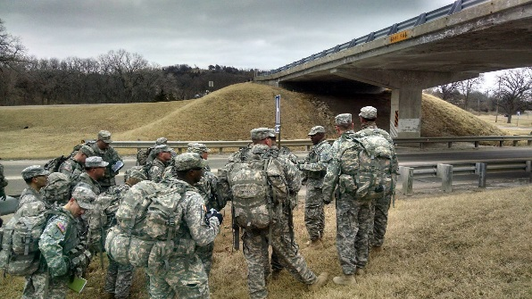
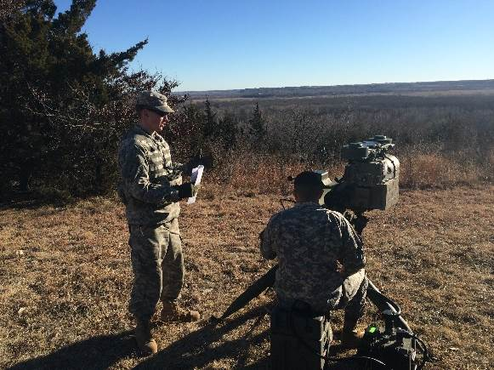
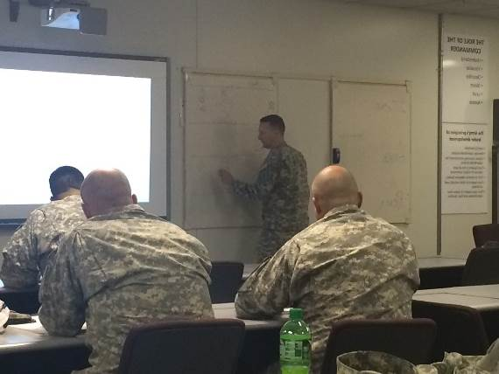
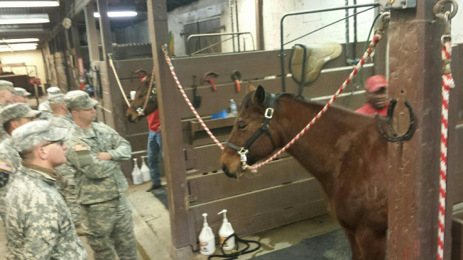
Cavalry Leaders University 1-4 CAV
Left: Leaders classify a bridge
Below: 1LT McDermott learns about the ITAS
Who: 1-4 CAV SQDN
What: Cavalry Leaders University
When: 26-29 JAN 15
Where: FT Riley, Kansas
Summary: Quarterhorse conducted a Cavalry Leaders University to ground their Leaders in doctrine and prepare them for future positions of responsibility and leadership throughout the Army. The program of instruction consisted of a day of classroom doctrine instruction, a day of hands on – technical employment of optics, communications, and weapons systems, a day of tactical table top exercises, and a practical exercise day where students were tested in route reconnaissance and bridge classification.
Effects: As ARSTRUC is accelerating and simultaneously planning/executing a Javelin Range, Quarterhorse proved that they can do what Cavalry Squadrons do best, perform a multitude of complex operations simultaneously and do them well!
TRAINING
MAINTAINING
MORALE
DISCIPLINE
Above: LTC Dente explains the difference of Recon Push and Recon Pull
Right: Leaders take a moment to learn their history and how to care for a horse

