Slide 1
Intelligence During Defense Support for Civil Authorities: Incident Awareness and Assessment (IAA)
FOUO
COL Scott Arnold, Staff Judge Advocate
Mr. Kevin W. Kapitan, Intelligence and Information Operations Legal Advisor
26 August 2011

Slide 2
Overview
Defining IAA and ISR
The Law of IAA and the need for SECDEF approval
ISR and “Traditional Intelligence”
Pre-Approved IAA Support: 7 IAA Force Packages
Importance of Task and Purpose, Not Assets
IAA and Law Enforcement
IAA and Unmanned Aircraft Systems
IAA and Domestic Imagery: DSCA, PUMS, and DIRs
IAA Analysis
Summary
Questions

Slide 3
Defining IAA and ISR
Department of Defense (DoD) forces involved in Defense Support to Civil Authorities (DSCA) conduct "incident awareness and assessment” (IAA), which is similar to intelligence, surveillance, and reconnaissance (ISR) operations used by DoD forces in combat.
ISR is an integrated Intelligence and operations function that is conducted by ISR assets, systems, resources, or capabilities consisting of platforms and packages.

Slide 4
More defining ISR and IAA
Limited national ISR resources are allocated among combatant commands.
ISR involves:
- Planning;
- Operating sensors; and
Processing, exploiting and disseminating data
IAA is based on the same concepts as ISR, but differs in its geographic scope and its governing laws and regulations.

Slide 5
The Geography of ISR and IAA
ISR is conducted outside the United States over foreign territory or within the United States during homeland defense events.
IAA is conducted within the United States in support of DSCA operations.

Slide 6
The Law of IAA
IAA can only address those information requirements permitted by law within a domestic environment.
Due to policy issues and a history of intelligence abuses in the 1960s and 1970s, there are laws and regulations, referred to as Intelligence Oversight, that balance Constitutional rights with the need for the federal government to collect information for national security purposes.

Slide 7
IAA, ISR, and SECDEF Approval
Domestic ISR activities, including IAA, do not occur without express permission of the Secretary of Defense (SECDEF).
Further, any use of intelligence capabilities for purposes other than traditional use - support of combat operations - must be expressly approved by the SECDEF.

Slide 8
“Traditional” Intelligence
DOD Intelligence components are authorized by SECDEF to conduct “Intelligence activities.”
“Intelligence activities” include the collection, production and dissemination of foreign Intelligence (FI) and counterintelligence (CI) by DOD Intelligence Components.
The restriction that DOD Intelligence components can only use Intelligence assets/capabilities for FI/CI is DOD policy derived from Executive Orders 12333 and 13470.

Slide 9
Pre-Approved IAA Support
Support for IAA required specific Secretary of Defense approval on a case-by-case basis.
In order to clarify the types of IAA support authorized, the Chairman of the Joint Chiefs of Staff (CJCS) DSCA EXORD contains pre-approved IAA support modules.
Even though pre-approved, use of the capabilities for any purpose other than that specified in the CJCS DSCA EXORD requires specific Secretary of Defense approval.

Slide 10
DSCA EXORD Seven IAA Force Packages
The CJCS DSCA EXORD contains seven pre-approved incident awareness and assessment support modules:
Situational Awareness Module
Damage Assessment Module
Evacuation Monitoring Module
Search and Rescue Module
Hydrographic Survey Module
Dynamic Ground Coordination Team
Chemical, Biological, Radiological, Nuclear, and High-Yield Explosives (CBRNE) Assessment Module.

Slide 11
Pre-Approved IAA Modules (1 of 3)
The IAA Situational Awareness Module includes sufficient platforms to provide 24-hour, full-motion video (FMV) coverage for 72 hours. ^{4.D.7.A.1.}
The IAA Damage Assessment Module includes capability to provide broad area and focused (point) imagery. ^{4.D.7.A.2.}
The IAA Evacuation Monitoring Module supports pre- and post-evacuation monitoring of large scale population movements. ^{4.D.7.A.3.}

Slide 12
Pre-Approved IAA Modules (2 of 3)
The IAA Search and Rescue Module supports first responders by identifying the most affected areas and providing near-real-time (NRT) coverage of named areas of interest to integrate with search and rescue personnel. ^{4.D.7.A.4.}
The IAA Hydrographic Survey Module provides surveys relating to the characteristic features of bodies of water, such as flow or depth, for evacuation of coastal areas and assessment of bridges, piers, and other critical maritime infrastructure. ^{4.D.7.A.6.}

Slide 13
Pre-Approved IAA Modules (3 of 3)
The IAA Dynamic Group Coordination Module is utilized with FMV-capable IAA aerial platforms and consist of specifically equipped teams which provide dynamic control of IAA assets and receive data and video, as well as satellite communications, in order to transmit FMV to USNORTHCOM. ^{4.D.7.A.7.}
The IAA CBRNE Assessment Module is employed when necessary to execute authorized CBRNE operations. ^{4.D.7.A.5.}

Slide 14
Focus on the Task and Purpose, Not the Assets
The DSCA EXORD, and the description of the IAA modules, reinforce the mandate to request a capability or result, not a specific asset:
4.D.7.B. POTENTIAL AERIAL AND GROUND ASSETS AVAILABLE TO EXECUTE THE IAA MISSIONS DESCRIBED ABOVE MAY BE A SINGLE PLATFORM OR CAPABILITY BELONGING TO MULTIPLE MODULES AND AERIAL ASSETS THAT MAY PERFORM MULTIPLE MISSIONS IN A SINGLE SORTIE. SUPPORTED CCDRS WILL PROVIDE TO FORCE PROVIDERS A CONOPS FOR EMPLOYMENT THAT AT A MINIMUM WILL INCLUDE TASK AND PURPOSE AND WILL DETAIL THE WHO, WHAT, WHERE, WHEN AND WHY INSTRUCTIONS. THE SUPPORTED CCDR WILL THEN COORDINATE WITH FORCE PROVIDERS TO DETERMINE THE APPROPRIATE SOURCING SOLUTIONS BASED UPON ASSETS AVAILABLE AND LOCATION OF THE REQUIRED SUPPORT.

Slide 15
IAA and Law Enforcement
Posse Comitatus Act
Restricts use of Intelligence assets for direct assistance to law enforcement (LE)
EXAMPLE: Cannot use full motion video to continue to tape an aggravated robbery in progress. Must notify LE authority (incidentally-acquired information) IAW DODD 5525.5.
Intelligence Oversight Rules
Restrictions on information that identifies a U.S. person
EXAMPLE: Can only use overhead reconnaissance if it is not directed at specific U.S. persons; but be careful of other side of Sensitive Information (SI)- violating DODD 5200.27.

Slide 16
The National Guard
Different rules apply for the National Guard in a State Active Duty or Title 32 Status.
The Posse Comitatus Act does not apply.
But Intelligence Oversight rules do apply while in Title 32 and Title 10 status, IAW 18 June 2008 NGB Memo and NGR 20-10/ANGI 14-101 (13 June 2011); these authorities also note that there is no authority to do FI or CI in SAD.

Slide 17
IAA and UAS
The use of DoD unmanned aircraft systems (UAS) in DSCA operations must be expressly approved by the SECDEF under the new DoDD 3025.18 related to DCSA (December 29, 2010):
4.o. No DoD unmanned aircraft systems (UAS) will be used for DSCA operations, including support to Federal, State, local, and tribal government organizations, unless expressly approved by the Secretary of Defense. Use of armed UAS for DSCA operations is not authorized.

Slide 18
IAA and Domestic Imagery
An IAA that involves domestic imagery may be authorized by SECDEF acceptance of a Request for Assistance (RFA) during a DSCA event or it may require a Proper Use Memorandum (PUM), a PUM amendment, or a Domestic Imagery Request, as set forth in NORAD and USNORTHCOM Instruction (N-NC) 14-3.
Domestic imagery is that covering the land areas of the 50 United States, the District of Columbia, and the territories and possessions of the United States, extending 12 nautical-miles seaward from land areas.

Slide 19
Domestic Imagery for DSCA
NORAD and USNORTHCOM Instruction 14-3 has a separate section relating to DSCA missions:
3.6.1. Upon SecDef acceptance of a Request for Assistance (RFA) during a DSCA event, NC-NC/JOIC-N will produce and disseminate image products derived from National Technical Means, commercial satellite imagery, and DOD, National Guard/Reserves, and Civil Air Patrol (CAP) – operated sensor platforms. In addition to disseminating locally produced material, N-NC/JIOC-N will serve as the focal point for dissemination of relevant image products acquired and/or processed by supporting DOD organizations.

Slide 20
IAAs and PUMs
If not part of a SECDEF accepted DSCA RFA, the domestic imagery for an IAA may be covered by an existing PUM since N-NC components and JTFs must generate PUMs to cover their specific use of domestic imagery for review and approval. ^{NNCI14-3, 3.2.3}
A PUM is a memorandum signed annually by an organization’s Certifying Government Official. The Imagery user organization submits this PUM annually that defines their requirements, intended use, and contains a proper use statement which acknowledges their awareness of the legal and policy restrictions regarding domestic imagery.

Slide 21
PUM Amendments and DIRs
If there is a PUM that would allow the domestic imagery for the IAA, but the organization did not have a DCSA mission at the time the PUM was approved, then a PUM Amendment must be submitted. PUM Amendments are only applicable when the mission of an organization changes.
If the domestic imagery for the IAA falls outside the scope of an approved PUM, and there is no organizational change, then a Domestic Imagery Request must be submitted.

Slide 22
IAA Analysis
When evaluating an IAA mission or request, consider the following questions:
What is the big picture mission?
What exactly is needed and why?
What exactly will be done?
Who will be doing it?
What equipment will be used to do it?
Where will it be done?
Who or what is being targeted?
Are we collecting information or data?
How will it be collected?

Slide 23
IAA Analysis (continued)
How will it be processed and disseminated?
Who will receive the information/products?
Does it require a security/classification review?
Will the information/intelligence be fused into one product?

Slide 24
Summary
IAA is similar to ISR, but it is conducted domestically where intelligence oversight rules apply.
IAA, as domestic ISR, requires SECDEF approval.
There are 7 Pre-Approved IAA Support Modules.
Focus on the task and purpose, not the assets.
Additional rules apply for IAA and law enforcement.
The use of UAS for DSCA requires SECDEF approval.
Additional rules apply for IAA and domestic imagery.
Beyond the legal considerations, using the IAA analysis is critical part of the process.

Slide 25
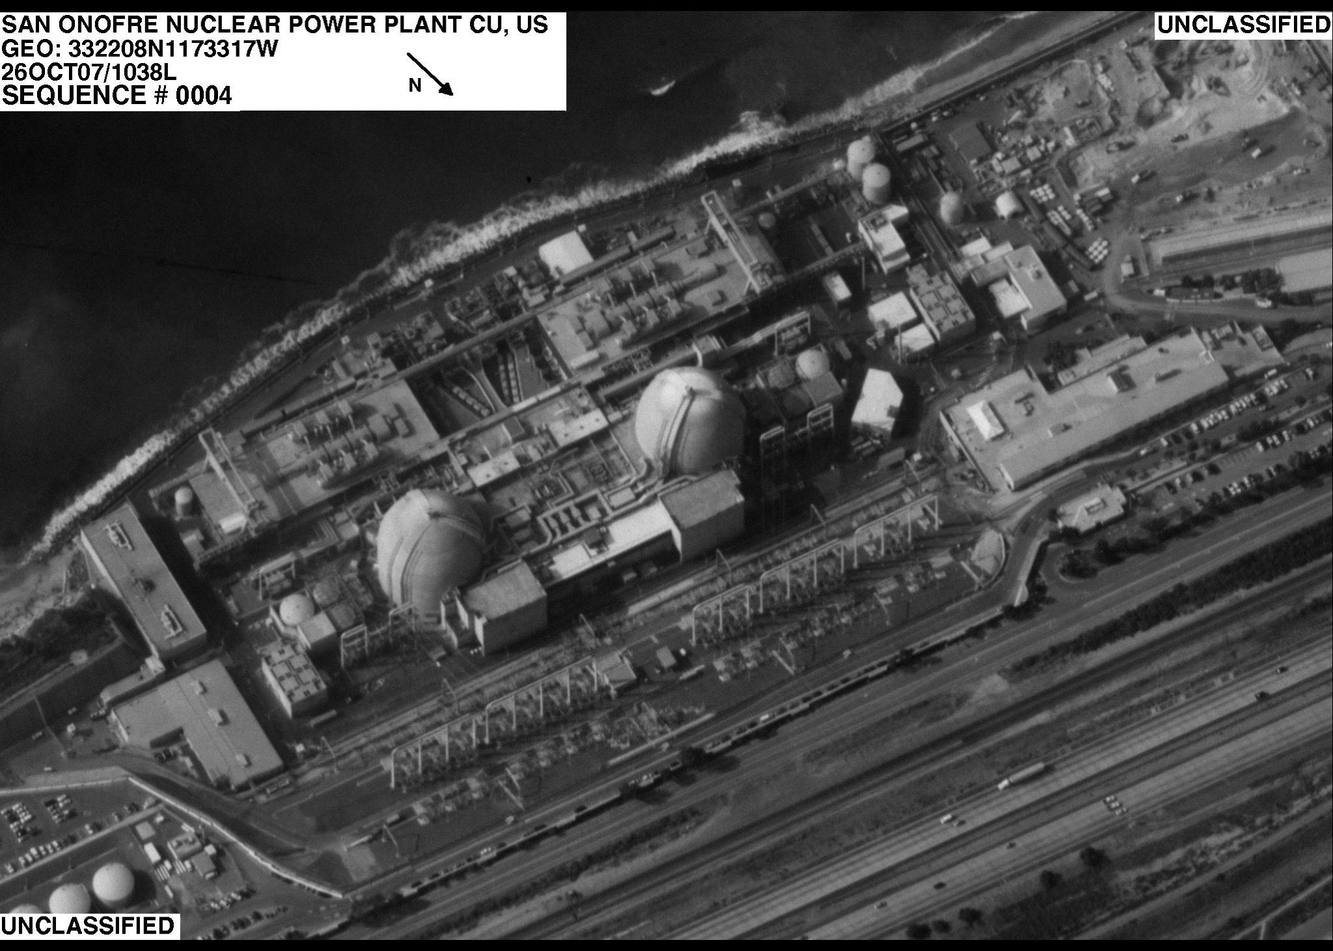
Electro-Optical (EO) Imagery
Description:
Airborne electro-optical sensor providing still imagery; basically black & white or color photo; point locations/ daylight only
Can include still frame images of FMV
EO Uses:
EO provides a medium for “drill down” and exploitation
Damage assessment
Situational awareness
Infrastructure
EO Capable Platforms:
Air Force Auxiliary (Civil Air Patrol)
U-2 Optical Bar Camera (OBC) or SYERS II/IIA (DoD-USAF)
OC-135 Open Skies (DoD-USAF)
RQ-4 Global Hawk UAS (DoD- USAF)
MORE
Notes:
Geotiff: allows exploitation to drill down, large files, ntiff is raw large Area images; customer tells us what they need!

Slide 26
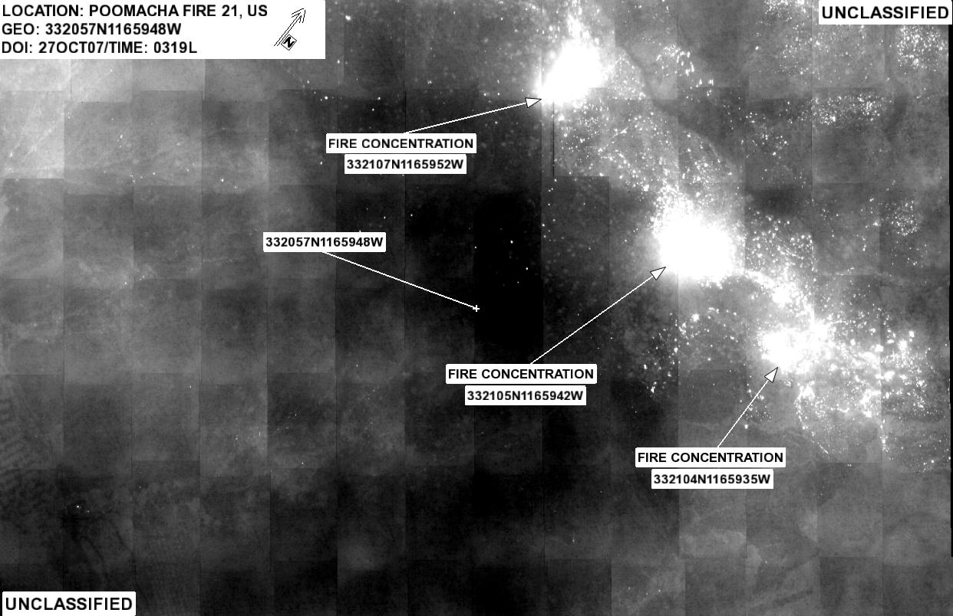
Infrared (IR) Imagery
Description:
Airborne infrared sensor providing the measurement of an object’s thermal energy against its background in low light and night conditions
IR Uses:
Damage assessment
Situational awareness
Infrastructure
Fire location identification
IR Capable Platforms:
RQ-1/9 Predator Unmanned Aerial System [UAS] (DoD)
C-130 Shadow Harvest (DoD)
U-2 SYERS II/IIA(DoD)
RQ-4 Global Hawk UAS (DoD)
Most FMV Platforms
MORE

Slide 27
Full Motion Video (FMV)
Description:
Airborne sensor providing near real time (NRT) streaming video to the customer for situational awareness
Uses:
Search and Rescue (SAR)
Lines of Communication (LOC)
Initial Damage Assessment (DA)
Fire Perimeter Identification
Situational Awareness (SA)
FMV Capable Platforms:
RC-26B (ANG)
OH-58 (ANG)
C-130 Scathe View (NV ANG)
RQ-1/9 Predator (DoD- USAF) (CBP)
P-3 AIP (DoD- USN) (CBP)
MORE
Notes:
CAP will be getting FMV, latest and greatest. Can give instant eye on!

Slide 28
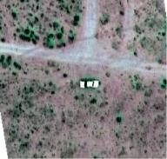
Hyper/Multi-Spectral Imaging (HIS/MSI)
H/MSI Description:
Airborne sensor that detects and/or gathers reflected radiation (light) from man-made or natural objects on the ground. Can detect specific spectral signatures, spectral anomalies and changes
H/MSI Uses:
Change detection
Specific signature identification
HSI Capable Aircraft:
Air Force Auxiliary “ARCHER” (CAP)
MSI Capable Aircraft:
C-130 Shadow Harvest (test phase)
U-2 SYERS II/IIA (DoD)
MORE

Slide 29
Electro-Optical (EO) Imagery
Description:
Airborne electro-optical sensor providing still imagery; basically black & white or color photo; point locations/ daylight only
Can include still frame images of FMV
EO Uses:
EO provides a medium for “drill down” and exploitation
Damage assessment
Situational awareness
Infrastructure
EO Capable Platforms:
Air Force Auxiliary (Civil Air Patrol)
U-2 Optical Bar Camera (OBC) or SYERS II/IIA (DoD-USAF)
OC-135 Open Skies (DoD-USAF)
RQ-4 Global Hawk UAS (DoD- USAF)
MORE
Notes:
Geotiff: allows exploitation to drill down, large files, ntiff is raw large Area images; customer tells us what they need!

Slide 30
Infrared (IR) Imagery
Description:
Airborne infrared sensor providing the measurement of an object’s thermal energy against its background in low light and night conditions
IR Uses:
Damage assessment
Situational awareness
Infrastructure
Fire location identification
IR Capable Platforms:
RQ-1/9 Predator Unmanned Aerial System [UAS] (DoD)
C-130 Shadow Harvest (DoD)
U-2 SYERS II/IIA(DoD)
RQ-4 Global Hawk UAS (DoD)
Most FMV Platforms
MORE

Slide 31
Full Motion Video (FMV)
Description:
Airborne sensor providing near real time (NRT) streaming video to the customer for situational awareness
Uses:
Search and Rescue (SAR)
Lines of Communication (LOC)
Initial Damage Assessment (DA)
Fire Perimeter Identification
Situational Awareness (SA)
FMV Capable Platforms:
RC-26B (ANG)
OH-58 (ANG)
C-130 Scathe View (NV ANG)
RQ-1/9 Predator (DoD- USAF) (CBP)
P-3 AIP (DoD- USN) (CBP)
MORE
Notes:
CAP will be getting FMV, latest and greatest. Can give instant eye on!

Slide 32
Hyper/Multi-Spectral Imaging (HIS/MSI)
H/MSI Description:
Airborne sensor that detects and/or gathers reflected radiation (light) from man-made or natural objects on the ground. Can detect specific spectral signatures, spectral anomalies and changes
H/MSI Uses:
Change detection
Specific signature identification
HSI Capable Aircraft:
Air Force Auxiliary “ARCHER” (CAP)
MSI Capable Aircraft:
C-130 Shadow Harvest (test phase)
U-2 SYERS II/IIA (DoD)
MORE

Slide 33
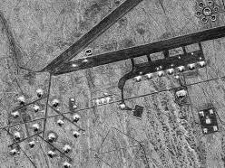
Synthetic Aperture Radar
(SAR)
Description:
Airborne sensor used to collect reflected energy to form an image. It can photograph any time of the day or night and can “see” through cloudy, dusty, and smoky conditions
SAR Uses:
Lines of Communication (LOC) Analysis
Initial Damage Assessment (DA)
SAR Capable Aircraft:
P-3 AIP (DoD)
C-130 Shadow Harvest (DoD)
U-2 ASARS (DoD)
RQ-4 Global Hawk UAS (DoD)
RQ-1/9 Predator Unmanned Aerial System [UAS] (DoD)
BACK

Slide 34
What is a Collection
Requirement (CR)?
Simply stated a collection requirement is:
An identified need for information which requires the collection of data in order to be answered
Types of collection requirements include:
Standing or Pre-Planned
Requirements pre-identified before collection efforts takes place
Ad Hoc
Requires collection during the current execution day
Dynamic Retasking
Time critical and/or high priority requirements that take precedence over current, pre-planned collection efforts
BACK
Notes:
34

Slide 35
What are my Collection Requirements?
Collection requirements (CRs) should be derived based upon guidance received from higher authority
Within the DoD, this guidance is expressed through Commander’s Critical Information Requirements (CCIRs) and Priority Information Requirements (PIRs)
These documents also aid in prioritization of the requirements
These items are usually expressed as questions to be answered
“What is the status of the major Lines of Communication within the affected area?”
Questions which cannot be fully answered with the information currently available, become Information Gaps
Data required to fill Information Gaps becomes CRs
Collection requirements should be highly specified
“Is the Interstate 10 Bridge still trafficable?”
“Are there obstructions on Interstate 10 from Baton Rouge to New Orleans?”
BACK

Slide 36
Where do my Collection
Requirements Come From
Collection requirements (CRs) can be generated at all levels of response operations
CRs, once generated, are forwarded to the next higher echelon
CRs are then combined with any previously received CRs
Other CRs maybe generated by other subordinate units or by the higher echelon itself
Duplicate requirements are removed, remaining CRs are validated, and then forwarded to the next higher echelon
CRs are passed to the organization serving as the Collection Operations Management cell
The COM will then task the requirements to the most appropriate assets based upon theater priority guidance
The COM Cell usually resides within the J2 but may also be located with the J3 Air
BACK

Slide 37
Available Title 32
Assets/Capabilities
Platform
Sensor
Coordination Required
Civil Air Patrol
RC-26B
OH-58
C-130 Scathe View
EO/ HSI
EO/ IR/ FMV
EO/ IR/ FMV
EO/ IR/ FMV
Civil Air Patrol Liaison
EMAC or JIEE Request to HQ NGB
EMAC, JIEE Request to HQ NGB
EMAC w/ Nevada, JIEE Request to HQ NGB
MORE

Slide 38
Available Title 10
Assets/Capabilities
Platform
Sensor
Coordination Required (After T10 Activation)
AF Auxiliary
RQ-1/9 Pred
RQ-4
P-3 AIP
U-2
Shadow Harvest
OC-135
EO/ HSI
EO/ IR/ FMV
EO/ IR
EO/ IR/ FMV/ SAR
EO/ SAR/ HSI/ MSI
EO/ IR/ SAR/ HSI/ MSI
EO
Civil Air Patrol Liaison/ CFACC Approval
RFF via NNC
MORE

Slide 39
Available OGA
Assets/Capabilities
Platform
Sensor
Coordination Required
Civil Air Patrol
CBP P-3
CBP RQ1-9
EPA Aspect
NASA IKANA
EO/ HSI
EO/ IR/ FMV
EO/ IR/ FMV
HSI/ MSI/ Rad Detect
EO/ IR
Civil Air Patrol Liaison
Air Marine Operations Center (AMOC)
Environmental Protection Agency
NASA Dryden, CA
BACK

