Slide 1
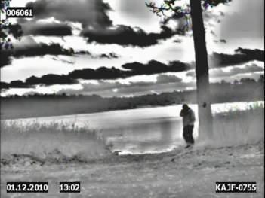
Operate the DVE

Slide 2
Operate the DVE
TLO
ACTION: Operate the AN/VAS-5A DVE
CONDITION: Given a classroom/ training area, DVE, TM 11-5855-311-12&P 2,vehicle
STANDARD: Operate the AN/VAS-5A IAW TM 11-5855-311-12&P-2

Slide 3
Operate the DVE
ELO A
ACTION: Identify the characteristics, safety, warnings, cautions and notes associated with the DVE
CONDITION: Given a classroom, TM 11-5855-311-12&P-2
STANDARD: Identify the characteristics, safety, warnings, cautions and notes associated withy the DVE IAW the operator manual

Slide 4
Operate the DVE
General Safety
Never work on electronic equipment unless there is another person nearby who is familiar with the operation and hazards of the equipment and who is competent in administering first aid
Power supply to the equipment must be shut off before working on equipment
Adhere to the unit load plans and perform pre-combat checks
Be careful not to contact high voltage connections or 115 volt AC input connections when installing or operating the equipment
Whenever the nature of the operation permits, keep one hand away from the equipment to reduce the hazard of current flowing through the body

Slide 5
Operate the DVE
General Safety Information
There are three conditions that can cause operations with the DVE to be unsafe
Training
Operational
Reduced Visibility

Slide 6
Operate the DVE
General Safety Information
Training
All training and licensing of DVE operators will be conducted according to Chapter 8, AR 600-55
Training should be recorded on each individual’s Operator’s Qualification Record (DA348-1-R) and U.S. Government Motor Vehicle Operator’s Identification Card (OF-346)
Once trained, personnel should utilize the DVE System frequently to prevent skill erosion

Slide 7
Operate the DVE
General Safety Information
Operational
Improper use of the DVE System (failure to observe safety precautions) could result in Death, Severe Injury, or System Loss
Follow these guidelines to prevent these hazards:
At night with lights off, the vehicle commander must wear NVG’s, be trained on the NVG’s, and be familiar with the operating characteristics of the vehicle

Slide 8
Operate the DVE
General Safety Information
Operational (cont.)
Before operating the vehicle ensure the following:
Ballistic Helmets will be worn by all occupants at all times while operating vehicles
  Verify DVE azimuth on the DCM is set at 0º and elevation indicator is between 0º and -12°
  Ensure locking knob teeth on the DCM mount are fully engaged. Failure to do so may cause injury to personnel
  Adjust vehicle seat if possible (screen should be at eye level)

Slide 9
Operate the DVE
General Safety Information
Operational (cont.)
Do not adjust the system while vehicle is moving
  The driver and co-driver must actively search for personnel or objects in/adjacent to the road during vehicle operations due to the restrictive 40 x 30 degree DVE System FOV – objects in front of and close to the vehicle may not be visible
  Stop or slow down sufficiently when approaching intersections until the driver and co-driver can verify the absence of approaching cross traffic

Slide 10
Operate the DVE
General Safety Information
Operational (cont.)
Slow the vehicle to 5 mph or less when approaching personnel at the side of the road until vehicle operator can ensure that all personnel have been passed
Unassisted backing is not permissible while using the DVE system, ground guides must be used
Operating speed will vary according to conditions and the driver’s experience. Do not ‘outdrive’ the DVE
  Looking too far down the course – cannot see upcoming / immediate hazards
  Driving too fast – Not enough time to react to hazards

Slide 11
Operate the DVE
General Safety Information
Operational (cont.)
  Drivers and vehicle commanders must use good judgment. Consider existing road and environmental conditions in determining safe operating speeds. Do not exceed the following operating speeds:
    Primary/Paved Roads 35 mph
    Secondary Roads 25 mph
    Off-Road Surfaces 10 mph
    Hilly Cross-Country 10 mph
  Limited Field Of View – Slow down sufficiently and use extreme caution when approaching curves and especially right-hand turns
  The DVE System is safe for planned use provided the above requirements are followed. All operators must be made aware of precautions listed above during New Equipment Training

Slide 12
Operate the DVE
General Safety Information
Reduced Visibility
Failure to account for the reduced DVE System field of view or degraded environmental conditions could result in Death, Severe Injury, or System Loss
Follow these guidelines to control reduced visibility
  Check the integrity of the DCM and the position of the SM prior to each driving operation
  The DVE System is not a “see-all” device. Objects may not be readily detectable due to dense fog, smoke, heavy rain, and thermal neutral conditions (diurnal cycle)
  Maintain environmental and weather condition awareness, reduce speeds to suit the prevailing operational environment and terrain

Slide 13
Operate the DVE
General Safety Information
Reduced Visibility (cont.)
  Driver fatigue and eyestrain are directly related to use of the DVE System. To reduce driving accidents, provide operators with periodic breaks; minimally every two hours while using the DVE System
  Staring too closely at the DCM can cause headaches, dizziness (vertigo), and / or vision impairment. Operator should occasionally look away
  Transitions in terrain (drop-offs, bumps, etc.) are often difficult to identify and may not clearly be defined on the DCM

Slide 14
Operate the DVE
General Safety Information
Reduced Visibility (cont.)
  If at any time the image becomes degraded or the operator feels unsafe with the driving situation while using the DVE system, stop the vehicle and discontinue use
  Immediately bring the vehicle to a safe halt to avoid collision if the following situations occur:
    Dead Pixels – The small dots that make up the display degrade to the point that the DCM image becomes unviewable
    Video Noise – Interference or static that blots out the display
  If unable to troubleshoot, report situation to higher level maintenance

Slide 15
Operate the DVE
General Safety Information
Reduced Visibility (cont.)
Because DVE System looks forward, intersecting pathways will disappear from the driver’s FOV prior to the vehicle entering the intersection
The EPTM can assist in making turns
        Stop the vehicle
        Survey the area around the vehicle, utilizing the Electronic Pan and Tilt Module (EPTM)
        Plan proper action
        Return the SM to home position (0º azimuth) and proper elevation
        Proceed
Slow vehicle to comfortable turning speed
Adjust turn rate as path comes back into view on display

Slide 16
Operate the DVE
Warnings, Cautions and Notes
Warnings – Operating or maintenance procedure,
practice, or condition that if not adhered to could result in injury or death to personnel
Cautions – Operating or maintenance procedure, practice, or condition that if not adhered to could result in damage or destruction of equipment or loss of mission effectiveness
Notes – A statement that clarifies the following procedures; it cannot replace an essential operating or maintenance procedure

Slide 17
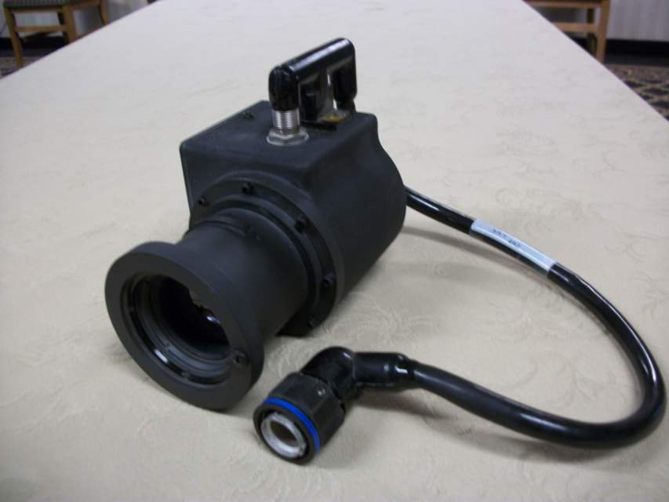
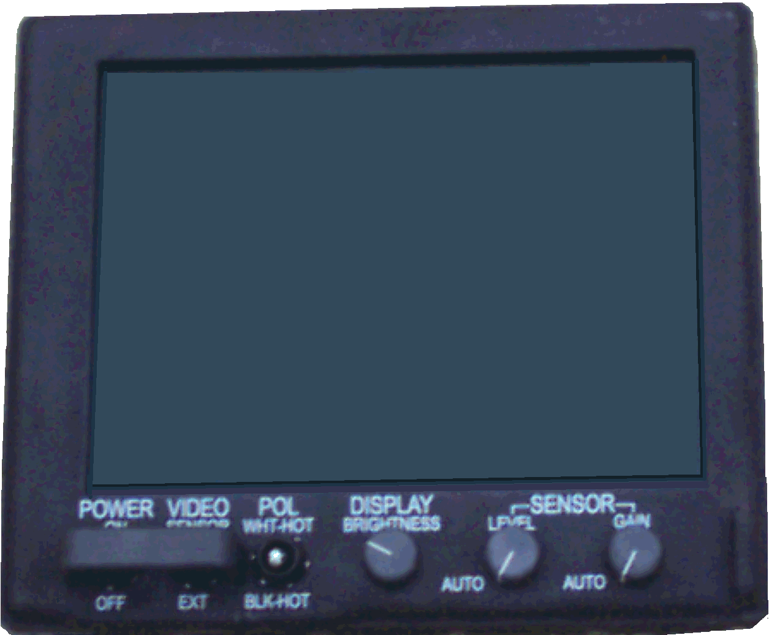
Operate the DVE
AN/VAS-5A(B) Viewer, Infrared System
DVE Major Components consist of:
Display Control Module (DCM)
Sensor Module (SM)

Slide 18
Operate the DVE
Characteristics and Capabilities
DISPLAY CONTROL MODULE (DCM)
Depth 4.19 inches (Maximum)
Width 10.47 inches (Maximum)
Height 8.98 inches (Maximum)
Weight 8.25 pounds (Maximum)
Power Dissipation 86 watts, (Maximum)(During warm-up)
30 watts, (Maximum) (Nominal)

Slide 19
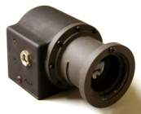
Operate the DVE
Sensor Assembly
Detects IR energy
Converts IR image to video signal
Sends video signal to DCM
Detects a standing person or a 22 inch (55.9 centimeter) object at 360 feet (110 meters) or greater
Operates from a single input voltage of 16 to 32 VDC
Width 3.64 inches
Height 5.25 inches
Depth 3.88 inches
Weight 2.73 pounds (Maximum)
Power Dissipation 10 watts (Maximum)

Slide 20
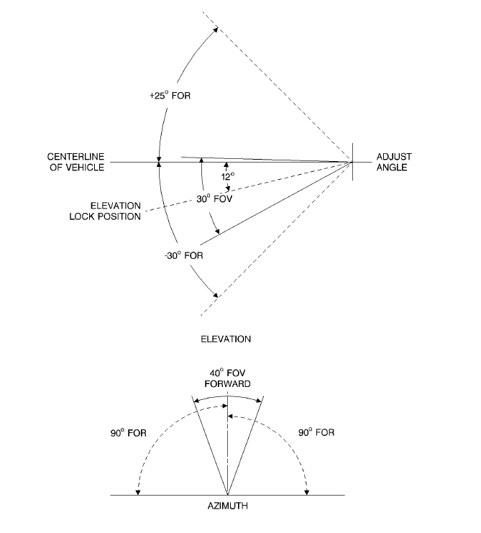
Operate the DVE
Sensor Assembly Cont.
Field Of Regard (FOR): +/- 90° Left and Right Azimuth /+25° to -30° Elevation (Area that can be examined while slewing through normal left/right up/down limits)
Can detect a standing person or a 22-inch (55.9 centimeter) object at 360 feet (110 meters)
Operates from a single input voltage of 16 to 32 VDC
Field Of View (FOV): 40° Azimuth x 30° Elevation
(Angular area visible through an optical instrument)

Slide 21
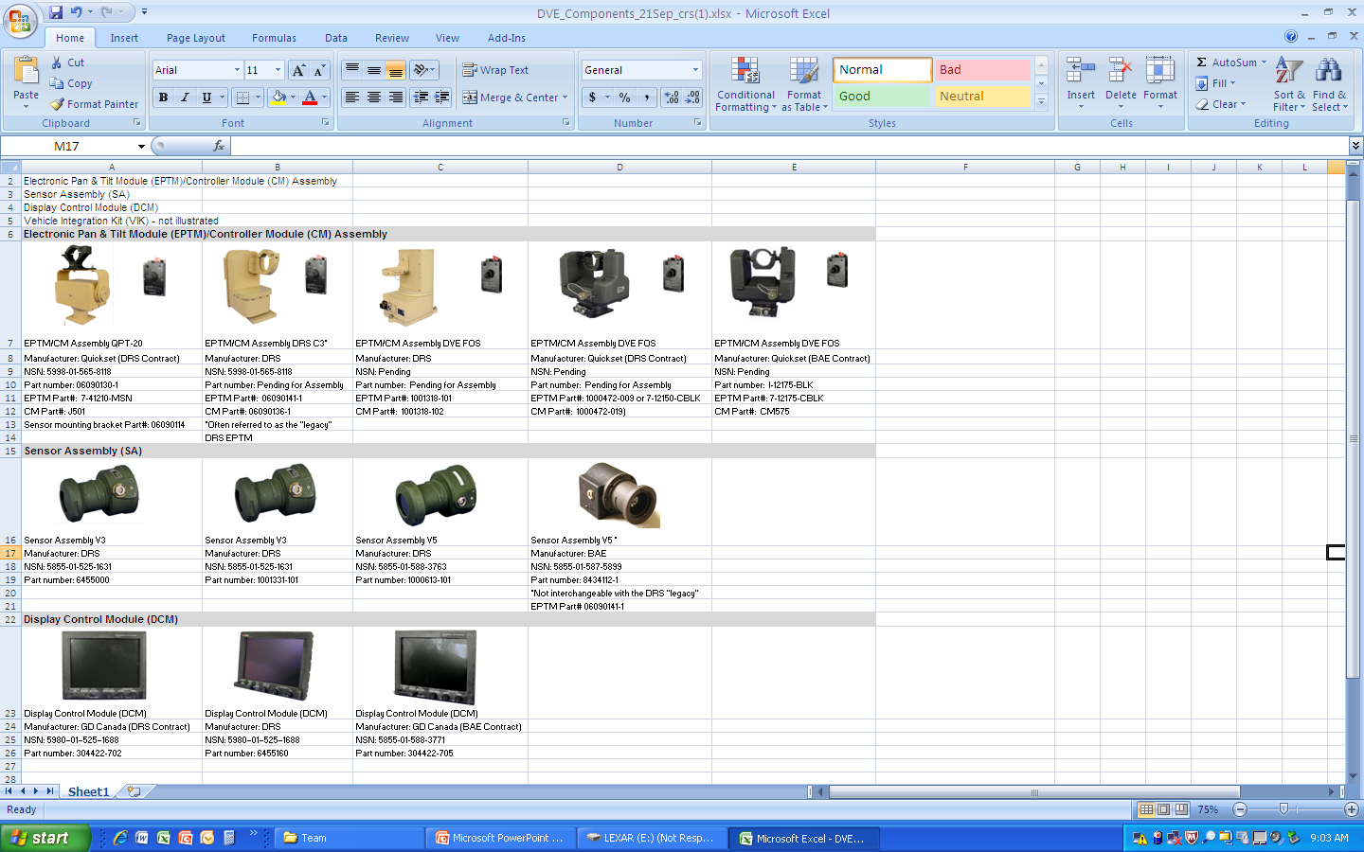
Operate the DVE
Electronic Pan Tilt Module and Control Module
Houses the Sensor Assembly (SA)
SA/PTM cable connects to PTM/DCM interconnect cable connector
Gives desired FOV when viewing a selected area
Allows for manual movement of SA thru the FOR
Width | 9.00 inches (Maximum)
Height | 9.18 inches (Maximum)
Depth | 4.31 inches (Maximum)
Weight | 5.70 pounds (Maximum)

Slide 22
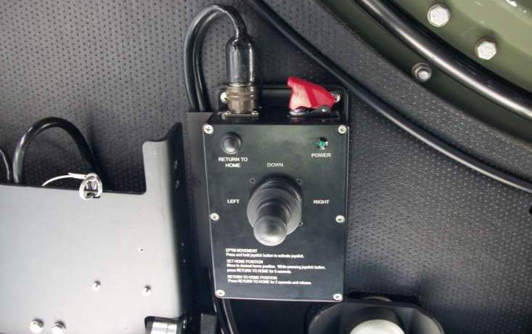
Operate the DVE
Controller Module (CM)
Azimuth Control – Rotates PTM ± 90°
Elevation Control – Adjusts the Sensor Assembly elevation FOR from +25° to - 30°
Azimuth lock – Locks PTM at 0° azimuth (driving) position when engaged
Elevation lock – Locks Sensor Assembly at - 12°el–vatin (driving) position when engaged

Slide 23
Operate the DVE
ELO B
ACTION: | Identify the controls, indicators and connectors of the AN/VAS- 5A DVE
CONDITION: In a classroom environment, given a DVE training device, TM 11-5855-311-12&P-2
STANDARD: Identify the controls, indicators and connectors of the DVE IAW the operator manual

Slide 24
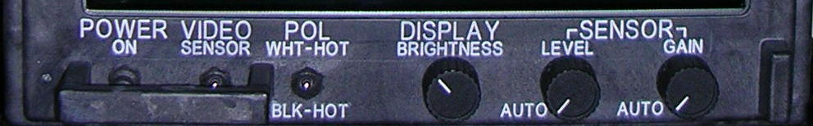
Operate the DVE
Display Control Module (DCM) Controls and Functions
POWER INDICATOR LED
Power Switch - Two position toggle switch
    Applies power to DVE when set to ON (up position). When power is applied, the LED power indicator is illuminated
    Time necessary for maximum image clarity will depend on temperature

Slide 25
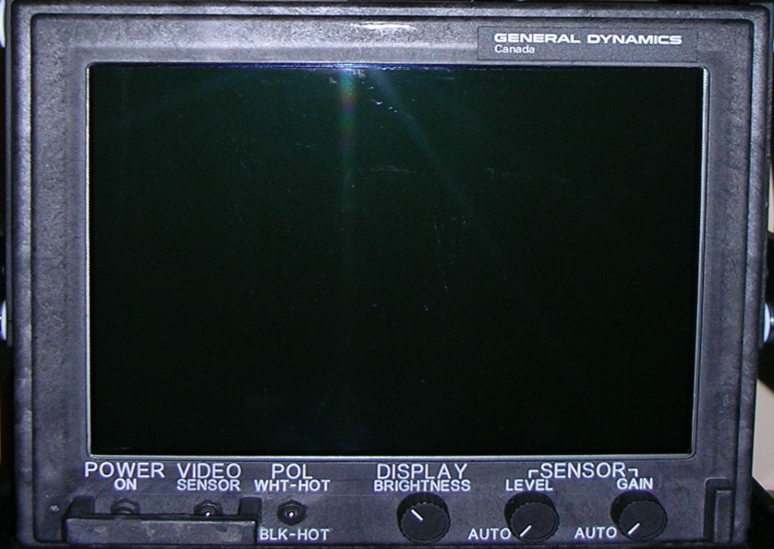
Operate the DVE
Display Control Module (DCM) Controls and Functions (cont.)
NO SENSOR VIDEO
CHECK VIDEO SWITCH
VIDEO SENSOR/EXT switch -
Two position toggle switch
In the SENSOR position, selects the sensor video in the DVE. In the EXT position, selects an external video input
If “NO SENSOR VIDEO – CHECK VIDEO SWITCH”
message is displayed, video source is not present

Slide 26
Operate the DVE
Display Control Module (DCM) Controls and Functions
POLARITY SWITCH
POLARITY INDICATOR - Indicates BLK-HOT or WHT-HOT polarity. Coincides with first block of grayscale
Up position is WHT-HOT
Objects radiating more
IR energy appear brighter
May not be best when
background is very hot
Down position is BLK-HOT
Objects radiating more IR
energy appear darker

Slide 27
Operate the DVE
Display Control Module (DCM) Controls and Functions
DISPLAY BRIGHTNESS KNOB
DISPLAY BRIGHTNESS control - Increases background lighting on the display with clockwise (cw) rotation of control and decreases background lighting on display with counterclockwise (ccw) rotation of control.
Adjusts the brightness of the display backlight
Adjusted too high could result on loss of useful video information
Affects the display and Power Indicator LED, not the source video
Operator’s experience and personal preference determine best setting
Lowest comfortable brightness level is recommended (light discipline)

Slide 28
Operate the DVE
Display Control Module (DCM) Controls and Functions
SENSOR LEVEL KNOB
SENSOR LEVEL Manual /AUTO – Manual adjustment of video level Automatic adjustment of video level
    Adjust to view images having very high thermal differences (e. g. vehicles, factories, or fires)
    Adjust to view images having very low thermal differences (e. g. Featureless desert or wet fields during or following a rain)
    For additional picture clarity, driver may move Auto LEVEL out of detent to manual and adjust for best image while stationary
    System will Auto Cal the picture in the manual position set by driver. Video may freeze for a fraction of a second

Slide 29
Operate the DVE
Display Control Module (DCM) Controls and Functions
SENSOR LEVEL (BRIGHTNESS)
SENSOR LEVEL Manual /AUTO – Automatic adjustment of video level
    Adjust to view images having very high thermal differences (e. g. vehicles, factories, or fires)
    Adjust to view images having very low thermal differences (e. g. Featureless desert or wet fields during or following a rain)
    For additional picture clarity, driver may move Auto LEVEL out of detent to manual and adjust for best image while stationary
    System will Auto Cal the picture in the manual position set by driver. Video may freeze for a fraction of a second

Slide 30
Operate the DVE
Display Control Module (DCM) Controls and Functions
SENSOR GAIN (CONTRAST)
SENSOR GAIN Manual /AUTO – Manual adjustment of video gain Automatic adjustment of video gain
    Adjust to view images having very high thermal differences (e. g. vehicles, factories, or fires)
    Adjust to view images having very low thermal differences (e. g. Featureless desert or wet fields during or following a rain)
    For additional picture clarity, driver may move Auto LEVEL out of detent to manual and adjust for best image while stationary
    System will Auto Cal the picture in the manual position set by driver. Video may freeze for a fraction of a second

Slide 31
Operate the DVE
Display Control Module (DCM) Controls and Functions
SENSOR GAIN KNOB
SENSOR GAIN Manual /AUTO – Manual adjustment of video gain Automatic adjustment of video gain
Provides the best image for most driving conditions
Enhances and refines the picture
Knob must be in full counterclockwise AUTO detent position
Sensor video contrast is adjusted automatically
It determines the hottest and coldest extremes and adjusts the video gain accordingly

Slide 32
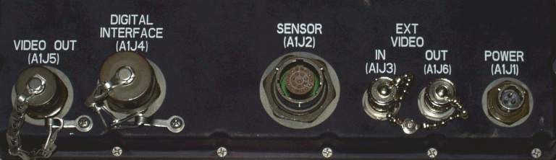
Operate the DVE
Display Control Module (DCM) Connectors and Function
Video out (A1J5) – Provides video output to auxiliary equipment
Digital Interface (A1J4) – Provides for external control of sensor assembly
Sensor (A1J2) – Provides power input to sensor assembly
Ext Video In (A1J3) – Provides for input of external video to display
Ext Video Out (A1J6) – Provides for output of display video to auxiliary equipment
Power (A1J1) – Provides power input to display

Slide 33
Operate the DVE
ELO C
ACTION: | Identify the basic thermal theory of the AN/VAS-5A DVE
CONDITION: |  | In a classroom environment, given a DVE training device, TM 11-5855-311-12&P-2
STANDARD: |  | Identify the basic thermal theory of the AN/VAS-5A DVE IAW the operator manual

Slide 34
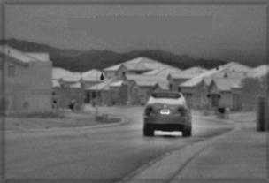
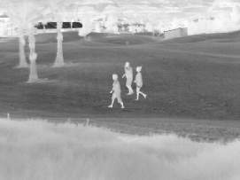
Operate the DVE
Basic Thermal Theory

Slide 35
Operate the DVE
THERMAL IMAGING SYSTEM (TIS) DVE-FOS
Night Vision Devices (NVD’s) allow you to see objects in both the Visible and Near-Infrared spectrum
NVD’s require ambient light to operate and are not designed to provide drivers the ability to see through environmental conditions
DVE does not require ambient light and is intended for vehicle operators to see through environmental obscurants, including rain, smoke, fog, haze, etc
DVE allows the Operator to see objects in the Thermal-Infrared spectrum, which does not use light, just thermal energy
The key difference between Thermal-IR (DVE-FOS) and Near-IR (NVD’s) is that Thermal-IR energy is Emitted by an object instead of Reflected off an object

Slide 36
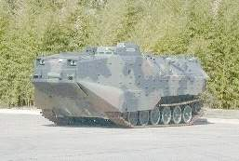
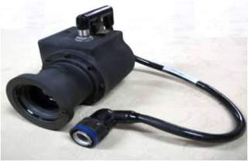
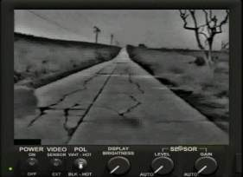
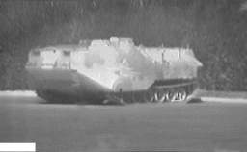
Operate the DVE
THERMAL IMAGING SYSTEM (TIS)
A Thermal Imaging System:
    Detects IR energy radiation from scene
    Converts IR energy to corresponding electrical signals for processing
    Generates a visible image representative of the IR scene

Slide 37

Operate the DVE
THERMAL IMAGING SYSTEM (TIS) (cont.)
Passive system
    Does not emit or transmit signals of any kind
    Only collects IR energy from scene
Ignores visible light input
    Only sensitive to IR energy
Versatile
    Effective 24 hours a day
    Enhances vision during poor visibility conditions
    Able to see camouflaged objects

Slide 38
Operate the DVE
Thermal Theory Definitions
Ultraviolet light is the radiation from the sun that causes a sunburn
Visible light is the light that we can see and is the only light detectable by the human eye
Infrared radiation is what we like to describe as heat. We can't see infrared waves, but we can feel them. Your body gives off heat, so it is an emitter of infrared radiation
Microwaves are used in radar and also in your microwave oven
Radio waves are found at the longest wavelengths on the electromagnetic spectrum

Slide 39
Operate the DVE
Optical Spectrum
All objects above absolute zero (-273.15° C / -459.67° F) emit Infrared Radiation (IR) that is an invisible form of light beyond the visible spectrum
OPTICAL SPECTRUM
X-RAYS
ULTRA-
VIOLET
VISIBLE
INFRARED
MICROWAVES
V
I
B
G
Y
O
R
NEAR
IR
MIDDLE
IR
FAR
IR
DVE
(8~12 um)
PHOTO
IR
0.1
0.37
0.72
0.9
3.0
6.0
1000 MICRONS (um)
The optical spectrum is part of the electromagnetic energy spectrum
IR is a part of the optical spectrum which consist of ultraviolet, visible, and infrared energy
Only a small part of the optical spectrum is visible to the unaided eye
The DVE can detect energy in the mid- to far-infrared portion of the optical spectrum

Slide 40
Operate the DVE
Solar Energy
The Sun emits solar energy across the entire energy spectrum
Solar energy encounters surface objects
Some energy is absorbed and stored as heat (thermal energy)
After sunset, the thermal energy remains and is emitted as IR energy

Slide 41
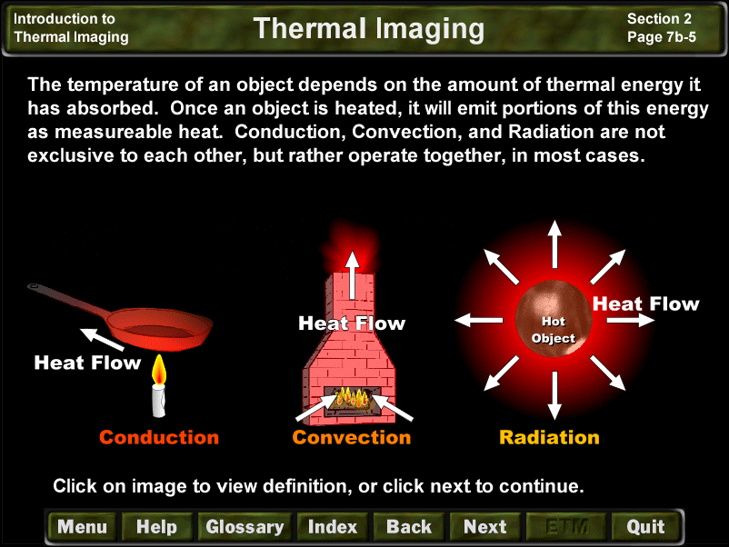
Operate the DVE
Heated Objects
Along with radiation, thermal energy can be absorbed or transferred through:
    Conduction or the transfer of heat between two parts of a stationary system, caused by a temperature difference between the parts
    Convection or the transfer of heat by the circulation or movement of the heated parts of a liquid or gas
The temperature of an object depends on amount of thermal energy absorbed
Heated objects emit IR radiation

Slide 42
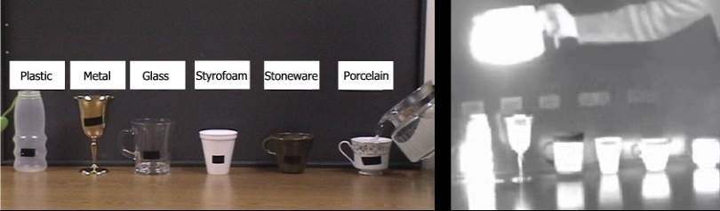
Operate the DVE
IR IMAGES
EMISSIVITY
Emissivity is a measure of an object’s ability to emit radiation
Objects emit absorbed IR energy at different rates based on their surface properties

Slide 43
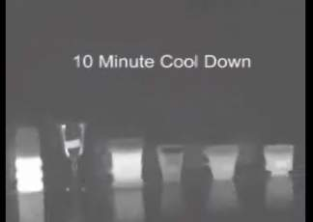
Operate the DVE
IR IMAGES
EMISSIVITY (cont).
Objects that are the same temperature may not emit the same amount of IR energy because they have different levels of emissivity
Objects with higher emissivity will emit more IR energy and appear hotter when viewed on the DCM
Objects with lower emissivity will emit less IR energy and appear colder when viewed on the DCM

Slide 44
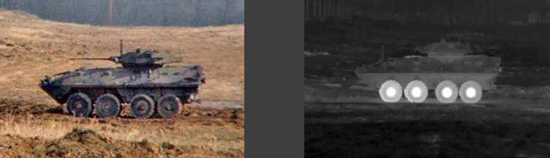
Operate the DVE
IR IMAGES
red INTENSITY (IR)
Intensity of IR energy radiation from any object depends on two factors:
    Temperature - amount of thermal energy absorbed
    Emissivity of object - rate that the object emits IR energy

Slide 45
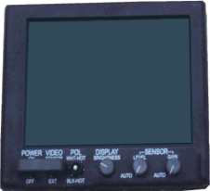


Operate the DVE
IR IMAGES
ATTENUATION = Air Composition + Density + Distance Traveled
Distance of Objects
DUST
HAZE
IR Energy Signature
SMOKE
A Thermal Imaging System must receive the IR energy from the environment
IR energy is attenuated (degraded) by air composition, density, and distance traveled
IR energy can travel through most obscurants better than visible light

Slide 46
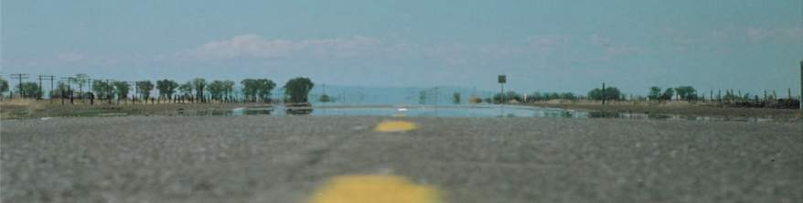
Operate the DVE
IR IMAGES
ATMOSPHERIC TURBULENCE
Twinkling and Shimmering
  Affects line-of-sight through air near heated surfaces, such as a desert floor or asphalt road
  Affects stability and clarity of image, may cause image to appear to move or be unfocused
If possible, to avoid atmospheric turbulence, wait for cooling temperatures

Slide 47
Operate the DVE
IR IMAGES
DIURNAL CYCLE
The period of time, after sunrise or sunset, when passive objects approach the same temperature as the background
    Sunrise: Objects begin to absorb thermal energy and increase in temperature
    Sunset: Objects begin to lose thermal energy and decrease in temperature
NOTE: The DIURNAL CYCLE is also known as the CROSSOVER PERIOD

Slide 48
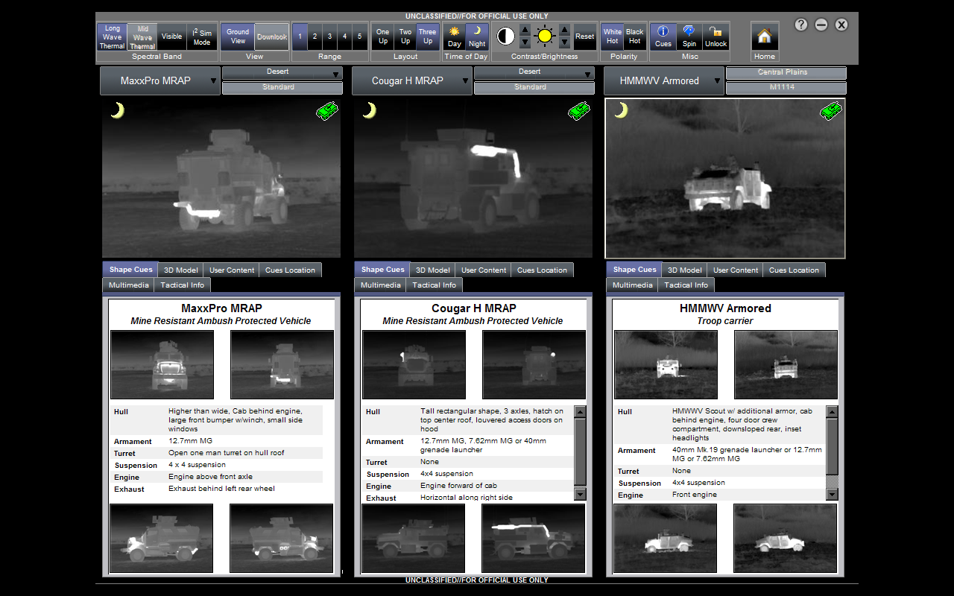
Operate the DVE
THERMAL SIGNATURES
VIEWING ANGLES
Viewing angle affects appearance of the thermal signature and the intensity of radiated IR. View flat sided objects as close to perpendicular as possible

Slide 49
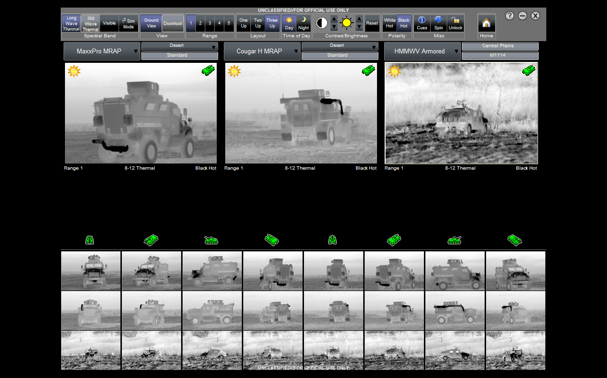
Operate the DVE
VIEWING ANGLES

Slide 50
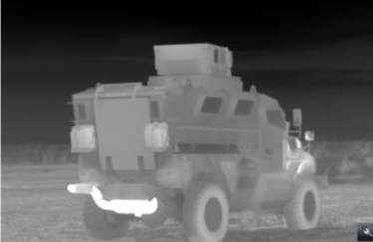
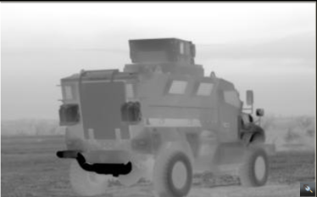
Operate the DVE
THERMAL SIGNATURE
POLARITY DIFFERENCES
White Hot objects in the scene appear lighter on a darker background
Interpretation of thermal images comes with experience and practice
Black Hot objects in the scene appear darker on a lighter background

Slide 51
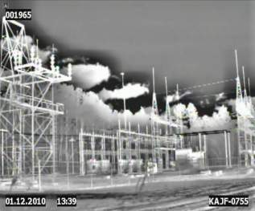
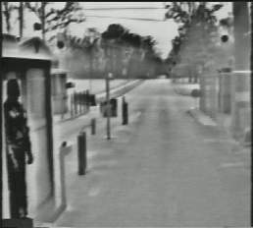
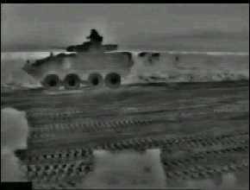
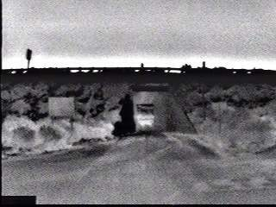
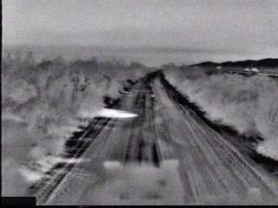
Operate the DVE
THERMAL SIGNATURE (cont.)
Man-made objects present distinct identifiable thermal signatures different from the natural environment
Combustion, friction, and body heat provide thermal signatures for mechanical and living objects

Slide 52
Operate the DVE
ENVIRONMENTAL EFFECTS
Moisture:
  Cools objects down
  Fog or clouds are very poor IR transmitters
  High humidity may cause degradation
  Amount and intensity of rain determines degree of TIS degradation
Overcast Sky:
  Reduces solar energy absorbed by environment
  Surface temperatures tend to become unvarying, causing reduced image contrast
Particulates: (dust, haze, smog, smoke, aerosols, etc.)
  Causes degradation of thermal imagery
  Amount of degradation depends on size, type, and concentration of particles
Surface reflections:
  Causes deceptive imagery – Smooth, glossy surfaces (windows, mirrors, still water) can produce strong reflections of IR energy from other sources

Slide 53
Operate the DVE
ELO D
ACTION: | Prepare the AN/VAS-5A Driver’s Vision Enhancer (DVE) for operation
CONDITION: |  | In a classroom environment/ maintenance bay, given a DVE, operator manual, designated vehicle
STANDARD: |  | Prepare the AN/VAS-5A Driver’s Vision Enhancer (DVE) for operation IAW the operator manual

Slide 54
Operate the DVE
Unstow and Setup Procedures
The DVE System should be inspected and PMCS conducted each time it is unstowed or stowed
Inspect the DVE to ensure that the unit is in good physical condition; inspect all components for surface damage that may have occurred during shipment/storage, including the environmental seal, if applicable
For missing or damaged components, refer to the Army forms and procedures used for equipment maintenance, as prescribed by DA PAM 750-8, The Army Maintenance Management System (TAMMS). Marine Corps personnel are encouraged to submit SF 368 in accordance with MCO 4855.10 (Quality Deficiency Report)

Slide 55
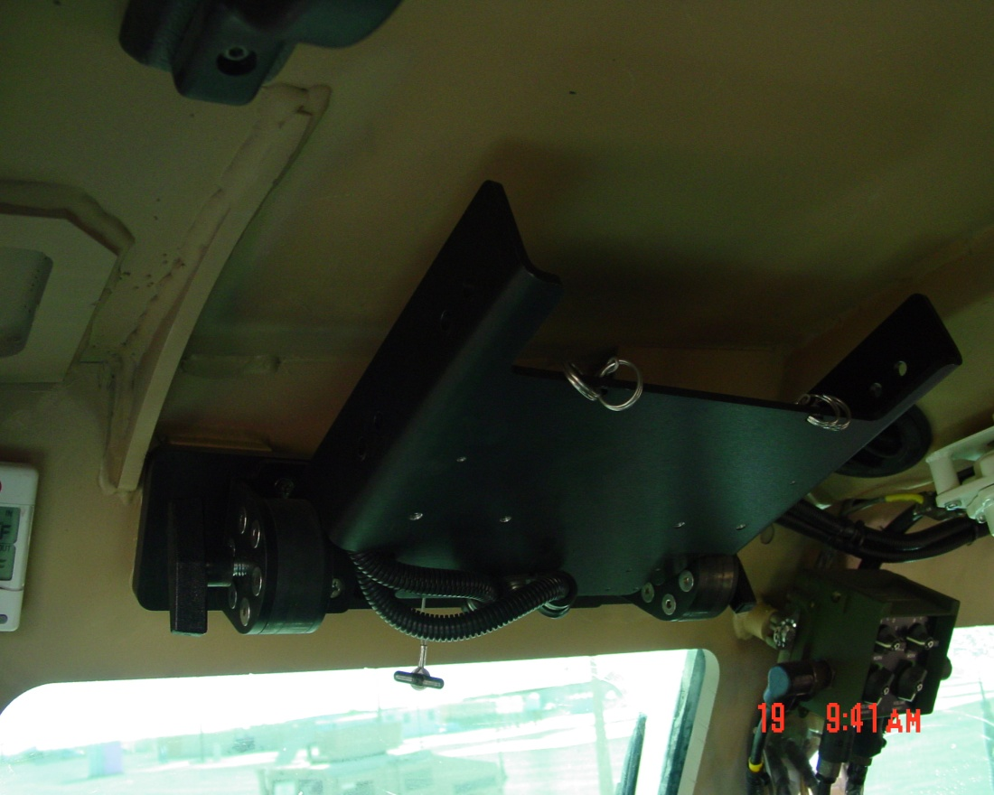
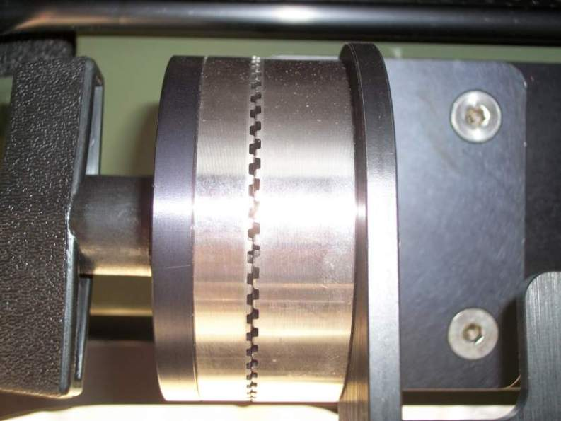
Operate the DVE
Unstow Procedures
Loosen two DCM locking knobs
Push DCM mount to the right
and lower mount
Tighten two DCM locking knobs

Slide 56
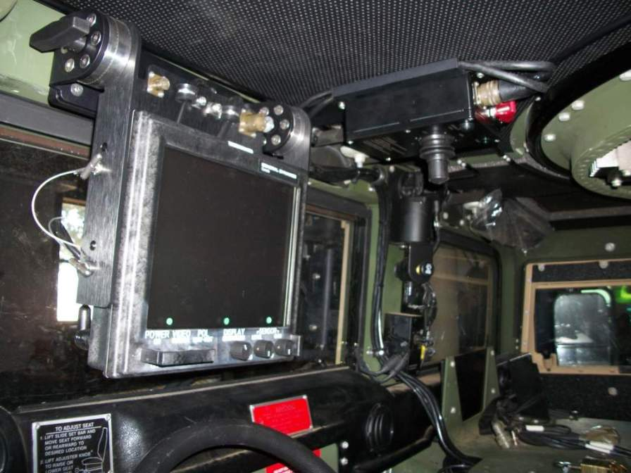
Operate the DVE
Unstow Procedures
Unstowed Position

Slide 57
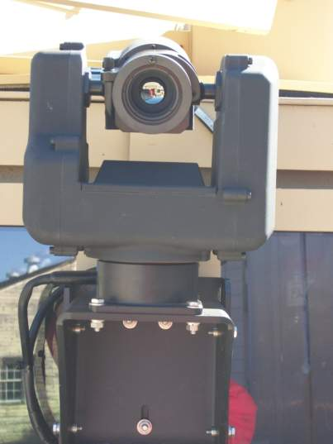
Operate the DVE
Sensor Assembly Installation

Slide 58
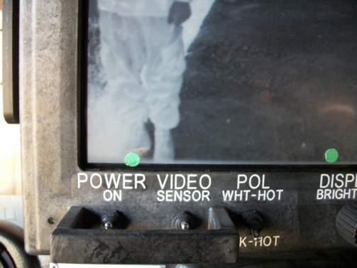
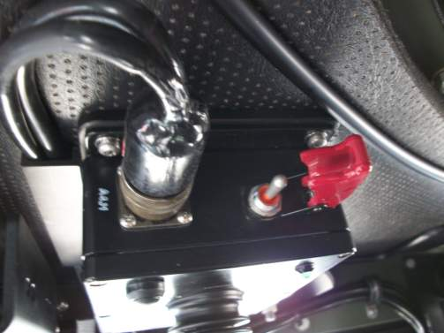
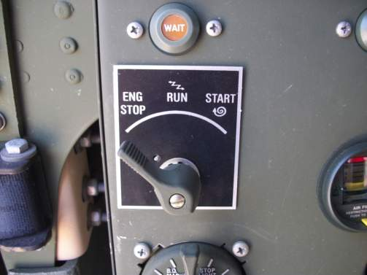
Operate the DVE
Sensor Assembly Installation
1
1
Ensure power is off before installing the DVE System
      DCM
      CM
      Vehicle
2
2
3
3

Slide 59
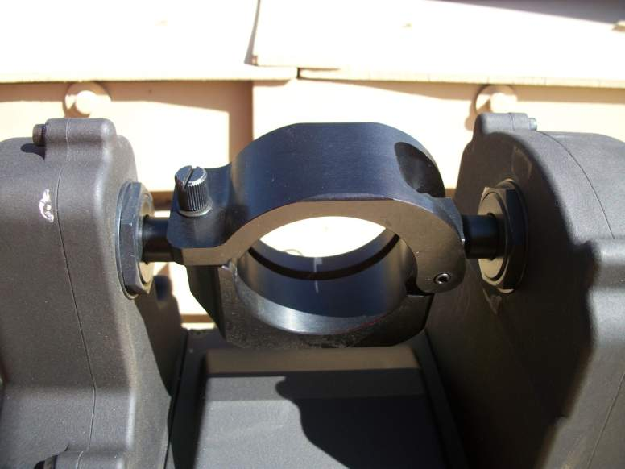
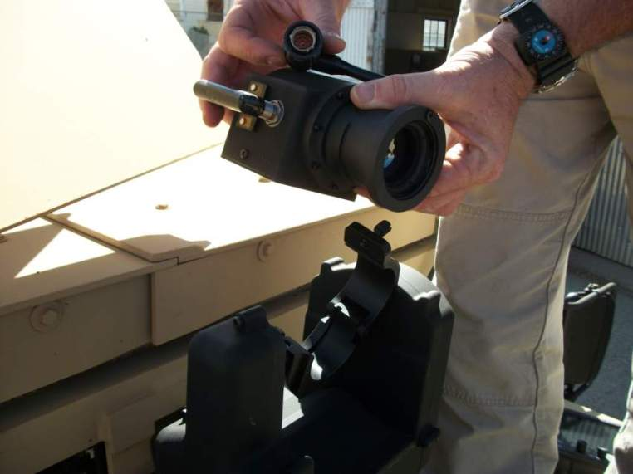
Operate the DVE
Sensor Assembly Installation

Slide 60
Operate the DVE
Sensor Assembly Installation

Slide 61
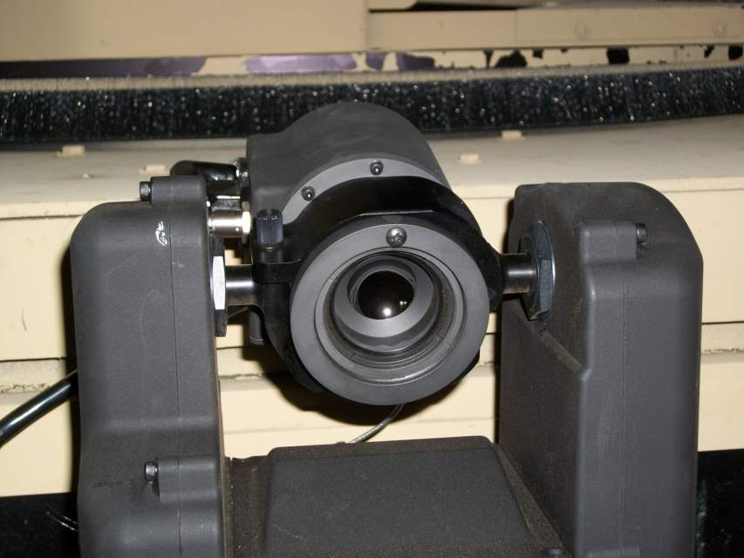
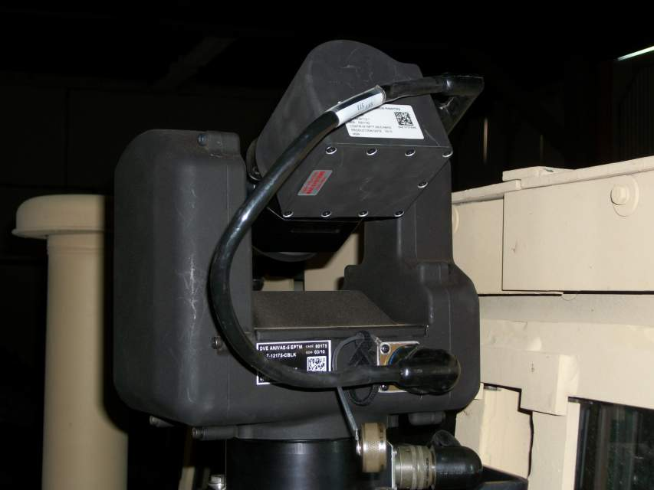
Operate the DVE
Sensor Assembly Installation
Tighten Clamp
Screw Hand-tight

Slide 62
Operate the DVE
Initial Setup Settings
Rotate SA azimuth and elevation to straight ahead and level 0 degree position
Set DVE POWER switch to OFF (down position)
Set VIDEO switch to SENSOR (up position)
Set POL switch to WHT-HOT (up position)
With DISPLAY BRIGHTNESS control turned fully Counterclockwise (CCW), rotate knob approximately ¼ turn Clockwise (CW) 11 0’clock
Set SENSOR LEVEL and SENSOR GAIN controls to fully Counterclockwise (AUTO) detent position

Slide 63
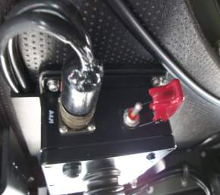

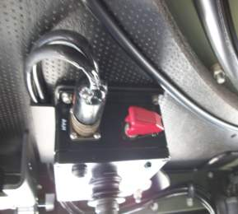
Operate the DVE
Initial Setup Settings
Open Switch Protector
Flip Power Switch to Right
Close Switch Protector
Place the Power Switch on the CM to the ON position. CM sends a signal to the DCM to pick-up the AZ/EL screen settings for viewing

Slide 64
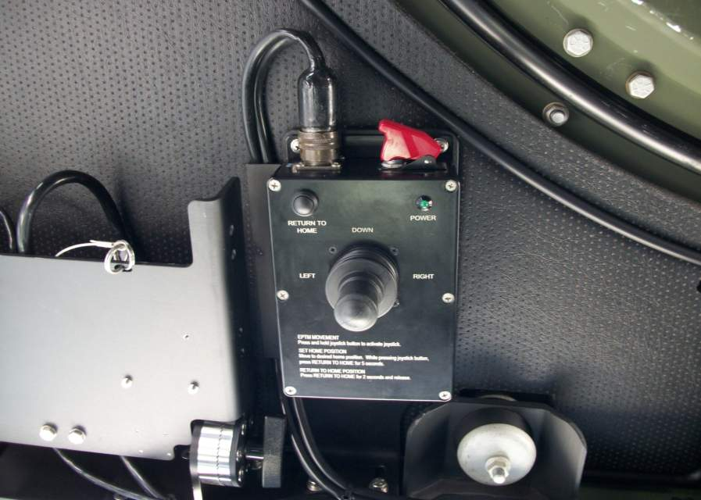
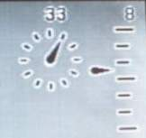
Operate the DVE
Initial Setup Settings
Set POWER to “ON” on the DCM when ready to use
If the Azimuth and Elevation Indicators are not visible on the DCM, power down both systems and repeat process, ensuring CM is powered on prior to powering on DCM
Azimuth and elevation should be displayed in upper right corner of DCM screen when complete
Return to Home
Button
Depress and hold both buttons at same time for 5 seconds to set the desired Home Position for Azimuth and Elevation
LED will flash 3 times when Home Position is set
Joystick Enable Button

Slide 65
Operate the DVE
Shutdown Settings
Set the SA azimuth and elevation to locked azimuth straight ahead position and 0 degree elevation position
Set SENSOR LEVEL and SENSOR GAIN controls to fully Counterclockwise (AUTO) detent position
With DISPLAY BRIGHTNESS control turned fully Counterclockwise, rotate knob approximately ¼ turn Clockwise
Set POL switch to WHT-HOT (up position)
Set VIDEO switch to SENSOR (up position)
Set POWER switch to OFF (down position)

Slide 66

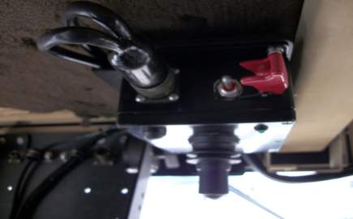

Operate the DVE
Shutdown Settings
1. Open Switch Protector
2. Flip Power Switch to Left
3. Close Switch Protector

Slide 67
Operate the DVE
Shutdown Settings
1
Ensure power is OFF before removing DVE System
      1. DCM
      2. CM
      3. Vehicle
2
3

Slide 68
Operate the DVE
Stow Procedures
Loosen two DCM locking knobs
Push DCM mount to the right
and raise mount
Tighten two DCM locking knobs

Slide 69
Operate the DVE
ELO E
ACTION: | Perform PMCS and troubleshooting procedures on the AN/VAS-5A Driver’s Vision Enhancer (DVE)
CONDITION: |  | Given a DVE, TM 11-5855-311-12&P-2, designated vehicle, DVE
STANDARD: |  | Perform PMCS and troubleshooting procedures on the DVE IAW TM 11-5855-311-12&P-2

Slide 70
Operate the DVE
PMCS Procedures
Operator PMCS
Preventive maintenance checks and services consist of a visual check for physical damage and routine cleaning services. Frequency of this task varies with the operating environment and should not require more than six minutes. The PMCS Table is divided into three main columns
Thoroughly inspect the DVE when it is unstowed and stowed. Inspect for existing damage or conditions that might result in further damage or malfunction. Inspect the unit, as described in Table 2-3 of the operator manual, to ensure a complete examination

Slide 71
Operate the DVE
PMCS Procedures
Corrosion Prevention and Control
(1) Corrosion prevention and control of Army material is a continuing concern. It is important that corrosion problems with this equipment be reported so that the problem can be corrected and improvements made to prevent the problem in future equipment
(2) While corrosion is typically associated with rusting metal, it can also include deterioration of other materials such as rubber and plastic. Unusual cracking, softening, swelling or breaking of these other materials may be a corrosion problem
(3) If a corrosion problem is identified, report it using SF 368, Product Quality Deficiency Report

Slide 72
Operate the DVE
PMCS Procedures
Cleaners and Chemicals
(1) Give cleaners / chemicals special care
(2) Keep cleaners / chemicals in approved safety containers and in minimum quantities
(3) Some cleaners / chemicals may have an adverse effect on the skin, eyes and respiratory tract. Observe manufacturers’ WARNING labels and current safety directives
(4) Use cleaners / chemicals only in authorized areas. Discard soiled clothes into safety containers
(5) Consult the local Bioenvironmental Engineer and/or Material Safety Data Sheets (MSDS) for specific precautions, protective equipment, hazardous material (i.e. Ozone Depleting Substances), components and ventilation requirements

Slide 73
Operate the DVE
PMCS Procedures
Cleaning Exterior Surfaces
The DVE should be cleaned using only approved materials listed in Appendix F of the operator manual. If unit is not kept clean, performance may be degraded, and dust, grease or other foreign matter may hide relatively obvious defects that would be noted in a visual inspection
Mild Liquid Soap
Wiping Cloth
Soft Cloth
Commercially available equivalents; computer monitor wipes, camera lens cleaning kit

Slide 74
Operate the DVE
PMCS Procedures
Cleaning Exterior Surfaces (cont.)
Use a dry, clean, cloth to remove dust, dirt, grease, moisture, or other foreign matter from the exterior surface
If the foreign matter cannot be removed using a dry, clean, cloth then dampen a clean cloth with a solution of mild liquid general purpose detergent mixed in warm water and clean all surfaces. Dry with a clean, dry cloth
Remove fingerprints, oil spots, and dirt by dabbing glass with soft cloth, moistened, not saturated with lens cleaning compound

Slide 75
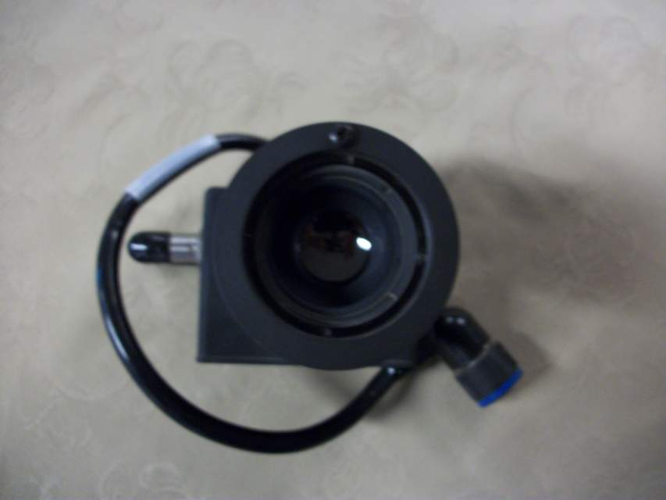
Operate the DVE
PMCS Procedures
Cleaning Optical Surfaces
Start at center of IR lens or DCM screen and wipe toward outside of glass. Keep clean area of cloth against glass surface by turning after each stroke or using a clean cloth after both sides have been used
If the optical surface remains contaminated, use a clean cloth and repeat steps 1 and 2
Normal hand pressure may be used to rub glass when cleaning

Slide 76
Operate the DVE
PMCS Procedures
Cleaning Exterior Surfaces (cont.)
CAUTION
Ensure that cleaning compound remains uncontaminated
DO NOT use excessive hand pressure when rubbing IR lens or DCM screen
DO NOT use ammonia base cleaners
WARNING
DO NOT touch, ingest, or inhale particles of a broken IR lens of the SM. This lens contains Germanium, which is slightly toxic if ingested or inhaled. Glass may be sharp enough to cut personnel if touched
Vacuum or sweep up material and place into a suitable zip-lock bag. Avoid ingestion and inhalation. Dispose of Germanium lenses through your supply channels in accordance with local environmental regulations

Slide 77
Operate the DVE
Operator Troubleshooting
Table 2-4 in the operator manual lists the common malfunctions that may occur. Table 2-4 does not list all the malfunctions that may occur, all the tests and inspections needed to find the fault, or all the corrective actions needed to correct the fault
If the equipment malfunction is not listed or the actions listed does not correct the fault, forward the entire system, to include all items referenced in Appendix C, to higher level of maintenance

Slide 78
Operate the DVE
ELO F
ACTION: Apply wheel indicators
CONDITION: Given a classroom, maintenance bay, DVE, TM 11-5855-311-12&P-2, vehicle
STANDARD: Apply wheel indicators on the AN/VAS-5A DVE IAW the wheel indicator TTP

Slide 79
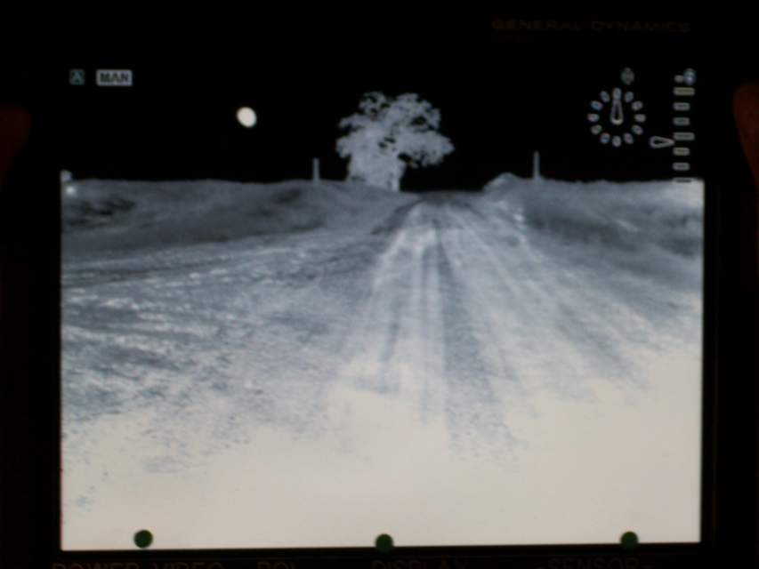
Operate the DVE
Applying Wheel Indicators
Guide Dots
Guide dots indicate the location of the vehicle’s wheels & the center of the vehicle on the DCM.
Outside edge
of left wheel
Center of vehicle
Outside edge
of right wheel

Slide 80
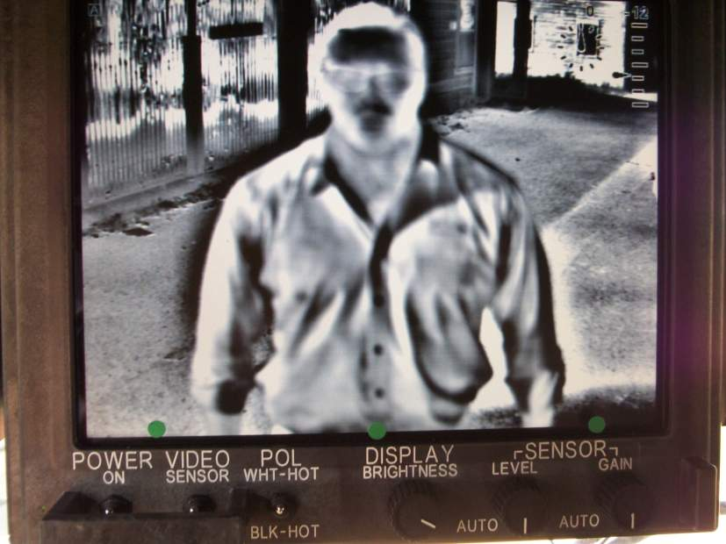
Operate the DVE
Applying Wheel Indicators
Center Dot
Place dot on individual’s
gig-line at the bottom edge of screen
This dot indicates the centerline of your vehicle.

Slide 81


Operate the DVE
Applying Wheel Indicators
Left Wheel Dot
Stand at the very center directly in front of the left wheel, far enough from the vehicle that the driver can see their feet on the DCM.
Slowly walk forward until his feet are just touching the bottom edge of the screen. Place a dot center of feet.
Place a dot in the center of your buddy’s feet. This dot indicates the center line of your left tire.
NOTE: Repeat the same steps for the right side of the vehicle

Slide 82
Operate the DVE
Applying Wheel Indicators
Where the Dots go, your wheels go

Slide 83
Operate the DVE
TLO
ACTION: Operate the AN/VAS-5A DVE
CONDITION: Given a classroom/maintenance bay, DVE, TM 11- 5855-311-12&P-2, vehicle
STANDARD: Operate the AN/VAS-5A IAW TM 11-5855-311-12&P-2

