Slide 1

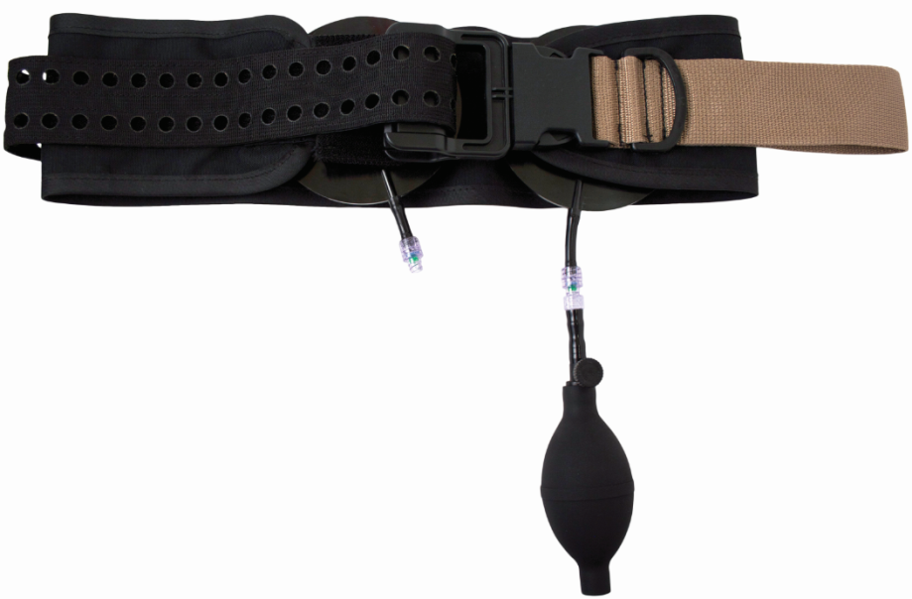
SAM® Junctional Tourniquet (SJT) Training
sammedical.com

Slide 2
Force Multiplication With One Device
Recent studies indicate
  Junctional hemorrhage accounts for up to 20% of preventable deaths in combat. Immediate, effective treatment is necessary for patient survival.*
  24% of patients with traumatic lower limb amputations from IEDs had associated pelvic fractures**
*Death on the battlefield (2001-2011): Implications for the future of combat casualty care. J Trauma Acute Care Surg
Eastridge et al. Volume 73, Number 6, Supplement 5
**British Editorial Society of Bone & Joint Surgery (2010): Lower Limb Traumatic Amputations - The importance of pelvic binding for associated pelvic fractures in blast injury. Cross et.al .J Bone Joint Surg Br 2012 vol. 94-B no. SUPP XXI 4

Slide 3
Training Overview
SJT Key Elements
Components of the SJT
Multiple Indications
  SAM® Junctional Tourniquet Pelvic Stabilization
  SAM® Junctional Tourniquet Control Inguinal Hemorrhage
  SAM® Junctional Tourniquet Control Axilla Hemorrhage
Considerations
Patient Scenarios

Slide 4
SJT Key Elements
Multiple Indications
  Pelvic Immobilization
  Control Inguinal Hemorrhage
  Control Axilla Hemorrhage
< 25 second application time
Lightweight (1 lb., 1 oz.) (488g)
Easy to use, 4 step application
FDA 510(k) cleared and CE marked
Step by step instructions printed directly on the device

Slide 5
Components of the SJT
The SJT is comprised of four basic parts
  Pelvic Belt
  Hand Pump
  (2) Target Compression Devices (TCD)
  Auxiliary Strap Support and TCD Extender

Slide 6
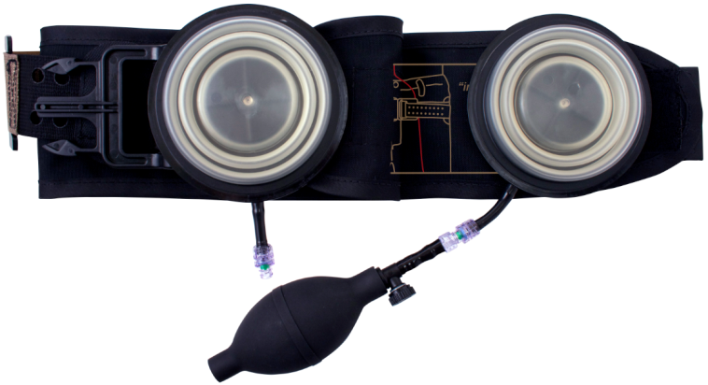
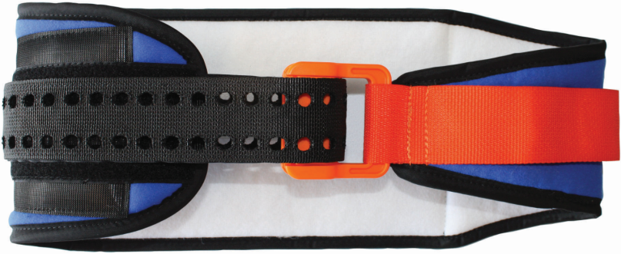
Pelvic Belt
Modified SAM Sling
Clinically proven to provide the prescribed safe and effective force for pelvic stabilization
Patented buckle design maintains correct base force to eliminate slack. “Click” provides clear feedback to confirm when to secure Velcro for correct application.

Slide 7
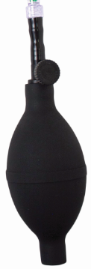
Hand Pump
Removable Hand Pump quickly inflates the Target Compression Device (TCD) to achieve hemorrhage control
Operates much like a blood pressure bulb and is made of PVC

Slide 8
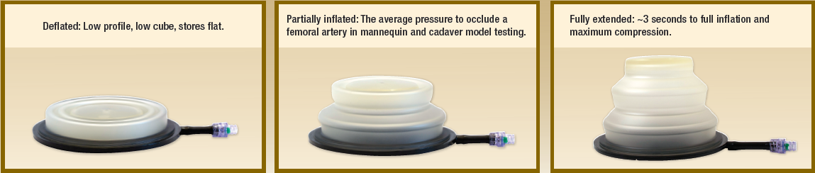
Target Compression Device (TCD)
Pressure Relief Valve (PRV) – 17 PSI
Burst Pressure ~70 PSI
Inflates to 3.2” high
Body of TCD is made of Texin – material also used in protective eyewear, golf ball and whitewater raft protective coating products
Base of TCD is Makrolon polycarbonate material, which is also used in bullet-proof glass and combat helmet products
Body and base are welded, not glued

Slide 9
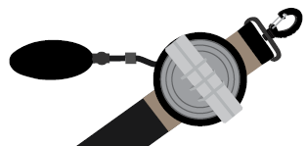
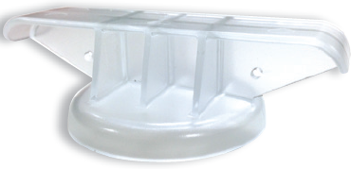
AUXILIARY STRAP SUPPORT & TCD EXTENDER
Auxiliary Strap Support - 35” x 2” adjustable Nylon Strap with d-rings on each end utilized to apply the SJT in a harness-style application
TCD Extender – Attached via lanyard to TDC, used to change the shape of the TCD prior to inflation

Slide 10

Multiple Indications
Pelvic Stabilization
Control Inguinal Hemorrhage
Control Axilla Hemorrhage
sammedical.com

Slide 11
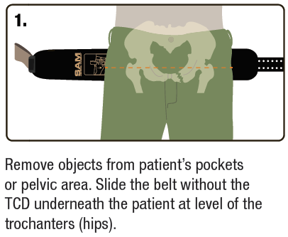
SAM® Junctional Tourniquet Immobilizes Pelvic Fractures

Slide 12
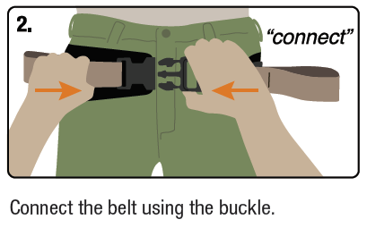
SAM® Junctional Tourniquet Immobilizes Pelvic Fractures

Slide 13
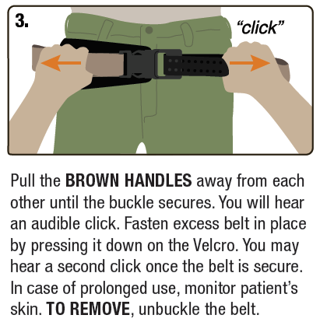
SAM® Junctional Tourniquet Immobilizes Pelvic Fractures

Slide 14
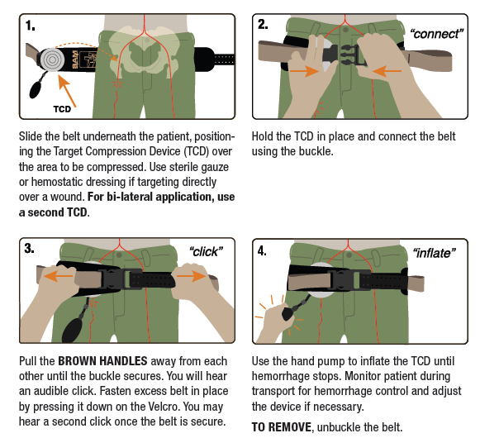
Control Inguinal Hemorrhage in 4 Steps

Slide 15
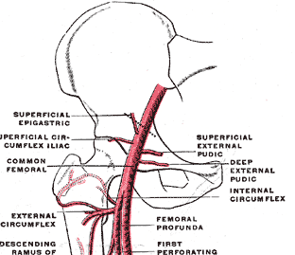
Occlude Femoral Artery

Slide 16
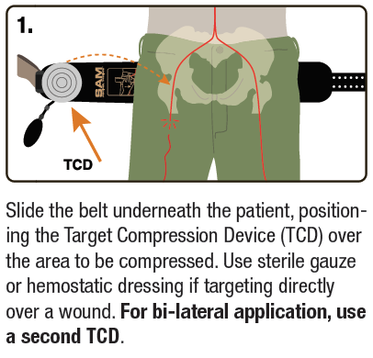
SAM® Junctional Tourniquet Hemorrhage Control
Note: The belt may attach on the left or right of the patient, depending on the location of the injury.

Slide 17
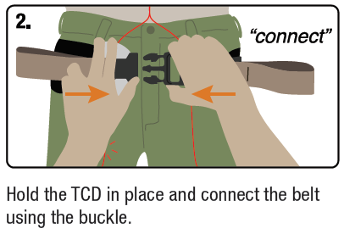
SAM® Junctional Tourniquet Hemorrhage Control

Slide 18
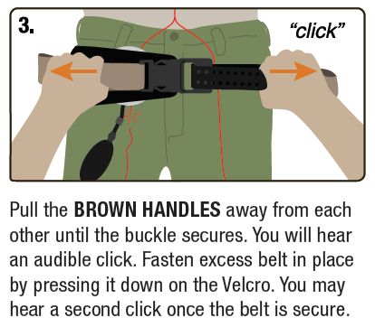
SAM® Junctional Tourniquet Hemorrhage Control

Slide 19
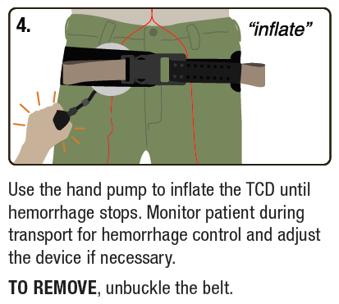
SAM® Junctional Tourniquet Hemorrhage Control

Slide 20
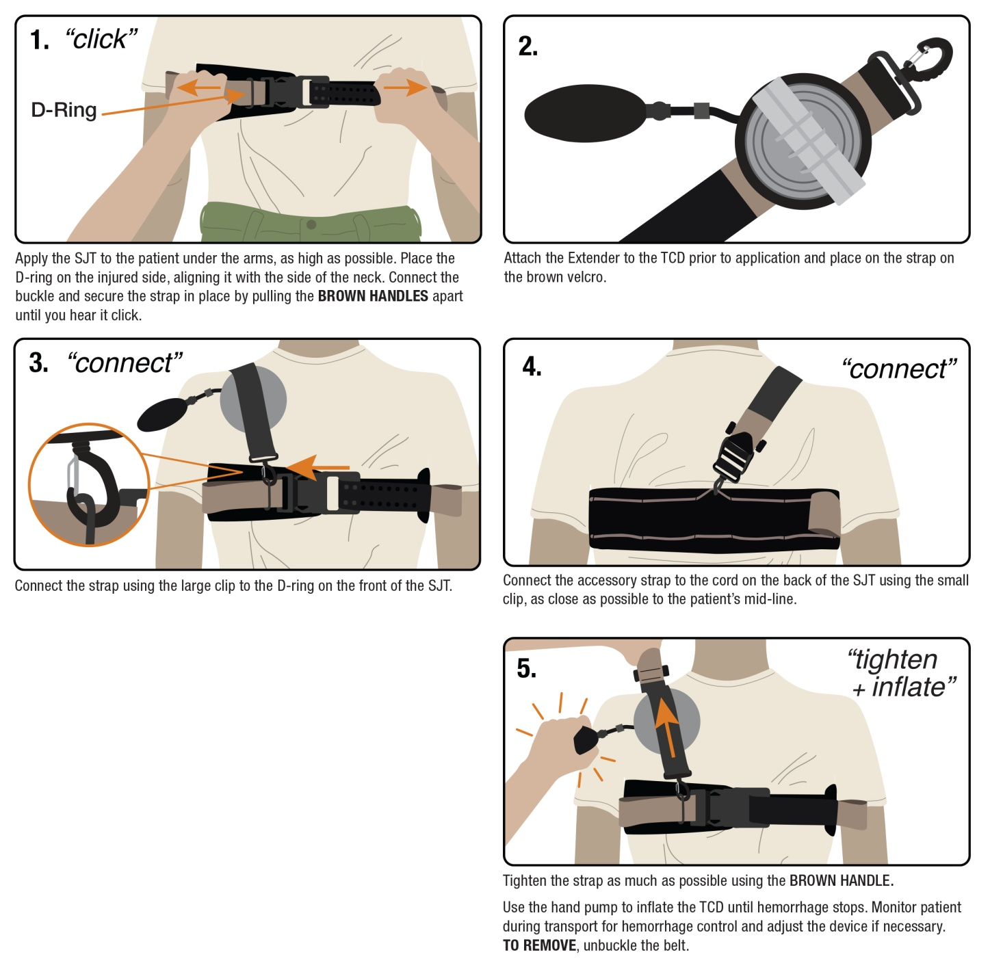
Control Axilla Hemorrhage

Slide 21
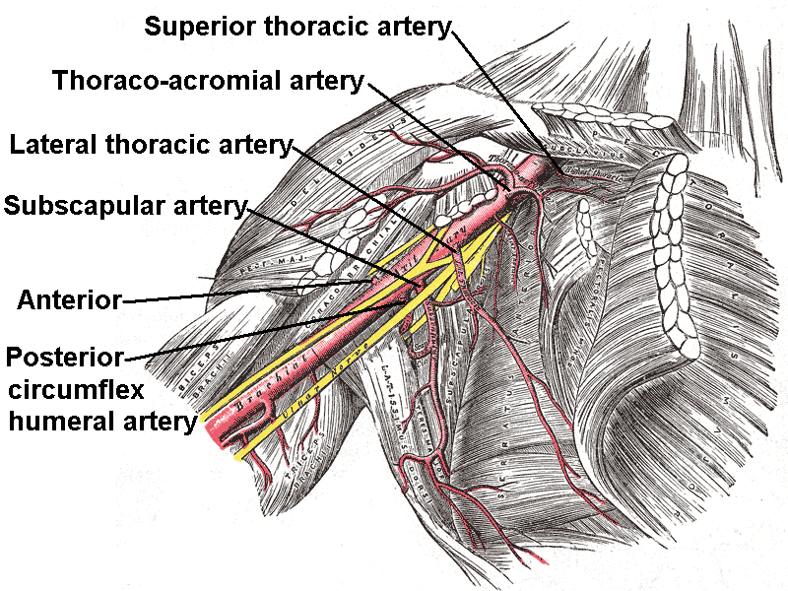
Axilla Artery

Slide 22
SAM® Junctional Tourniquet Axilla Hemorrhage Control
Maintain tension and secure the strap by pressing it down on the Velcro.

Slide 23
SAM® Junctional Tourniquet Axilla Hemorrhage Control
The Extender allows for more direct pressure on the artery.

Slide 24
SAM® Junctional Tourniquet Axilla Hemorrhage Control

Slide 25
SAM® Junctional Tourniquet Axilla Hemorrhage Control

Slide 26
SAM® Junctional Tourniquet Axilla Hemorrhage Control

Slide 27
Considerations
The SAM® Junctional Tourniquet is intended to be left on for up to four hours
Remove only at a Definitive Care Facility
Additional inflation of the TCD may be necessary with changes in altitude

Slide 28
Patient Scenario 1
Patient with SJT on ascends past the cracking pressure of the PRV (17 PSI), then descends.
  5,000ft descent = 15.3 PSI final
  10,000ft descent = 13.4 PSI final
  15,000ft descent = 11.0 PSI final
Average Internal TCD Pressure required to achieve hemostasis in cadaver trials = 3.48 PSI
Conclusion: Descent after TCD reaches its cracking pressure is extremely unlikely to cause rebleed.

Slide 29
Patient Scenario 2
Operator inflates TCD just to the point of hemostasis. A small descent could lead to rebleed.
Partially mitigated by tissue relaxation and compression. This may allow the TCD to “nest” closer to the artery, minimizing the effect of small Extension changes

Slide 30
Questions
sammedical.com

