Slide 1
Commander’s Guide to HARRIS Radio Systems

Slide 2
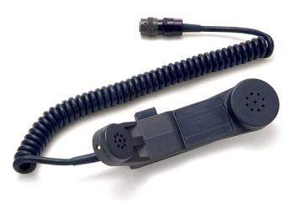
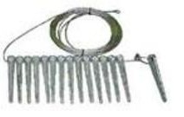

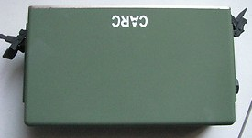
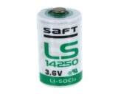
AN/PRC-150A
LIN: R62247
NSN: 5820-01-575-6358
P/N: 10540-0100-01
CL: 7G
Type: HF
Freq: 1.6 – 59.9 MHz
Output: 10 W max
RT-1694D(P)(C)/U
LIN: R45766
NSN: 5820-01-496-3523
P/N: 0N672486-02
CL: 2G QTY: 1 each
Handset, Modified H-250
NSN: 5965-01-463-7915
P/N: 10075-1399
CL: 9G QTY: 1 each
Accessory Kit, Antenna (Manpack Antenna)
NSN: 5985-01-516-0105
P/N: 10372-0240-02
CL: 9G QTY: 1 each
Cable Assembly, Special
(KDU 6' Cable, RT-J4 to KDU)
NSN: 5995-01-461-5300
P/N: 10511-0704-012
CL: 9G QTY: 1 each
Case, Elect Com
(Backpack)
NSN: 5895-01-436-3367
P/N: RF-5930-CA002
CL: 9G QTY: 1 each
Kit, Ground Stake
NSN: 5985-01-423-6221
P/N: 10303-1008-01
CL: 9G QTY: 1 each
Adapter, Ant to Xmit
(RT-J7)
NSN: 5985-01-519-3642
P/N: 10372-1260-01
CL: 9G QTY: 1 each
Battery Box
NSN: 6160-01-468-0685
P/N: 10513-4800-02
CL: 9G QTY: 1 each
Cell, Battery
NSN: 6135-01-525-9943
P/N: LS14250C
CL: 9B
or
Cell, Battery
NSN: 6135-01-435-4921
P/N: LS14250
CL: 9B
----------------------------------
Total of QTY: 1 each

Slide 3


AN/VRC-104(V)5
LIN: R44706
NSN: 5820-01-575-9257
P/N: 10540-0220-12
CL: 7G
Type: HF
Freq: 1.6 – 59.9 MHz
Output: 20 W max
Adapter, Power Supply
NSN: 6130-01-519-6014
P/N: RF-5851-AD001
CL: 9G QTY: 1 each
Loudspeaker-Amplifier
NSN: 5965-01-480-8784
P/N: 10181-5180-01
CL: 9G QTY: 1 each
RT-1694D(P)(C)/U
LIN: R45766
NSN: 5820-01-496-3523
P/N: 0N672486-02
CL: 2G QTY: 1 each
HANDSET, MODIFIED H-250 NSN: 5965-01-463-7915
P/N: 10075-1399
CL: 9G QTY: 1 each
Mounting Base, Elect
NSN: 5975-01-516-7373
P/N: RF-5870-VM001
CL: 9G QTY: 1 each
ANTENNA
NSN: 5985-01-541-8880
P/N: SB-V35FHV
CL: 9G QTY: 1 each
Ant Adapter to Ant Base
(antenna tilt whip adapter)
NSN: 5985-01-519-6245
P/N: RF-1980-AT001
CL: 9G QTY: 1 each
Locking device, Ckt Bkr
(mounting base locking kit)
NSN: 5925-01-516-7365
P/N: RF-5870-VM002
CL: 9G QTY: 1 each

Slide 4
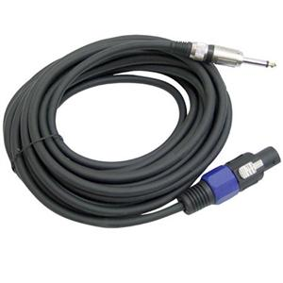
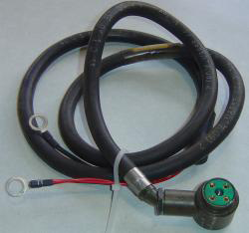
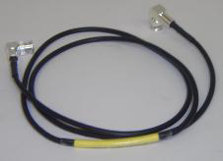
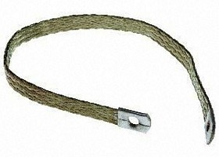
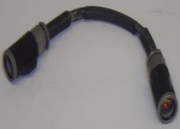
AN/VRC-104(V)5 (continued)
Cable Assembly, Power Elect
(audio, RT-J1 to speaker, 20’)
NSN: 5995-01-514-6066
P/N: 10535-0707-A020
CL: 9G QTY: 1 each
Cable Assy, Pwr Elect
(speaker to 24V DC, 9’)
NSN: 5995-01-514-6575
P/N: 10535-0708-A009
CL: 9G QTY: 1 each
Cable Assembly, RF
(KDU Ext cable, 20’, RT-J4 to KDU)
NSN: 5995-01-551-2593
P/N: 10511-0704-040
CL: 9G QTY: 1 each
Strip, Elect Grounding
NSN: 5999-01-486-1606
P/N: 7147-1167-3
CL: 9G QTY: 1 each
&
Strip, Elect Grounding
NSN: N/A
P/N: 12045-4006-A16
CL: 9G QTY: 1 each
Cable Assembly, Power Elect
(RT Pwr Adptr to 24V DC, 20’)
NSN: 6150-01-549-7444
P/N: 12027-0205-A020
CL: 9G QTY: 1 each
Cable Assembly, Power Elect
(HV cable, RT-J7 to Antenna)
NSN: 5995-01-584-7379
P/N: 10564-3355-A004
CL: 9G QTY: 1 each

Slide 5
AN/VRC-104(V)6
LIN: R87139
NSN: 5820-01-575-9305
P/N: 10540-0720-12
CL: 7G
Type: HF
Freq: 1.6 – 59.9 MHz
Output: 150 W max
HANDSET, MODIFIED H-250 NSN: 5965-01-463-7915
P/N: 10075-1399
CL: 9G QTY: 1 each
AMPLIFIER, RF
(150 Watt, no low pass
filter, no Internal RF-5245)
NSN: 5996-01-519-7548
P/N: RF-5833H-PA001
CL: 9G QTY: 1 each
&
FILTER, LOW PASS
NSN: 5915-01-437-0950
P/N: 10497-0350-01
CL: 9G QTY: 1 each
OR
Adapter, Power Supply
NSN: 6130-01-519-6014
P/N: RF-5851-AD001
CL: 9G QTY: 1 each
RT-1694D(P)(C)/U
LIN: R45766
NSN: 5820-01-496-3523
P/N: 0N672486-02
CL: 2G QTY: 1 each
LOUDSPEAKER-AMP
NSN: 5965-01-480-8784
P/N: 10181-5180-01
CL: 9G QTY: 1 each
COUPLER, ANTENNA
NSN: 5985-01-459-5388
P/N: RF-382A-15
CL: 9G QTY: 1 each
ANTENNA
NSN: 5985-01-541-8880
P/N: SB-V35FHV
CL: 9G QTY: 1 each
Ant Adapter to Ant Base
(antenna tilt whip adapter)
NSN: 5985-01-519-6245
P/N: RF-1980-AT001
CL: 9G QTY: 1 each
Mounting Base, Elect (PA)
NSN: 5975-01-429-4953
P/N: 10497-0200-01
or RF-5073VM
CL: 9G QTY: 1 each
OR
Mounting Base, Elect (PA)
NSN: 5975-01-517-1766
P/N: RF-5073VSM
CL: 9G QTY: 1 each
SHOCK, MOUNT: (coupler)
NSN: 5340-01-480-6930
P/N: RF-384VM-03
CL: 9T QTY: 1 each

Slide 6
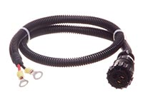


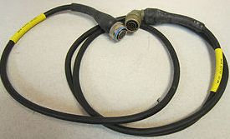

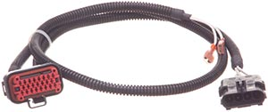
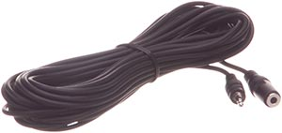
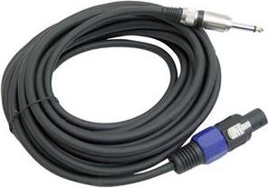
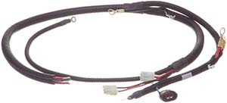
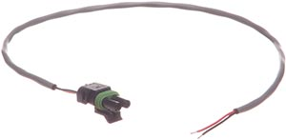

AN/VRC-104(V)6 (continued)
LOCKING DEVICE: (PA-RT locking device)
NSN: 5340-01-518-3753
P/N: 10497-0870-01
CL: 9T QTY: 1 each
CABLE ASSY, POWER, ELECT: (audio cable, 20’, RT-J1 to speaker)
NSN: 5995-01-514-6066
P/N: 10535-0707-A020
CL: 9G QTY: 1 each
CABLE ASSY, SPEC PURPOSE, ELECT: (RF cable, 20', CPLR-J1 to LPF)
NSN: 5995-01-460-5697
P/N: 10181-9824-020
CL: QTY: 1 each
Cable Assy, RF
(KDU Ext cable, 20’,
RT-J4 to KDU)
NSN: 5995-01-551-2593
P/N: 10511-0704-040
CL: 9G QTY: 1 each
CABLE ASSY, SPEC PURPOSE, ELECT:
(RT-J1 to PA-J6)
NSN: 5995-01-468-0688
P/N: 10497-5036-01
CL: 9G QTY: 1 each
CABLE ASSY, RF:
(RF cable,RT-J7 to PA-J1) NSN: 5995-01-526-0202
P/N: 10497-5020-A08
CL: 9G QTY: 1 each
CABLE ASSY, POWER, ELEC: (PA-J3 to Spkr)
NSN: 5995-01-514-6626
P/N: 10535-0713-A020
CL: 9G QTY: 1 each
DC POWER SWITCH ASSEMBLY, 150W
NSN: N/A
P/N: 11080-3970-01
CL: QTY: 1 each
Strip, Elect Grounding
NSN: 5999-01-486-1606
P/N: 7147-1167-3
CL: 9G QTY: 1 each
&
Strip, Elect Grounding
NSN: N/A
P/N: 12045-4006-A16
CL: 9G QTY: 1 each
CABLE ASSY, RF
(RF cable, LPF to PA-J11)
NSN: 5995-01-467-8115
P/N: 10497-0363-01
CL: 9G QTY: 1 each
CABLE: (PA control cable, 18”, RT-J6 to PA-J2)
NSN: 5995-01-470-2728
P/N: 10535-0720-B17
CL: 9G QTY: 1 each
CABLE ASSY, SPEC PURPOSE, ELECT: (DC Pwr Cable, PA J-10 to Pwr Source)
NSN: 5995-01-370-5985
P/N: 10181-9826-020
CL: 9G QTY: 1 each
CABLE ASSY, SPECIAL PURPOSE, ELECT: (coupler control cable, 20’, PA-J9 to CPLR-J2)
NSN: 5995-01-561-1764
P/N: 10181-9823-020
CL: 9G QTY: 1 each

Slide 7
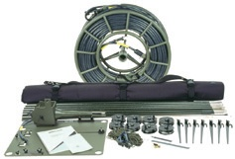
AN/TRC-209B
LIN: R44956
NSN: 5820-01-575-9287
P/N: 10540-0810-12
CL: 7G
Type: HF
Freq: 1.6 – 59.9 MHz
Output: 150 W max
Amplifier, RF, 150 watt
W/O low pass filter or Internal RF-5245)
NSN: 5996-01-519-7548
P/N: RF-5833H-PA001
CL: 9G QTY: 1 each
&
FILTER, LOW PASS
NSN: 5915-01-437-0950
P/N: 10497-0350-01
CL: QTY: 1 each
OR
Amplifier, RF, 150 Watt
W/ low pass filter & Internal RF-5245)
NSN: 5996-01-542-7912
P/N: RF-5833H-PA004
CL: 9G QTY: 1 each
HANDSET, MODIFIED H-250 NSN: 5965-01-463-7915
P/N: 10075-1399
CL: 9G QTY: 1 each
LOUDSPEAKER-AMPLIFIER
NSN: 5965-01-480-8784
P/N: 10181-5180-01
CL: 9G QTY: 1 each
COUPLER, ANTENNA
NSN: 5985-01-459-5388
P/N: RF-382A-15
CL: 9G QTY: 1 each
RT-1694D(P)(C)/U
LIN: R45766
NSN: 5820-01-496-3523
P/N: 0N672486-02
CL: 2G QTY: 1 each
POWER SUPPLY
NSN: 6130-01-411-9306
P/N: RF-5051-PS001
CL: 9G QTY: 1 each
Reel, Cable
NSN: 8130-01-295-4369
P/N: RC-435/U
CL: 9G QTY: 1 each
ANTENNA
NSN: 5985-01-516-2662
P/N: RF-1912T-AT002
CL: 9G QTY: 1 each
ACCESSORY KIT, ANTENNA: (RF-1937 Antenna)
NSN: 5985-01-549-7635
P/N: 10251-0030
CL: QTY: 1 each
LOCKING DEVICE: (PA-RT locking device)
NSN: 5340-01-518-3753
P/N: 10497-0870-01
CL: 9T QTY: 1 each

Slide 8
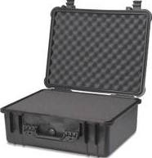
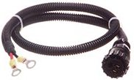


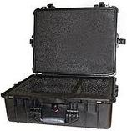

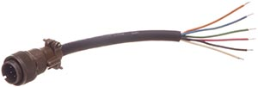
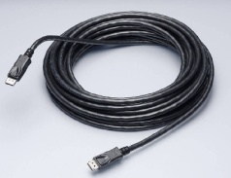
AN/TRC-209B (continued)
Shipping & Storage Container, Electrical
(RT/PA Transit Case)
NSN: 8145-01-551-2758
P/N: 11040-1200-01
CL: 9B QTY: 1 each
Cable Assy,
Spec Purpose, 9’
(PA J-17 to AC Pwr)
NSN: 6150-01-451-1909
P/N: 10181-9831-009
CL: 9G QTY: 1 each
Cable Assy, RF
(LPF to PA-J11)
NSN: 5995-01-467-8115
P/N: 10497-0363-01
CL: 9G QTY: 1 each
Cable Assy, RF
(RF cable,RT-J7 to PA-J1) NSN: 5995-01-526-0202
P/N: 10497-5020-A08
CL: 9G QTY: 1 each
Cable Assy, Special Purpose
(RT-J1 to PA-J6)
NSN: 5995-01-468-0688
P/N: 10497-5036-01
CL: 9G QTY: 1 each
Case, Antenna Coupler
NSN: 5985-01-527-3604
P/N: 10400-0561-14
CL: 9G QTY: 1 each
CASE ASSY (Power Supply Transit Case)
NSN: 5820-01-463-7925
P/N: 10400-0561-02
CL: 9G QTY: 1 each
Cable Assy, Power
PA-J16 to Speaker)
NSN: 6150-01-500-9208
P/N: 10535-0706-A009
CL: 9G QTY: 1 each
CABLE: (PA control cable, RT-J6 to PA-J2)
NSN: 5995-01-470-2728
P/N: 10535-0720-B17
CL: 9G QTY: 1 each
NSN: 5999-01-486-1606
P/N: 7147-1167-3
CL: 9G QTY: 1 each
&
NSN: N/A
P/N: 12045-4006-A16
CL: QTY: 1 each
Cable Assy, Power
PA-J15 to PA-J10, 4’
NSN: 5995-01-444-8049
P/N: 10181-9833-004
CL: 9G QTY: 1 each
Cable Assy, Special Purpose
PA-J7 to speaker, 9’
NSN: 6150-01-500-9194
P/N: 10535-0707-A009
CL: 9G QTY: 1 each
Cable Assy
150' PA-J9 to CPLR-J2)
NSN: 5995-01-369-5985
P/N: 10181-9823-150
CL: 9G QTY: 1 each
Cable Assy
150', PA-J2 to CPLR J1 NSN: 5995-01-369-5987
P/N: 10181-9824-150
CL: 9G QTY: 1 each

Slide 9
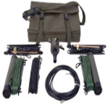
AN/TRC-210B(V)3
LIN: R21064
NSN: 5820-01-575-9263
P/N: 10540-0410-12
CL: 7G
Type: HF
Freq: 1.6 – 59.9 MHz
Output: 400 W max
HANDSET, MODIFIED H-250 NSN: 5965-01-463-7915
P/N: 10075-1399
CL: 9G QTY: 1 each
LOUDSPEAKER-AMPLIFIER
NSN: 5965-01-480-8784
P/N: 10181-5180-01
CL: 9G QTY: 1 each
COUPLER, ANTENNA
NSN: 5985-01-459-5388
P/N: RF-382A-15
CL: 9G QTY: 1 each
CONTROL, FREQUENCY SELECTOR
NSN: 5895-01-540-5816
P/N: RF-5845H-PP101
CL: 9G QTY: 1 each
RT-1694D(P)(C)/U
LIN: R45766
NSN: 5820-01-496-3523
P/N: 0N672486-02
CL: 2G QTY: 1 each
ANTENNA
NSN: 5985-01-564-4607
P/N: RF-1944-AT400
CL: 9G QTY: 1 each
POWER SUPPLY
NSN: 6130-01-411-9306
P/N: RF-5051-PS001
CL: 9G QTY: 1 each
Reel, Cable
NSN: 8130-01-295-4369
P/N: RC-435/U
CL: 9G QTY: 1 each
ANTENNA
NSN: 5985-01-516-2662
P/N: RF-1912T-AT002
CL: 9G QTY: 1 each
AMPLIFIER, RADIO FREQUENCY
NSN: 5996-01-501-2519
P/N: RF-5834H-PA001
CL: 9G QTY: 1 each
ACCESSORY KIT, ANTENNA: (RF-1937 Antenna)
NSN: 5985-01-549-7635
P/N: 10251-0030
CL: 9G QTY: 1 each

Slide 10
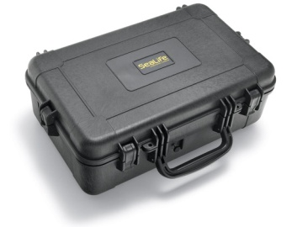
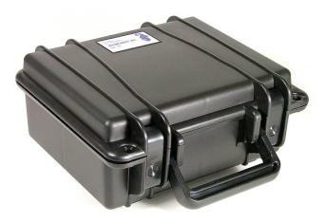
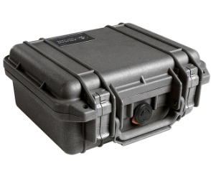
AN/TRC-210B(V)3 (continued)
CASE, ELECTRONIC COMMUNICATIONS EQUIPMENT: (T-Case Assy, Receiver-Transmitter)
NSN: 5895-01-527-3602
P/N: 11040-1100-01
CL: 9G QTY: 1 each
CASE, ELECTRONIC COMMUNICATIONS EQUIPMENT: (RT-J6 to Pre/Post-J6)
NSN: 5995-01-558-6134
P/N: 10535-0720-C006
CL: QTY: 1 each
CASE, ELECTRONIC COMMUNICATIONS EQUIPMENT: (T-Case Assy, 400W PA)
NSN: 5895-01-527-3603
P/N: 10400-0561-17
CL: QTY: 1 each
FILTER, LOW PASS
NSN: 5915-01-584-1028
P/N: 10564-1720-05
CL: 9G QTY: 1 each
CASE, ELECTRONIC COMMUNICATIONS EQUIPMENT: (T-Case Assy, Pre/Post Selector)
NSN: N/A
P/N: 10564-3340-01
CL: QTY: 1 each
CASE, ELECTRONIC COMMUNICATIONS EQUIPMENT: (T-Case Assy, Dual Power Supply)
NSN: 6130-01-527-3601
P/N: 10400-0561-16
CL: QTY: 1 each
CASE, ANTENNA COUPLER
NSN: 5985-01-527-3604
P/N: 10400-0561-14
CL: 9G QTY: 1 each

Slide 11
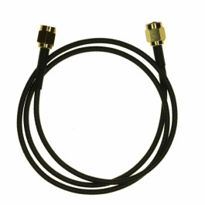
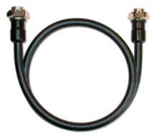
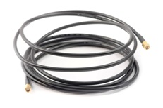
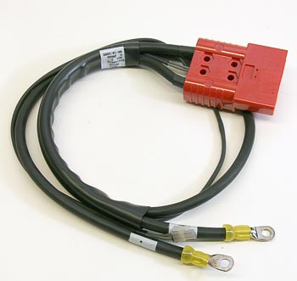
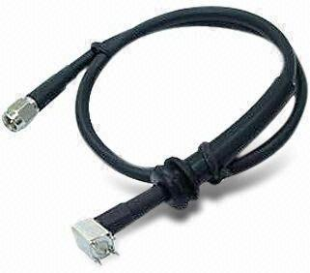
AN/TRC-210B(V)3 (continued)
Cable Assy, RF:
J3 to PA-J11, 6’
NSN: 5995-01-527-2575
P/N: 10394-9050-006
CL: 9G QTY: 1 each
Cable Assy, RF
RT-J7 to PRE/POST-J5, 6’
NSN: 5995-01-558-8445
P/N: 10394-9020-006
CL: QTY: 1 each
Cable Assy, Power
RT-J1 to speaker)
NSN: 5995-01-530-5531
P/N: 10535-0707-A002
CL: 9G QTY: 1 each
Cable Assy, Power
Speaker to PS-J16)
NSN: 6150-01-530-5529
P/N: 10535-0706-A008
CL: 9G QTY: 1 each
Cable Assy, Spec Purpose
PA-J10 to PS-J15
NSN: 6150-01-451-1908
P/N: 10181-9834-004
CL: 9G QTY: 1 each
Cable Assy, RF
J4 to PA-J12)
NSN: 5995-01-527-2577
P/N: 10394-9021-006
CL: QTY: 1 each
Cable Assy
150', PA-J2 to CPLR J1 NSN: 5995-01-369-5987
P/N: 10181-9824-150
CL: 9G QTY: 1 each
Cable Assy, Special Purpose
PA J-17 to AC Pwr
NSN: 6150-01-451-1909
P/N: 10181-9831-009
CL: 9G QTY: 1 each
Cable Assy, Special Purpose
PA-J15 to PS-J16
NSN: 6150-01-451-1906
P/N: 10181-9836-002
CL: 9G QTY: 1 each
Cable Assy
150' PA-J9 to CPLR-J2)
NSN: 5995-01-369-5985
P/N: 10181-9823-150
CL: 9G QTY: 1 each
Cable Assy, RF
J7 to PA-J8
NSN: 5995-01-528-7559
P/N: 10394-9011-006
CL: QTY: 1 each

Slide 12
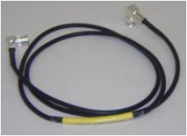
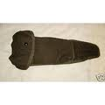
AN/PRC-117F(V)2
Type: SATCOM
Freq Ranges
VHF: 30-224.9 MHz
UHF: 225-512 MHz
Output: 20 W max
LIN: R87207
NSN: 5820-01-580-2575
P/N: RF-5800M-MP110
CL: 7G
RT-1796(P)(C)/PRC
LIN: FA204K (non-std)
NSN: 5820-01-521-0291
P/N: 10513-1000-07
CL: 2G QTY: 1 each
HANDSET, MODIFIED H-250 NSN: 5965-01-463-7915
P/N: 10075-1399
CL: 9G QTY: 1 each
ANTENNA, FLEX, V/UHF
NSN: 5985-01-424-6403
P/N: 10369-0205
CL: 9G QTY: 1 each
CABLE ASSY, SYNCHRONOUS/
ASYNCHRONOUS
NSN: 6150-01-513-1361
P/N: 10513-0730-A2
CL: 9G QTY: 1 each
Cable Assembly, Special
(KDU 6' Cable, RT-J4 to KDU)
NSN: 5995-01-461-5300
P/N: 10511-0704-012
CL: 9G QTY: 1 each
MANPACK BLADE ANTENNA NSN: 5985-01-516-8345
P/N: 10512-0201-01
CL: 9G QTY: 1 each
SATCOM Antenna
NSN: 5985-01-485-4672
P/N: RF3080-AT001 or 10513-0200-01
CL: 9G QTY: 1 each
BAG, ANTENNA
NSN: 5895-01-425-0306
P/N: CW-503/PRC-25
CL: 9G QTY: 1 each
HPW Data Cable
NSN: 6150-01-513-1365
P/N: 10513-0710-A006
CL: 9G QTY: 1 each
CABLE ASSY, REMOTE/PROGRAMMING
NSN: 6150-01-513-1353
P/N: 10513-0740-A006
CL: 9G QTY: 1 each
BATTERY BOX
NSN: 6160-01-468-0685
P/N: 10513-4800-02
CL: 9G QTY: 1 each

Slide 13
AN/VRC-103
Type: SATCOM
Freq Ranges
VHF: 30-224.9 MHz
UHF: 225-512 MHz
Output: 50 W max
LIN: R29704
NSN: 5820-01-579-0420
P/N: RF-5800M-V330
CL: 7G
RT-1796(P)(C)/PRC
LIN: FA204K (non-std)
NSN: 5820-01-521-0291
P/N: 10513-1000-07
CL: 2G QTY: 1 each
HANDSET, MODIFIED H-250 NSN: 5965-01-463-7915
P/N: 10075-1399
CL: 9G QTY: 1 each
ANTENNA, FLEX, V/UHF
NSN: 5985-01-424-6403
P/N: 10369-0205
CL: 9G QTY: 1 each
SPEAKER
NSN: 5965-01-480-8784
P/N: RF-5980-SA001 or 10181-5180-01
CL: 9G QTY: 1 each
Cable Assembly, Special
(KDU 6' Cable, RT-J4 to KDU)
NSN: 5995-01-461-5300
P/N: 10511-0704-012
CL: 9G QTY: 1 each
MANPACK BLADE
ANTENNA
NSN: 5985-01-516-8345
P/N: 10512-0201-01
CL: 9G QTY: 1 each
SATCOM Antenna
NSN: 5985-01-485-4672
P/N: RF3080-AT001 or 10513-0200-01
CL: 9G QTY: 1 each
BAG, ANTENNA
NSN: 5895-01-425-0306
P/N: CW-503/PRC-25
CL: 9G QTY: 1 each
KDU Gimbal Mount
NSN: 5895-01-564-5078
P/N: RF-5940-MT001
CL: 9G QTY: 1 each
Multi-band whip antenna
NSN: 5985-01-534-7171
P/N: RF-390-AT003
CL: 9O QTY: 1 each

Slide 14


AN/VRC-103 (continued)
MOUNTING KIT, HMMWV ANT
NSN: 5985-01-541-8860
P/N: 10181-5178-06
CL: 9G QTY: 1 each
FOLDABLE X-WING YAGI SATCOM ANTENNA
NSN: 5985-01-534-5958
P/N: 12006-9001-01
CL: 9G QTY: 1 each
POWER AMPLIFIER ASSLY, Incl Shock Mount & 2 RF Cables
NSN: 5996-01-570-2796
P/N: AM-7588
CL: 9G QTY: 1 each
DC SWITCH ASSY, Incl. Mounting hardware
NSN: 5930-01-584-1859
P/N: 11080-3980-01
CL: 9G QTY: 1 each
BATTERY BOX
NSN: 6160-01-468-0685
P/N: 10513-4800-02
CL: 9G QTY: 1 each
CABLE ASSY, SYNCHRONOUS/
ASYNCHRONOUS
NSN: 6150-01-513-1361
P/N: 10513-0730-A2
CL: 9G QTY: 1 each
CABLE ASSY, REMOTE/PROGRAMMING
NSN: 6150-01-513-1353
P/N: 10513-0740-A006
CL: 9G QTY: 1 each
HPW Data Cable
NSN: 66150-01-513-1365
P/N: 10513-0710-A006
CL: 9G QTY: 1 each
DC Power Cable, Install Kit, PA-J1 to Veh DC Power Source
NSN: 6150-01-515-0155
P/N: 10570-0720-01
CL: 9G QTY: 1 each
Speaker Audio Cable, RT-J1 to Speaker
NSN: 5995-01-514-6066
P/N: 10535-0707-A020
CL: 9G QTY: 1 each
RF CABLE TO SOTM ANTENNA
NSN: 5995-01-418-5820
P/N: 10369-7211-25
CL: 9G QTY: 1 each
Speaker Power Cable, Speaker to Veh. DC power source
NSN: 6150-01-584-3206
P/N: 10535-0706-A020
CL: 9G QTY: 1 each
Cable, KDU Extension, 20-foot
NSN: 5995-01-551-2593
P/N: 10511-0704-040
CL: 9G QTY: 1 each

Slide 15

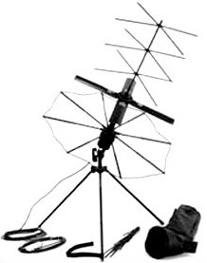

AN/TRC-223
LIN: R29636
NSN: 5820-01-579-0476
P/N: RF-5800M-V331
CL: 7G
Type: UHF SATCOM
Output: xx watts
RT-1796(P)(C)/PRC
LIN: FA204K (non-std)
NSN: 5820-01-521-0291
P/N: 10513-1000-07
CL: 2G QTY: 1 each
HANDSET, MODIFIED H-250 NSN: 5965-01-463-7915
P/N: 10075-1399
CL: 9G QTY: 1 each
Antenna, Dual band
NSN: 5985-01-424-6403
P/N: 10369-0205
CL: 9G QTY: 1 each
Power Supply Shock Mount
NSN: 5975-01-515-8365
P/N: RF-5071VSM-03
CL: 9G QTY: 1 each
Cable Assembly, Special
(KDU 6' Cable, RT-J4 to KDU)
NSN: 5995-01-461-5300
P/N: 10511-0704-012
CL: 9G QTY: 1 each
Man Pack Antenna
NSN: 5985-01-516-8345
P/N: 10512-0201-01
CL: 9G QTY: 1 each
BAG, ANTENNA
NSN: 5895-01-425-0306
P/N: CW-503/PRC-25
CL: 9G QTY: 1 each
POWER AMPLIFIER ASSLY, Incl Shock Mount & 2 RF Cables
NSN: 5996-01-570-2796
P/N: AM-7588
CL: 9G QTY: 1 each
Multi-band whip antenna
NSN: 5985-01-534-7171
P/N: RF-390-AT003
CL: 9O QTY: 1 each
SATCOM Antenna
NSN: 5985-01-485-4672
P/N: RF3080-AT001 or 10513-0200-01
CL: 9G QTY: 1 each

Slide 16
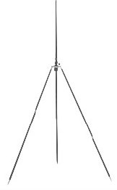
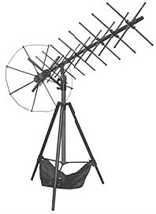
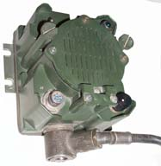
AN/TRC-223 (continued)
Power Supply
NSN: 6130-01-411-9306
P/N: RF-5051-PS001 or RF-5051PS-125 or RF5051PS-125C
CL: 9G QTY: 1 each
Antenna Mount
NSN: 5985-01-418-5247
P/N: RF-292
CL: 9G QTY: 1 each
High Gain Antenna, FOLDABLE X-YAGI SATCOM ANTENNA NSN: 5985-01-548-3086
P/N: 12006-9000-01
CL: 9G QTY: 1 each
RF-392-AT001 Tripod Mount
NSN: 5985-01-548-1379
P/N: 12006-1010-01
CL: 9G QTY: 1 each
Loudspeaker
NSN: 5965-01-583-7392
P/N: 10570-3512-01
CL: 9G QTY: 1 each
Transit Case
NSN: 8145-01-583-8317
P/N: 10400-0562-01
CL: 9G QTY: 1 each
Battery Box
NSN: 6160-01-468-0685
P/N: 10513-4800-02
CL: 9G QTY: 1 each

Slide 17

AN/TRC-223 (continued)
Cable Assy, Remote/Programming
NSN: 6150-01-513-1353
P/N: 10513-0740-A006
CL: 9G QTY: 1 each
HPW Data Cable
NSN: 66150-01-513-1365
P/N: 10513-0710-A006
CL: 9G QTY: 1 each
Speaker Audio Cable 6 ft NSN: 6150-01-570-2798
P/N: 10570-3573-A006
CL: 9G QTY: 1 each
Speaker Power Cable 6 ft NSN: 6150-01-583-6792
P/N: 10570-3574-A006
CL: 9G QTY: 1 each
Cable Assy, Synch/Asynch
NSN: 6150-01-513-1361
P/N: 10513-0730-A2
CL: 9G QTY: 1 each
RF Cable 75'
NSN: 6145-01-584-1697
P/N: 10369-7211-075
CL: 9G QTY: 1 each
DC Power Cable
PA to Power Supply
NSN: 5995-01-514-6654
P/N: 10570-0716 or 10570-0716-A006
CL: 9G QTY: 1 each
RF Cable, BNC - RG400 - N(F)
NSN: 5995-01-583-7289
P/N: 11080-3918-A050
CL: 9G QTY: 1 each

Slide 18
AN/PRC-117G(V)4
LIN: R45846
NSN: 5820-01-579-0452
P/N: RF-7800M-MP110
CL: 7G
Type: UHF SATCOM
Output: xx watts
RT-1949B(P)(C)/PRC
LIN: FA2050 (non-std)
NSN: 5820-01-554-8564
P/N: ON707070-1 or ON707070-7
CL: 2G QTY: 1 each
or
RT-1949C(P)(C)/PRC
LIN: FA2050 (non-std)
NSN: 5820-01-585-2735
P/N: ON707070-9
CL: 2G QTY: 1 each
HANDSET, MODIFIED H-250 NSN: 5965-01-463-7915
P/N: 10075-1399
CL: 9G QTY: 1 each
ANTENNA, L1/L2 ACTIVE GPS, SOLDIER
NSN: 5985-01-584-1742
P/N: RF-3070-AT242
CL: 9G QTY: 1 each
Cable Assembly, Special
(KDU 6' Cable, RT-J4 to KDU)
NSN: 5995-01-461-5300
P/N: 10511-0704-012
CL: 9G QTY: 1 each
ANTENNA, 225MHZ - 450MHZ, MANPACK
NSN: 5985-01-583-9196
P/N: RF-3164-AT122
CL: 9G QTY: 1 each
OR
ANTENNA, UHF and L-Band Dismount Antenna (225MHz to 2000HHz) NSN: 5985-01-583-9196
P/N: RF-3164-AT122
CL: 9G QTY: 1 each
ANTENNA, VHF, 30MHZ - 108MHZ, MANPACK
NSN: 5985-01-583-9197
P/N: RF-3150-AT152
CL: 9G QTY: 1 each
ANTENNA, MANPACK, 30MHZ-512MHZ, MULTIBAND
NSN: 5985-01-584-3770
P/N: RF-3152-AT152
CL: 9G QTY: 1 each
BAG, ANTENNA, GREEN
NSN: 5985-01-583-7410
P/N: 10372-0349-01
CL: 9G QTY: 1 each
SATCOM Antenna
NSN: 5985-01-485-4672
P/N: RF3080-AT001 or 10513-0200-01
CL: 9G QTY: 1 each
BATTERY BOX
NSN: 6160-01-583-8140
P/N: 12043-4800-01
CL: 9G QTY: 1 each
HPW Data Cable
NSN: 6150-01-513-1365
P/N: 10513-0710-A006
CL: 9G QTY: 1 each

Slide 19
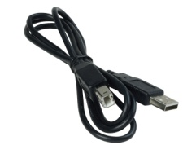
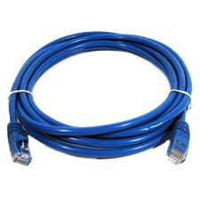
AN/PRC-117G(V)4 (continued)
BATTERY BOX
NSN: 6160-01-583-8140
P/N: 12043-4800-01
CL: 9G QTY: 1 each
CABLE ASSY, J3, (PPP, HPW, and VULOS SA)
NSN: 5995-01-577-8908
P/N: 12043-2710-A006
CL: 9G QTY: 1 each
CABLE ASSY, J3, DATA/REMOTE 'Y'
NSN: 5995-01-577-8916
P/N: 12043-2730-A006
CL: QTY: 1 each
CABLE ASSY, (USB) Programming
NSN: 5995-01-583-5717
P/N: 12043-2750-A006
CL: 9G QTY: 1 each
CABLE ASSY, J3, ETHERNET
NSN: 5995-01-577-8915
P/N: 12043-2760-A006
CL: 9G QTY: 1 each

Slide 20

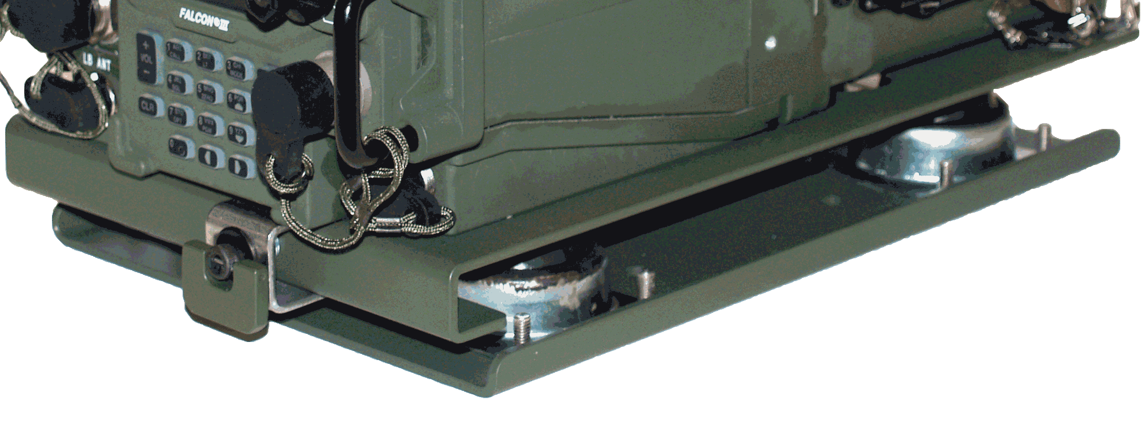
AN/VRC-114(V)3
LIN: R87716
NSN: 5820-01-579-0432
P/N: RF-300M-V210
CL: 7G
Type: UHF SATCOM
Output: 50 watts
RT-1949B(P)(C)/PRC
LIN: FA2050 (non-std)
NSN: 5820-01-554-8564
P/N: ON707070-1 or ON707070-7
CL: 2G QTY: 1 each
or
RT-1949C(P)(C)/PRC
LIN: FA2050 (non-std)
NSN: 5820-01-585-2735
P/N: ON707070-9
CL: 2G QTY: 1 each
HANDSET, MODIFIED H-250 NSN: 5965-01-463-7915
P/N: 10075-1399
CL: 9G QTY: 1 each
MOUNT, KDU VEHICLE GIMBAL
NSN:
P/N: RF-5940-MT002
CL: QTY: 1 each
SPEAKER
NSN: 5965-01-480-8784
P/N: RF-5980-SA001 or 10181-5180-01
CL: 9G QTY: 1 each
Cable Assembly, Special
(KDU 6' Cable, RT-J4 to KDU)
NSN: 5995-01-461-5300
P/N: 10511-0704-012
CL: 9G QTY: 1 each
SHOCK MOUNT and VIM ASSY
NSN: 5975-01-584-1854
P/N: 12050-3000-03
CL: 9G QTY: 1 each
FOLDABLE X-WING YAGI SATCOM ANTENNA
NSN: 5985-01-534-5958
P/N: 12006-9001-01
CL: 9G QTY: 1 each
ANTENNA KIT, L1/L2 ACTIVE GPS, VEHICULAR
NSN: 5985-01-580-7142
P/N: RF-3071-AT230
CL: QTY: 1 each
KIT, VAA SYSTEM, ANC/CABLE
NSN: 5820-01-590-5486
P/N: 12064-5005-01
CL: 9G QTY: 1 each
POWER AMPLIFIER, Incl. DC Switch, Suppressor Kit
NSN: 5895-01-579-6107
P/N: RF-7800M-PA150
CL: 9G QTY: 1 each

Slide 21
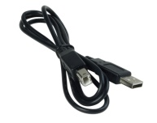
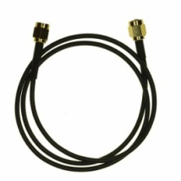

AN/VRC-114(V)3 (continued)
Cable Assy, (USB) Programming
NSN: 5995-01-583-5717
P/N: 12043-2750-A006
CL: 9G QTY: 1 each
Cable Assy, J3 Ethernet
NSN: 5995-01-577-8915
P/N: 12043-2760-A006
CL: 9G QTY: 1 each
Cable, KDU Extension,
20-foot
NSN: 5995-01-551-2593
P/N: 10511-0704-040
CL: 9G QTY: 1 each
Cable Assy, Spkr Pwr
(right angle)
NSN: N/A
P/N: 10535-2713-A020
CL: QTY: 1 each
Multi-band antenna
NSN: 5985-01-534-7171
P/N: RF-390-AT003
CL: 9O QTY: 1 each
OR
Antenna, Vehicular
30-2000MHZ, MB, TAN
NSN:
P/N:
CL: QTY: 1 each
RF Cable TO SOTM Antenna
NSN: 5995-01-418-5820
P/N: 10369-7211-25
CL: 9G QTY: 1 each
Cable Assy, N - N,
LMR-400DB, 25 FEET (Only with RF-3187-AT324 Antenna)
NSN: 5995-01-577-6710
P/N: 10513-0810-A025
CL: QTY: 1 each
Cable Assy, Coax LMR-195 BNC(M) TO BNC(M) (Only with RF-3187-AT324 Antenna)
NSN: N/A
P/N: 11138-1382-A025
CL: QTY: 1 each
Speaker Audio Cable, RT-J1 to Speaker
NSN: 5995-01-514-6066
P/N: 10535-0707-A020
CL: 9G QTY: 1 each
MOUNTING KIT, WHIP ANTENNA, HMMWV
NSN: 5985-01-541-8860
P/N: 10181-5178-06
CL: QTY: 1 each
Install Kit, X-WING, THREE LCTN
HMMWV, TAN
NSN: N/A
P/N: 11080-3900-11
CL: QTY: 1 each
Install Kit, HMMWV,
50-M
NSN: N/A
P/N: 11080-6500-01
CL: QTY: 1 each

Slide 22
AN/TRC-227(V)1
LIN: R31575
NSN: 5820-01-579-0466
P/N: RF-300M-V211
CL: 7G
Type: UHF SATCOM
Output: 25 watts
RT-1949B(P)(C)/PRC
LIN: FA2050 (non-std)
NSN: 5820-01-554-8564
P/N: ON707070-1 or ON707070-7
CL: 2G QTY: 1 each
or
RT-1949C(P)(C)/PRC
LIN: FA2050 (non-std)
NSN: 5820-01-585-2735
P/N: ON707070-9
CL: 2G QTY: 1 each
HANDSET, MODIFIED H-250 NSN: 5965-01-463-7915
P/N: 10075-1399
CL: 9G QTY: 1 each
POWER SUPPLY
NSN: 6130-01-411-9306
P/N: RF-5051-PS001 or RF-5051PS-125 or RF-5051PS-125C
CL: 9G QTY: 1 each
ANTENNA, FOLDABLE X-YAGI SATCOM
NSN: 5985-01-548-3086
P/N: 12006-9000-01
CL: 9G QTY: 1 each
or
ANTENNA, FOLDABLE X-YAGI SATCOM
NSN: 5985-01-449-3240
P/N: AV2011
CL: 9G QTY: 1 each
Cable Assembly, Special
(KDU 6' Cable, RT-J4 to KDU)
NSN: 5995-01-461-5300
P/N: 10511-0704-012
CL: 9G QTY: 1 each
TRANSIT CASE Assy For PA150 Assy
NSN: N/A
P/N: 10400-0572-01
CL: QTY: 1 each
SHOCK MOUNT and VIM ASSY
NSN: 5975-01-584-1854
P/N: 12050-3000-03
CL: 9G QTY: 1 each
POWER AMPLIFIER, Incl. DC Switch, Suppressor Kit
NSN: 5895-01-579-6107
P/N: RF-7800M-PA150
CL: 9G QTY: 1 each
TRANSIT CASE Assy for Speaker & Power Supply
NSN: N/A
P/N: 10564-3450-01
CL: QTY: 1 each
KIT, VAA SYSTEM, ANC/CABLE
NSN: 5820-01-590-5486
P/N: 12064-5005-01
CL: 9G QTY: 1 each
RF-292 ANTENNA MOUNTING KIT
NSN: 5985-01-369-8580
P/N: 919-6224
CL: QTY: 1 each

Slide 23
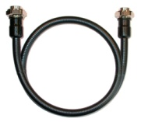

AN/TRC-227(V)1 (continued)
Antenna, Tact Mast Ant Set,
30-512 MHz
NSN: N/A
P/N: RF-3193DB-AT420
CL: QTY: 1 each
OR
Antenna, Tact Mast Ant Set,
30-88,108-512,550-2000MHZ
NSN: N/A
P/N: RF-3193TB-AT420
CL: QTY: 1 each
Cable Extn Kit,
(for RF-3193TB-AT420 Antenna)
NSN: N/A
P/N: 12006-3021-01
CL: QTY: 1 each
Cable Assy, (USB) Programming
NSN: 5995-01-583-5717
P/N: 12043-2750-A006
CL: 9G QTY: 1 each
Cable Assy, J3, Ethernet
NSN: 5995-01-577-8915
P/N: 12043-2760-A006
CL: 9G QTY: 1 each
Suppressor Conversion Kit
(12064-1900-01 Suppressor,
using RF-3193DB-AT420 Ant)
NSN: N/A
P/N: 12064-1900-99
CL: QTY: 1 each
OR
Suppressor Conversion Kit
(12064-5100-08 Suppressor,
using RF-3193TB-AT420 Ant)
NSN: N/A
P/N: N/A
CL: QTY: 1 each
Cable Assy
20 ft KDU Extension
NSN: 5995-01-551-2593
P/N: 10511-0704-040
CL: 9G QTY: 1 each
Cable Assy, RG400,
BNC-N(F)
NSN: 5995-01-583-7289
P/N: 11080-3918-A050
CL: 9G QTY: 1 each

Slide 24

AN/PRC-152
LIN: R55336
NSN: 5820-01-566-0746
P/N: RF-300M-HH001
CL: 7G
Type: Multi-BAND
Output: xx watts
BLADE ANTENNA
NSN: 5985-01-551-9607
P/N: 12011-2700-01
CL: 9G QTY: 1 each
HIGH CAP LITHION BATTY PK, RECHARGEABLE OD GRN
NSN: 6140-01-548-7566
P/N: 12041-2100-02
CL: 9G QTY: 2 each
RT-1916(P)(C)/U
LIN: FA203M (non-std)
NSN: 5820-01-554-7059
P/N: ON689740-1
CL: 2G QTY: 1 each
or
RT-1916A(P)(C)/U
LIN: FA203M (non-std)
NSN: 5820-01-554-9530
P/N: ON689740-3
CL: 2G QTY: 1 each
or
RT-1916B(P)(C)/U
LIN: FA203M (non-std)
NSN: 5820-01-578-9775
P/N: ON689740-7
CL: 2G QTY: 1 each
or
RT-1916E(P)(C)/U
LIN: FA203M (non-std)
NSN: 5820-01-602-6522
P/N: ON689740-19
CL: 2G QTY: 1 each
ANTENNA, BLADE, 20M MB HH
NSN: 5985-01-559-4696
P/N: 12011-2710-01
CL: 9G QTY: 1 each

Slide 25
AN/VRC-110(V)1
LIN: R68668
NSN: 5820-01-578-8805
P/N: RF-300M-HV200
CL: 7G
Type: Multi-BAND
30-90 MHz, 50 watts
90-512 MHz
Output: xx watts
RT-1916(P)(C)/U
LIN: FA203M (non-std)
NSN: 5820-01-554-7059
P/N: ON689740-1
CL: 2G QTY: 1 each
or
RT-1916A(P)(C)/U
LIN: FA203M (non-std)
NSN: 5820-01-554-9530
P/N: ON689740-3
CL: 2G QTY: 1 each
or
RT-1916B(P)(C)/U
LIN: FA203M (non-std)
NSN: 5820-01-578-9775
P/N: ON689740-7
CL: 2G QTY: 1 each
or
RT-1916E(P)(C)/U
LIN: FA203M (non-std)
NSN: 5820-01-602-6522
P/N: ON689740-19
CL: 2G QTY: 1 each
Grand total of 2 each
HANDSET, MODIFIED H-250 NSN: 5965-01-463-7915
P/N: 10075-1399
CL: 9G QTY: 1 each
BLADE ANTENNA
NSN: 5985-01-551-9607
P/N: 12011-2700-01
CL: 9G QTY: 1 each
AMPLIFIER, VEHICULAR ADAPTOR
NSN: 5820-01-583-4233
P/N: 12049-0100-01
CL: 9G QTY: 2 each
or
AMPLIFIER, VEHICULAR ADAPTOR
NSN: 5996-01-583-4230
P/N: 12053-0100-01
CL: 9G QTY: 2 each
or
AMPLIFIER, VEHICULAR ADAPTOR
NSN: 5820-01-559-6055
P/N: 12053-0100-02
CL: QTY: 2 each
or
AMPLIFIER, VEHICULAR ADAPTOR
NSN: 5820-01-570-9746
P/N: 12053-0100-09
CL: 9G QTY: 2 each
Holster
NSN: 5895-01-571-7463
P/N: RF-5932-CA001
CL: 9G QTY: 2 each
ANTENNA, BLADE,
20M MB HH
NSN: 5985-01-559-4696
P/N: 12011-2710-01
CL: 9G QTY: 1 each
BAG, HH ACCESSORY
NSN: 8465-01-551-6852
P/N: 12041-1595-01
CL: 2B QTY: 2 each
HIGH CAP LITHION BATY PK, RECHARGEABLE OD GRN
NSN: 6140-01-548-7566
P/N: 12041-2100-02
CL: 9G QTY: 2 each
TRAY BATTERY, AA BATTERY HOLDER
NSN: 6160-01-571-7464
P/N: RF-5911-PS001
CL: 9G QTY: 4 each

Slide 26
AN/VRC-110(V)1 (continued)
Panel, Signal Distribution, Radio
NSN: 5996-01-583-4220
P/N: 12049-6000-01
CL: 9G QTY: 1 each
OR
Panel, Signal Distribution, Radio
(Only when using a 12049 & 12053 VAA combo)
NSN: 5820-01-553-1937
P/N: 12053-6000-01
CL: QTY: 1 each
ANTENNA T-ADAPTER, TNC/BNC
NSN: 5985-01-552-9403
P/N: 12049-0500-01
CL: 9G QTY: 2 each
CABLE ASSY, RT/VAU, RT-Ant Conn to VAA-J4 NSN: 5995-01-553-1967
P/N: 12049-1400-A1
CL: 9G QTY: 2 each
CABLE ASSY, RT/ANTENNA ADAPTER, T-Conn to VAA-J4 (Only when using a 12049 VAA) NSN: 5995-01-584-5060
P/N: 12049-1410-A1
CL: 9G QTY: 2 each
CABLE ASSY, RF COAX, T-Adapter to VAA-J5, (Only when using a 12053 VAA)
NSN: 5995-01-559-0063
P/N: 12053-1420-A2
CL: 9G QTY: 2 each
CABLE ASSY, INTERFACE, 32-PIN TO 32-PIN
NSN: 5995-01-584-5072
P/N: 12049-1600-01
CL: 9G QTY: 2 each
CABLE ASSY, AUDIO, FRONT PANEL TO INTERFACE BOX, VAA Front Panel to SIM-J22/J23
NSN: 5995-01-584-5079
P/N: 12049-6010-A1
CL: 9G QTY: 2 each
POWER CABLE, VAU TO INTERFACE POWER, VAU TO SIM-Pwr Out
NSN: 5995-01-584-5087
P/N: 12049-6020-A1
CL: 9G QTY: 2 each

Slide 27
AN/VRC-110(V)2
LIN: R68736
NSN: 5820-01-579-4483
P/N: RF-300M-HV201
CL: 7G
Type: Multi-BAND
Output: xx watts
RT-1916(P)(C)/U
LIN: FA203M (non-std)
NSN: 5820-01-554-7059
P/N: ON689740-1
CL: 2G QTY: 1 each
or
RT-1916A(P)(C)/U
LIN: FA203M (non-std)
NSN: 5820-01-554-9530
P/N: ON689740-3
CL: 2G QTY: 1 each
or
RT-1916B(P)(C)/U
LIN: FA203M (non-std)
NSN: 5820-01-578-9775
P/N: ON689740-7
CL: 2G QTY: 1 each
or
RT-1916E(P)(C)/U
LIN: FA203M (non-std)
NSN: 5820-01-602-6522
P/N: ON689740-19
CL: 2G QTY: 1 each
Grand total of 2 each
HANDSET, MODIFIED H-250 NSN: 5965-01-463-7915
P/N: 10075-1399
CL: 9G QTY: 1 each
BLADE ANTENNA
NSN: 5985-01-551-9607
P/N: 12011-2700-01
CL: 9G QTY: 1 each
HIGH CAP LITH ION BATY PK, RECHARGEABLE OD GRN
NSN: 6140-01-548-7566
P/N: 12041-2100-02
CL: 9G QTY: 2 each
AMPLIFIER, VEHICULAR ADAPTOR
NSN: 5996-01-583-4230
P/N: 12053-0100-01
CL: 9G QTY: 2 each
or
AMPLIFIER, VEHICULAR ADAPTOR
NSN: 5820-01-559-6055
P/N: 12053-0100-02
CL: QTY: 2 each
or
AMPLIFIER, VEHICULAR ADAPTOR
NSN: 5820-01-570-9746
P/N: 12053-0100-09
CL: 9G QTY: 2 each
Holster
NSN: 5895-01-571-7463
P/N: RF-5932-CA001
CL: 9G QTY: 2 each
TRAY BATTERY, AA BATTERY HOLDER
NSN: 6160-01-571-7464
P/N: RF-5911-PS001
CL: 9G QTY: 4 each
ANTENNA, BLADE, 20M MB HH
NSN: 5985-01-559-4696
P/N: 12011-2710-01
CL: 9G QTY: 1 each
BAG, HH ACCESSORY
NSN: 8465-01-551-6852
P/N: 12041-1595-01
CL: 2B QTY: 2 each

Slide 28
AN/VRC-110(V)2 (continued)
PANEL,SIGNAL DISTRIBUTION, RADIO NSN: 5820-01-559-6037
P/N: 12053-6800-01
CL: 9G QTY: 1 each
ANTENNA T-ADAPTER, TNC/BNC
NSN: 5985-01-552-9403
P/N: 12049-0500-01
CL: 9G QTY: 2 each
CABLE ASSY, RF COAX, T-Adapter to VAA-J5, (Only when using a 12053 VAA)
NSN: 5995-01-559-0063
P/N: 12053-1420-A2
CL: 9G QTY: 2 each

