Slide 1
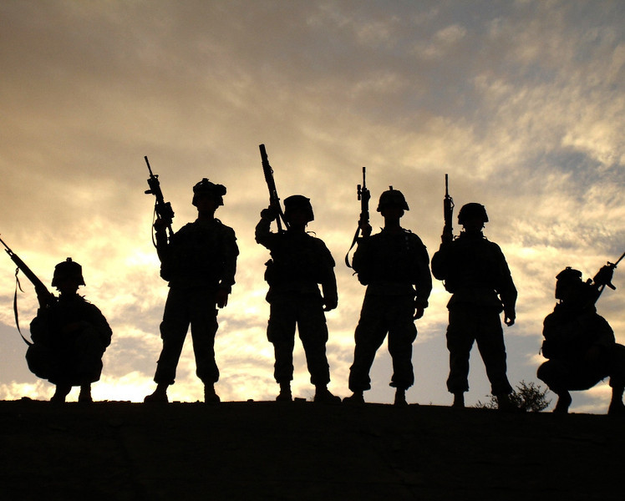
MCoE Priorities & Focus Areas
Enduring Priorities
Focus Areas
Identify those fundamentals that our Soldiers and leaders must master, then ensure that we have the right instructors and resources in place to positively affect that outcome. Must be done in close coordination with the operating force. This should also inform expected training outcomes.
Identify immediate initiatives to enhance the physical resiliency of our newly arrived Soldiers and leaders within the training population as well as the permanent party population. Look for the mid-term enhancements and begin working to resource.
Ensure our battle lab initiatives are fully connected with the field and the requisite experts to ensure wide understanding of ongoing experimentation and applicability across the force.
Be fully nested with AOC…and ensure we are able to adjust POI’s to meet the requirements of the complex battlefield.
Leader, Soldier, Civilian Development
Understand Future Maneuver and Affects On Doctrine, Concepts, Design, & Material Solutions
Care of Our Soldiers, Families, & Outreach to the Community
Big Rocks
Improve manning and address the personnel pipeline in and out of the MCoE.
Manage resources and apply contracting tools swiftly and effectively to achieve the mission.
Fix facility maintenance problems that affect the mission.
Manage collaborative execution of our doctrine revision.
Establish collaboration forums for all that we do and ensure our internal and external communications are flawless.
Align our courses to maximize combined arms integration.

