Slide 1
milSuite and Open Source
Born from open source code. Raised on transparency.
Presenter: Todd Miller

Slide 2
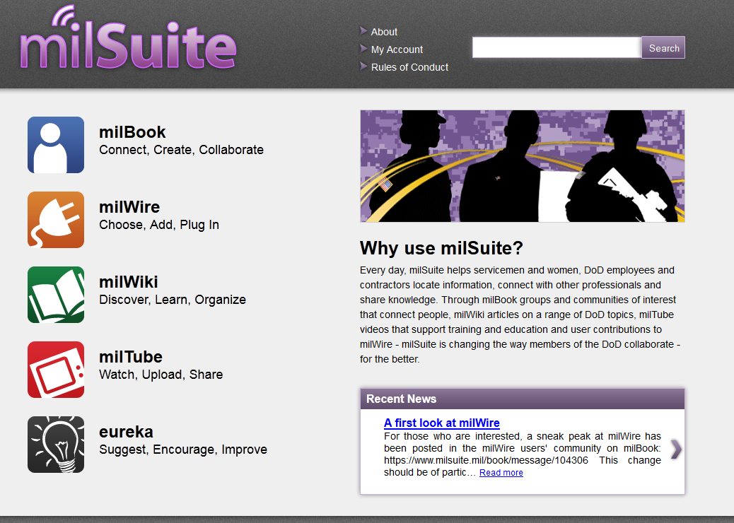










What is milSuite?
Secure DoD suite of Web 2.0 and social media capabilities that facilitate knowledge sharing, information exchange, and professional networking across the enterprise.
Cloud based lightweight adaptable applications, with flexible and customizable platforms, mobile ready and extensible by other DoD developers that can be accessed from any platform in the world.
Current suite consists of:
  Military encyclopedia (milWiki)
  Military professional networking (milBook)
  Military information sharing service (milWire)
  Military video sharing service (milTube)
  DoD Enterprise Ideation (eureka)
Available to any active military, civilian, reserve, or contractor that is a working member of the DoD* on the UNCLASSIFIED NIPRNET. Common Access Card (CAC) required for registration and access.
Working with DISA and Army CIO/G6 to provide milSuite as a DoD Enterprise Service offering.
Secure DoD Firewall
WIKIPEDIA
TUMBLR
FACEBOOK
YOUTUBE
REDDIT
PINTEREST
LINKEDIN
TWITTER
Non-secure Social Media
* Some restrictions apply

Slide 3
The Principles of milSuite
All-inclusive – For everyone across the DoD.
Information Awareness - The more information is shared and discoverable the better chance duplicative programs aren’t stood up costing money, time, and impacting missions.
Facebook Generation – Service members use social media everyday, and that does not stop when they are deployed. They require secure tools providing a similar experience.
Emergent Collaboration - Not a document dumping ground where files go to languish. People are collaborating on virtual documents in real-time, participating in online discussions, and the community is making decisions regardless of rank, position, or service.
Ease of use - People shouldn’t have to be trained on systems that mimic their everyday use of the web.
Maximize Efficiencies - Better tools means better productivity. If you can find an answer in one minute versus days you can make smarter and timely decisions.
Low Cost – Good software doesn’t necessarily mean expensive software. Open source is free, well vetted, and powerful.
Integrating technology - Seamlessly collecting/displaying information from multiple locations in one website.
  Allows developers to create applications using milSuite data/functionality (Ex: SharePoint Web Parts).
  Widgets let you personalize milSuite to meet your information needs.
Enterprise Service - milSuite integrated with Enterprise Services including: Messaging (Enterprise Email), File Management/Workflow (SharePoint), Unified Collaboration (DCS, VOIP) and other Enterprise Business/Tactical Applications.

Slide 4

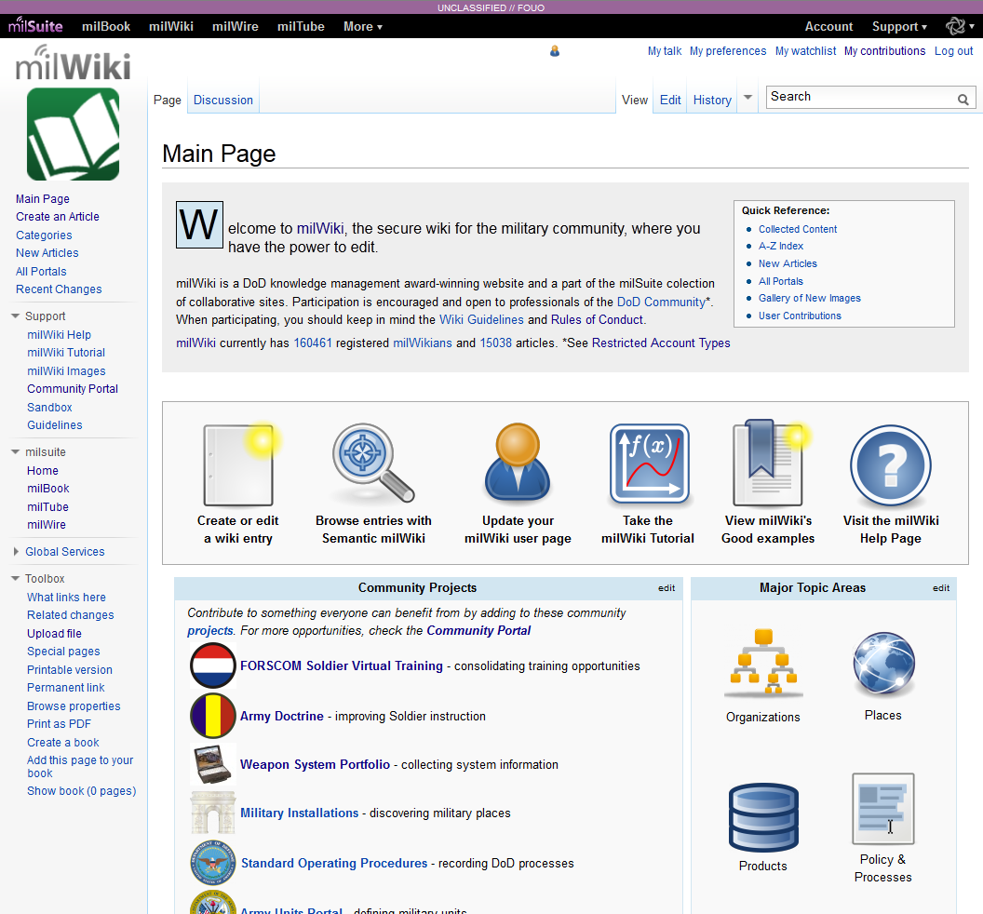
milWiki Overview
Knowledge is power
  Discover and contribute information on DoD people, places, organizations, systems and processes
Making an encyclopedia
  Build and maintain information in wiki articles including processes, policies, organization pages, biographies, etc.
  Share information with DoD wide audience via individual wiki articles, and integrated wiki portals leveraging standard templates
  Search for information using Semantic Wiki
4

Slide 5

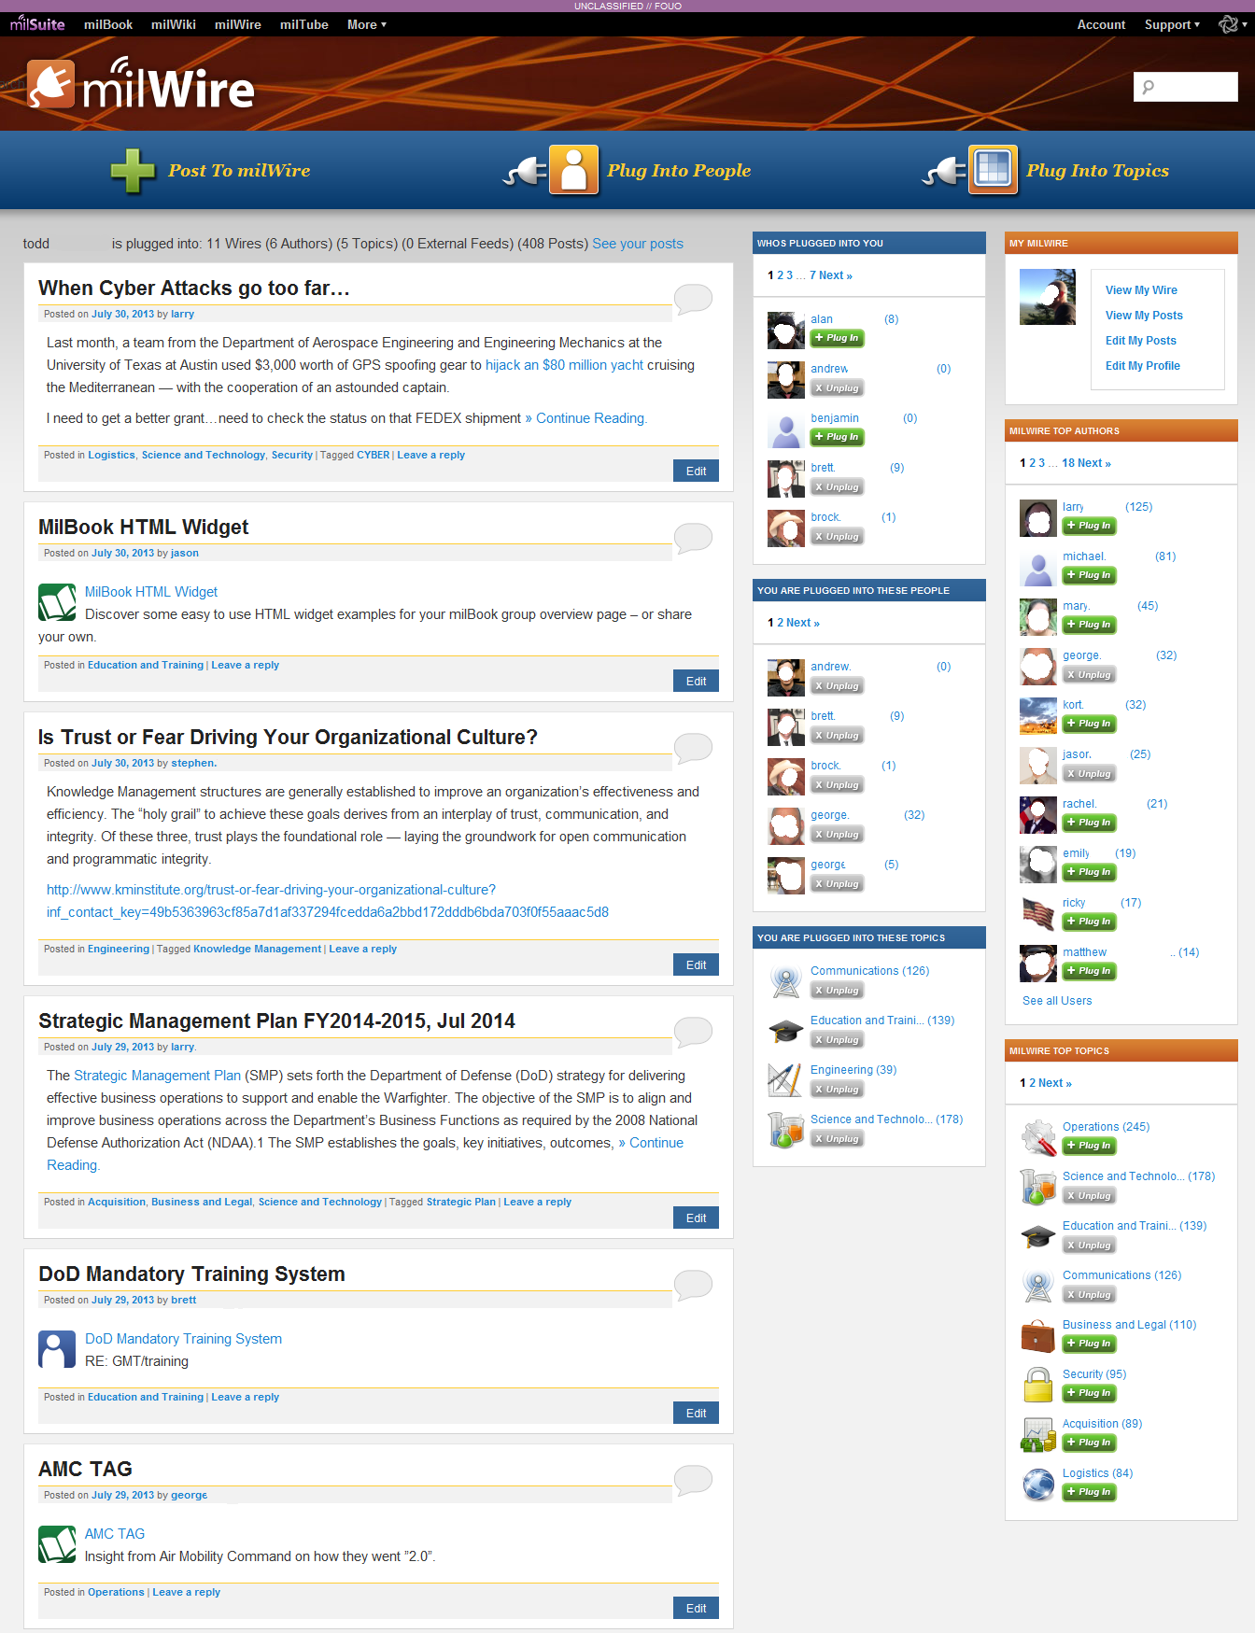
milWire Overview
Targeted Communications
Users can post to the wire:
  Strategic Communications
  Announcements
  News and Alerts
  Events
  Achievements/ Awards
  …and whatever else they want to share
Discoverable Content via search, categories and tags
Plug into People and Topics
Subscribe by “plugging into” different people that are posting things of interest
Subscribe to topics that cover the entire DoD
5

Slide 6

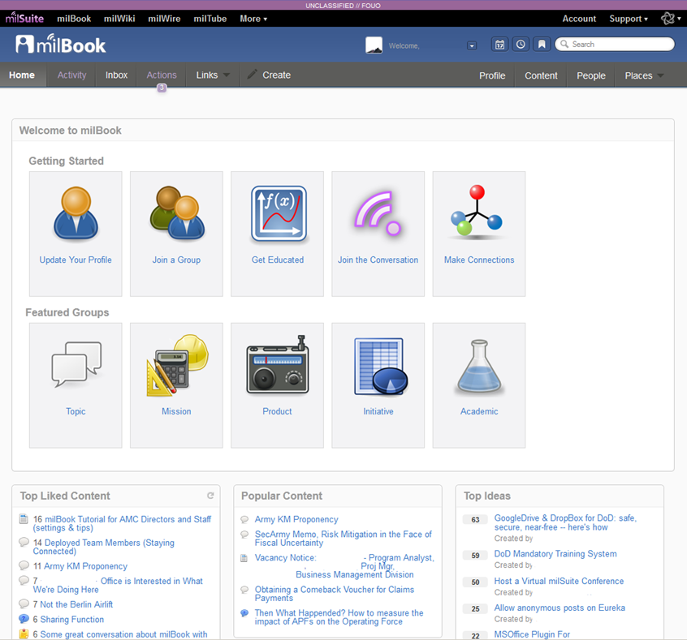
milBook Overview
Make it personal
  Follow People and Activities across all of DoD
  Provide Status Updates
  Track activities in your network
  Personal Tasks and Bookmarks
  Advanced Profiles with milConnect
Business is social
  User generated Public and Private Groups
  Customizable Communities of Practice & Interest
  Project Tracking
  Idea/Discussion Capability
  Calendar/Event Management
  Document & File Collaboration
  Personal & Group Blogs
6

Slide 7

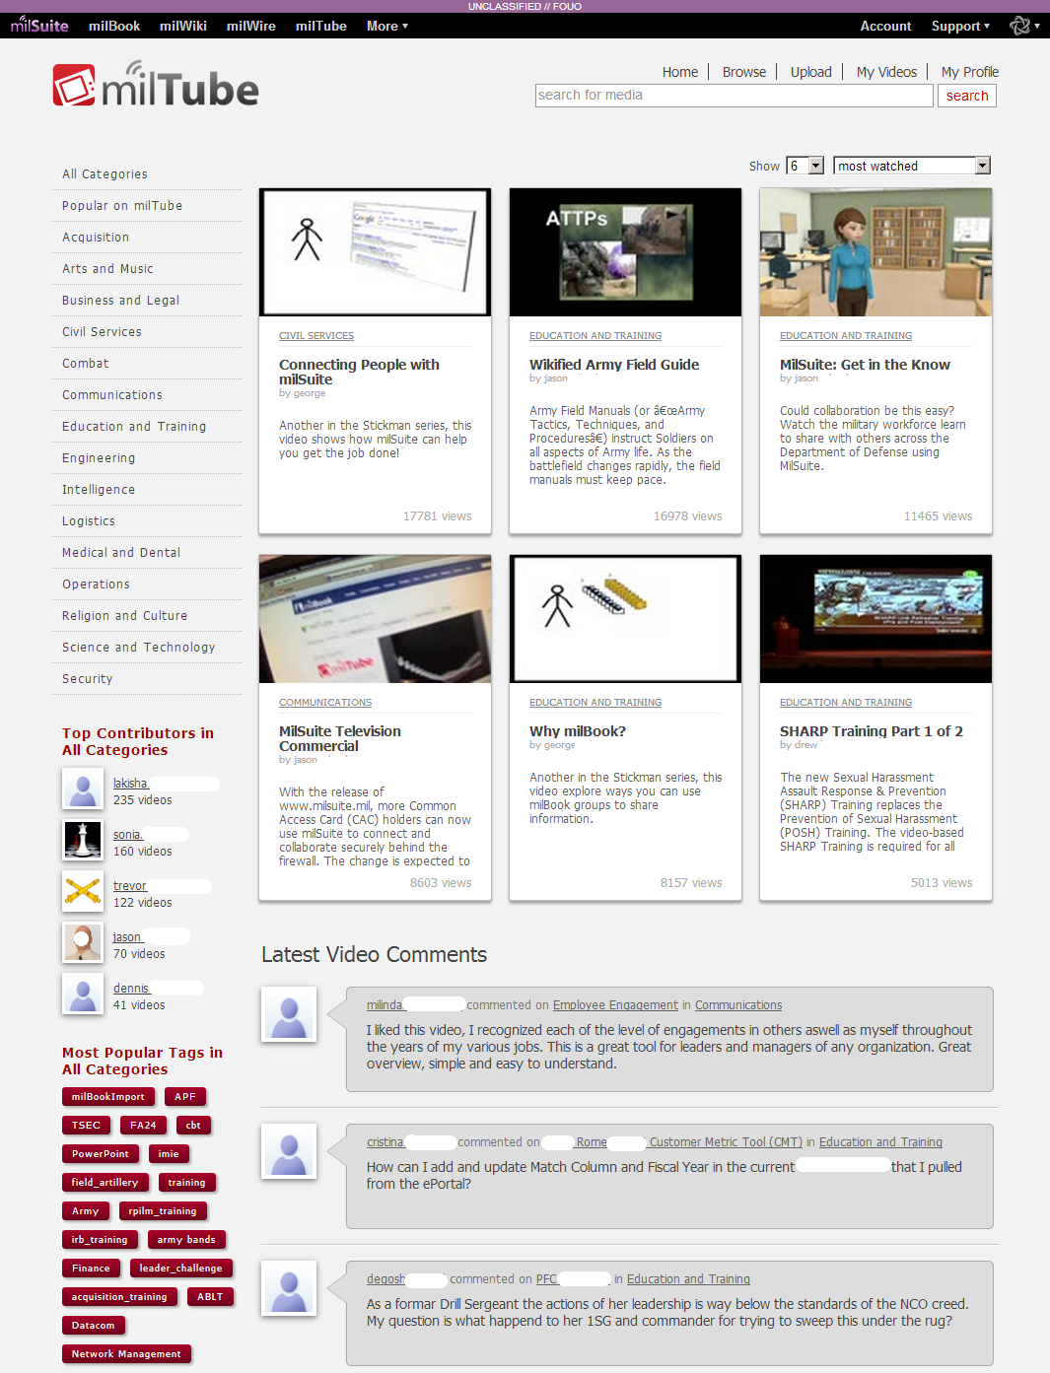
milTube Overview
Watch, learn, and upload
  Broadcast videos
  Announcements
  Vignettes
  Training and Guidance
  News and Features
  Interviews
  Promote tools, sites, projects and achievements
Sharing is caring
  Embed videos into other milSuite products and beyond
  Establish Channels to organize, share videos and provide a face to the community
7

Slide 8

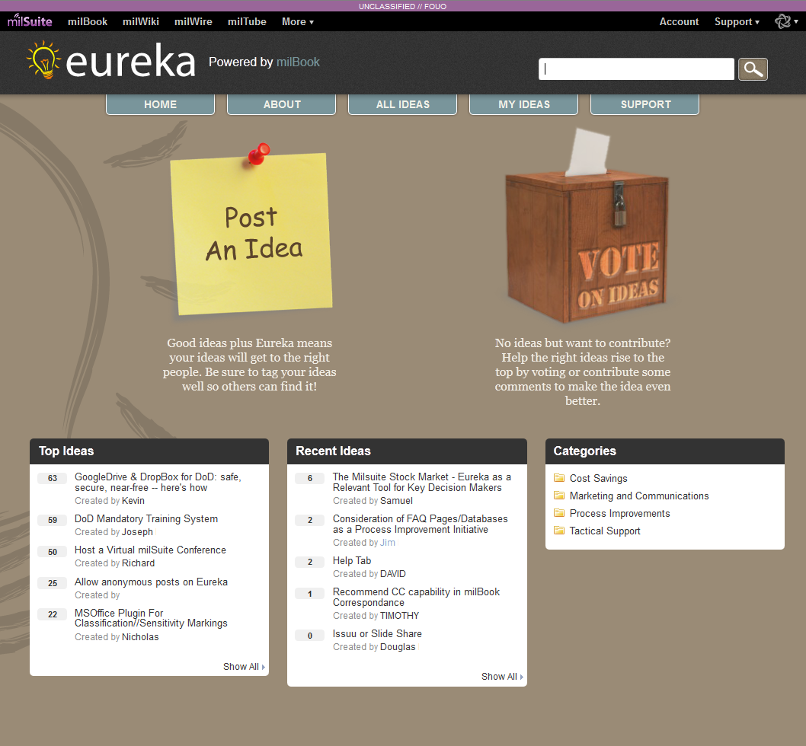
eureka Overview
Idea generation
  Post an idea
  Vote on others ideas
  Discuss and vet an idea with the community
  Organize ideas through tags and categories
Making dreams a reality
  Posting ideas is great, but solving ideas is even better
  eureka uses the power of milBook to get ideas in front of the groups and communities that may have a chance to solve them
  Related idea widget brings visibility to the content you are working on

Slide 9








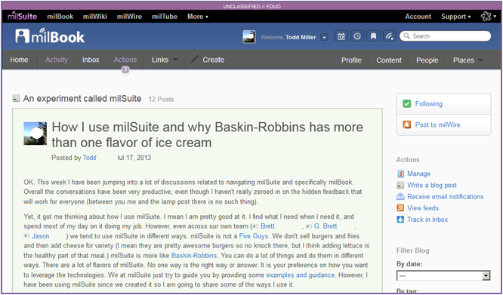
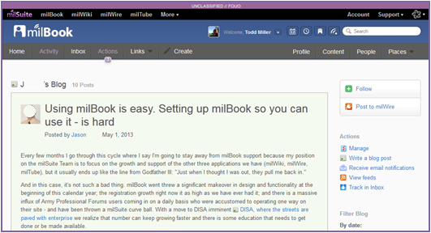
milSuite and Open
Open software
milSuite leverages popular open source technologies and open source components in all of its products
Open principles
milSuite started small and grew through grass roots and word of mouth
milSuite Rules of Conduct and Guidelines were written by the original community and continue to evolve through feedback
All ideas, development projects, and road maps are presented to the community for discussion
milSuite team members all blog and share their personal thoughts and challenges

Slide 10
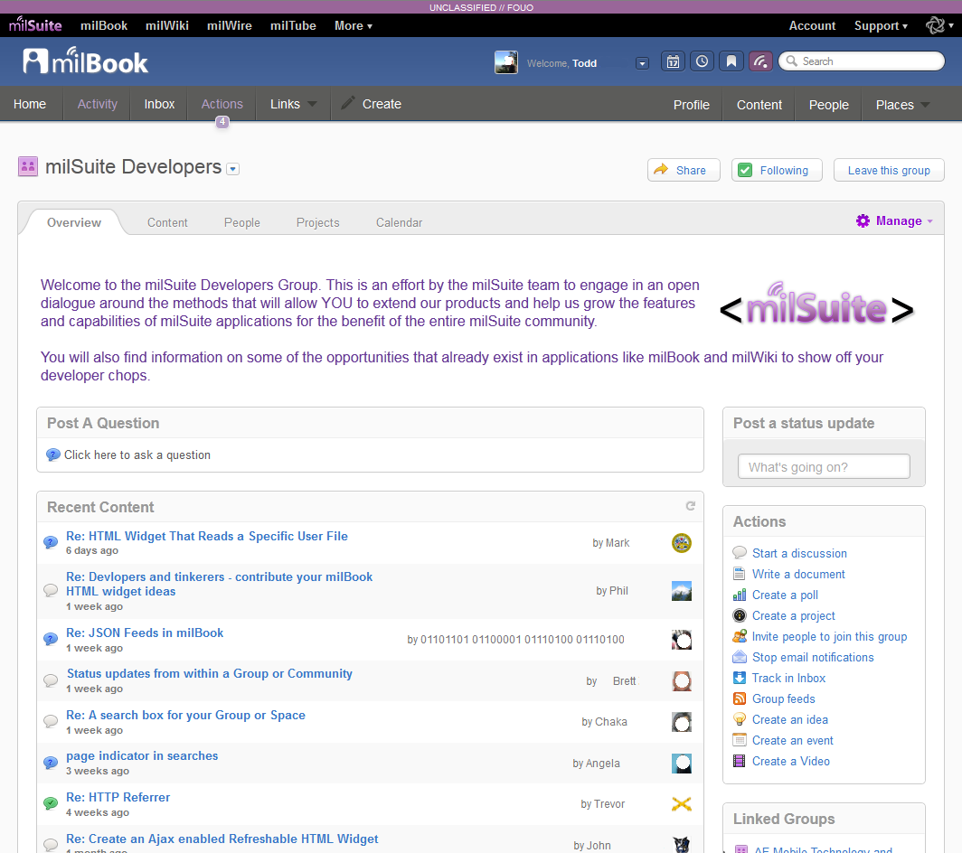
milSuite Developers
Developer Outreach
Build the community
Define the process
Showcase the results
Extend the Products
Leverage existing out of the box components
  milBook HTML Widgets
  milWiki Templates
milSuite API Framework (under development)
  Collection of objects
  Read/write permissions
  Secure access
milSuite OSS development
  MediaWiki Extensions
  Wordpress Plug-ins
  Jive Plug-ins/Applications

Slide 11

Points of Contact
Visit milSuite at https://www.milsuite.mil
MilTech Solutions Director:
Claudia DeCarlo claudia.decarlo.civ@mail.mil
milSuite Product Director:
Tom Curran thomas.curran1.civ@mail.mil
milSuite Deputy Product Director:
Robert Wheeler robert.b.wheeler1.ctr@mail.mil
milSuite Operations Chief:
Todd Miller todd.f.miller10.ctr@mail.mil
milSuite mailbox: milsuite.mil@us.army.mil

