Slide 1
INTEGRATED PLAYER UNIT
INSTALLATION GUIDE
FOR THE M93 FOX PLATFORM AT THE
DIGITAL MULTI-PURPOSE
RANGE COMPLEX
FORT RILEY, KS
(August 2011)

Slide 2
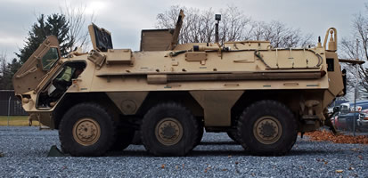
M93 FOX

Slide 3
M93 FOX PRE-INSTALLATION CREW ACTIONS
REMOVE EXCESS EQUIPMENT FROM THE RIGHT SIDE AREA NEXT TO AND BEHIND THE CO-DRIVER/GUNNER.
CLEAR EXCESS MILITARY GEAR FROM THE FLOOR AND SEATS AROUND THE DRIVER, CO-DRIVER/GUNNER AND OTHER PASSENGER POSITIONS.
DURING THE INITIAL INSTALLATION PROCESS, ALL POWER TO THE VEHICLE MUST BE TURNED OFF.
Once the initial installation has been completed, any vehicle returning to the Install Pad for maintenance, batteries, etc., should have the radios on and operational.

Slide 4
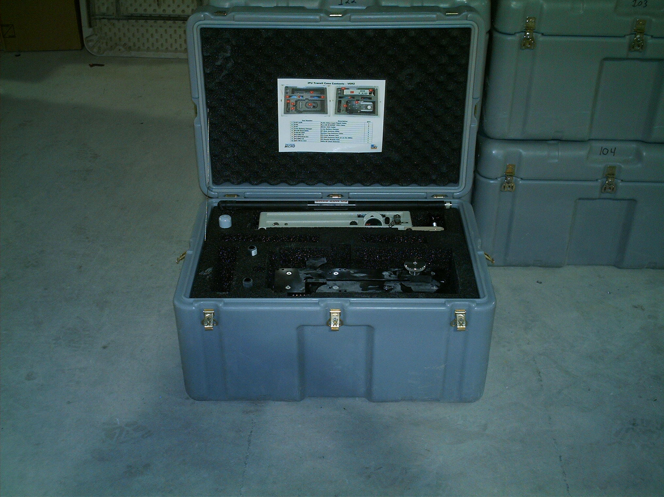

GRAY TRAVEL CASE FOR THE BUSTLE AND CREW MODULES FOR THE INTEGRATED PLAYER UNIT

Slide 5
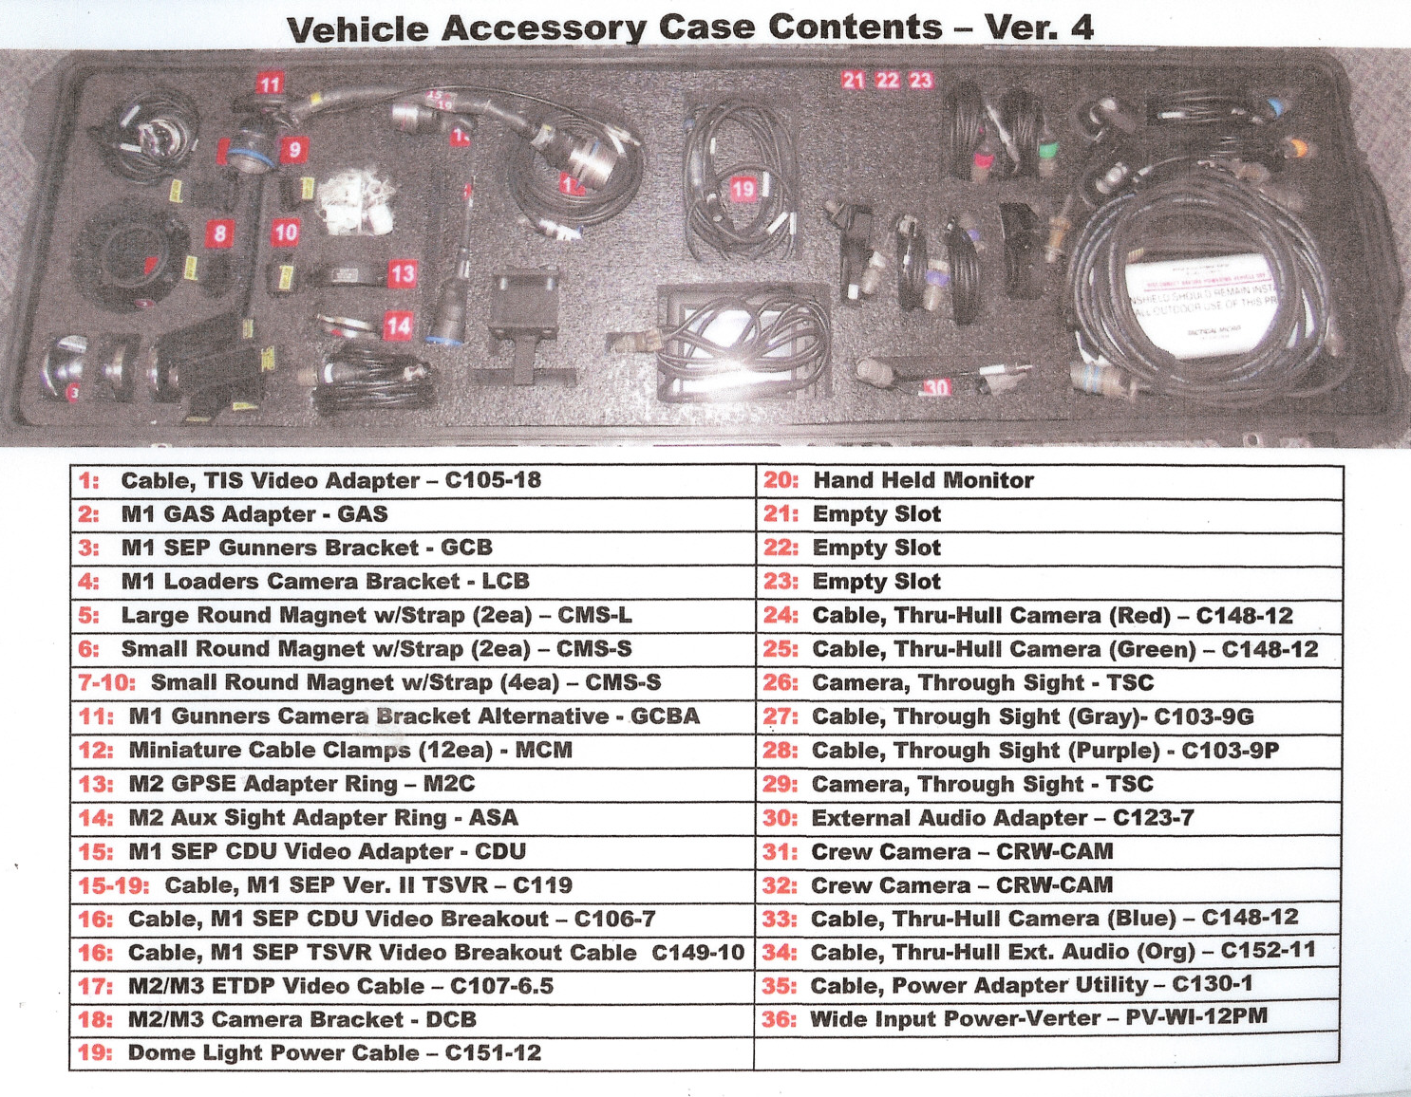
The black travel case houses various cables, connectors, cameras and mounting hardware for the IPU. The contents of the case are listed inside on the lid.

Slide 6
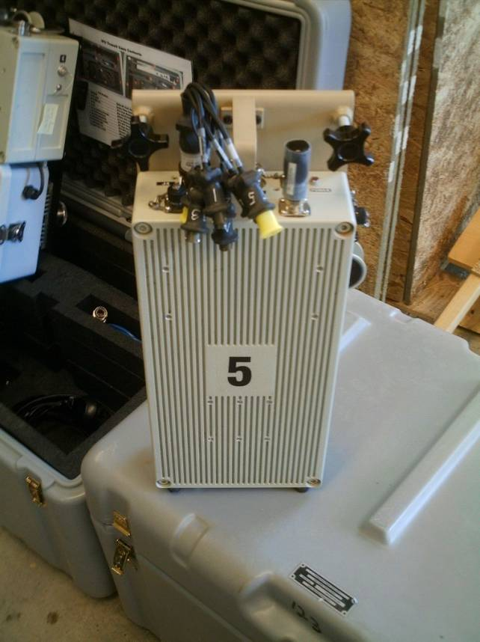
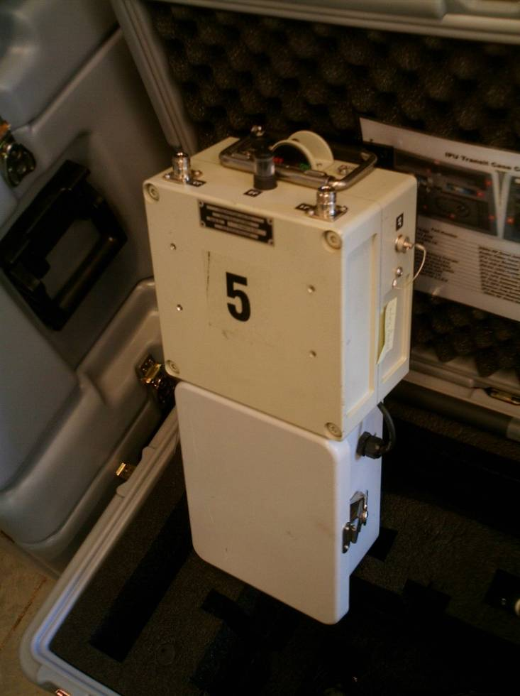
The Integrated Player Unit (IPU) consists of two main components. The Crew Module Unit (CMU) replaces the A/V Breakout Box, A/V Interconnect Cable, BIM and the Vehicle Power Supply box. It is designed to receive the Audio and Video input as well as the 1553 data from the vehicle and wirelessly transfer it to the Bustle Mounted Unit (BMU). The M93 FOX does not use the 1553 Data Cable. The BMU provides GPS tracking and sends data to the Tower via access points/nodes and relay points.
CMU
BMU

Slide 7
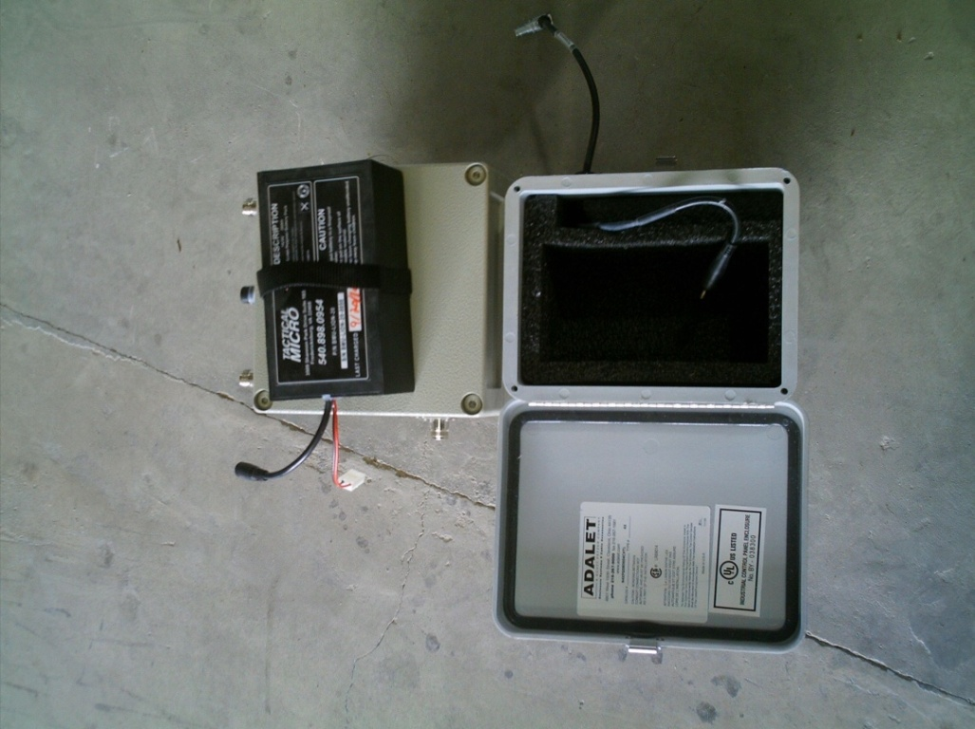
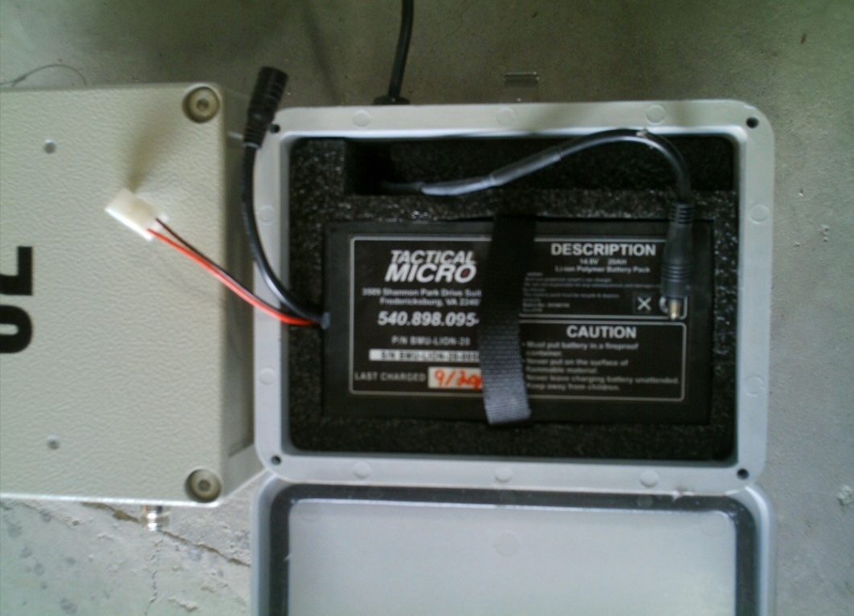
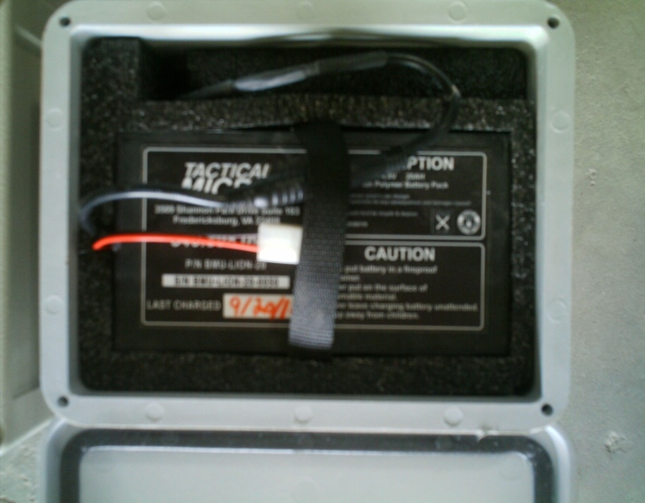
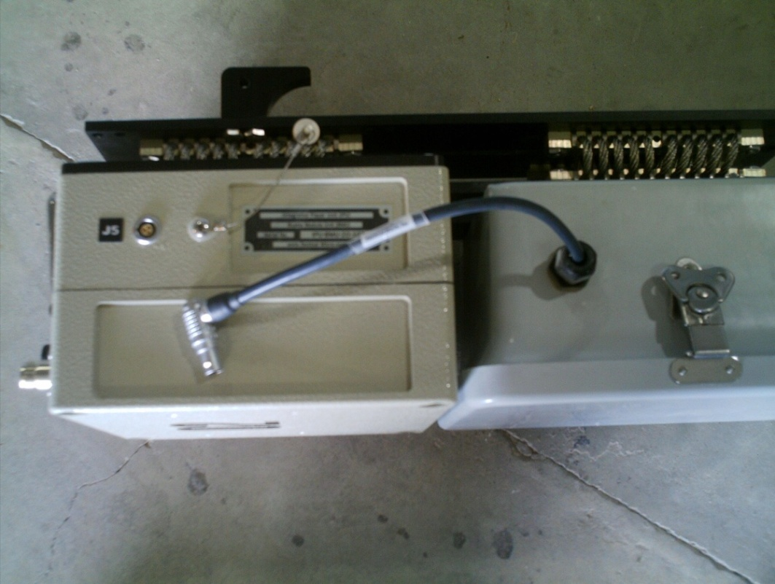
The BMU is powered by a 14.8V LI-ION Battery Pack
CAUTION: THE CABLE TO THE J5 PORT SHOULD BE DISCONNECTED WHEN NOT IN USE OR IN THE STORAGE CASE.

Slide 8
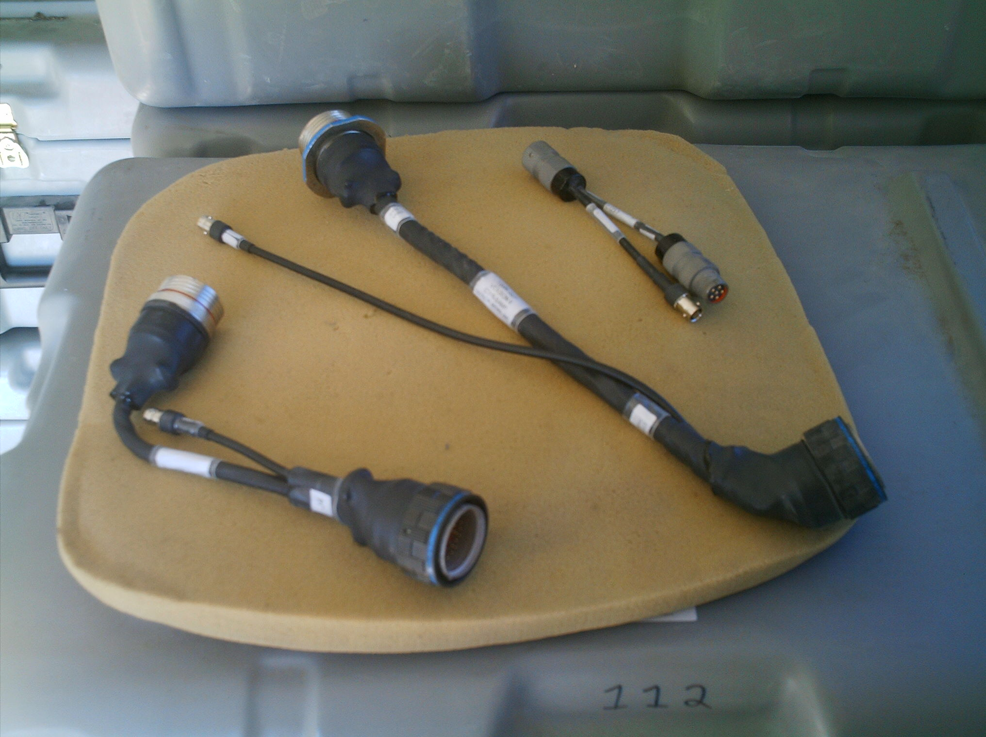
Left to right: CDU Adapter (new model), TSVR V2, and External Audio Adapter

Slide 9
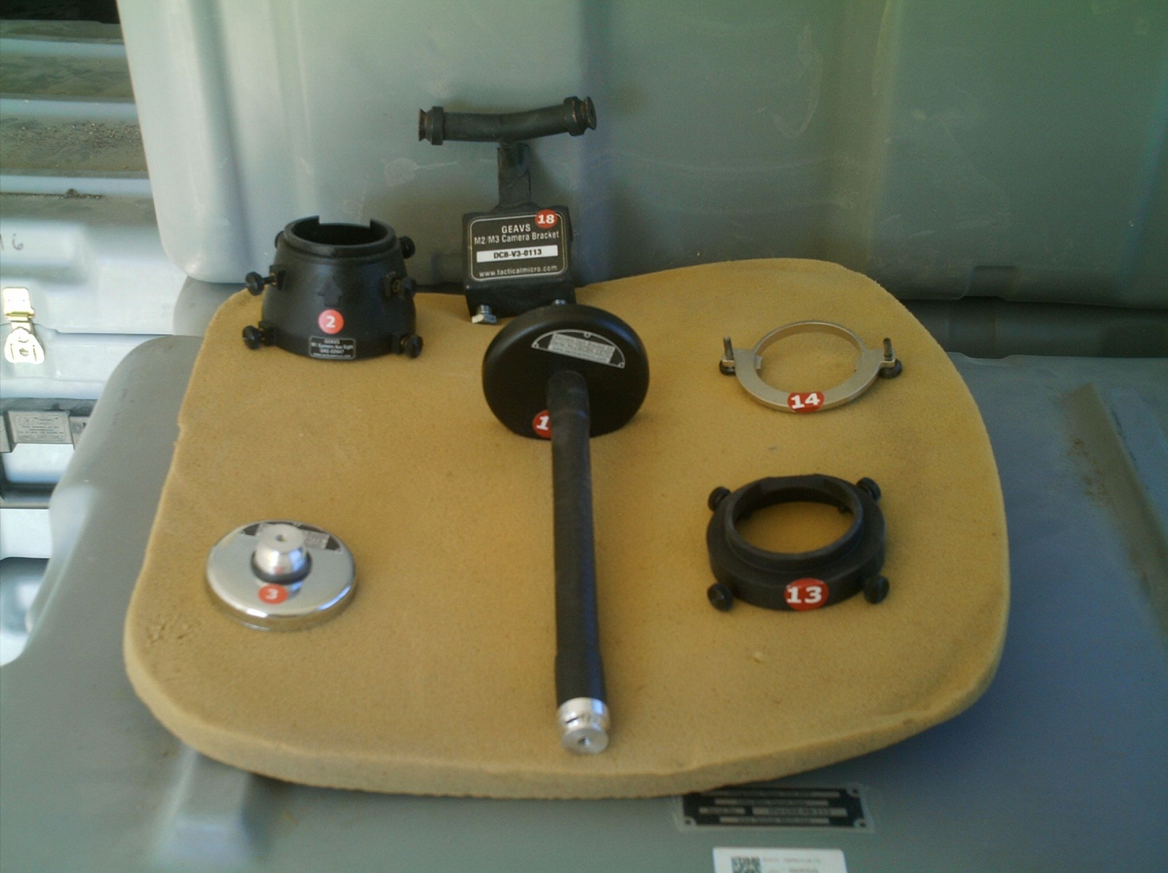
C
E
A
B
D
F
A- M1 GAS Adapter for Gunner’s Through Sight B – M1 Crew Camera Loader’s Mounting Bracket C – M2/3Crew Camera Mount for Gunner and Commander’s Cameras D – M1 Gunner’s Camera Bracket Alternative E – M2/3 GAS Adapter for the Commander’s Auxiliary Through Sight F – M2 GPSE Mounting bracket for use on the M2 ODS (*Item B and D are the only mounts that are used on the M93 FOX)

Slide 10
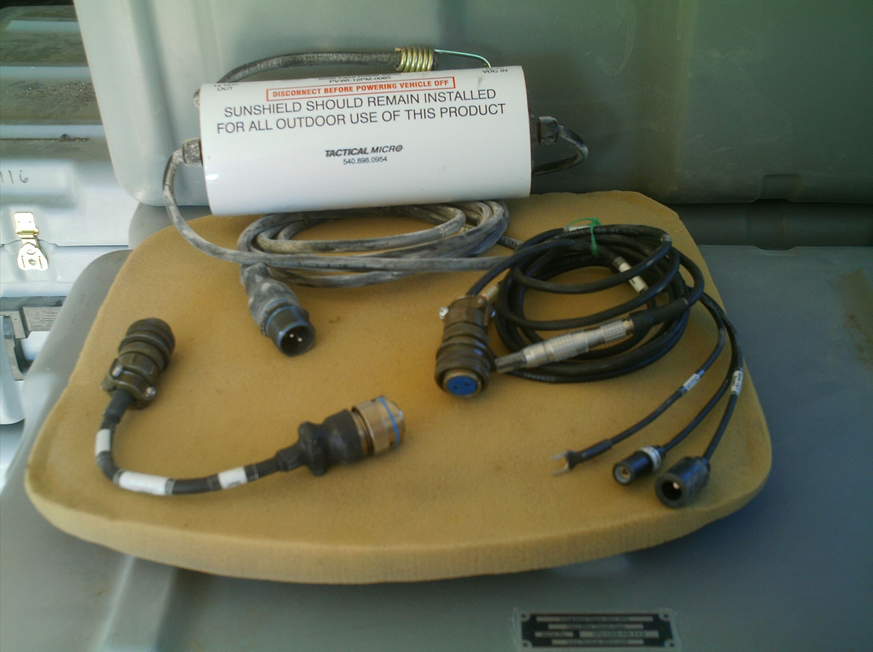
A
C
B
A - Voltage Regulator (Power-Verter) used with all IPU platforms
B – M1 Power Adapter
C – M2/3 Power Adapter & M93 FOX

Slide 11
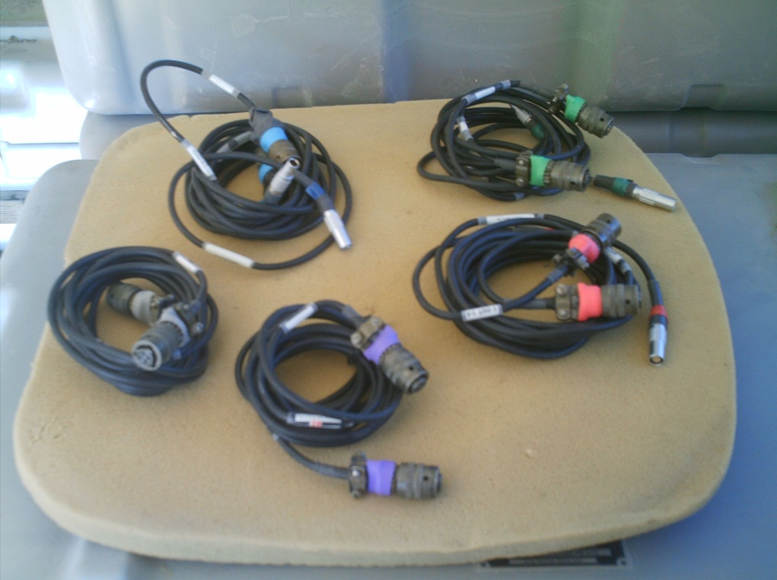
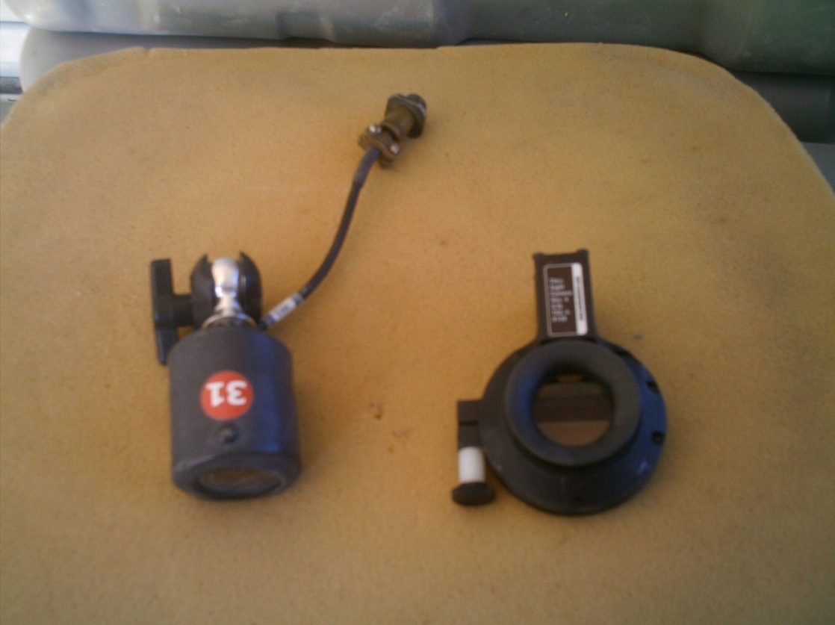
Five color coded camera cables are in each VAB.
Shown are The Crew and Through Sight Cameras. The Through Sight Cameras are not used on the M93, a third Crew Camera is used in place of a Through Sight Camera.
Crew
Through Sight

Slide 12
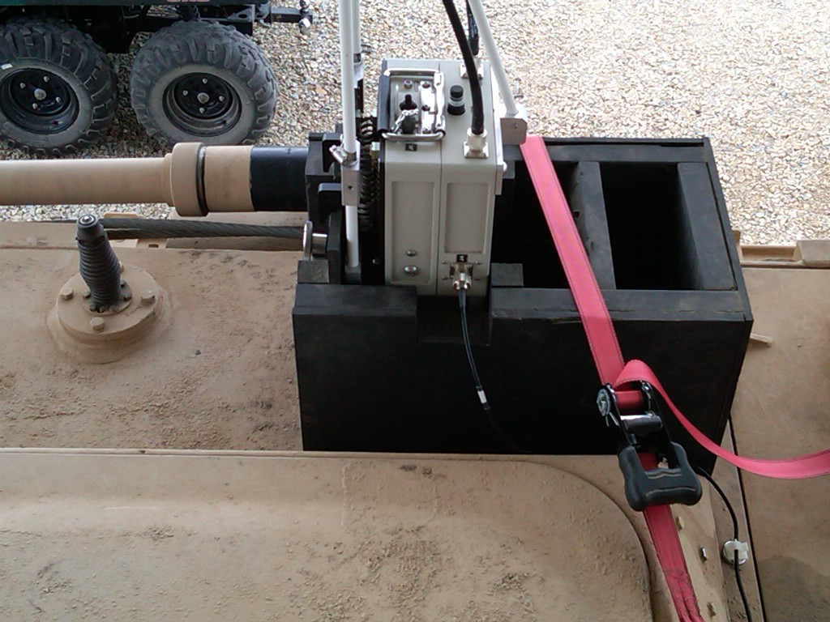
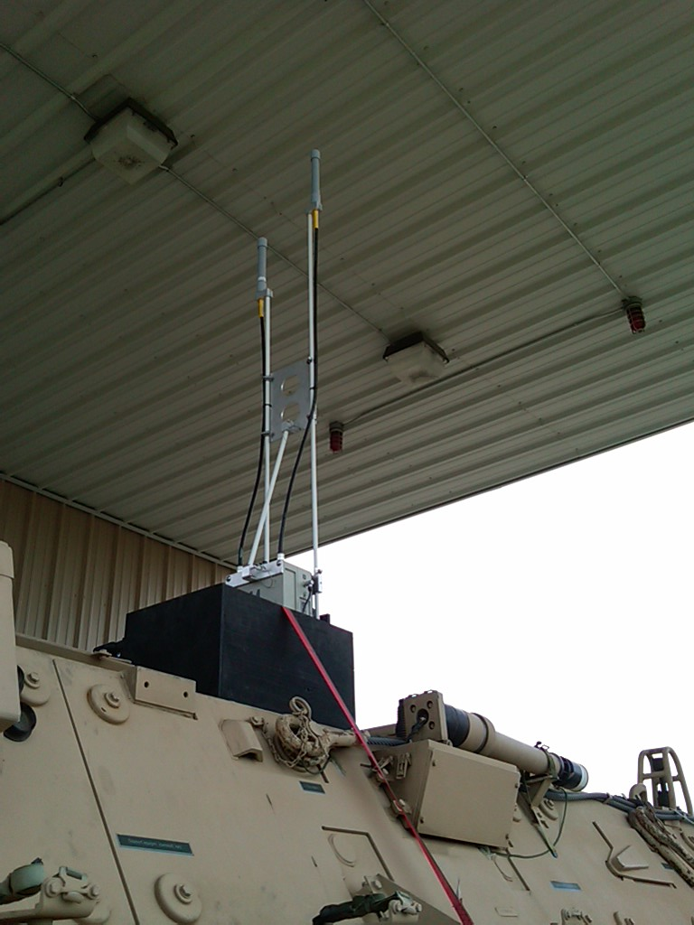
The BMU is installed on top, the left/middle side of the M93. These views show the BMU placed inside a wooden box that was designed by the Tech Dept at the DMPRC.

Slide 13
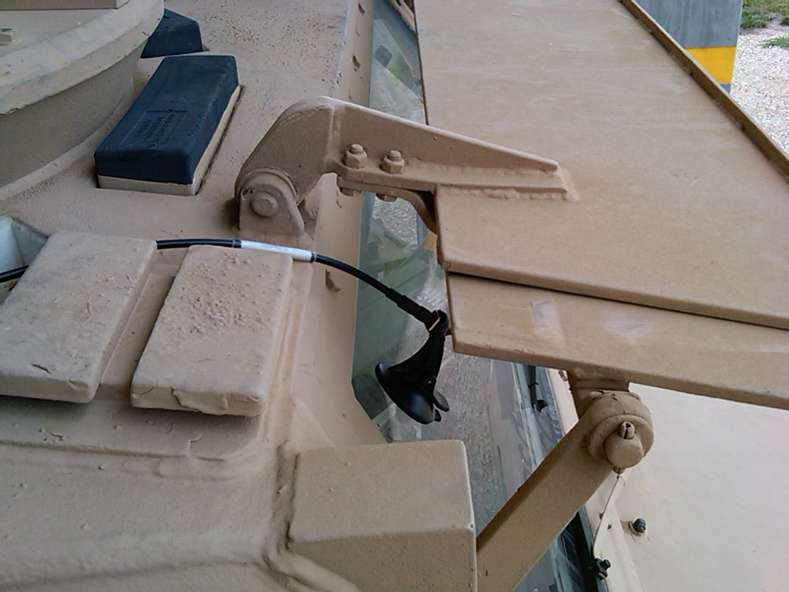
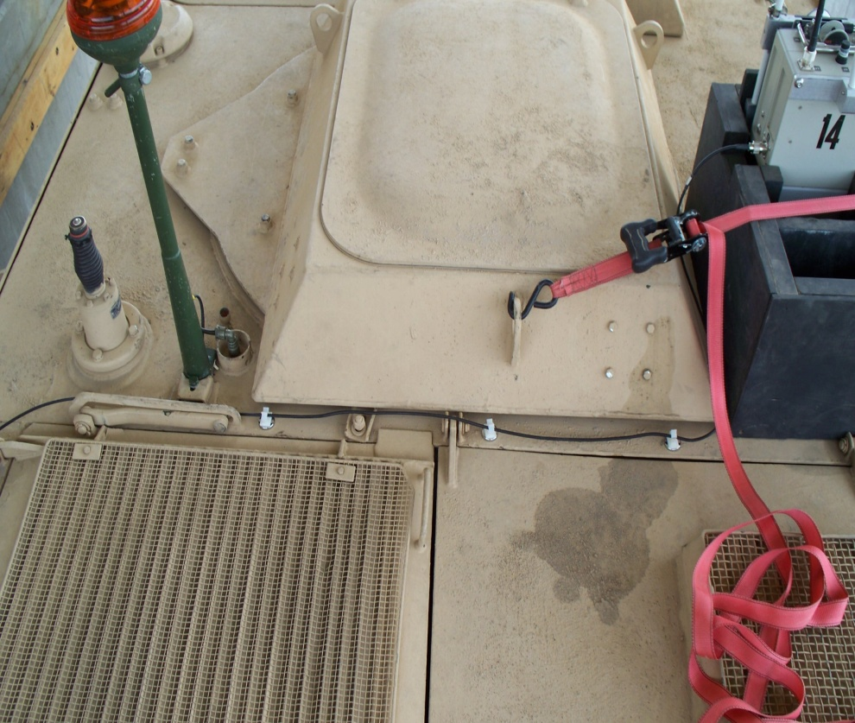
BMU J4 Port
The optional antenna assembly is attached to the windshield, on the Co-Driver/Gunner’s side using the suction cup attachment. The cable is run down the right side/top of the vehicle next to the vents and across the middle of the vehicle to the BMU J4 Port. (The Suction Cup sticks better if moistened before attaching)

Slide 14
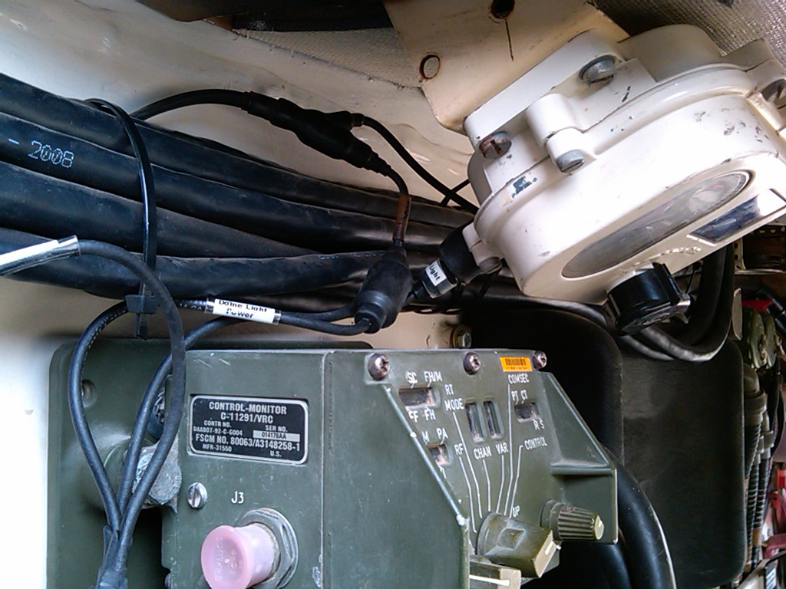
Power is supplied to the CMU using the Power Adapter Cable and the Voltage Regulator (Power-Verter) used with all IPU platforms. The Power Adapter Cable is plugged into the vehicles light system. It plugs directly into the light.

Slide 15
Next, the vehicles own cable powering the light is plugged directly into our Power Adapter Cable.

Slide 16
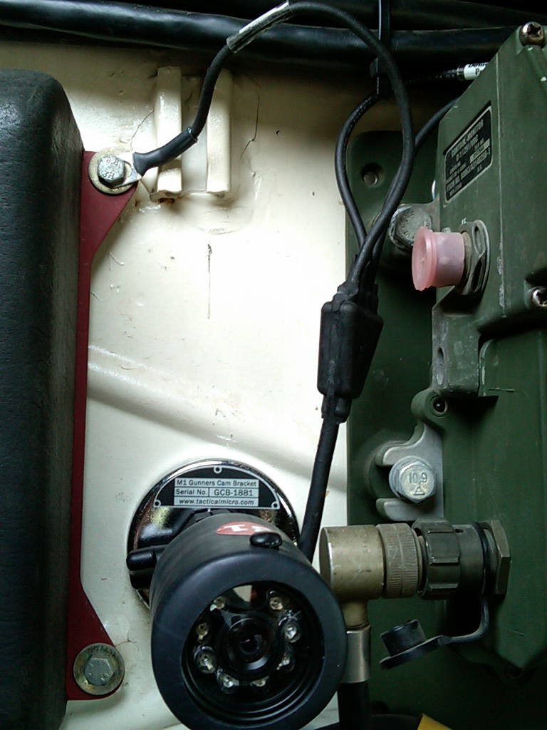
Finally, the Power Adapter Cable is grounded off inside the cab.

Slide 17
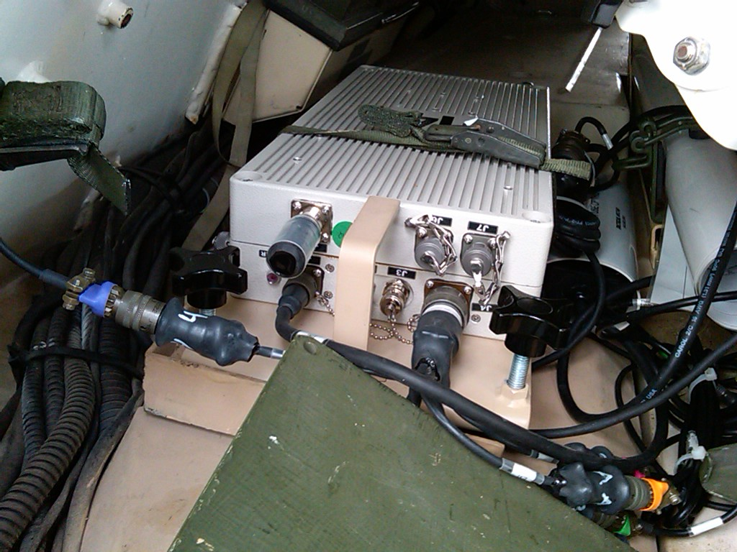
The Power Adapter Cable is ran behind the Co-Drivers/Gunners seat and connects into the J-1 Port on the CMU.

Slide 18
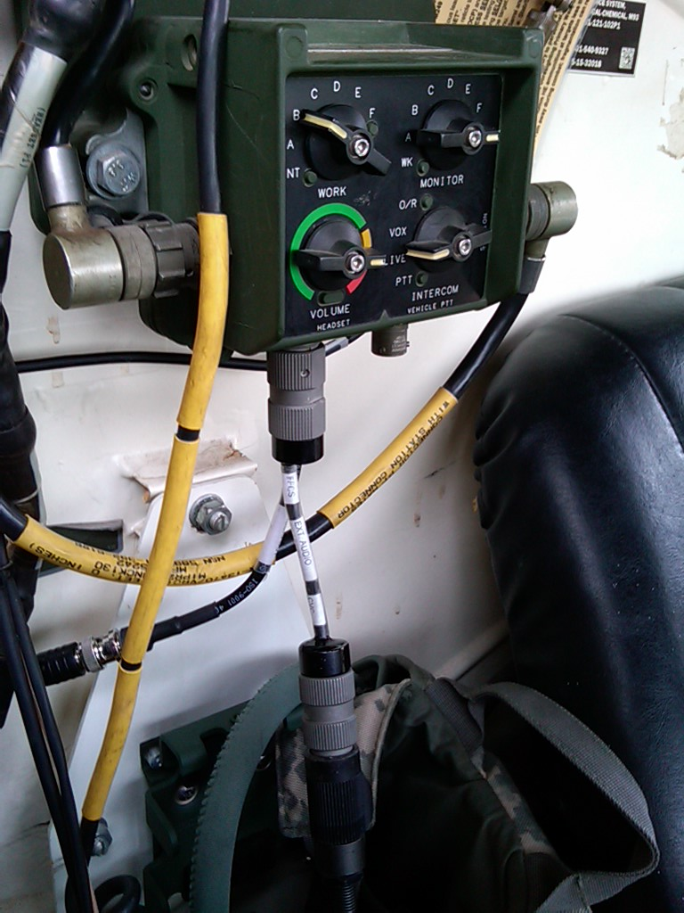
A
The External Audio Adapter (EAA) (A) attaches to the C-Box located on the rear of Cab. The crews headset audio cable then connects to our EAA Cable located at the arrow.

Slide 19
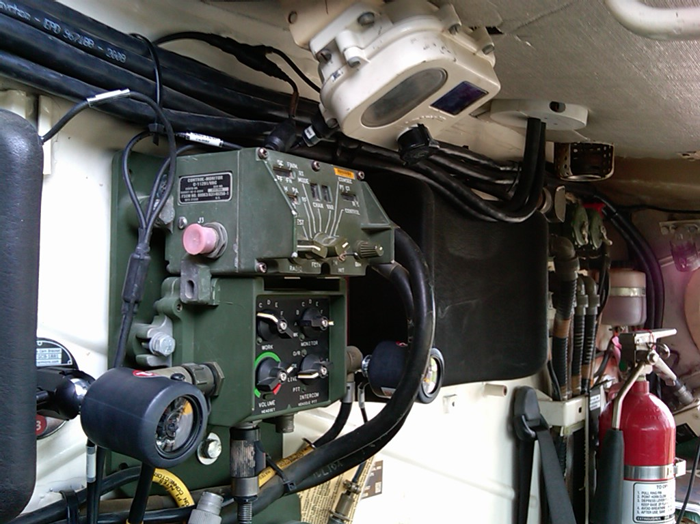
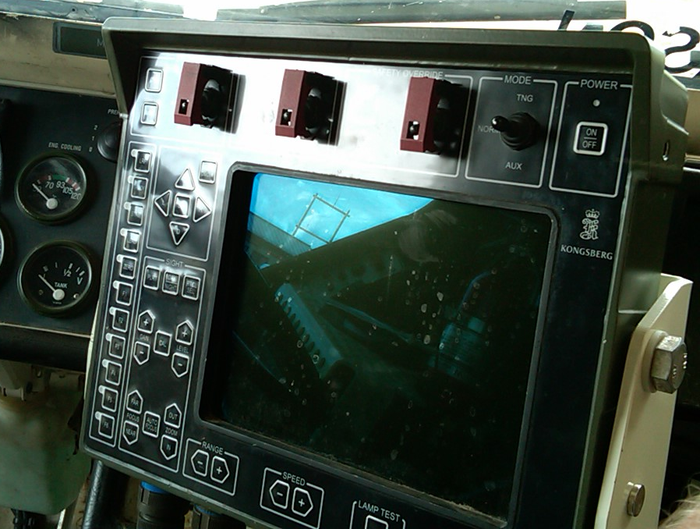
The Co-Driver’s/Gunner’s Crew Camera is mounted on the back of cab. This camera attaches to Port 2 on the Octopus Cable using the Red Cable. Use two Mini-magnets to attach the cable to the wall of the M93.
The camera should be facing the computer screen so the choices that are being made are visible.

Slide 20
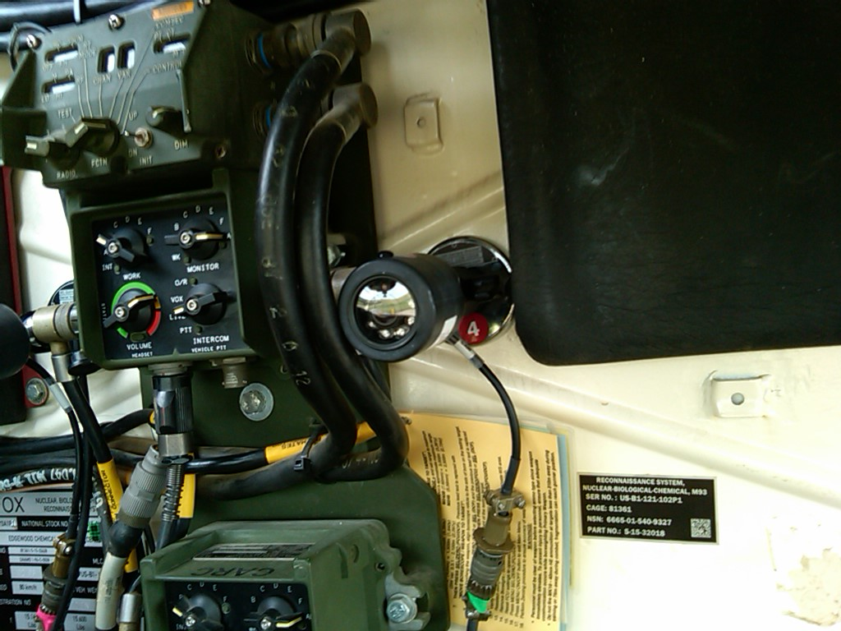
The Driver’s Crew Camera is mounted on the back of cab between the Head Pad and the C-Box. This camera attaches to Port 3 on the Octopus Cable using the Green Cable. Use two Mini-magnets to attach the cable to the Cab wall of the M93.

Slide 21
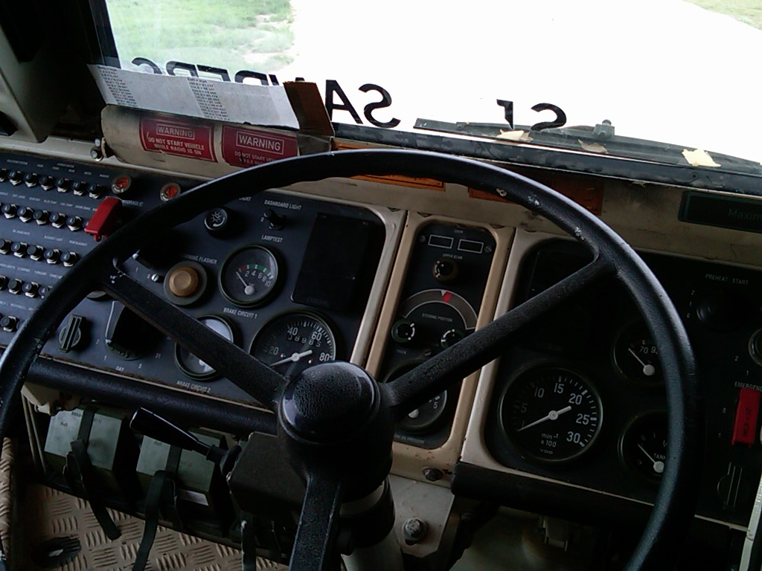
The camera should be facing towards the drivers dashboard area so it is visible.

Slide 22
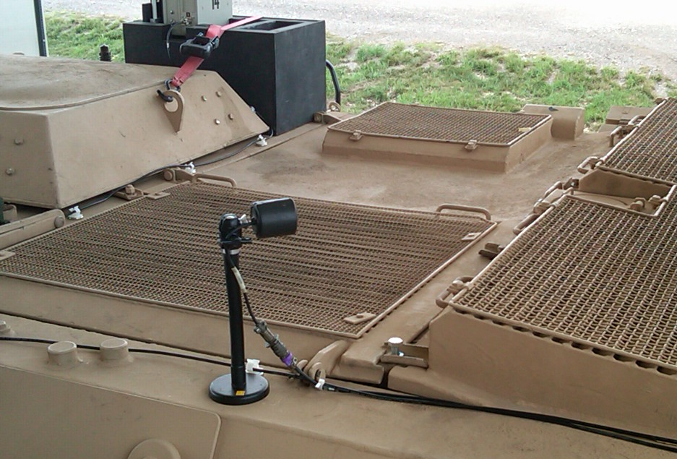
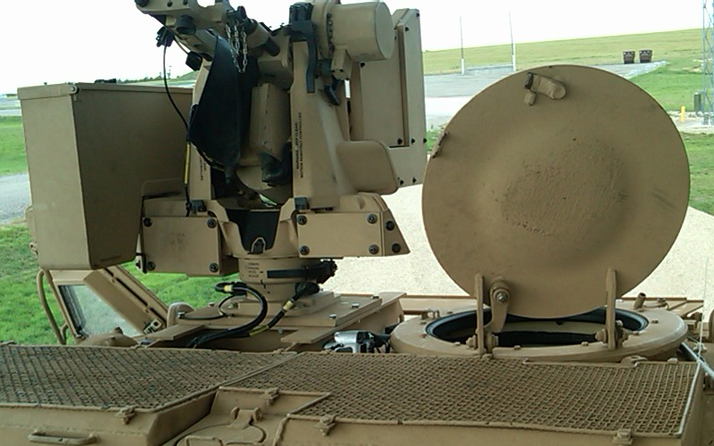
The Gunner’s Camera is mounted on the top of the M93 just behind the Co-Drivers/Gunners hatch area. The Purple Camera Cable connects to cable 1 on the Octopus Cable. The Purple Camera Cable is run along the top right side and down through the removed vision block. It is then ran along the top, inside of cab to the CMU. Ensure the cable is placed so it can not be disturbed by the Co-Driver/Gunner.
Make sure that the camera is pointed to show the view that is shown on the right.

Slide 23
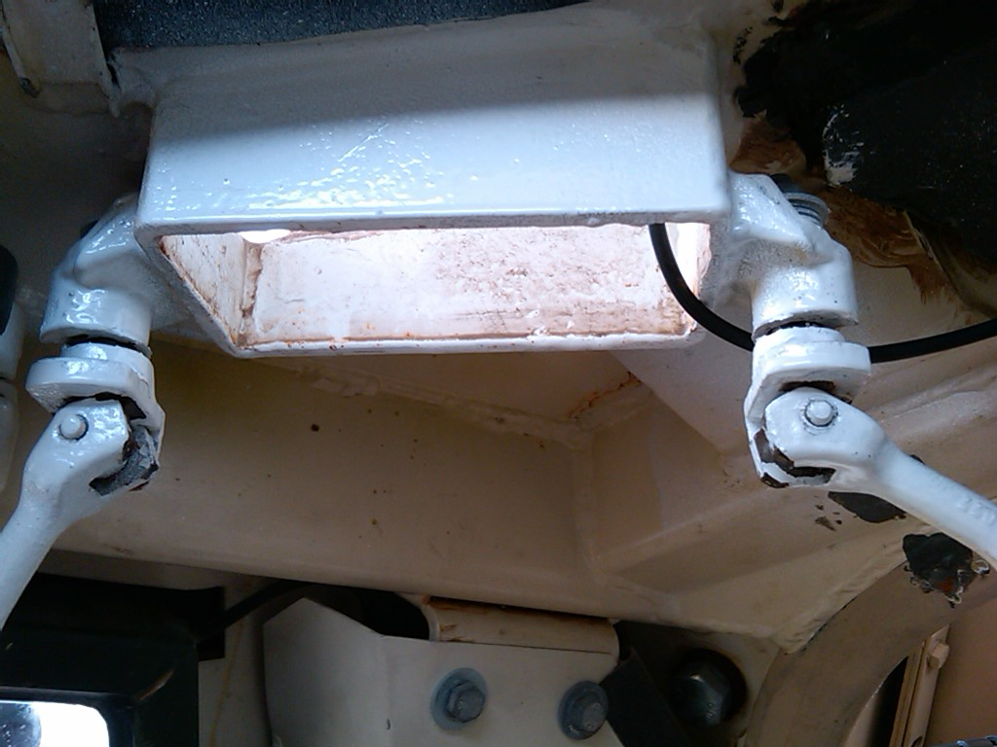
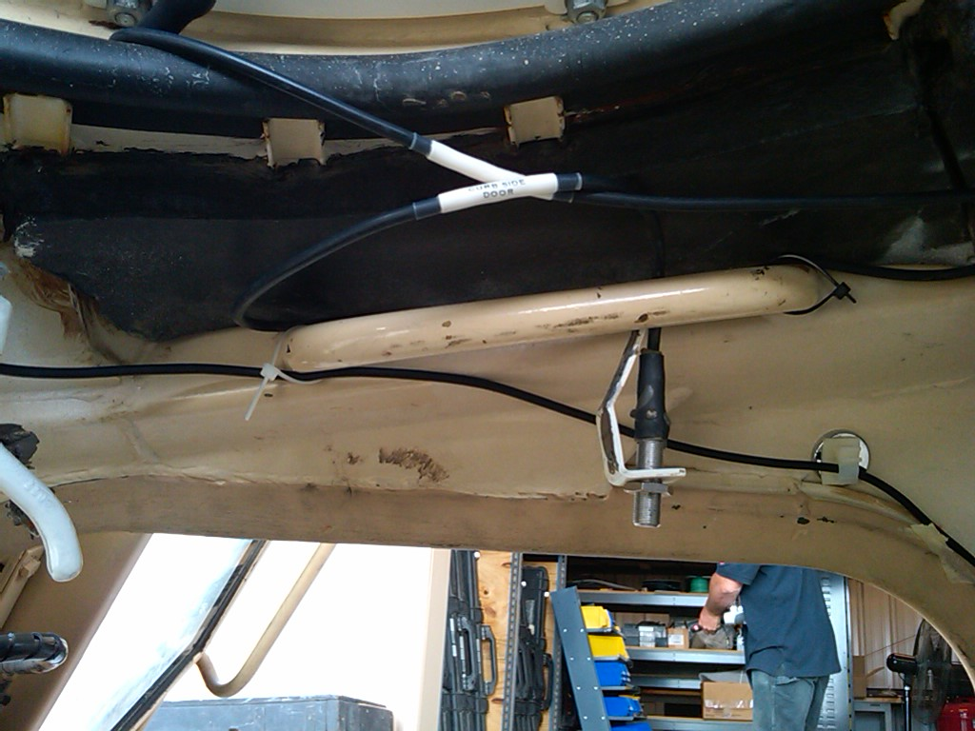
The Purple Camera Cable is ran through the vision block as shown
And runs along the top right side above the door. It then needs to be ran down the back side of the door as shown on the next slide.

Slide 24
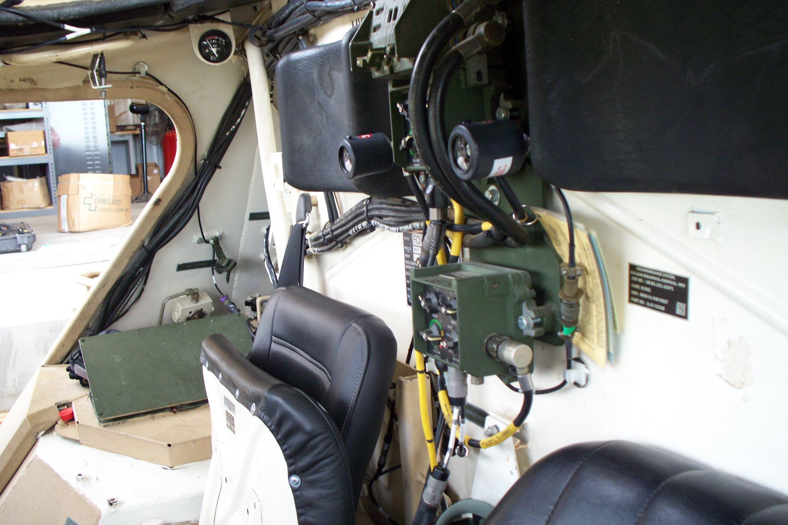
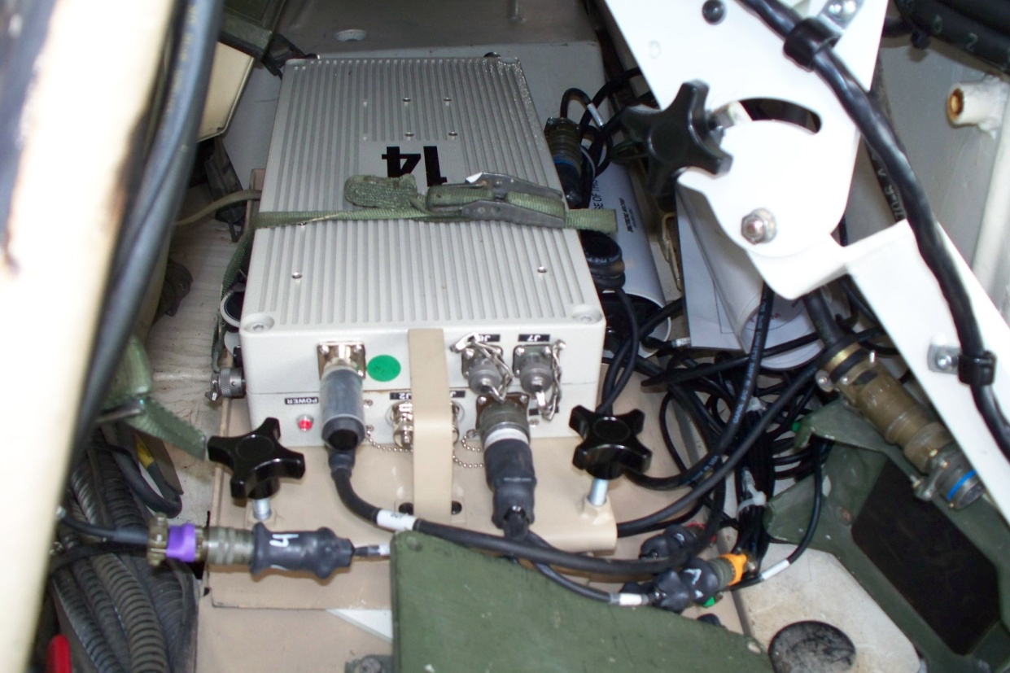
The cable is then ran down the back side of the door, and connects to the CMU that is located just behind the green plate.
Voltage Regulator
CMU
The Purple Camera Cable is shown connecting to the CMU that is stowed just behind the green plate. The Voltage Regulator (Power-Verter) is placed just to the right of the CMU.

Slide 25
Risk Assessment Considerations:
IPU mount is secure and proven with legacy system.
The Voltage Regulator (Power-Verter) is used as a protection for both the vehicle and the Player Unit. Ensuring any power surge from the vehicle would not be transferred to the Player Unit, Also it would prevent any electrical shorts from damaging the vehicles systems.
The risk is low to the vehicle and equipment due to the fuse system in the Voltage Regulator (Power-Verter) and the fuse on the CMU. The fuse on the CMU is accessible on the CMU without opening the box. The BMU is powered by its own battery system, therefore provides no risk on this family of vehicles due to power concerns.
With proper installation and education of the crew on the equipment, the instrumentation of this family of vehicles with the IPU poses no more risk to the crew or equipment than when this family of vehicle is instrumented with the legacy player unit.

