Slide 1
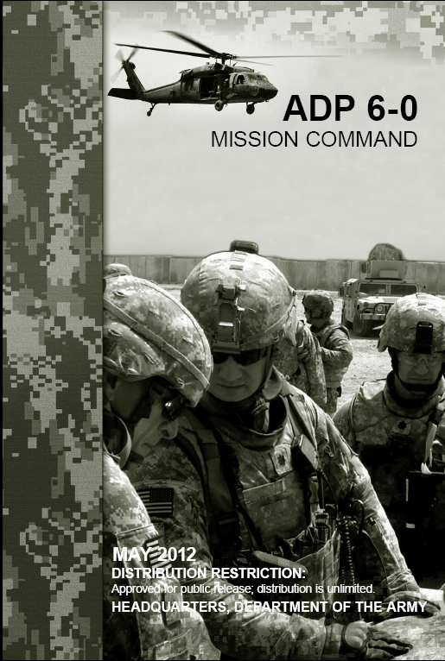
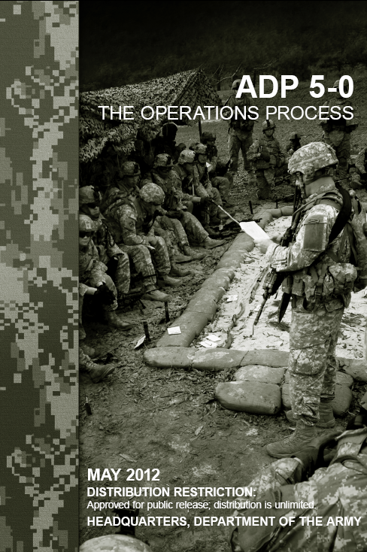
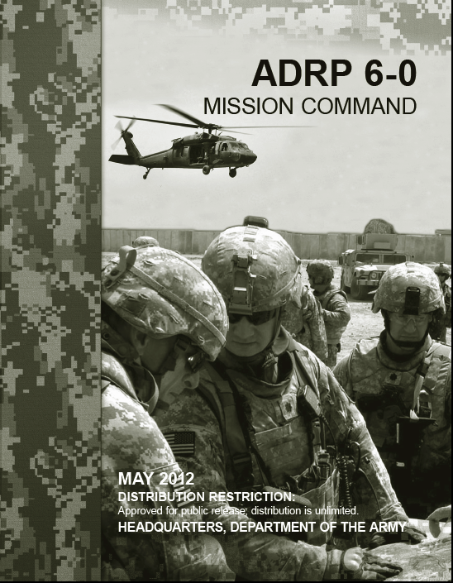
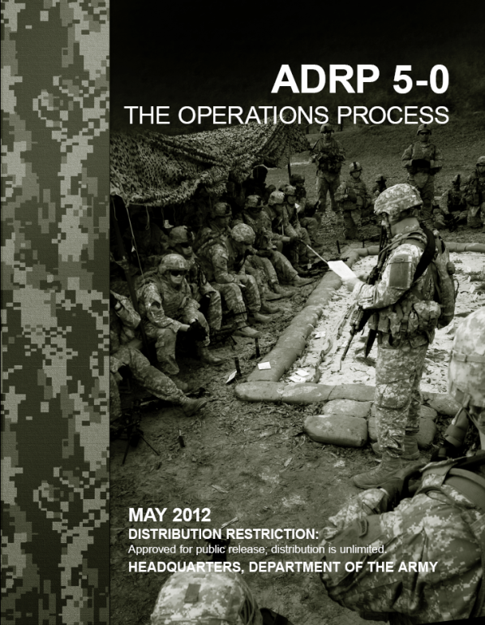
Mission Command & The Operations Process
Forever Forward OPD
8 Feb 2013

Slide 2
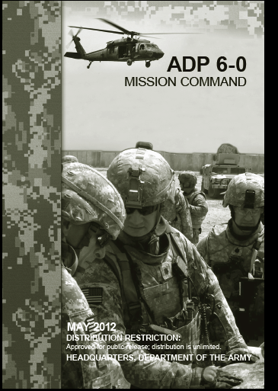
Mission Command Defined
UNIFIED LAND OPERATIONS AND MISSION COMMAND
1. Unified land operations is the Army’s operational concept. This concept is based on the central idea that Army units seize, retain, and exploit the initiative to gain a position of relative advantage over the enemy. This is accomplished through decisive action—the simultaneous combination of offensive, defensive, and stability operations (or defense support of civil authorities) that set the conditions for favorable conflict resolution.
2. The mission command philosophy of command is one of the foundations of unified land operations. Mission command is the exercise of authority and direction by the commander using mission orders to enable disciplined initiative within the commander’s intent to empower agile and adaptive leaders in the conduct of unified land operations. The mission command philosophy effectively accounts for the nature of military operations. Throughout operations, unexpected opportunities and threats rapidly present themselves. Operations require responsibility and decisionmaking at the point of action. Through mission command, commanders initiate and integrate all military functions and actions toward a common goal—mission accomplishment.
ADP 6-0, C1 (10 Sept 2012), page 1

Slide 3
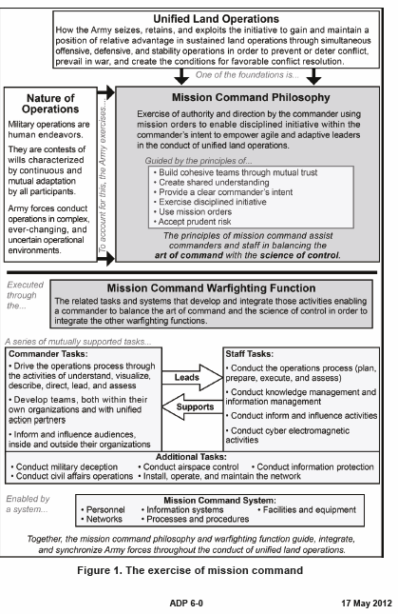

Slide 4
Six principles of Mission Command
Build cohesive teams through mutual trust.
Create shared understanding.
Provide a clear commander’s intent.
Exercise disciplined initiative.
Use mission orders.
Accept prudent risk.

Slide 5
The Challenge
“War is governed by the uncertain and the unknown and the least known factor of all is the human element.”
Captain Adolf Von Schell

Slide 6
MISSION COMMAND
Includes:
Visualizing the current state
Visualizing the future state
Formulate a concept of operation
Assign missions
Prioritize and allocate resources
Select critical times and places to act
Know how and when to make adjustments during the fight

Slide 7
MISSION COMMAND
Decision
Know if to decide…
…then when and what to decide
Tactical judgment
Anticipate activities once a decision is made
Know irretrievable commitments
Anticipate outcomes

Slide 8
MISSION COMMAND
Basis for decision
Mission; task and purpose
See/understand the enemy
See/understand the terrain/environment
See/understand self (friends/allies too)
Time
Others impacted by our actions
METT-TC

Slide 9
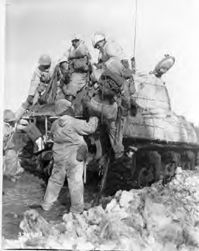
MISSION COMMAND
THE
UNAVOIDABLE
RISK
GIs in Germany, 1945

Slide 10
MISSION COMMAND
THEREFORE YOU MUST HAVE
WILL TO WIN
COURAGE
JUDGMENT

Slide 11
MISSION COMMAND
THE DIFFICULT CHALLENGE
“One of the most difficult things we have to do in war is to recognize the moment for making a decision.”
Captain Adolf Von Schell

Slide 12
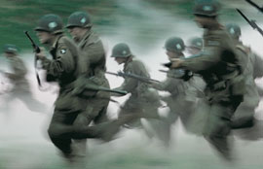
MISSION COMMAND
“Band of Brothers” Netherlands
Fall 1944
Disk 3, Part 5 – Crossroads: Start Time 1512

Slide 13
MISSION COMMAND
Leadership
Taking Responsibility for decisions
Loyalty to subordinates
Inspiring and directing assigned forces to a purposeful end
Establishing a teamwork climate that engenders success
Moral and physical courage
Provide vision

Slide 14
MISSION COMMAND
Command Imperatives
Battlefield position
Be with soldiers, sharing hardships, pride, and pain
Flexibility (Agile & Aggressive)
Know commander’s intent two levels above
Know your immediate commander’s concept of operation
Know the responsibilities of flank and supporting units

Slide 15
MISSION COMMAND
Control
Inherent in mission command
Set standards
Monitor status and standards of unit
Allows the commander freedom to operate
Staff works in the commander’s intent
Communications
Reporting

Slide 16
MISSION COMMAND
Forever Forward Brigade Mission Command
Uncompromising will to win; this means “fighting”
Combined arms commanders must understand and act on their decision quickly
Accurate and timely information
Decentralized
Burden of sound, timely decisions at the lowest level
Situational awareness/understanding of front, flanks, and rear…our environment and the threat

Slide 17
MISSION COMMAND
Key skills, etc.
Know combined arms combat doctrine
Know why and how the enemy fights
Know why and how our friends/allies fight
Know and appreciate terrain/environment
Know weapons
Know TLP and MDMP
Earn your soldier’s trust and respect

Slide 18
MISSION COMMAND
Conclusion
Know what must be done
Have a plan to get it done
Communicate that plan to your soldiers
Take note: Good combat skills will overcome a bad decision. Therefore, train well to kill and not be killed.

Slide 19
Now What?

Slide 20
SAFETY
(1 OF 3)
Safety is the result
of training,
confidence, discipline,
and leadership.
Purpose: Prevent unnecessary loss
of combat power
Safety is not an endstate; it is the way
we do business. Soldiers and equipment
should never be pushed beyond their
capabilities or used beyond their designed limits.
Train and educate soldiers to standard and apply established procedures. Develop soldiers who can use assigned weapons, vehicles, and equipment against all enemies in all conditions without killing or injuring themselves or their comrades. Good training makes soldiers confident and willful.

Slide 21
SAFETY
(2 OF 3)
Safety is the result
of training,
confidence, discipline,
and leadership.
Discipline soldiers to apply what they have
been trained to do. Develop them
to do what is right regardless of
circumstances. Teach soldiers to be ever
aware of conditions and change in conditions.
This requires a sense of duty and mental
and physical endurance.
Develop soldiers to care and look out for one another.
Leaders must be skilled in timely risk assessment. We
must be technically and tactically capable enough to
understand how the enemy, weather, terrain and friendly
forces increase risks. Leaders must always make and adjust
accordingly plans and orders and communicate/take action.
Never forget the last TLP:
SUPERVISION: LEADERS DO THIS FROM THE FRONT!

Slide 22
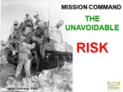
SAFETY
(3 OF 3)
TLP(Leaders):
-Commo
-OPORD/patrol ord
-Inspections
-Rehearsals
-Risk Assessment
-AAR
SAFETY
Trained/educated, rested,
& disciplined soldiers
Time
Distance
SAFETY
“OPTEMPO”
SAFETY
Complacency
Challenging Conditions
Quality
Maintenance
SAFETY
SOPs:
-Load plan
-Rollover drills
-Uniform
-Seatbelts
-Fire Evac
Certifying Facilitators,
Dispatching &
Licensing Vehicles

