Slide 1

1-7 CAV
“GARRYOWEN!”
TACSOP
DEC 2013

Slide 2
Table of Contents
Card Number | Title
Mission Command (000 series)
000-1, 000-2 | CAV Big 8
001 | SQDN Standard Graphics Names
002 | SQDN Rehearsal Format
003 | Confirmation Brief Format
004 | Back Brief Format
005 | SQDN COMMO Card / Net usage
006 | Standing CCIR
007-1, 007-2 | TOC Configuration
008 | CMD & SPT Relationship
009-1, 009-2 | Enabler / Attachments
010 | New Attachment Checklist
Intelligence (100 Series)
100 | PIR/SIR/Indicator linkage
101 | Information Collection
102 | Site Exploitation
103 | Results of Reconnaissance
Movement & Maneuver (200 Series)
200 | REDCON Status
201 | Adjacent Unit Coordination
202 | Relief in Place Checklist
203 | Passage of Lines Checklist
204 | Assembly Area Procedures
205 | Quartering Party Procedures
206 | Reconnaissance Methods / Types
207-1, 207-2, 207-3,207-4 | Route Recon Symbols and Overlay example
208 | Set & Established Criteria
Fires (300 Series)
300 | Target Block Numbers
301 | Clearance of Fires
302 | Emergency CAS
303-1, 303-2 | Air Ground Integration
304 | LZ Operations
305 | Information Operations
306 | Media Interaction
Sustainment (400 Series)
400 | 3-Day Recovery Plan
401-1, 401-2 | M113 Ambulance Load plan
402-1, 402-2 | MASCAL SOP
403 | Aid Station Capabilities
404 | EVAC SOP
405 | EPW Casualty SOP
406 | CTCP Overview
407 | FTCP Overview
408 | UBL (Bradley)
Protection (500 Series)
500-1, 500-2 | Risk Managment
501-1, 501-2 | Breach Lane Marking
502 | Bypass Marking
503 | EWO
504 | MOPP Levels / Unmasking Procedures
505 | Uniform & Weapon Safety Postures
Reports | GREEN Reports
 | BLUE Reports
 | YELLOW Reports
 | RED Reports
 | PURPLE Reports
 | CBRNE Reports

Slide 3
Mission Command
000 series cards
CAV Big 8
Squadron Standard Graphics Names
Squadron Rehearsal Format
Confirmation Brief Format
Back Brief Format
Commo Card / Net Usage
Standing CCIR
TOC Configuration
Command and Support Relationship Chart
Enabler / Attachment Chart
New Attachment Checklist

Slide 4
Card: # 000-1
CAV Big 8
1 BCT CAV BIG 8 STANDARDS
 | BLACK(1) | RED (2)
1. OPORD | No orders issued | Failure to issue or develop any paragraph or failure to restate essential tasks or task and purpose
A. DIRECT FIRE PLAN | No plan | Did not attain one or more areas under criterion for (AMBER)
2. GRAPHICS | Not done | No refinement of graphics; no dissemination or briefing of SITEMP; and/or graphics not issued to all subordinate elements or attached/OPCON elements.
3. PCC/PCI | Not conducted | Did not attain one or more areas under the criterion for (RED); did not attempt to correct deficient areas
A. BORESIGHT | Not done | Not done by all or not conducted to the same standard
B. 5988E | Not done or turned in | PMCS, faults verified by mechanics, Not done by all or not conducted to same standard
C. RESUPPLY | Not identified. | Unit has not met one of the above criteria for a (AMBER); insufficient material to accomplish the mission; unaware of CL III/V/VIII status
4. REHEARSALS | Not conducted | Did not meet one or more of the criteria for a (AMBER)
5. SECURITY | No plan | Security drops below required levels, unaware of compromise
8. RISK MANAGEMENT | No risk assessment conducted | Risk identified but no reduction by control measures nor any supervision

Slide 5
Card: # 000-2 CAV Big 8
1 BCT CAV BIG 8 STANDARDS
 | AMBER (3) | GREEN (4/5)
1. OPORD | Maximizes available time through the use of WARNOs and FRAGOs, a five paragraph Order that has been developed through analysis of the higher order; clearly restates the essential tasks (task and purpose); addresses accomplishment of each specified task from the higher HQ order; assigns a task and purpose to each subordinate element, and is based on IPB. | Analysis of implied tasks and addresses further development of branches and sequels to the base plan.
A. DIRECT FIRE PLAN | Leaders apply factors of METT-T and IPB/OCOKA to determine direct fire control and execution to support task/purpose; id scheme of maneuver and adequate control measures to focus, shift, mass, and distribute the combined effects of weapon systems | Leaders specific methods to control fires; fire control plan is rehearsed; integration of indirect fires into fire control plan; plans for limited visibility and degraded capabilities.
2. GRAPHICS | Support task and purpose, scheme of fires, scheme of maneuver, throughout the AO's depth; disseminated to all vehicle commanders; infantry squad leaders, and attached/OPCON elements. | Graphics support branch plans and sequels; issues refined SITEMP; issues a refined DST; disseminates a copy of consolidated graphics; issues CSS graphics.
3. PCC/PCI | Conduct prep-to-fire checks; weapons test fires; load plans inspected and made safe; camouflage applied; perform before ops pmcs; complies with UNIT commanders prescribed list from WO/OPORD/SOP; CONDUCTS A COMMO CHECK ON Command, subordinate, fire support, and CSS nets; uniform and MOPP are IAW OPORD; graphics checked and subordinate unit briefbacks conducted. | Progress of preparations tracked and reported to higher HQ; Commander inspects or has designated inspection team SMEs check prescribed areas; deficiencies re-inspected
A. BORESIGHT | All combat systems boresighted to a known distance at day and night, verified and reported to higher HQ | Conducted at multiple ranges by weapon type against moving targets
B. 5988E | Administrative and equipment data correct; PMCS conducted, all faults verified by mechanics, all faults annotated all faults have part numbers or job orders. Signed or initialed by operator and mechanic NCO. | All corrected faults annotated, all parts on order have valid status.
C. RESUPPLY | Unit crosses LD or defends with “Green” UBL status on CLIII/V/VII; completes and verifies at least 90% of combat systems 5988s, and maintains a status of NMC vehicles | Available assets to conduct resupply of III/IV/VII enroute or at consolidation; issues infantry demolitions (breach kits) and hand grenades; and planned for normal and NBC casualty evacuation; CSS plan and maneuver plan integrated and briefed, rehearsed, and on graphics
4. REHEARSALS | Reinforces higher and lower's task and purpose, scheme of maneuver, fires, and support; integrates actions of subordinate elements throughout operation; identified MPCOA, MDCOA, composition, disposition, and strength; depicts graphics, terrain, enemy, and friendly forces during rehearsal; uses appropriate type and technique given available time and resources | Discusses higher intent, scheme of maneuver, fires and CSS; branch plans and contingencies without wargaming; addresses the 7 forms of contact; incorporates attached/OPCON units into rehearsal; subordinate elements conduct generic, mission oriented battle drill rehearsals prior to; conduct separate CSS and/or fire support rehearsals
5. SECURITY | Designates a security plan; maintains security throughout planning and preparation phases; has passive NBC defense established (M22 detectors/M9 paper); conducts active/passive security patrols; and enforces REDCON levels | Designates air guards; conducts adjacent unit coordination for security plans and patrols routes; designates a QRF in case of imminent attack; and/or executes a jump plan to a new location if compromised by enemy ground or air reconnaissance
8. RISK MANAGEMENT | Uses an effective SOP or conducts formal risk assessment to ID & assess hazards, develop control measures, disseminates control measures, implement control measures, and supervise | Continues to refine or regularly update risk level by FM or voice; tracks risk level in company CP; ID types of risk – Tactical and Accidental; and conducts and internal evaluation risk review after mission execution

Slide 6
Card: # 001
Standard Graphics Names
STANDARD GRAPHICS IAW 1BCT TACSOP
CONTROL MEASURE DESIGNATION
Phase Lines Female names
Objectives Presidents
Routes NFL Teams
Areas (Assembly, LZ, etc) Trees
Axes Weapons
Points 200-299
NAIs 200-299
Targets AE 2000-2999
Target Groups E20R-E29R
Other Control Measures Soft Drinks
Named Operations Domestic Beers

Slide 7
Card: # 002
SQDN Rehearsal Format
Squadron Rehearsal Format
XO – Agenda/Rules/Briefing Sequence & Script
S3 – Operation Overview (Mission, Intent and Concept of the Operation) & Orient Participants to the Terrain
XO – Define Key Events to be Rehearsed & Time (See Below)
S2 – MPCOA
S3 – Friendly Forces Disposition at Rehearsal (L/D, NLT LD)
Units Participating in Operation – By Unit, By WFF (See Script)
S2 – Update Enemy Actions Across WFF
Terminate Rehearsal After Reaching Commander’s Endstate
Potential Verbal/Written FRAGOs May Result
Rehearse Decision Points and Branch Plans
Script
XO – Key Event/Phase Description/Time
S2 – Enemy Movement
Unit Participating
  Maneuver Units
  Fires Coordinator
  Protection
  Sustainment
  Mission Command
  Decision Point or Endstate of Key Event/Phase
Briefing Format
CBT Power and Locations
Task Organization
Task & Purpose
Key Coordination/Issues
Key Events to Rehearse
Instructions for the Recorder
Issue:
Responsibility to Fix
Suspense

Slide 8
Card: # 003
Confirmation Brief Format
Used to confirm information on a mission to next higher level Commander
  Used immediately after OPORD brief
  May be verbal or digital, face to face, or via radio/telephone
Consists of:
Higher Mission and Commander’s Intent.
Assets available.
Your unit’s link to the main effort and how you will support the mission/intent.
Specified/Implied tasks.
Coordination required
Questions/Concerns
Sample Format
ASSETS AVAILABLE
SPECIFIED/IMPLIED TASKS
HIGHER MISSION/INTENT
MY LINK TO MAIN EFFORT
COORDINATION REQUIRED
QUESTIONS/CONCERNS
PIR
SIR
Indicators

Slide 9
Card: # 004
Backbrief Format
Used to confirm information on a mission to next higher level Commander
  Used to back brief next higher level commander of Troop mission analysis and mission information you will provide to subordinate units.
  May be verbal or digital, face to face, or via radio/telephone
Consists of:
Task Organization
Your Mission
Your Commanders Intent
Concept of the Operation/Scheme of Maneuver
Troop to Tasks (Specified tasks to subordinate units)
Anticipated decision points
Concerns
PIR / SIR & NAI Coverage plan
Sample Format
Task Organization
Mission
Concept
Troops to Task
Intent
Anticipated Decisions
Concerns
PIR
SIR
Indicators

Slide 10

GARRYOWEN COMMO CARD
Card: # 005
AS OF 10 DEC 2013
Unit | Section | Call Sign | NET ID | S/C |  | SUFFIXES |  |  | EXPANDERS |  |  | COMPANY CALL SIGNS
CMD GROUP & HQ |  |  |  |  |  | POSITION | SUFFIX |  | POSITION | EXP |  | WHEN FIXED CALL SIGNS ARE NOT USED
1-7CAV SQDN | CMD | GARRYOWEN | 424 | M67.725 |  | CDR | 6 |  | ABN CP | A |  | UNIT |  |  | PREFIX
 | O/I |  | 425 | M81.875 |  | CSM/SGM/1SG | 9 |  | ALT | H |  | A CO |  |  | ALPHA
 | A&L |  | 426 | M41.025 |  | ADC (M) | 7 |  | ASSUALT | L |  | B CO |  |  | BRAVO
1-7 FIRES | (V) |  | 427 | M64.725 |  | ADC (S) | 8 |  | AVLB | N |  | C CO |  |  | CHARLIE
1-7 FIRES | (D) |  | 428 | M69.525 |  | COFS/XO | 5 |  | BATCON | B |  | D CO |  |  | DELTA
HHT |  |  |  |  |  | S1 | 1 |  | COLT | P |  | E CO |  |  | ECHO
HHT/1-7 CAV | CMD | HELLFIGHTER | 429 | M74.725 |  | S2 | 2 |  | CREW CHIEF | C |  | HHC/HHT |  |  | HOTEL
A TRP |  |  |  |  |  | S3 | 3 |  | DEPUTY | W |  | 1ST PLT |  |  | RED
A/1-7 CAV | CMD | APACHE | 430 | M45.825 |  | S4 | 4 |  | DECON | Q |  | 2ND PLT |  |  | WHITE
1/A/1-7 CAV |  |  | 202 | M42.325 |  | S6 | 23 |  | GUNNER | U |  | 3RD PLT |  |  | BLUE
2/A/1-7 CAV |  |  | 203 | M84.075 |  | FSE/FSO/FIST | 14 |  | DRIVER | D |  | 4TH PLT |  |  | GREEN
MOTR A/1-7 |  |  | 431 | M46.725 |  | LNO | 24 |  | NCOIC | E |  | 5TH PLT |  |  | YELLOW
B TRP |  |  |  |  |  | CHAPLAIN | 28 |  | FORWARD | J |  | HQ PLT |  |  | SILVER
B/1-7 CAV | CMD | BLACKHAWK | 432 | M65.175 |  | CHEM | 30 |  | TAC | T |  | RECON |  |  | GOLD
1/B/1-7 CAV |  |  | 204 | M86.575 |  | ENG | 34 |  | MAIN/TOC | M |  | MEDICAL |  |  | BLACK
2/B/1-7 CAV |  |  | 205 | M59.175 |  | EWO | 36 |  | OBSERVER | O |  | MORTER |  |  | BRONZE
MORT/B/1-7 CAV |  |  | 433 | M77.175 |  | LOG/OPNS | 41 |  | OIC | V |  | AMMO |  |  | ORANGE
C TRP |  |  |  |  |  | MAINTINANCE | 12 |  | REAR/CP | R |  | SUPPORT |  |  | BROWN
C/1-7 CAV | CMD | COMANCHE | 434 | M76.175 |  | MEDICS | 40 |  | RECON | X |  | SNIPER |  |  | GRAY
1/C/1-7 CAV |  |  | 206 | M31.625 |  | RETRANS | 70 |  | SCOUT | Y |  | FIST |  |  | COPPER
2/C/1-7 CAV |  |  | 207 | M63.125 |  | TRANSPO | 89 |  | CTCP | Z
MORT/C/1-7 CAV |  |  | 435 | M67.575
DFST |  |  |  |  |  | SMOKE and PYROTECHNICS |  |  |  |  |  |  |  | TACSAT NET
D/115TH FSC | CMD | DARKHORSE | 436 | M31.275 |  | SMOKE |  | KEY SIGNAL DEFINITIONS |  |  |  |  |  | SATELLITE #
D/115TH FSC | O/I |  | 437 | M34.975 |  | WHITE |  | No Meaning - use for screening purposes only |  |  |  |  |  | SATELITE LOC:
1/D/115TH |  |  |  |  |  | RED |  | Danger Do Not Land, Parachute or drop supplies here |  |  |  |  |  | SATELITE CHAN
2/D/115 FSC |  |  |  |  |  | GREEN |  | Target Destination |  |  |  |  |  | TERMINAL CHAN
3/D/115 FSC |  |  |  |  |  | VIOLET |  | Safe to Land, Parachute, or drop supplies here |  |  |  |  |  | UPLINK
 |  |  |  |  |  | YELLOW |  | Real Emergency - Send Assistance to this area |  |  |  |  |  | DOWNLINK
UNIT | CALL SIGN | NET | NET ID | SC |  | PYROTECHNICS |  | DEFINITIONS |  |  |  |  |  | AZIMUTH
1BCT | IRONHORSE | CMD | 400 | M31.325 |  | WHITE STAR CLUSTER |  | Commence Firing/Launch Attack |  |  |  |  |  | ELEVATION
2-8 CAV | STALLION | CMD | 453 | M60.575 |  | WHITE STAR PARACHUTE |  | Air Strike, CBR, or Ground Strike Anticipated |  |  |  |  |  | MODE OF OPER.
2-5 CAV | LANCER | CMD | 438 | M54.975 |  | GREEN STAR CLUSTER |  | Objective Taken/Mission Accomplished |  |  |  |  |  | BANDWIDTH
1-82 FA | DRAGON | CMD | 465 | M63.075 |  | GREEN STAR PARACHUTE |  | Cease All Fires/Cease Air Strike |  |  |  |  |  | CALLSIGN
1BSTB | CENTURION | CMD | 410 | M44.725 |  | AMBER STAR CLUSTER |  | No Meaning - Use for Illumination only
115TH BSB | MULESKINNER | CMD | 491 | M80.775 |  | AMBER STAR PARACHUTE |  | Request Supporting Fires |  |  |  |  |  | HF NET
 |  |  |  |  |  | RED STAR CLUSTER |  | Break Contact with Enemy/Withdraw |  |  |  |  |  | DAY TIME FREQ (P)
UNIT | CALL SIGN | NET | NET ID | SC |  | RED STAR PARACHUTE |  | Spare |  |  |  |  |  | DAY TIME FREQ (A)
RANGE CONTROL | RANGECONTROL | PRIMARY | N/A | M30.450 |  | RED SMOKE STREAMER |  | Lift Supporting Fires |  |  |  |  |  | NITE TIME FREQ (P)
LIFESAVER | LIFESAVER | PRIMARY | N/A | M38.450 |  | YELLOW SMOKE STREAMER |  | Challenge: Are you Friendly? |  |  |  |  |  | NITE TIME FREQ (A))
 |  |  |  |  |  | GREEN SMOKE STREAMER |  | No Meaning - Use for Illumination only
 |  |  |  |  |  | VIOLET SMOKE STREAMER |  | Reply: Friendly Troops Here
NET STRUCTURE | BDE CMD | BDE A/L | SQDN CMD | SQDN O/I | SQDN A/L | FIRES VOICE | FIRES DIG
TOC | X |  | NCS | X | X
TAC |  |  | X | X
SCO |  |  | X
S3 |  |  | X
SXO |  |  | X |  | X
CSM |  |  |  |  | X
S-2 |  |  | X | NCS
FIRES |  |  |  |  |  | NCS | NCS
TRP TOCs |  |  | X | X | X | X | X
TRP 1SGs |  |  |  |  | X
TRP FIST |  |  |  |  |  | X | X
CTCP |  | X | A/NCS | A/NCS | NCS | A/NCS | A/NCS
S4 |  |  | X |  | X
FTCP |  |  | X |  | A/NCS
SMO |  |  |  |  | X
SPT PLT |  |  |  |  | X
S6 |  |  | X
MED PLT |  |  |  |  | X
AID STATIONS |  |  |  |  | X
ATTACHMENTS |  |  | X |  | X | X | X
Net Usage
Squadron Command Net
  Control of the close fight
  Pertinent, real time information
  Used for sending/receiving decisions/conclusions
  Operations and Intelligence Net (O&I)
    Control of the deep or future fight
    Used for sending/receiving data requiring analysis
    Administrative and Logistics Net (A&L)
    Sustainment operations
    Routine, non-critical information
    LOGPAC and convoy control
    Fires (Voice and Digital)
    Fire support coordination
    Fire mission requests

Slide 11
Standing CCIR
Card: # 006
Standing CCIR
PIR
Contact with enemy armor or ATGM system, and type of contact (observed, direct fire, indirect fire, CBRN, etc)
Accurate and sustained enemy IDF
FFIR
Death or serious injury of GO Trooper
Loss of section size or greater of combat power
Loss of sensitive item
Engagement, disengagement, displacement criteria met
Loss of MC / Sustainment node
EEFI
Location of Mission Command Nodes
Location of friendly IDF assets
Location of Sustainment Nodes

Slide 12
Entrance
Squadron TOC Layout
Card # 007-1
TOC Layout
Plans
CMD
Tent
Entrance
10K
TMSS
ECP Tent
TMSS
S3
Mission
Command
Fires
HQ300
HQ30
S2
HQ20
NIPR / SIPR LINES
S6
HQ18
ENEMY
STT
HCLOS
Status | Planned Stationary Time
Red | <12 hours
Amber | >12 hours
Green | >24 hours

Slide 13
Squadron TOC SICPS Layout
(Amber / Green)
Card # 007-2
TOC Layout
Entrance
ECP Tent
Tracker board
OPs Map
S2 Map
Fires Map
FSCMs
Enablers
Fires trackers
S3
Mission Command
BLT CPT
Fires
AFATDS
S3 Track Ramp
Fires Track Ramp
CMD
A&L
O/I
BDE
CPOF
SVOIP
NIPR
BTL NCO
SXO
SVOIP
EWO
FSO
HF
FBCB2
JTAC
Coffee pot
SVOIP
CPOF
Detached SICP
DCGS
S2
NIPR
S2 Track Ramp
SIPR
CPN
NIPR
CPN
S6
NIPR / SIPR LINES
OSRVT
GBS
Help desk
S6 Track Ramp
SVOIP

Slide 14
Card: # 008
Command and Support Relationship Chart
Use this chart to define your responsibilities if you receive an attachment or are detached to another unit.
Proponent publication for this chart is Appendix F, FM 5-0
IF RELATIONSHIP IS: |  | INHERENT RESPONSIBILITIES ARE:
 |  | Has CMD Relationship With: | May Be Task Organized By: | Receives CSS From: | Assigned Position or AO By: | Provides Liaison To: | Establishes/ Maintains Comms With: | Has Priorities Established By: | Gaining Unit Can Impose Further CMD or Suppt Relationship of:
COMMAND | Attached | Gaining Unit | Gaining Unit | Gaining Unit | Gaining Unit | As Req by Gaining Unit | Unit to which attached | Gaining Unit | Attached; OPCON; TACON; GS; GSR; R; DS
 | Operational Control (OPCON) | Gaining Unit | Parent and Gaining Unit; Gaining Unit may pass OPCON to Lower HQ. NOTE 1 | Parent Unit | Gaining Unit | As Req by Gaining Unit | As Req by Gaining and Parent Unit | Gaining Unit | OPCON; TACON; GS; GSR; R; DS
 | Tactical Control (TACON) | Gaining Unit | Parent Unit | Parent Unit | Gaining Unit | As Req by Gaining Unit | As Req by Gaining and Parent Unit | Gaining Unit | GS; GSR; R; DS
 | Assigned | Parent Unit | Parent Unit | Parent Unit | Gaining Unit | As Req by Parent Unit | As Req by Parent Unit | Parent Unit | N/A
SUPPORT | Direct Support (DS) | Parent Unit | Parent Unit | Parent Unit | Supported Unit | Supported Unit | Parent Unit: Supported Unit | Supported Unit | NOTE 2
 | Reinforcing (R) | Parent Unit | Parent Unit | Parent Unit | Reinforced Unit | Reinforced Unit | Parent Unit; Reinforced Unit | Reinforced Unit; Then Parent Unit | N/A
 | General Support Reinforcing (GSR) | Parent Unit | Parent Unit | Parent Unit | Parent Unit | Reinforced Unit and as Req by Parent Unit | Reinforced Unit and as Req by Parent Unit | Parent Unit; then Reinforced Unit | N/A
 | General Support (GS) | Parent Unit | Parent Unit | Parent Unit | Parent Unit | As Req by Parent Unit | As Req by Parent Unit | Parent Unit | N/A
 | NOTE 1. In NATO, the gaining unit may not task-organize a multinational unit (see TACON)
 | NOTE 2. Commanders of units in DS may further assign support relationships between their subordinate units and elements of the supported unit after coordination with the supported commander

Slide 15
Use this chart as a guide when you are given an attachment or enabler
Card: # 009-1
Enablers / Attachments
Enablers
WFF | Enabler | Description | Capabilities | Limitations | Tasks (example) | Purpose (ex)
Movement & Maneuver | Air Weapons Team | 2x AH64 8x Hellfire 8km 36x 2.75” Rkt 8km 1200rds 30mm 4200m | Destroy armored vehicles and personnel; conduct area/route recon; block or deterrent if used overtly; optics to 8km | Limited station time (2hrs); DART mission if shot down | ABF, SBF | destroy, fix, deny, attrit, interdict
 | Scout Weapons Team | 2x OH58 .50 cal 1800m 7x 2.75” Rkt 8km 2x Hellfire 8km | Long range day & night optics 10km; can observe fires; | Limited station time (2hrs); DART mission if shot down; cannot destroy armored vehicles | Route/ area recon, screen | identify, confirm or deny
 | Air Insertion Aircraft | 2x UH60 | Insert 11x dismounts per aircraft to OPs much faster and to terrain inaccessible to Bradleys | Large signature into forward battle space; DART mission if shot down | Air insert, Air assault | Support, enable
 | Fixed Wing AV | F15, F16, F/A18, B1 | Long range precision munitions; Psychological effects; Long range optics 20-30km | Limited station time (2hrs); weapon release authority; Very deliberate planning | ABF, Fix, Interdict, Recon, Suppress | destroy, identify, deny
 | Sniper Team | 3x man team (sniper, spotter, security) | M110/M24 7.62 or M107 .50 cal; up to 2km range, observation 5k; | Should be covertly inserted, may require additional security, if compromised require immediate extraction | Interdict, attrit, harrass, infiltrate | Deny, prevent, protect, support
 | Tank Plt | 4x M1A1/2 Abrams | 3km direct fire range; Optics comparable to CIV; Psycological effects; can destroy anything | Large CLIII, V allocation | ABF, SBF, assault, breach, suppress | destroy, fix, deny, attrit, interdict
 | Infantry Plt | ~27x Soldiers | Greater dismount capability; machine gun squad; AT capability | Unless Mechanized, will need transportation; Large CL I, V allocation | Secure, Defend, Sieze strongpoints; Ambush & Raid | destroy, fix, deny, attrit, interdict
Fires | Paladin Btry | 6x 155mm | 24-30km range; Paladins can keep up with Bradleys and traverse similar terrain; | PAA may need additional security; enemy counter fire; Large CL III, V allocation | Block, Delay, Defeat, Destroy, Fix, Isolate, Neutralize, Suppress | Disrupt, neutralize, Destroy, suppress, obscure
 | MLRS Btry | 4x Launchers | 64km range; Can fire DPICM or guided munitions | Massive firing signature; PAA may need additional security; Large CL V allocation
 | JTAC / ROMAD | 3-4x USAF personnel | Specialists in coordinating Air to Ground operations with CAS; can be inserted forward to an OP | Will need security provided | Follow & Support | Conduct targeting cycle with fixed wing aircraft

Slide 16
Card: # 009-2
Enablers / Attachments
WFF | Enabler | Description | Capabilities | Limitations | Tasks (example) | Purpose (ex)
Intelligence | SIGINT (PROPHET) | 3x HMMWV (2x sensors, 1x control truck) | Sensor trucks must be spread out over terrain IOT identify enemy comms | Need security provided, only personal weapons | Conduct signal recon | Identify full spectrum enemy commo signals
 | HUMINT | Team / squad | Gather information on local populace | Will need security provided | Conduct human recon | confirm, deny
 | PSYOPS & Civil Affairs | Team / squad | Messaging and information operations to influence local populace and/or enemy | Will need security provided | Conduct information operations | Pursuade, inform, influence
Protection | Chemical Recon | 4x Strykers | Identify type of CBRN agent; conduct on site contamination severity assessment and downwind hazard | Will need security provided | Conduct CBRN Recon | Protect the Troop / squadron, Confirm or deny CBRN hazard
 | Decontamination | PLT size, LMTV, HMMWV w/ trailers | Provide Operational decon or Troop level hasty decon | Will need security provided; Needs large area to conduct decon far away from friendly forces; Require 5k gallons of water | Conduct Decon | Protect the force from confirmed or suspected CBRN exposure
 | Engineer Recon | 1-2x Bradley | Identify location and type of obstacle, assist with breach planning; can traverse same terrain as 1-7 | Will need some security provided if decisively engaged with obstacle recon | Identify number, size, type of obstacles | Prevent friendly forces from entering obstacle belt
 | Military Police | Squad - PLT | Secure detainees; riot control; IDP / refugee mvmt control; small area security, route security | Possibly need security and transportation | Secure | Control movement of civilians
Sustain-ment | Utility Lift Aircraft | 2x UH60 or CH47 | Airlift supplies and/or personnel very rapidly | Must have suitable LZ; DART mission if shot down | Transportation, Resupply | Provide BDE wide LOG support
Mission CMD | Retrans | 1x HMMWV with antenna | Boosting comms range of FM nets | Must be have local security if not co-located with MC node | Retrans ___ Freq(s) | Enable further Lines of Comms
Human Dimension | SOF | Team / squad | Direct Action, HUMINT, PSYOPS | Limited enemy available | Established by SOF HQ

Slide 17
100 – 90%
Use this checklist as at a minimum when receiving an attachment or enabler.
Some attachments may have additional data points
This is preferably done face to face, but can be done over FM or digital systems
Card: # 010
New Attachment Checklist
89 – 75%
74 – 60%
59 – Below
Attachment Check-In Checklist
WFF | Status | Task | Notes
Mission Command |  | Call signs & Frequencies
 |  | CCIR Review
 |  | Define Command and Support Relationship
Intelligence |  | Enemy Situation
 |  | Share Graphics
 |  | Analog
 |  | Digital
 |  | PIR Crosswalk
Movement & Maneuver |  | Most current OPORD / FRAGO
 |  | Issue Task and Purpose (Cards 009-1, 900-2) | T:
 |  |  | P:
 |  | Share Friendly Unit Locations
 |  | Verify Enabler Weapon Systems and Capabilities
Fires |  | Share Fires Targets, NFAs, FSCMs
 |  | Synchronize Air Space (ROZs, Air Corridors)
Protection |  | Location of Obstacles
Sustainment |  | Verify Enabler Personnel Numbers
 |  | Supply Status What do they need from 1-7? What do they have?
 |  | Class I
 |  | Class III
 |  | Class V
 |  | Maintenance
 |  | Medical
 |  | Unique Requirements

Slide 18
Intelligence
100 Series Cards
PIR / SIR / Linkage Diagram
Information Collection
Site Exploitation
Results of Reconnaissance

Slide 19
Card: # 100
PIR/SIR/Indicator Matrix
The main purpose of the Matrix is to ensure that Decision Points (DP) established by the Squadron or higher commander have been linked to Priority Intelligence Requirements (PIR) which are then further developed into Specific Information Requirements (SIR) and Indicators of those SIRs, linking them to Named Areas of Interest (NAI) and identifying the period for collection to occur and determining which organic and inorganic assets are capable of identifying the Indicators.
Priority Intelligence Requirement (PIR): A question that, when answered, allows the Commander to knowledgably address a Decision Point (DP).
Intelligence Requirement (IR): A question that needs to be answered in order for the Commander to maintain situational awareness but is not directly tied to a decision point.
Specific Information Requirement (SIR): A collection of focused questions that together answer the PIR/IR.
Indicator: An observable (direct or indirect) that when combined with other indicators will answer the SIR.
Decision Point(DP): A point in space and time when the commander or staff anticipates making a key decision concerning a specific course of action. (ADRP 5-0)
Named Area of Interest (NAI): The geographical area where information that will satisfy an SIR can be collected. (ADRP 1-02)
Start/Stop: Used to identify the earliest/latest (by Time, H Hour, or Phase) that information collected will be relevant. ETIOV/LTIOV can be used.
Organic: An asset that can be directly tasked by the Staff section creating the Matrix and has the capability of observing the Indicator will be marked with an X. Once the asset has been tasked, a T replaces the X.
Higher: Available assets that cannot be directly tasked by the Staff section creating the Matrix and have the capability of observing the indicator will be marked with an R.
 |  |  | . |  |  |  |  | ORGANIC |  |  |  | BDE AND HIGHER
 | PIR/IR | SIR | INDICATOR | DP | NAI | START | STOP | A TRP | B TRP | C TRP | RAVEN | FMV | EO Imagery | GMTI | CF Radar | GS Radar | SIGINT | HUMINT

Slide 20
Card: # 101
Information Collection
IC Operations | Initiate Movement of IC Assets | Recon Pull (Develop Information/Answer Assumptions) | Recon Push (Confirm/Deny COA) | Update IC Taskings (FRAGO)
GO 6 | Initial guidance for ISR operations PIR approval | Additional guidance for ISR operations Refine guidance | Approve CCIR updates Refine guidance | Refine guidance for FRAGO
S2 Section | General enemy situation Initial collection plan with ISR overlay Initial PIR Designate recon objectives Plan for mixing and redundancy of ISR assets Post products on TOCLAN Identify initial targets for SEAD | Refine enemy situation Complete enemy SITEMPs Request updated Black, Grey, White list Refine Association Matrix Refine Event Matrix Nominate targets with FSO Queue assets as needed or directed by Cdr Post updates to TOCLAN | Confirm/Deny ECOAs Refine collection plan Update PIR Update ECOA for wargaming Queue assets as needed or directed by Cdr Post updates to TOCLAN Publish INTSUM Nominate/update targets based on updated ECOA | Refine enemy situation Update PIR Update collection plan Assign new NAIs and recon objectives
S3 Section | Higher headquarters mission, intent, concept Adjacent unit mission Define AO ISR mission statement Confirm recon objectives with S2 LD/LC time Task organization Routes to AO FPOL Initial CCIR Post products to TOCLAN | Commander’s intent for ISR operations Initial CCIR Update timeline Refine/execute extraction plan Refine/execute re-constitution plan Post updates to TOCLAN | Determine any re-tasking to subordinate units Refine CSS operations supporting IC Update CCIR Update timeline Refine/execute re-constitution plan Post updates to TOCLAN | Update and/or change IC Mission Update friendly COA - base on adjusted ECOA Issue FRAGO
FSO | Identify fire support coordination measures Identify initial targets (SEAD for air insertions) | Nominate Targets with S2 Assign NFAs | Refine targets based on updated ECOA | Update targets Assign new NFAs
CHEMO | Identify CBRN recon assets available Assist S2 in identifying CBRN threat (include industrial chemicals if in urban environment) | Refine CBRN reconnaissance plan
GO 5 | Determine civil considerations for IC (i.e. If IC asset encounters civilians) | Update S2 and S3 on Civil-Military considerations for ISR
Medical PL | Identify CASEVAC assets available | Refine CASEVAC plan
GO 4 | Identify CSS assets available Determine supply and re-supply plan Determine re-constitution plan | Refine/execute re-supply plan Refine/execute re-constitution plan | Refine/execute re-supply plan Refine/execute re-constitution plan
GO 23 | Identify commo problems and recommend resolutions Integrate Retrans w/ MC & Sustainment nodes | Concept of signal support to ISR operations | Refine signal plan | Plan for signal support of new IC mission
LNOs | Get copy of BCT ops and ISR overlay | Provide BCT with TF IC plan |  | Provide BCT with CAB ISR FRAGO

Slide 21
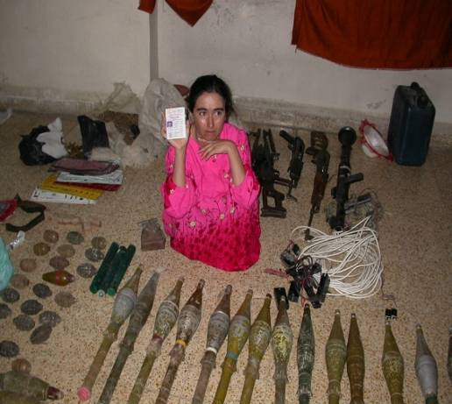
Garryowen Site Exploitation Smart Card
Card: # 102 Sensitive Site Exploitation
Sensitive Site Exploitation PCI Checklist:
Plastic bags, Boxes or Sandbags to be used to segregate, store, evidence for prosecution or later exploitation
Permanent markers used to annotate information on containers of detainee property.
Latex or rubber gloves for handling detainees and evidence
Flexi-cuffs, Duct tape or 550 cord to restrain detainees.
Flexi-cuff cutters to cut flexi-cuffs.
3” x 5” or 5” x 8” Index Cards.
Blacked-out goggles, bandanas, bandages or other cloth to blindfold or gag detainees.
Polaroid Cameras for hasty screening of detainees.
Digital Cameras to document CEM and Detainees for future processing.
Exploitable Items Include:
Digital Media
Thumb-drives
CDs
Hard-drives
Computers
Tapes
Floppy disks
Video Cameras
Photo Cameras
Communications
Cell Phones
Sat/ Iridium Phone
Walkie Talkies
Military Comms
Miscellaneous Items
Safe Contents
Foreign/ unusual
foods
Foreign/ unusual
clothing
Large sums of
cash
Military uniforms
Suspicious electronic
Devices
License Plates
Documents
Notebooks
Pocket Litter
Phone Books
Receipts
Maps
Schematics
Registrations
House Titles
Passports
Travel Documents
IDs
Photographs
S.T.R.E.S.S. Detainee/ CEM Field Processing
Search
- Search each captive/bldg; consolidate personnel & items/equipment at place of capture.
Use index cards to ID name of detainee and grid location of bldg where captured and take digital photo.
Tag
- Bag all evidence by detainee and location that will return to S2.
On a separate index card include the following information: DTG of the capture. Location of the capture (grid coordinates). Capturing unit.
Circumstances of capture (ex. Did detainee resist, was he armed, etc).
Place index card in bag.
Report
- Report #’s and names of detainees to higher HQs that will be moving to
BN EPW collection point.
Evacuate
Evacuate captives from the battlefield as quickly as possible.
Deliver to EPW collection point all documents and other property captured with the detainees.
Injured or ill detainees must be taken to the nearest medical-aid station for treatment and evacuation through medical channels.
Segregate
Segregate detainees based on positions of authority, leaders from non-leaders, minor and female detainees from adult male detainees.
Safeguard
- Safeguard the captives according to the Geneva Conventions and US
policy.
- Ensure detainees are not exposed to unnecessary danger and are protected (afforded the same protective measures as the capturing force) while awaiting evacuation.
Example of CEM and Detainee Layout
10 TGS
12345 67890
3” x 5” Card
With name of detainee
3” x 5” Card
Location of capture

Slide 22
Card: # 103
Results of
Reconnaissance
Results of Zone Reconnaissance
Report using overlays with accompanying BLUE Reports
- Compile section and platoon notes, diagrams, and overlays into a Troop level overlay to pass to Squadron
Overlay should include:
All obstacles; create and mark lanes as specified in orders
Extent of CBRN contaminated areas
Trafficability of all terrain, such as choke points and ambush sites that the enemy can use to dominate movement along routes in the zone
Bypasses around urban areas, obstacles, and contaminated areas
Fords or crossing sites near all bridges
Identify key municipal infrastructure that can affect military operations
Results of Route Reconnaissance
-Report individual aspects using appropriate BLUE Reports
Include the following:
Route width, in meters
Limited access
Single lane
Single flow
Double flow
-Route type
Type X
Type Y
Type Z
-Military load classification
MLC 50, average traffic (Bradleys)
MLC 80, heavy traffic (Abrams)
MLC 120, very heavy traffic (HETs)
-Overhead clearance
-Route obstructions
Overhead obstructions
Reductions in traveled way widths
Slopes
Curves
Ferries
Fords
-Snow Blockage and Flooding
Results of Area Reconnaissance
Report using overlays with accompanying BLUE Reports, same requirements as zone recon, pertaining to the area
Area Reconnaissance is more detailed and focused on a smaller geographic area than a zone.

Slide 23
Movement & Maneuver
200 Series Cards
REDCON Status
Adjacent Unit Coordination
Passage of Lines Checklist
Relief in Place Checklist
Assembly Area Procedures
Quartering Party Procedures
Reconnaissance Methods / Types
Route Reconnaissance Symbols and Overlay example

Slide 24
Card: # 200
REDCON Status
REDCON Status and Definitions:
The Squadron will use the following readiness conditions to identify the speed with which a unit must be ready for combat or movement. This usually accompanies WARNOs.
Subordinate units will also report their readiness to move by stating their REDCON status. Additionally, mechanics, medics, and others should use these codes to estimate when elements (injured personnel, combat vehicles, supplies, etc) will be ready for combat.
1. REDCON 1 - Full alert; able to move immediately.
A. Radio checks complete; FBCB2 fully operational.
B. Vehicles loaded, secured; weapons manned.
C. Personal equipment stowed, NBC alarms; all OP’s pulled in. All personnel alert and mounted on vehicles.
D. Engines running. (Commander will initiate “Short Count” if deemed necessary.)
2. REDCON 1.5 – A variant of REDCON 1; ready to move in five minutes.
A. Engines are off; crews prepared to initiate “Short Count” O/O from Commander.
3. REDCON 2 - Full security; able to move in 15 minutes.
A. Vehicles loaded with all equipment. (Except NBC alarms.)
B. Primary weapons manned and prepared to fire.
C. Vehicles shut down.
D. Mission fully briefed and understood by all members of maneuver element.
(All Pre-Combat Checks are complete.)
(Note: Depending on the tactical situation and orders from the commander,
dismounted OP’s may remain in place.)
4. REDCON 3 - Reduced security; able to move in 30 minutes.
A. 50 % of each crew stands down for maintenance, crew rest.
B. TC / BC positions manned and radios monitored.
C. PMCS performed with no major disassembly of equipment.
5. REDCON 4 - Minimum security; able to move in 60 minutes.
A. Minimum of 25% security. Digital and FM links with TOC’s and other platoon’s
maintained.
B. Primary weapon manned and operational.
C. Maintenance performed with minor disassembly allowed.
6. REDCON 5 – Reduced security to 10 – 20%, Ready to move in 2 hours.
A. Conduct thorough maintenance.
B. Consolidation and Reorganization.
C. Maintain continuous operations.

Slide 25
Card: # 201
Adjacent Unit Coordination
Adjacent Unit Coordination
Adjacent unit coordination must be conducted prior to and during missions to mitigate risk, share information, and ensure mission accomplishment. This coordination is accomplished face-to-face, by FM, or through FBCB2.
Before Mission (NLT 24 hrs. out)
CDR or representative from each unit exchange the following information:
  5W’s for their mission
  Unit Graphics to include Enemy Most Probable and Most Danger COA and contact points
  Frequencies and Call Signs
  Near / Far recognition signals
CDR briefs subordinate leaders on adjacent unit information
CDR assigns Contact Points to subordinate units and relays relevant information for adjacent unit
During Mission
CDR or leader of responsible unit coordinates movement to and execution of Contact Points
Coordination must also be conducted for the following situations:
  Movement into adjacent unit’s sector
  Adjacent unit movement into unit’s sector
  Enemy contact in or near adjacent unit’s sector
  Firing into adjacent unit’s sector
  Enemy movement in or into adjacent unit’s sector
  Any other times the CDR or leader deems necessary
Contact Point Checklist
  Enemy Situation. (Strength, Type, Location etc.)
  Own unit disposition. (Task, Purpose, Front Line Trace etc.)
  Unit level Graphics.
  Location of obstacles, IEDs, and contaminated areas
  Frequencies, and Call Signs
  Recognition signals
  Tactical support available
  Location of next Contact/Coordination Point

Slide 26
Card: # 202
Relief in Place Checklist
Relief In Place Checklist
1. Link up and coordination.
A. Link up.
(1) Units contact each other via FM(P) net to work out exact linkup location (FBCB2 is Alternate).
(2) Unit leaders at each relieving point identify link up point (rotate to avoid patterning).
(3) Both units responsible for security during link up.
B. Information Exchange.
(1) Location of weapon systems by type (sniper rifles, crew served, etc.).
(2) Last known enemy contact(s) (SALUTE report and form of contact [i.e. Indirect, Direct, Observation or Obstacle/IED]).
(3) Last known suspicious activity (SALUTE report and form of contact [i.e. Indirect, Direct, Observation or Obstacle/IED]).
(4) All Friendly unit (to include Local Security Forces and MPs if known) dispositions (location, composition, orientation, scheduled patrols and FM frequencies).
(5) Known adjacent unit large scale operations.
(6) UAV and Attack Aviation scheduled windows of support, flight plan, etc.
(7) Raven / Shadow Operator BHO.
(8) Position Range Card exchange (Terrain orientation, TRPs, sectors of fire, RFLs, obstacles, etc.).
(9) Unit Fire Plan (Friendly EAs, Fields of fire, Fratricide prevention measures, etc.).
(10) Unit Obstacle Plan (if any).
(11) MEDEVAC LZ (location and confirmation TOC has location).
(12) Any additional Graphic Control Measures created during that shift.
C. Coordinate.
(1) Sequence of Relief (east to west, north to south, etc.).
(2) Turnover of OPs (mounted and dismounted).
(3) Turnover of C2.
(4) Relieved unit exfil routes.
(5) Transfer of any Classes of supply or equipment that remain at the position.
(6) Transfer of any personnel that remain at the position
D. Exfil and assumption of mission.
(1) RIP preferably done during hours of limited visibility.
(2) Unit begins sequence of relief.
(3) Relieved unit moves along planned exfil routes to release point.
(4) Relief is conducted quickly and quietly maintaining the highest level of security.
(5) Transfer of responsibility for overall security now to relieving unit.
(6) Relieving unit and relieved unit operate on relieved units net until RIP is complete.
(7) Relieving unit subordinate positions inform relieving unit leader that all positions are established.
(8) RIP complete when relieving unit informs SQDN TOC via FM.

Slide 27
Card: # 203
Passage of Line Checklist
STATIONARY UNIT PROVIDES |  |  |  | PASSING UNIT PROVIDES
1 | Unit designation |  |  | 1 | SOI data-including digital links between ABCS equipment
2 | Enemy situation at front |  |  | 2 | Numbers and types of passing vehicles
3 | Friendly situation / location of units |  |  | 3 | Passing unit’s OBJ and attack plan, PA
4 | Unit Mission and Battle Plan |  |  | 4 | Order of march
5 | Locations for Passing unit CPs, sensors and FA, EW, ADA, Engineer, Signal and CSS elements |  |  | 5 | Recognition signal (day/ night)
6 | Contact Points, Passage Lanes, Passage Points, Attack positions, o/o AA, RP, TCP |  |  | 6 | Estimated time of arrival of units at each contact point and markings of the first and last vehicles
 | Obstacles / Contaminated Area |  |  | 7 | Terrain requirements for passing elements
8 | Indirect fires available and target locations
9 | CS and CSS support to be provided
10 | Decon site location
11 | SOI data-including digital links between ABCS equipment
12 | Near and Far recognition signals
13 | Persons manning contact point/ link up time
14 | Establish common graphic control measures
15 | Use of deception, EW, counter surveillance and smoke
CONDUCT A PASSAGE OF LINES
STATIONARY UNIT ACTIONS |  |  | PASSING UNIT ACTIONS
1 |  | Meet at contact point with recognition signal | 1 |  | Meet at contact point with recognition signal
2 |  | Confirm passing unit’s coordinated info | 2 |  | Provide changes to previous coordinated info
3 |  | Provide changes to previous coordinated info | 3 |  | Confirm stationary unit’s coordinated info
4 |  | Ensure passage lane is clear and manned | 4 |  | Report to CDR when stationary unit is ready
5 |  | Initiate support | 5 |  | Unit moves directly to contact points
6 |  | Assist unimpeded passage with guides | 6 |  | Displays recognition signal
7 |  | Report passage completion to BCT TOC | 7 |  | Unit moves directly through under control of stationary unit
 |  |  | 8 |  | Unit reports completion of passage to BCT TOC
 |  |  | 9 |  | Collocate TOC with Stationary units TOC if possible

Slide 28
Card: # 204
Assembly Area Occupation
An assembly area (AA) is a site at which a Troop prepares for future operations. In general, a good AA has the following characteristics:
Concealment from enemy ground and air observation
Defensible terrain
Good drainage and a surface that will support vehicle traffic
Suitable entrances, exits, and internal trails
Sufficient space for dispersion
2. When occupying an AA, the Troop will use the procedures for hasty occupation of a BP. The ability to defend the AA is the most critical step the Troop will perform. Once the perimeter is defensible and all vehicles are set, the Troop will occupy the AA following these steps. THERE WILL BE NO VEHICLE MOVEMENT ONCE PLATOONS REPORT SET IN THE AA.
Troop short count.
Establish local security (25% minimum).
Establish Troop CP
Conduct sensitive items inventory and report to Troop CP
Establish OPs.
Develop range cards and fire plans.
Emplace M22 / JCAD alarms (UPWIND)
Camouflage positions and monitor noise and light discipline.
Establish long range commo (OE-254)
Select and disseminate company rallying point
Select alternate and supplementary positions.
Recon displacement routes.
Distribute ammunition, rations, water, supplies, and special equipment.
Inspect AA and refine as necessary (on-going process).
Establish platoon personal hygiene and field sanitation site.
3. In open terrain, the Troop will use a “desert box” formation for the AA. In restrictive terrain, the Troop will use a triangle shaped perimeter.
4. Once the AA is occupied and the perimeter defense is set, the company will prepare for operations using the following standing priorities of work. Additional tasks may be inserted and are mission dependent.
Security
Boresight
Prep to fire checks
Weapons cleaning and maintenance
Vehicle maintenance
Personal maintenance
5. The Troop will perform stand-to on a daily basis. Stand-to time will be directed in the OPORD. At stand-to, all vehicles will be REDCON 1 following a Troop short count.
6. All Garryowen elements will maintain at least 25% security at all times. 25% security means that one combat vehicle is at REDCON 1.5 (see Card 200)
7. On order, each platoon will establish a Listening Post/Observation Post (LP/OP). Each LP/OP will be positioned in order to provide early warning of enemy approaching the Troop to allow the Troop to increase its readiness posture in response.

Slide 29
Key tasks for the quartering party (QP):
  Recon the site and route(s) used to approach and occupy.
  Secure the area prior to occupation.
  Organize site and assign vehicle locations
Characteristics for assembly area:
  Cover and concealment(from direct fire and overhead cover).
  Adequate exits and entrances.
  Good drainage; ground surface able to support vehicle movement.
  Enough space for adequate dispersion.
  1SG and XO will brief quartering party and main body on:
    Necessary Equipment
    Location Of AA
    Sp Times
    OOM
    MOPP Level
Quartering party tasks:
  Move to AA on assigned route(s).
  Maintain security.
  Recon route(s) and AA site; marking obstacles and bypasses.
  Report all critical information to higher
Actions for QP at AA:
  Mark entrances, exits, and internal routes.
  Clear dead-space and maintain local security.
  Mark and clear obstacles.
  Mark vehicle positions for main body to ensure there will be 360 security.
  Facilitate main body movement into AA.
Composition:
  Squadron TOC: OIC (S-3) or NCOIC (Ops SGM), TAC (HQ33, HQ66, and HQ305 [Air Liaison Officer]), SQDN NBC NCO, SIGO, and any additional personnel needed to clear the area.
  Line Troop: OIC (XO) or NCOIC (1SG), Section leader from each platoon, Troop CBRN, and any additional personnel needed to clear the area.
  Combat Trains: S4 NCOIC, 2 guides from each section, and any additional personnel needed to clear the area or provide security.
  Field Trains: OIC (D TRP XO), 2 guides from each section, and any additional personnel needed to clear the area or provide security.
Equipment
  M256 Kit.
  M8/M9 Paper.
  Mine detector(s).
  Engineer tape with stakes.
  Chemlight sticks.
  NVGs.
  SOI/Challenge and password.
  M22 / JCAD alarm.
  Radiac test set.
Card: # 205
Quartering Party Procedures

Slide 30
Card: # 206
Reconnaissance
RECONNAISSANCE METHODS
Sensor Reconnaissance
Prophet
GSR
Hornets
Aerial Reconnaissance
Mounted Reconnaissance
Dismounted Reconnaissance
TYPES OF RECONNAISSANCE
Route
Determine the trafficability of the route
Find and report all enemy forces that can influence the route
Reconnoiter all built up areas along the route
Reconnoiter, to the limit of direct fire range, all lateral routes
inspect and classify all bridges on the route
Locate fords or crossing sites near all bridges on the route
Inspect and classify all overpasses, underpasses, and culverts
Locate minefields and other obstacles along the route
Locate a bypass around built up areas, obstacles, restrictions, and contaminated areas
Determine the type and volume of traffic on the route
Report route information
-Area & Zone
Find and report all enemy forces within the area or zone
Reconnoiter and determine trafficability of all terrain within the area or zone
Inspect and classify all bridges within the area or zone
Locate fords or crossing sites near all bridges in the area or zone
Inspect and classify all overpasses, underpasses, and culverts in the area
Within capability, locate all minefields and other obstacles in the area, reduce or breach
them, clear and mark lanes
Locate bypasses around built-up areas, obstacles, and contaminated areas
Report information
Identify threat activities, countermeasures, and probable COA’s
Determine the size, location, composition of society demographics.
Establish and maintain contact with local civilian and military leadership
Conduct reconnaissance of society with HUMINT teams
Identify key municipal infrastructure / SWEAT-MSO
Identify the allegiance of the local populace to factions, religious groups, or other
organizations

Slide 31
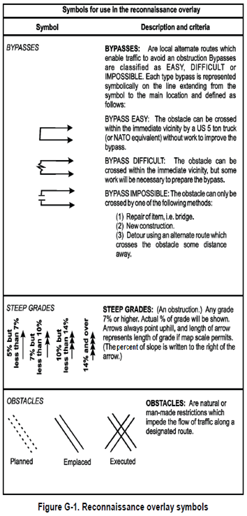
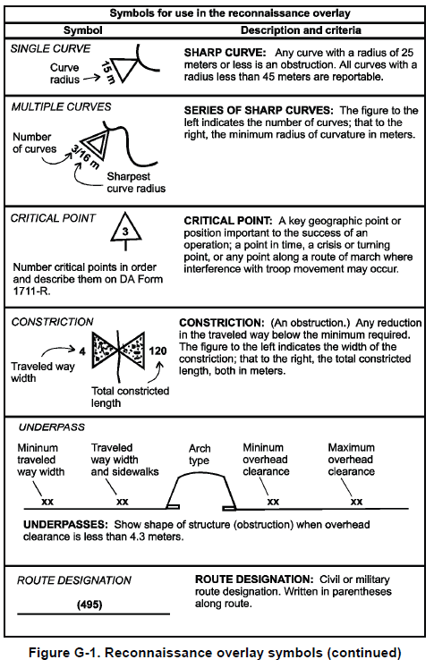
Card: # 207-1
Route
Reconnaissance
ROUTE RECONAISSANCE SYMBOLS

Slide 32
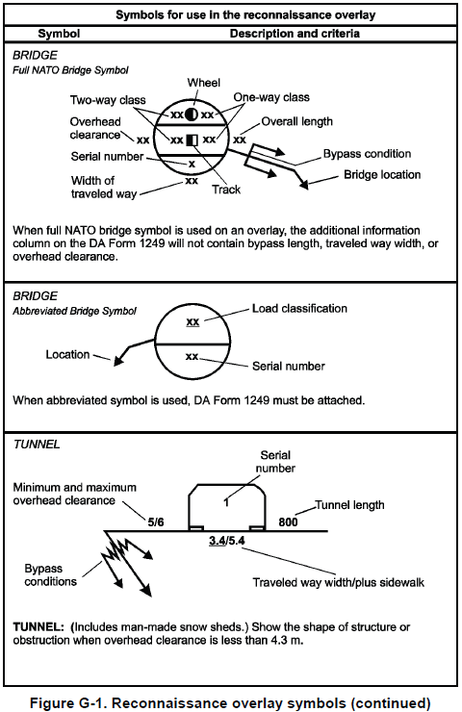
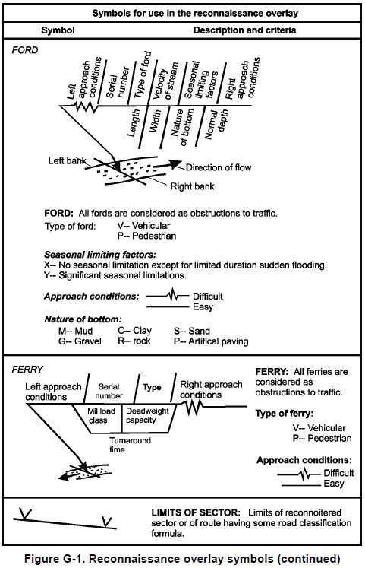
Card: # 207-2
Route
Reconnaissance
ROUTE RECONAISSANCE SYMBOLS

Slide 33
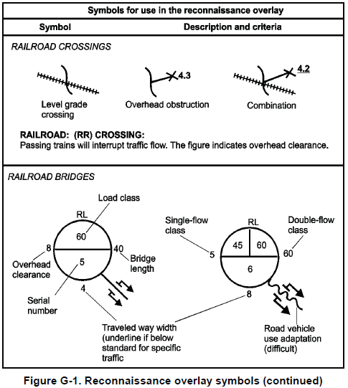
Card: # 207-3
Route
Reconnaissance
ROUTE RECONAISSANCE SYMBOLS

Slide 34
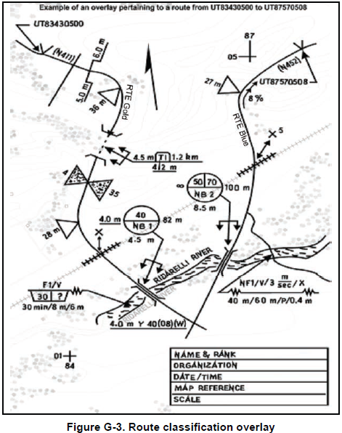
Card: # 207-4
Route
Reconnaissance
ROUTE CLASSIFICATION OVERLAY
The Route Classification Formula
The name, rank, SSN, of the person in charge of classification
The unit conducting the classification
The DTG showing when it was conducted
The map name, edition, and scale
Any remarks necessary to ensure complete understanding

Slide 35
Card: # 208
Set / Established Criteria
Security Position (Screen, OP, Wide area security)
Set
Vehicles in initial positions
Vehicle range cards begun
Dismounted OP positions identified
Dismounted OP range cards begun
Dismounted R&S teams sent out to clear immediate area of enemy/civilian presence
Camouflaging of vehicles and equipment initiated
Established
Vehicles in final positions
Secondary vehicle position identified
Platoon sector sketch complete
Dismounted OP primary positions in place, secondary positions identified
Platoon sector sketch / map overlay sent higher
NFAs established at Sqdn level
Local security check complete
All vehicles, equipment, and positions camouflaged
Upon reaching each overall status (set or established), Troops will report SET and ESTABLISHED to the Squadron TOC as soon as METT-TC variables allow.

Slide 36
Fires
300 Series Cards
Target Block Numbers
Clearance of Fire Procedures
Emergency CAS Request
AGI Smart Card
Air Load Ops
Information Operations Activities
Media Guidelines

Slide 37
Card # 300
Target Block Numbers
Target Blocks
The target number is comprised of six characters consists of two letters and four numbers. The two letters indicate the originator of the target number and/or the echelon holding the target data.. The senior headquarters establishes and publishes in the operations order the assigned first letter.
Table H-1. Assignment of first letter (example)
Organization | Letter | Organization | Letter
CENTCOM | C | France | F
United States | A | Germany | D
United Kingdom | B | MNC | M
EUROCORPS | E | NRDC Italy | N
Table H-2. Assignment of letters (example)
Elements | Letters | Elements | Letters
Corps | AA | 4 BCT | AH
Fires Cell | AB | Y Division | AJ
TACP | AC | 1 BCT | AK
X Division | AD | 2 BCT | AM
1 BCT | AE | 3 BCT | AN
2 BCT | AF | 4 BCT | AQ
3 BCT | AG
Table H-3. Assignment of blocks of numbers (example)
Numbers | Brigade elements
0000-2999 | BCT Fires Cell and COLT
3000-3999 | Fires cell, lowest numbered maneuver battalion or squadron¹
4000-4999 | Fires cell, second lowest numbered maneuver battalion or squadron
5000-5999 | Fires cell, third lowest numbered maneuver battalion or squadron
6000-6999 | Additional Fires cells or fire support assets
7000-7999 | FDC, BCT fires battalion
8000-8999 | Counterfire targets
9000-9999 | Spare
Legend: ¹ Lowest regimental number BCT - brigade combat team COLT – combat observation and lasing team FDC – fire direction center
Table H-4. Additional assignment of blocks of numbers (example)
Numbers | Squadron elements
X000-X199 | Battalion Fires Cell
X200-X299 | FIST, Troop A
X300-X399 | FIST, Troop B
X400-X499 | FIST, Troop C
X500-X999 | Spare
Legend: FDC – fire direction center FIST – fire support team X – numeral assigned by higher HQ
Target numbers are usually established in the division or BCT tactical SOP. The numbers suballocated to brigades should be incorporated into the brigade, battalion/squadron, company/troop, and platoon SOPs.
NOTE: At this time the Division has assigned the 1st BDE, 1st Cavalry Division target block AE.

Slide 38
Card # 301
Clearance of Fires Procedures
Request Coordination through Brigade FEC
Receive Fire Mission
Plot TGT Location. Are TGT location and Firing unit in SQDN AO?
FIRES:
Notify Battle Captain
Notify Intel
Notify TACP
Record TGT DATA
NO
Coordination Approved?
YES
YES
NO
Send Mission to Firing Unit
End of Mission
Simultaneous
FIRES | Battle Captain | TACP
Determine GTL/ Max Ord Clear FSCMs Issue WARNO to Firing Unit | Clear Ground with Troop Commander | Receive GTL/ Max Ord Deconflict air if necessary
Necessary Coordination Complete?
NO
Was Coordination Denied or not possible?
YES
NO
YES
Notify SCO for decision
Continue Coordination.
Send Fire Mission to Firing Unit

Slide 39
Card # 302
Emergency CAS Request
Close Air Support Execution with Non-Joint Terminal Attack Controller Personnel
(Emergency Close Air Support)
a. Units that have a reasonable expectation to conduct terminal attack control need to have certified JTACs available. Non-JTAC controllers must clearly state to attacking aircraft that they are “non-JTAC qualified.”
b. Due to the complexity of CAS, the commander must consider the increased risk of fratricide when using personnel who are not qualified JTACs and accept full responsibility for the results of the attacks. The requester must notify/alert his/her command element when a JTAC or FAC(A) is unavailable to conduct Type 1, 2, or 3 controls. If the maneuver commander accepts the risk, he / she forwards the request to the CAS controlling agency. This information will alert the CAS controlling agency (ASOC/DASC) that aircrew will be working with non-JTAC-qualified personnel. In the absence of the ASOC / DASC, the joint air operations center can perform as a CAS controlling agency.
c. Ground personnel will:
(1) Identify themselves as “non-JTAC qualified” on aircraft check-in.
(2) Make every effort to involve a qualified JTAC / FAC(A) in the situation.
(3) Provide as much of the 9-Line briefing as possible.
(4) As a minimum, pass target elevation, target location, target description, and restrictions.
d. Aircrew in this situation will:
(1) Make every effort to involve a qualified JTAC / FAC(A) in the situation.
(2) Be prepared to “PULL” information to complete the critical portions of the CAS briefing.
(3) Exercise vigilance with target identification, weapons effects, and friendly location.

Slide 40
Card: # 303-1
IH AGI Smart

Slide 41
Card: # 303-2
IH AGI Smart

Slide 42
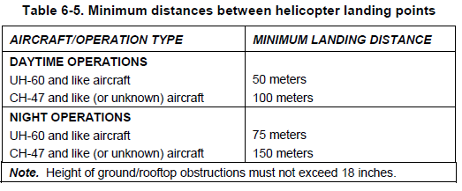
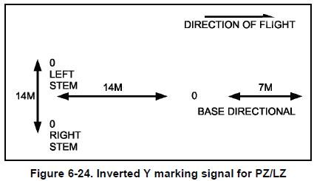
Card: #304
LZ
Operations
PICKUP/LANDING ZONE OPERATIONS
Select and control the PZ/LZ
Secure the PZ/LZ
Provide wind velocity and direction, cloud cover,
visibility, ceiling
-Provide if any, obstacles, wire hazards, enemy SITEMP
CONDITIONS IN THE PZ/LZ
-Size of PZ/LZ
-Landing site requirement
-Surface conditions
-Approach/departure direction
MARKING OF THE PZ/LZ
-Daylight operations
-Night operations

Slide 43
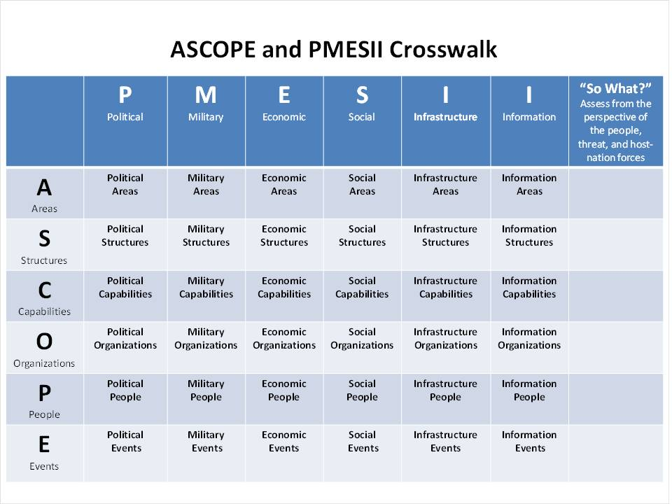
Card: #305 Information Operations
A. Planning: Use ASCOPE (Area, Structures, Capabilities, Organizations, People, and Events) and PMESII (Political, Military/Security, Economic, Social, Infrastructure, and Information) to focus the Information Operation IPB process in order to identify relevant variables within the OE.
B. Targeting: Utilize the D3A Targeting methodology. Decide-Detect-Deliver-Assess
C. Execution: The monitoring of non-lethal task execution in support of on-going operations is decentralized. The Non-Lethal section tracks significant daily events through the S3 battle captain.
D. Assessment: The Non-Lethal Targeting Officer assesses the effects of the SQDN’s information operations tasks by analyzing trends within the OE as compared to the Information Engagement objectives established or adjusted for the executed targeting cycle.

Slide 44
Card: #306 Media Interaction
GENERAL MEDIA ENGAGEMENT RULES
Never get too comfortable when talking to the news media
Plan for every media engagement – visualize the goal and stay on message
Soldiers and especially commanders are encouraged to engage the news media; stay in your lane – talk about what you have direct control over.
Always be professional – issues should be addressed to the command not the media.
Working With Media On the Battlefield:
-You do not have to talk to the media.
-However, Soldiers who refuse to speak with media present the impression that they are withholding information.
Your comments matter
You’re the best spokesperson we have and
We need you to tell the Army story BUT we also need you to do it right!
-All Soldiers need to talk to the news media about what they are doing; stay in your lane.
-Discuss only those matters over which you have direct responsibility or personal knowledge. If you don’t know, say so.
Before the interview:
PLANNED/OPPORTUNITY:
-- Identify and report the journalist’s name and agency to your TOC.
-- Verify credentials with higher HQs.
-- Determine the topic and ensure you are the right spokesperson. If not, locate and prep the right Soldier.
-- Know what you want to say (messages).
PLANNED:
Choose the location (OPSEC, backdrop).
Prepare an opening and closing statement (20-30 Sec.).
Prepare for 4 easy & 4 hard questions.
Rehearse, rehearse, rehearse.
During the interview:
-- Stay in you lane –
-- Only talk about what you have direct control over. Talk about your job, your Soldiers and your mission.
-- Avoid – Political, hypothetical & critical questions
-- The news media will tell their story with or without you – only way to balance?
-- Engage with a plan, Develop an easily identifiable theme, No more than three core messages
-- Provide personal examples
-- Visualize end result… attain end result
-- Mission – Soldier – Family – Team
After the Interview:
Take an opportunity photo with the reporter.
What is the deadline and expected publication date?
Contact BCT PAO with following information--MEDIA CONTACT REPORT format as per CARD 0920 (This report is required for planned and unplanned media)

Slide 45
Sustainment
400 Series
3 Day Recovery Plan
M113 Ambulance Load Plan
MASCAL SOP
CASEVAC SOP

Slide 46
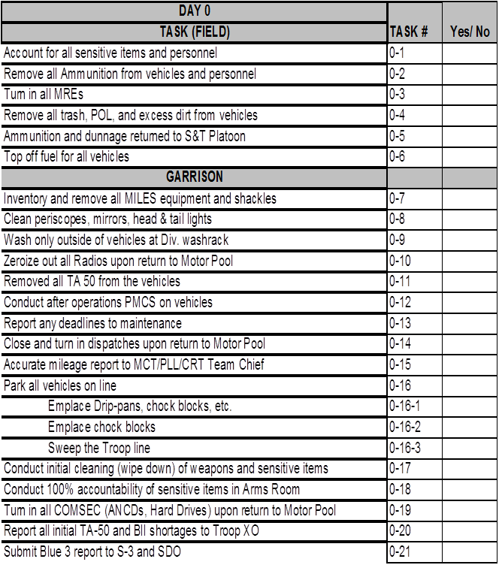
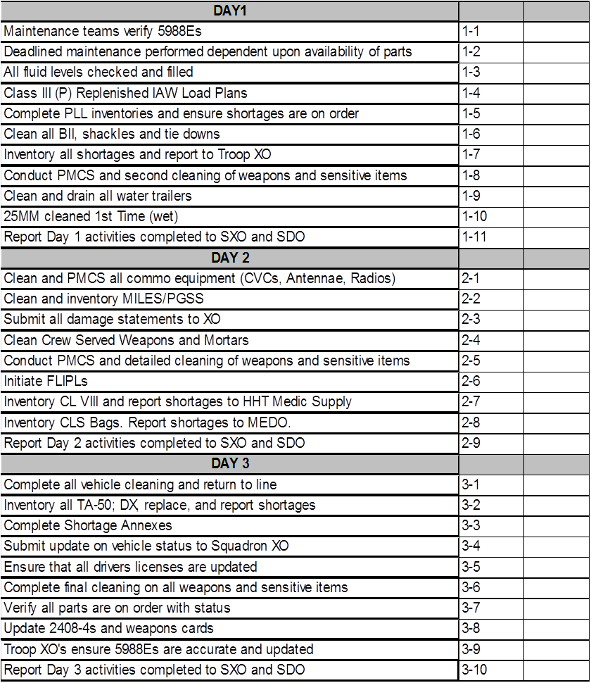
3 Day Recovery Plan
Card: # 400
3 Day Recovery Checklist

Slide 47
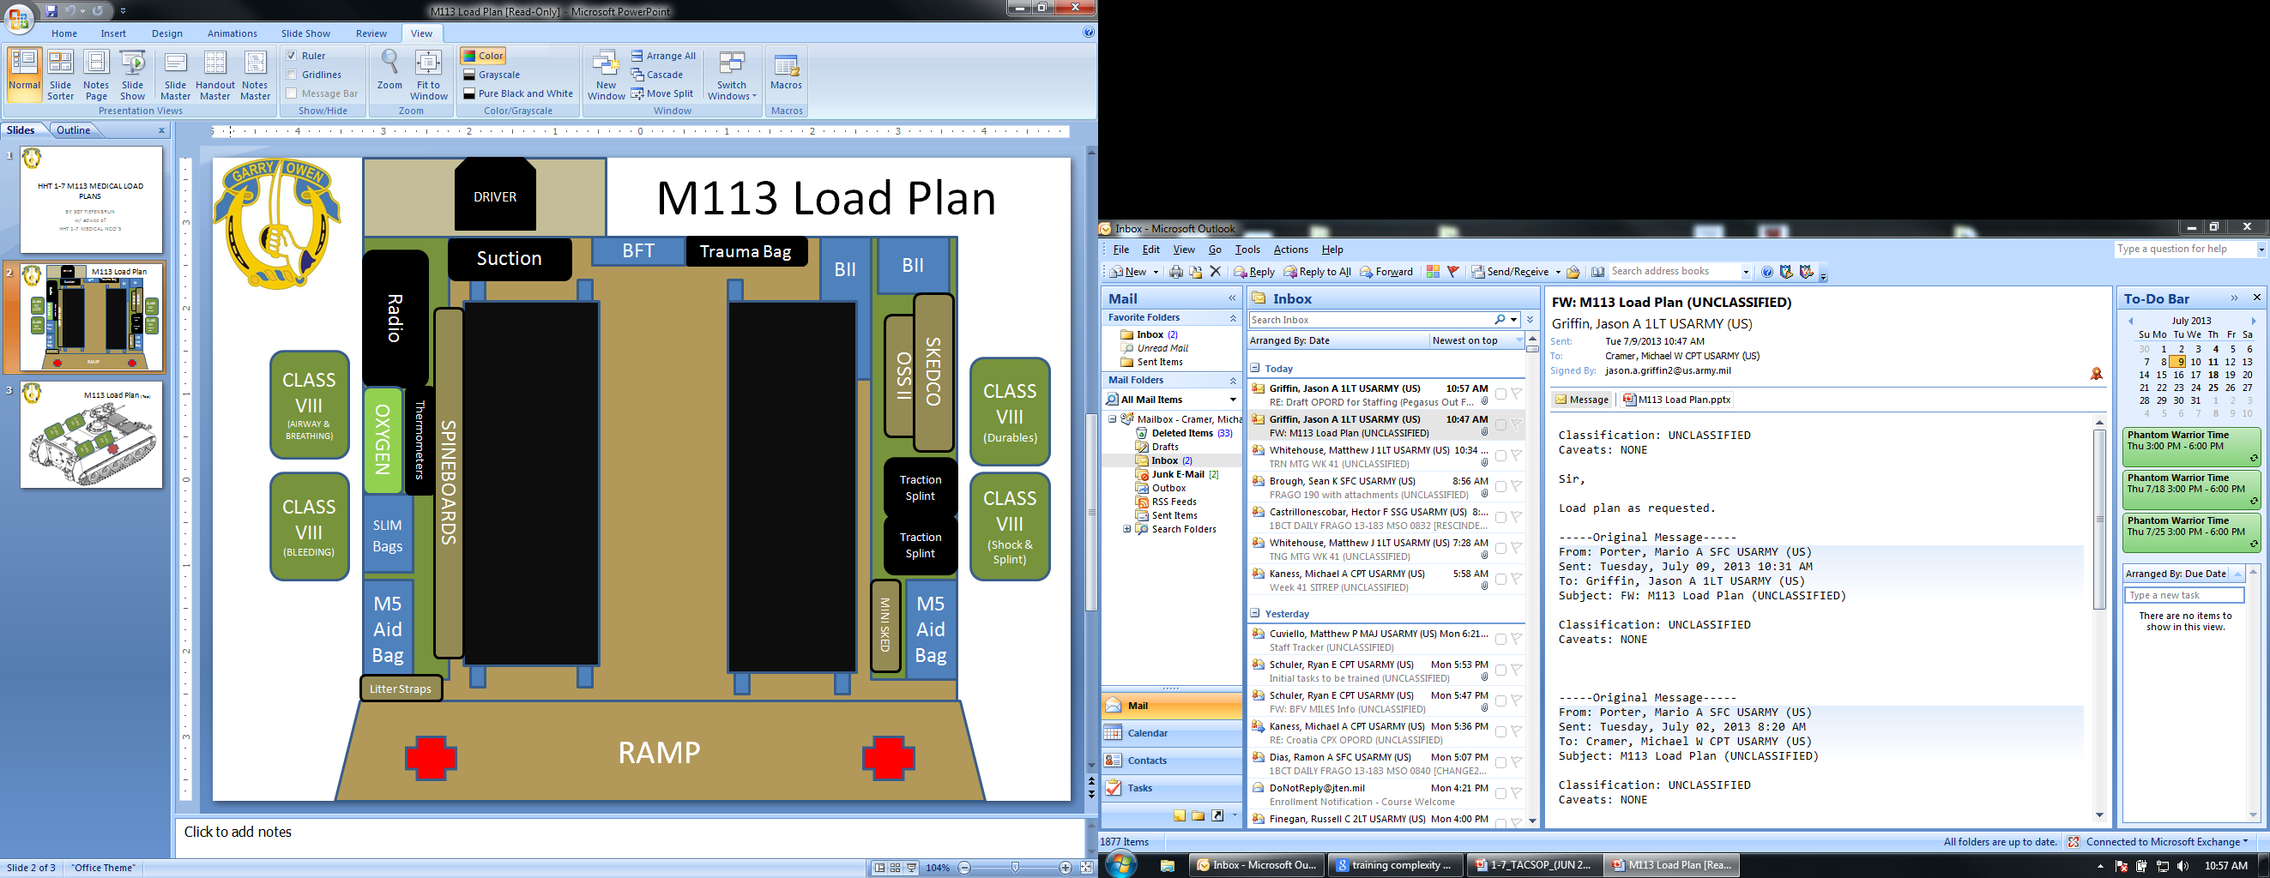
Card: # 401-1
Ambulance Load Plan

Slide 48

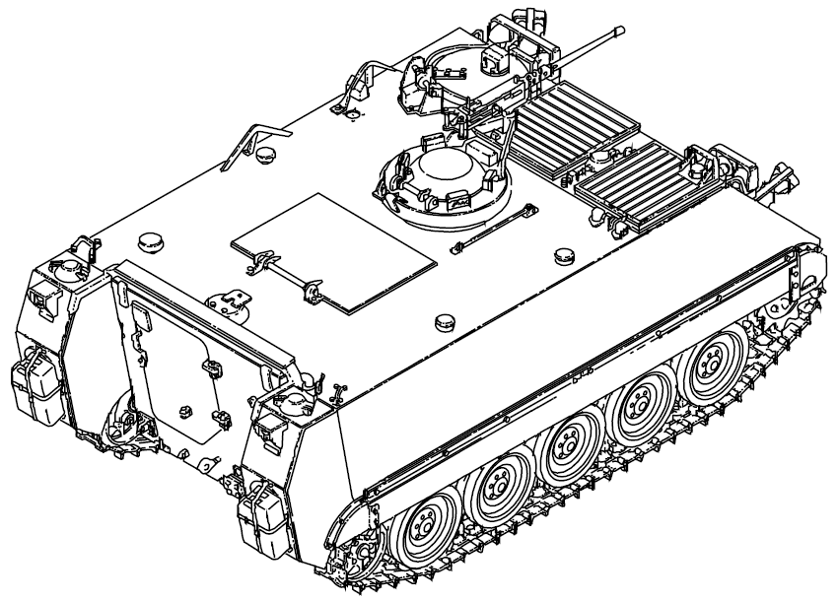
M113 Load Plan (Top)
Card: # 401-2
Ambulance Load Plan
CLASS VIII
CLASS VIII
CLASS VIII
CLASS VIII

Slide 49
Card: # 402-1
MASCAL SOP
MASCAL
A MASCAL (mass casualties) exists any time the patient load exceeds the treatment or evacuation capabilities of the medical PLT.
Upon notification of a MASCAL the medical PLT LDR will immediately assess the situation to determine what support is required.
The medical PLT LDR will then notify the TOC to ensure that they are aware of the situation and can assist in shifting of assets if required.
Planning considerations for MASCAL situations include but are not limited to:
Establishing a control element to control activities and provide info updates. Conducted by the SQDN TOC.
Securing the area and limiting the access to essential medical personnel.
Establishing triage, treatment and holding areas.
Marking routes for vehicles.
Orienting all personnel working in the area on stations, markings and requirements to be accomplished during the MASCAL.
Organize medical and non-medical personnel for staffing of the different areas.
Ensuring adequate Class VIII items are available.
The medical PLT LDR will assist the PA in requesting all necessary support. The SQDN will support the MASCAL with the following support:
Litter teams from the Troops.
Security for ground EVAC is necessary.
Non-standard evacuation platforms as required for patient evacuation. The medical PLT will normally have vehicles already prepared for the event.
Triage- patients will be triaged into one of four treatment categories. This will normally be conducted by the triage NCO. To ease a non-medical person’s ability to recognize these categories, coded signs will be utilized. During the hours of darkness, colored chemlights will be utilized. During daylight hours the first letter of each word will be shown on a sign.
Immediate (I) red
Delayed (D) yellow
Minimal (M) green
Expectant (E) blue
Each of the treatment category stations will have a medic in charge of that station to provide care to those soldiers until they are treated by a physician.

Slide 50
Card: # 402-2
MASCAL SOP
MASCAL SOP (cont.)
Personnel- two personnel pools will be established. One for medical and one for nonmedical personnel. All personnel will be marked to aid identification during the MASCAL. Medical personnel will wear the Red Cross brassard on their left sleeve and nonmedical personnel will wear white engineer tape on their left sleeve and will write "litter bearer” on it. This white engineer tape will be provided to the Troops at the first MASCAL rehearsal meeting after occupying the MAS. At that time, it will also be encouraged that Troops identify their litter bearers and have them recon the site so that they will be able to find the MAS quickly. Someone will be placed in charge of the two areas to ensure the work rest cycle is enforced and all stations are properly manned. Patients triaged into the minimal category should be used to the fullest extent possible to act as messengers, litter bearers, or guides in order to ensure that all medical personnel are freed to perform medical tasks.
Patient accountability- (critical!) Assign a number system for all casualties and log as they arrive. This number will be used to log all treatments and medications administered to the patient. As the MASCAL begins to resolve all required info can be obtained and proper accountability can be regained. At no time will a casualty be evacuated from the medical PLT without the following being known: name, rank, SSN, unit, diagnosis, destination, and EVAC category.
Equipment accountability- when the medical PLT LDR is notified what Troops are involved in the MASCAL, a representative from the medical PLT will notify that Troop’s CP. The SQDN will send an S-1 representative and an S-4 representative to assist in personnel and equipment accountability. All equipment will be tagged by the patient admin specialist, turned over to troop supply rep, and returned to the casualty's Troop CP.
Disposition of remains- if required a temporary morgue will be established by the medical PLT. This is only to be used by the medical PLT to hold those casualties who are DOA to the MAS. This temporary morgue will be established out of sight of all triage and treatment areas. If possible, it will be established behind a natural barrier. This is only a holding area! The Casualty Feeder Card must still be completed by a physician. Remains will be held until mortuary affairs (MA) is notified and secures the remains. If DOAs arrive, they should be sent directly to the MA Collection point and S-1 assumes responsibility.
Rehearsals- rehearsals will be conducted within 24 hours of occupying a new operating site and weekly afterwards.

Slide 51
Card: # 403
Aid Station Capabilities
Squadron Aid Stations
The primary mission of the Squadron Aid Stations are to treat the sick and wounded, stabilize the patients’ condition, and provide emergency medical evacuation to the combat support hospital or other medical treatment facility. The treatment squad can split into two treatment teams and operate as two separate aid stations, Main Aid Station (MAS) and Forward Aid Station (FAS). In continuous operations, when operating for longer periods, personnel efficiency and unit capability will tend to deteriorate. Each team employs three treatment vehicle(s) equipped with a Medical Equipment Set (MES) kit; each MES kit has the capabilities to perform both trauma and sick call functions.
  Main Aid Station (MAS)- consisting of a physician and (68W’s) combat medics.
  Forward Aid Station (FAS)- consisting of the Physician Assistant (PA) and (68W’s) combat medics.
This allows the section to support more than one troop or care as the troop advances or withdraws to and from their objective. The Treatment Teams (MAS/FAS) role’s and capabilities are:
  Provides Level I Medical Care: Triage, Emergency Medical Treatment (EMT), Advanced Trauma Management (ATM), Sick Call Services, Combat Stress Control, Preventative Measures (PM).
  Establish & Operate aid stations in direct support of the troop.
  Capable to support out of sector mission with medical treatment and evacuation.
  Provides Level 1 Medical Care through use of Medical Equipment Sets (MESs).
  Provide Class VIII resupply.
The two medical providers assigned to the squadron (Physician and PA) have certain roles and capabilities:
Physician’s Role:
  Provides Level I Medical Care: Triage, EMT, ATM, Sick Call, Combat Stress Control (As supervising physician).
  Advises the squadron commander of the health of the command and medical threats.
  Coordinates and oversees all medical training to include: CLS and 68W Sustainment.
  Operates the BAS and MAS in direct support of a troop.
  Oversees field medical record maintenance.
• PA’s Role:
  Provides Level I Medical Care: Triage, EMT, ATM, Sick Call, Combat Stress Control (Assists physician)
  Assists Surgeon in overseeing all medical training.
  Operates the FAS in direct support of a troop.

Slide 52
Card: # 404
EVAC SOP
EVAC SOP
1. Priority of evacuation/medical care will always be conducted according to triage category regardless of origin. However, within triage categories, the priority is as follows unless otherwise stated in OPLAN/OPORD:
US service personnel
Allied service personnel
Enemy prisoners of war
US civilians
Allied civilians
Indigenous personnel
2. Evacuation categories:
A. Urgent: should be evacuated as soon as possible and within a maximum of two hours in order to save life, limb, or eyesight.
B. Priority: sick or wounded requiring prompt medical care within a maximum of four hours.
C. Routine: sick or wounded requiring prompt medical care within a maximum of 24 hours. Psychiatric patients should be placed into this category.
D. Convenience: patient for whom evacuation by medical vehicle is a matter of medical convenience rather than necessity.
3 . Primary means of evacuation for urgent casualties is through air MEDEVAC.
4. In the event air MEDEVAC is unavailable, Troops are responsible for evacuating casualties to the nearest, highest level of care using ground MEDEVAC assets first then non-standard CASEVAC as necessary.

Slide 53
Card: # 405
EPW Casualty SOP
CASUALTY SOP
Enemy Prisoner of War (EPW) Casualties
EPWs will be evacuated through medical channels with the same priorities as US patients, with the following considerations.
  EPWs will remain under armed guard at all times during evacuation. Guards for EPWs being evacuated through medical channels will be provided by appropriate non-medical units.
  When possible, EPWs will not be evacuated in the same vehicle as US or allied patients. When possible, EPWs will be transported directly to the EPW cage and a medic will be sent to begin treatment.
  EPWs will be searched prior to evacuation and prior to admission to any medical treatment facility. While in a US medical treatment facility they will be searched daily.
  Immediately upon admitting an EPW to the medical treatment facility the treatment platoon must notify the Squadron TOC. The Squadron TOC will then immediately notify the CI/EPW team operating in the MAS. The CI/EPW team will be permitted to see the patient as soon as possible.
2. Reporting of EPW casualties: EPW casualties will be reported through the Squadron TOC immediately.

Slide 54
Card: # 406
CTCP SOP
COMBAT TRAINS COMMAND POST (CTCP)
OVERVIEW
The CTCP plans and coordinates sustainment for tactical operations and serves as an alternate mission command node for the Squadron TOC. The CTCP consists of the squadron S-1, S-4, the HHT commander, XO, first sergeant, the FST XO, the FST first sergeant, and line troop supply sergeants. When established, the CTCP usually consists of organic or attached sustainment elements (support platoon, maintenance platoon, field feeding section), the main aid station, (MAS), the maintenance control section, squadron S-1, and squadron S-4. Some of these nodes may be co-located with the Field Trains Command Post (FTCP) to allow for hasty displacement of the CTCP as METT-TC dictates.
The HHT commander is in charge of the CTCP and is responsible for the tactical deployment of its assets. Some tactical variables to consider when establishing a CTCP are:
􀁺Proper concealment from the enemy
􀁺Base security
􀁺Accessible routes for primary movers (M978 fuel trucks, M1120 LHS’s, etc.) for throughput of commodities
􀁺Location of squadron TOC and line troops
􀁺Location of Brigade Support Area (BSA) and Field Trains Command Post (FTCP)
The S-4 is the OIC of the ALOC and works with the FTCP to coordinate sustainment for the squadron. The S-4 is responsible for LOGSTAT reporting and logistical planning for the squadron.
The ALOC serves the following functions:
􀁺 Track the current battle.
􀁺 Control sustainment of the current operation.
􀁺 Provide sustainment representation to the main CP for planning and integration.
􀁺 Forecast and coordinate future requirements.
􀁺 Monitor MSRs and control sustainment traffic.
􀁺 Coordinate the evacuation of casualties, equipment, flatracks, and detainees.

Slide 55
Card: # 407
FTCP SOP
FIELD TRAINS COMMAND POST (FTCP)
OVERVIEW
The Field Trains Command Post (FTCP) is the primary direct coordination element between the squadron and the BSA support area. The FTCP usually consists of the FST commander, maintenance control officer, S-4 NCOIC, an NCO from the support platoon, and an FST unit supply representative. Sustainment nodes such as the field feeding section and maintenance platoon can be located at the FTCP if the CTCP needs to be able to move quickly. The FST commander is the OIC of the FTCP.
FTCP personnel facilitate the movement of commodities from the BSA to the squadron AO by ensuring that LOGPACs are organized and configured according to the unit’s requests and that the LOGPACs make it forward to the LRP and back to the BSA/regimental support area. The BSB’s distribution company is responsible for providing the transportation of all classes of supply from the BSA to the CTCP with coordination through the FTCP.
The FTCP works closely with the BSB SPO to coordinate sustainment for the squadron. The FTCP serves the following functions:
􀁺 Track commodity flow.
􀁺 Plan for sustainment of future operations.
􀁺 Provide a representative for the BSA for planning and integration.
􀁺 Forecast and coordinate future requirements.
􀁺 Coordinate the return to duty of Soldiers and repaired equipment.

Slide 56
Card: # 408
BFV UBL
BASIC LOAD -
This card prescribes basic loads and load plan for BFV systems.
Basic load commodities:
Class I:
  Three-day supply of MREs upon initial deployment per BFV
  Water: 2 Five Gallon cans
Class II:
  Chemlights
  1 box BA30 batteries
  Four 6-volt batteries (during miles training)
  12 AA batteries
  TRP marking panel
Class IIIP (reference Bradley TM for NSNs):
  1 gal of antifreeze
  1 lb can GAA
  1 gal of breakthrough cleaning compound
  1 gal 15/40 motor oil
  1 drum of scrubbing soap
  1 lb of wiping rags
  1 pint of CLP
Class IV:
  Two strands concertina wire
  10 pickets
Class V:
25mm: Ready 300 Stowed 1200
7.62 (M240C): Ready 800 Stowed 2200
TOW: Ready 2 Stowed 10
7. Class VIII:
  Two combat lifesaver bags (w/ inventory list) (1 for dismount element)
  Two first aid kits
  Litter kit
8. Class IX:
  One road wheel
  Four track blocks
100 – 90%
89 – 75%
74 – 60%
59 – Below

Slide 57
Protection
Risk Mitigation
Breach / Bypass Marking
EWO Standards
MOPP Criteria including Unmasking Criteria
CBRNE Decontamination
Uniform Standards
Standing ROE

Slide 58
Card 500-1
Risk Management (1 of 2)
Mission
Duration of the operation and size/range of the OE
Complexity of the plan. (Is the plan well developed and easily understood?)
Proximity and number of maneuvering units
Enemy
Knowledge of the enemy situation
Enemy capabilities
Availability of time and resources to conduct reconnaissance
Terrain and Weather
Visibility conditions, including light, dust, fog, and smoke
Precipitation and its effect on mobility
Extreme heat or cold
Restrictiveness of terrain
Additional natural hazards (broken ground, steep inclines, and water obstacles)
Troops and Support Available
Troop organization, including number of platoons and type of weapons / equipment
Status of weapons / equipment
Experience the units conducting the operation have working together
Danger areas associated with the troop’s weapon systems
Soldier / Leader proficiency
Soldier / Leader rest situation
Degree of acclimatization to environment
Impact of new leaders and/or Soldiers
Time Available
Time available for TLPs and rehearsals by subordinates
Time available for PCCs / PCIs
Civil Considerations
Applicable ROE and / or ROI
Potential stability and / or civil support operations involving contact with civilians (such as NEOs, dislocated civilians or disaster assistance, or counter terrorism)
Potential for media contact / inquiries

Slide 59
Card 500-2
Risk Management (2 of 2)
Levels of Risk
Extremely High – Someone will die or suffer permanent disability
High – More often than not, someone will suffer an injury that requires less than three months to heal
Moderate – More often than not, someone will require first aid or minor medical treatment
Low – Someone is likely to need first aid or minor medical treatment
Severity |  | Probability
 |  | Frequent | Likely | Occasional | Seldom | Unlikely
Catastrophic |  | E | E | H | H | M
Critical |  | E | H | H | M | L
Marginal |  | H | M | M | L | L
Negligible |  | M | L | L | L | L
E - Extremely High Risk
H - High Risk
M - Moderate Risk
L - Low Risk
Risk Management is conducted for all operations regardless of task or environmental condition for tactical AND safety risk.

Slide 60
INITIAL (HASTY) BREACH LANE MARKING
* Use violet smoke to signal the lane is open and marked; send “BUSTER” over FM
Card: # 501-1
Initial Breach Marking
LANE WIDTH :
* 4.5m / (1m for Dismounted Lanes)
INITIAL LANE MARKERS:
HEMMS poles and VS-17 at entrance and exit (place before assault force passes).
Left side panels have orange side showing.
Right side panels have pink side showing.
All funnel markers have arrows pointing toward lane.
ENTRANCE MARKERS:
Two HEMMS poles high, indicate entrance to lane positioned 50m from first row of obstacle.
PINK SIDE
ORANGE SIDE
15m
LIMITED VISIBILITY:
Red chemlights on every pole of each VS-17 panel
IR or red chemlights or HEMMS lights on every other HEMMS pole in the lane
One IV line
or 200m
FINAL APPROACH MARKER:
VS-17 panels - in a V-shape
Orange side faces the friendly
forces
Usually 1 terrain feature
away
Notes:
17
17

Slide 61
INTERMEDIATE BREACH LANE MARKING
Far side final approach marker
orange side faces rearward traffic flow
Card: # 501-2
Intermediate Breach Marking
Note:
All lanes are upgraded to intermediate marking before EENT and supplemented by night markings.
During limited visibility attacks, the intermediate lane marking pattern is used from the start.
ONE IV LINE
LANE WIDTH :
4.5m / (1m for Dismounted Lanes)
INTERMEDIATE LANE MARKERS:
HEMMS poles w/ bike
flags for right handrail
Place after passing
assault force (placed
by last engineer
element of support
force)
ENTRANCE MARKERS:
LIMITED VISIBILITY:
Red chemlights on every pole of each VS-17 panel
IR or red chemlights or HEMMS lights on every other HEMMS pole in the lane
ONE IV. LINE
FINAL APPROACH MARKER:
VS-17 panels - not used in close terrain
Usually 1 terrain feature away
TWO IV LINES
FAR RECOGNITION MARKER
VS-17 panel and HEMMS poles. Orange on left, pink on right
Notes:
18
18

Slide 62
Card: # 923-3
Final Breach Marking
FINAL BREACH LANE MARKING
FAR RECOGNITION MARKER:
VS-17 panel and HEMMS poles. Orange on left, pink on right
FAR SIDE FINAL APPROACH MARKER:
Orange side faces rearward traffic flow
Two IV Lines
One IV Line
LANE WIDTH
10m
CENTER MARKERS Long pickets, spaced 15m apart
ENTRANCE MARKERS:
LIMITED VISIBILITY:
Red chemlights on every pole of each VS-17 panel
IR or red chemlights or HEMMS lights on every other HEMMS pole in the lane
Two IV Lines
One IV Line
FINAL APPROACH MARKER:
VS-17 panels - not used in close terrain
Usually 1 terrain feature away
FAR RECOGNITION MARKER:
VS-17 panel and HEMMS poles. Orange on left, pink on right.
Notes:
19
19

Slide 63
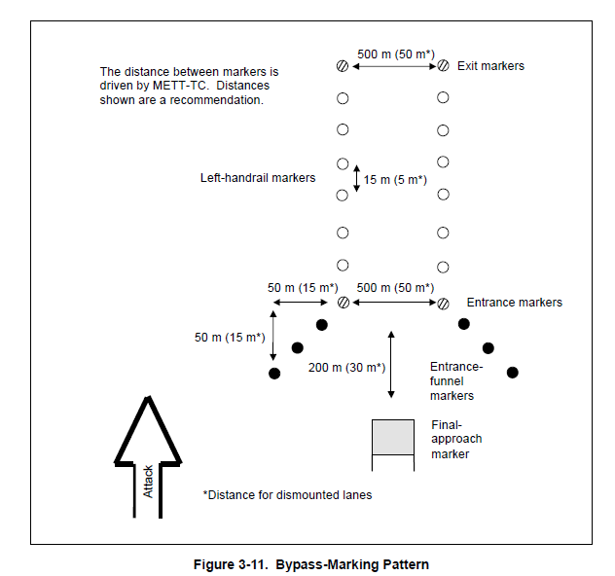
Card: # 502
Bypass Marking
Bypass Marking
Bypasses are marked using the same lane-marking patterns, marking devices, and visual cues as an initial breach lane.
The amount of room available for forces to maneuver must be determined. (50-500 meters)
Both left and right handrails need to be marked and simultaneously visible while in the lane.
Bypasses are expanded away from the obstacle and cannot hinder the unit’s ability to maneuver around the obstacle being bypassed.

Slide 64
SQUADRON EWO RESPONSIBILITES:
Assist the S-2 during the Intelligence Preparation of the Battlefield.
Determine intelligence requirements for EW.
Determine EW Targets.
De-conflict of EW assets.
Develop Electronic Warfare Target List.
Integrate EW into the targeting process.
Integrate EW target data into the Attack Guidance Matrix and Target Synchronization Matrix.
Prepare JTASR and EARF (include JRFL considerations).
Identify the functions of the EWWG.
Prepare Electronic Warfare Products in support of the MDMP process. (subtasks may include Running Estimate, EW Annex, Electronic Warfare Target List, Electronic Attack tasking and the Electronic Warfare portion of the Sensor/Attack Matrix)
EW Appendix 4 to Annex P, and other specified EW Reports and Messages using Appendix 4 to Annex P, and Other specified EW reports and Messages using Appendices B, C, and D of FM 3-36 and the MDMP – include ROE considerations).
De-conflict EW effects and recommend Task Organization changes to maximize effects.
Coordinate Spectrum Management RF De-confliction.
Integrate EW into tactical operation execution.
Monitor EMS for indications, threats, and warnings for immediate threat recognition and targeting (understand Title 50 authorities).
Prepare EW input for Unit SOPs.
Insure Troops have the required number of CREW Master Gunners and CREW Maintainers.
Card: # 503
SQDN EWO
Integrate Electronic Warfare Systems Into Unified Land Operations:
Integrate Electronic Attack Systems (Characteristics, capabilities, and limitations).
Integrate Electronic Support Systems (Characteristics, capabilities, and limitations).
Integrate Electronic Protect Systems (Characteristics, capabilities, and limitations).
Apply Special Purpose EA Systems (Characteristics, capabilities, and limitations).
Integrate Space Operations (Characteristics, capabilities, and limitations).
Conduct Electronic Warfare During Unified Land Operations:
Adapt EW plans during the execution of Unified Land Operations.
Serve as the Jamming Control Authority IAW JP3-13.1.
Lead all EW related operations in a staff.
Manage EA target requests (SLC consideration).
Assess EW execution using measures of Performance (MOP).
Assess EW effects using Measures of Effectiveness (MOE).
Employ Electronic Warfare Equipment:
Operate assigned EW Systems – one subtask per system. (For CREW, must include load, perform emergency destruction procedures, and zeroize).
Manage the employment of assigned EW systems.
Conduct Reprogramming procedures.
Operate the Spectrum Analyzer.
Demonstrate Events Log analysis fundamentals utilizing the Event Log Analysis Tool software.
Perform proper pre-combat checks and pre-combat inspections for CREW systems.
Implement EW training program within the unit’s overall training strategy.

Slide 65
Card: # 503
MOPP Levels
MOPP Equipment | MOPP LEVELS |  |  |  |  |  | CMD
 | MOPP Ready | MOPP Zero | MOPP 1 | MOPP 2 | MOPP 3 | MOPP 4 | Mask Only
Mask | Carried | Carried | Carried | Carried | Worn¹ | Worn | Worn
Over- garment | Ready³ | Available⁴ | Worn¹ | Worn¹ | Worn¹ | Worn
Vinyl Overboot | Ready³ | Available⁴ | Available⁴ | Worn | Worn | Worn
Gloves | Ready³ | Available⁴ | Available⁴ | Available⁴ | Available⁴ | Worn
Helmet Protective Cover | Ready³ | Available⁴ | Available⁴ | Worn | Worn | Worn
Chemical Protective Under-garment² | Ready³ | Available⁴ | Worn² | Worn² | Worn² | Worn²
¹ In hot weather coat or hood can be left open for ventilation. ² The CPU is worn under ACUs ³ Must be available to the soldier within two hours. Second set available in 6 hours. ⁴ Within arms reach of soldier.
UNMASKING CRITERIA
Once the ON GROUND Commander (6 element or representative thereof) has declared ALL CLEAR using redundant chemical detection equipment, reported ALL CLEAR to the TOC, the Commander will break his mask’s seal first.
At no time will a “most expendable person” be identified and used for unmasking procedures

Slide 66
Decontamination
Card: # 504
CBRNE Decon
Decon Levels / Techniques
Level | Technique | Best Start Time* | Performed by | Gains
Immediate | Skin Decon | Before 1 min | Individual | Stops agent from penetrating
 | Personnel Wipedown | Within 15 min | Individual or Crew
 | Operator Spraydown
Operational | MOPP Gear Exchange** | Within 6 hours | Unit | Possible temporary relief from MOPP 4; Limits liquid agent spread
 | Vehicle Wash down*** |  | BN Crew or Decon PLT (-)
Thorough | Detailed Equip Decon | When mission allows reconstitution | Decon PLT | Probable long-term MOPP reduction with minimum risk
 | Detailed Troop Decon |  | Unit
* The techniques become increasingly less effective the longer they are delayed
** Performance degradation and risk assessment need to be considered when exceeding 6 hours
*** Vehicle wash down is most effective within 1 hour, but will often have to be delayed for logistical reasons

Slide 67
Uniform
ACUs and FLC with water source and ability to carry 6x magazines will be worn in a field / training environment with PC or ACH per mission requirements. Eyepro will be worn, gloves at the ready or worn.
Live fire exercises
All personnel will upgrade to body armor with plates, ACH, and eyepro. Armored vehicle crews will wear vehicle crew member soft armor and ACH (CVC when operating a tracked vehicle.)
Card: # 505
Uniform & Weapon Safety Postures
Weapons Safety Posture
Weapon Type | GREEN | AMBER | RED
M9 | Weapon cleared, on safe, magazine removed | Magazine in weapon, no round in chamber, on safe | Magazine in weapon, round chambered, on safe
M16 / M4 | Weapon cleared, on safe, magazine removed | Magazine in weapon, no round in chamber, on safe | Magazine in weapon, round chambered, on safe
M203 / M320 | Weapon cleared, on safe | No round in chamber, on safe, ammo ready | Round chambered, weapon on safe
M249 | Weapon cleared, on fire, bolt forward | Bolt forward, on fire, ammo on feed tray | Bolt locked to rear, on safe, ammo on feed tray
M240 Series | Weapon cleared, on fire, bolt forward | Bolt forward, on fire, ammo on feed tray | Bolt locked to rear, on safe, ammo on feed tray
M500 | Weapon cleared, on safe | Shells in magazine tube, on safe, no shell in chamber | Shells in magazine tube, shell chambered, on safe
M14 | Weapon cleared, on safe | Magazine in weapon, no round in chamber, on safe | Magazine in weapon, round chambered, on safe
M2 | Weapon cleared, on safe, bolt forward | Bolt forward, on safe, rounds locked into top cover, chamber clear | Weapon charged, round chambered, weapon on safe
MK19 | Weapon cleared, on safe, bolt forward | Bolt forward, on safe, rounds on feed tray, chamber clear | Weapon charged, round chambered, weapon on safe
25mm | Feeder, and gun cleared, on electrical and manual safe, ammo stowed | Rounds cranked into feeder, no ghost rounds cycled, on electrical and manual safe | Ghost round cycled, on electrical and manual safe
TOW | No missile in tube, launcher in stowed position | Missile in tube, launcher in stowed position, system on electric safe | Missile in tube, launcher raised, on electric safe
Javelin (CLU) | No missile attached to CLU, CLU on safe | Missile not attached to CLU, CLU on safe, Missiles at the ready | Missile attached to CLU, CLU on safe

Slide 68
Garryowen Reporting SOP
Report | Description | Required | Primary | Alternate | Contingency | Emergency
Green 2 | Sensitive Items Report | 0500 & 1700 Daily | CMD | O/I | FBCB2 | Runner
Green 3 | Weather Report | Significant change | O/I | FBCB2 | Runner
Green 4 | BDA Report | As accurate BDA becomes known | O/I | FBCB2 preformat | FBCB2 free text | Runner
Green 5 | Intelligence Summary | As needed; Min daily at 0001 | FBCB2 | O/I | Runner
Green 6 | Captured Enemy Equipment | Within 2hr of capture | O/I | FBCB2 preformat | FBCB2 free text | Runner
Blue 1 | Spot Report | ASAP on contact | CMD | FBCB2 | O/I | Runner
Blue 2 | SITREP | As req by CDR; Min 2x Daily | CMD | FBCB2 | O/I | Runner
Blue 3 | Closing Report | NLT 30min after complete | CMD | O/I | FBCB2 | Runner
Blue 4 | Bridge Report | As reconnaissance is conducted | O/I | FBCB2 preformat | FBCB2 free text | Runner
Blue 5 | Crossing Report | As reconnaissance is conducted | O/I | FBCB2 preformat | FBCB2 free text | Runner
Blue 7 | Route Report | As reconnaissance is conducted | O/I | FBCB2 preformat | FBCB2 free text | Runner
Blue 8 | Airspace Control Measure Request | NLT Published Time in higher Order | FBCB2 | O/I | Runner
Blue 9 | Obstacle Report | As reconnaissance is conducted | O/I | FBCB2 preformat | FBCB2 free text | Runner
Blue 10 | Bypass Report | As reconnaissance is conducted | O/I | FBCB2 preformat | FBCB2 free text | Runner
Yellow 1 | LOGSPOT | When unit is Amber in status | A/L | FBCB2 | O/I | Runner
Yellow 2 | LOGSTAT | NLT 1900 Daily | A/L | FBCB2 | O/I | Runner
Yellow 3 | Class III Status Report | As needed; Min 2x Daily | A/L | FBCB2 | O/I | Runner
Yellow 4 | Emergency Ammo Request | When unit is Red on CL V sooner than expected | A/L | FBCB2 | O/I | Runner

Slide 69
Garryowen Reporting SOP (Continued)
Report | Description | Required | Primary | Alternate | Contingency | Emergency
Red 1 | Personnel Manning Report | Daily NLT 0600 | A/L | FBCB2 | O/I | Runner
Red 2 | Personnel Spot Report | When unit is Amber due to personnel loss | CMD (Initial Report) | A/L (After Initial) | FBCB2 | O/I
Red 7 | Suspected Law Violation Report | As soon as accurate info available | CMD (Initial Report) | O/I (After Initial) | FBCB2 | Runner
Red 8 | Suspected Friendly Fire Report | As Necessary | CMD (Initial Report) | O/I (After Initial) | FBCB2 | Runner
Red 9 | Accident Report | As accurate info is available; no more than 1 hour after incident | CMD (Initial Report) | O/I (After Initial) | FBCB2 | Runner
Red 10 | Serious Incident Report | As accurate info is available; no more than 1 hour after incident | CMD (Initial Report) | O/I (After Initial) | FBCB2 | Runner
Red 11 | MEDEVAC Request (9-Line) | ASAP after injury | CMD (Initial Report) | O/I (After Initial) | FBCB2 | Runner
Purple 1 | Detainee Report | Immediately upon Detention | O/I | FBCB2 | Runner
Purple 4 | IED / UXO Report | ASAP after discovery | CMD (Initial Report) | O/I (After Initial) | FBCB2 | Runner
CBRNE 1 | Observer's Initial Report or Follow Up | Upon discovery of contaminated area and appropriate MOPP level achieved | CMD (Initial Report) | O/I (After Initial) | FBCB2 | Runner
CBRNE 4 | Area of Contamination Report | After CBRNE 1 is sent for confirmed attack; used determine size of contaminated area | CMD (Initial Report) | O/I (After Initial) | FBCB2 | Runner
CBRNE 6 | Decontamination Request | ASAP after unit is clear of immediate CBRNE threat | CMD (Initial Report) | O/I (After Initial) | FBCB2 | Runner

Slide 70
Card: # 500-1
Green Reports
Green 2 - Sensitive Items Report
Purpose. The sensitive items report is to ensure that all sensitive items are accounted for.
If an item is missing the unit will provide the following information:
Line 1: DTG of loss:______________________________________________________
Line 2: Approximate Location of Loss:_______________________________________
Line 3: Missing Item Serial #:_______________________________________________
Line 4: Name, Rank, SSN of Ind Resp:_______________________________________
Line 5: Actions Taken to Recover Item:_______________________________________
Green 3 - Weather Report
Purpose. The weather report provides the commander with timely analysis
of how the weather will affect his operations. Sent from higher to lower. Sent on O/I Net.
Required: If a significant change in weather which might adversely affect operations.
Transmission: Primary: FM BDE O/I NET
Alternate: FBCB2 preformat
Tertiary: FBCB2 free text
Line 1: Location:_________________________________________________________
Line 2: DTG:____________________________________________________________
Line 3: Ceiling:__________________________________________________________
(Lowest forecast ceiling in hundreds of feet)
Line 4: Cover:___________________________________________________________
(Percentage of cloud cover)
Line 5: Visibility:_________________________________________________________
(Prevailing visibility in meters)
Line 6: Weather:_________________________________________________________
(Weather phenomena being forecasted)
Line 7: Max Temp:_______________________________________________________
(Centigrade and Fahrenheit)
Line 8: Min Temp:_______________________________________________________
Line 9: Wind:___________________________________________________________
(Direction and wind speeds in knots)
Line 10: Gusts:__________________________________________________________
(Peak gusts in knots)
Line 11: Barometric Pressure:______________________________________________
(In both millibars and atmospheres)
Line 12: Light Data:_______________________________________________________
EENT____ MR____MS______ BMNT______ SR_____SS_____
Line 13: Significant Weather Effects__________________________________________

Slide 71
Card: # 500-3
Green Reports
Green 4 - BDA Report
Purpose. To provide information to the SQDN S-2 on enemy losses in order to estimate enemy combat strength.
Line 1: Time:____________________________________________________________
Line 2: Location:_________________________________________________________
Line 3: Each Type of System:
#Destroyed/#Damaged__________________________________________________
Line 4: Enemy Unit (State Known or Assessed)
____________________________________________________________________________
Line 5: Source of BDA (Direct Fire, Indirect, CAS)_______________________________
Line 6: Report what remains of unit (if known) ______________________________________________________________________
Green 5 – Intelligence Summary Report
Purpose. The INTSUM is used to provide the S-2s with intelligence summaries
covering the previous 12 hours of enemy activity. Sent from higher to lower.
Line 1: Issuing Unit:______________________________________________________
Line 2: Time of Issue:_____________________________________________________
Line 3: Summary of Activity ________________________________________________
______________________________________________________________________
______________________________________________________________________
______________________________________________________________________
Line 4: Enemy Strength & Disposition:_______________________________________
Line 5: Enemy Frontline Trace:_____________________________________________
Line 6: Most Likely COA:_________________________________________________
Line 7: Enemy Weaknesses:_______________________________________________
______________________________________________________________________
______________________________________________________________________
Line 8: Current PIR/IR:____________________________________________________
______________________________________________________________________
______________________________________________________________________
______________________________________________________________________
______________________________________________________________________
______________________________________________________________________
______________________________________________________________________
______________________________________________________________________

Slide 72
Card: # 500-4
Green Reports
Green 6 - Reporting Captured Enemy Equipment
Purpose. To provide intelligence information to the commanders on enemy
composition, strengths, and weaknesses.
Line 1: DTG Found:______________________________________________________
Line 2: Type and Quantity of Equipment:______________________________________
Line 3: Country of Origin:__________________________________________________
Line 4: Brief Description of each item:________________________________________
______________________________________________________________________
______________________________________________________________________
______________________________________________________________________
______________________________________________________________________
______________________________________________________________________
______________________________________________________________________
______________________________________________________________________
______________________________________________________________________
Line 5: Commander Name and Unit that Captured Equipment:_______________________________________________________
Line 6: Actions taken with Equipment:_______________________________________________________
______________________________________________________________________
______________________________________________________________________

Slide 73
Card: # 501-1
Blue Reports
Blue 1 - Spot Report
Purpose. The Spot Report provides the commander with immediate information on the enemy that could influence the conduct of operations. Sent from lower to higher.
Line 1: Reporting Unit I.D.:_________________________________________________
Line 2: Size:____________________________________________________________
Line 3: Activity:__________________________________________________________
______________________________________________________________________
Line 4: Location (Grid):____________________________________________________
Line 5: Time:____________________________________________________________
Blue 2 (SITREP)
See following Page.
Blue 3 - Closing Report
Purpose. The closing report is used when a unit has moved from one location to another and provides information letting the commander know that all personnel and equipment have relocated and have been accounted.
Line 1: Unit:______________________________________________________
Line 2: DTG:______________________________________________________
(DTG when unit departed from last location)
Line 3: DTG:______________________________________________________
(DTG when unit closed at new location)
Line 4: DTG:______________________________________________________
(DTG for Trail Party or disabled vehicles)
Line 5: Location (Grid):______________________________________________
(Grid location to new location)
Line 6: Sensitive Items: Use color code to indicate unit status._______________
Line 7: Personnel: Use color code to indicate unit status.___________________

Slide 74
Card: # 925-2
Reports
Blue 2 – Situation Report (SITREP)
Purpose. To provide commander accurate status of subordinate units.
Line 1. As of DTG
Line 2. Brief summary of enemy activity, casualties inflicted, and prisoners captured, or personnel detained.
Line 3. Friendly locations
  CP locations
  Center mass of all elements
  Any additional comments necessary
  Major changes in concept of ops or scheme of maneuver
  Line 4. Combat vehicles operational
  Line 5. Defensive obstacles and locations
    MF – Minefield
    TD – Tank ditch
    AB – Abatis
    RC – Road crater
    CW – Concertina wire
  Line 6. Personnel strength fit for duty using color chart
  Line 7. Classes III and V supplies available for combat vehicles using color chart
  Line 8. Summary of tactical mission
100 – 90%
89 – 75%
74 – 60%
59 – Below

Slide 75
Card: # 925-3
Reports
BLUE 4, 5, 7, 8, 9 10 Reports
Purpose. To provide information to the SQDN S-2 on route characteristics
Blue 4 – Report for Bridge, Overpass, Culvert, Underpass, or Tunnel (BRIDGEREP)
Line Alpha: Type and Grid location
Line Bravo: Overall length
Line Charlie: Width of roadway
Line Delta: Height restrictions
Line Echo: Length and number of spans
Line Foxtrot: Computed classification (MLC)
Line Golf: Bypass locations and conditions
Blue 5 – Report for Ford, Ferry, or other Crossing Site (CROSSREP)
Line Alpha: Type and Grid location
Line Bravo: Length of crossing
Line Charlie: Usable width
Line Delta: Current speed in per second
Line Echo: Maximum depth in meters
Line Foxtrot: Bottom material and condition
Line Golf: Capacity classification of any existing ferry equipment
Line Hotel: Slope of entry bank
Line India: Slope of exit bank
Line Kilo: Other comments as necessary

Slide 76
Card: # 925-5
Reports
Blue 7 – Route Reconnaissance Report (ROUTEREP)
Line Alpha: Begin grid location
Line Bravo: End grid location
Line Charlie: Type of route using the following designations:
Highway
Road
Trail
Cross-country
Line Delta: Classification of route. (Height, width, weight restrictions for military load classifications)
75. Tank
35. Bradley
20. Loaded LHS family
4. HMMWV family
Line Echo: Seasonal Limitations
X. All weather (Year round usage)
Y. Limited all weather (Use limited during bad weather)
Z. Fair weather (Impassable during bad weather)
Line Foxtrot: Rate of movement the route will support
Fast
Slow
Line Golf: Location and type of any critical points, including:
Curves with a radius of 45m or less
Uphill slopes with grades of 5% or greater
Width restrictions of 6m or less for one-way traffic; 10m or less for two-way traffic
Overhead clearance of 4.3m or less

Slide 77
Card: # 501-2
Blue Reports
Blue 8- Airspace Control Measure Request.
Purpose. To request specific airspace control measures for inclusion on a future airspace control order.
Required: NLT published time in DIV OPORD.
Transmission: Primary: CPOF
Alternate: FM SQDN O&I NET
Tertiary: FBCB2
Line 1- DTG ___________________________________________________________
Line 2- Unit sending report________________________________________________
Line 3- Requesting Unit __________________________________________________
Line 4- Type of Airspace Control Measure ___________________________________
Line 5- Name of Airspace____ ____________________________________________
Line 6- Purpose of special use airspace ____________________________________
Line 7- Transit instructions _______________________________________________
Line 8- From DTG _____________________________________________________
Line 9- To DTG _______________________________________________________
Line 10- Description of area to be defined ___________________________________
Line 11- Grid coordinates _______________________________________________
Line 12- Width/Radius of control measure __________________________________
Line 13- Lower limit ___________________________________________________
Line 14- Upper limit ___________________________________________________
Line 15- Call sign of Control Agency ______________________________________
Line 16- Primary Frequency ____________________________________________
Line 17- Secondary Frequency _________________________________________
Line 18- Narrative ____________________________________________________
Line 19- Authentication ________________________________________________

Slide 78
Blue 9 – Obstacle Report
Line Alpha: Type of obstacle or obstruction
Line Bravo: Grid location
Line Charlie: Dimensions and orientation
Line Delta: Composition
Line Echo: Enemy weapons influencing obstacle
Line Foxtrot: Observer’s actions
Card: # 925-6
Reports
Blue 10 – Bypass Report
Line Alpha: Observer or source
Line Bravo: Length, width, surface type, grade
Line Charlie: Coordinates of “from” and “to” locations
Line Delta: Seasonal / weather limitations (Use X, Y, or Z as described in Blue 7)
Line Echo: Bypass markings
Line Foxtrot: Observer’s actions

Slide 79
Card: # 502-1
Yellow Reports
Yellow 1 – LOGSPOT
Purpose. The LOGSPOT provides information on actual or anticipated changes in logistic situation that may have a major impact on the operational capability of the reporting unit.
Line 1: Reporting Unit:______________________________________________
Line 2: DTG:______________________________________________________
Line 3: Equipment Losses
Type Equipment Loss O/H
a. Line Item #:_______________________________________________________
b. " " " ________________________________________________________
c. " " " ________________________________________________________
Line 4: Personnel Losses:
Position Loss O/H
a. :________________________________________________________________
b. :________________________________________________________________
c. :_________________________________________________________________
Line 5: Significant Supply Losses:
Class Loss
a. :________________________________________________________________
b. :________________________________________________________________
c. :_________________________________________________________________
Line 6: Combat Capability of Unit: (Use color indicator)_____________________
Yellow 2 –LOGSTAT
See following page.
Yellow 3 – CLIII
Yellow 4: (Emergency Ammunition Request)
Purpose: The Emergency Ammunition Request is used when a unit's CL V basic load for major combat platforms have been depleted to such an extent that that unit cannot accomplish it's mission without an emergency resupply.
Line 1: Line # of Type of Ammunition:________________________________________
Line 2: Qty Required:_____________________________________________________
Line 3: Location (grid) to Resupply:___________________________________________
100 – 90%
89 – 75%
Use color chart to report statuses
74 – 60%
59 – Below

Slide 80
Yellow 2 –LOGSTAT
Card: # 502-2
Yellow Reports
 | YELLOW 2 (LOGSTAT)
 | UNIT:Garryowen 1-7 CAV 1 BCT 1 CD
 | LINE 1: MAINTENANCE STATUS |  |  |  |  |  |  |  |  | LINE 7: CL V (Ammo)
 | MODEL |  | O/H | FMC | MAINT | BMP # and REMARKS |  |  |  | TYPE | O/H | EXP. | REQ.
1 | M3A3 |  |  |  |  |  |  |  |  | 1. 5.56 Ball
2 | M2A3 |  |  |  |  |  |  |  |  | 2. 5.56 Blank
3 | M1064 |  |  |  |  |  |  |  |  | 3. 5.56 LNK Ball
4 | M1025/1026 |  |  |  |  |  |  |  |  | 4. 5.56 Tracer
5 | M1114 |  |  |  |  |  |  |  |  | 5. 5.56 LNK 4x1
6 | M1151 |  |  |  |  |  |  |  |  | 6. 5.56 LNK Blank
7 | M1068/577 |  |  |  |  |  |  |  |  | 7. 7.62 LNK
8 | M113 |  |  |  |  |  |  |  |  | 8. 7.62 LR (Sniper)
9 | M113 AMB |  |  |  |  |  |  |  |  | 9. 7.62 LNK 4x1
10 | M9 ACE |  |  |  |  |  |  |  |  | 10. 7.62 Tracer
11 | M88A1 |  |  |  |  |  |  |  |  | 11. 7.62 LNK Blank
12 | M88A2 |  |  |  |  |  |  |  |  | 12. 9mm Ball
13 | M998/M1038 |  |  |  |  |  |  |  |  | 13. .50 CAL
14 | M1097 |  |  |  |  |  |  |  |  | 14. .50 CAL 4x1
15 | M1113 |  |  |  |  |  |  |  |  | 15. .50 CAL Blank
16 | M1078 |  |  |  |  |  |  |  |  | 16. 25mm TPDS-T
17 | M1079 |  |  |  |  |  |  |  |  | 17. 25mm TP
18 | M1083 |  |  |  |  |  |  |  |  | 18. 25mm HE
19 | M1087 |  |  |  |  |  |  |  |  | 19. 25mm AP
20 | M1088 |  |  |  |  |  |  |  |  | 20.
21 | M1089 |  |  |  |  |  |  |  |  | 21.
22 | M977 HEMMT |  |  |  |  |  |  |  |  | 22.
23 | M978 |  |  |  |  |  |  |  |  | 23.
24 | M969 |  |  |  |  |  |  |  |  | 24.
25 | M984 |  |  |  |  |  |  |  |  | 25.
26 | M1120 |  |  |  |  |  |  |  |  | PYRO, SMOKE, ILLUMINATION, SIMULATORS
27 | M1075 |  |  |  |  |  |  |  |  | 26.
28 | M1112 Buffalo |  |  |  |  |  |  |  |  | 27.
29 | PU-798/802/803 |  |  |  |  |  |  |  |  | 28.
30 | FLU-419 SEE |  |  |  |  |  |  |  |  | 29.
31 | M7 |  |  |  |  |  |  |  |  | 30.
32 | M1101 |  |  |  |  |  |  |  |  | 31.
33 |  |  |  |  |  |  |  |  |  | 32.
34 |  |  |  |  |  |  |  |  |  | 33.
35 |  |  |  |  |  |  |  |  |  | 34.
22 | LINE 2: CL I (Water/Rations) |  |  |  | LINE 5: CL III(P) |  |  |  |  | LINE 8: CL VIII
22 |  | O/H | REQ | DTG | TYPE |  | O/H | REQ | SIZE | ITEM |  | O/H | REQ
1 | MRE: |  |  |  | 1. 15/40 wt |  |  |  |  | 1.
2 | Water (gal): |  |  |  | 2. 10 wt |  |  |  |  | 2.
3 | ICE: |  |  |  | 3. 80/90 wt |  |  |  |  | 3.
4 | REQUEST FOR UGR-As |  |  |  | 4. Antifreeze |  |  |  |  | 4.
 | PAX | DTG and LOCATION |  |  | 5. GAA |  |  |  |  | 5.
4 |  |  |  |  | 6. GMD |  |  |  |  | LINE 9: BATTERIES
 | LINE 3: CL II |  |  |  | 7. FRH |  |  |  |  | TYPE | NSN | O/H | REQ
 | ITEM |  | QTY | NSN | 8. Turboshaft |  |  |  |  | 1.
1 |  |  |  |  | 9. Dextron III |  |  |  |  | 2.
2 |  |  |  |  | 10. |  |  |  |  | 3.
3 |  |  |  |  | 11. |  |  |  |  | 4.
 | LINE 4: CL III(B) |  |  |  | 12. |  |  |  |  | 5.
1 | TYPE |  | QTY | DTG | LINE 6: CL IV |  |  |  |  | 6.
1 | JP 8 |  |  |  | ITEM |  | O/H | REQ | DTG | LINE 10: STATUS- (Current/Projected)
2 | DIESEL |  |  |  | 1. Sandbags |  |  |  |  | Class of Supply | Current | 24 | 48
3 | MOGAS |  |  |  | 2. Long Pickets |  |  |  |  | CL I (Gal / MREs)
 | LINE 11: REMARKS |  |  |  | 3. Concertina Wire |  |  |  |  | CL III(B)
 |  |  |  |  | 4. Barriers |  |  |  |  | CL III(P)
 |  |  |  |  | 5. |  |  |  |  | CL V

Slide 81
Card: # 503-1
Red Reports
Red 1 - Commander's Personnel Manning Report.
Purpose. The Personnel Status Report provides a daily personnel status to the brigade commander.
Line 1: Report as of DTG.________________________________________________
Line 2: Unit:____________________________________________________________
LINE # AUTH/ASGD/PDY/REMARKS
3 Officer
4 Warrant
5 Enlisted
Line 6: Unit personnel status: (G) (A) (R) (B)
Red 2 - Personnel Spot Report
Purpose. Used for reports of casualties.
Line 1. Unit:________________________________________________________
Line 2. Location:_____________________________________________________
Line 3. Cause of Casualties_____________________________________________
Line 4. Soldier Losses: Hostile Action A. KIA_____ B. WIA_____ C. MIA_____
Non-Hostile Action D. KIA_____ E. WIA_____ F. MIA_____
Line 5. Current Operational Effectiveness:____________________________________
Line 6. Remarks:________________________________________________________
100 – 90%
89 – 75%
74 – 60%
59 – Below

Slide 82
Card: # 503-2
Red Reports
RED 7 - Suspected Law Violation Report
Purpose: The Suspected Law Violation Report provides reporting of possible law violations.
Line 1: Description of Incident:______________________________________________
______________________________________________________________________
______________________________________________________________________
______________________________________________________________________
Line 2: Location of Incident:________________________________________________
______________________________________________________________________
Line 3: DTG of Incident:___________________________________________________
Line 4: DTG of Discovery:__________________________________________________
Line 5: Who caused suspected violation:______________________________________
______________________________________________________________________
______________________________________________________________________
______________________________________________________________________
Line 6: Name of Witnesses:________________________________________________
______________________________________________________________________
Line 7: POC:____________________________________________________________
RED 8 - Suspected Friendly Fire Report
Purpose: The Suspected Friendly Fire Report provides reporting of possible friendly fire incidents.
Line 1: Description of Incident:______________________________________________
______________________________________________________________________
______________________________________________________________________
______________________________________________________________________
Line 2: Location of Incident:________________________________________________
Line 3: DTG of Incident:___________________________________________________
Line 4: DTG of Discovery:__________________________________________________
Line 5: Who caused suspected violation:______________________________________
______________________________________________________________________
______________________________________________________________________
Line 6: Name of Witnesses:________________________________________________
______________________________________________________________________
______________________________________________________________________
Line 7: POC:___________________________________________________________

Slide 83
Card: # 503-3
Red Reports
RED 9 - Accident Report
Purpose. The accident report provides timely information to the commander on accidents that occur within the unit.
Line 1: Description of Accident: ______________________________________
______________________________________________________________________
______________________________________________________________________
Line 2: Location of Accident: ________________________________________
Line 3: DTG of Accident: ___________________________________________
Line 4: DTG of Discovery: __________________________________________
Line 5: Cause of accident: __________________________________________
Line 6: Name of Witnesses: _________________________________________
______________________________________________________________________
______________________________________________________________________
Line 7: Name or BR# of injured, names of civilians involved (Claims Card Issued) ______________________________________________________________________
______________________________________________________________________
Line 8: Bumper number and Nomenclature of equipment involved, type of civilian vehicles: ________________________________________________________________
Line 9: POC:______________________________________________________

Slide 84
Card: # 503-4
Red Reports
RED 10 - Serious Incident Report (SIR)
Purpose. The SIR provides information to the commander relating to any serious incidents. Units will submit the report in hardcopy following the provided format.
Required: As soon as accurate information is available, but not less than one hour after the incident
Transmission Primary: FM SQDN CMD NET
Alternate: O/I
Contingency: FBCB2 Free Text
Emergency: Runner
Line 1: Unit in which incident occurred:_______________________________________
Line 2: DTG incident occurred:______________________________________________
Line 3: Location of incident:________________________________________________
Line 4: Type of incident:___________________________________________________
Line 5: Personnel involved:
a. Name_________________________________________________________
b. Grade_________________________________________________________
c. SSN__________________________________________________________
d. Race__________________________________________________________
e. Sex___________________________________________________________
f. Age___________________________________________________________
g. Position________________________________________________________
h. Security Clearance_______________________________________________
i. Residence(Barracks/On or Off Post)__________________________________
j. Others involved__________________________________________________
Line 6: Was anyone injured?_______________________________________________
a. nature/severity of injury___________________________________________
b. treatment time, location, and status of individual ___________________________________
Line 7: Was military equipment lost or damaged?_________________________
Line 8: Was law enforcement involved?________________________________
Line 9: Who else notified of incident:
a. Company________________________________________________
b. BN_____________________________________________________
c. Other___________________________________________________
Line 10: Authority Releasing this Report from BN to BDE:___________________

Slide 85
Card: # 503-5
Red Reports
RED 11 - MEDEVAC Request
Any person who needs treatment to save life, limb, or eyesight is entitled to evaluation and treatment if necessary.
Patient movement priorities are: 1. Air 2. Ground 3. Opportunity Air Lift 4. Unit Vehicles
FOR URGENT CASUALTIES, USE THE NATO 9-LINE MEDEVAC/ CASEVAC REQUEST FORMAT:
Line 1: Location (8 digit grid) of pickup site:___________________________________
Line 2: Frequency and Call Sign at Pickup Site:________________________________
Line 3: Number of patients by category:_______________________________________
a. Urgent-Surgical (All Trauma) – need immediate surgical care
b. Urgent (Non-Surgical) – evacuate ASAP, maximum of 2 hours
c. Priority – evacuate within 4 hours
d. Routine – evacuate within 24 hours
e. Convenience – evacuate when possible
Line 4: Special equipment required:__________________________________________
None
Hoist
Extraction equipment
Ventilator
Line 5: Number of patients by type:__________________________________________
L + # litter patients
A + # ambulatory patients
Line 6: WARTIME: Security of pickup site:_____________________________________
N – No Enemy Troops
P – Possible Enemy Troops in the Area
E – Confirmed Enemy Troops in the Area (Use Caution)
X – Engaged with Enemy Troops (Armed Escort Recommended)
Line 7: Method of marking site:______________________________________________
Panels
Pyrotechnic (what color)
Smoke (what color)
Light (what color)
None
Other
Line 8: Patients Status and Nationality if Known:_________________________________
A – US/ Coalition Military, Nationality =
B – US/ Coalition Force Civilian, Nationality =
C – Non US/Coalition Military, Nationality =
D – Non US/ Coalition Civilian, Nationality =
E – Detainee
F – High Value Target (Armed Escort Required)
Line 9: WARTIME: NBC Contamination:_____________________________________
Nuclear
Biological
Chemical
* MEDEVAC Frequency for FT. Hood is 38.300 SCPT

Slide 86
Card: # 504-1
Purple Reports
PURPLE 1 – IRONHORSE DETAINEE REPORT
Purpose: To track the detention of enemy elements
IRONHORSE DETAINEE REPORT
LINE 1 | UNIT REPORTING
LINE 2 | UNIT DETAINING (TROOP LEVEL)
LINE 3 | TIME OF REPORT
LINE 4 | TIME OF DETENTION
LINE 5 | LOCATION OF DETENTION
LINE 6 | NUMBER OF DETAINEES
LINE 7 | REASON FOR DETENTION
LINE 8 | LOCATION OF SQDN HOLDING AREA
LINE 9 | DOES UNIT REQUIRE MORE THAN 24hr
 | TO EVAC TO BDE HOLDING AREA?
 | IF SO, WHY?

Slide 87
Card: # 504-2
Purple Reports
PURPLE 4 (IED/UXO Report)
9 Line IED Report
Line 1. DTG
Line 2. Location
Line 3. Unit and contact means
Line 4. Nature of IED/Type of Munitions/Delivery
Unknown
IED Strike
PIED
UXO
Line 5. NBC contamination
Unknown N/A
Line 6. Resources Threatened
Coalition Forces
Local Nationals
IA
IP
Line 7. Impact on Mission
Stop Mission
End Mission
None
Line 8. Force Protection Measures Taken
5/25 Complete
300m Cordon Set
Line 9. Recommended Priority
Immediate
Minor
Routine
Additional Information
Patrol Composition
H=M1114 HMMWV BR=M2A3 BFV T=M1A2 Abrams MBT B=Buffalo
(W/WO FRAG KITS)
#______
# CREW and Types
R/G=Red/green R=Red B=Blue G=Green B/G=Blue/green
Direction of Travel
Where IED is located
BDA(What vehicle in the convoy was hit?)
Casualties US x WIA LN x WIA
___x KIA x KIA

Slide 88
Card: # 505-1
CBRNE Reports

Slide 89
Card: # 505-2
CBRNE Reports

Slide 90
Card: # 505-3 CBRNE Reports
CBRNE 6 (Decontamination Request)
LINE 1 – Date and Time ______________________________(DTG)
LINE 2 -- Unit________________________________________(Unit Making Report)
LINE 3 -- Type Decon_________________________________(Type of Decontamination Support Required (Operational/Thorough))
LINE 4 – Type / Quantity______________________________(Type and Quantity of Equipment to be Decontaminated)
LINE 5 – Decon Location___________________________(Six-Digit Grid Coordinate Grid Zone Designator of Decontamination Site Location)
LINE 6 -- Personnel__________________________________(Number of Personnel Requiring Decontamination)
LINE 7 – Type Contamination _______________________(Type of Contamination (Nuclear, Biological, or Chemical), if Chemical, Type Agent if Known)
LINE 8 – Time to Decon ______________________________(Request Time to Start Decontaminate)
LINE 9 – Link Up POC________________________________(Frequency and Call Sign of Link-Up Point POC)
LINE 10 -- CP at Decon Site__________________________(Link-up Point Decontamination Assets)
**Repeat lines 3 through 10 to report multiple mission/mission data. Assign sequential line numbers to succeeding iterations; for example, first iteration 3 through 10; second iteration 3a through 10a; third iteration 3b through 10b; and so on.
LINE 11 – Narrative _________________________________(Free Text for Additional Information Required for Clarification of Report)
LINE 12 – Authentication ___________________________(Report Authentication)

Slide 91
Card: # 506
Training Closure Report
TRAINING CLOSURE REPORT
Unit
Training Event
DTG Training Completed
Location of Training
# Personnel Trained
# Rounds Fired by DODIC
 | DODIC |  | # Rounds Fired
Sensitive Items (Green/Amber/Red)
Personnel (Green/Amber/Red)
Lessons Learned / Remarks
Submitted By
Range Control Clearance

Slide 92
To be used for deployment / redeployment to / from field training or tactical mission. Turn in to S3 shop / TOC NLT 72 Hrs prior to LD.
Card: # 507
Trip Ticket
ADMINISTRATIVE DATA
UNIT
Name and Rank
Contact Number
Email Address
Date Submitted
RANGE / TRAINING AREA / SUPPORT
Training Event / Location
Task / Purpose
HET Request Submitted |  |  | No |  | Approved
SP HET P/U DTG |  |  | N/A |  | Location
SP HET D/O DTG |  |  | N/A |  | Location
RP HET P/U DTG |  |  | N/A |  | Location
RP HET D/O DTG |  |  | N/A |  | Location
Night Training Y/N |  |  |  | Night Live Fire Y/N
Total # of Soldiers to be trained |  |  |  | Max # Soldiers training at once
OIC
RSO
I/O
PERSONNEL / VEHICLES
# PAX |  | OFFICER |  | NCO |  | ENLISTED
VEHICLE TYPE |  | # |  | VEHICLE TYPE |  | #
REMARKS / COMMENTS
RECEIVED BY
TRACKING #

