Slide 1


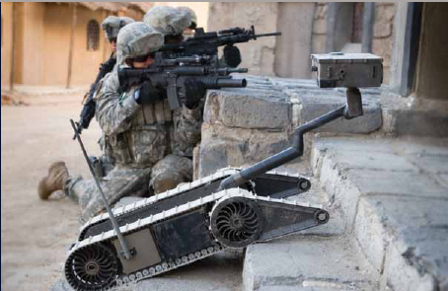
Calibration

Slide 2
Terminal Learning Objective
Action: | Identify Calibration Procedures for the SUGV.
Conditions: | In an operational environment provided with TM 9-2350-397-13&P, SUGV Job Aid, SUGV Student Guide, and an Operational SUGV System.
Standards: | Identify Calibration Procedures for the SUGV in accordance with TM 9-2350-397-13&P by: Calibrate the Flippers; Calibrate SUGV Head Latch; Calibrate SUGV head and neck with 100% accuracy.

Slide 3
Enabling Learning Objective A
Action: | Calibrate the flippers.
Conditions: | In an operational environment provided with TM 9-2350-397-13&P, SUGV Job Aid, SUGV Student Guide, and an Operational SUGV System.
Standards: | Identify Calibration Procedures for the SUGV in accordance with TM 9-2350-397-13&P by; Calibrate the Flippers with 100% accuracy.

Slide 4
NOTE
If it appears that the robot is out of sync before you apply any poses to it, you should calibrate the flipper assemblies, latch, and neck assembly.
NOTE
If calibration fails or the robot needs to be re-calibrated frequently, send it to higher level maintenance.

Slide 5
Calibrating the Flippers
Press the Flippers Down button on the hand controller to rest the flippers flat on the surface in front of the robot.
Press the Menu toggle button on the hand controller to display the Main menu.
Select Options > Calibration to display the Calibration menu.
Select Calibrate Flipper to calibrate the flippers. Calibrate DONE appears in the display.
Check to verify that the robot icon on the display correctly reflects the position of the flippers.

Slide 6
Enabling Learning Objective B
Action: | Calibrate the SUGV Head Latch.
Conditions: | In an operational environment provided with TM 9-2350-397-13&P, SUGV Job Aid, SUGV Student Guide, and an Operational SUGV System.
Standards: | Identify Calibration Procedures for the SUGV in accordance with TM 9-2350-397-13&P by; Calibrate the SUGV Head Latch with 100% accuracy.

Slide 7
Calibrating the Latch
NOTE
If the head latch is latched, or partially latched, unlatch it by turning the manual latch override counterclockwise until it stops.
Press the Menu toggle button on the hand controller to display the Main Menu.
Select Calibrate Latch to calibrate the head assembly latch.
Press the Cancel/Back button on the hand controller to return to the Options menu.
Select Head Latch > Latch and verify that the latch moves through the full range of motion.
If you see the warning “Head Latching Failed, Returning to Unlatched” ignore it. The head is not in the chassis, so it cannot latch.

Slide 8
Enabling Learning Objective C
Action: | Calibrate the SUGV Head and Neck.
Conditions: | In an operational environment provided with TM 9-2350-397-13&P, SUGV Job Aid, SUGV Student Guide, and an Operational SUGV System.
Standards: | Identify Calibration Procedures for the SUGV in accordance with TM 9-2350-397-13&P by: Calibrate the SUGV Head and Neck with 100% accuracy.

Slide 9
Calibrating the Neck
Ensure that the head latch is properly aligned.
Press the Menu toggle button on the hand controller to display the Main menu.
Select Options > Calibration > Calibrate Mode On.
NOTE
When Calibrate Mode On is selected, the robot’s collision avoidance software turns off. This requires that you take care to ensure that head and neck components do not collide or become jammed.
4. Confirm that the Robot Icon has turned orange to indicate that the robot is in Calibration Mode.

Slide 10
Calibrating the Neck
5. Use the Head Pitch/Pan joystick to position the head so that it is tilted backward with the front of the head looking straight up.
6. Use the Tilt 1 Forward button to tilt the head forward until it rests on the neck.
7. Use the Neck Backward button on the hand controller to move the neck and head back into the chassis until the neck rest is sitting firmly on the chassis neck stop.
8. Manually power off the robot.

Slide 11
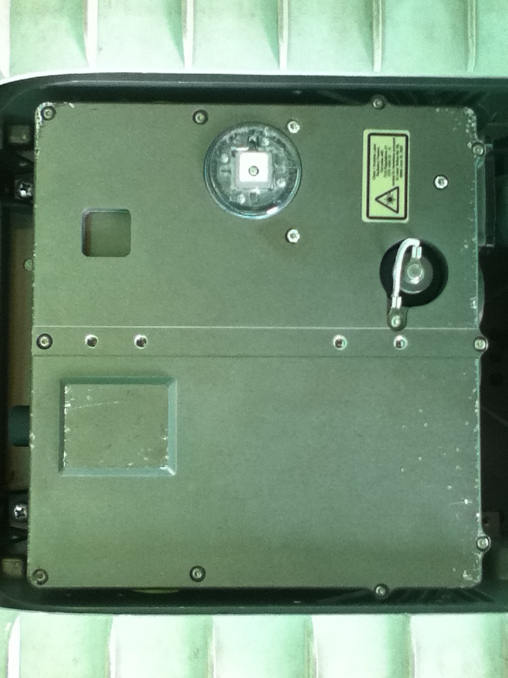
FRONT
.
9. Lightly press the head in the three locations indicated above to ensure the head is all the way down and resting on its chassis supports.
NOTE
Do not push on the neck with your hands. This action causes the neck to spring out of position.

Slide 12
Calibrating the Neck
10. Power up the robot.
11. Select Calibration > Calibrate Mode On.
12. Select Calibration > Calibrate Neck.
13. Confirm that Calibrate DONE appears in the display.
14. Confirm that the robot icon on the display reflects the correct position of the neck in relation to the robot.
15. Select Calibration > Calibrate Mode Off.
16. Verify that Calibrate Mode OFF is displayed in the heads-up
17. Display and the robot icon is green.

Slide 13
Calibrating the Neck
Press the Cancel/Back button on the hand controller to return to the Main menu.
Select Poses > Drive to enter the robot into Drive pose.
Check that the head is looking straight forward by verifying that the center line of the head matches the center line of the chassis.
Select Poses > Stow to enter the robot into Stow pose.
22. Verify that the head does not catch on either side of the chassis and that the head latch closes completely.

Slide 14
Summary
Terminal Learning Objective
Action: Identify Calibration Procedures for the SUGV.
Condition: In an operational environment provided with TM 9-2350-397-13&P, SUGV Job Aid, SUGV Student Guide, and an Operational SUGV System.
Standard: Identify Calibration Procedures for the SUGV in accordance with TM 9-2350-397-13&P with 100% accuracy.
ELO A: Calibrate the flippers.
ELO B: Calibrate the SUGV Head Latch.
ELO C: Calibrate the SUGV Head and Neck.

Slide 15
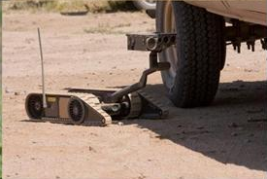
Troubleshooting Procedures

Slide 16
Terminal Learning Objective
ACTION: | Identify Troubleshooting Procedures at operator level.
CONDITIONS: | In an operational environment, provided TM 9-2350-397-13&P, SUGV Job Aid, SUGV Student Guide, and an operational SUGV system.
STANDARDS: | Identify troubleshooting procedures at operator level in accordance with TM 9-2350-397-13&P at 80% accuracy when: The tracks disengage; The SUGV will not turn on; The OCU will not turn on; The SUGV will not respond to the hand controller; The display does not appear in the heads up display; The SUGV will not assume a pose; The head latch will not latch/ unlatch; The drive camera will not function; The thermal camera will not function; The LRF will not function.

Slide 17
WARNING
Ensure the SUGV is powered off and the batteries are removed before conducting any vehicle maintenance. Injury may occur if the SUGV moves or is driven while maintenance is being conducted.
CAUTION
Do not pick up or carry the SUGV by its tracks, flippers, antennae or head. Damage to the SUGV may occur.

Slide 18
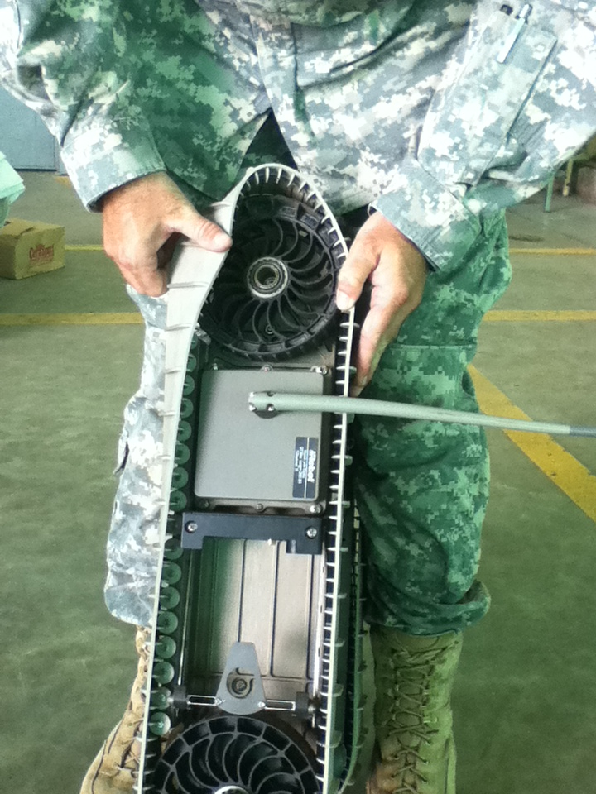
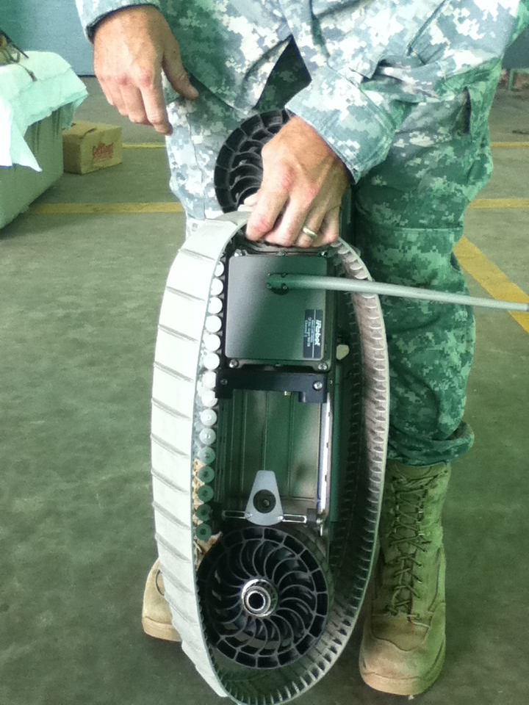
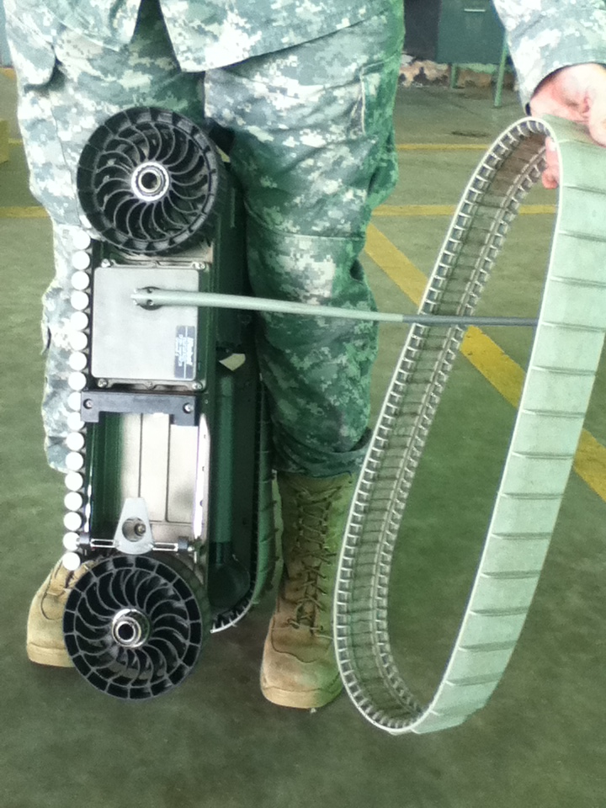
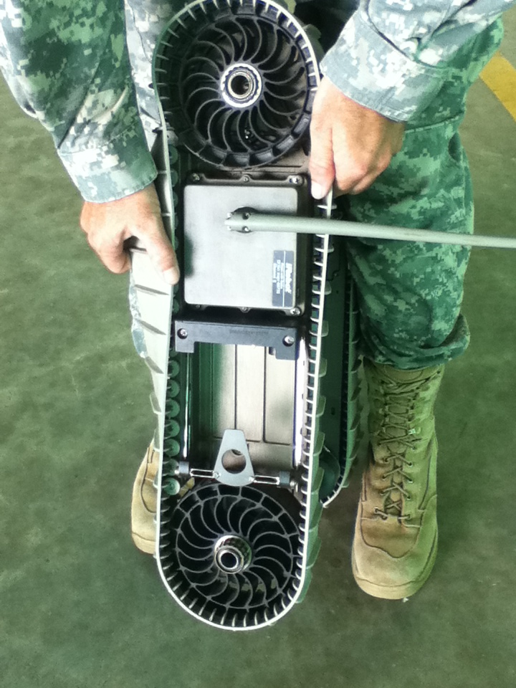
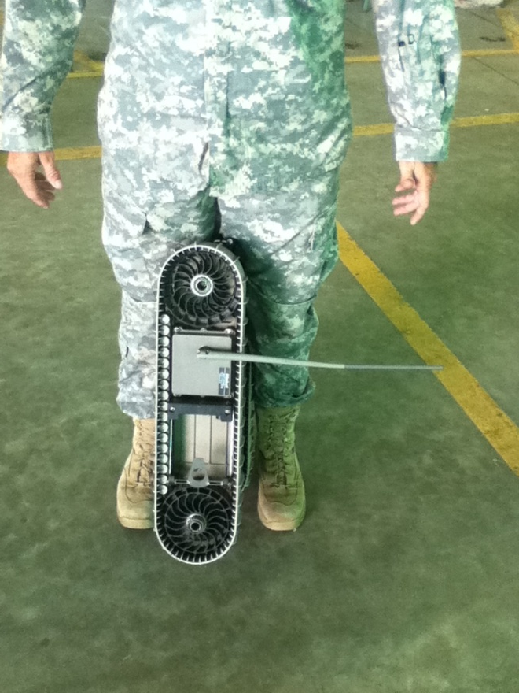
The chassis tracks disengage/become unserviceable
Remove the Chassis Tracks
Tip the SUGV on its end.
Stand over it and brace it between your legs so that one leg is pressing against the top of the chassis, the other is pressing against the bottom of the chassis, and the chassis track you want to remove is in front of you.
                With one hand, grab one side of the chassis track in front of you, halfway between the two wheels. With the other hand, press on the chassis track on top of the wheel.
                Pull the chassis track upward and outward to start easing it off the top wheel. As you pull the chassis track upward, press downward with the other hand. Continue this action until the chassis track slips off the wheel.
                Repeat the above steps to remove the second chassis track.
Notes:
Instructor demonstration

Slide 19
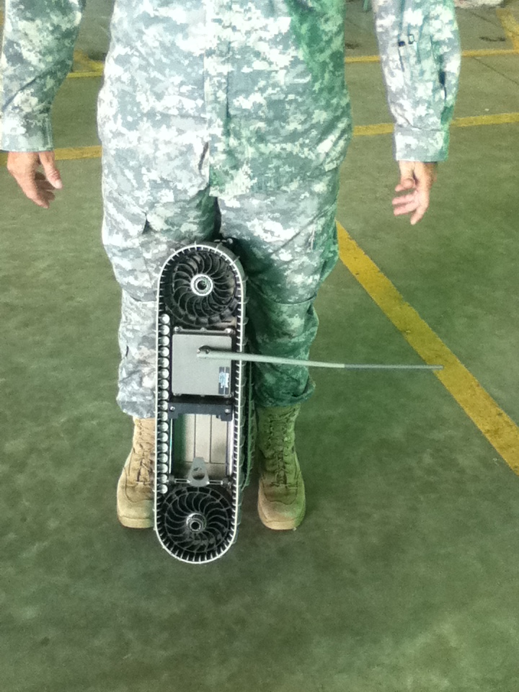
Install the Chassis Tracks
Tip the SUGV on its end.
Stand over it and brace it between your legs so that one leg is pressing against the top of the chassis, the other is pressing against the bottom of the chassis.
Wrap the inside of the chassis track around the bottom of the wheel and pull it upward to secure it around the top of the wheel.
              Pull the chassis track up over the edge of the top wheel, place your hand against the side of the top wheel and the chassis track, and simultaneously push the wheel and the chassis track upward with your hand while you pull the chassis track downward with your other hand on the other side.
              Continue this action until the chassis track eases onto the top wheel and the wheel rests securely inside it.
Notes:
Instructor demonstration

Slide 20
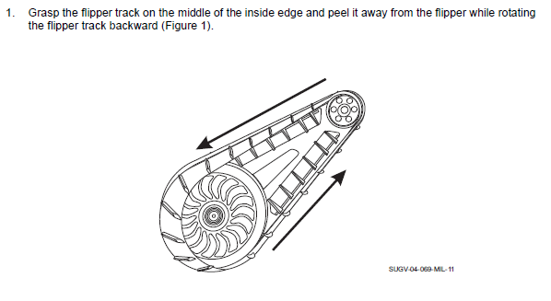
REPLACE FLIPPER TRACKS

Slide 21
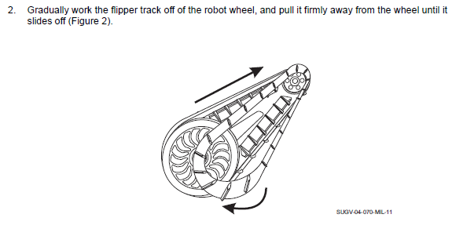

Slide 22
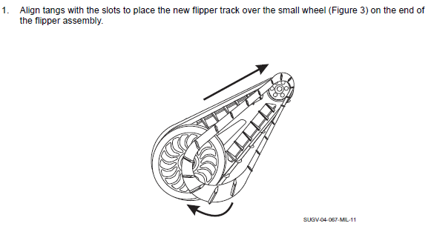


Slide 23
The SUGV will not turn on
  Remove the two robot batteries.
  Verify that the batteries are charged.
  Inspect the battery compartment for dirt, debris, water, and damage.
  If needed, clean the batteries and their compartments. Use a dry and clean cotton tipped swab to clean the connectors inside the battery compartments.
  Re-install the batteries or replace with fully charged batteries as needed.
  If the problem persists, send the SUGV system to higher level maintenance.

Slide 24
The OCU will not turn on
  Verify that the battery is charged and installed properly.
  Attempt to reboot the OCU.
  If the OCU still does not function, send to higher level maintenance.

Slide 25
The SUGV will not respond to the hand controller
  Ensure the controller is properly connected to the OCU.
  Verify that the OCU battery is charged and installed properly.
  Attempt to reboot the OCU.
  If the hand controller still does not function, send to higher level maintenance.

Slide 26
The display does not appear in heads up display
  Ensure the heads up display is properly connected to the OCU.
  Verify that the OCU battery is charged and installed properly.
  Attempt to reboot the OCU.
  If the heads-up display still does not function, send to higher level maintenance.

Slide 27
The SUGV will not assume a pose
  Check the Connection Status Indicators in the upper-left corner of the Heads Up Display to verify radio communications.
  Press the hand controller Menu toggle button to display the Main menu.
  From the Main menu, select Options to display the Options menu.
  Select Shutdown > Reboot Robot.
  If the SUGV still does not assume a pose, send to higher level maintenance.

Slide 28
The head latch will not latch/unlatch
If the head latch is latched, or partially latched, unlatch it by turning the manual latch override counterclockwise until it stops.
Press the Menu toggle button on the hand controller to display the Main Menu.
Select Calibrate Latch to calibrate the head assembly latch.
Press the Cancel/Back button on the hand controller to return to the Options menu.
Select Head Latch > Latch and verify that the latch moves through the full range of motion.
If you see the warning “Head Latching Failed, Returning to Unlatched” ignore it. The head is not in the chassis, so it cannot latch.

Slide 29
The drive camera will not function
Check the Connection Status Indicators in the upper-left corner of the Heads Up Display to verify radio communications.
Depress the Menu toggle button on the hand controller to display the Main menu.
From the Main menu, select the Options menu.
Select Shutdown > Reboot Robot.
If the SUGV drive camera still does not function, send to higher level maintenance.

Slide 30
The thermal camera will not function
Check the Connection Status Indicators in the upper-left corner of the Heads Up Display to verify radio communications.
Depress the Menu toggle button on the hand controller to display the Main menu.
From the Main menu, select the Options menu.
  4. Select Shutdown > Reboot Robot.
  5. If the SUGV thermal camera still does not function, send to higher level maintenance.

Slide 31
The LRF will not function
1. Check the Connection Status Indicators in the upper-left corner of the Heads Up Display to verify radio communications.
2. Depress the Menu toggle button on the hand controller to display the Main menu.
3. From the Main menu, select the Options menu.
  4. Select Shutdown > Reboot Robot.
  5. If the SUGV LRF still does not function, send to higher level maintenance.

Slide 32
Summary
Terminal Learning Objective
Action: Identify Troubleshooting Procedures at operator level.
Condition: In an operational environment provided with TM 9-2350-397-13&P, SUGV Job Aid, SUGV Student Guide, and an Operational SUGV System.
Standard: Identify troubleshooting procedures at operator level in accordance with TM 9-2350-397-13&P at 80% accuracy when: The tracks disengage; The SUGV will not turn on; The OCU will not turn on; The SUGV will not respond to the hand controller; The display does not appear in the heads up display; The SUGV will not assume a pose; The head latch will not latch/ unlatch; The drive camera will not function; The thermal camera will not function; The LRF will not function.

