Slide 1

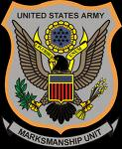
Introduction to Soviet Block Weapons
Small Arms Readiness Team (SARTS)
UNCLASS/FOUO

Slide 2
Introduction
Soviet block weapons are the most widely used weapons by both enemy and local national forces in today’s COE.
This block of instruction will give the soldier a working knowledge of the AK series of weapons which addresses needs common to ALL soldiers in theater
Also provides the foundation necessary for trainers or embedded teams to advance to more technical training such as marksmanship instruction, intelligence analysis etc.

Slide 3
ACTION: Familiarize with the AK series
weapons systems
CONDITIONS: In a classroom environment,
given a powerpoint class, AK
series rifle and a PI/AI
STANDARDS: Familiarization.
CLASSIFICATION: UNCLASS/FOUO

Slide 4
ENABLING LEARNING
OBJECTIVES:
        Give overview of Soviet block wpns in OEF
        Review the Nomenclature and History of the AK
        Review the technical data of the AK series
        Review Clearing the AK, disassembly/re-assembly
        Review the information requirements for intelligence support
        related to identifying the country of origin and condition of weapon
        Review the types of ammunition for the AK series and their markings as relates to information support to intelligence.

Slide 5
Why do I need to know about them?
The most common response, is that I might have to pick up an AK and use it. GOOD ANSWER!
But, there are others as well, largely specific to the various missions in OEF:

Slide 6
OEF MISSIONS
SECFOR:
SECFOR (Security Force) is responsible for base camp security, QRF, Convoy Security etc.
ETT
ETT’s (Embedded Training Team) mentor the ANA on a all aspects of training and operations. As an ETT member, you not only need to have a basic understanding of the AK series, but be able to oversee Marksmanship training and tactical employment.
PRT
PRT’s (Provincial Reconstruction Teams) lead reconstruction and humanitarian efforts in their Areas of Responsibility. Often, this means going into the countryside and meeting with elders, local government officials and working with NGOs.

Slide 7
SECFOR
SECFOR will often work alongside ANA/ANP soldiers and by understanding their weapons systems, can better produce fire plans for defense or offensive operations.
Additionally, by learning about the weapons systems the SECFOR is better prepared to provide information to intelligence regarding the type and quality of weapons found on objectives which can lead to significant strategic actions.
For example, a SECFOR soldier notes an enemy weapon in good shape. Based upon information learned in this class, takes notes on the condition and photographs relevant markings on the rifle for the S2.
The S2 identifies the markings as Iranian and passes the data up. ATF verifies the date and place of manufacture and political pressure is applied in public about Iranian support to insurgents. The Coalition now knows to ramp up interdiction on arms supply routes across the border.

Slide 8
ETT
ETT’s are embedded trainers. As trainers for a society which has a Warrior Culture, one of the first impressions will be based upon weapons knowledge.
If you have to have the Afghan’s teach you about their weapons, how much credibility have you established as a trainer?
If unprepared trainers arrive, what message does that send about US abilities as ground soldiers without the aid of technology?
See again the previous comments about fire plans and integration into offensive/defensive planning both for enemy and friendly COAs.

Slide 9
PRT’s
PRT’s often work with local nationals and deal with the same elements as previously mentioned with the same considerations.
In addition, a smart PRT doesn’t simply plan for a short-term reconstruction project. In order to be effective, projects must be sustainable for the future and in addition to the typical economic/infrastructure type considerations for sustainability, DEFENSE of the project must be planned for and will eventually fall to either local tribesmen and their “Lashkar’s” or to the ANA/ANP.

Slide 10
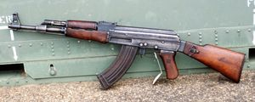
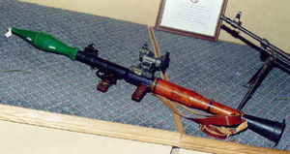
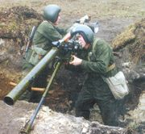
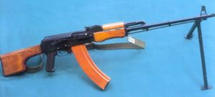
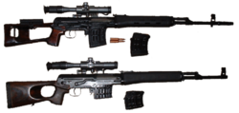
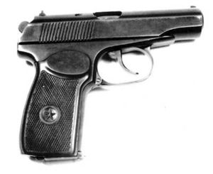
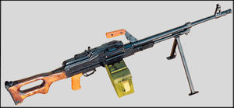
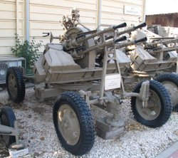
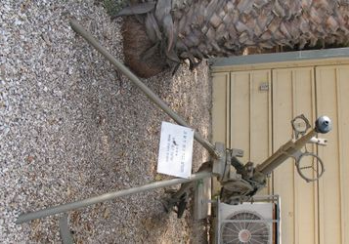
CURRENT ANA WEAPONS
GREEN
FORCES
Notes:
Quiz the soldiers who can name each system shown above to help ID possible AI’s and level of experience.

Slide 11
The standard AK-47 or AKM fires a 7.62 × 39 mm round with a muzzle velocity of 710 m/s (2,329 ft/s). Muzzle energy is 1,990 joules (1,467 ft•lb). Cartridge case length is 38.6 mm, weight is 18.21 g. Projectile weight is normally 8 g (123 gr). The AK-47 and AKM, with the 7.62 × 39 mm cartridge, have a maximum effective range of around 300 meters. For comparison, the 7.62 × 54 mm R cartridge has a projectile of 9.6-12 g (148-185 gr [depending on the weapon]) at a velocity of 818 m/s (2,683 ft/s) for approximately 4,000 joules (2,950 t•lb) of energy.
GREEN
FORCES
AK-47

Slide 12
A (RPG) is a hand-held, shoulder-launched anti-tank weapon capable of firing an unguided rocket equipped with an explosive warhead. Most modern main battle tanks (MBTs) are largely immune to unguided anti-tank weapons due to advances in armor design requiring more precise aiming to hit weak spots. RPGs, however, are still used very effectively against light-skinned vehicles such as armored personnel carriers (APCs) or unarmored wheeled vehicles, as well as against buildings and bunkers. They can still be a threat to an MBT under certain tactical conditions (see below).
RPG is the Russian acronym of "Ruchnoy Protivotankovy Granatomyot" (Ручной противотанковый гранатомёт, РПГ) and is translated into English as "handheld antitank grenade-launcher" The commonly used term "rocket-propelled grenade" is a mistranslation, backformed from the acronym RPG and does not follow correct naming conventions used by English speaking militaries to describe these weapons.
An RPG is composed of two main parts: the launcher and the rocket equipped with a warhead. The most common types of warheads are high explosive (HE) or high explosive anti-tank (HEAT) rounds. These warheads are affixed to a rocket motor and stabilized in flight with fins. Some types of RPGs are single-use disposable units similar to the U.S. M72 LAW; others are reloadable such as the Soviet RPG-7.
The RPG launcher is a hollow tube that concentrates the rocket exhaust to create an over-pressure within the tube. This over-pressure propels the warhead at a higher speed than from the specific impulse of the rocket alone. This higher speed is necessary for the rocket to be stable in flight. The launcher is also designed so that the rocket burns completely within the tube and exits the launcher without discharging an exhaust that would be dangerous to the operator. The high-temperature rocket exhaust is hazardous 15 to 20 metres to the rear of an RPG launcher. The launcher must be cleaned periodically, as built-up residue will result in an excess of over-pressure, causing the sighting mechanism to be driven into the operator's eye when the rocket is fired. Blindness in one eye often results
Ammunition
The RPG-7 can fire a variety of warheads for anti-armor (HEAT, PG-) or anti-personnel (HE, OG-) purposes, usually fitting with an impact (PIBD) and a 4.5 second fuze. Armor penetration is warhead dependent and ranges from 30 to 60 cm of homogenous steel; two warhead types (PG-7BR and VR) are 'tandem' devices, used to defeat reactive armor with a single shot.
GREEN
FORCES
RPG-7

Slide 13
The SPG-9 Kopye (Spear) is a Russian tripod-mounted man-portable, 73 mm recoilless gun developed by the Soviet Union. It fires fin-stabilised, rocket-assisted HE and HEAT projectiles similar to those fired by the 73 mm 2A28 Grom low pressure gun of the BMP-1 vehicle.
The projectile is launched from the gun by a small charge, which gives it an initial muzzle velocity of around 250 m/s to 400 m/s. The charge also imparts spin to the projectile by a series of offset holes in the launch charge. Once the projectile has travelled approximately 20 meters from the launcher a rocket motor in the projectile ignites. For the PG-9 projectile, this takes it to a velocity of 700 m/s before the motor burns out.
The weapon is in service with a large number of armed forces, and a variety of ammunition is produced, however mostly they are copies of the original soviet PG-9 HEAT and OG-9 FRAG-HE rounds.
Specifications
Calibre: 73 mm smoothbore
Weight: 47.5 kg (59.5 kg with the tripod)
Length: 2110 mm
Height: 800 mm
Elevation: + 25 degrees maximum
Traverse 30 degrees total
GREEN
FORCES
SPG-9

Slide 14
The Kalashnikov Handheld Machine Gun model 1974 (Ruchnoy Pulemyot Kalashnikova obraztsa 1974 goda, RPK-74, Russian: Ручной пулемёт Калашникова образца 1974 года, РПК-74) is a squad automatic weapon or SAW developed by the Kalashnikov Design Bureau of the Soviet Union in 1974. It is a light machine gun that fires 5.45 x 39 mm M74 ammunition, and is very similar to the AK-74, though with a heavier, longer barrel, a bipod and some differences in the stock and forearm (handguard). The RPK-74 can also be used as a light anti-aircraft gun, using 75 or 100-round drum magazines. However it cannot be fired for sustained periods of time due to the RPK-74s inability to change barrels
GREEN
FORCES
RPK-74
Specifications
Type | Selective fire automatic rifle
Caliber | 5.45 mm
Ammunition | 5.45 x 39 mm
Feed system | 30 or 45-round detachable box
Action | Gas-operated, rotating bolt
Length | 1,060 mm
Barrel length | 590 mm
Weight | 5 kg
Rate of fire | 600 round/min

Slide 15
The Dragunov Sniper Rifle (Russian: Снайперская винтовка Драгунова, Snayperskaya Vintovka Dragunova, abbreviated SVD, GRAU index 6V1), is a semiautomatic rifle designed by Evgeniy Fedorovich Dragunov in the Soviet Union between 1958 and 1963. The SVD was the world's first purpose-built military precision marksman's rifle, and is common (along with several variants) throughout the former Eastern Bloc.
The SVD is chambered for the 7.62 x 54R rimmed cartridge, with a muzzle velocity of about 830 meters per second. The rifle can accept the older M1891/30 cartridge, but a more accurate 7N1 round was designed specifically for it. The 7N1 was the original load developed by Russian armorer Sabelnikov in conjunction with the development of the SVD back in the late 1950's. It has a steel jacketed projectile with an air pocket, steel core, and a lead knocker in the base for maximum terminal effect. The 7N1 was replaced in 1999 by the 7N14 round. The 7N14 is a new load developed for the SVD. It consists of a 151 grain projectile which travels at the same 2723 ft/s, but it has a lead core projectile and is supposed to be the more accurate of the two. Nikolai Bezborodov, head of R&D at Izhmash, stated that it was the most accurate load for the SVD. However, the Soviet Union never offered this ammunition for export, and it is very rare outside of Russia. This ammunition can be identified by its packaging which has Russian: "Снайперские" (Sniper) stamped on its crates, cans, and paper wrap to prevent it from being wasted in other weapon applications.
Dragunov
GREEN
FORCES

Slide 16
The Makarov was the result of a competition held to design a replacement for the aging Tokarev TT-33 semi-automatic pistol. The TT had been loosely derived from the FN Model 1903 automatic pistol and was, by 1945, deemed too large, heavy, and unreliable for a general service pistol. Rather than building his gun around an existing cartridge, Nikolai Makarov designed a new round, the 9 x 18 mm PM, based on the popular Browning 9 x 17 mm/.380 ACP cartridge. In the interests of simplicity and economy, the Makarov pistol was to be of straight blowback operation, and the 9 x 18 mm round was found to be the most powerful which could be fired safely from such a design. Although the given dimension was 9 mm, the bullet was actually 9.3 mm in diameter, being shorter and wider and therefore incompatible with pistols chambered for the popular 9 mm Luger/Parabellum round. This meant that Soviet ammunition was unusable in NATO firearms, and NATO forces in a conflict would not be able to gather ammunition from fallen Soviet soldiers or Soviet munition stockpiles.
The Makarov has a DA/SA or "Double Action, Single Action" operating system. After loading the pistol and charging the slide, the Makarov can be carried with the hammer down and the safety engaged. To fire, the slide-mounted safety is pushed down to the "fire" position, after which the user simply squeezes the trigger. The act of squeezing the trigger for the first shot also cocks the hammer, an action which necessitates a long, heavy trigger pull. The firing of the round and cycling of the action pre-cocks the hammer for subsequent shots, which are then fired Single Action with a short, light trigger pull. After pushing the safety up to "safe," the hammer is safely de-cocked. Operation is semi-automatic, firing as fast as the user can pull the trigger. Fired brass is ejected to the right rear of the shooter, typically traveling 5-7 meters.
The PM's standard magazine holds eight rounds, although ten- and twelve-round capacity magazines. After firing the last round in the magazine, the slide locks open. When engaged, the Makarov's safety switch blocks the hammer from hitting the rear of the firing pin. The Makarov's magazine release location is common with that of many European pistols, being located on the heel or "butt" of the handgrip.
MAKAROV PISTOL
GREEN
FORCES
Type: | pistol
Place of origin: | Soviet Union
Service history
Used by: | Soviet Union
Production history
Designer: | Nikolai Fyodorovich Makarov
Specifications
Length: | 161.5 mm (6.34 in)
Barrel length: | 93.5 mm (3.83 in)
Cartridge: | 9 x 18 mm PM (9mm Makarov)
Caliber: | 9mm
Action: | blowback
Muzzle velocity: | 315 m/s
Effective range: | 50 m (49 yd)
Feed system: | 8-round detachable box magazine
Sights: | blade front, notch rear (adjustable for drift)

Slide 17
The PK is a 7.62mm general purpose machine gun designed in the Soviet Union and currently in production in Russia. Its NATO equivalents are the FN MAG, M240, MG3 and M60 machine guns. The PK machine gun was introduced in the 1960s and replaced the SGM and DP machine guns in Soviet service. One notable feature, is that the standard model ejects it's rounds via an ejection port on the left side of the weapon, as opposed to the usual right side ejection port.
PK machine gun
Country | Soviet Union/Russia
Type | general purpose machine gun
Inventor | Mikhail Kalashnikov
Date of design | early 1960s ca
Service duration | 1960s - today
Action | Gas-Operated
Rate of fire | 650 round/min
Muzzle velocity | 825 m/s
Effective range | ~?
Weight (unloaded) | 8.99kg on bipod, 16.48kg with tripod
Length | 1,173 mm
Barrel length | 658 mm
Feed system | belts in 100/200/250 round box
Sights | Front: iron Back: iron
Variants | PK, PKS, PKT, PKM, PKMS
PKM
GREEN
FORCES

Slide 18
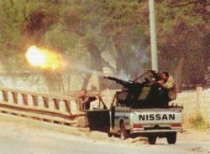
The ZPU-4 is a towed quadruple barreled anti-aircraft gun. Based on the Soviet KPV 14.5 mm machine gun. It entered service with the Soviet Union in 1949 and is used by over 50 countries worldwide. Double and single barreled version of the weapon exist - called the ZPU-2 and ZPU-1 respectively.
Development of the ZPU-2 and ZPU-4 began in 1945, with development of the ZPU-1 starting in 1947. All three were accepted into service in 1949. Improved optical predicting gunsights were developed for the system in the 1950s.
All weapons in the ZPU series have air cooled quick change barrels and can fire a variety of ammuniiton including API (BS.41), API-T (BZT), I-T (ZP) projectiles. Each barrel has a maximum rate of fire of around 600 rounds per minute, though this is practically limited to about 150 rounds per minute.
The quad ZPU-4 uses a four-wheel carriage simitar to that once used by the obsolete 25 mm automatic antiaircraft gun M1940. In firing position the weapon is towered onto firing jacks. It can be bought in and out of action in about 15 to 20 seconds, and can be fired with the wheels in the travelling position if needed.
The double ZPU-2 was built in two different version, an early model with large mud guards and two wheels that are removed in the firing position. The late model has wheels that fold and are raised from the ground in the firing position.
The single ZPU-1 is carried on a two wheeled carriage. Weapon can be broken down into several 80 kg units for transport over rough ground.
Ammunition:
ZPU-4
API (BS.41) - Full metal jacket round with a tungsten-carbide core. Projectile weight is 64.4 g and Muzzle velocity is 976 m/s. Armour penetration at 500 m is 32 mm of RHA at 0 degrees.
API-T (BZT) - Full metal jacket round with a steel core. Projectile weight is 59.56 g and muzzle velocity is 1,005 m/s. Tracer burns to at least 2,000 m.
I-T (ZP) - Projectile weight is 59.68 g.
ZPU-4
GREEN
FORCES

Slide 19
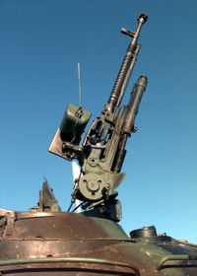
The first such gun, the Degtyarev, Krupnocalibernyi (was built in 1930 and this gun was produced in small quantities from 1933 to 1935. The gun was fed from a drum magazine of only thirty rounds, and had a poor rate of fire. Shpagin developed a belt feed mechanism to fit to the DK giving rise, in 1938, to the adoption of the gun as the DShK 1938. As an anti-aircraft weapon it was mounted on pintle and tripod mounts, and on a triple mount on the GAZ-AA truck. Late in the war, it was mounted on the cupolas of IS-2 tanks and ISU-152 self-propelled guns. As an Infantry heavy support weapon it used a two-wheeled trolley, similar to that developed by Sokolov for the 1910 Maxim gun. It was also mounted in vehicle turrets, for example, in the T-40 light amphibious tank.
DSHK
Type | heavy machine gun
Nation(s) of origin | Soviet Union
Operators | Soviet Union,
War service | WW2
Variants | DShKM
Specifications
Type | air cooled
Caliber | 12.7
Ammunition | 12.7 x 109 mm
Feed system | belt 50 rounds
Action | gas
Length | 1625 mm
Barrel length | 1070 mm
Weight | 34 kg (gun only) 157 kg on wheeled mounting
Rate of fire | 600 rounds/min
Muzzle velocity | 850 m/s
GREEN
FORCES

Slide 20
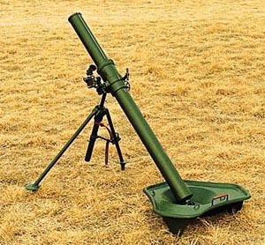
The 82 mm Mortar is the standard mortar in service with PLA Motorized Infantry Battalions to provide indirect fire support. Each Infantry Battalion is equipped with 4~6 82 mm mortars, which are transported by vehicles over long distances and carried by soldiers into firing positions for battle.
The first generation 82 mm mortar in service with the PLA is Type 53, which is a copy of the Soviet M-37. This mortar is no longer in service.
The Type 67 was type classified in 1967 and entered service in 1971 to replace the Type 53. The mortar features a triangular baseplate with a handle. Currently the PLA is still equipped with a large number of Type 67 mortars. It is also fitted on the Type 63 and Type 85 armored personnel carrier (APC) to provide fire support for the mechanized infantry units.
The third generation Type 84 (also known as PP87) entered service in the mid-1980s to replace the Type 67. The Type 84 features a round baseplate and longer tube. A 81 mm version called W87 was developed for the export market. Both Type 84 and W87 can fire the latest extended
82 mm Mortar
GREEN
FORCES

Slide 21
Nomenclature
Abbreviation
“Avtomat Kalashnikova” with “47” being the year of production.
MYTH!- All AK series weapons are “AK-47s”
Grossly incorrect, unprofessional, misleading and provides faulty information for intelligence analysis which is regurgitated as bad intel for the solders outside the wire.

Slide 22
Origins
History
Based on German “Sturmgehewr” assault rifle developed at the end of WWII by the Germans, the M1 Garand and the Browning Model 8.
Producers name was Mikhail Kalishnakov.
More AK series assault rifles have been produced than any other type in the world.

Slide 23
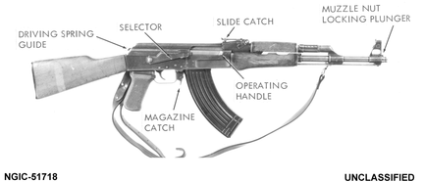
Technical Data – AK 47
AK-47
Section II. Technical Data
    Country of origin: Russia and others
    Caliber: 7.62 x 39 mm
    Max effective range: 300 m
    Rate of fire: 600 rpm (250 rpm–semi-auto)
    Operation: Select fire (auto/semi-auto)
    Overall length: 900 mm (AK-47); 550/800mm (AKS-47)
    Feed device: 30-rd box magazine
Weight loaded: 4.3 kg

Slide 24
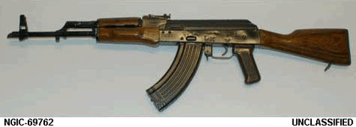
Technical Data – AKM (M=Modernized)
  Country of origin:
Russia and others
  Caliber: 7.62 x 39 mm
  Max effective range: 300 m Rate of fire: 600 rpm (120- 150* rpm–semi- auto)
Operation: Select fire (auto/semi-auto)
    Feed device: 30-rd box magazine/Drum magazine
    Weight loaded: 3.75-3.86 kg (AKM) & 3.2 kg (AKMS)
AKM

Slide 25
TRANSITION TO AK CLASS ENGLISH/ARABIC
AS THE PI READS THRU THE SLIDES, THE AI WILL DEMONSTRATE ON AN AK
NOTE: ENSURE WEAPON IS CLEARED FIRST

Slide 26
CLEARING AN AK
Point weapon into clearing barrel or safe direction
Place weapon on safe
Remove magazine
Place weapon on Semi (all the way down)
Pull bolt to rear/inspect chamber ensure its clear
Return weapon to safe

Slide 27
USE
AK CLASS
ENGLISH/ARABIC
GET TRANSLATED INTO
DARI/PASHTU
GIVE BREAK AFTER PRACTICAL EXERCISE

Slide 28
INFORMATION SUPPORT TO INTELLIGENCE
Most of the weapons currently in play in OEF by the Bad Guys (BG’s) are leftovers from the war with the Soviet Union.
Most are in poor condition and are recognizably in bad shape.
New weapons and ammo are pouring in
By understanding the basics of what to look for/record on a weapon that’s in good shape, you can enable intelligence to identify their source and for higher to take actions both politically and militarily to interdict their flow into theater.

Slide 29
These are markings on the receiver which indicate the country of manufacture

Slide 30
These are markings by the selector switch indicating auto or semi auto fire mode which again, indicate the country of origin

Slide 31
Information support to Intelligence
You don’t have to remember all this, just know what to look for and what to record.
If you have a camera, take a full picture of the weapon, then zoom in on the receiver
The above markings are the tip of the iceberg
Other specific info requirements on weapons in good condition are:

Slide 32
SIR’s on Captured Weapons
Bluing and stock condition
Oiled/rusty etc?
Photo of entire weapon
Serial number and markings on both sides of receiver
How much ammo/mags were on the enemy soldier?
Photo and bring back samples of the ammo
Was the weapon on semi or auto? (photo should have it in original position
What range were the sights set on?
Was the enemy in the defense or on the move? State the specifics of the contact.
Lay out the enemy KIA’s with their weapons as close to the the formation you engaged them in and photograph.
Were there any indications of the KIAs duty position/rank?
What rate of fire were you engaged with and at what distance?
Is this typical for your AO or no (weapons/ammo/rate of fire etc)?
Your comments

Slide 33
Ammunition
Don’t underestimate the importance of ammo.
Some key points are:
a). Chinese ammo has a corrosive primer
b). Paki/Arab ammo often misfires
c). Eastern Block ammo is very reliable and indicates a current pipeline

Slide 34
M1943 7.62x39-mm Ammunition Head stamps.
  The standard method of head stamping M1943 7.62x39-mm ammunition is to mark it with the year of manufacture and with a factory identification mark.
  The factory identification mark is generally located on the top (12 O’clock position) of the head stamp while the year of manufacture is located on the bottom (6 O’clock position) of the head stamp.
  Remember, nobody expects you to memorize the markings and their meaning, just to know they are important, particularly for material that looks to be new and in good condition for intelligence analysis and follow up interdiction efforts.
  The below markings are examples. There are large databases going back decades with more.

Slide 35
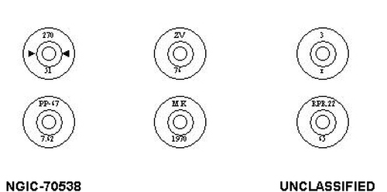

Slide 36
Closing
This class has introduced you to the AK series of weapons.
The AK is the most widely produced assault rifle in the world and widely used by threat forces.
They are not going away any time soon and it is important for all soldiers to “know your enemy” and the equipment they use
The AK series is also widely used by friendly local national forces. It is equally important that you know the capabilities of our allied forces

Slide 37
QUESTIONS?

Slide 38
AFTER ACTIONS REVIEW
ACTION: Familiarize with the AK series
weapons systems
CONDITIONS: In a classroom environment,
given a powerpoint class, AK
series rifle and a PI/AI
STANDARDS: Familiarization.
CLASSIFICATION: UNCLASS/FOUO

Slide 39
AFTER ACTIONS REVIEW
Did we meet the standard? (familiarize)
Sustain Improve

