Slide 1
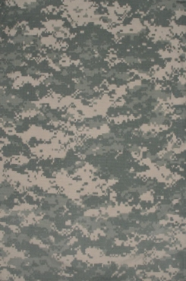

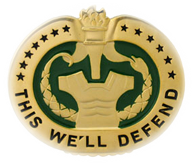
Manage the Airway
First Aid 3
M1303
Version 6.0
COURSE: 012-SQIX
TITLE: DRILL SERGEANT SCHOOL

Slide 2
Terminal Learning Objective
Action: | Open and Manage the Airway of a Conscious or Unconscious Casualty
Conditions: | Given a casualty who is unconscious or having difficulty breathing.
Standards: | Open the airway, insert a nasal airway, apply an occlusive dressing to an open chest wound, perform a needle chest decompression, clear an obstruction from the throat of a conscious/unconscious casualty, and perform mouth-to mouth resuscitation

Slide 3
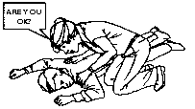
Check the Casualty for Responsiveness
If the casualty appears to be unconscious, check the casualty for responsiveness. Ask in a loud, but calm, voice: “Are you okay?” Also, gently shake or tap the casualty on the shoulder.
If the casualty does not respond, position the casualty and open his airway.
Notes:
Establish responsiveness. Use the AVPU system to determine level of consciousness.

Slide 4
Open the casualty's airway
Open the casualty's airway using the head-tilt/chin-lift method
Even if the casualty is still breathing, positioning the airway will allow him to breathe easier.
Notes:
If casualty is unconscious open the airway using the head-tilt chin lift method. Just being unconscious can compromise your casualty’s airway.

Slide 5
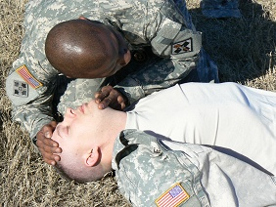
Open the Casualty’s Airway
(Head-Tilt/Chin-Lift)
Look, Listen, Feel
Count number of respirations for 30 seconds
Maintain head-tilt/chin-lift
Remove any foreign
matter from mouth
Notes:
Look listen and feel for respirations, count respirations for 30 seconds and multiply by 2. Attempt to remove any foreign material with a crooked finger.

Slide 6
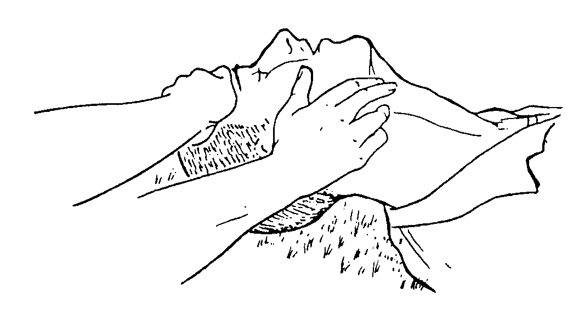
Feel for a carotid pulse

Slide 7
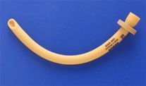
Nasopharyngeal Airway
Notes:
The nasopharyngeal airway (NPA) is the primary airway adjunct used by the CLS in a tactical setting.

Slide 8
Nasopharyngeal Airway (cont.)
Do not use the nasopharyngeal airway (NPA) if there is evidence of head trauma and the roof of the casualty's mouth is fractured or brain matter is exposed.
Do not use the nasopharyngeal airway if there is evidence of head trauma and clear fluid is coming from the ears or nose.
Notes:
Before inserting an NPA inspect the roof of the casualty’s mouth. Look for any disruption of the soft and hard palate. If bleeding or brain matter is exposed do not insert the NPA. A NPA must be used cautiously in any casualty with head trauma.

Slide 9
Nasopharyngeal Airway (cont.)
Leaking cerebrospinal fluid may indicate a skull fracture.
The advantage of the nasopharyngeal airway over the oropharyngeal airway is that you can place a NPA into a conscious, semi-conscious or unconscious casualty.
Notes:
NPAs can be used in a casualty with any level of consciousness. OPAs cannot be inserted in a conscious or semiconscious casualty. They will cause gagging.

Slide 10
Nasopharyngeal Airway (cont.)
Place the casualty on his back (face up)
Remove airway and lubricant from aid bag
Lubricate the tube
Notes:
Position the casualty, lubricate the tube…..

Slide 11
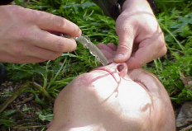
Nasopharyngeal Airway (cont.)
Expose the opening of the casualty’s nostril
Insert the tip of the airway into right nostril with bevel facing septum
Advance until flange rests against the nostril
Tape in place
Notes:
Lift up on the tip of the nose exposing the nostril opening. Insert the tip of the NPA into the right nostril with bevel towards the septum, and advance it all the way to the flange . Secure it in place with tape.

Slide 12
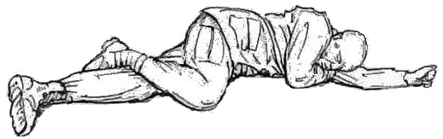
Nasopharyngeal Airway (cont.)
If there is resistance or blockage, use the other nostril.
If both attempts fail, position the casualty in the recovery position and seek medical help.
Notes:
If unable to insert into the right nostril try the left one. Work the NPA back and forth to help it slide into place. If unable to advance it, Do Not force it. A bloody nose is the most common complication of the NPA. Positioning the casualty is the next best way to keep the airway open either in the recovery position or if the casualty is conscious sitting up and leaning forward.

Slide 13
Treat an Open Chest Wound – Introduction
One of the greatest dangers to a casualty's ability to breathe is injury to the chest.
The body has two lungs.
Each lung is enclosed in a separate airtight area within the chest.
Inside the chest is a negative pressure.
Notes:
It is important to understand some basic physiology of respiration to understand penetrating chest injuries. Pressure inside the chest cavity is normally negative. This negative pressure helps respiration with contraction of the diaphragm and expansion of the chest, drawing air into the lungs.

Slide 14
Treat an Open Chest Wound – Introduction (cont.)
This is normal and helps with respiration. If an object punctures the chest wall and allows air to get into one of these areas, the lung within that area begins to collapse, because the negative pressure is replaced with positive pressure from the outside.
Notes:
However, when there is a penetrating injury to the chest cavity the negative pressure is replaced with atmospheric pressure (from the air outside the chest) which is under positive pressure. If positive pressure enters the chest cavity it will cause the lung to collapse. The bigger the hole, the more positive pressure enters the chest, and the more lung collapse there is.

Slide 15
Treat an Open Chest Wound – Introduction (cont.)
In order for both lungs to collapse, both sides of the chest would have to be punctured.
However, any degree of collapse of either lung interferes with the casualty's ability to breathe and reduces the amount of oxygen available for use by the body.
Notes:
When lungs collapse they are not able to ventilate well. This decreases the amount of oxygen in the blood that is available to all the cells in the body.

Slide 16
Normal Chest and Lungs
Windpipe
Chest cavity
Ribs
(end view)
Lungs
Diaphragm
Notes:
Anatomic picture of the lungs, and heart.

Slide 17
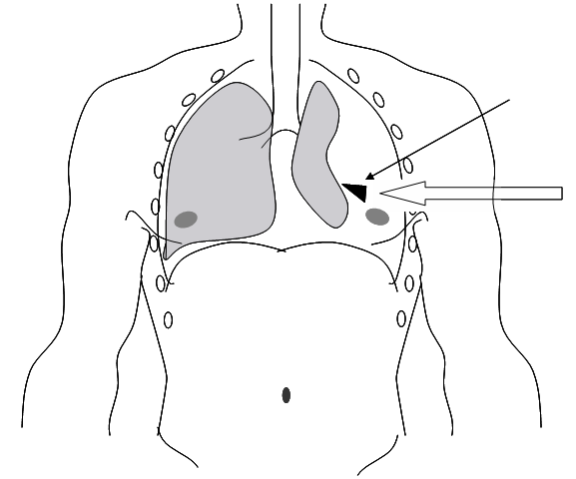
Collapsed Lung
Air flows into the chest cavity from a penetrating wound, collapsing the lung.
Projectile
Flow of Air

Slide 18
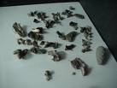
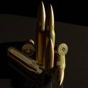

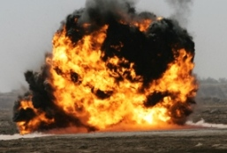
Signs and Symptoms of an Open Chest Wound
When an object penetrates the chest wall, the injury is called an open chest wound. The penetration can be caused by a bullet, knife blade, shrapnel, or other object.
Anytime there is an open chest wound, there is danger of the lung collapsing.
Notes:
Penetrating injuries to the chest are a life threatening injury and need to be treated expeditiously.

Slide 19
Signs and Symptoms of an Open Chest Wound (cont.)
Sucking or hissing sounds coming from chest wound. (When a casualty with an open chest wound breathes, air goes in and out of the wound, creating a "sucking" sound.
Because of this distinct sound, an open chest wound is often called a "sucking chest wound.")
Notes:
Not all penetrating chest wounds may produce a sucking sound. In fact many times you will not know if the injury actually penetrated into the chest cavity. Look for small bubbles that form at the injury site. This may be a clue as to whether the injury actually penetrated into the chest cavity. If you are not sure, treat it as a penetrating injury anyway.

Slide 20
Signs and Symptoms of an Open Chest Wound (cont.)
In order for a wound to become a “sucking chest wound” it must be at least 2/3 the diameter of the trachea. So unless it is relatively large it may not be a “sucking chest wound”.
Casualty coughing up blood.
Frothy blood coming from the chest wound. (The air going in and out of an open chest wound causes bubbles in the blood coming from the wound.)
Notes:
Most sucking chest wounds are usually large 2/3rds the diameter of the trachea. However, this is just a guideline and not a hard and fast rule. Casualties with penetrating chest wounds frequently have bloody sputum.

Slide 21
Signs and Symptoms of an Open Chest Wound (cont.)
Shortness of breath or difficulty in breathing.
Chest not rising normally when the casualty inhales.
Pain in the shoulder or chest area that increases with breathing.
Bluish tint of lips, inside of mouth, fingertips, or nail beds (cyanosis) caused by a decrease of oxygen in the blood.
Rapid and weak heartbeat (shock).
Notes:
These are all the classic signs and symptoms of chest injuries.

Slide 22
Signs and Symptoms of an Open Chest Wound (cont.)
If you are not sure if the wound has penetrated the chest wall completely, treat the wound as though it were an open chest wound.

Slide 23
Check for Open Chest Wounds
You must seal the open chest wound so that air from the atmosphere will not get into the casualty's chest and collapse the lung.
The first step is to locate the open chest wound.
Check for both entry and exit wounds. Look for a pool of blood under the casualty's back. Use your hand to feel for wounds on the casualty's back.
Notes:
Sealing the penetrating wound is the first step in treatment of this condition. You must use an occlusive dressing that does not allow air to pass through it. On the battlefield you must open the casualty’s IBA and uniform to locate the injury. This should only be done once the tactical situation allow you time to do so. Also remember to roll the casualty over to look for any additional wounds on the posterior.

Slide 24
Check for Open Chest Wounds (cont.)
If there is more than one open chest wound, treat the first wound you find in your assessment.
If the casualty has two wounds (an entrance and exit wound) affecting the same lung, apply an occlusive dressing to both.

Slide 25
Expose the Wound
Expose the area around the open chest wound by removing, cutting, or tearing the clothing covering the wound. Scissors from the aid bag, a knife, or a strap cutter may be used.
Notes:
Exposing the wound is important to evaluate and treat it.

Slide 26
Expose the Wound (cont.)
Do not remove clothing stuck to the wound as this may cause additional pain and injury. The combat lifesaver should cut or tear around the stuck clothing so that the wound is exposed, but the stuck material remains in position.
Do not clean the wound or remove objects stuck in the wound.
Notes:
If there is an impaled object in the wound, do not remove it. Apply a bulky bandage around the wound and stabilize it. Vaseline gauze works well as an occlusive seal around impaled objects.

Slide 27
Seal the Open Chest Wound
Airtight
material

Slide 28
Prepare Sealing Material
Since air can pass through most dressings and bandages, you must place airtight material over the chest wound before you dress and bandage the wound.
Plastic from a field dressing or other bandage pack is one source of airtight material.
Specific chest seals like the Hyfin® or Bolin® chest seal may be used
Notes:
There are multiple different material you can use as an occlusive bandage, MRE wrappers, empty IV bags, plastic from around the battle dressing, tegaderm bandages. Vaseline gauze, and piece of plastic, etc. There are also some commercial chest seals designed specifically for this purpose.

Slide 29
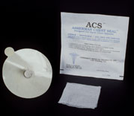
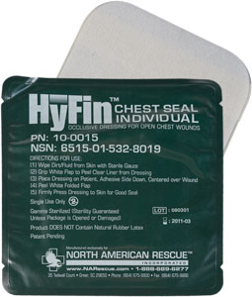
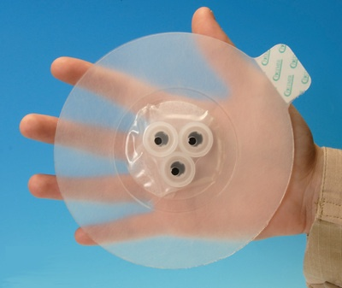
Commercial Chest Seals
Asherman Chest seal
Hyfin Chest Seal
Bolin Chest Seal
Notes:
These are three of the commercially made chest seals. Many people do not like the Asherman seal as the adhesive on it does not stick well to a sweaty bloody chest. The Hyfin and Bolin have improved adhesive to make them stick better to the chest wall.

Slide 30
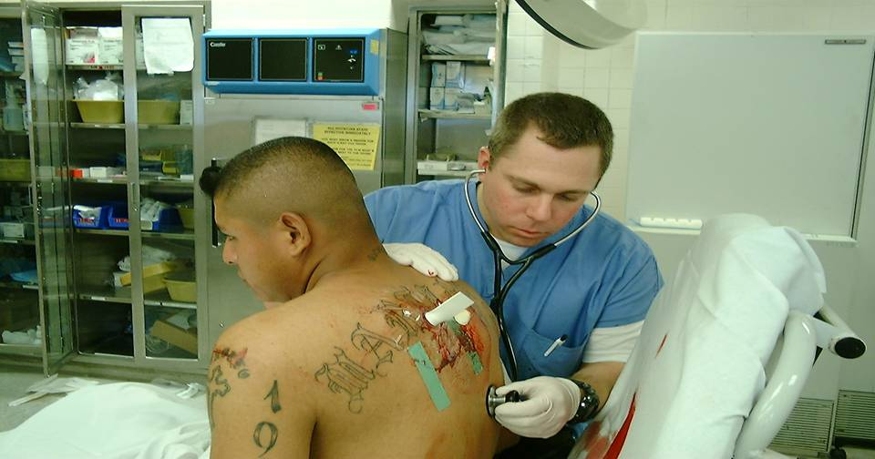
Seal an Open Chest Wound Using an Asherman Chest Seal
Notes:
Example of an asherman chest seal applied to penetrating wound.

Slide 31
Seal an Open Chest Wound Using an Improvised Seal
Expose the wound.
Tell the casualty to exhale and hold his breath.
Place the occlusive material or chest seal directly over the hole in the chest to seal the wound.
Tape it on all four sides as needed.
Notes:
The new rule for taping occlusive material to the chest wall is to tape the material on all four sides. There is no need to keep one side open. In addition, you can get the occlusive material and tape to stick better if you dry the chest wall off with a roll of kerlix, and paint the chest wall with tincture of benzoin.

Slide 32
Seal an Open Chest Wound Using an Improvised Seal (cont.)
Check the sealing material to ensure that it extends at least two inches beyond the wound edges in all directions.
Tell the casualty to resume normal breathing.
Notes:
This will help the material sick to the chest wall better.

Slide 33
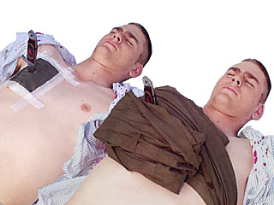
Seal an Open Chest wound With an Impaled Object
One problem you may encounter is an object protruding from the wound.
For instance, an explosion may have propelled a small broken tree limb with enough force to penetrate a soldier's chest.
Notes:
Bulky dressing applied around an impaled object.

Slide 34
Impaled Object
Place an occlusive material bandage around the impaled object. Vaseline gauze works well for this.
Use bandaging material to build up and stabilize the impaled object to keep it from moving around.
Do not attempt to remove the object

Slide 35
Seal an Open Chest Wound Using an Improvised Seal (cont.)
Place casualty in a recovery position with injured side to the ground, or sitting up to make breathing easier.
Notes:
Position the casualty to help assist with ventilation. Sitting up if conscious or laying on the injured side if unconscious in the recovery position.

Slide 36
Tension Pneumothorax
Pneumothorax basically means air (pneumo) in the chest (thorax).
Tension refers to pressure.
Tension pneumothorax occurs when the air in the chest continues to accumulate, builds up pressure, and cannot escape.
This condition results in increasing danger to the casualty's respiratory and cardiovascular system.
Notes:
In some penetrating chest wounds air will enter the chest cavity but cannot escape. This causes a rise in the pressure in that side of the chest with each breath. This is called a tension pneumothorax.
Not all chest injuries develop a tension pneumothorax. It is important that you monitor you casualty’s respiration to watch for the development of a tension pneumothorax.

Slide 37
Tension Pneumothorax (cont.)
First, the pocket of trapped air continues to increase in size.
This results in pressure that causes the lung on the affected side to begin to collapse.
In addition, the growing pocket of trapped air pushes against the heart and major blood vessels and against the uninjured lung.
Notes:
As the pressure in the chest continues to increase it can put pressure on the heart and the other lung.

Slide 38
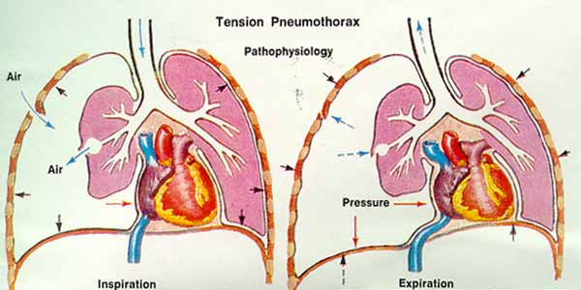
Tension Pneumothorax (cont.)
Notes:
Increased pressure on the injured side can begin to affect the uninjured side. Notice the collapsed lung on the injured side.

Slide 39
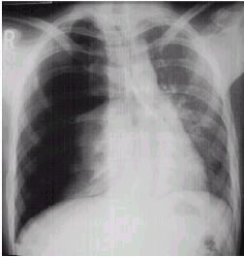
Tension Pneumothorax (cont.)
Air pushes over heart and collapses lung
Air outside lung from wound
Heart compressed and not able to pump well
Notes:
When the pressure gets to much it can compress the heart. This does not allow the heart to fill with blood completely. This prevents it from pumping a full volume of blood to the rest of the body. In addition, the pressure compresses the good lung and prevents it from ventilating effectively.

Slide 40
Tension Pneumothorax (cont.)
This interferes with the casualty's circulatory and respiratory systems.
Tension pneumothorax can occur even if you applied a flutter valve type seal to the open chest wound.
Tension pneumothorax is potentially a fatal condition.
This condition is treated by inserting a needle/catheter into the chest and allowing the air under pressure to escape.
Notes:
A tension pneumothorax can become fatal in a short period of time. Recognition of the development of this problem is paramount. Treatment can be easily accomplished if recognized.

Slide 41
Signs and Symptoms of Tension Pneumothorax
Anxiety, agitation, and apprehension.
Diminished or absent breath sounds.
Difficulty in breathing with cyanosis (bluish tint of lips, inside of mouth, fingertips, and/or nail beds)
Rapid, shallow breathing.
Distended neck veins.
Notes:
These are some of the classic signs and symptoms of a tension pneumothorax.

Slide 42
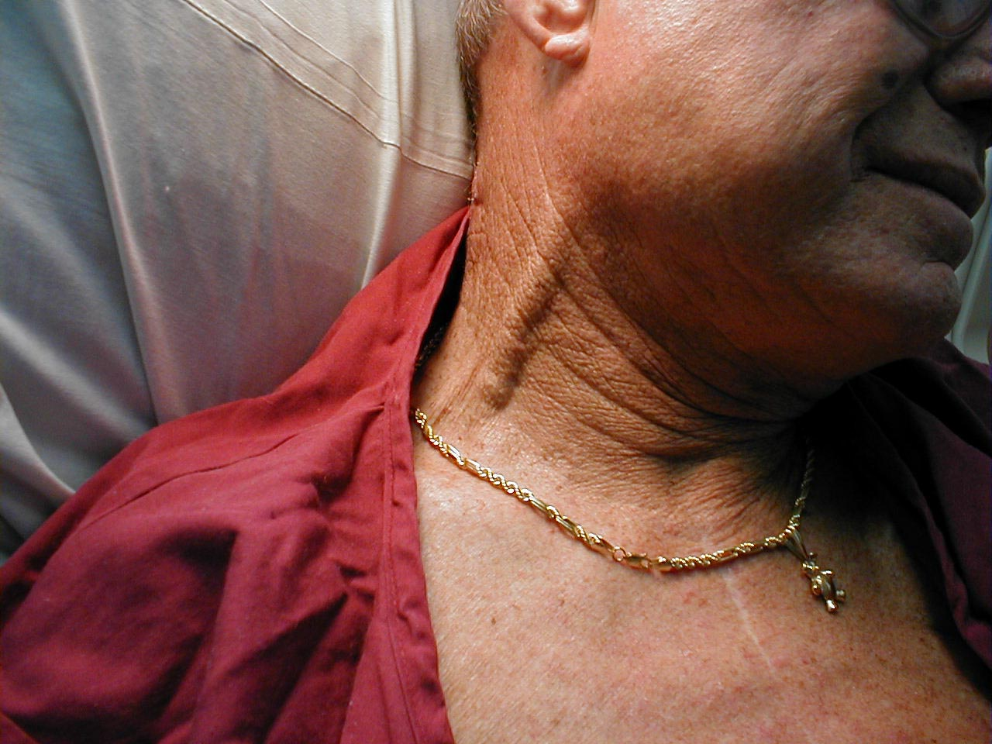

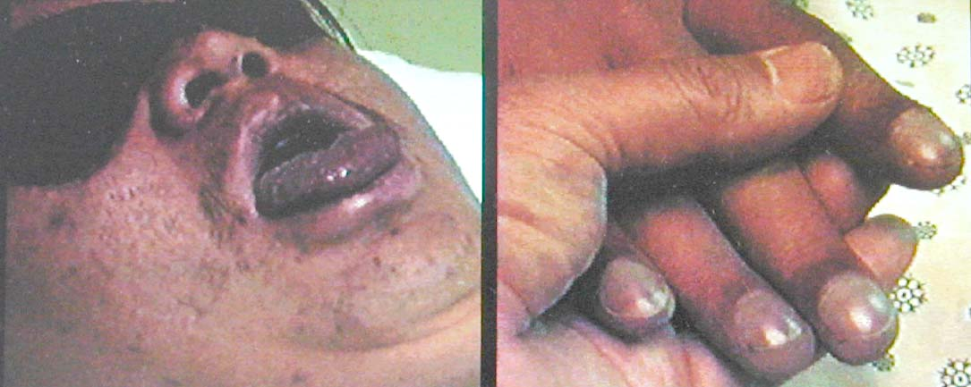
Signs and Symptoms of Tension Pneumothorax (cont.)
Notes:
More signs and symptoms.

Slide 43
Signs and Symptoms of Tension Pneumothorax (cont.)
Abnormally low blood pressure (hypotension) evidenced by a loss of radial pulse.
Cool, clammy skin.
Decreased level of consciousness (AVPU scale) or loss of consciousness.
Visible deterioration
Notes:
More signs and symptoms.

Slide 44
Signs and Symptoms of Tension Pneumothorax (cont.)
Tracheal deviation (a shift of the windpipe to the right or left).
Tracheal deviation is a late sign of tension pneumothorax and will probably not be observed.
The above signs and symptoms may be difficult to assess at night, in the dark, in a combat situation.
Notes:
Tracheal deviation is the sign most people remember but it occurs very late in the development of a tension pneumothorax. Most of these signs and symptoms are very difficult to detect on the battlefield, especially if it is dark.

Slide 45
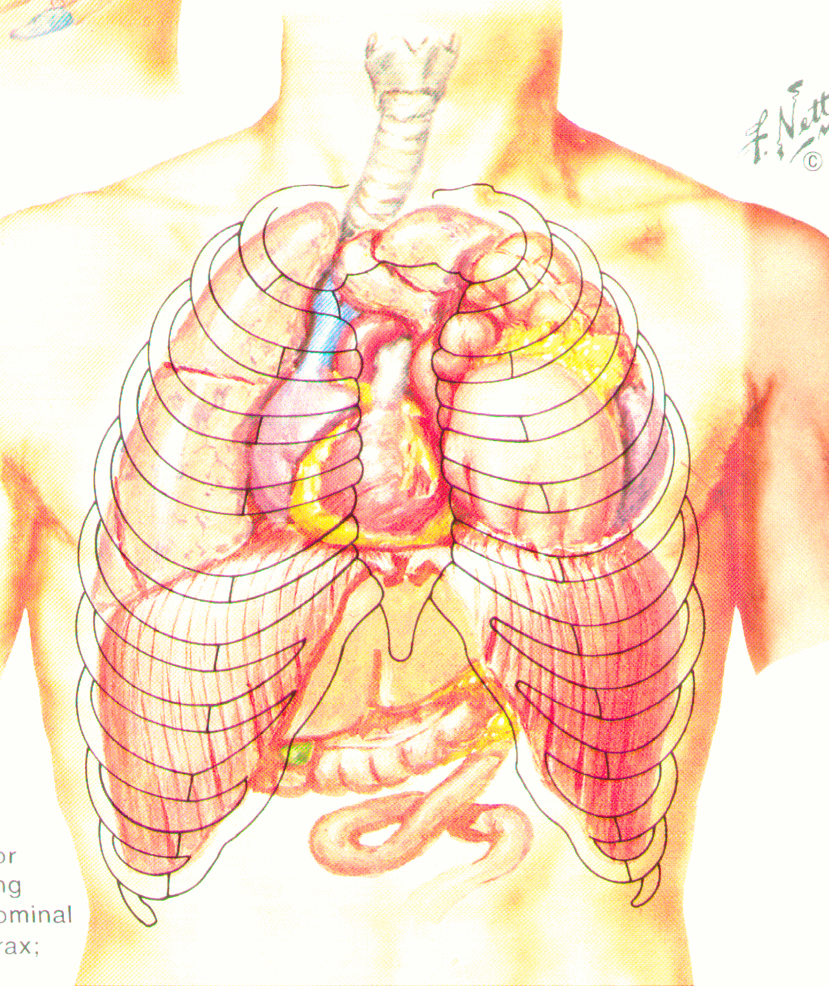
Signs and Symptoms of Tension Pneumothorax (cont.)
Tracheal
Deviation
Notes:
By the time that tracheal deviation has occurred the heart and lung have been moved from their normal position and are being compromised in their function.

Slide 46
Signs and Symptoms of Tension Pneumothorax (cont.)
You must be alert to the possibility of tension pneumothorax whenever a casualty has a penetrating chest wound.
Many of the signs are difficult to detect or see at night on the battlefield
Therefore, the sole criteria for treating a tension pneumothorax with needle decompression is thoracic trauma with progressive respiratory difficulty.
Notes:
The primary indication you should be observing for is the development of progressive respiratory distress. Your casualty’s having more and more difficulty breathing. You should be asking yourself why is this guy having so much trouble breathing all of a sudden. The reason is because he is developing a tension pneumothorax and you need to treat it.

Slide 47
Needle Chest Decompression
The buildup of trapped air in the casualty's chest can be relieved by puncturing the chest cavity with a needle and catheter unit and allowing the trapped air under pressure to escape.
This is called a needle chest decompression.
A needle chest decompression is performed ONLY if the casualty has torso trauma and progressive trouble breathing.
Notes:
Treatment of a tension pneumothorax is to relieve the pressure building up in the effected side of the chest.

Slide 48
Needle Chest Decompression (cont.)
Obtain a large bore (14 gauge, 3.25 inch) needle and catheter unit and a strip of tape from your aid bag.
Locate the insertion site--the second intercostal space just above the third rib at the mid-clavicular line on the same side as the chest wound.
Notes:
To perform this procedure you will need a 14 gauge 3.25 inch long needle catheter unit.
Locate the second intercostal space (the indentation between the second and third rib). If unable to feel this indentation; put two fingers together and slide them up the chest wall until your fingers bump into the bottom of the collarbone. Just below your second finger should be the second intercostal space. This is an easy way to find this space. The mid-clavicular line runs from the middle of the collarbone through the nipple line.

Slide 49
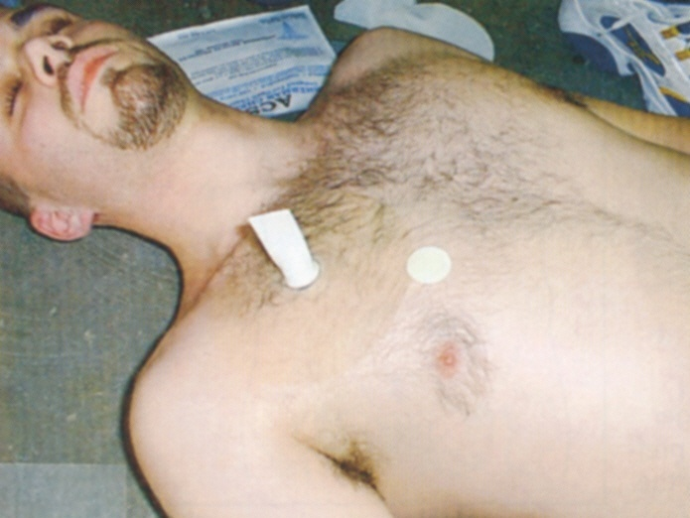
Needle Decompression Lines
MCL
AAL
MAL
Notes:
Mid clavicular line from the middle of ht collarbone through the nipple. You want to keep your needles to the outside of this line, because the heart and large blood vessels may be indies the line.

Slide 50
Needle Chest Decompression (cont.)
Firmly insert the needle into the skin at a 90-degree angle, just over the top of the third rib.
Continue inserting the needle all the way to the hub
You will feel a "pop" as the needle enters the chest cavity. A hiss of escaping air under pressure should be heard.
Withdraw the needle while holding the catheter in place.
Notes:
Insert the needle catheter just above the third rib at a 90 degree angle to the chest. The needle should be inserted all the way to the hub. Withdraw the needle leaving the catheter in place and secure it with tape to the chest wall.

Slide 51
Needle Chest Decompression (cont.)
Notes:
Over the top of the rib.

Slide 52
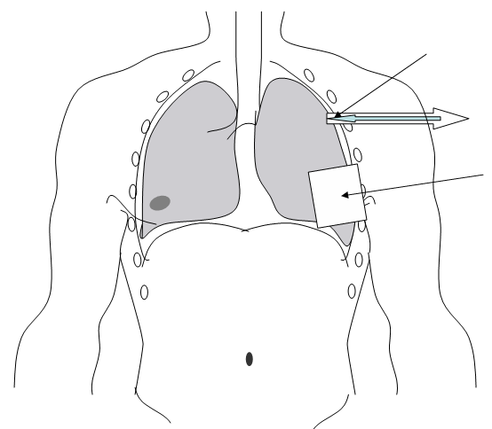
Re-inflating Lung with Needle Decompression
By applying airtight material over the wound and inserting a large-bore needle into the chest wall, trapped air flows out of the chest cavity, permitting the lung to re-inflate.
Large-bore Needle
Flow of Air
Airtight Material

Slide 53
Needle Chest Decompression (cont.)
Your casualty’s breathing should improve.
Use the strip of tape to secure the catheter hub to the chest wall.
The catheter will remain as a means for air trapped in the chest to escape to the atmosphere.
The tape should secure the hub without interfering with the opening.
There is no need to place a one way valve or three way stopcock over the catheter.
Notes:
This treatment will usually result in a significant improvement to your casualty’s breathing in a very short time. Continue to monitor your casualty’s respiration for any other changes. There is no need to put a cut finger or three way stopcock on the catheter.

Slide 54
Needle Chest Decompression (cont.)
By allowing trapped air to escape from the pleural area, the casualty's respirations should quickly improve.
Monitor the casualty’s respiration until medical arrives or they are evacuated to a MTF. If progressive respiratory distress re-occurs there may be a blockage in the original catheter, and a new catheter may need to be inserted.
Notes:
When the pressure in the chest is released, the heart and good lung will again continue to function normally.

Slide 55
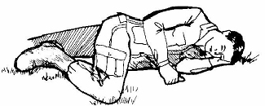
Positioning
When the casualty is evacuated, he can be positioned:
  On his side with the injured side down
  In a sitting-up position if the casualty finds that position more comfortable and is conscious enough to hold onto the litter.
Notes:
Position the casualty in the position in which it best assists his ventilation.

Slide 56
Terminal Learning Objective
Action: | Open and Manage the Airway of a Conscious or Unconscious Casualty
Conditions: | Given a casualty who is unconscious or having difficulty breathing.
Standards: | Open the airway, insert a nasal airway, apply an occlusive dressing to an open chest wound, perform a needle chest decompression, clear an obstruction from the throat of a conscious/unconscious casualty, and perform mouth-to mouth resuscitation
SUMMARY

Slide 57
Manage the Airway
First Aid 3
M1303
Version 6.0
QUESTIONS

