Slide 1
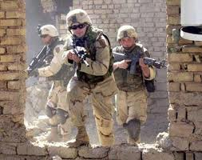
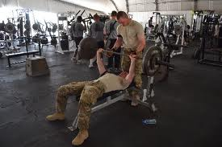
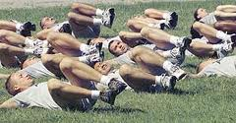
The building blocks to the Adaptable Soldier

Slide 2
The building blocks to the Adaptable Soldier
AGENDA
Spiritual Fitness
Nutrition
Exercise
Weight training
=
Adaptable, Agile, and Deployable Soldier

Slide 3
Spiritual Fitness
As society evolves, so must the Army. In order to keep up with society, the Army must change and change is difficult with out adaptable and agile leaders.
Years ago, trainee’s reporting to FT Benning, Ga for basic training were in better spiritual, physical, and mental shape. (not smarter but more confident stronger)
Today, overall the Society and the Army has become more secular and our Spiritual shape has diminished. We now need a comprehensive makeover.

Slide 4
Spiritual Fitness
The Army’s new Comprehensive Soldier Fitness program, (CSF), was devised to enhance the spiritual fitness of the Soldiers in order to help them become more agile and adaptable to stress and war. In many aspects, our spiritual fitness will help Soldiers cope more than the push ups and sit ups of yesterday.
The army wants motivated, resilient, and morally grounded soldiers, so they’ve paid heed to the research linking spirituality with health.
Past decades of research has shown the positive effects of spirituality. Spirituality correlates with stronger immune systems, better heart health, and resilience. Overall the general trend links strong spirituality with health.

Slide 5
Nutrition
Think of your body as a car. Are you going to put diesel fuel in a vehicle that calls for unleaded? The answer is no!
To feel great and for our bodies to run at its max potential we must feed our the bodies the right mix of nutrients. Which starts with six essential building blocks: carbohydrate, water, protein, fat, vitamins&minerals
Carbohydrates- provide 40 to 50 percent of the energy requirement. Carbohydrates yield more energy per unit of oxygen. As work intensity increases, carbohydrate utilization increases.

Slide 6
Nutrition
For Soldiers to get enough energy they need to eat three meals of various foods.
Even snacking between meals can contribute to good nutrition if the right foods are eaten.
Soldiers must consume enough calories to meet their energy needs.
Proper weight is maintained when there is a energy balance, or, when the number of calories used equals the number of calories consumed. The following guidelines may help build lean muscle mass and create more energy.
Eat high protein, low fat items such as: fish, beans, whole wheat pasta, egg whites, skim or 1 percent milk, and low fat yogurt.
Avoid items such as: fried items, high fat meats, egg yolks, and whole milk.
For a good source of vitamins eat a diet rich in raw or steamed vegetables, green leafy romaine, whole grain breads, and fruits with skin.
Avoid fried vegetables, iceberg lettuce (no nutrients), white bread, and canned fruits in syrup.
Cook with olive oil or sunflower oil, omit or use less lard and meat fat. Limit or omit creamy salad dressings high in fat content, cookies, cakes, pies, and pastry goods.

Slide 7
The Six Essential Classes of Nutrients
Suggested menu for the Soldier/Athletes:

Slide 8
The Six Essential Classes of Nutrients
Water- is an important nutrient for the Soldier/athlete.
Soldiers/ Athletes should start any event hydrated and replace as much lost fluid as possible by drinking chilled liquids at frequent intervals during the event.
Chilled fluids are absorbed faster and help lower body temperature
Fats- provides body fuel, about half of the total energy is derived from free fatty acid metabolism. If the event lasts more than an hour, the body will use mostly fats for energy.
Trained Soldier/athletes use fat for energy more quickly than untrained athletes.
Fat may contribute as much as 75 percent of the energy demand during prolonged aerobic work in the endurance-trained athlete.

Slide 9
The Six Essential Classes of Nutrients
Protein - After carbohydrates and fats, protein provides energy for the body. Exercise may increase an athlete's need for protein, depending on the type and frequency of exercise. Extra protein consumed is stored as fat.
A varied diet will provide more than enough protein
Americans tend to eat more than the recommended amounts of protein.
Excess protein can deprive the athlete of more efficient fuel and can lead to dehydration.
High-protein diets increase the water requirement necessary to eliminate the nitrogen through the urine. Also, an increase in metabolic rate can occur and, therefore, increased oxygen consumption. Protein supplements are unnecessary and not recommended.
Vitamins & minerals - Increased caloric intake through a varied diet ensures a sufficient amount of vitamins and minerals for the Soldier/athlete. There is no evidence that taking more vitamins than is obtained by eating a variety of foods will improve performance.

Slide 10
The Six Essential Classes of Nutrients
Vitamins & minerals cont..- Carbohydrate and protein foods are excellent sources of these vitamins.
Milk products not only increase the riboflavin level but also provide protein and calcium.
The body stores excess fat-soluble vitamins A, D, E and K. Excessive amounts of fat-soluble vitamins may have toxic effects.
Minerals play an important role in performance. Sweating during exercise increases the concentration of salt in the body. Good sodium guidelines are to: 1) avoid excessive amounts of sodium in the diet and 2) beverages containing sodium after endurance events may be helpful.
Foods to eat - foods such as oranges, bananas, potatoes, fruits, vegetables, whole grain breads and cereals.

Slide 11
The Six Essential Classes of Nutrients
Vitamins & minerals cont..-

Slide 12
Exercise and weight lifting
Cardio- In order to improve fitness it is important to reach your bodies Target Heart Rate, or training heart rate. The THR is a desired range of heart rate reached during aerobic exercise, which enables your heart and lungs to receive the most benefit from a workout. This will improve your endurance. Experts recommend goal is to stay in the zone of 50 to 85 percent of your THR.
Strength/weight lifting- Soldiers need a high level of muscular endurance and strength. Although muscular endurance and strength are separate fitness components, they are closely related. Progressively working against resistance will produce gains in both of these areas. For example, weightlifting is one way to train muscle groups but injuries will occur when improper lifting techniques are combined with lifting too much weight.
Flexibility- is the range of movement of a joint, or series of joints, and their associated muscles. Good flexibility can help you efficiently accomplish physical tasks like lifting, loading, climbing, parachuting, running, and rappelling with less risk of injury. Stretching during your warm-up and cool-down helps you maintain overall flexibility

Slide 13
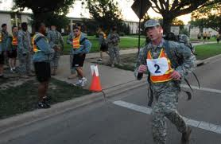
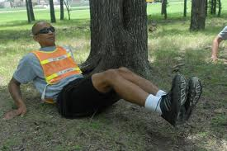
Adaptable, Agile, and Deployable Soldier

Slide 14
References:
http://www.patheos.com- The new spiritual soldier, Jonathan Morgan, 18Apr12
Eating for Peak Performance or Competition Nutrition from Colorado Dairy Council, Inc
Sports Nutrition Guidebook, by Nancy Clark, Leisure Press, 1996
Nutrition for Fitness and Sports, Melvin Williams; Brown, Benchmark, 1995

