Slide 1
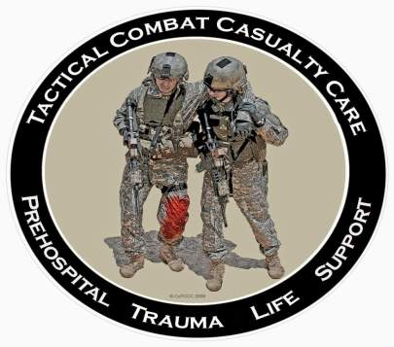
Tactical Combat Casualty Care
October 2012
Direct from the Battlefield: TCCC Lessons Learned in Iraq and Afghanistan

Slide 2
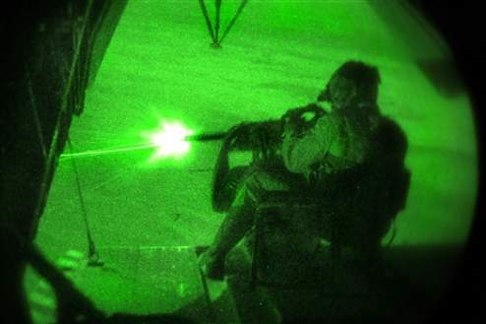
TCCC Lessons Learned in Iraq and Afghanistan
Reports from Joint Trauma System (JTS) weekly Trauma Telecons – every Thursday morning
  Worldwide telecon to discuss every serious casualty admitted to a Level III hospital from that week
Published medical reports
Armed Forces Medical
Examiner’s Office reports
Feedback from doctors,
corpsmen, medics,
and PJs
Notes:
This is the BREAKING NEWS in battlefield trauma care!

Slide 3
Training
Notes:
New Generation VI C-A-T has the white time band
Also a new manufacturer and date stamp
Tactical Combat Casualty Care (TCCC)
11/27/2013
DRAFT
3

Slide 4
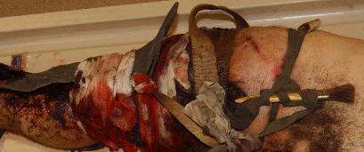
Fatal Extremity Hemorrhage
This casualty was wounded by an RPG explosion and sustained a traumatic amputation of the right forearm at the mid-forearm level and a right leg wound. He bled to death from his leg wound despite the placement of three field-expedient tourniquets.
What could have saved him?
C.A.T. Tourniquet
TCCC training for all
unit members
*Note: Medic killed at
onset of action
Notes:
This kind of event can be prevented with good TCCC training for everyone in the unit.
TCCC – it’s not just for medics and corpsmen anymore!

Slide 5
Do Aviation Personnel Need
TCCC?
In-Flight Tourniquet
24 June 2010
AF Pave Hawk pilot on EVAC mission to pick up wounded UK soldier
Gunshot wounds (GSW) both legs
Severe bleeding R leg
PJ crawled up into cockpit and applied tourniquet
Bleeding controlled - pilot completed mission
Notes:
Yes, they do.
Especially helicopter crews.

Slide 6
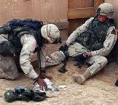
Eliminating Preventable Death on the Battlefield
Kotwal et al – Archives of Surgery 2011
All Rangers and docs trained in TCCC
Ranger preventable death incidence: 3%
U.S. military preventable deaths: 24%

Slide 7
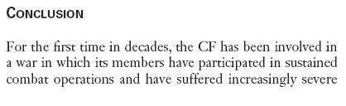
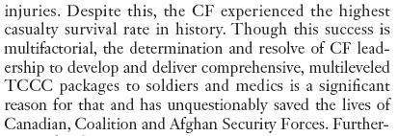
TCCC in Canadian Forces
Savage et al: Can J Surg 2011

Slide 8
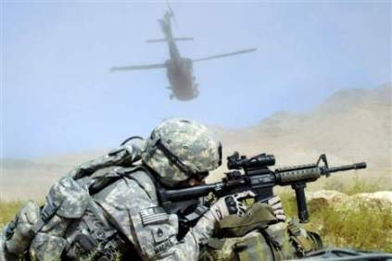
Train ALL Combatants in TCCC
Service medical departments responsible for training combat medical personnel only
Line commanders must take the lead to have an effective TCCC training program for all combatants
Ranger First Responder Course is the best model
Notes:
Some units have almost ELIMINATED preventable deaths by training everyone in TCCC.
Kotwal – Archives of Surgery 2011
Savage – Journal of Trauma 2011

Slide 9
Tourniquets
Notes:
New Generation VI C-A-T has the white time band
Also a new manufacturer and date stamp
Tactical Combat Casualty Care (TCCC)
11/27/2013
DRAFT
9

Slide 10
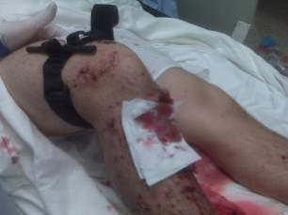
Tourniquet Studies
COL John Kragh USAISR
Get tourniquets on BEFORE the onset of shock
  Mortality is very high if casualties are already in shock before tourniquet application
If bleeding is not controlled and distal pulse is not eliminated with first tourniquet – use a second one just proximal to first
  Increasing the tourniquet WIDTH with a
  second tourniquet controls
  bleeding more effectively
  and reduces complications
Notes:
COL John Kragh from the Army Institute of Surgical Research – 3 great tourniquet papers
Journal of Trauma 2008
Annals of Surgery 2009
Journal of Emergency Medicine 2009

Slide 11
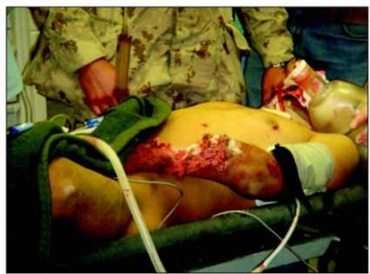
Tourniquet Studies
COL John Kragh USAISR
Tighten velcro band on tourniquets as tight as possible before starting to use windlass – a loose velcro band contributes to tourniquet malfunction
  Should be effective with
  approximately three 180
  degree turns of windlass
  Use second tourniquet as
  needed
11
Notes:
Common tourniquet mistake – not getting the velcro band tight before starting to crank the windlass.
Recommendations from COL John Kragh at USAISR

Slide 12
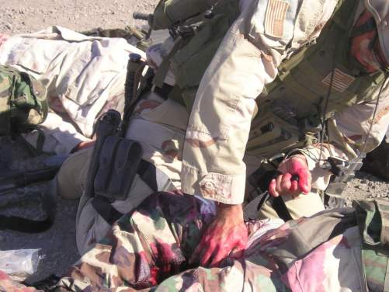
Tourniquet Case Report
Afghanistan – Nov 2009
Soldier with gunshot wound to left leg
Open fracture left femur
Injury to popliteal artery and vein
Three CAT tourniquets
placed
Life saved
Leg doing well
Multiple casualties each
week being saved with
tourniquets
12
Notes:
Tourniquets are saving lives on the battlefield EVERY WEEK.

Slide 13
Preventable Near-Death Event from Tourniquet Issue
JTS Trauma Telecon 12 July 2012
Dismounted IED attack and GSW
Severe bleeding right leg in popliteal region
CAT applied – ineffective
No second CAT applied initially
Nearly bled to death from leg wound
CPR being done on admission to MTF
Second CAT placed at FOB – effective
Massive transfusion – kidney failure – dialysis at WR

Slide 14

Counterfeit CAT
Tourniquets
Fake CAT tourniquets that are prone to malfunction are turning up in theater – ensure that you have this NSN tourniquet:
NSN 6515-01-521-7976
Notes:
Make sure you have the right tourniquets!

Slide 15
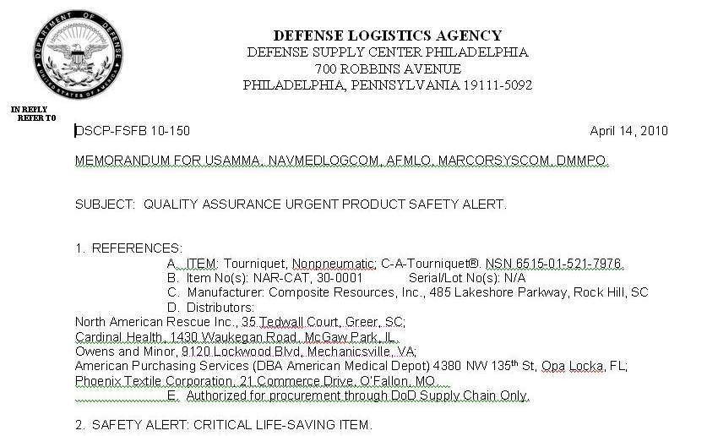
Counterfeit CAT
Tourniquets
Order CATs from approved distributors!
Notes:
Message from Defense Logistics Agency outlining problem
This letter lists authorized C.A.T. distributors

Slide 16
Tourniquet on Uninjured Arm
JTS Trauma Telecon 8 April 2010
IED casualty
Arrived at Kandahar with C-A-T in place on left arm
Evaluation: no injuries sustained on left arm
Follow-up: No explanation available
Lessons Learned:
  No injury = No tourniquet
  Reassess – reassess - reassess
Notes:
This mistake could have been avoided if the casualty had been reassessed in TFC.

Slide 17
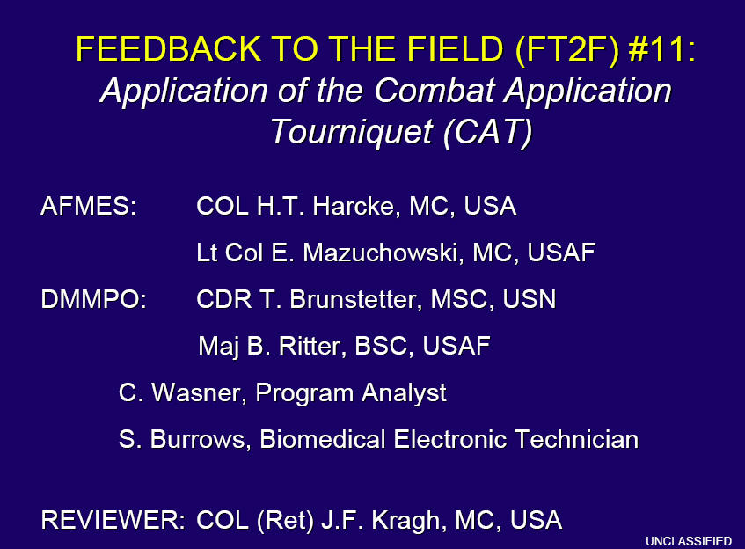

Slide 18
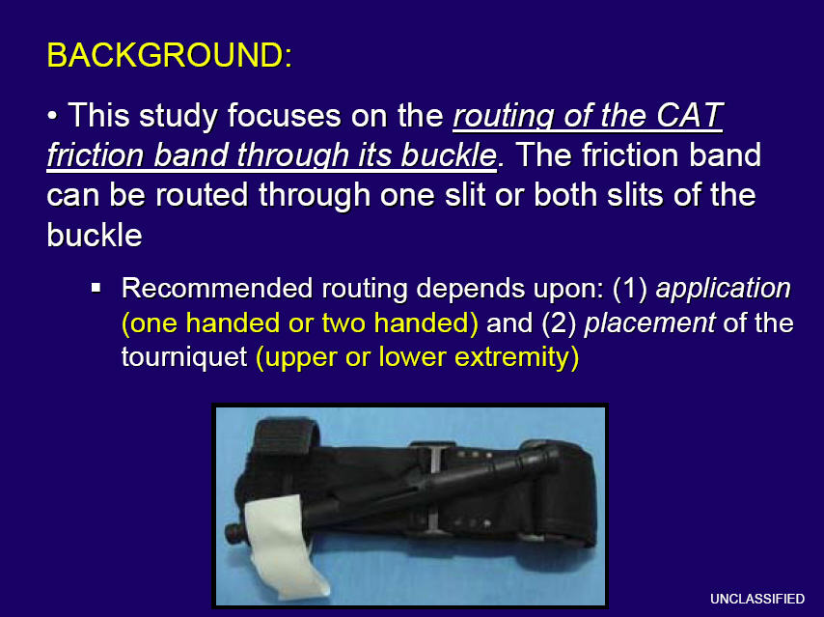

Slide 19
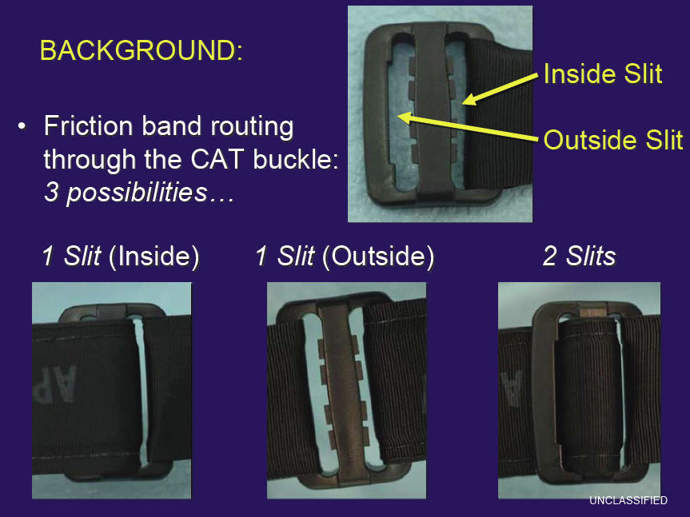

Slide 20
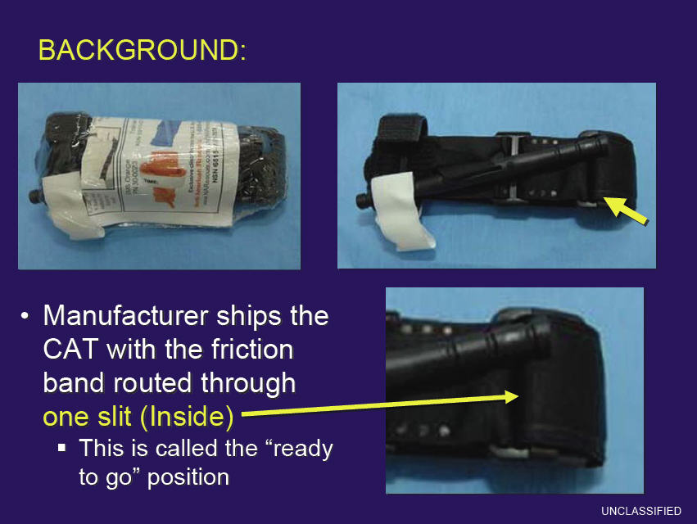

Slide 21
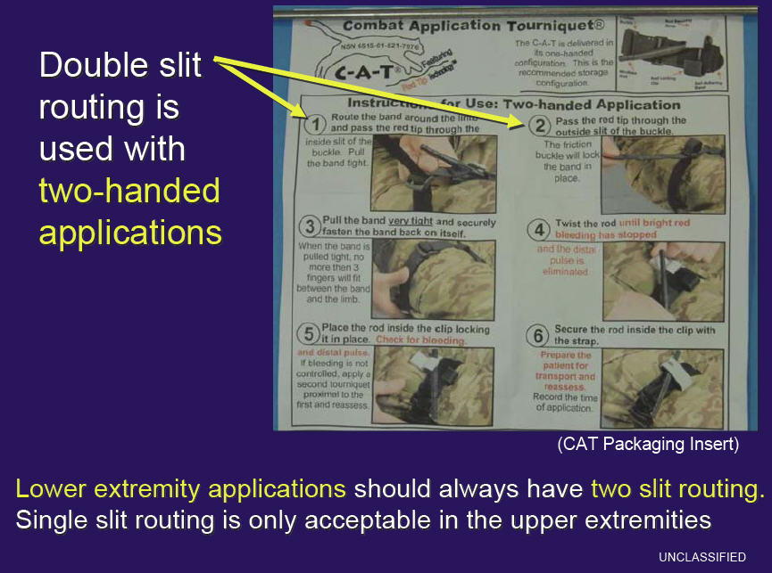

Slide 22
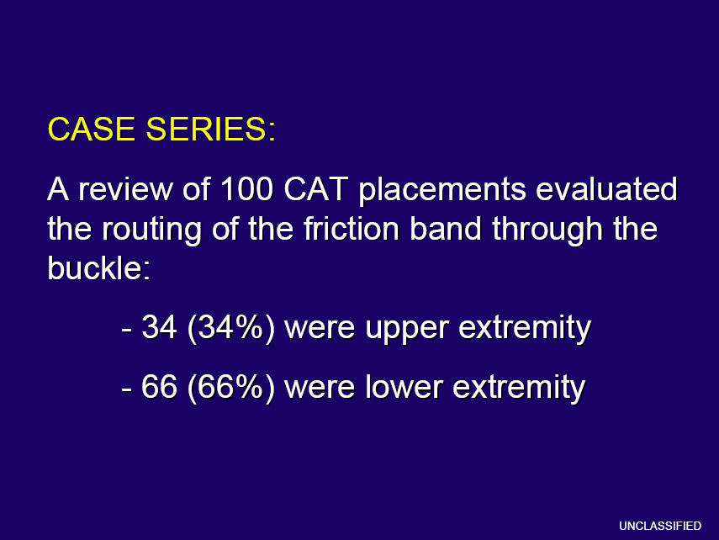

Slide 23
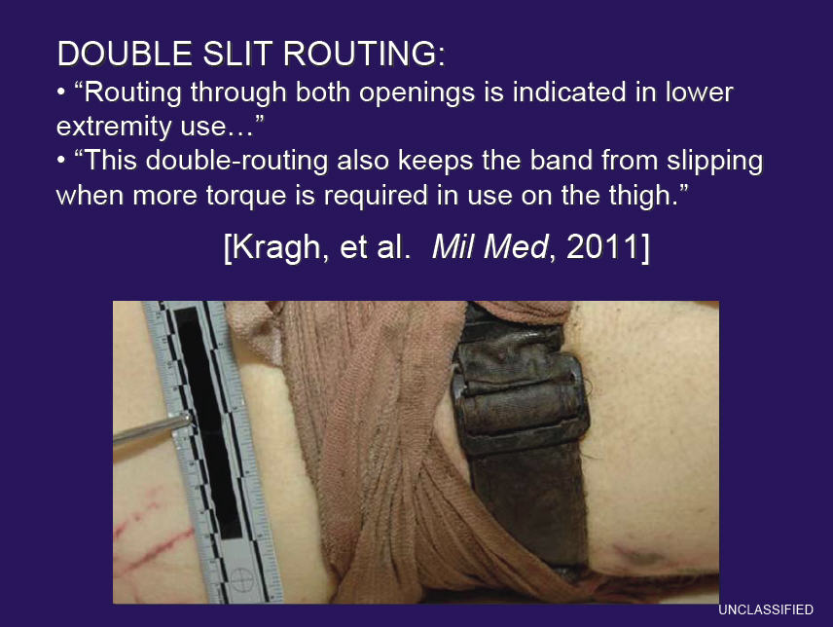

Slide 24
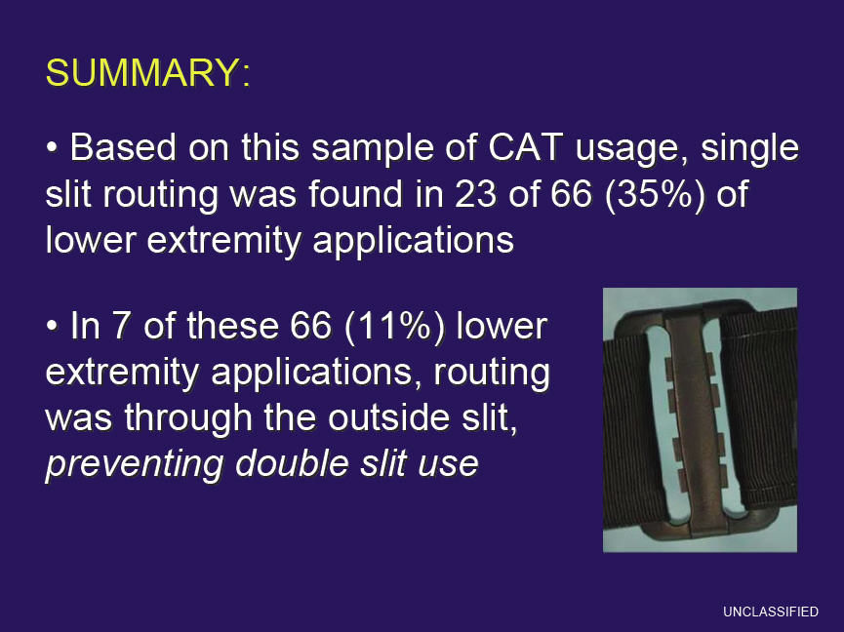
Double-slit routing
for leg tourniquets!

Slide 25
Tourniquet Mistakes to Avoid!
Not using one when you should
Using a tourniquet for minimal bleeding
Putting it on too proximally – place the TQ
just above where the site of bleeding is!
Not taking it off when indicated during TFC
Taking it off when the casualty is in shock or has only a short transport time to the hospital
Not making it tight enough – the tourniquet should eliminate the distal pulse
Not using a second tourniquet if needed
Waiting too long to put the tourniquet on
Periodically loosening the tourniquet to allow blood flow to the injured extremity
* These lessons learned have been written in blood. *
Notes:
These are common mistakes made by first responders applying tourniquets.

Slide 26
Eye Injuries
Notes:
New Generation VI C-A-T has the white time band
Also a new manufacturer and date stamp
Tactical Combat Casualty Care (TCCC)
11/27/2013
DRAFT
26

Slide 27
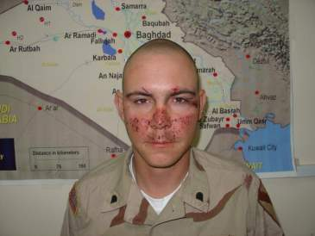
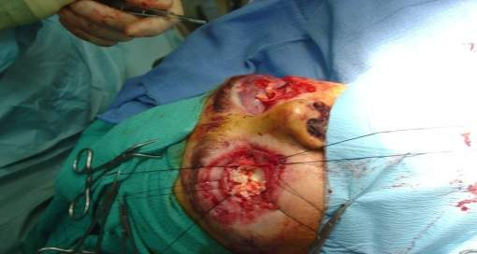
Wear Your Eye Protection!
Jan 2010
22 y/o near IED without eye protection
Now blind in both eyes
Don’t let this happen to you – see slides below
With eye pro – eyes OK! Without eye pro – both eyes lost
Notes:
Prevention, prevention, prevention………

Slide 28
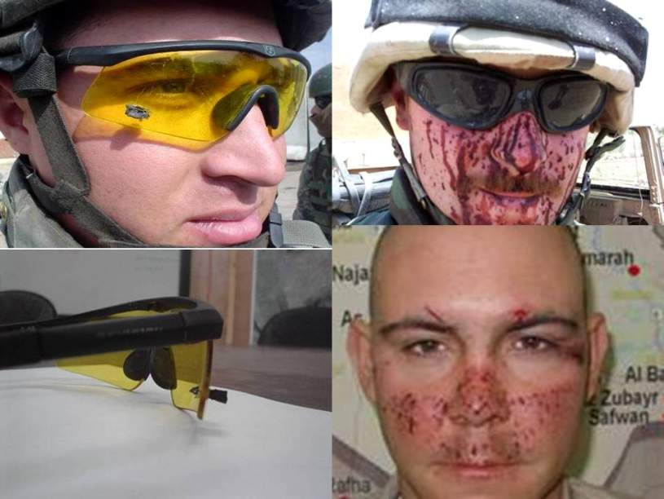
Eye Armor – It Works!
Notes:
On left – large shrapnel fragment stopped by eye armor
On right – multiple shrapnel wounds to face; eyes unharmed thanks to eye armor

Slide 29
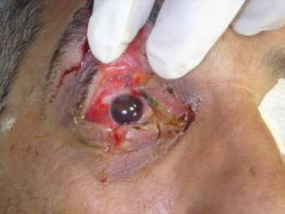
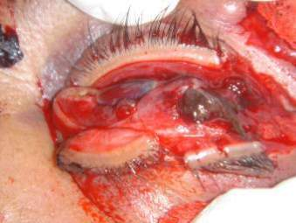
Penetrating Eye Trauma
Rigid eye shield for obvious or suspected eye wounds - often not being done – SHIELD AND SHIP!
Not doing this may cause permanent loss of vision – use a shield for any injury in or around the eye
Eye shields not always in IFAKs
IED + no eye pro + facial wounds = Suspected Eye Injury!
    Shield after injury
    No shield after injury
Notes:
The eye on the left has a good chance of recovering vision.
The eye on the right will have to be surgically removed.

Slide 30
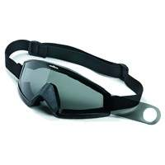
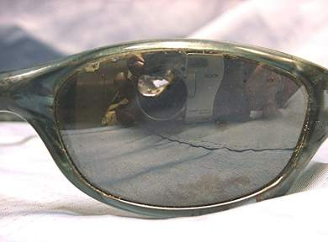
Eye Protection
Use your tactical eyewear to cover the injured eye if you
don’t have a shield.
Using tactical eyewear in the field will generally prevent
the eye injury from happening in the first place!
Notes:
30
Tactical eyeware can be used to protect the eye if no eye shield is available.
Use of tactical eyeware is an excellent way to prevent this type of injury from happening in the first place.

Slide 31
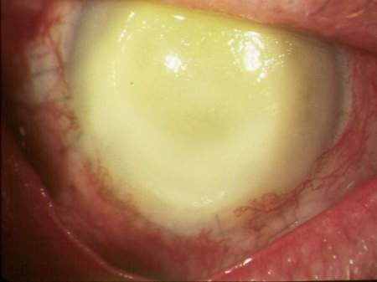
JTTS Trauma Telecon
9 Sept 2010
Recent case of endophthalmitis (blinding infection
inside the eye)
Reminder – shield and moxifloxacin in the field
for penetrating eye injuries – combat pill pack!
Also – need to continue
moxi both topically and
systemically in the MTFs
Many antibiotics do not
penetrate well into the
eye
Notes:
Eye infections can cause permanent loss of vision after eye injury.
Give antibiotics in the Combat Pill Pack to help prevent!

Slide 32
Patched Open Globe
22 July 2010
Shrapnel in right eye from IED
Had rigid eye shield placed
Reported as both pressure patched and as having a gauze pad placed under the eye shield without pressure – NO pressure patches on eye injuries
Extruded uveal tissue (intraocular contents) noted at time of operative repair of globe
Do not place gauze on injured eyes! COL Robb Mazzoli: Gauze can adhere to iris tissue and cause further extrusion when removed even if no pressure is applied to eye.
At least two other recent occurrences of patching
Notes:
COL Robb Mazzoli was formerly the Army Surgeon General’s Consultant for Ophthalmology
Reminder: Rigid eye shields GOOD, pressure patch BAD for eye trauma
Should put no gauze underneath the shield at all – may cause problems as noted above

Slide 33
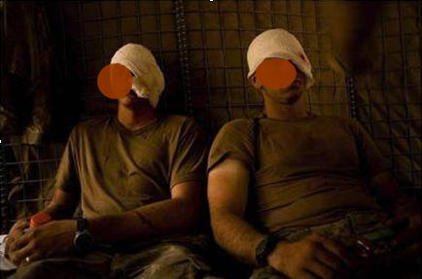
Pressure Dressings on
Eye Injuries
The wrong thing to do – makes a bad situation potentially much worse – SHIELD ONLY
Notes:
A recent picture from Afghanistan – this is how NOT to do it

Slide 34
Airways
Notes:
New Generation VI C-A-T has the white time band
Also a new manufacturer and date stamp
Tactical Combat Casualty Care (TCCC)
11/27/2013
DRAFT
34

Slide 35
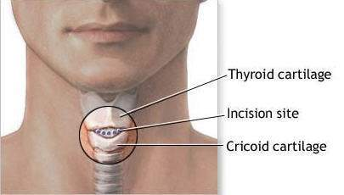
Surgical Airways
Joint Trauma System e-mail of 24
September 09
3 field crics done incorrectly in OIF
One was done through the center of the
thyroid cartilage and through one of the
vocal cords
Notes:
Surgical airways are probably the most technically difficult intervention in TCCC.
Some have been done incorrectly.

Slide 36
Surgical Airways in Combat:
The Rest of the Story
“The setting of the casualty care was at night in a non-permissive environment. The medic had sustained a sacral injury and damaged his NVG's during a hard landing on infil. The casualty had sustained a gunshot wound to the jaw. The medic was not called to the scene for ten minutes due to an ongoing firefight. The jaw was shattered and he had heavy maxillofacial bleeding. The recovery position was attempted repeatedly, but the casualty refused to remain like that. Anxiolysis was attempted with Versed to facilitate maintaining the airway with position alone, but did not work. The casualty became increasingly combative and the decision was made to perform the cric out of fear of completely losing the airway during evacuation. Due to the fact that the medic's NVGs were damaged, an operator (former 18D with two successful prior combat cric's) attempted the procedure with assistance by the medic. By then all landmarks had disappeared due to soft tissue swelling of the neck. Although complications resulted from the procedure, a definitive airway was established under extremely difficult conditions and the casualty lived.”
Notes:
Another dramatic example of how difficult it can be to provide trauma care on the battlefield.

Slide 37
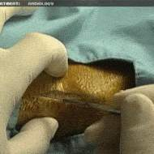
Surgical Airways
Recommendations:
Live tissue training for this procedure if possible
“Sim Man” trainer may be second-best option
Don’t attempt a surgical airway just because the casualty is unconscious
Try the “sit-up and lean forward”
position prior to attempting a
surgical airway if the casualty
is conscious
Notes:
The “Sim Man” trainer is the device used to train Army 68W medics in surgical airways.

Slide 38
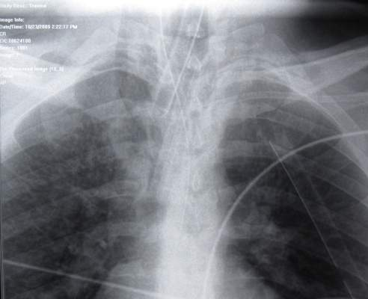
Surgical Airways
If you cut the endotracheal tube, you must tape it very securely or the tube will slip down into the trachea, cease to function correctly, and have to be
surgically removed.
Like this one…..
Notes:
Read text

Slide 39
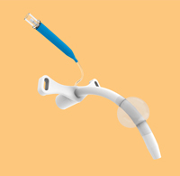
Surgical Airways
Or – even better
Use the right tool for the job
A cuffed cric tube with tabs that
prevent slippage
Like this one…..
Notes:
Read text

Slide 40
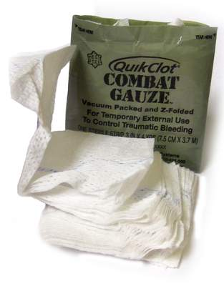
Surgical Airways
Be prepared for bleeding
Have Combat Gauze at hand
Vertical incision to reduce risk of bleeding
Notes:
Read text

Slide 41
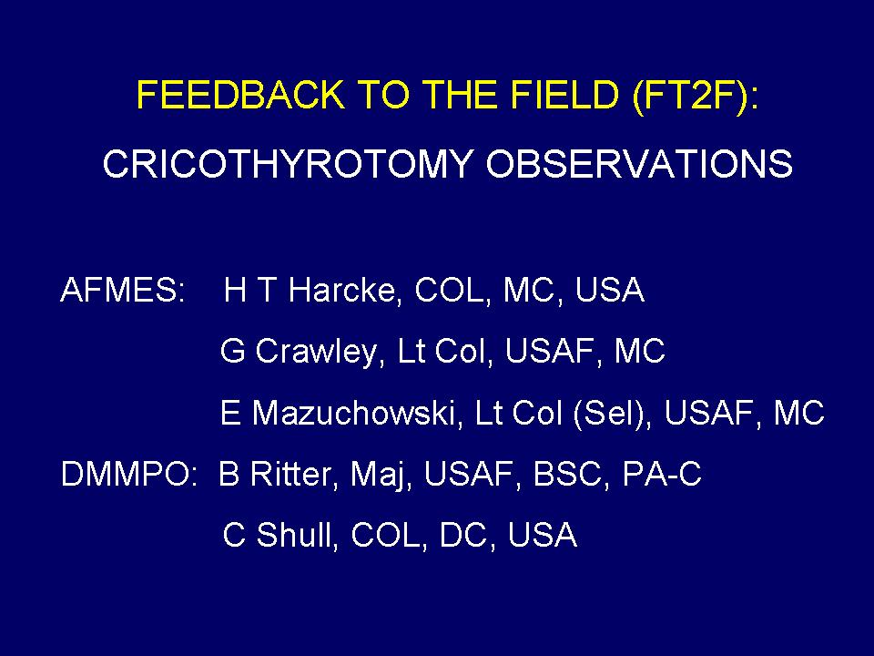
Surgical Airways
41
Notes:
Read text

Slide 42
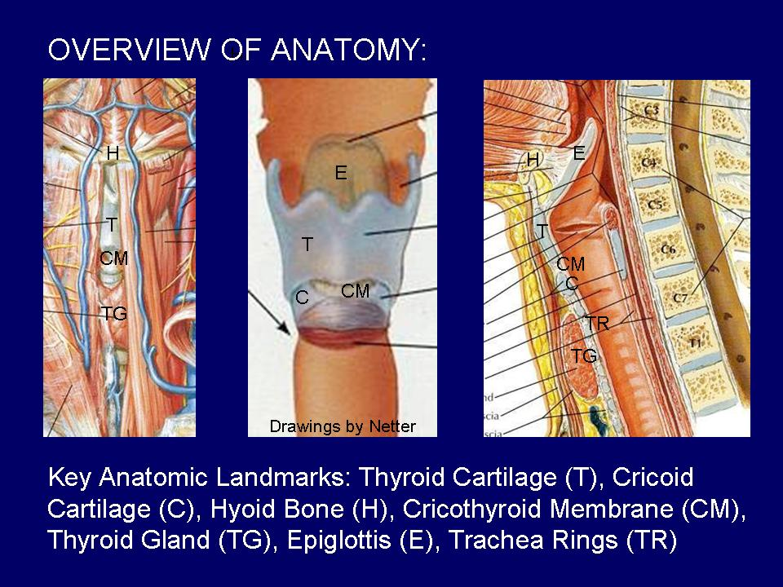
Surgical Airways
42
Notes:
Read text

Slide 43
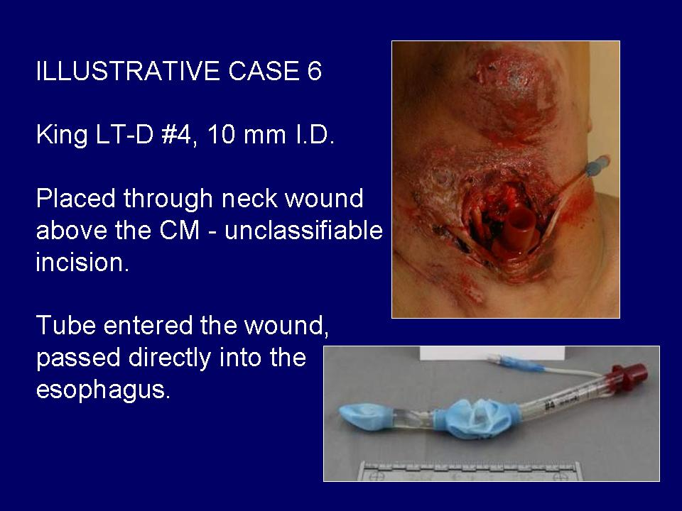
Surgical Airways
43
Notes:
Read text

Slide 44
Airway Take-Home #1:
Sit-Up and Lean Forward If Able
Many casualties with isolated maxillofacial injury can
protect their airways by simply sitting up, leaning
forward, spitting our the blood in their airway, and
continuing to breathe in that position.
This has saved multiple casualties discussed in the
trauma telecons.
Maxillofacial injury should not trigger a knee jerk
reflex for the medic to attempt a surgical airway.

Slide 45
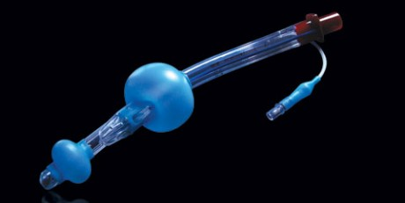
Airway Take-Home #2:
Don’t Force the Surgical Airway
Casualties who are unconscious from hemorrhagic
shock or severe TBI, but who have not suffered direct
airway trauma are likely to be the best candidates for
supraglottic airways such as the King LT.

Slide 46
Airway Take-Home #3:
Follow the Bubbles
JTS Trauma Telecon 2011
Casualty with a gunshot wound to the neck
Airway was obstructed with blood
Medic noted air bubbles coming from the tracheal wound
No need for an incision in this case – the medic put a cric tube directly into the trachea through the wound
Held it there until the casualty got to a hospital
Casualty did well - great save
With penetrating neck wounds, follow the bubbles if you see them!
Notes:
Great airway save

Slide 47
Airway Take-Home #4:
Surgical Airway Technique
Know your anatomy
Dotted line at incision site during training
Have the right tools for the job
Supervised procedures before deployment – Live Tissue Training if possible
Pulse ox in difficult airway casualties
Reassess – Reassess – Reassess!

Slide 48
Spinal Precautions after IED Blasts
Notes:
Tactical Combat Casualty Care (TCCC)
11/27/2013
DRAFT
48

Slide 49
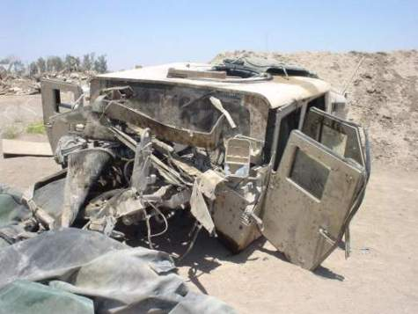
IED Casualties
IED blast casualties often have multiple mechanisms of injury
  Blunt trauma
  Penetrating trauma
  Blast
  Burns
Majority of casualties
are now from IEDs
Notes:
Mechanisms of wounding have changed with the increasing use of IEDs.
Casualties from IED attacks often have more than just penetrating trauma.

Slide 50
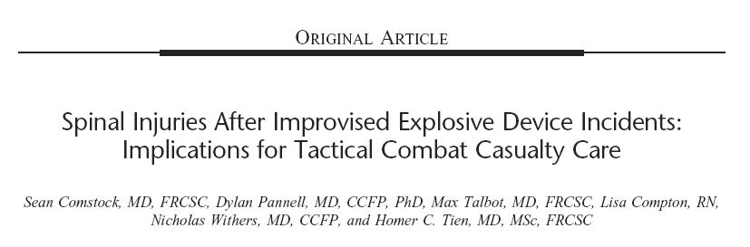
Comstock 2011
Journal of Trauma
8% of IED casualties were found to have spinal fractures
Almost half of these fractures were unstable and placed the casualty at risk for spinal cord injury
Notes:
Mechanisms of wounding have changed with the increasing use of IEDs.
Casualties from IED attacks often have more than just penetrating trauma.

Slide 51
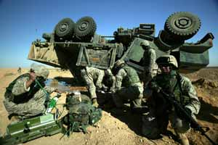
IED Casualties
IED attack OR blunt trauma such as motor
vehicle crash with neck or back pain or
unconscious – think spinal precautions
Try to maintain spinal alignment at all times
C-collar AND spine
board/litter applied
Have C-collars and spine
boards/litters in vehicles
Notes:
This may be done by a second rescuer manually maintaining head and neck alignment if needed.

Slide 52
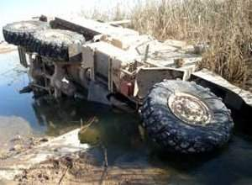
IED Attacks
IED events – be alert for secondary IEDs or ground assaults after initiation of the IED
Notes:
Use of a second IED is a common tactic. Move the casualties “Off the X.”

Slide 53
Combat Gauze
Notes:
New Generation VI C-A-T has the white time band
Also a new manufacturer and date stamp
Tactical Combat Casualty Care (TCCC)
11/27/2013
DRAFT
53

Slide 54
JTS Trauma Telecon
26 Aug 2010
23 y/o male
GSW left infraclavicular area with external hemorrhage
“Progressive deterioration”
External hemorrhage noted to increase as casualty resuscitated in ED
No record of Combat Gauze use
All injuries noted to be extrapleural
Lesson learned: see following slide
Notes:
Read text

Slide 55
Combat Gauze™
It doesn’t work if you don’t use it.
Notes:
Read text

Slide 56
Combat Gauze™
Point of Emphasis:
If making a pressure dressing – Combat Gauze should be the first layer to stop bleeding
Notes:
Read text

Slide 57
Intraosseous Devices
Notes:
New Generation VI C-A-T has the white time band
Also a new manufacturer and date stamp
Tactical Combat Casualty Care (TCCC)
11/27/2013
DRAFT
57

Slide 58
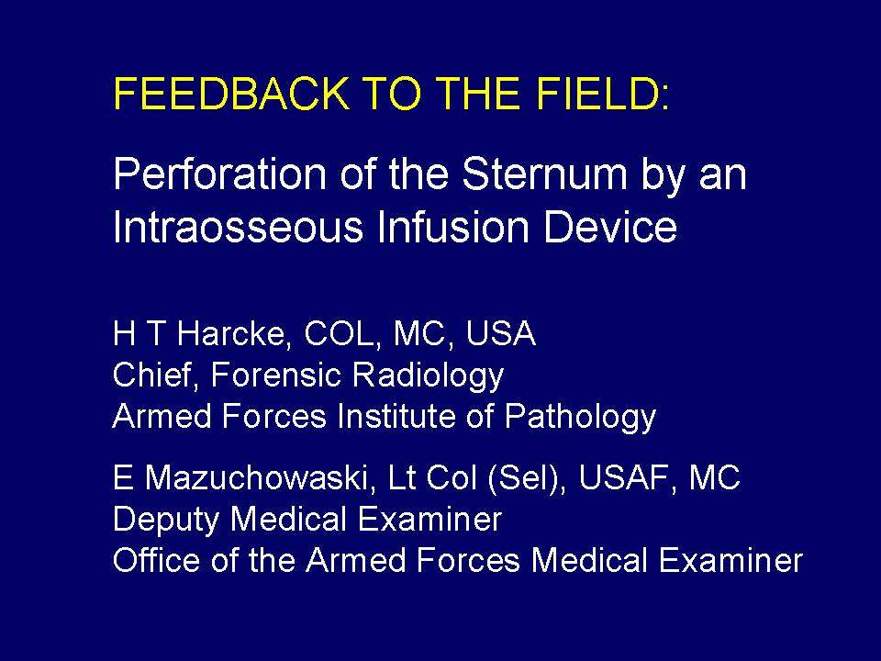
58
Notes:
Some Lessons Learned come from autopsy findings
Strong work done by Drs Harcke and Mazuchowaski to get word out to combat forces

Slide 59
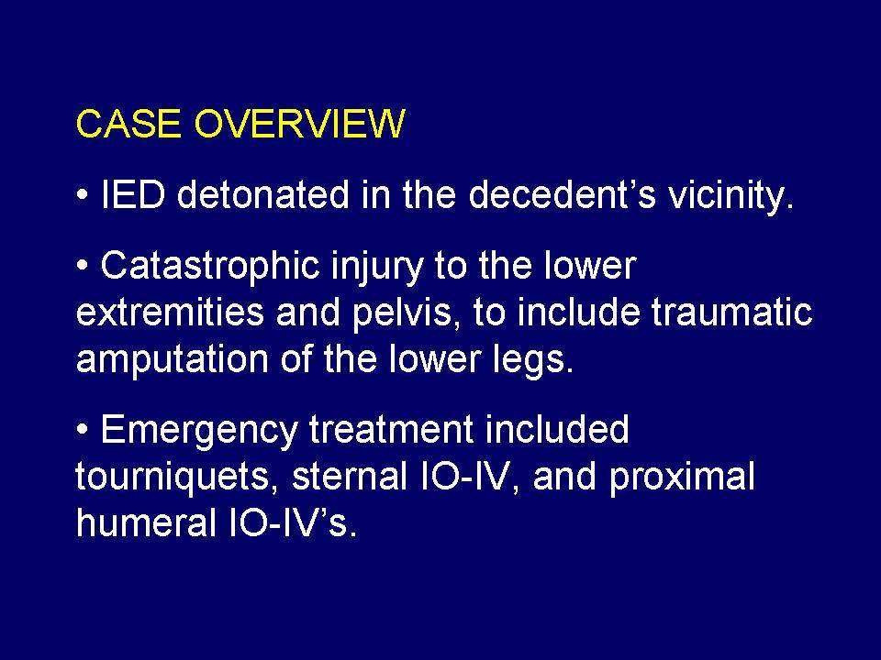
59
Notes:
Read casualty scenario

Slide 60
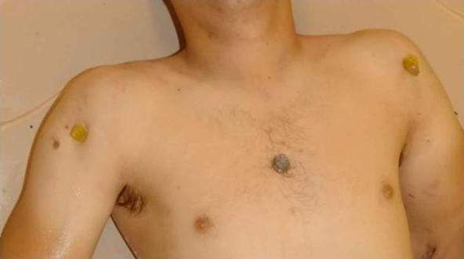
Note sternal IO in place
Notes:
Note sternal IO

Slide 61
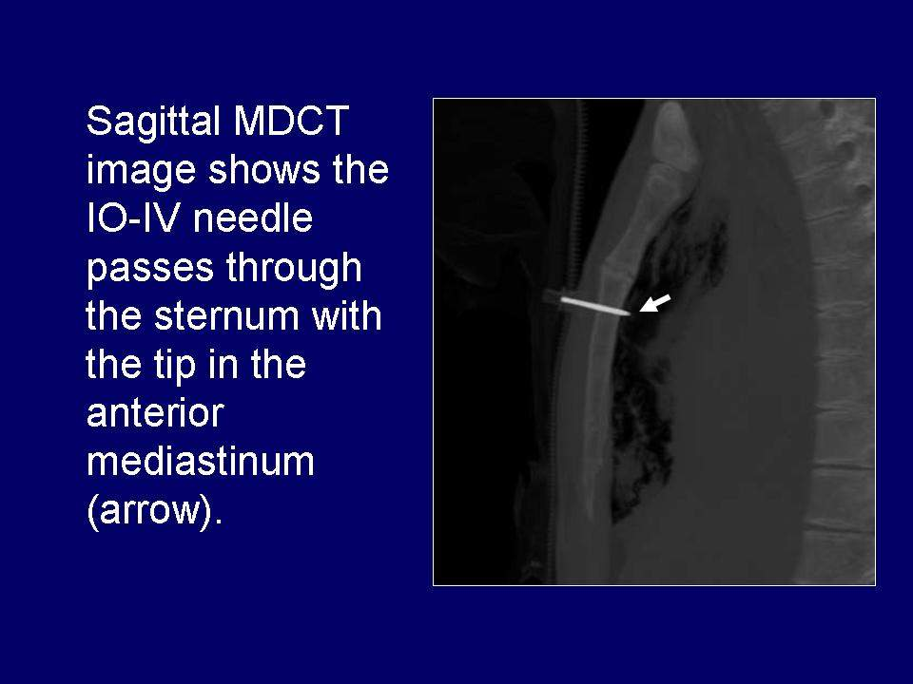
Autopsy CT Scan
This is NOT where you want the infused fluids to go!
61
Notes:
Infused fluids in this case went INTO THE CHEST CAVITY.
NOT GOOD!

Slide 62
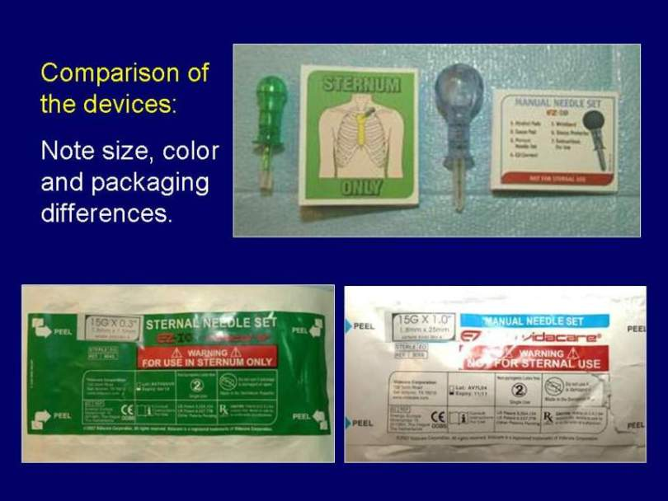
IO Devices
Lessons Learned
Sternal IO Extremity IO
Do you really want to try to tell these two IO needles apart in the dark in a tactical mass casualty scenario?
Notes:
Yes they are clearly marked, but don’t forget about nighttime operations.
Also, the confusion and urgency of a mass casualty scenario in the field.

Slide 63
Hypothermia Prevention Equipment
Notes:
New Generation VI C-A-T has the white time band
Also a new manufacturer and date stamp
Tactical Combat Casualty Care (TCCC)
11/27/2013
DRAFT
63

Slide 64
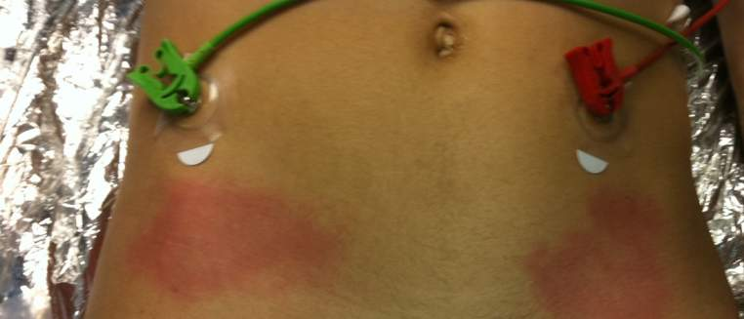
Ready Heat Skin Burns
Do NOT place the Ready-Heat Blanket directly on the skin - multiple reports of skin burns from this being done
Keep T-shirt on

Slide 65
Toxic Products of Combustion in Burning Vehicles
Notes:
New Generation VI C-A-T has the white time band
Also a new manufacturer and date stamp
Tactical Combat Casualty Care (TCCC)
11/27/2013
DRAFT
65

Slide 66
Possible Halon Exposure in a Combat Medic Presentation
Ground vehicle convoy in Afghanistan
Casualties inside vehicles during and after AFES discharge
  “Smoldering” inside vehicle during casualty treatment
Total time of exposure to fire suppression agent unknown
Halon blamed for subsequent pulmonary sx in casualties and medic
Halon off-gassing from casualties’ clothing in helo?
Notes:
In this casualty scenario, the fire suppression agent in the tactical vehicle was blamed for sx of pulmonary irritation that developed in the casualties and the treating medic during helicopter evacuation. The medic who presented this scenario did not think to blame the pulmonary sx on inhalation of toxic byproducts of combustion of structural materials inside the crew compartment.

Slide 67
What is “Halon”?
Halons are a group of chemical compounds consisting of hydrogen and carbon with linked halogens like bromine
  There are many commercial halons with many uses, including fire suppression
  Halon 1301 used in fire suppression systems in tactical vehicles phased out in mid-1990s
HFC-227 is the new agent
Non-toxic BUT
Notes:
The United States stopped producing halons and many other ozone-depleting compounds in 1995, ahead of the schedule agreed to in international treaties. The Department of Defense was forced to search for a replacement for the halon that was used as a fire suppression agent in tactical vehicles.

Slide 68
Toxic Byproducts of Combustion
Fires in tactical vehicles can produce a variety of toxic byproducts:
  Nitrous oxide, nitrous dioxide
  Carbon monoxide, carbon dioxide
  Hydrofluoric acid, hydrochloric acid, hydrogen cyanide
  Acrolein, formaldehyde
These are all pulmonary irritants!
Also ammunition rounds “cooking off”

Slide 69
Field Treatment for Smoke and Toxic Fume Inhalation
Prevent by removing the casualty from the burning vehicle as quickly as possible
Pulse oximetry monitoring
Aggressive airway management
Documentation of smoke exposure
Oxygen when available if oxygen saturation is low or if casualty is having respiratory difficulty

Slide 70
Analgesia
Notes:
New Generation VI C-A-T has the white time band
Also a new manufacturer and date stamp
Tactical Combat Casualty Care (TCCC)
11/27/2013
DRAFT
70

Slide 71
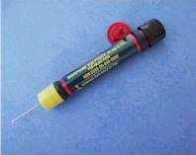
NO Narcotic Analgesia for Casualties in Shock
Narcotics (morphine and fentanyl) are CONTRAINDICATED for casualties
who are in shock or who are likely to
go into shock; these agents may worsen
their shock and increase the risk of death
Four casualties in two successive weekly telecons were noted to have gotten narcotics and were in shock during transport or on admission to the MTFs
Use ketamine for casualties who are in shock or at risk of going into shock but are still having significant pain
Notes:
Great airway save

Slide 72
Case Report
September 2012
Male casualty with GSW to thigh
Bleeding controlled by tourniquet
In shock – alert but hypotensive
Severe pain from tourniquet
Repeated pleas to PA to remove the tourniquet
PA did not want to use opioids because of the shock
Perfect candidate for ketamine analgesia
Not fielded at the time with this unit
Notes:
Read text

Slide 73
JTS Trauma Telecon
25 October 2012
Male casualty injured in dismounted IED attack
Bilateral leg amputations
Tourniquets applied to both legs by ground medic
Bleeding initially controlled
Casualty in shock (BP 72/46) with but 8/10 pain
Given 100 mg ketamine – pain decreased to 2/10
Flight medic reassessed casualty
Bleeding from both amputation sites
Controlled by re-tightening of tourniquets
Repeat BP 98/68 after 500 mLs of Hextend
73
Notes:
Read text

Slide 74
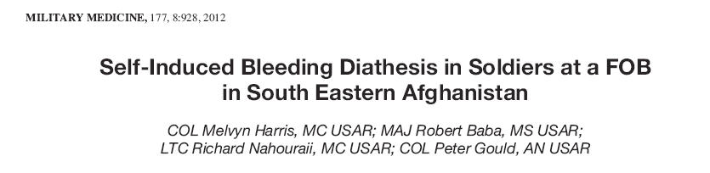
First – Do No Harm
Harris et al – Mil Med 2012
Survey of 175 Soldiers at a FOB in SE Afghanistan
“Do you take over-the-counter or prescription
NSAIDs?”
If so, how often?

Slide 75
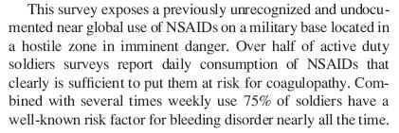
First – Do No Harm
Harris et al – Mil Med 2012

Slide 76

First – Do No Harm
Harris et al – Mil Med 2012
Recommendations:
Earlier platelets in DCR
Consider restricting NSAIDs in theater
Other analgesic choices: acetaminophen,
cox-2 selective NSAIDs, tramadol

Slide 77
Junctional Hemorrhage
Notes:
New Generation VI C-A-T has the white time band
Also a new manufacturer and date stamp
Tactical Combat Casualty Care (TCCC)
11/27/2013
DRAFT
77

Slide 78
JTS Trauma Telecon Dec 2011
IED Blast Injury
3 of 5 casualties had complex blast injuries
None flown by MERT – reportedly flown by Dustoff – rapid transport to Level II
All 3 with high traumatic LE amputations and reported difficulty with hemorrhage control despite tourniquet use
Combat Gauze reportedly not used
All 3 would have been CRoC candidates
Reported prehospital care: no IV access; no blood products; no Hextend; no IO; no TXA
2 of 3 required massive transfusion

Slide 79
Combat Gauze™
It doesn’t work if you don’t use it.
Notes:
Read text

Slide 80

Combat Ready Clamp
It doesn’t work if you don’t use it.
Notes:
Read text

Slide 81
Tension Pneumothorax
Notes:
New Generation VI C-A-T has the white time band
Also a new manufacturer and date stamp
Tactical Combat Casualty Care (TCCC)
11/27/2013
DRAFT
81

Slide 82
JTTS VTC 21 April 11
Tension Pneumo
19 y/o with GSW right chest (no body armor)
Hypotensive in aircraft
NDC done – improved - catheter left in but kinked
Chest seal placed on exit wound in back
Later found to have active bleeding from exit site chest seal saturated with blood – replaced with CG
Hypotensive in ED
Also had recurrence of tension pneumo
Reassess – Reassess - Reassess

Slide 83
Documentation of TCCC Care
Notes:
New Generation VI C-A-T has the white time band
Also a new manufacturer and date stamp
Tactical Combat Casualty Care (TCCC)
11/27/2013
DRAFT
83

Slide 84

TCCC Card –
Fill It Out!
You’re not done taking care of your casualty until this is done
Mission Commanders – this is a leadership issue!
Notes:
Read text

Slide 85

Questions?
Questions?

Slide 86
Backup Slides
Notes:
New Generation VI C-A-T has the white time band
Also a new manufacturer and date stamp
Tactical Combat Casualty Care (TCCC)
11/27/2013
DRAFT
86

Slide 87
Direct from the Battlefield
Additional Information on Halon

Slide 88

AFES Performance Criteria
From MEDCOM: Swanson, Dennis, “Fire Survivability Parameters for Combat Vehicle Crewmen,” Department of the Army, Office of the Surgeon General, 20 February 1987.
Notes:
The Army Surgeon General specified performance criteria for Automatic Fire Extinguishing Systems (AFESs) that protect crew-occupied spaces in tactical vehicles. These criteria guided the Army’s search for a replacement for Halon 1301. An AFES is required to extinguish all flames and prevent re-flash in 250 milliseconds or less. Note that acid gasses are the by-products of heating of the fire suppression agent, and they are pulmonary irritants.
88

Slide 89
US Army Ground Vehicle Crew
Compartment Halon Replacement Program (U)
HFC-227ea
  Heptafluoropropane (CF3CHFCF3)
  Ozone Depletion Potential = 0
  LOAEL = 10.5% by volume.
  NOAEL = 9% by volume.
  Decomposes by reaction with high temperature (open flames, glowing metal surfaces, etc.) forming hydrofluoric acid, carbonyl fluorides, carbon monoxide and carbon dioxide.
  Leaves no residue
Mike Clauson and Steve McCormick, US Army Tank-automotive and Armaments Command
AMSTA-TR-R / 263
Warren, MI 48397-5000
(810) 574-5948
Notes:
HFC-227ea was the fire suppressant selected to replace Halon 1301. It is a colorless, odorless gas that is stored as a liquid under pressure and dispensed as a colorless, electrically nonconductive, gaseous vapor. Its primary action is through physically cooling the fire at the molecular level. That is, it removes the thermal energy from the fire to the extent where combustion cannot be sustained.
LOAEL is the Lowest Observable Adverse Effect Level. This is the lowest concentration at which an adverse toxicological or physiological effect has been observed in lab testing with animals.
NOAEL is the No Observed Adverse Effect Level. This is the highest concentration at which no adverse toxicological or physiological effect has been observed.
The adverse effect first noticed in testing was cardiac sensitization. This manifests typically as the appearance of Premature Ventricular Contractions (PVCs) in the presence of elevated adrenaline levels. Sx of pulmonary irritation have not been observed in testing at NOAEL and LOAEL concentrations.
89

Slide 90

ASSESSMENT OF THE FIRE SUPPRESSION MECHANICS FOR
HFC-227ea COMBINED WITH NaHCO³
R.REED SKAGGS
U.S. Army Research Laboratory
Aberdeen Proving Ground, MD 21005 Hal Cross, US Army Aberdeen Test Center
Aberdeen Proving Ground, MD 21005-5059
(410) 278-5020
Notes:
In Automatic Fire Extinguishing Systems (AFESs) in tactical vehicles, HFC-227ea is mixed with sodium bicarbonate. Mixing the two helps in two ways. First, the sodium bicarb helps extinguish the fire, thus reducing the amount of HFC-227ea needed to extinguish the fire. That in turn reduces the amount of hydrofluoric acid (HF) and other toxic byproducts produced when the AFES is discharged to suppress a fire. Second, sodium bicarb also reacts directly with hydrofluoric acid, converting it to non-toxic compounds.
In testing, the mixture of HFC-227ea and sodium bicarb eliminates fire in the required time (220 ms < required 250ms), while producing acceptable levels of toxic gasses (134 ppm < required 1000 ppm) . It achieves this outcome with a peak concentration of HFC-227ea of about 7.5% by volume. This is below the NOAEL (9%) and far below the LOAEL (10.5%) for HFC-227ea.
Theoretically, the AFES can extinguish a fire in a crew compartment, and allow the crew to keep fighting the vehicle. The chance of pulmonary irritation resulting from the designed discharge of modern AFESs is extremely low.
90

Slide 91
Possible Fires in Tactical Vehicles
Class A fires involving air filters, canvas, paper
Class B hydrocarbon fuel fires fed by vehicle fuel, hydraulic fluid, lubricants, and miscellaneous materials such as paint
Class C electrical fires including batteries
Class D ammunition fires.
Notes:
Fires in crew compartments in tactical vehicles can involve a variety of materials.
Crew compartments are isolated from ammunition compartments in modern tactical vehicles, so crew members are unlikely to be exposed to toxic byproducts of ammunition fires.
91

