Slide 1




BLACKHAWKS
TACSOP
As of December 2014
Notes:
-add Table of Contents

Slide 2
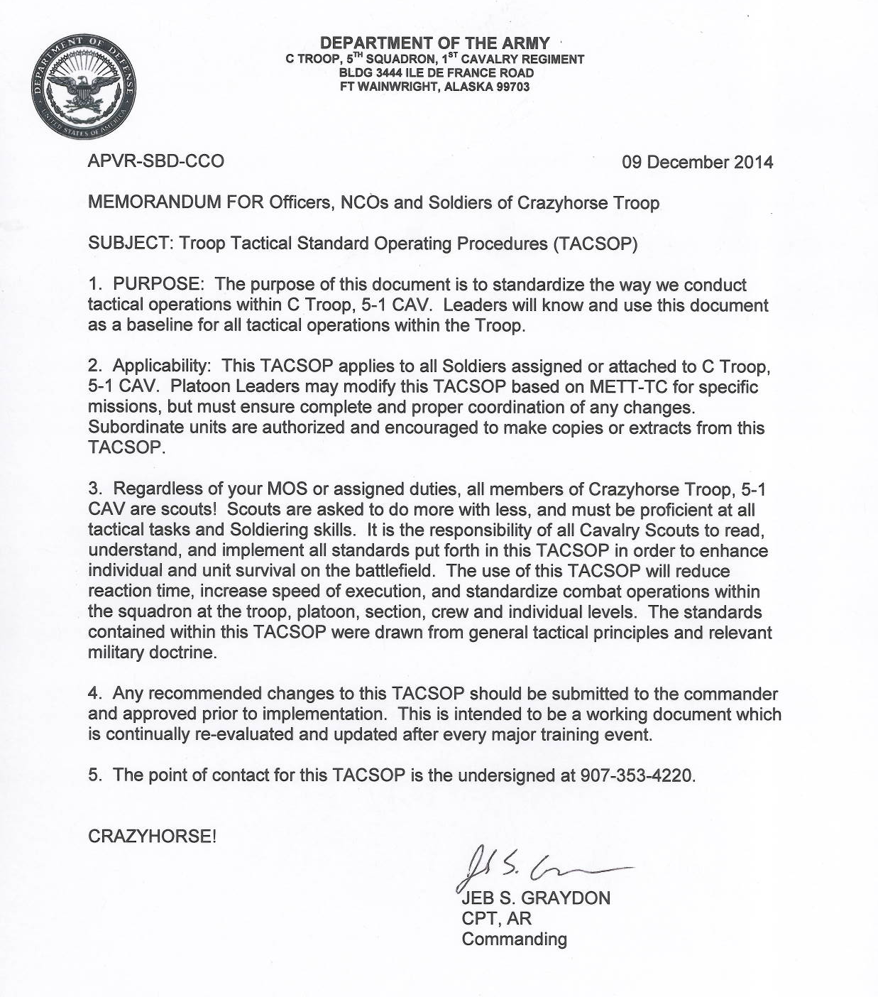

Slide 3
TROOP GRAPHICS SOP
  GRAPHIC: GRAPHICS WILL BE ON, AT A MINIMUM, THE ISSUED MAP. FBCB2 GRAPHIC WILL ALSO BE CREATED AND DISTRIBUTED IF TIME PERMITS. THE GUNNERS ARE REPONSIBLE FOR ENSURING THEIR VC’S GRAHICS ARE COMPLETE W/ NO LESS THAN THE MINIMUM REQS
  2. MINUMUM GRAPHIC REQUIREMENTS:
    UNIT BOUNDARDS:BDE,SQD(IF APPLICABLE),TRP,PLT,SEC (BLACK)
    LOA(BLACK)
    LD(BLACK)
    PHASE LINE(BLACK)
    OBJ(BLUE)
    ASSEMBLY AREA(BLUE)
    ALL TRPs AND IDF TARGETs (BLUE)
    ALL TEMPLATED ENEMY LOCATIONS AND TRPs (RED)
    ADJACENT UNIT ASSEMBLY AREA LOCATIONS AND LABELLED
    ALL CHECK POINTS, ROUTES (W/NAMES) AND COORDINATION POINTS (BLACK)
    NAIs AND TAIs (BLACK)
    2x GRID REFERENCE MARKS / WITNESS MARKS
  3. ASSIGNMENTS
    GRAPHICS
      PRIMARY: HQs PLT
      ALTERNATE: WHITE PLT
    FBCB2 GRAPHICS
      PRIMARY: HQs PLT
      ALTERNATE: RED PLT
    TERRAIN KIT OR TERRAIN SKETCH
      PRIMARY: HQs PLT
      ALTERNATE: BLUE PLT

Slide 4
GRAPHIC NAMING
CONVENTION
Control Measure | Designation
Phase Lines/RFLs/Handover Lines | Female Names
Objectives | Native American Tribes
Routes | NFL Teams
Assembly Area | Unit Name
Axes/Direction of Attack | Weapons
Points | C1-C99
Battle Position/Strong Point/Assault Positions | Great Cats
Attack by Fire/Support by Fire positions | Trees
Landing Zones | Fruits
Engagement Areas | Famous General Officers
Air Corridors/ROZs/ACAs | Birds
Infiltration Lanes | Phonetic letters
NAIs/TAIs | Soft Drinks
Brevity Codes | City Names
All other Control Measures | Nuts

Slide 5
TACTICAL MOVEMENT SOPS
Base Vehicle interval/speed for Tactical Roadmarch
(Changes based on METT-TC)
Conditions Interval (day/night) Speed (day/night)
Open road 100/50 meters 30/25 kph
Open terrain 300/150 meters 30/25 kph
Built-up area 50/25 meters 20/15 kph
Dense/wooded terrain 100/50 meters 20/15 kph
Interstate 100/50 meters 40/35 kph
Blackout 50/25 meters 25/20 kph
PRE-MOVEMENT EX-CHECK
SLANT REPORT (#OF WHEELES BY TYPE/ #OF SOLDIERS).
TOP OFF CLASS III.
UPLOAD AMMUNITION AND OTHER CLASS V.
COMPLETE PMCS AND OTHER PREFIRE CHECKS.
COMPLETE ROLLOVER AND FIRE EVAC DRILLS.
EACH VC HAS COPY OF GRAPHICS, ROUTE(S), AND TIMELINE.
CONDUCT REHEARSALS FOR AOC, ACTIONS AT HALTS, MEDEVAC/CASEVAC, AND OTHER APPLICABLE BATTLE DRILLS.
COMPLETE FIRE SUPPORT PLAN.
CHECK LOAD PLANS.
RADIO/FBCB2 CHECKS (30 MIN PRIOR TO SP).
DESIGNATE OOM, SPEED, INTERVAL, AND MVMT TECHNIQUE.
IF APPLICABLE, PREPARE FOR LIMITED OR LOW VISIBILITY (NIGHT VISION OPTICS, CHANGES TO ROM, MVMT TECHNIQUE, ETC)
When told to execute a GEAR, subordinate unit will average the following distance moved/hour according to METT-TC
GEAR 1: 5-8 KPH
GEAR 2: 8-15 KPH
GEAR 3: 15-20 KPH
GEAR 4: 20+ KPH
BASE TRM SECURITY PLAN SOP:
DIRECTION OF TRAVEL IS 12 O’CLOCK.
LEAD VEHICLE SCAN 10-2.
SUBSEQUENT VEHICLES ALTERNATE SCANNING 8-11 AND 1-4.
TRAIL VEHICLE SCANS 4-8
Distance Moved
MVMNT RATE | 1KM | 2KM | 3KM | 4KM | 5KM | 6KM | 7KM | 8KM | 9KM | 10KM
40 KPH | 1.5m | 3m | 4.5m | 6m | 7.5m | 9m | 10.5m | 12m | 13.5m | 15m
30 KPH | 2m | 4m | 6m | 8m | 10m | 12m | 14m | 16m | 18m | 20m
25 KPH | 2.4m | 4.8m | 7.2m | 9.5m | 12m | 14.4m | 16.8m | 19.2m | 21.6m | 24m
20 KPH | 3m | 6m | 9m | 12m | 15m | 18m | 21m | 24m | 27m | 30m
15 KPH | 4m | 8m | 12m | 16m | 20m | 24m | 28m | 32m | 36m | 40m
10 KPH | 6m | 12m | 18m | 24m | 30m | 36m | 42m | 48m | 54m | 60m
5 KPH | 12m | 24m | 36m | 48m | 60m | 72m | 84m | 96m | 108m | 120m
Time in Minutes

Slide 6
PCC/PCI
Pre-Combat Checklist (PCC)
First line leaders will conduct the following checks prior to all operations at a minimum:
Weapon systems, optics, ammunition
Night Vision Devices
Maps, compass/GPS
Vehicle PMCS
Radios, FBCB2, internal vehicle communications
CLS Bags
CBRN (Mask, JLST)
Dismount Bags
Sensitive Item Tie-Downs
3 DOS (Class 1 and 3)
Pre-Combat Inspection (PCI)
Platoon or Troop Leadership will conduct the following checks prior to all operations at a minimum:
Confirmation Brief (mission, intent, PIR)
1xGraphics for each vehicle
5988E
Load Plans
Roll Over / Evacuation Drills rehearsed
PACE Plan
Recovery / CASEVAC Plan
Additional checks can be added by the Chain of Command based on METT-TC

Slide 7
STAND-TO PROCEDURES
STAND TO will be conducted 30 minutes prior to sunrise
Troop CP will issue the stand-to time nightly
Commo checks will be done 5 minutes prior to stand-to
Short count will be initiated by the Troop CP.
REDCON and GREEN 2 status will be given immediately upon engine start cycle completion to the PSG in SEQUENCE. PSG will report REDCON and GREEN 2 status to Troop CP.
Platoons remain at REDCON 1 until directed to Stand Down by Troop CP. Engine shut off will be done via a second short count initiated by the Troop CP.

Slide 8
REDCON STATUS
DEFINITIONS
The TRP will use the following readiness conditions to identify the speed with which a unit must be ready for combat or movement. Subordinate units will also report their readiness to move by stating their REDCON status. Additionally, mechanics, medics, and others should use these codes to estimate when elements (injured personnel, combat vehicles, supplies, etc) will be ready for combat.
REDCON 1 - Full alert; able to move or take off immediately.
  Radio checks complete; FBCB2 fully operational.
  Vehicles loaded, secured; weapons manned.
  Personal equipment stowed, NBC alarms, and hot loop equipment stowed; all OP’s Pulled in. All personnel alert and mounted on vehicles.
  Engines running. (PL OR PSG will initiate “Short Count”.)
REDCON 1.5 – A variant of REDCON 1; ready to move in five minutes.
  Engines are off; crews prepared to initiate “Short Count” O/O.
REDCON 2 - Full security; able to move in 15 minutes.
  Vehicles loaded with all equipment. (Except hot loop and NBC alarms.)
  Primary weapons manned and prepared to fire.
  Vehicles shut down.
  Mission fully briefed and understood by all members of patrol.
(All Pre-Combat Checks are complete.)
(Note: Depending on the tactical situation Dismounted OP’s may remain in place.)
4. REDCON 3 - Reduced security; able to move in 30 minutes.
  50 % of each crew stands down for maintenance, crew rest.
  TC / BC positions manned and radios monitored.
  PMCS performed with no major disassembly of equipment.
REDCON 4 - Minimum security; able to move in 60 minutes.
  Minimum of 25% security. Digital and FM links with TOC’s and other platoonS maintained.
  Primary weapon manned and operational.
  Maintenance performed with minor disassembly allowed.
REDCON 5 – Reduced security to 10 – 20%, Ready to move in 2 hours.
  Conduct thorough maintenance.
  Consolidation and Reorganization.
  Maintain continuous operations.

Slide 9
QUARTERING PARTY
KEY TASKS FOR THE QUARTERING PARTY:
  RECON THE SITE AND ROUTE(S) USED TO APPROACH AND OCCUPY.
  SECURE THE AREA PRIOR TO OCCUPATION.
  ORGANIZE SITE AND ASSIGN VEHICLE LOCATIONS
CHARACTERISTICS FOR ASSEMBLY AREA:
  COVER AND CONCEALMENT(FROM DIRECT FIRE AND OVERHEAD COVER).
  ADEQUATE EXITS AND ENTRANCES.
  GOOD DRAINAGE; GROUND SURFACE ABLE TO SUPPORT VEH MOVEMENT.
  ENOUGH SPACE FOR ADEQUATE DISPERSION.
  1SG AND XO WILL BRIEF QUARTERING PARTY AND MAIN BODY ON:
    NECESSARY EQUIPMENT
    LOCATION OF AA
    SP TIMES
    OOM
    MOPP LEVEL
QUARTERING PARTY TASKS:
  MOVE TO AA ON ASSIGNED ROUTE(S).
  MAINTAIN SECURITY.
  RECON ROUTE(S) AND AA SITE; MARKING OBSTACLES AND BYPASSES.
  REPORT ALL CRITICAL INFORMATION TO HIGHER
ACTIONS FOR QP AT AA:
  MARK ENTRANCES, EXITS, AND INTERNAL ROUTES.
  CLEAR DEAD-SPACE AND MAINTIAN LOCAL SECURITY.
  MARK AND CLEAR OBSTACLES.
  MARK VEHICLE POSITIONS FOR MAIN BODY TO ENSURE THERE WILL BE 360 SECURITY.
  FACILITATE MAIN BODY MOVEMENT INTO AA.
QP WILL CONSIST OF THE SENIOR SCOUT FROM EACH PLATOON (THE “2” VEHICLES), THE TRP XO, AND POSSIBLY THE NBC REP AND MECHANIC REP

Slide 10
OCCUPATION OF TAA-QUARTERING PARTY:
12
Quartering party establishes initial security
C5 guides troop into the TAA from the 6 O’clock
PLT vehicles move into position to the right of the “2” vehicle.
HQs establishes CP, maintenance point and MFP in the center of the TAA
C12
C5
C32
C22
8
4
REMAINDER OF TROOP:
12
C12
PRIORITIES OF WORK
Security/Sketch card
PLT Fires Plan
Vehicle/MILES Maintenance
MILES Boresight
LOGPAC
Rest Plan
1st PLT 12 to 4
100m between vehicles
3rd PLT 8 to 12
100m between vehicles
C5
CP Tent
C66
MAINT & LOG Vehicles
C32
C92
C91
C22
8
2nd PLT 4 to 8
100m between vehicles
4

Slide 11
ASSEMBLY AREA PRIORITIES
OF WORK
Upon arrival at TAA, elements will conduct the following activities:
ALL ELEMENTS:
Immediate actions:
  Establish 100% security.
  Vehicles move to assigned positioned(checked by PL/PSG for gaps in sec).
  Reduce to REDCON 2 on short count.
  Establish OPs.
  Assign sectors of fire, TRPs, trigger lines.
  Get accurate green 2 report.
  Gunners develop range cards and sector sketches.
by 30 min:
  Reduce to REDCON 3.
  NBC alarms set.
  Sector sketches turned in to PL.
By 60 min:
  Reduce to REDCON 4.
  Platoon fire plan complete.
  Camoflauge vehicles
  Priorities of work:
    TLPs
    Weapon/vehicle maintenance.
    LOGPAC resupply
    Implement rest plan
TROOP COMMANDER:
by 30 min
Conduct coordination with SQDN
Establish Security Level
by 60 min
Maintain Communication with SQDN
Establish sectors of observation
by 120 min
Complete Troop Fire Plan
Review Security level
Sustainment
Planning for future OPS
FIRST SERGEANT
by 30 min
Establish Security according to security posture
by 60 min
Gather personnel status
Coordinate for refuel and resupply
Submit LOGSTAT Report to SQDN for resupply
by 120 min
Redistribute personnel
Sustainment
Enforce sleep plan
Enforce Noise, light, litter discipline

Slide 12
ASSEMBLY AREA
PRIORITIES OF WORK
EXECUTIVE OFFICER
by 30 min
Conduct coordination with flank units
Report Green 2 and Location to SQDN
Establish the CMD Post
by 60 min
Establish Security Level
Coordinate for refuel and maintenance
by 120 min
Redistribute Ammo and class III
Sustainment
Inspect 5988e
PLATOON SERGEANT
by 30 min
Establish Security according to security posture
Gather personnel status
by 60 min
Inspect camouflage of positions
Inspect PMCS of Vehicles, Commo, Weapons
Inspect personnel (with medics, if possible)
by 120 min
Coordinate for refuel and resupply
Redistribute Ammo , class III and personnel
Submit 5988e arrange for link up with mechanics to verify parts
Submit resupply reports
Coordinate with PLT LDR for long term security/Rest plan
Sustainment
Sleep plan/ Security
Assist in follow on operations
PLATOON LEADER:
by 30 min
Maintain Communication with TRP/SQDN
Establish Security Level
Establish sectors of observation
Conduct coordination with units and X-RAY
Report Green 2 and Location to X-RAY
by 60 min
Consolidate range cards
by 120 min
Forward PLT security plan to TRP
Enforce sleep plan
Receive any missions
Enforce Noise, light, litter discipline
Sustainment
Zero weapons
Prep for future OPS

Slide 13
LINK UP & NEAR/FAR RECOGNITION
Stationary element establishes link-up rally point (LURP). Takes control of link-up procedures and directs moving elements.
Stationary element sends LU TM to establish LU point at a recognizable terrain feature (should be predetermined and understood by both elements prior to SP, but can be in route if situation dictates). Size of LU team is the number of moving elements plus two (personnel or vehicles).
First moving element sends link-up party to LU point. Establishes far and near recognition. Guide moves with LU party back to first moving element and guides element to the LURP. Establishes far and near recognition. Stays in LURP with stationary element.
Additional moving elements repeat step 3 until all moving elements are in LURP.
LU TM returns to LURP only after all have successfully linked-up. LU TM must stay in place in case a guide gets lost (last known location).
Far Recognition Signals
Near Recognition Signals
* 1st Signal is from moving unit, stationary unit returns signal stated in matrix
** When a mounted element is conducting link-up with a dismounted unit that requires different signals based on unit type, each unit will use its own signal and must know the appropriate reply to expect from the opposite unit per this TACSOP.
 | Day | Night
Primary | Mntd: FM Dis: FM | Mntd: FM Dis: FM
Alternate | Mntd: FIPR Dis: SAT | Mntd: FIPR Dis: SAT
 | Day | Night
Primary | Both: VS-17- Pink-Pink* | Both: IR Buzzsaw
Alternate | Mntd: 1 Sig Flag-2 sig Flag* or VS-17 Dis: Red Buzzsaw | Both: Red Buzzsaw

Slide 14
BATTLE/RECCE HANDOVER
Battle Handover criteria are set during planning. Once these criteria have been met, the commanders of both units confer. At a minimum, criteria will include:
  Majority of combat power, as defined by moving unit, has passed.
  COC has situational awareness. Communication is up with alternate means designated for redundancy (FM, FIPR, Satellite, Runners).
  FS agencies are FIRECAP. FS nets are up.
  Security forces are emplaced in the security area.
Both commanders agree on Battle Handover criteria. TF commander retains battle handover criteria approval for CO/TM. Time of Battle Handover is noted.
At Battle Handover, the new controlling unit has OPCON of all forces within his sector. The controlling unit has priority for all terrain, assets and fires. Stationary Unit or Outgoing Unit assets roll to the moving unit's Tac. All fire support assets fire in support.
Control Measures. There is no relationship between the Battle Handover Line and the Passage Point. At Battle Handover, the BHL becomes the boundary between the moving unit and the stationary unit. Units crossing the BHL do not trigger automatic battle handover.
Reconnaissance Handover. A Reconnaissance Handover will generally occur between the TF’s Reconnaissance Platoon and a forward Company element or a higher headquarters recon assets and the TF’s Reconnaissance Platoon. The Reconnaissance Handover will include:
  link-up between the Recon Platoon Leader and the forward Company Commander, or their delegated stand-ins. Link-up is preferably conducted face-to-face, but can occur digitally or by FM.
  time in sector
  NAIs and TAIs observed by time
  PIR answered by asset
  NAIs or TAIs unobserved
  PIR unanswered
  SIGACTS.
  Known enemy locations
  Any special activity or situation that occurred or was observed that does not fall under any other category.
See “Link-Up and Near/Far Recognition” for further L/U guidance.
See “Forward Passage of Lines” for further passage guidance during RHO.

Slide 15
Adjacent Unit
Coordination
Adjacent Unit Coordination
Adjacent unit coordination must be conducted prior to and during missions to mitigate risk, share information, and ensure mission accomplishment. This coordination is accomplished face-to-face, by FM, or through FBCB2.
Before Mission (NLT 24 hrs. out) Also to be used for link up with attachments
CDR or representative from each unit exchange the following information:
  5W’s for their mission
  Unit Graphics to include Enemy Most Probable and Most Danger COA and contact points
  Frequencies and Call Signs
  Near / Far recognition signals
CDR briefs subordinate leaders on adjacent unit information
CDR assigns Contact Points to subordinate units and relays relevant information for adjacent unit
During Mission
CDR or leader of responsible unit coordinates movement to and execution of Contact Points
Coordination must also be conducted for the following situations:
  Movement into adjacent unit’s sector
  Adjacent unit movement into unit’s sector
  Enemy contact in or near adjacent unit’s sector
  Firing into adjacent unit’s sector
  Enemy movement in or into adjacent unit’s sector
  Any other times the CDR or leader deems necessary
Contact Point Checklist
  Enemy Situation. (Strength, Type, Location etc.)
  Own unit disposition. (Task, Purpose, Front Line Trace etc.)
  Unit level Graphics.
  Location of obstacles, IEDs, and contaminated areas
  Frequencies, and Call Signs
  Recognition signals
  Tactical support available
  Location of next Contact/Coordination Point

Slide 16
Relief in Place Checklist
Relief In Place Checklist
1. Link up and coordination.
A. Link up.
(1) Units contact each other via FM(P) net to work out exact linkup location (FBCB2 is Alternate).
(2) Unit leaders at each relieving point identify link up point (rotate to avoid patterning).
(3) Both units responsible for security during link up.
B. Information Exchange.
(1) Location of weapon systems by type (sniper rifles, crew served, etc.).
(2) Last known enemy contact(s) (SALUTE report and form of contact [i.e. Indirect, Direct, Observation or Obstacle/IED]).
(3) Last known suspicious activity (SALUTE report and form of contact [i.e. Indirect, Direct, Observation or Obstacle/IED]).
(4) All Friendly unit (to include Local Security Forces and MPs if known) dispositions (location, composition, orientation, scheduled patrols and FM frequencies).
(5) Known adjacent unit large scale operations.
(6) UAV and Attack Aviation scheduled windows of support, flight plan, etc.
(7) Raven / Shadow Operator BHO.
(8) Position Range Card exchange (Terrain orientation, TRPs, sectors of fire, RFLs, obstacles, etc.).
(9) Unit Fire Plan (Friendly EAs, Fields of fire, Fratricide prevention measures, etc.).
(10) Unit Obstacle Plan (if any).
(11) MEDEVAC LZ (location and confirmation TOC has location).
(12) Any additional Graphic Control Measures created during that shift.
C. Coordinate.
(1) Sequence of Relief (east to west, north to south, etc.).
(2) Turnover of OPs (mounted and dismounted).
(3) Turnover of C2.
(4) Relieved unit exfil routes.
(5) Transfer of any Classes of supply or equipment that remain at the position.
(6) Transfer of any personnel that remain at the position
D. Exfil and assumption of mission.
(1) RIP preferably done during hours of limited visibility.
(2) Unit begins sequence of relief.
(3) Relieved unit moves along planned exfil routes to release point.
(4) Relief is conducted quickly and quietly maintaining the highest level of security.
(5) Transfer of responsibility for overall security now to relieving unit.
(6) Relieving unit and relieved unit operate on relieved units net until RIP is complete.
(7) Relieving unit subordinate positions inform relieving unit leader that all positions are established.
(8) RIP complete when relieving unit informs SQDN TOC via FM.

Slide 17
PASSAGE OF LINES (POL)
A Passage of Lines entails movement of one or more units through another unit. This operation becomes necessary when the moving units(s) cannot bypass the stationary unit and must pass through it. The primary purpose of the passage is to maintain the momentum of the moving elements. A passage of lines may be designated as either forward or rearward.
The controlling task force is responsible for the planning and coordination of a passage of lines involving the company team. In some situations, as when the company team is using multiple passage routes (such as a separate route for each platoon), the team commander must take responsibility for planning and coordinating each phase of the operations.
Passage Lanes: Passage should facilitate transition to follow-on missions.
Use of Deception: Deception techniques may be employed to enhance security during the passage.
Battle Handover: Controlling cmdr must clearly define the battle handover criteria and procedures to be used during the passage. Cover roles of passing/ stationary units and use of direct/indirect fires. Specify location of BHOL. FPOL BHOL is usually the LD for the passing force; in a rearward passage, it is normally a location within the direct fire range of the stationary force. In general, a defensive handover is complete when the passing unit is clear and the stationary unit is ready to engage the enemy. Offensive handover is complete when the passing unit has deployed and crossed the battle handover line.
Obstacles: Passing/stationary units must coordinate obstacle information, method of marking lanes and/or bypasses, and of guides of the passage.
Air Defense: Normally, the stationary unit will be responsible for providing air defense.
CSS Responsibilities: Must be clearly defines (i.e. CASEVAC, vehicle recovery).
Command and Control: The company team will collocate a C2 note with a similar element from the stationary or moving unit to ensure effective C2 during the passage.

Slide 18
Passage of Lines
Checklist
STATIONARY UNIT PROVIDES |  | PASSING UNIT PROVIDES
1 | Unit designation | 1 | SOI data-including digital links between ABCS equipment
2 | Enemy situation at front | 2 | Numbers and types of passing vehicles
3 | Friendly situation / location of units | 3 | Passing unit’s OBJ and attack plan, PA
4 | Unit Mission and Battle Plan | 4 | Order of march
5 | Locations for Passing unit CPs, sensors and FA, EW, ADA, Engineer, Signal and CSS elements | 5 | Recognition signal (day/ night)
6 | Contact Points, Passage Lanes, Passage Points, Attack positions, o/o AA, RP, TCP | 6 | Estimated time of arrival of units at each contact point and markings of the first and last vehicles
7 | Obstacles / Contaminated Area | 7 | Terrain requirements for passing elements
8 | Indirect fires available and target locations
9 | CS and CSS support to be provided
10 | Decon site location
11 | SOI data-including digital links between ABCS equipment
12 | Near and Far recognition signals
13 | Persons manning contact point/ link up time
14 | Establish common graphic control measures
15 | Use of deception, EW, counter surveillance and smoke
CONDUCT A PASSAGE OF LINES
STATIONARY UNIT ACTIONS |  | PASSING UNIT ACTIONS
1 | Meet at contact point with recognition signal | 1 |  | Meet at contact point with recognition signal
2 | Confirm passing unit’s coordinated info | 2 |  | Provide changes to previous coordinated info
3 | Provide changes to previous coordinated info | 3 |  | Confirm stationary unit’s coordinated info
4 | Ensure passage lane is clear and manned | 4 |  | Report to CDR when stationary unit is ready
5 | Initiate support | 5 |  | Unit moves directly to contact points
6 | Assist unimpeded passage with guides | 6 |  | Displays recognition signal
7 | Report passage completion to BCT TOC | 7 |  | Unit moves directly through under control of stationary unit
 |  | 8 |  | Unit reports completion of passage to BCT TOC
 |  | 9 |  | Collocate TOC with Stationary units TOC if possible

Slide 19
PASSAGE OF LINES (POL) CRITICAL TASKS
1 unit is designated as the Stationary Unit, all others are designated as Moving Units.
The Stationary Unit conducts reconnaissance and marks the passage lanes, SP, and RP (outside the obstacle plan).
The Moving Unit executes a long security halt at the Contact Point to LU.
The Stationary unit executes a LU with the Moving Unit and then conducts final coordination.
Moving Unit prepares to conduct passage per checklist.
Stationary Unit verifies passage lane and executes stand to (100% Alert).
Stationary Unit guides lead the Moving Unit through the passage lane to the release point.
RADIO PROCEDURES
Jump Freq: When given the command “Saddle Up”, all units add 100 to their FH frequencies and report to Troop CP in sequence.
When operating on SC/PT or when enemy net monitoring is suspected, report friendly positions and obstacles using TIRS/GIRS. If no TIRS/GIRS are provided, use the BLACKHORSE code below:
B L A C K H O R S E
1 2 3 4 5 6 7 8 9 0
For example, if you want to report your grid at 455980 you would report it as “CHARLIE-KILO-KILO-SIERRA-ROMEO-ECHO.”

Slide 20
DOWNED AIRCRAFT
RECOVERY
Air Mission Commander (AMC) alerts BDE TOC about downed aircraft and last known location
BDE TOC informs GO TOC about downed A/C to include:
  Location
  Aircraft status
  Pilots status
Gather most current enemy intelligence from the S2 in order to determine appropriate force protection measures
Ground Troop who is closest to the downed aircraft assumes security of downed aircraft and performs immediate first aid for pilots as needed. Reports status of aircraft and pilots upon arrival on scene, and recommend if more combat power is needed to secure site.
Squadron QRF will be notified along with squadron recovery and any EOD assets available. Squadron QRF will assist in securing site while EOD renders safe all aircraft ordnance.
If site can not be secured and aircraft can not be removed , aircraft must be disabled, all sensitive items removed or destroyed, all aircraft ordnance disabled, recovered or destroyed by EOD, and photos taken.
If site is secured, DART will take position on the downed aircraft.
Once in position, the DART executes the following:
The DART OIC and his team move to the aircraft and begin troubleshooting and any maintenance. The DART OIC/NCOIC immediately confirms or denies disposition of aircraft to the Squadron.
If the aircraft can be flown out the OIC begins run up procedures with his NCOIC in the CPO seat.
If the aircraft is not able to be recovered on sight, the OIC and his team move back to their UH-60/HMMWV and coordinate with recovery assets on the site.
The security team remains on sight until relieved or until the aircraft is recovered. Security team NCOIC ensures his team has the needed supplies to maintain a 36 hour guard of the aircraft.
Upon safe return of the DART, EOD, and Squadron recovery, the security unit will brief the SCO on recovery operations or destruction criteria of the aircraft, whichever is the most applicable.

Slide 21
OBSERVATION POST
OCCUPATION
1. ESTABLISH OBSERVATION POST
OP LOCATION AT GRID _________________________
CONFIRM YOU CAN SEE (DAY AND NIGHT) THE LOCATIONS YOU WERE TASKED TO OBSERVE (BINOS, THERMAL SIGHTS, NVDS)
NAI OR TAI # ___________ AT GRID____________________
WHAT INFORMATION REQUIREMENT DOES OBSERVING THIS NAI OR TAI ANSWER?
WHAT AM I LOOKING FOR? WHEN SHOULD I BE LOOKING?
INDICATORS 1.________________________________
2.________________________________
3.________________________________
4. ________________________________
2. REMAIN UNDETECTED AND SECURE
CAMOUFLAGE MYSELF, MY POSITION AND MY VEHICLE
STRICTLY ENFORCE NOISE, LIGHT AND MOVEMENT DISCIPLINE (Red Lens is visible at distance).
ENSURE 360 DEGREE SECURITY OF OP SITE, ESTABLISH REST PLAN
IDENTIFY EXFILTRATION ROUTES IN CASE OF COMPROMISE
CALL UP YOUR POSITION TO HIGHER
3. ESTABLISH COMMUNICATIONS
CONFIRM RADIO CHECK IN PROCEDURES WITH HIGHER
CONFIRM COMSEC AND BATTERY REQUIREMENTS
NO COMMUNICATIONS PLAN→ MOVE TO REGAIN COMMS
MEMORIZE SQUADRON FREQUENCIES WHICH ARE MONITORED 24-7
4. KILL WITH FIRES
DEVELOP IDF TARGETS, CALL TO HIGHER
IDENTIFY TACTICAL TRIGGER LINES (DAY & NIGHT)
IDENTIFY TECHNICAL TRIGGER LINES (DAY & NIGHT)
REPORT BDA
HAND OFF ENEMY TARGETS TO NEXT OP
Time x Speed=
Distance
CALL FOR FIRE = 1Min
GUNS COMPUTATIONS = 2Min
GUNS LAY ON TARGET = 2Min
TIME OF FLIGHT = 30Sec
TOTAL = 5:30min

Slide 22
DISMOUNTED OPERATIONS
Dismount OP Kit (Short Duration, less than 12 Hrs)
Map of the area, with required graphic only.
Compass.
At least two forms of communications equipment (wire and/or radio).
Observation devices (binoculars, Vector 21, Mark VII, NVDs with 4x monocular).
Pyro (smoke, star clusters, etc.)
CLS Bag
LZ Marking kit
IR Strobe Lights/IR Chem Lights
Water (1L/Soldier/Hr), MREs
SOI extract.
Report formats.
Weapons (personal, crew-served, and/or Javelin; mines are included, if necessary).
Seasonal uniform and load-bearing equipment (LBE).
Ghille suits/camouflage material
Appropriate NBC equipment to achieve the highest MOPP level prescribed in the OPORD.
Dismount OP Kit (Long Duration, over 12 Hrs)
Everything on the “Short Duration” packing list
Additional food and water as appropriate
3-piece sleep system
Additional batteries for radios, optics and other equipment

Slide 23
BYPASS MARKING SOP
~20M
~20M
~20M
~20M
~20M
Arrows are green on a white 1 meter by 1 meter background. They are lighted with IR chem lights at night (one on each pole).
FAR RECOGNITION
~500-1000 M
DIRECTION OF ATTACK

Slide 24
BREACH LANE MARKING SOP
~20M
~20M
4M
LEFT SIDE & FUNNEL MARKERS ARE TRAFFIC CONES WITH IR CHEMLITE AT NIGHT
~20M
~20M
~100M
Arrows are green on a white 1 meter by 1 meter background. They are lighted with IR chem lights at night.
NEAR RECOGNITION
~200-400 M
FAR RECOGNITION
~500-1000 M
NOTES:
Additional marking for night:
Arrows + IR Chem Lights (one on each HEMMS pole)
Cones + Pole + IR Chem Light
Initial marking by Scouts/Dismounts is arrows only; marking to be improved to Division standard as soon as possible.
If ALL arrows on near side are down then the lane is closed.

Slide 25
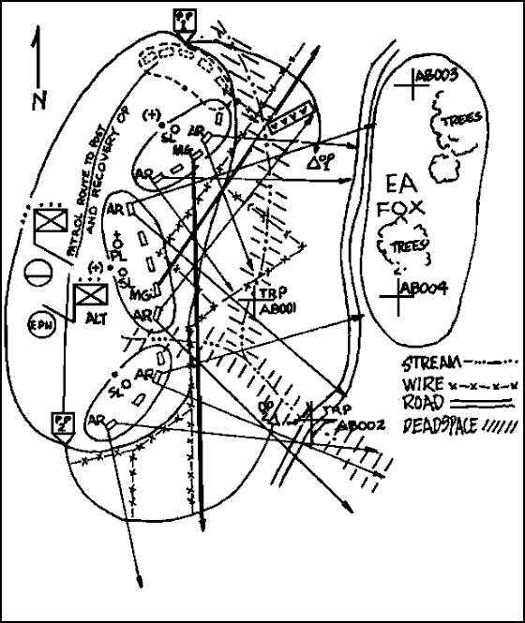
SECTOR SKETCH
PREPARATION
STEP | ACTION
1 | Draw your unit sector or EA
2 | Draw main terrain features in sector(s)
3 | Draw sectors of fire
4 | Draw MEL for each weapon/ammo
5 | Draw FPL
6 | Draw location of CP/OPs
7 | Draw TRPs and RPs in sector
8 | Draw obstacles (METT-TC Dependent)
9 | Draw indirect fire target locations/final protective fire locations
10 | Place your unit ID, name, and DTG prepared on sketch

Slide 26
ACTIONS ON CONTACT
ACTIONS ON CONTACT
Seven Forms of Contact
- Visual - Direct Fire
- Obstacle - Indirect Fire
- Air - Chemical
- Electronic Warfare / Jamming - Civilian
Basic Actions on Contact
1. Deploy (seek cover and return fire) and Report (contact report).
2. Develop the Situation (recon, fire and maneuver, SALT report).
3. Develop and Recommend a Course of Action.
4. Execute Approved Course of Action.
Visual
1. Seek cover and concealment
2. Send contact report
3. Section in contact gathers information on enemy (mounted and dismounted)
4. Send initial SALT report
5. Elements not in contact continue mission to gather information to exploit enemy weakness
6. Determine Course of action:
a. Break contact and bypass
b. Maintain contact and bypass
c. Maintain contact to support target handover
d. Conduct hasty attack
e. Destroy with indirect fires
7. PL sends updated SALT report and recommended COA
8. Receive approval and FRAGO from commander
9. PL issues battle order for platoon to execute

Slide 27
ACTIONS ON CONTACT
Direct Fire
1 a. Section in contact returns fire to destroy or suppress
b. Section in contact takes evasive action and seeks cover and concealment
c. Send contact report
2 a. Initiate indirect fires against enemy
b. Section in contact gathers information on enemy (mounted, dismounted, or direct/indirect recon by fire)
c. Attempt to ‘Fire and Maneuver’ or ‘Attack by Fire’ to fix, suppress, or destroy enemy
d. Send initial SALT report
e. Elements not in contact continue mission to gather information to exploit enemy weakness
3 a. Break contact and bypass
b. Maintain contact and bypass
c. Maintain contact to support hasty attack
d. Conduct hasty attack
e. Establish hasty defense
4 a. PL sends updated SALT report and recommended COA
b. Receive approval and FRAGO from commander
5. PL issues battle order for platoon to execute

Slide 28
ACTIONS ON CONTACT
Quadrant method of target location
A
B
Direction of
travel
D
C
Identifying element announces “CONTACT! Alpha!”
The quadrant is centered on the middle of the movement formation and is oriented in the direction of travel. The quadrant moves with the formation and allows more accurate target identification that the traditional clock method.
Obstacle
1 a. Section in contact with obstacle marks location on ground and FBCB2
b. Suppress / obscure identified enemy positions with indirect fire
c. Send contact report
d. Immediately begin attempting to find a bypass. DO NOT STOP!
2 a. Section in contact gathers information on enemy at, around, or observing obstacle
b. Other sections look for bypass (mounted or dismounted)
c. If bypass is found, platoon reports and moves to provide far-side security, near-side security, and flank security
e. Send initial obstacle and bypass reports
3. Bypass or conduct hasty breach*
4. PL sends updated obstacle and bypass report and recommended COA
5 . PL issues battle order for platoon to execute

Slide 29
ACTIONS ON CONTACT
Indirect Fire
1. If element is moving:
a.Immediately close hatches If NBC threat is likely, don protective mask and gloves.
b. Avoid impact area or continue to move through the area - continuing straight through the arty is where the enemy wants you to go (i.e., his kill sack), move at a 90 degree . angle.
c. Send contact report.
2. If element is stationary:
a. Immediately close hatches.
b. Move out of the impact area to covered position.
c. Element may need to remain in defensive positions.
d. Send contact report.
3. Based on OPORD/FRAGO or type of incoming rounds, unit may have to react to chemical contact.
4. PL sends updated SALT report and recommended COA.
5. PL issues battle order for platoon to execute.
Air
1. Alert the unit with contact report (“Contact, Red Air, [Cardinal Direction]”).
2. Vehicle commanders prepare to engage aircraft with machine guns.
3. If element is not in the direct path of the aircraft, the element executes the following passive air defense measures:
a. Seek cover and concealment.
b. Continue mission considering MTETT.
4. If element is in the direct path of the aircraft, executes the following actions:
a. Disperse from the aircrafts flight path at 45-degree angles.
b. Maintain a 100 meter interval between vehicles.
c. Element fires at aircraft IAW proper lead technique.
5. PL sends updated SALT report and recommended COA .
6. PL issues battle order for platoon to execute.

Slide 30
ACTIONS ON CONTACT
Chemical
1. React to the sound of chemical agent alarm or signs of NBC attack.
a. Troopers put on protective mask with hood in 15 seconds.
. b. Troopers give alarm.
c. Send contact report.
d. Begin chemical recon with M256 kit.
e. Send initial NBC-1 report.
f. Seek additional shelter, mount vehicle.
g. Administer nerve-agent antidote if necessary.
h. Request permission to conduct unmasking procedures.
2. Conduct basic decontamination:
a. Individual and equipment decon
b. Crews decon vehicles by operator spray-down.
3. Element reorganizes
a. Chain of command and communications are reestablished.
b. Report personnel status.
c. Identify, treat, prepare, and evacuate casualties.
d. Continue mission.
4. Continue recon to identify the type and extent of hazard.
a. Send follow-up NBC-1 report.
b. Continue unmasking procedures.
5. Replenish chemical defense equipment and continue mission.

Slide 31
FUNDAMENTALS OF
RECONNAISSANCE
Before Contact / Planning
  Orient on the reconnaissance object
  - Enemy (SALT), Terrain (OCOKA), Infrastructure, Society
  2. Ensure continuous coverage
    - conduct ISR before, during, and after all types of operations for all assigned NAIs
3. Maximize reconnaissance effort
  - integrate all asset to maximized effectiveness with nothing in
  reserve
B. Execution / After Contact
  4. Gain and maintain contact
  - maintain contact using all available means (sensors, sound, and visual) handing over from one observer to the next
  5. Report all information timely and accurately
  - report as you see: never assume, exaggerate, distort, or interpret
  6. Develop the situation
  - continue to maneuver to gain information and set conditions
  7. Retain freedom of maneuver
  - don’t get fixed by the enemy and maintain the ability to react to any situation
Commander’s Intent
Focus (Recon Objective)
1. Enemy
2. Terrain
3. Infrastructure
4. Society
Tempo
1. Level of Covertness: Stealthy vs. Forceful
2. Level of Detail: Deliberate vs. Rapid
3. Level of Force: Discreet vs. Aggressive
Engagement Criteria
1. Size of force to bypass
2. Size to engage
3. Weapons use guidance (direct / indirect)

Slide 32
CBRN PROCEDURES
HASTY DECONTAMINATION PROCEDURES
Request chemical DECON from TOC, include number of contaminated vehicles. NBC OIC/NCOIC will establish a link-up point and DECON site
Company/platoon tasks prior to arrival at DECON site
  Inspect personnel and equipment for contamination
  Administer first aid and monitor all contaminated personnel
  Use M11 DECON apparatus to DECON hatches, weapons, and vehicles as necessary
  For nuclear DECON - sweep all loose particles and debris off top deck of vehicle
Clean vehicle must be used to make link-up
Maintain 50% security at all times
Once company has completed vehicle wash down, unit moves 300 meters upwind for MOPP gear exchange
Inspect all personnel and equipment for contamination; DECON, burn, or bury and mark all contaminated material
At completion of MOPP gear exchange, company moves an additional 500m upwind to perform M256 kit. Report results to TOC and await further instructions.
The NBC vehicles:
Continue to monitor for chemical contamination or nuclear radiation.
Maintains a record of the radiation dose received by the platoon.
Reports to the platoon leader the contamination level of the platoon.
Report to TOC when DECON is complete and unit is prepared to receive new mission.

Slide 33
CBRN PROCEDURES CONT.
MOPP GEAR EXCHANGE AND UNMASKING PROCEDURES
1. MOPP GEAR EXCHANGE (BUDDY TEAM)
Decontaminate Individual Gear
Decontaminate Hood and roll it up
Remove BDO (Battle Dress Overgarment)
Remove Overboots and Gloves
Put on new BDO
Put on new Overboots and Gloves
Secure Hood
Repeat steps b through g for Buddy
Secure Individual Gear
2. UNMASKING PROCEDURES
a. With M256 Kit (15-20 Min)
1. After results from 2 or more chemical detection devices are negative, the Commander will call Squadron on main net and declare all clear. Once Squadron approves the all clear, Troop TOC will give all clear.
2. Commander on ground will be first to break seal:
a. Move to a shady place
b. Unmask for 5 Minutes
c. Clear and reseal masks
3. Observe for 10 Minutes
5. Watch for delayed symptoms
6. Have first-aid available
b. Without M256 Kit (35-40 Min)
1. Senior person selects one or two soldiers
a. Move to a shady place
2. Have Soldiers
a. Take a deep breath, hold it, and break seal
b. Keep eyes open for 15 seconds
c. Clear and reseal masks
3. Observe them for 10 Minutes. If there are no symptoms
a. Break seal on mask and take 2 to 3 breaths
b. Clear and reseal masks
4. Observe them for 10 Minutes
5. If there are no symptoms unmask for 5 minutes and then remask
6. If no symptoms appear after 10 minutes, give all clear
7. Watch for delayed symptoms
8. Have first aid constantly available

Slide 34
INDIVIDUAL MOPP UNIFORM
MOPP level guidelines:
1. The BCT commander can increase the MOPP level for the BCT when required by the tactical situation.
2. Commanders will direct MOPP to permit continued execution of operations while protecting personnel.
3. Commanders may modify MOPP, when no immediate hazard is present, to reduce heat stress on soldiers.
4. Commanders may always increase the directed MOPP level based on METT-TC and local conditions.
5. MOPP equipment will be worn or carried in the manner indicated, based on the directed MOPP posture. MOPP equipment is used as shown in the following illustration.
6. Mask canisters will be marked with tape labeled with the soldier’s name and rank IAW the Squadron CBRN SOP.

Slide 35
CLASS III AVERAGE
CONSUMPTION RATES
Vehicle | Type | Capacity | Cruising Range | Consumption | Company
Stryker | JP8 | 44 GAL | 280-330mi 448-531 km | 3-6mi / GAL 4.8-9.6km / GAL | 1060 GAL for entire company to fill from empty
Stryker | 15W 40 | 5.5 QT |  | 1 QT /10hrs OPS | 20 QT
FMTV | JP8 | 56 GAL | 300mi 480km | 5mi / GAL
FMTV | 15W 40 | 25 QT |  | 1 QT/24hrs OPS | 3 QT
M998 | JP8 | 25 GAL | 335mi 542km | 13mi / GAL 21km / GAL
M998 | 15W 40 | 8 QT |  | 1 QT/48hrs OPS | 2 QT

Slide 36
WEAPON SAFETY POSTURE
Weapon |  | Red | Amber | Green
CLOSED BOLT | M9 Pistol | ROUND CHMB, WPN ON SAFE | MAG IN WPN, NO RND CHMB, WPN ON SAFE | WPN CLRD, NO RNDS OR MAGS IN WPN, WPN ON SAFE
 | M4/M16
 | M203 | ROUND CHMB ONLY WHEN ENGAGING | NO ROUND IN TUBE, WPN ON SAFE
 | M14,24,107 | ROUND CHMB, WPN ON SAFE | ROUNDS IN WPN, NO RND CHMB, WPN ON SAFE | WPN CLRD, NO RNDS OR MAGS, WPN ON SAFE
 | Shotgun
 | M2 50cal | BELT IN WPN, BOLT TO REAR, WPN ON SAFE | BELT IN WPN, BOLT FWD,WPN ON SAFE | WPN CLRD, NO RNDS OR BELT IN WPN, BOLT FWD, WPN ON SAFE
 | MK19
OPEN BOLT | M249 | AMMO IN FEED TRAY, BOLT TO REAR, WPN ON SAFE | AMMO IN FEED TRAY, BOLT FWD,WPN OFF SAFE
 | M240
 |  | Open Bolt | Closed Bolt | M203/Shotgun
Dismounted OPNS |  | Red | Red | Amber/Red
Inside Vehicles |  | Amber | Red | Amber/Amber

Slide 37
MAIN EFFORT AXIS
Operations Symbols
STRONGPOINT
5-1 CAV
SUPPORTING EFFORT AXIS
FEINT AXIS
AMBUSH
PLANNED AXIS
BLOCKING POSITION
CHECKPOINT
1
SUPPORT BY FIRE
RAID
BYPASS
RAID
RAID
CONVOY MOVING
CORDON &
KNOCK
OBSERVATION POST
KNOCK
CONVOY STOPPED
CORDON & SEARCH
ROAD BLOCK
SEARCH
ATTACK BY FIRE
OBJECTIVE
FORWARD LINE OF OWN TROOPS (FLOT)
OBJ 1

Slide 38
TACTICAL TASK DEFINITIONS
Ambush: A surprise attack by fire from concealed positions on a moving to temporarily halted enemy.
Attack by Fire: A tactical msn task in which a Cdr uses direct fires, supported by indirect fires, to engage an enemy with out closing with him to destroy, suppress, fix, or deceive him.
Breach: A tactical msn task in which the unit employs all available means to break through or secure a passage through an enemy defense, obstacle, minefield, or fortification.
Block: Denies the enemy access to an area or prevents his advance in a direction or along an avenue of approach.
Bypass: A tactical msn task in which the unit maneuvers around an obstacle, position, or enemy force to maintain the momentum of the OPN while deliberately avoiding combat with an enemy force.
Canalize: The CDR restricts enemy movement to a narrow zone by exploiting terrain coupled with the use of obstacles, fires, or friendly maneuver.
Clear: The commander removes all enemy forces and eliminates organized resistance within an assigned area.
Contain: Requires the CDR to stop, hold, or surround enemy forces or to cause them to center their activity on a given front and prevent them from withdrawing any part of their forces for use elsewhere.
Counterattack: A form of attack by part or all of a defending force against an enemy attacking force, with the general objective of denying the enemy his goal in attacking.
Delay: Slow and defeat as much of the enemy as possible without sacrificing the tactical integrity of the unit; presents low risk to the unit.
Destroy: Physically renders an enemy force combat-ineffective until it is reconstituted. To destroy a combat system is to damage it so badly that it cannot perform any function or be restored to a usable condition without being entirely rebuilt.
Disrupt: Cdr integrates direct and indirect fires, terrain, and obstacles to upset an enemy formation or tempo, interrupt his timetable, or cause his forces to commit prematurely or ATK in a piecemeal fashion.
Fix: Commander prevents the enemy from moving any part of his force from a specific location for a specific period.
Follow and Assume: A 2nd committed force follows a force conducting an offensive OPN. and is prepared to cont. the msn if the lead force is fixed, attrited, or unable to cont.
Follow and Support: A committed force follows and supports a lead force conducting an offensive operation.
Infiltration: Entails movement through or into an area occupied by an enemy or friendly force by small groups or individuals at extended or irregular intervals in which contact with then enemy is avoided
Interdict: Commander prevents, disrupts, or delays the enemy's use of an area or route.
Isolate: Requires a unit to seal off-both physically and psychologically-an enemy from his sources of support, deny him freedom of movement, and prevent him from having contact with other enemy forces.

Slide 39
TACTICAL TASK DEFINITIONS
Lane: A route through an enemy or friendly obstacle that provides a passing force safe passage. The route may be reduced and proofed as part of a breach OPN. or constructed as part of a friendly obstacle. It is a clear route that moves all the way through an obstacle.
Main Effort: The activity, unit, or area that commanders determine to be the most important task at the time. (FM 3-0, DTD. June 2001)
Neutralize: results in rendering enemy personnel or materiel incapable of interfering with a particular operation.
Occupy: Moving a friendly force into an area so that it can control that area. Both the force's movement to and occupation of the area occur with out enemy opposition.
Penetrate: A form of maneuver in which an attacking force seeks to rupture enemy defenses on a narrow front to disrupt the defensive system.
Relief in place: A tactical enabling OPN in which, by the direction of higher authority, all or part of a unit is replaced in an area by the incoming unit.
Retain: A tactical msn task in which the CDR ensures that a terrain feature controlled by a friendly force remains free of enemy occupation or use.
Retirement: A form of retrograde in which a force out of contact with the enemy moves away from the enemy.
Secure: Involves preventing a unit, facility, or geographical location from being damaged or destroyed as a result of enemy action.
Security Operations: OPNs undertaken by a CDR to provide early and accurate warning of enemy OPNs, to provide the force being protected with time and maneuver space within which to react to the enemy, and to develop the situation to allow the commander to effectively use the protected force.
Screen: A form of security operations that primarily provides early warning to the protected force.
Cover: A form of security OPNs whose primary task is to protect the main body by fighting to gain time while also observing and reporting info and preventing enemy ground observation of and direct fire against the main body.
Guard: A form of security OPNs whose primary task is to protect the main body by fighting to gain time while also observing and reporting info and preventing enemy ground observation of and direct fire against the main body. Units conducting a guard msn cannot operate independently because they rely upon fires and CS assets of the main body.
Seize: A tactical mission task that involves taking possession of a designated area by using overwhelming force.
Support by Fire: A maneuver force moves to a position where it can engage the enemy by direct fire in support of another maneuvering force.
Turn: Involves forcing an enemy element from one avenue of approach or movement corridor to another.
Withdraw: a form of retrograde, is a planned operation in which a force in contact disengages from an enemy force.

Slide 40
TROOP COMMAND POST OPERATIONS
The Troop CP serves as the primary command and control center for the reconnaissance troop, responsible for assisting the troop commander. The CP is responsible for collecting all information from the troop and distributing it to the SQDN as required. It is also responsible for disseminating all significant combat information from the SQDN to the troop. In addition to the collection and dissemination of combat information the CP is also responsible for the coordination of combat service support: Air Operations, CASEVAC (AXP), and resupply. The CP assists the commander by tracking the battle. For the Recon Troop this includes the tracking of SQDN units, and the status, composition, and location of Brigade levels assets that are in support of or are working in the SQDN AO.
Composition of the Recce Troop CP
1. Troop XO
2. Operations NCO
3. CI NCO
4. NBC NCO
5. Commo NCO
6. XO’s Driver
7. Armorer (Dependent)
RESPONSIBILITIES
1. Maintain Current Battle Map
2. Send all reports to higher
3. Monitor and coordinate logistics and personnel status and reports of all organic units and attachments.
4. Answer all calls from higher unless specifically directed to the commander respond for the commander when he does not respond.
5. Relay any calls directed to unit or within unit.
SET UP
1. Location (in priority of mission desirability).
a. Reverse slopes of hills
b. Draws and Wadis

Slide 41
TROOP COMMAND POST OPERATIONS
c. Highly vegetated terrain
d. Abandoned urban areas
2. Characteristics of locations
a. Must have Commo with higher and the commander.
b. Cover and concealment
c. Firm ground
3. Priority of set up
a. Local Security
b. Establish communications w/ Troop and SQDN
c. Set up QEAMS
d. Internal set up of the CP for operations
e. Receive current location and sit reps from all units and attachments.
f. Update situation map
g. Report disposition of the troop to higher
h. Camo nets/concertina wire / early warning devices
i. Select alternate CP location
CONTINUOUS OPERATIONS
1. Shift 1:
a. XO
b. Commo NCO
c. Runner
2. Shift 2:
a. Operations NCO
b. NBC NCO
c. Armorer
3. There will be at least 30 minute overlap of shifts. Update briefing will be given at change of shift.
SECURITY
1. Stealth is the primary means of security. Under certain conditions or tactical situations the CP may employ the CDR’s or supply FMTV in an active security role. This technique will be utilized at the XO’s discretion. A continuous guard will be posted (either OP or local patrol).
2. Utilize covered and concealed locations

Slide 42
TROOP COMMAND POST OPERATIONS
3. Do not allow vehicles other than CDR, XO, and 1SG to congregate near CP.
4. Enforce noise and light discipline.
5. Emplace M22 chemical alarm agent.
BATTLE TRACKING
1. Keep a log of all incoming and outgoing transmissions and messages on DA Form 1594.
2. Drivers pull PMCS prior to or immediately after shift.
3. Maintain a situation map and FBCB2 with:
a. All unit locations.
b. Current Troop and SQDN graphics
c. Fire Support targets
d. Obstacles
e. Known enemy locations
f. Location of flank units
g. Location of unit trains, FSC’s ,and ALOC.
h. Location of Battalion and Brigade CP’s and trains.
i. TIRS (Troop and SQDN)
4. Maintain communications on (in priority)
a. Troop Command
b. SQDN O/I
c. SQDN Command
d. SQDN Fires ( as required)
e. SQDN / TRP HF (as required by situation)
f. Single Channel TACSAT
g. SQDN A&L ( as required)
h. Troop Fires
5. Maintain the CP tracking charts
6. Updated SA on FBCB2 IAW SQDN SOP.
a. Ensure: Dismounted OP and patrol locations are entered and updated
b. Message addressing IAW SQDN SOP
c. Graphics posted and updated

Slide 43
TROOP COMMAND POST OPERATIONS
Shift Change Brief Format
This briefing is given during Command Post shift change, all personnel on both shifts should be present to ensure accurate information is passed from the outgoing shift to the oncoming shift personnel. The brief should last no longer than 20 minutes.
1. Show all current friendly locations (updated within the last 30 minutes) on either a map or the FBCB2 screen. Also, ensure current friendly locations are updated on either the dry erase board or the DA Form 1593. All friendly vehicle positions, dismounted front line trace, and OP locations must be briefed.
2. Enemy situation over the duration of the outgoing shift. Show on either a map or FBCB2 the most recent enemy contacts, enemy disposition, and strength. Be sure to include any intelligence updates that came via FBCB2 or FM from SQDN, the troop, or adjacent units.
3. All significant events within the duration of the outgoing shift. Cover FRAGOs, WARNOs, OPORDs, or change of mission, intent, or concept of the operation if it has changed.
4. Update slant on either the dry erase board or piece of paper. The slant will be written and briefed in the following format: RVs/MCVs/FSVs/Javelins/Dismount Teams
5. Maintenance issues to include vehicle deadlines, accidents, NMC weapons, optics, or communications equipment.
6. Personnel strength on dry erase board or log, broken down by platoon to include any attachments or detachments with necessary comments.

Slide 44
FIRE SUPPORT WPNS/
CAPABILITIES
MORTARS
Wpn | Ammunition |  | Dan g e r Close | Range (Meters) |  | Rates of Fire
 | Model | Type |  | Min | Max
60mm M224 | M720/ M888 M722 M721 M302A1 M83A3 M49A4 | HE HE WP ILLUM WP ILLUM HE | 600m | 70 70 70 200 35 725 45 | 3,4891 3,489 3,489 3,489 1,830 950 1,830 | 30 rds/min for 4 min2 then 20 rds/min sustained. Diameter of Illumination: M721– 500m M83A3–300m
81mm M29A1 | M374A2 M374A3 M375A2 M301A3 | HE HE WP ILLUM | 600m | 70 73 70 100 | 4,600 4,800 4,595 3,150 | 25 rds/min for 2 min then 8 rds/min sustained. Diameter of Illumination: 360m
81mm M252 | M821/ M889 M374A3 M819 M375A2 M853A1 M301A3 | HE HE HE RP WP ILLUM ILLUM | 600m | 80 83 73 300 73 300 100 | 5,800 5,800 4,800 4,875 4,595 5,060 3,950 | 18 rds/min for 2 min, then 15 rds/min sustained. Diameter of Illumination: 650m
120mm M120 | M57 M68 M91 M933 M934 M929 M930 | HE WP ILLUM HE (PD) HE (MOF) WP ILLUM | 600m | 200 200 200 200 170 170 170 | 6,800* 6,800* 6,800* 6,800* 6,800* 6,800* 6,800* | 16 rds/min for 1 min, then 4 rds/min sustained. Diameter of Illumination: 1,500m *Normal max of 7,200 reduced due to Stryker chassis
HE–High Explosive |  |  | 1 Bipod-mounted, charge 4 (maximum handheld is 1,300 meters)
WP–White Phosphorus
ILLUM–Illumination |  |  | 2 Charge 2 and over. (30 rounds per minute can be sustained with charge 0 or 1).
RP–Red Phosphorus

Slide 45
FIRE SUPPORT WPNS/
CAPABILITIES
ARTILLERY
Artillery | Ammunition |  | Danger Close |  | Range (Meters) |  |  | Rates of Fire/Notes
 | Projectile | Fuze |  |  | Max | DPICM | RA P
105mm M119A1 | HE, HC, WPILLUM, APICM, DPICM | PD, VT, MT, MTS,Delay |  | 600m1 | 11,500 | 14,100 | 19,500 | Sustained rate of fire: 3rds/min. Max rate of fire: 10 rds/min
155mm M198 | HE, HC, WPILLUM, CPHD, APICM, DPICM,M825 SmokeSCAT-MINE | PD, VT, MT, MTSQ, Delay |  | 600m1 | 18,300 or 22,000 with M795 HE, M825 Smoke | 18,000 or 28,200 with M864 | 30,100 | Sustained rate of fire: 2rds/min.Max rate of fire: 4rds/min.
155mm M109A5/A6 | HE, HC, WPILLUM, CPHD, APICM, DPICM,M825 SmokeSCAT-MINE | PD, VT, MT, MTSQ,Delay |  | 600m1 | 18,200 or 21,700 with M795 HE,M825 Smoke | 17,900 or 28,100 with M864 | 30,000 | Sustained rate of fire:1 rd/min. Max rate of fire: 4 rds/min.
MTSQ– mechanical time superquick PD– point detonating SADARM– sense and destroy armor VT– variable time WP-(white phosphorous) 1 See Appendix E: Cannon Risk Estimate Distances for detailed discussion of “Danger Close. ” APICM– anti-personnel improved conventional munition CPHD– Copperhead DPICM– dual-purpose improved convention munition HC– hexachloroethane HE– high explosive ILLUM– illumination MT– mechanical time
ARTILLERY/MORTAR ILLUMINATION FACTORS
 |  | HOB | Burn Time | Rate of Fall
WEAPON | TYPE | (meters) | (seconds) | (m/sec)
60mm | M83A1 | 160 | 25 | 6
60mm | M83A2/3 | 160 | 32 | 6
81mm | M301A3 | 600 | 60 | 6
105mm | M314A2 | 750 | 60 | 10
105mm | M314A3 | 750 | 70–75 | 10
120mm | M930 | 500 | 50 | 5
155mm | M118 | 750 | 60 | 10
155mm | M485A | 600 | 120 | 5

Slide 46
OPORD Responsibilities
WARNO
CDR
PARA 1 – SITUATION/CIVILIAN SIT.
CDR/CI NCO
PARA 2 – MISSION
CDR
PARA 3 – EXECUTION
CDR
PARA 4 – SERVICE SUPPORT
XO, 1SG
PARA 5 – COMMAND AND SIGNAL
XO, COMMO SGT
MDL LOAD
XO, COMMO SGT
GRAPHICS REPRODUCTION / FBCB2 INPUT
CDR GNR/DVR
CMD POST CHARTS
XO/OPS SGT
TERRAIN MODEL
TRAINING SGT
Based on time available, CDR will decide how detailed OPORD set-up will be.
1. Maneuver Graphics
OPORD SET-UP
2. Fire Support Overlay
3. Situation Template
MAP BOARD
MISC.
CONCEPT
INFO
SR
CI
SKETCH
1SG
1st
PL
1st
PSG
FSO
2nd
PL
2ND
PSG
3RD
PL
3RD
PSG

Slide 47
ORDERS GROUP
Used to gather leaders for orders planning and OPORD. X-Ray will initiate the following net call: “ORDERS GROUP ____, meet at (location) at (time).”
PERSONNEL
A
-
B
C
CDR
X
X
X
XO
X
X
X
FSO
X
X
X
1SG
X
X
1
st
PL
X
X
2
nd
PL
X
X
3rd PL
X
X
1st PSG
X
2nd PSG
X
3rd PSG
X
OPS NCO
X
X
X
COMMO
X
CI NCO
X
NBC NCO
X
TROOP REHEARSALS
In accordance with Squadron policy, the Troop will always conduct a rehearsal, regardless of time constraint. Plan and coordinate a specific security plan for all rehearsals. Designate a security OIC/NCOIC for the rehearsal.
Types of rehearsals: The Commander determines which type of rehearsal to conduct based on time and resources available.
- Full Rehearsal. Every soldier and system participating in the operation conducts this rehearsal. Because of the demand on time and resources, the Troop will typically rehearse only the decisive point(s) in the operation and actions on the objective. This rehearsal is conducted over a terrain model in the vicinity of the Troop CP
- Key Leader Rehearsal. This type of rehearsal involves only the Troop key leaders. (Troop CDR, XO, 1SG, FSO, PLs and PSGs) The commander decides the level of leader involvement. This rehearsal is also conducted over a terrain model in the vicinity of the Troop CP. -

Slide 48
TROOP REHEARSALS
CONTINUED
- Sketch Map Rehearsal. Conducted in the same manner as the terrain model rehearsal above, with a large sketch in place of the model. This may be used when time is critical or when inclement weather precludes a planned outdoor terrain model rehearsal. The sketch must be large enough for all participants to view.
-Map Rehearsal. Conducted in the same manner as the sketch map rehearsal, except the commander will use the map and operations overlay as a visual aid to the rehearsal. This rehearsal type is most effective when conducted at a vantage point overlooking the terrain in the area of operations.
-Radio Rehearsal. Conducted over radio. The rehearsal proceeds in a sequence of events that the commander establishes.
-Terrain Model Rehearsal. The Troop conducts this rehearsal when time is limited and rehearsing on the actual terrain is not possible. The CDR identifies critical events to rehearse. At a minimum, the terrain model consists of a blow up of the objective with all graphic control measures (including fire control measures) and decision points marked with a large blue star. The standard attendees to this rehearsal are: Troop Commander, XO, 1SG, FSO, FSNCO, HQ PSG, Senior CI, PLs, PSGs, Section Leaders, Vehicle Commanders, Mortar Section Leader.
- The Standard timeline for the rehearsal follows the squadron pattern:
1. XO Roll Call
2. CDR Review BDE / SQDN / Troop mission, terrain / AO orientation Review Commander’s Intent
Troop Task, Purpose, and concept for the first phase / critical event
3. Platoon Leaders Mission, orientation, task, purpose,and scheme of MVR
4. FSOs Task, purpose, and scheme of fires / EFET support
5. 1SG CASEVAC / Emergency Resupply Plans
Repeat steps 3 – 5 through all phases
6. CDR Review / Discuss Contingencies
7. XO Reviews timeline and gives PLGR time hack

Slide 49
TROOP BACK BRIEF
FORMATS
The following formats are standard back-briefs by respective leaders to the troop commander during the planning process. The information listed in each back-brief delineates the minimum requirements.
Leader Confirmation Brief Format
This brief occurs 15 minutes following the issuance of the troop OPORD and is standard for all leaders (PLs, FSO, Mortar PSG, XO). The brief requires no development of a hasty COA, but serves only to ensure that leaders fully understand the troop mission, commander’s intent, and their respective task and purpose. This information is briefed PRIOR to starting the PLT orders process so that the commander can ensure the PL clearly understands what the platoon must accomplish.
My element critical collective task is:
My purpose is:
My critical sub-tasks are:
My task organization concerns are:
My equipment, ammunition, supply concerns are:
I am responsible for coordinating with the following units:
My rest plan is:
My tentative timeline is:
My concerns/issues are:

Slide 50
TROOP BACK BRIEF
FORMATS
Platoon Leader Backbrief Format
This briefing is given to the troop commander prior to the issuance of the platoon operations order to ensure the platoon leader’s plan fits into the troop commander’s intent. The backbrief consist of the following information:
The troop mission is
The commander’s intent is:
My platoon mission is:
PLT concept including
  Task organization
  Maneuver plan including task/purpose for each section
  Effects Plan
  Control measures
  Command and Control
PLT equipment status:
  Vehicles
  Weapons
  Personnel
  Ammunition
  Commo
Logistical/resupply plan:
CASEVAC plan:
EPW collection plan:
Commo plan:
Concerns about the operation:
Mortar Section Leader Backbrief Format
Commander’s intent for fires is:
Terrain and weather considerations are:
Concept for executing commander’s intent for fires is:
  Section movement plan
  On-call targets during movement are:
  Priority targets are:
  I will employ my mortars:

Slide 51
TROOP BACK BRIEF
FORMATS
a. Target list/mortar positions during movement and actions on the objective are:
2. Equipment, ammunition, supply concerns are:
a. We have ___ HE rounds, __ WP, and __ ILLUM carried by the mortar section
3. My commo plan is:
4. I am responsible for coordinating with the following elements:
5. My concerns are:
FSO Backbrief Format
1. Commander’s intent for fires:
2. Terrain and weather considerations:
3. Assets available and status:
4. Concept for Mortar and Artillery integration:
a. FIST movement plan
b. Purpose, priority, allocation and restrictions by system
c. Targeting with observer and shooter
d. Ammunition mixes
e. Clearance of fires requirements
5. Control measures (RFLs, CFLs, NFAs, etc.):
6. Non-lethal effects plan:
7. My commo plan is:
8. I am responsible for coordinating with the following elements:
9. My concerns are:
TAC-P Backbrief Format
1. Commanders intent for CAS:
2. Terrain and Weather Consideration:
3. Assets available and status:
4. Fire Support Coordination Measures:
5. Communication plan:
6. Priority of Targets:
7. Airspace coordination issues:
8. My Concerns are:

Slide 52
Senior CI Backbrief Format
1. The Troop CI Mission is:
2. The Commander’s intent is:
3. My HUMINT collection plan is:
4. CI equipment status:
a. CHATS / ITRT
b. Weapons
c. Personnel
d. Ammunition
e. Commo
5. Questioning Plan is:
6. Commo Plan:
7. Concerns are:
PCI RESPONSIBILITIES
Troop Commander Inspects:
Leader Knowledge
Leader Maps / Graphics
Mission Equipment
Ensures TLPs were conducted
FSO Inspects:
PLT Fire Plans
FSV
Mortar PLT Readiness
Conducts Commo Check on Fires NET
Non Lethal Effects Plan Rehearsed.
Troop Commander Spot Checks:
PLT Work / Rest Plans
Vehicles
Soldier Knowledge
XO Inspects:
PLT Vehicle 5988s
HQ Communications Status
HQ FBCB 2 Status
CP Manning Schedule
Conducts Commo Checks
with PLTs

Slide 53
PCI RESPONSIBILITIES
1SG Inspects:
PLT CASEVAC Plans
PLT CL I Status
PLT Ammo Status
PLT Sensitive Items Card
Medics Equipment
Supply SGT Readiness
All HQ weapons
XO Spot Checks:
Troop Commo Equipment
Troop ANCDs / SOI Filled
HQ Platoon Vehicles
HQ PLT Crew Served WPNs
NBC NCO Inspect:
PLT / HQ NBC Equip
Spot Check PLT Pro-Masks
HQ PSG Inspects:
HQ CL I, III, V
HQ PLT Sensitive items cards
ANCD / SOI Fill
Water Buffalo Filled
Medic Equipment
HQ soldier knowledge
Commo Plan
Resupply plan
HQ Vehicle Load plans
Armorer Tool Kit
Mortar Section Leader Inspect:
All Weapons
Mortar Systems
Uniforms
NVDs
Ammunition Stowage
Soldier Knowledge
Commo Equip
Mortar Carriers
Vehicle Safety Checks
Rollover Drills Complete
Misfire Drills Complete
Commo NCO Inspect:
Troop ANCD / SOI Fill
Troop FBCB2 Settings
Troop Battery Supply

Slide 54
PCI RESPONSIBILITIES
PL / PSG Inspects
Crew Served Weapons
RV / Load plan
Section sensitive items card
Safety
RTO / Radios / FBCB 2
Leader / Individual Knowledge
PL / PSG Spot Checks
Individual Weapons
NVD’s
Javelin
Demo Kit
Map / Compass
Water / Food
CLS Bags
Breach Kit / Demo Kit
Section Leader Inspects
Crew Served Weapons
Individual Weapons
Javelins
Vehicle CDR’s Sensitive items card
ICOM
CLS Bags
Safety
Breach Kit / Demo Kit
Communications Equipment
Section Leader Spot Checks:
SKL / SOI Filled
Water / Food
Soldier Uniform
Soldier Knowledge
Packing List
Team Leader Inspects
All weapons
Aiming Devices
Soldier Uniform
NVD’s
ICOMs
Ammunition
Tie-Downs
Water Filled
MREs
Dismount R/T
CLS Bags
Soldier Knowledge
SKL / SOI Filled
Vehicle Commander Inspects
PMCS
Driver Uniform
Load Plan
Individual Weapons
Mounted Weapon systems
BII stowage
Fuel Levels
Driver Knowledge
Conducts all Safety Checks
Conducts Rollover Drills
Vehicle Communications Equipment
FBCB2 Settings and Graphics

Slide 55
Troop Leading Procedures Outline
Type of operation
General location of operation
Initial operational timeline
Reconnaissance to initiate
Movement to initiate
Planning and preparation instructions
  To include planning timeline
Information requirements (IR and CCIR)
Mission
Mission, Intent, Concept
- 1 up and 2 up
Purpose
Tasks
Specified
Implied
Essential
Constraints (require / limit action)
Restated mission
*Significant conclusions
Time
Battalion times
Hard times
Company TLPs
Light data
Enemy data
1/3, 2/3 rule
*Significant conclusions
1. Receive the mission
Initial timeline, possible mission
2. Issue the WARNO
5 Paragraph format (min info)
3. Make a tentative plan
a. Mission analysis
b. COA development
c. COA analysis
d. COA comparison
e. COA selection
4. Initiate movement
XO, 1SG
5. Conduct reconnaissance
6. Complete the plan
Orders production
7. Issue the order
  Verbal, terrain model,
  paper
8. Supervise
  Confirm briefs
  Back briefs
  Rehearsals
  PCC – 1 up = check equipment
  PCI – 2 up = company, mission
METT-TC
Summary of mission analysis
  Restated mission
  Key tasks
  Tentative decisive point
  Initial commander’s intent
Enemy
General situation
Disposition
Composition
Strength
Capabilities by WFF elements, HVTL
PCOA & MDCOA
*Significant conclusions
Terrain
AO
AOI-CAR
Terrain
  Obstacles
  Avenues of approach
  Key terrain
  Observation & fields of fire
  Cover and concealment
Weather
  Visibility
  Wind
  Precipitation
  Cloud coverage
  Temp/humidity
*Significant conclusions
Analyze relative combat power
Generate options
Array Forces
Develop concept of operations
Assign responsibilities (2-5)
Prepare COA statement and sketch
Troops
Leadership
Morale
Training and experience
Capabilities by WFF elements
*Significant conclusions
COA Screening Criteria at end of COA Dev
COA must be:
- Suitable - Complete
- Acceptable - Feasible
- Distinguishable
Form of maneuver or type of defensive operation
Decisive point and why
Task and purpose of decisive, shaping and sustaining operations
Reserve planning priorities
Purpose of critical WFFs (May be expressed as the purpose of key enablers)
Endstate
Civil Considerations
Areas
Structures
Capabilities
Organizations
People
Events
*Significant conclusions
COA Analysis (war game)
*Action – Reaction – Counteraction*
Finalized HPTs based on COAs
Methods
  Box
  Belt
  Avenue in depth

Slide 56
WARNO ____ TO OPORD _______________
Page 1 of 2
Initial Task Org:
Effective:
1. SITUATION: General Enemy Overview:
AO:
North
South
East
West
Who the CO/TM is fighting:
AoI:
North
South
East
West
BCT Mission:
BCT Cdr Intent:
BN/TF Mission:
BN/TF Cdr Intent:
2. MISSION: Upcoming Task and Purpose or Type of Operation/General location:
3. EXECUTION:
Recon Team:
Movement Instructions/Movement to initiate:
Recon Tasks/ Recon to initiate
Information Requirements
Our Current Location: ______________
Our Next Location: ________________
Objective Location: ________________

Slide 57
WARNO ____ TO OPORD _______________
Page 2 of 2:
COORD INSTRUCTIONS:
CCIR
PIR: _______________
___________________
___________________
FFIR: ______________
___________________
___________________
Priorities of Work/Priorities of Rehearsal:
MOPP: _____________
OOM: ______________
ROUTE: ______________
ZERO/BORESIGHT: ______________
PCC: ______________
Initial Operational / Planning timeline:
BN
CO/PLT PLANNING/ OPERATIONAL
ENEMY
WX / LIGHT DATA
4. SUSTAINMENT:
Planning/preparation instructions
CTCP Grid: ________
UMCP Grid: ________
CLASS I: ________
LRP Grid: ________
CLASS III: ________
AXP Grid: ________
CLASS IV: ________
CCP Grid: ________
CLASS V: ________
MCP Grid: ________
5. COMMAND AND CONTROL::
Succession of Command: _________
BN TOC Grid: ______________
_________________
CPT

Slide 58
MAINTENANCE OPERATIONS
BEFORE / AFTER MISSION
1. 5988E on the following:
  Vehicles
  LRAS3 Calibration
  All crew served weapons
  All Communications equipment
  All NVDs
  All personal weapons
*if 5988e unavailable turn in 2404
2. Before LOGPAC is complete turn in one copy of 5988e to PSG, second copy goes in log book
3. XO/1SG will coordinate with maintenance to bring mechanics forward with LOGPAC to LRP or brought to SQDN TOC to verify parts
4. Parts will be replaced as soon as they are received unless it interferes with the mission
DURING MISSION
1. If a vehicle breaks down during a mission:
  Immediately notify PL/ PSG
  Try to move to hide position
  Wingman moves away and provides overwatch while self recovery is attempted
  Crew has 1/2 hour to recover vehicle before it is sent to CTCP
2. If vehicle is not recovered in 1/2 hour wingman vehicle picks up the crew. The Section Sergeant and two soldiers stay with disabled vehicle
  Remove all sensitive items
  Manpack 1 radio
  Sends 10 digit grid to position
  Crew remaining moves into position to overwatch vehicle if not in hide, camouflage vehicle if in hide
3. PSG coordinates for recovery assets or moves forward to pull vehicle back
4. If vehicle is found by enemy remaining crew begins escape and evasion techniques to link up with platoon
5. During mission vehicles will be recovered to supporting SQDN CTCP (ID in OPORD).
  Once the battle is in the R&S phase Troop will receive priority of maintenance and parts.
  If part is on hand SQDN will replace/repair.
  If parts are not on hand vehicle will be moved to HHC BDE (vehicles will only remain in SQDN CTCP for 6 hours)

Slide 59
BASIC LOAD
This card prescribes basic loads and load plan for Strykers.
Basic load commodities:
Class I:
  Three-day supply of MREs upon initial deployment per RV
  Water:
  2 Five Gallon Containers
Class II:
  Cleaning supplies
  Chemlights
  1 box BA30 batteries
  Four 6-volt batteries (during miles training)
  12 AA batteries
  TRP marking panel
Class III: (per platoon)
  One 5-gal can 10 wt
  One container breakfree
  Five gallons antifreeze
  One 5-gal can GAA
  Four tubes of GMD
  Distilled water
Class IV:
  Three rolls concertina
  10 pickets
  One picket pound per section
  100 sandbags
  Two TRP stakes
Class V:
  RV
M2 .50 CAL: 1200 rds
7.62 (M240): Ready 800 Stowed 2200
MK-19: 800 rds
JAVELIN: 2
  Demolitions Basic Load
Det Cord: 100
C4: 30
M11: 20
M12: 4
M14: 10
Class VIII:
  Two combat lifesaver bags (w/ inventory list) (1 for dismount element)
  Two first aid kits
  Litter kit
Class IX: Spare Tire (if available)
100 – 90%
89 – 75%
74 – 60%
59 – Below
59

Slide 60
CALL FOR FIRE
(CFF) FORMATS
Primary CFF will be sent digitally (FBCB2), secondary is voice on TRP Fires NET for MTRs and SQDN Fires NET for FA/CAS/Air Integration assets. SQDN STD Target location is an 8-digit UTM using LRAS, FS3, map spot. TRP FSEs are responsible for training troops on all formats to the CFF and ensuring soldiers understand the procedures and necessary information to initiate a CFF.
Fire for Effect Mission (GRID METHOD)
1) “__________” this is”_________”, Fire for Effect , Over
(FDC Call Sign) (Observer Call Sign)
2) ”GRID______OVER”
(8-Digit UTM, include ALT if possible)
3) “Target Description: “_________”,
(Size, Activity, Disposition)
Method Engagement: “________”,
(*Optional: Danger Close, Mark, High Angle, Ammo/Fuze Type)
Method of Fire and Control: “_________”,over.
(*Optional: At My Command, Do Not Load, Time on Target)
4) Direction “________”, Over” (Observer to TGT-expressed in Mils or Degrees)
(*Mils is default-Observer will specify if using DEGREES)
*FDC (MTRs/FA) may challenge after the read back above. Observer be prepared to authenticate.
Message to Observer-MTO (sent from FDC to Observer, Mandatory Call)
Unit to Fire (Firing Unit, Adjusting Unit)
Changes to Call for Fire (if any)
Number of Rounds (Per Tube)
Target Number (FDC establishes new TGT if no TGT sent from Observer in the FS PLAN)
Additional information (Optional)
Probable error in range (PER – in meters)
Angle-T (sent to observer when there is a 500 mill or greater difference between the GT- line and the OBS/TGT-line)
Time of Flight (the time between shot and splash in seconds)
Ordinate Altitude Information (if FSO needs to deconfllict airspace coordination)
Rounds Impact and Observer will observe bursts and prepare adjustments if necessary.
5) “Left/Right_____” (in Meters, Distance from Impact to Observer TGT Line)
“Add/Drop_____” (in Meters, Distance from Impact to TGT)
“Repeat, Over” (only if direct hit on TGT)
Mission Complete once Observer receives desired effect on TGT.
6) “End of Mission_________, Over.”
(BDA and Target Activity)

Slide 61
CALL FOR FIRE
(CFF) FORMATS
Fire for Effect Mission (POLAR PLOT METHOD)
“________” this is “________”, Fire for Effect, Polar, over.
(FDC Call Sign) (OBS Call Sign)
Direction “________”, Distance”________”, Up/Down “________”, over.
(Mils) (Meters) (Differnce between OBS loc
& TGT loc in Meters if 35 or greater)
3) Target Description:”_________”,
(Size, Activity, Disposition)
Method Engagement:”________”,
(*Optional: Danger Close, Mark, High Angle, Ammo/Fuze Type)
Method of Fire and Control: ”________”, over.
(*Optional: At My Command, Do Not Load, Time on Target)
Message to Observer-MTO (sent from FDC to Observer, Mandatory Call)
Unit to Fire (Firing Unit, Adjusting Unit)
Changes to Call for Fire (if any)
Number of Rounds (Per Tube)
Target Number (FDC establishes new TGT if no TGT sent from Observer in the FS PLAN)
Additional information (Optional)
Probable Error in Range (PER – in meters)
Angle-T (sent to observer when there is a 500 mill or greater difference between the GT-line and the OBS/TGT-line)
Time of Flight (TOF between shot and splash in seconds)
Ordinate Altitude Information (if FSO needs to deconfllict airspace coordination)
Rounds Impact and Observer will observe bursts and prepare adjustments if necessary.
4) “Left/Right_____” (in Meters, Distance from Impact to Observer TGT Line)
“Add/Drop_____” (in Meters, Distance from Impact to TGT)
“Repeat, Over” (only if direct hit on TGT)
Mission Complete once Observer receives desired effect on TGT.
5) “End of Mission_________, Over.”
(BDA and Target Activity)
SHIFT FROM KNOWN PT MISSION (GRID METHOD)
Requirements for this mission: MTR/FA FDC must have a known pt that is established (using a CP/ NAI/ TGT- must be recorded and sent back as “Known PT 1 or 2…”
1) “DIRECTION______” in mils/degress grid
(Observer to TGT LINE- nearest 10 mils/deg)
(NOTE: Must specify degrees to FDC only if direction is given in degrees)
“LEFT/ RIGHT (Lateral Shift) _____” in meters (to nearest 10m)
“ ADD/DROP (Range Shift) ______” in meters (to nearest 5m)
“UP/DOWN (Vertical Shift) ______” in meters (to nearest 5m)
(NOTE: Difference in target altitude with respect to known point altitude.)

Slide 62
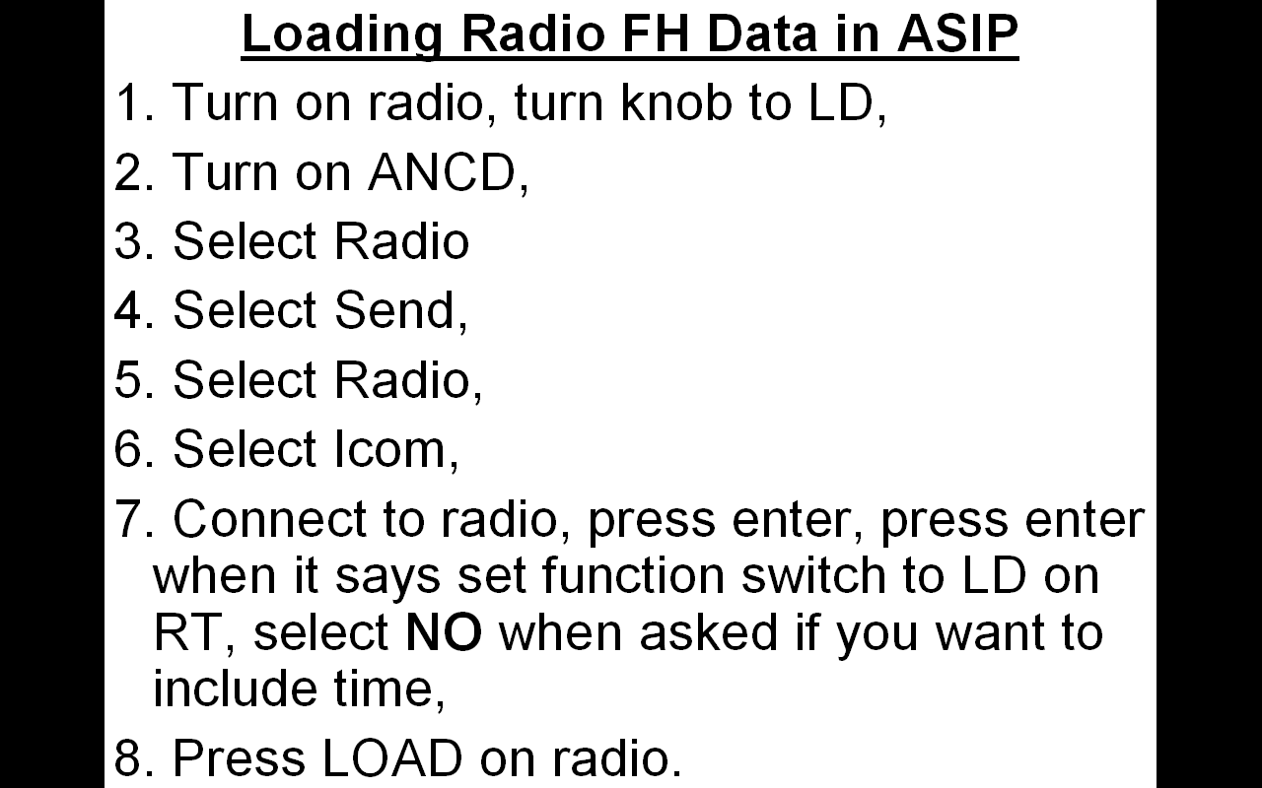
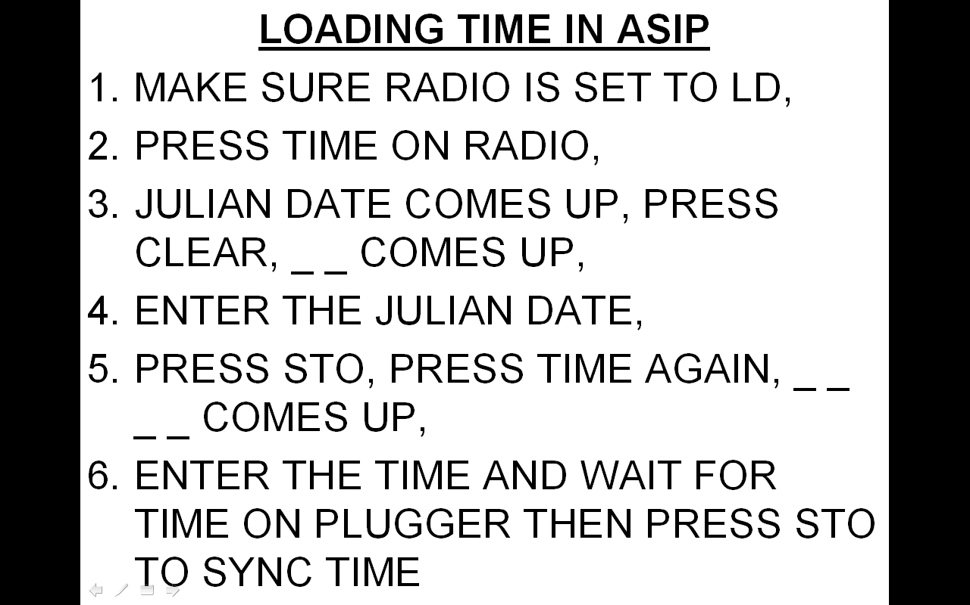
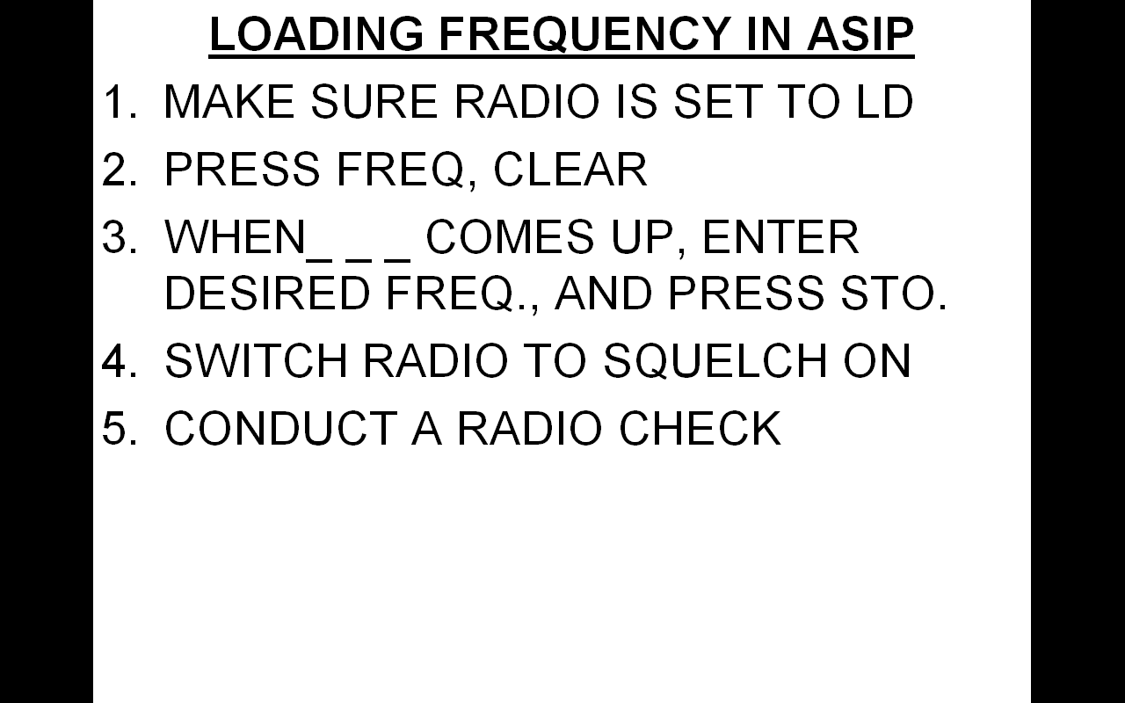
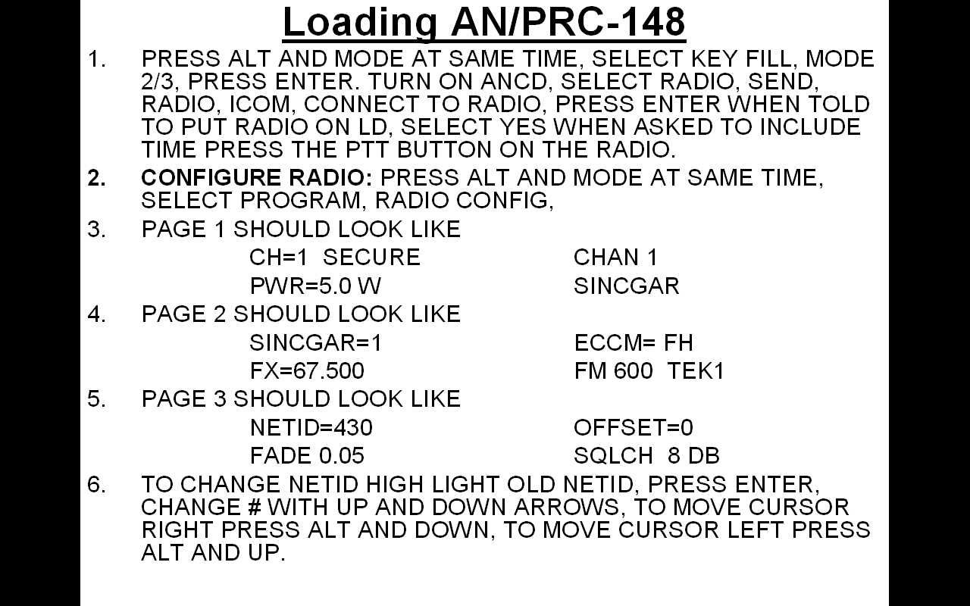
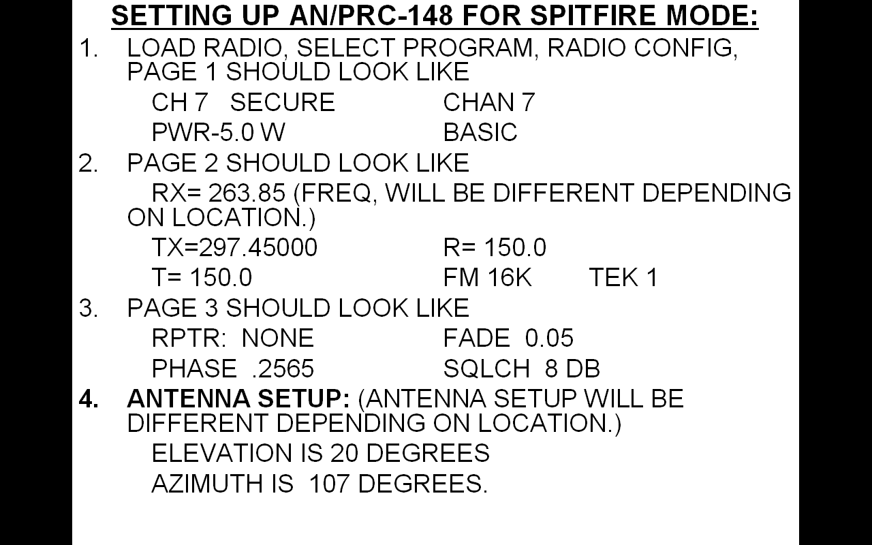

Slide 63
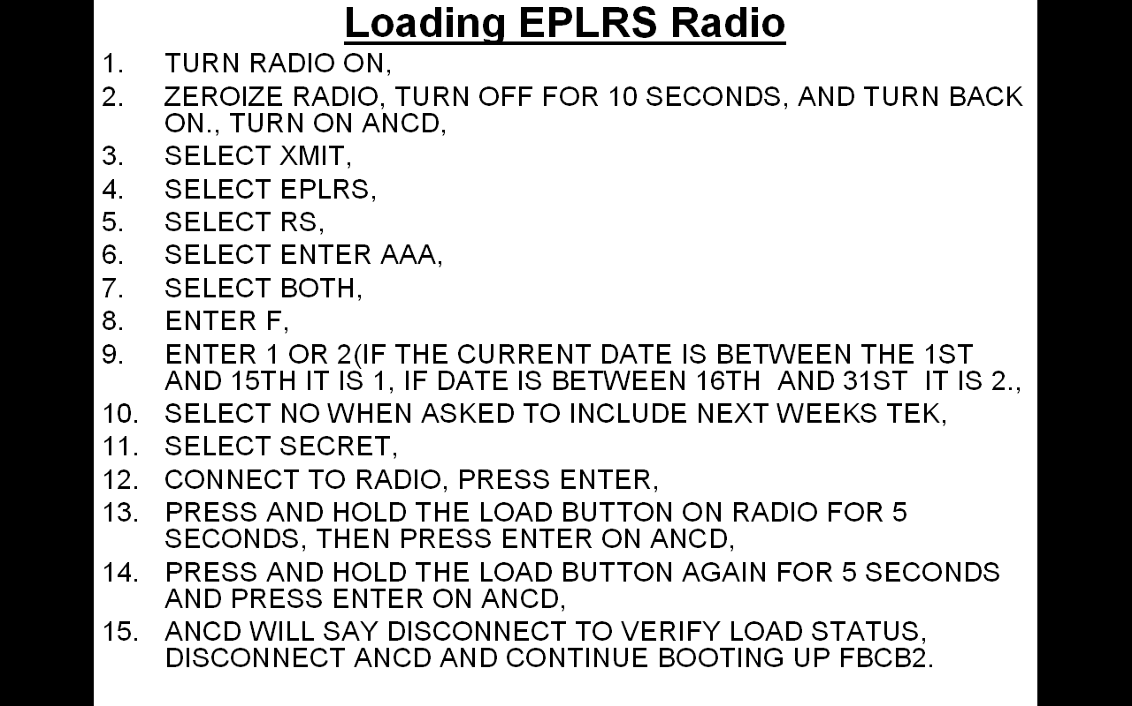
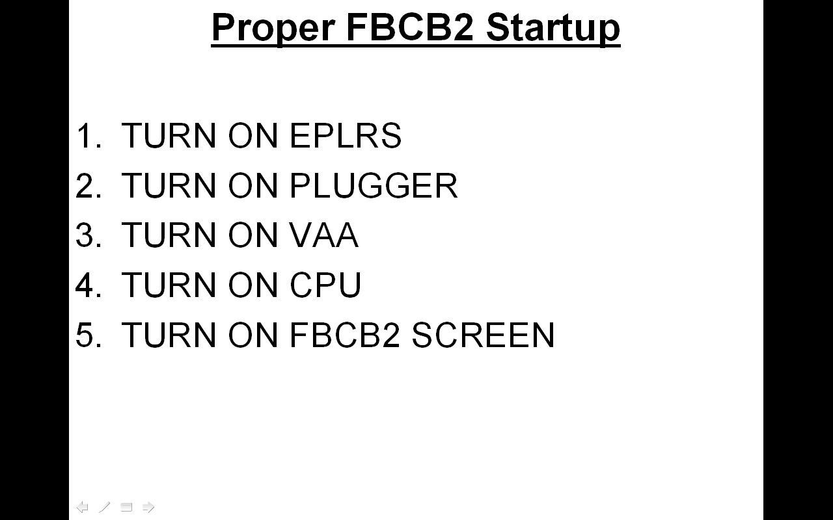
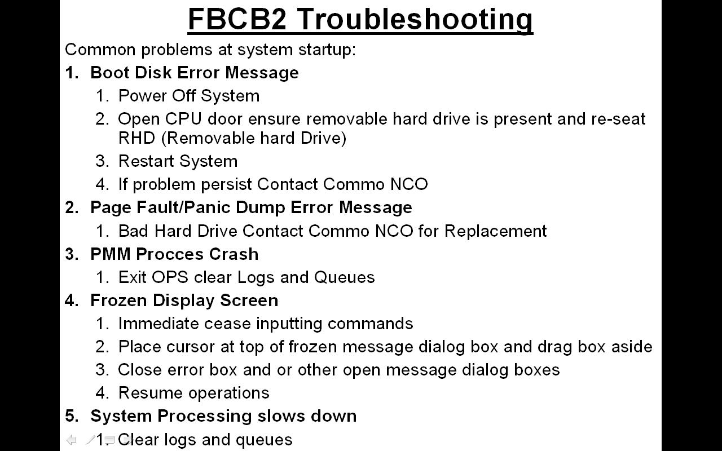
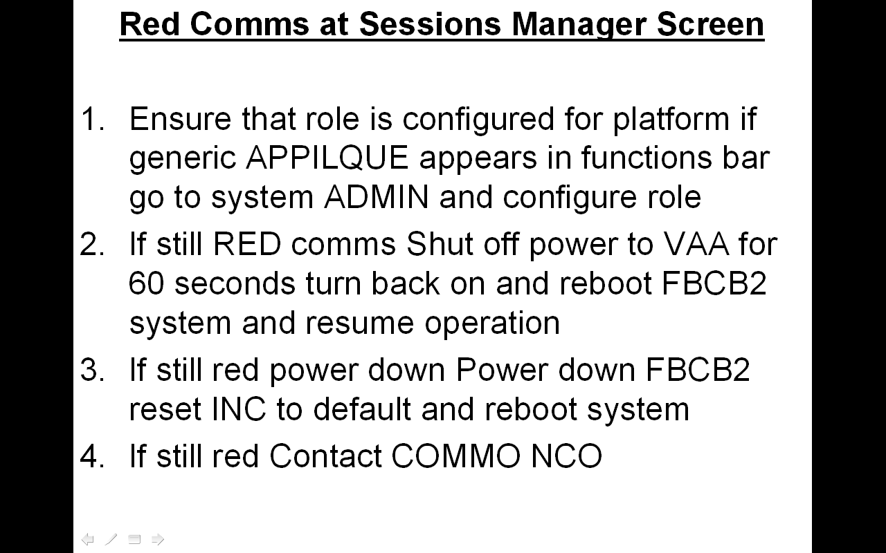
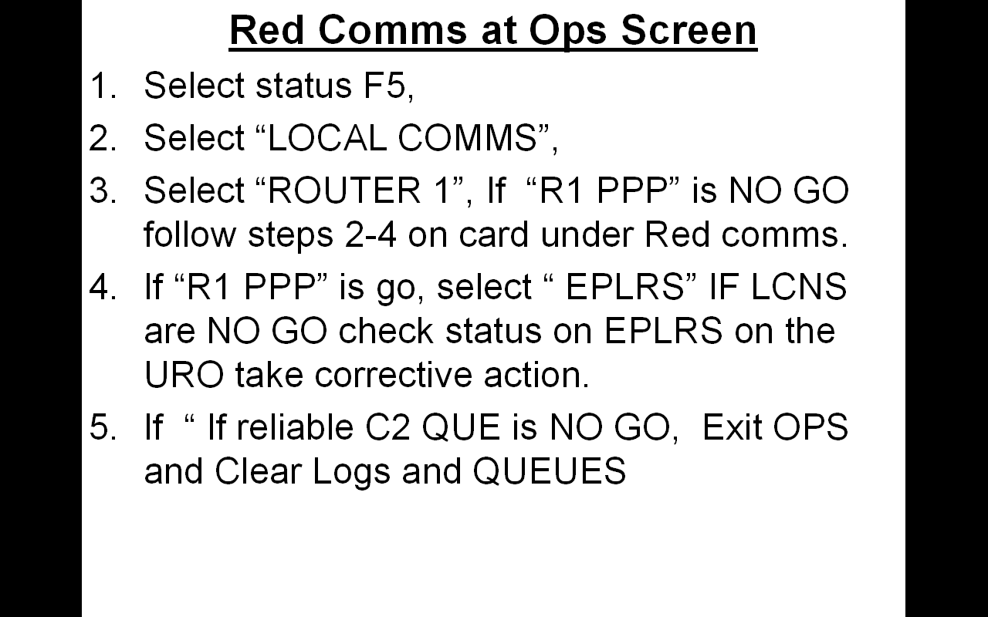
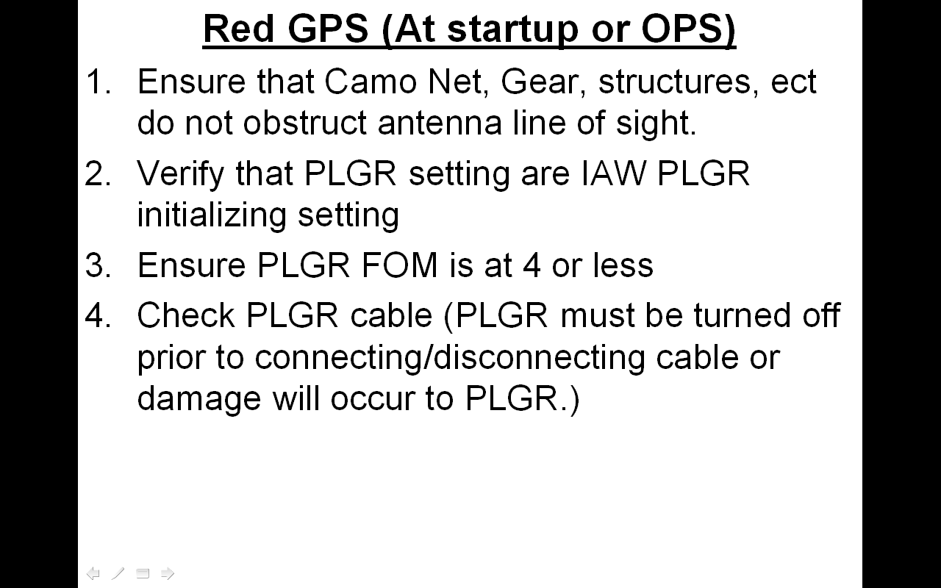

Slide 64
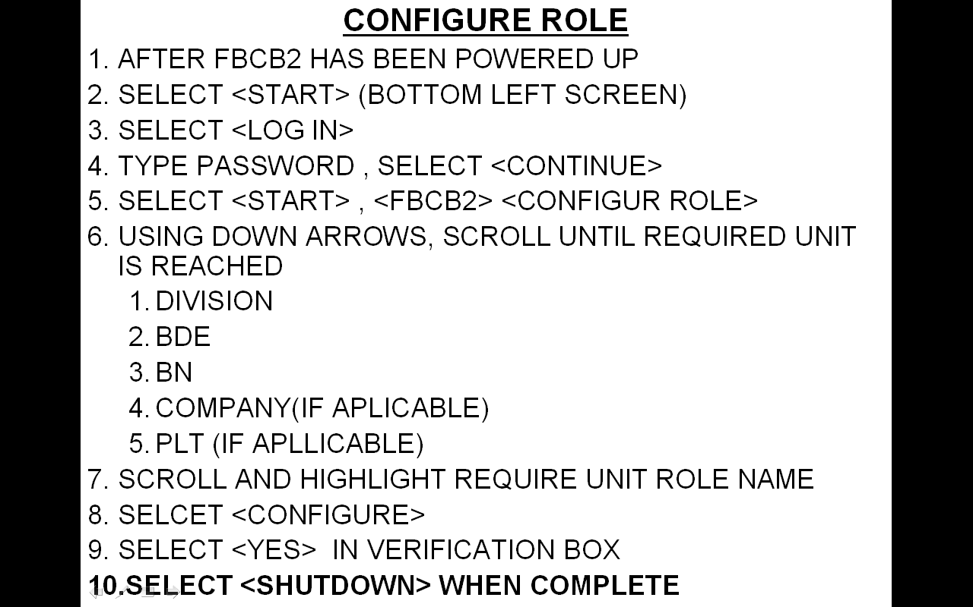
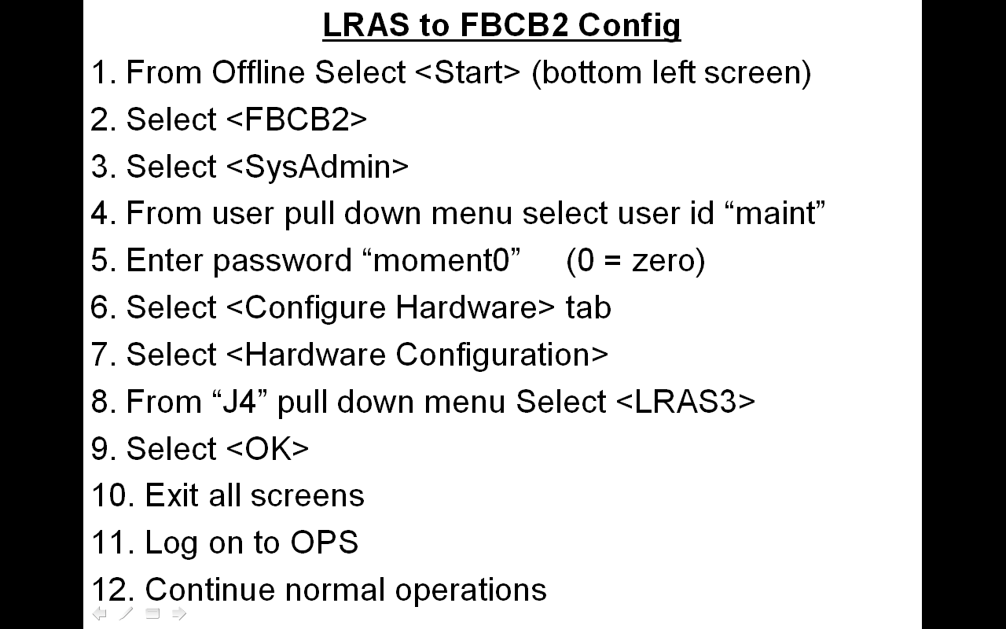
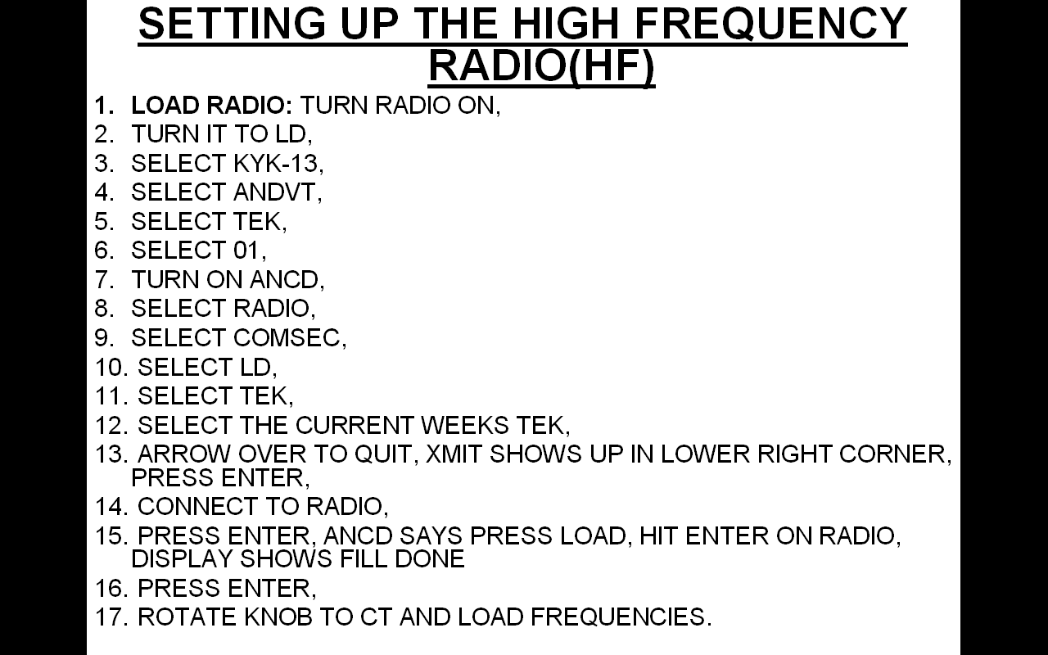
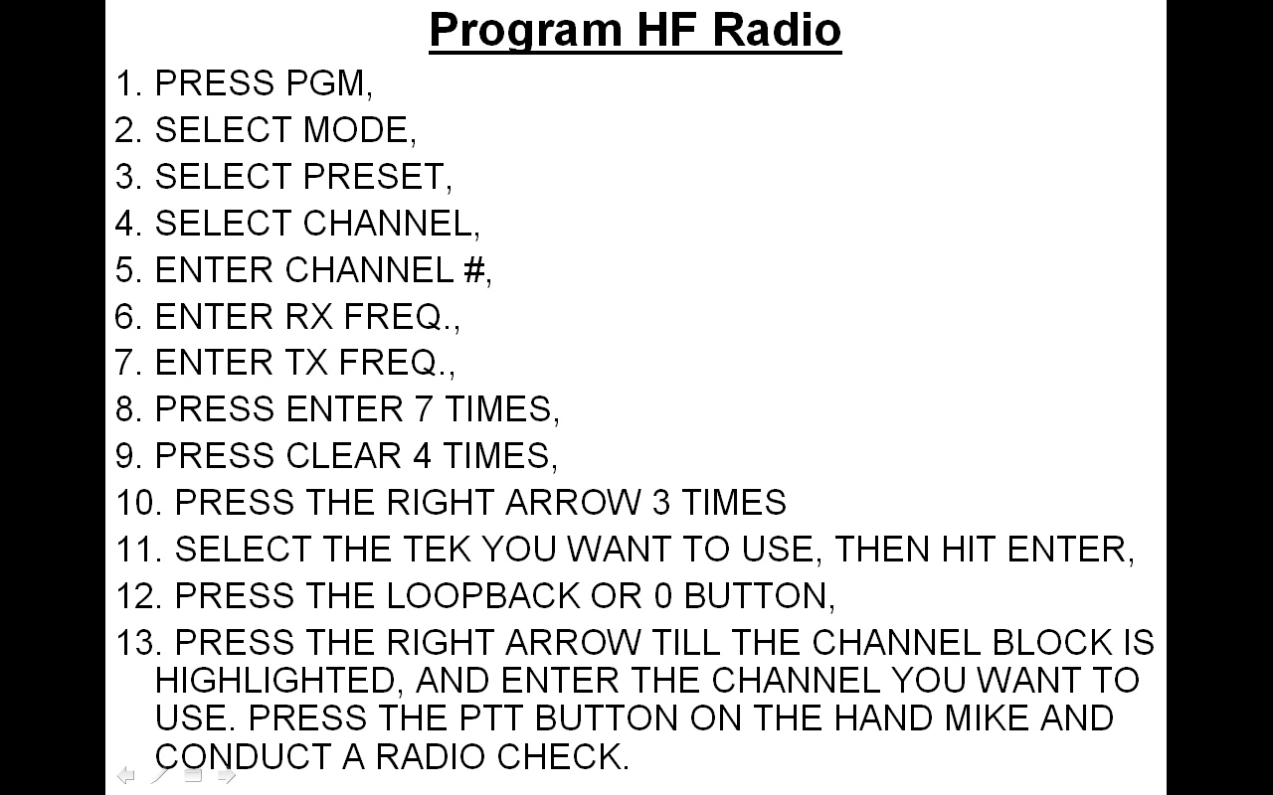

Slide 65
COMMUNICATIONS
BATTLE DRILLS
Loss of FM Communication:
If a unit cannot communicate via FM with adjacent or higher elements, take the following step in order. Once the problem is fixed, immediately notify higher:
Dismounted:
1. Change battery, increase RT power to HIGH, and fully extend long whip antenna. 2. Move to last known location for successful communications.
3. Attempt to gain communications with the CP on High Frequency radio TROOP NET.
4. Conduct link up with other element within platoon and attempt to regain contact with their radio.
5. Conduct link up with a vehicle in the platoon and attempt to use vehicle radios.
6. Return to CP location (if stationary) and link up with HQ personnel to troubleshoot radio and regain communication with platoon.
Mounted:
1. Check hand mike, antenna cables, and power cords.
2. Change out radios, place RT in PA, and ensure power is getting to the power amplifier.
3. Send message via FBCB2 to CDR, CP, PL, and PSG notifying them of loss of communication.
4. Move vehicle to last known location for successful communications.
5. Attempt to gain communications with the CP on High Frequency radio TROOP NET.
6. Conduct link up with another vehicle in the platoon, be sure to display proper recognition signal to avoid fratricide.
7. Return to CP location and link up with HQ personnel to troubleshoot radio system and regain communication with platoon.
Loss of FBCB2 Communication:
1. Following troubleshooting tips from FBCB2 TM.
2. Notify CP via FM radio and inform X-ray of the problem.
3. Check all cables, EPLRS antenna, and other connections.
4. Refill EPLRS w/ ANCD.
5. If PLGR fails, but FBCB2 is otherwise operational, continually update unit location every 5 minutes (moving) or 300 m.

Slide 66
COMMUNICATIONS
BATTLE DRILLS
FBCB2 Compromise:
1. Immediately notify higher X-ray through secure means, specify bumper # and type of compromise (vehicle captured, enemy personnel entered vehicle, etc.).
2. All other vehicles disconnect PLGR from FBCB2 system and edit/erase all dismounted OP locations.
3. On order from higher, move vehicle and OP locations.
Radio Net Compromise:
A net may be compromised if:
  Vehicle stolen or lost
  ANCD stolen or lost
  Radio stolen or lost
  Increased amount of unknown traffic
  Possible jamming / eavesdropping identified
Upon suspicion that a net is compromised:
  1. Troop CDR initiates a Net Call and announces “Bewitched” followed by a number (“Bewitched 7”).
  2. All units acknowledge in sequence of receipt of Bewitched.
  3. All units will then add the number to their Julian Date (Julian Date of 117 + Bewitched 7 = Julian Date of 124).
  4. Units initiate radio checks on the new Frequency.
  If any element cannot establish radio contact, return to the original Julian Date. The CDR will return to provide assistance.
Electronic Warfare / Jamming:
1. Disconnect RF cable to confirm jamming.
2. Increase radio power.
3. Send transmission again.
4. Do not disclose the effectiveness of the jamming over the net.
5. Change frequencies IAW Net Compromise Battle Drill.
6. Reestablish net, ensuring all vehicles are on the new net. (TOC ensures all stations are up)
7. Submit GREEN 5 (MIJI Report) to Squadron TOC.

Slide 67
SALUTE FORMATS
Personnel Reporting Criteria
Provide clear, concise, detailed and pertinent information in your reporting to preempt as many questions as possible from higher elements in order to minimize radio traffic. For example, if an OP can’t observe any passengers in a vehicle that is passing he should include in his report that he can’t see the passengers. If personnel are unarmed that should be specifically stated in the report. Establish a push system of information flow upwards to minimize additional traffic from higher.
1. SIZE – Number of personnel.
2. ACTIVITY – Include specific activity personnel are engaged in. Always include whether or not the personnel are actively displaying hostile intent.
3. LOCATION – The grid location of the personnel under scrutiny. Include their disposition and dispersion within the three dimensional environment. Include the location of personnel in relationship to prominent land marks or urban terrain. If the personnel are in transit include the direction of travel and destination.
4. UNIT – Always include combatant, non-combatant or unknown status when reporting. At a minimum include uniform if apparent, approximate age and sex of personnel under scrutiny. For personnel of special interest include height, weight, ethnicity, facial hair, eye color, hair color, complexion, identifying marks and all relevant details that assist in identification. Describe the type of clothing the personnel are wearing.
5. TIME – Time observed.
EQUIPMENT – Always include a report on the armament status of the personnel in question as this critical information identifies them as combatants on the battlefield. Identify any special equipment or other items of note that the personnel may be carrying.
Vehicle Reporting Criteria
SIZE – Make; Color; Distinguishing characteristics (flatbed truck, soft top, etc.) of vehicle. Number of passengers (if known, report that the number of passengers are unknown).
ACTIVITY – Stationary/Moving/Idling or Engine off with direction of travel and approximate speed.
LOCATION – Grid. If moving, state where the vehicle is coming from and where it’s moving to. If activity is in an urban area, use building numbers and/or descriptions to orient vehicle movement.

Slide 68
SALUTE FORMATS
Vehicle Reporting Criteria (continued)
UNIT – Markings on vehicle that affiliate it to any organization. Uniform of the passengers (give detailed information of how they are dressed if information is available).
TIME – Time observed. If this is a “roll-up” report of the vehicle’s activity, state how long it was stationary and/or moving, idling.
EQUIPMENT – Armament carried on vehicle and passengers and any other specialized equipment (winch, antennas, spotlinght, etc.)
Building Reporting Criteria
SIZE – Report the dimensions of the building and include the number of stories. Include the existence of any perimeter walls, storage sheds or any other significant structures of note in proximity of the building in your report.
ACTIVITY – Include the specific activity of any personnel in or around the building and any identifiable civil/military purpose the building may serve. Always include any identifiable communication or C2 nodes (antennas, satellite dishes, etc.) in your report. Make sure to include a roll up of any suspicious or hostile activity observed in the proximity of the building.
LOCATION – the grid location of the building. Include the building number and its relationship to other structures in the three dimensional urban environment.
UNIT – Treat the building as a complex piece of urban terrain and include a description of its relationship to the surrounding battle space utilizing the OAKOC analysis tool. Identify any dominating points of OBSERVATION AND FIELDS OF FIRE the building provides in relationship to its surroundings. Identify high speed AVENUES OF APPROACH to the building and all identifiable entrances and exits. Identify the building as KEY TERRAIN if its occupation provides a marked tactical advantage over other buildings in the area. Identify any OBSTACLES in the approach to the building or any barricading that can be observed inside. Include a description of the building’s composition and effects it may have on breaching and penetration. Identify the presence of CIVILIANS and combatants in the area.
TIME – Time observed.
EQUIPMENT – Always include a report on the armament status of any personnel in the proximity of the building as this critical information identifies them as combatants on the battlefield. Identify any special equipment or notable features of the building.

Slide 69
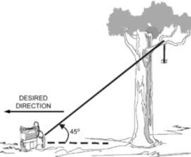
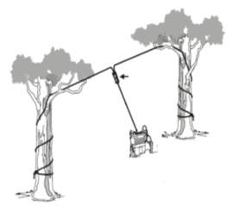
DISMOUNTED COMMUNICATIONS/
FIELD EXPEDIENT ANTENNAS
OPERATING FREQ. IN MHz | ANTENNA LENGTH
30………………………...2.38 m | (7 FT 10 IN)
32………………………...2.23m | (7 FT 04 IN)
34………………………...2.10 m | (6 FT 11 IN)
36………………………...1.98 m | (6 FT 06 IN)
38………………………...1.87 m | (6 FT 02 IN)
40………………………...1.78 m | (5 FT 10 IN)
43………………………...1.66 m | (5 FT 05 IN)
46………………………...1.55 m | (5 FT 01 IN)
49………………………...1.46 m | (4 FT 09 IN)
52………………………...1.37 m | (4 FT 06 IN)
55………………………...1.30 m | (4 FT 03 IN)
58………………………...1.23 m | (4 FT 00 IN)
61………………………...1.17 m | (3 FT 10 IN)
64………………………...1.12 m | (3 FT 08 IN)
68………………………...1.05 m | (3 FT 05 IN)
72………………………...0.99 m | (3 FT 03 IN)
76………………………...0.94 m | (3 FT 01 IN)
FM 3-55.93 LONG-RANGE SURVEILLANCE UNIT OPERATIONS (June 2009)
MCRP 6-22D USMC FIELD ANTENNA BOOK (June 1999)
Contents OF field expedient antenna kit
4ea Cobra Heads | 2ea Rolls Electrical Tape
3ea Coax Balun | 6ea Insulators (MRE Spoon)
2ea Carabineer | 100 feet Antenna Wire
10ea 300ohm Resistors | 10ea 600ohm Resistors
MANPACK CONFIGURATION Capabilities
RADIO | RANGE (LOS) | BATTERY | WEIGHT
AN/PRC 150 | 1-10 km | 18-20hrs | 15.8lbs
AN/PRC 119 | 3-5 km | 06-08hrs | 9.0lbs
AN/PRC 148 | 3-5 km | 06-08hrs | 2.2lbs
Sloping Wire - Bidirectional antenna. Connect far end of antenna to insulator. Connect insulator to 550 cord with a weight. Throw weight over tree so that antenna forms 30-45 degree angle to ground. Angles greater than 45 degrees are used for ground waves and less than 30 degrees for sky waves. The angle formed by the wire should point in the opposite direction of the base station.
Dipole - Bidirectional antenna. Attach the Coax Balun to the radio and the Cobra Head. Attach a single strand of antenna wire to the black and a single strand of antenna wire to the red Cobra Head connectors. Use insulators and 550 cord to form a T-shaped (Dipole) antenna. 550 cord should be the only material touching the trees.

Slide 70
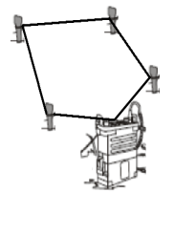
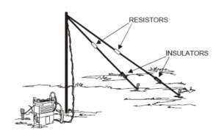
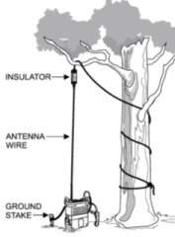
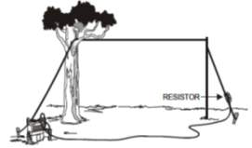

DISMOUNTED COMMUNICATIONS/
FIELD EXPEDIENT ANTENNAS
Square Loop - Closed-loop antenna used when a structure obstructs LOS view between RTO and base station. This is an excellent antenna to use in sub-surface hide/surveillance sites and in urban environments. Connect one side of antenna wire to black Cobra Head connector and the other side to the red connector. Create a square shape antenna on the inside of a window or the inside of your OP.
Sloping Vee - Directional antenna. Attach the Coax Balun to the radio and the Cobra Head. Attach a single strand of antenna wire to the black and a single strand of antenna wire to the red Cobra Head connectors. Use 1 ea 300 ohms resistor on each antenna leg. Connect insulators and 550 cord to ground stakes. The RTO aims the antenna so that the line cutting the “V” in half points at the base station.
Horizontal Long Wire - Directional antenna. Attach one side of the antenna wire to the black adapter on the Cobra Head. Attach the other side of the antenna wire to an insulator that has a 600 ohms resistor attached to it. Use 550 cord with a weight to toss the insulator & resistor over a tree branch. Tie the insulator & resistor to the bottom of a tree or a stake using 550 cord.
Vertical Wire - Omnidirectional antenna. Attach one side of the antenna wire to the black adapter on the Cobra Head. Attach the other side of the Antenna wire to an insulator. Use 550 cord with a weight to toss the insulator high in a tree. Tie the 550 cord off to a tree.

Slide 71
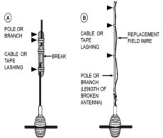
DISMOUNTED COMMUNICATIONS/
FIELD EXPEDIENT ANTENNAS
Characteristics
RADIO | OP. FREQS | MAX PW | VEH. KIT
AN/PRC 150 | 1.6-60 MHz | 20Watts | AN/VRC-104
AN/PRC 119 | 30-88 MHz | 4Watts | VRC-89/92
AN/PRC 148 | 30-512 MHz | 5Watts | AN/VRC-111
Interoperability
RADIO | VHF | PT | CT | LOS
AN/PRC 150 | X | X | X | X
AN/PRC 119 | X | X | X | X
AN/PRC 148 | X | X | X | X
REPAIR PROCEDURES FOR WHIP ANTENNA
A) Remove paint and clean sections to be joined. Place sections together and secure using bare wire or tape. B) If whip is badly damaged use wire of same length. RTO removes plastic around lower end of wire, twists conductors together, pushes them into antenna base and secures them with a piece of wood material. RTO supports antenna wire with a tree or a pole.

Slide 72
HF-150 OPERATION STEPS
INITIAL RADIO SET-UP
Attach Batteries and battery box to AN/PRC 150
Connect H-250/U handset to the radio J1/Audio
Connect Antenna to the J7 Antenna connector
PREPARING TO LOAD COMSEC WITH SKL
Place the function switch to PT position, radio will initialize.
Place the function switch to LD (load) position
One the AN/PRC-150 is set to LD position, the radio is offline and the J18 FILL port is configured to interface wit the COMSEC fill device.
Connect fill device to J18 FILL connector using a fill cable.
To navigate through menus use the 6(up) and 9(down) keys on the KDU faceplate. To go back or deselect an item press CLR key; to select an item press ENT key.
Select KYK-13 fill device.
Select the desire COMSEC Type: ANDVT. VINSON, KG-84
Select TEK by pressing enter, then select 01
Press enter to initiate will display on the screen:
  Do not press ENT at this time.
When all fill data is entered, select NO when the MORE FILL DATA prompt displays.
Turn off fill device and disconnect it from J18 FILL connector
Rotate function switch from LD to CT.
LOADING COMSEC WITH SKL
  Place selector Knob on “LD”
  Arrow up to “KYK13” hit enter
  Arrow up to “ANDVT” hit enter
  Hit enter twice “TEK 01”
  On SKL highlight key 1428 Edition CH Segment 10
  Select Load (Upper Right Corner)
  Make sure Protocol say “DS-102” and activate mode “KYK-13” enter OK twice
  Make sure SKL is connected to the J1 FILL PORT and press enter on Radio
  Select done on SKL and press enter on Radio
  More fill data? Press enter on yes
  Press clear once
  Arrow up twice and select “satellite” press enter
  Press enter twice on “TSK 01”
  On SKL highlight key “C5595 edition BI segment 4”
  Press load
    Repeat steps 1-10
  More fill data? Select NO
  Disconnect SKL from Radio
  Move Selector switch to “CT”
FIXED FREQUENCY OPERATION
Press the MODE button to scroll through the available operating modes. Press MODE until FIX is displayed
Press ENT to select FIX mode
Press > until CH)) is highlighted. Press ENT
Type the number of the Channel you wish to select. Press ENT
Press > until the Receive Frequency is highlighted. Press ENT
Type in the Freq that you received from SQDN S-6. Press ENT
The radio automatically copies the receive frequency to the transmit frequency. If you want to change it, enter in new frequency. When finished press ENT.

Slide 73
AN/PRC 117F TACSAT
OPERATION STEPS
PROGRAMMING DAMA
  Press 8 PGM on radio
  Scroll to DAMA and press enter
  Select presets and press enter
  Select nets and press enter
  Press enter
  Select channel and press enter
  Channel 041
  Press enter four times
  Scroll to ADDR and press enter
  TYPE in the Terminal Base Address
  Press clear
  Scroll to TRANSEC and press enter twice
  13. Key location 0 ”TSK 01” press enter
  14. Select “TSK 01” for key location 1-7
  15. Press clear
  Scroll to Port CONFIGS
  and press enter twice
  17. Select COMSEC press enter
  18. Up arrow twice to “ANDVT” press enter
  19. Press “ENCRYPTION KEY” TEK 01
  20. Press enter three times
  21. Press clear
  Scroll to “DESTINATIONS” and
  press enter twice
  23. Scroll to 25K_AC and enter
  24. Select add and press enter
  25. Enter “64217” and press enter
  26. Press clear six times
PLACE RADIO INTO OPERATION
  Press 3 mode
  Up arrow until you see DAMA and press enter
  Watch the radio screen until you see “RCCOW ACKNOWLEDGED”
PLACING A CALL
  Press 1 “Call”
  Press enter 3 times

Slide 74
Green 1 – INTSUM
Purpose: The Intelligence Summary (INTSUM) is used to provide the S-2s with intelligence summaries
covering the previous 12 hours of enemy activity. Sent from higher to lower.
Required: As necessary, minimum daily at 2400
Transmission methods: Primary: CPoF
Alternate: BDE O&I
Tertiary: FBCB2 Free Text
Line 1: Issuing Unit
Line 2: Time of Issue
Line 3: Summary of Activity
Line 4: Enemy Strength & Disposition
Line 5: Enemy Frontline Trace
Line 6: Most Likely COA
Line 7: Enemy Weaknesses
Line 8: Current PIR/IR
Green 2 – Sensitive Items Report
PURPOSE: The sensitive items report is to ensure that all sensitive items are accounted for.
MEANS: Troop to Squadron: Primary- FBCB2 to TOC and CTCP; Alternate- FM CMD; Required Daily from Troop to Squadron at 0600 and 1800
LINE 1. DTG
LINE 2. Unit
LINE 3. Status (“UP” = 100 percent complete, or “UNIT GREEN” to denote report with no discrepancy; if unit is Green skip to Line 10; when discrepancy is noted, report “UNIT RED” and continue report)
LINE 4. Losing Unit (unit making report loss)
LINE 5. Item (item lost by serial number)
LINE 6. DTG of loss
LINE 7. Details (circumstances of loss)
LINE 8. Action Taken (actions taken to recover the item)
LINE 9. Narrative
LINE 10. Authentication

Slide 75
Green 3 – Periodic Intelligence Report
Line 1. COMPOSITION AND DISPOSITION
An overlay is usually attached to present the graphic display of enemy units. The initial subparagraphs always contain information pertaining to organization. Information concerning identification and disposition is listed by mentioning the highest echelons first, followed by subordinate units from left to right, or top to bottom, as displayed on the overlay. Related items may be combined and presented in a single entry.
Line 2.STRENGTH. Report information pertaining to enemy personnel, weapons, and equipment losses during the period. Replacement rates and strength figures of individual units may be listed.
Line 3.TACTICS. Report only new tactics and deviations from prescribed tactical doctrine.
Line 4.TRAINING. Report new development recent changes in training programs or methods of special training undertaken by the enemy since the initiation of hostilities.
Line 5. LOGISTICS. Report those items which will affect current enemy operations such as supply status, supply systems, and locations of supply facilities.
Line 6. COMBAT EFFECTIVENESS. Report data on the combat effectiveness of enemy units, either of the entire force or of a major tactical unit. List items indicating morale, esprit, quality of troops and commanders. The ability of the enemy unit to accomplish its expected mission is expressed.
Line 7. MISCELLANEOUS DATA. List personalities, unit history, field post office (FPO), code numbers and names, order of battle changes, and any other item of order of battle intelligence that cannot be properly inserted in preceding paragraphs.
Green 5 – Route Report
PURPOSE: To provide results of route reconnaissance requested by higher unit. SUBMITTED BY: CO CP S2 to NEXT HIGHER HQ (S2).
FORMAT:
LINE 1: From (start location):
LINE 2: To (end location:
LINE 3: What:(1Highway, 2Road, 3Trail 4cross country)
LINE 4: Class route:
1.Only tracked vehicles
2.Any wheel vehicles
3.Dismounted only
4.Only wheels
LINE 5: Type:
1.All weather
2.Limited all weather
3.Fair weather LINE
LINE 6:: Movement possible:
1.Fast
2.Slow
LINE 7: Critical points (Y/N):

Slide 76
Green 6 – BDA Report
Purpose: To provide information to the SQDN S-2 on enemy losses in order to estimate enemy combat strength.
Required: As accurate BDA becomes known
Transmission methods: Primary: FM SQDN O/I NET
Alternate: FBCB2 pre-format
Tertiary: FBCB2 free text
Line 1: Time
Line 2: Location
Line 3: Each Type of System (#Destroyed / #Damaged)
Line 4: Enemy Unit (State Known or Assessed)
Line 5: Source of BDA (Direct Fire, Indirect, CAS)
Line 6: Report what remains of unit (if known)
Green 8: Captured Enemy Equipment
PURPOSE: To provide intelligence information to Squadron on enemy composition, strengths, and weaknesses.
MEANS: Troop to Squadron: Primary- FBCB2 to ALL; Alternate- FM CMD
Line 1: DTG Found
Line 2: Type and Quantity of Equipment
Line 3: Country of Origin
Line 4: Brief Description of each item
Line 5: Commander Name and Unit that Captured Equipment
Line 6: Actions taken with Equipment

Slide 77
Green 7 – Request for Information
GENERAL INSTRUCTIONS: Use to request information from requesting unit’s command post or other units.
LINE 1 –DATE AND TIME (DTG)
LINE 2 –UNIT (Unit Making Request)
LINE 3 –REQUEST (Desired Information (Specific
Order or Request))
LINE 4 –PRIORITY (Requestor's Priority: ONE,
TWO, THREE, or FOUR)
LINE 5 –BY (DTG Information Required)
LINE 6 –LTIOV (DTG of Latest Time of
Intelligence/Information Value)
LINE 7 –NARRATIVE
Blue 1: SPOTREP
PURPOSE: To report a single event/battlefield encounter.
MEANS: Primary- FBCB2 to TOC, CTCP, and S2; Alternate- FM CMD
FORMAT
Line 1: Reporting Unit
Line 2: DTG
Line 3: Size of enemy
Line 4: Activity of enemy
Line 5: Location of enemy
Line 6: Unit (if known)
Line 7: Time
Line 8: Equipment observed
Line 9: Action your unit is taking and Combat Power reported in slant format

Slide 78
Blue 2: SITREP
PURPOSE: To report any changes to the tactical situation and status.
MEANS: Troop to Squadron at 0700 and 1900 daily; Primary: FBCB2 to ALL; Alternate: FM CMD
FORMAT:
LINE 1: Unit
LINE 2: DTG
LINE 3: Brief summary of TRP activity last 12hrs & 24hrs
LINE 4: Enemy activity/assessment
LINE 5: Communications status: (G) (A) (R) (B)
LINE 6: TRP slant Current: _____/____ (G) (A) (R) (B) Projected: _____/____ (G) (A) (R) (B)
LINE 7: CO TASK/PURPOSE
LINE 8: OP Locations:
LINE 9: Operations next 12hrs/24hrs
LINE 10: Commander’s remarks:
Blue 4 – CDR SITREP
Line 1. Unit
Line 2. DTG
Line 3. Combat Power
Line 4. Significant Activities (Past 12hrs)
Line 5. Planned Activities (Next 12hrs)
Line 6. Commander’s Evaluation
Line 7. Unit Locations
Line 8. Remarks

Slide 79
Blue 5 – SIR Report
SIR Number:
LINE 1. Category:
LINE 2. Type of Incident:
LINE 3. Date/Time of Incident:
LINE 4. Location of Incident:
LINE 5. Other information:
a. Racial:
b. Trainee Involvement:
6. Personnel Involved:
  a. Subject:
    (1) Pay grade:
    (2) SSN:
    (3) Race:
    (4) Sex:
    (5) Age:
    (6) Position:
    (7) Security clearance:
    (8) Unit and station of assignment:
    (9) Duty status: Active
    (10) Deployed in the last 12 months:
    (11) Date return deployment:
    (12) First Term Soldier:
LINE 7. Summary of Incident:
LINE 8. Remarks:
LINE 9. Publicity: None
LINE 10. Provost Marshal Involved: N/A
LINE 11. Chain of Command notified:
Platoon Leader –Yes
Company Commander –Yes
Battalion Commander -Yes
LINE12. Point of Contact:
Blue 6 – Obstacle Report
Line ALPHA: Type of obstacle or obstruction.
Line BRAVO: Location, using grid coordinates. For large, complex obstacles, send the coordinates of the ends and of all turn points.
Line CHARLIE: Dimensions and orientation.
Line DELTA: Composition.
Line ECHO: Enemy weapons influencing obstacle.
Line FOXTROT: Observer’s actions.

Slide 80
Blue 7- SCATTERABLE MINEFIELD
GENERAL INSTRUCTIONS: Use to request authority to execute a planned scatterable minefield (SCATMINE) obstacle. Use the SCATMINREQ to request authority to plan a SCATMINE obstacle and the SCATMINREC to record an executed SCATMINE obstacle.
LINE 1 –DATE AND TIME (DTG)
LINE 2 –UNIT (Unit Making Report)
LINE 3 –TGT/OBSTCL NO. (Target/Obstacle Number, as per Unit SOPs)
LINE 4 –EMPLACING SYSTEM (Emplacing System (Volcano (Air or Ground), Artillery (Type), MOPMS, Air Delivered (Air Force), or Gator)
LINE 5 –ANTITANK MINES (Antitank Mines (YES or NO))
LINE 6 –ANTIPERSONNEL MINES (Antipersonnel Mines (YES or NO))
LINE 7 –AIMING POINTS (Grid Coordinates of Aim Points/Corner Points)
LINE 8 –SAFETY ZONE (Size of Safety Zone)
LINE 9 –MINEFIELD MARKING (Type of Marking, if Applicable)
LINE 10 –LIFE CYCLE (DTG of Life Cycle)
LINE 11 –ACTIONS (Actions Taken by Personnel Involved)
LINE 12 –NARRATIVE (Free Text for Additional Information Required for Clarification of Report)
LINE 13 –AUTHENTICATION (Report Authentication)
Blue 8- UXO/IED Report
Line 1: Date time group discovered: (Command policy will dictate Local or Zulu time)
Line 2: Reporting activity: (UIC / Unit Designation), Location (8-digit grid -Include landmarks and reference pts)
Line 3: Contact Method: (Radio Freq / Call Sign or Telephone #. If using telephone # provide point of contact)
Line 4: Type of IED / Ordnance: (Dropped, Projected, Placed or Thrown)
Line 5: CBRN Contamination: Yes/No, known or suspected CBRN contamination. If Yes, report type of agent if known / identified.
Line 6: Target / Resource Threatened: (What resource is threatened –is it a critical asset?)
Line 7: Impact on Mission: (How the UXO is affecting the mission)
Line 8: Protective Measures Taken: (Unit emplaced protective measures)Line
Line 9: Recommended Priority: (Immediate, Indirect, Minor, or No Threat).

Slide 81
Blue 9 – Report of Ford or Crossing
Line ALPHA: Type and location, using either a TIRS point or grid coordinates.
Line BRAVO: Length of crossing in meters.
Line CHARLIE: Usable width.
Line DELTA: Current speed in meters per second.
Line ECHO: Maximum depth in meters.
Line FOXTROT: Bottom material and condition.
Line GOLF: Capacity classification of any existing ferry equipment.
Line HOTEL: Slope of entry bank.
Line INDIA: Slope of exit bank.
Line KILO: Other comments as necessary.
Blue 10 – Route Reconnaissance Report
Line ALPHA: “From” location, reported using a control measure or TIRS point.
Line BRAVO: “To” location, reported using a control measure or TIRS point.
Line CHARLIE: Type of route, reported using the following designations:
Highway, reported using the number “1.”
Road, number “2.”
Trail, number “3.”
Cross-country, number “4.”
Line DELTA: Classification of route. Check for height, width, and weight restrictions to determine the appropriate class, and report what vehicles the route is capable of handling using the following designations:
Line ECHO: Seasonal limitations of route based on weather-support capability, reported as follows:
All-weather (usable year-round), reported using the letter “X.”
Limited all-weather (use limited during bad weather), letter “Y.”
Fair weather (may be impassable during bad weather), letter “Z.”
Line FOXTROT: Rate of movement the route will support, reported as follows:
Fast, reported using the number “1.”
Slow, number “2.”
Line GOLF: Location and type of any critical points (send the applicable report). Report the following obstructions in all cases: curves with a radius of 45 meters or less; uphill slopes with grades of 5 percent or greater; width restrictions of 6 meters or less for one-way traffic, 10 meters or less for two-way traffic; and overhead clearance of 4.3 meters or less.

Slide 82
Blue 11- Bypass Report
Line ALPHA: Observer or source.
Line BRAVO: Length; width; surface type; grade.
Line CHARLIE: Coordinates of “from” and “to” locations.
Line DELTA: Seasonal/weather limitations. Use letter designation (X, Y, or Z) as described
for the Blue 7 report (ROUTEREP).
Line ECHO: Bypass markings.
Line FOXTROT: Observer’s actions.
Blue 15: CLOSEOUT REPORT
CLOSEOUT REPORT- may be submitted digitally (S3 shop) or via FM (Staff Duty) following each training event.
LINE 1- DTG OF REPORT / UNIT MAKING REPORT:
LINE 2- LOCATION OF TRAINING (GRID):
LINE 3- DTG RP:
LINE 4- TASK AND NUMBER OF PAX TRAINED:
LINE 5 - NUMBER OF ROUNDS FIRED BY DODAC:
LINE 6- MISSING OR DAMAGED EQUIPMENT:
LINE 7- SENSITIVE ITEMS STATUS:
LINE 8- ACCIDENTS (Accidents/Incidents/Enemy Activity Encountered):
LINE 9- ISSUES THAT EFFECTED TRAINING (Narrative):
LINE 10- NARRATIVE (Identify one or more Soldiers who performed with distinction.)
LINE 11- AUTHENTICATION (Name and rank of person submitting report)

Slide 83
Orange 1 – SITREP (LOGSITREP)
GENERAL INSTRUCTIONS: Use to report logistic problems, required logistic assistance and reallocation, and recommended or intended courses of actions. Reference: FM 700-80 and FM 701-58.
LINE 1 –DATE AND TIME (DTG)
LINE 2 –UNIT (Unit Making Report)
LINE 3 –MAP (UTM or Six-Digit Grid Coordinate With MGRS Grid Zone Designator for the Map Being Referenced)
LINE 4 –EVALUATION (Major Units, Combat Operation Type, and Days Logistically Supportable)
UNIT__________________OPERATION___________________DAYS__________
LINE 5 –IDENTIFICATION (Identification/Designation of Component, Agency, or Unit Making Report)
LINE 6 –LOCATION (UTM or Six-Digit Grid Coordinate With MGRS Grid Zone Designator)
LINE 7 –COMMENT (Pertinent Unit Comments)
LINE 8 –FORCE WEAPON SYSTEMS (Line Item Numbers and Quantities on Hand, Authorized, and Operational)
UNIT____________ON HAND_________AUTH________OPER_____ REQ_____
LINE 9 –AMMUNITION (Type of Ammunition, Quantity on Hand, Quantity Due in, and RDD)
TYPE_____________ON HAND___________DUE_____________RDD______ REQ_____
LINE 10 –CRYOGENICS (Comments or Status of Cryogenics)
LINE 11 –PETROLEUM (Product Type, Quantity and Unit of Measure on Hand, and Days of Supply on Hand)
PRODUCT_____________ON HAND______________DAYS____________REQ_____
LINE 12 –EQUIPMENT (National Stock Numbers and Quantities on Hand, Authorized, and Operational)
NSN________________ON HAND_______AUTH_________OPER_________REQ_____
LINE 13 –CRITICAL EQUIPMENT (Type, Quantity Nonoperational, Materiel Damage Level (MDLV) (MODERATE or SEVERE), and as of DTG)
TYPE________________NONOP_______DMLV_________AS OF_________REQ_____
LINE 14 –REPAIR MATERIEL (Type, National Stock Number, and Quantity of Critically Required Repair Materiel)
TYPE______________NSN_________________________QTY_______________ REQ_____
LINE 15 –RATIONS (Ration Type, Number of Meals on Hand, and Days of Supply on Hand)
TYPE_______________ON HAND________________________DAYS_________ REQ_____
LINE 16 –WATER (Water Type (Potable or Non-potable) Gallons Available, and Days of Supply on Hand)
TYPE___________________GALLONS_____________________DAYS_________REQ_____
LINE 17 –CDR'S SUMMARY (Narrative Comments Addressing Degraded Capabilities, Shortages, or Problems Impacting on War fighting Capability as well as Recommended Courses of Action)
LINE 18 –NARRATIVE (Free Text for Additional Information Required for Clarification of Report)
LINE 19 –AUTHENTICATION (Report Authentication)
** Repeat Lines 5-16 as required.

Slide 84
Orange 2 – Class IV Bulk Material Request
GENERAL INSTRUCTIONS: Use to report a periodic update, forecast, or formal request of Class IV barrier materials.
LINE 1 –DATE AND TIME (DTG)
LINE 2 –UNIT (Unit Making Report)
LINE 3 –REQUEST TYPE (Update, Forecast, or Request)
LINE 4 –MATERIALS (Type) a) Pickets b) Wire c) Sand Bags d) Wood Type/Size
LINE 5 -QTY OH (Specify)** Repeat as Required
LINE 6 -QTY REQ (Required Quantity)** Repeat as Required
LINE 7 –UOM (Unit of Measurement Times Number Requested)
LINE 8 –MOR (Method of Resupply Requested (Aerial, LOGPAC))
LINE 9 –LOCATION (UTM or Six-Digit Grid Coordinate With MGRS Grid Zone Designator to Class IV Supply Point or LRP)
LINE 10 –NLT TIME (Time Limit For Class IV to Arrive at Supply Point)
LINE 11 –NARRATIVE (Free Text for Additional Information Required for Clarification of Report)
LINE 12 –AUTHENTICATION (Report Authentication)
Yellow 1A – Battle Loss Report
Line 1: Time of loss.
Line 2: Number of pieces of equipment to be evacuated to troop/battalion or higher for
maintenance. Refer to the appropriate line numbers from the Yellow 1 report.
Line 3: Number of pieces of equipment destroyed and abandoned in pieces. Refer to the
appropriate line numbers from the Yellow 1 report.
Line 4: Location (encoded) of abandoned equipment.

Slide 85
Yellow 2– Ammunition Status Report
GREEN: 90% or more on hand, all ammunition types.
AMBER: 80% to 89% on hand, all ammunition types.
RED: 60% to 79% on hand, all ammunition types.
BLACK: 59% or less on hand, all ammunition types.
Yellow 3 – POL Status Report
GREEN: 90% or more of the required quantity on hand.
AMBER: 80% to 89% on hand.
RED: 60% to 79% on hand.
BLACK: 59% or less on hand.
Yellow 3A – POL Request
Line 1: Report as-of DTG.
Line 2: MOGAS (gal).
Line 3: Diesel (gal).
Line 4: Oil, OE-10 (gal).
Line 5: Oil, OE-30 (gal).
Line 6: Oil, OE-50 (gal).
Line 7: Oil, OE-90 (gal).
Line 8: Antifreeze (gal).
Line 9: Brake fluid (gal).
Line 10: Hydraulic fluid, OHA (qt).
Line 11: Hydraulic fluid,
OHT (qt).
Line 12: Hydraulic fluid,
FRH (qt).
Line 13: Oil, penetrating (qt).
Line 14: Oil, PL-special (qt).
Line 15: Oil, PL-medium (qt).
Line 16: Bore cleaner (gal).
Line 17: Oil, LSA (qt).
Line 18: Grease, GAA (lb).
Line 19: Grease, wheel
Line 20: Solvent (gal).

Slide 86
Red 1 – Personnel Report
PURPOSE. Reports personnel status to higher headquarters and provides a tool for requisitioning new personnel.
    MEANS:
    Troop to Squadron: Primary- FBCB2 to TOC and CTCP (Digital Format); Alternate- FM A&L
    Squadron to BCT: Primary- FBCB2 (Roll-up of Digital Reports); Alternate- FM A&L
    Analog Format
UBMITTED BY LINE IN SLANT FORMAT BY OFFICER/WARRANT/ENLISTED
LINE ITEM EXAMPLE
UNIT/DTG
PERSONNEL ASSIGNED 5/0/86
PERSONNEL ATTACHED 0/0/7
PERSONNEL DETACHED 0/0/4
TOTAL PERSONNEL 5/0/89
TOTAL PERSONNEL PRESENT FOR DUTY 5/0/75
WOUNDED IN ACTION ---
KILLED IN ACTION ---
MISSING IN ACTION --
PERSONNEL ON LEAVE/PASS 0/0/2
PERSONNEL TDY ---
PERSONNEL AWOL ---
PERSONNEL ON REAR DETACHMENT 0/0/12
PERSONNEL REPLACEMENTS REQUIRED
(RANK/SPECIALTY/QUANTITY)

Slide 87
Red 3: 9-LINE MEDEVAC
    PURPOSE. Requests immediate evacuation of casualties. This is not a notice of an on-going evacuation, but a request for evacuation assests beyond the organic capability from a established point to a higher level of care.
    COMMUNICATION INSTRUCTIONS:
      Submitted by the fastest means available. Requests for urgent casualties should always be initiated on FM to get the most rapid response, followed by a digital request. Routine evacuation request may be sent via FBCB2 MEDEVAC message, but should be accompanied by an FM alert to the primary addressee
LINE 1. Location of pickup site (grid coordinates)
      LINE 2. Radio Frequency (your call sign and suffix)
      LINE 3. Number of patients by precedence:
        Urgent (save life, limb, eyesight w/i 2 hours)
        Urgent -Surgical (surgery required to save life and stabilize)
        Priority (required medical care is not avail, will deteriorate to Urgent within 4 hours)
        Routine (sick and wounded who require evacuation within 24 hours)
        Convenience
      LINE 4. Special equipment required
        None
        Hoist
        Extraction
        Ventilator
      LINE 5. Number of patients by type
        L + # patients - Litter
        A + # patients - Ambulatory
      LINE 6. Security of pick up site
        N - no enemy troops in area
        P - possible enemy troops
        E - enemy troops in area, approach with caution
        X - enemy troops in area, armed escort required
      LINE 7. Method of marking pickup site (LZ)
        panels
        Pyrotechnic signal
        Smoke signal
        None
        Other
      LINE 8. Patients nationality and status
        US military
        US civilian
        Non-US military
        Non-US civilian
        EPW
      LINE 9. CBRN contamination
        N – nuclear;
        B – biological;
        C – Chemical;
        U – Unknown;
        A - All Clear
      Installation MEDEVAC FM frequencies:
FORT WAINWRIGHT MEDEVAC: 40.500
FORT IRWIN MEDEVAC: 38.900
While deployed, seek higher headquarters guidance for frequencies.
**When air/ground communications are established, the pilot will require the following information from the ground (LZ): Size of LZ, obstacles (wire, antennas, ditch, and vehicles), wind direction and velocity and the slope of the terrain.
    FBCB2 MEDEVAC Message
      The combat MEDEVAC report is used to call for a medical evacuation. All required fields are provided on this form. The system allows the user to input up to 17 characters in the call sign and up to 8 characters in the frequency field. Users should use the call sign and frequency of the platform that will communicate with the MEDEVAC platform.
      Prior to utilizing the combat MEDEVAC, users must enter the Radio Freq and Call Sign for their platform in the “Admin>Platform Settings>Misc” dialog box on the BCOPS screen. This will allow the software to automatically fill the information in the message. Users cannot enter this information directly into this form. Both the call sign and frequency fields are required to be filled in order to send the MEDEVAC message.
      Select the MEDEVAC report from the Combat Messages Box using the MEDEVAC tab. Fill in the fields using the drop down menus. Type in the pickup location or use the map or LRF fill options. Ensure that the Radio Freq and Call Sign are showing.

Slide 88
Red 2 – Casualty Report
FORMAT:
LINE 1: Battle roster number.
LINE 2: FOXTROT: Body not identified.
LINE 3: GOLF: MIA.LINE
LINE 4: HOTEL: Captured.LINE
LINE 5: INDIA: WIA, slight, hostile action.LINE
LINE 6: JULIET: WIA, serious, hostile action.
LINE 7: KILO: WIA, slight, non-hostile action.
LINE 8: LIMA: WIA, serious, non-hostile action.
LINE 9: MIKE: Accident.
LINE 10: Status of evacuation and location to which casualties are evacuated.
Purple 1 – Detainee Report
PURPLE 1 – DETAINEE REPORT
Purpose: To track the detention of enemy elements
Required: Immediately upon detention
Transmission: Primary: CPOF
Alternate: FM
Tertiary: FBCB2 free text
LINE 1: UNIT REPORTING
LINE 2: UNIT DETAINING (DOWN TO troop LEVEL)
LINE 3: TIME OF REPORT
LINE 4: TIME OF DETENTION
LINE 5: LOCATION OF DETENTION
LINE 6: NUMBER OF DETAINEES
LINE 7: REASON FOR DETENTION
LINE 8: LOCATION OF Squadron HOLDING AREA
LINE 9: DOES UNIT REQUIRE MORE THAN 24 HOURS TO EVAC TO BDE DHA-A? IF SO WHY?

Slide 89
CBRN 1 Report
Use to provide the observer's initial report giving basic data on a nuclear attack,
biological attack, chemical attack, or releases other than attack (ROTA).
LINE 1 -- DATE AND TIME (DTG)
LINE 2 – UNIT (Unit Making Report)
LINE 3 -- EVENT(Type of Incident: NUCLEAR, NUC.NAV, BIOLOGICAL, BIO.NAV, CHEMICAL, or CHEM.NAV)
LINE 4 -- ALFA(CBRN Strike Serial Number)
LINE 5 -- BRAVO(Position of Observer: UTM or Six-Digit Grid Coordinate With MGRS Grid Zone Designator)
LINE 6 -- CHARLIE(Direction of Attack in Mils or Degrees as Measured Clockwise From Grid, True, or Magnetic North of Attack or ROTA From the Observer)
LINE 7 -- DELTA(DTG of Detonation or Beginning of Attack or
ROTA)
LINE 8 -- ECHO(End DTG of Attack or ROTA)
LINE 9 -- FOXTROT(UTM or Six-Digit Grid Coordinate With MGRS Grid Zone Designator of Attack and Code Used to Represent if Reported Location of Attack or ROTA is Actual or Estimated)
LINE 10 -- GOLF(Vehicle or Device by Which Weapon Was Delivered or ROTA Was Released)
LINE 11 – HOTEL (Type of Burst, Biological/ Chemical Agent, and Persistency)
LINE 12 -- INDIA (Number of Munitions or Aircraft)
LINE 13 – JULIET (Time in Seconds Denoting Flash-to-Bang DTG of Nuclear Attack)
LINE 14 – KILO (Terrain and Vegetation Description or Crater Indicator and Width in Feet or Meters)
LINE 15 -- LIMA (Nuclear Burst Angular Cloud Width Measured at Five Minutes After Detonation Measured in Degrees or Mils)
LINE 16 – MIKE (Stabilized Cloud Top or Bottom Height in Feet or Meters or Angular Cloud Top or Bottom Angle in Degrees or Mils Recorded at H+10 Minutes after Detonation)
LINE 17 -- PAPA ALFA ROMEO (Coordinate(s) of Hazardous Cloud or Area)
LINE 18 -- PAPA BRAVO ROMEO (Downwind Direction of Radioactive Cloud)
LINE 19 – SIERRA (DTG of the Reading, for Nuclear Reporting, or Initial Detection Time, for Biological/Chemical or ROTA Report)
LINE 20 – YANKEE (Representative Downwind Direction and Wind Speed or Radial Line Sector)
LINE 21 -- ZULU ALFA STABILITY (Air Stability Indicator, Either Detailed or Simplified)
LINE 22 -- ZULU ALFA TEMPERATURE (Surface Air Temperature)
LINE 23 -- ZULU ALFA HUMIDITY (Relative Humidity Range)
LINE 24 -- ZULU ALFA WEATHER (Significant Weather Phenomena)
LINE 25 -- ZULU ALFA COVER_(Cloud Cover)
LINE 26 -- ZULU BRAVO ILLUMINATION (Illumination Time)
LINE 27 – TIME (DTG of Observation)
LINE 28 – NARRATIVE (Free Text for Additional Information Required for Clarification of Report)
LINE 29 – AUTHENTICATION (Report Authentication)

Slide 90

BLACKHAWKS
Notes:
-add Table of Contents

