Slide 1
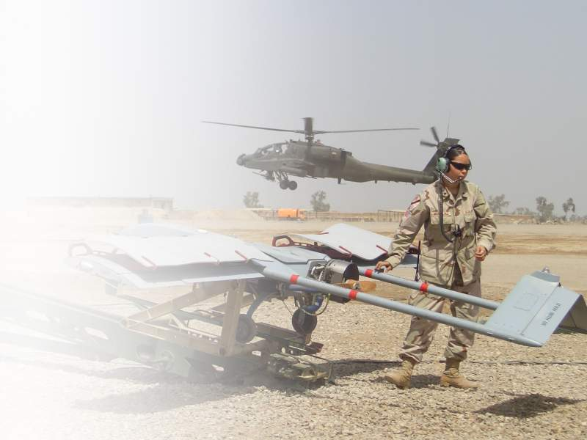
Aviation Shaping Operations
Attack, Reconnaissance and UAS Support
References:
JP 1-02
ADP 3-0
FM 3-90
FM 3-04.126
FM 1-02
ATTP 3-04.15 (UAS Reference - FOUO. Not utilized in this brief)
TC 1-400

Slide 2
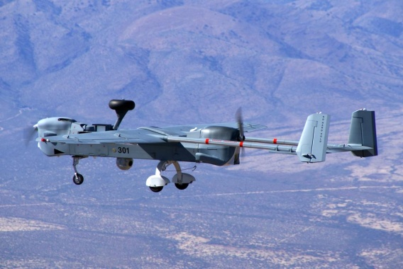
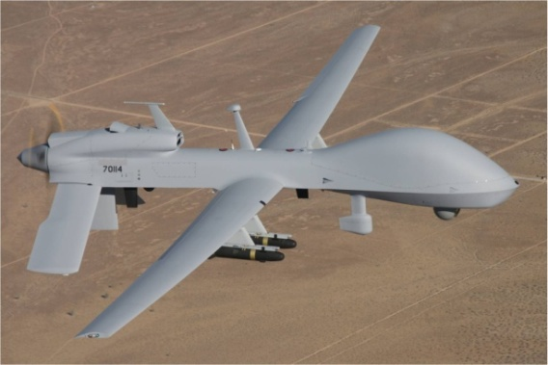
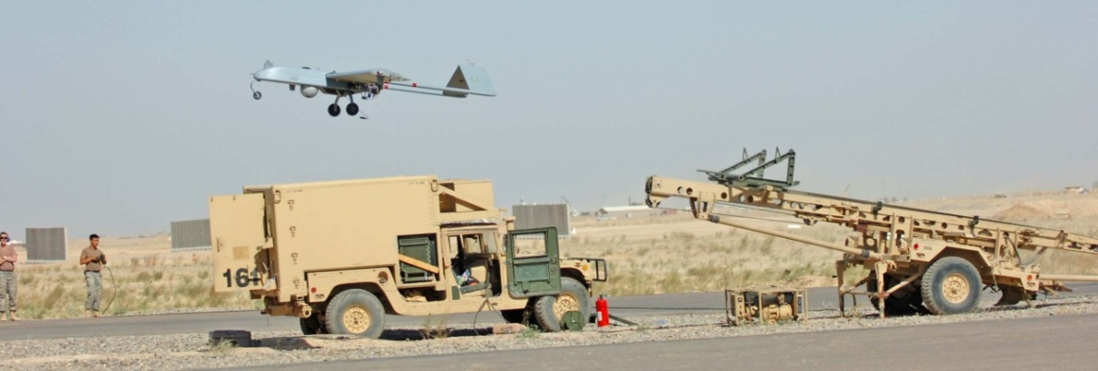
Unmanned Aircraft Systems (UAS)
Shadow and MQ-1C UAS are Organic to Aviation Brigades; employed at Division and Below
PURPOSE: Provide situational awareness with multi-role capabilities on demand (including communications, reconnaissance, and armed response)
TASKS:
SUPPORTS. . .
MOVEMENT AND MANEUVER
INTELLIGENCE
FIRES
PROTECTION
SUSTAINMENT
MISSION COMMAND
Missions: UAS significantly increase situational awareness (SA) and the ability to decisively influence current and future operations when employed as a tactical reconnaissance, surveillance, and target acquisition (RSTA) platform, and provides Intelligence at the operational level. UAS provide battlefield data, precision engagement, and increased mission command capability to prosecute the fight and shape the battlefield for future operations. UAS capabilities are maximized when employed as part of an integrated and synchronized effort.

Slide 3
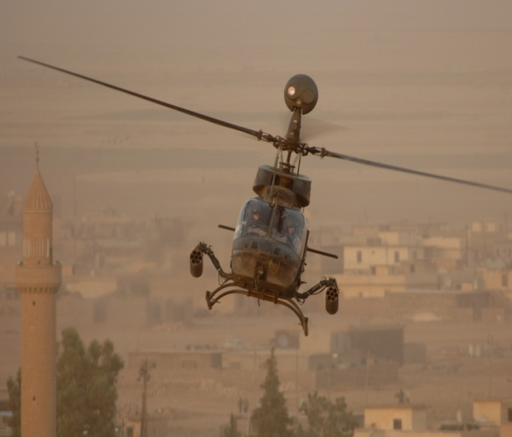
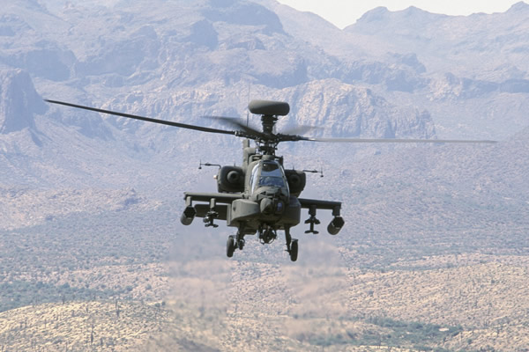
Attack Reconnaissance Battalion (ARB)
PURPOSE: Conduct decisive, integrated air-ground operations, close combat attacks, interdiction attacks, reconnaissance and security.
TASKS:
CONDUCT. . .
RECON
SECURITY
MOVEMENT TO CONTACT
ATTACK
TARGET ACQUISITION
BATTLE DAMAGE ASSESSMENT
ARBs comprised of OH-58D and AH-64D aircraft.
Generally used as a shaping force – can dominate terrain for short amount of time but cannot occupy or secure terrain.

Slide 4
Reconnaissance
Reconnaissance: A mission undertaken to obtain, by visual observation or other detection methods, information about the activities and resources of an enemy or potential enemy, or to secure data concerning the meteorological, hydrographic, or geographic characteristics of a particular area. (FM 1-02) The principles of an air route reconnaissance are the same as for a ground route.
Route: A directed effort to obtain detailed information of a specified route and all terrain from which the enemy could influence movement along that route. (FM 1-02)
Zone: A form of reconnaissance that involves a directed effort to obtain detailed information on all routes, obstacles, terrain, and enemy forces within a zone defined by boundaries. (FM 1-02)
Area: A form of reconnaissance operations that is a directed effort to obtain detailed information concerning the terrain or enemy activity within a prescribed area. (FM 1-02)
    Aerial Surveillance: Systematic observation to obtain detailed information of a specific target or area.

Slide 5
Route Reconnaissance
Areas of Interest for air reconnaissance will differ from ground based on enemy and terrain
CP
1
SP
CP
2
CP
3
RP
RTE GREEN
PL SPUR
PL BIT
PL STAR
PL ROPE

Slide 6
Zone Reconnaissance
Areas of Interest for air reconnaissance will differ from ground based on enemy and terrain
CP
4
XX
CP
3
A
CP
2
CP
1
B
NAI
2
RTE DIAMOND
NAI
1
XX
PL STETSON
(LD)
PL SADDLE
PL SPUR
PL BOOT
(LOA)

Slide 7
Area Reconnaissance
Areas of Interest for air reconnaissance will differ from ground based on enemy and terrain
The purpose of an area reconnaissance is to gather intelligence or conduct
surveillance of a specified area to include terrain outside the specified area
from which the threat can influence friendly operations.
More permissive than a zone recon.
Includes key terrain, a farm, bridge, ridgeline, wooded area, LZ/PZ, NAI, etc.

Slide 8
Aerial Surveillance
Purpose:
Systematic observation to obtain detailed information of a specific target or area.
Generally a point target such as a house, car, section of road, or any other defined area with specific threat indicators to satisfy the PIRs to trigger or make an adjustment to a Decision Point.
When performed by attack reconnaissance aircraft, surveillance is normally overt in nature with the purpose of deterring enemy movement or activity.

Slide 9
Security Operations
Purpose of security operations – provide protected force early and accurate
warning of adversary operations and develop situation to provide time and
maneuver space within which to effectively use protected force to exploit or
react to adversary actions.
  Defensive in nature
  Requires little protection
  Normally a mission assigned to a company without augmentation
Maintain surveillance of avenues of approach
Locate and destroy or defeat enemy recon elements (Counter-reconnaissance) within capabilities.
Impede and harass the enemy with indirect fires

Slide 10
Employment – Security
Screen - a security element whose primary task is to observe, identify, and report information, and which only fights in self-protection. (JP 1-02)
Guard - A form of security operation whose primary task is to protect the main force by fighting to gain time while also observing and reporting information, and to prevent enemy ground observation of and direct fire against the main body by reconnoitering, attacking, defending, and delaying. A guard force normally operates within the range of the main body's indirect fire weapons. (JP 1-02)
Aerial Security - Specialized area security operations conducted to protect air assault and air movement operations.
Convoy Security - A specialized kind of area security operations conducted to protect convoys. (FM 1-02)
Area Security - A form of security operations conducted to protect friendly forces, installation routes, and actions within a specific area. (FM 1-02)

Slide 11
Movement to Contact
Movement to contact gains initial contact with the enemy or regains lost
contact.
The ARC plans and executes the movement to contact like a zone
reconnaissance. Unlike a zone reconnaissance, the effort focuses on finding
the enemy force, developing the situation early, and preventing the premature
deployment of the BCT main body. As a result, movement to contact
proceeds much faster than a zone reconnaissance.
The movement to contact terminates when the ARC reaches the objective
or Limit of Advance (LOA) without enemy contact or upon contact with an
enemy force.

Slide 12
Movement to Contact
CP
4
XX
CP
3
CP
2
A
CP
1
B
NAI
2
NAI
1
ROUTE DIAMOND
XX
PL SADDLE
PL SPUR
PL BOOT
(LOA)
PL STETSON
(LD)
Movement to Contact - A form of the offensive designed to develop the situation and to establish or regain contact. (JP 1-02)

Slide 13
Interdiction Attack (IA)
A hasty or deliberate attack by army aircraft to divert, disrupt, delay, degrade, or destroy the enemy before they can be used effectively against friendly forces. (FM 3-04.126)
Employment:
Continuous
Phased
Maximum Destruction
Notes:
This is done at such a distance from ground forces that detailed integration with ground forces is not needed – This is what we use to refer to as a “deep attack”. This can be done hasty or deliberate.

Slide 14
Continuous Attack
I
I
EA
I
One CO in EA, One Enroute or in a Holding Area, One in FARP
Maintains constant pressure on enemy in EA
Provides most flexibility to CDR
Facilitates efficient FARP operations
FARP

Slide 15
Phased Attack
I
I
EA
Modification of continuous attack
“Phases” in a 2nd ARC from different ABF
Surges combat power with 2 x CO
FARP limitations eventually revert this
into continuous attack
I
FARP

Slide 16
Maximum Destruction Attack
I
I
I
EA
All three COs in contact at once
Overwhelms the enemy with massed fires
After initial attack, expect up to 90 minutes
to refuel/rearm battalion
FARP

Slide 17
Other Missions
In addition to finding, fixing, and destroying enemy forces and confirming
intelligence, the battalion can facilitate shaping operations by:
Conducting reconnaissance and surveillance (R&S) operations to
complement other maneuver forces.
Orchestrating Joint Air Attack Team (JAAT) operations.
Providing security for air assault and air movement operations.
Conducting feint and/or demonstration operations.

Slide 18

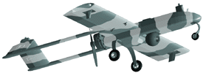

Joint Air Attack Team (JAAT)
A JAAT is an engagement technique using a combination of attack reconnaissance aircraft and joint fixed wing aircraft operating together to locate and attack high priority targets and other targets of opportunity.
The JAAT normally operates as a coordinated effort supported by FS, ADA, NSFS, ISR systems, EW systems, and ground maneuver forces against enemy forces (JP 3-09.3).
Interdiction Attack - An attack by Army aircraft to divert, disrupt, delay, or destroy the enemy before it can be used effectively against friendly forces. (FM 3-04.126, 2007)
LAM
JDAM
JSTARS
Shaping
Operation
U.S. AIR FORCE
Interdiction: An action to divert, disrupt, delay, or destroy the enemy's surface military potential before it can be used effectively against friendly forces. (JP 1-02)
Decisive
Operation
Notes:
The overall goal of JAAT planning is to apply constant, overwhelming firepower from multiple sources against the enemy. This goal must be tempered with the need to maintain proper coordination to avoid fratricide.
I use the example of a CAS box vs the doctrinal definition of a kill box. CAS Box requires careful detailed planning and coordination for fratricide prevention due to proximity of friendly forces…kill box does not. Reference FM 3-09.34 (Kill Box) – see below for definition and purpose of kill box:
Definition: A kill box is a three-dimensional fire support coordinating measure (FSCM) used to facilitate the expeditious air-to-surface lethal attack of targets, which may be augmented by or integrated with surface-to-surface indirect fires. While kill boxes are permissive FSCMs with respect to the deliverance of air-to-surface weapons they are also restrictive in nature; trajectories and effects of surface-to-surface indirect fires are not normally allowed to pass through the kill box. A kill box is a unique FSCM that may contain other measures within its boundaries [e.g., no-fire areas (NFAs), restricted operations area (ROAs), airspace coordination areas (ACAs), etc.]. Restrictive FSCMs and airspace control measures (ACMs) will always have priority when established in a kill box.
b. Purpose: When established, the primary purpose of a kill box is to allow air assets to conduct interdiction against surface targets without further coordination with the establishing commander and without terminal attack control. A kill box will not be established specifically for close air support (CAS) missions. However, this does not restrict CAS missions inside of established kill boxes if all CAS requirements are met. When used to integrate air-to-surface and surface-to-surface indirect fires, the kill box will have appropriate restrictions. The goal is to reduce the coordination required to fulfill support requirements with maximum flexibility, while preventing fratricide.

Slide 19
Notional JAAT Scenario
Animated – Click center to activate

Slide 20
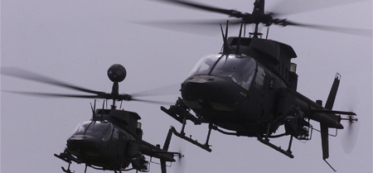
OH58D KIOWA WARRIOR
WEAPON
MAX LOAD
MAX RNG
.50 CAL MG
2.75” RKTS
HELLFIRE (laser)
STINGER
500 RNDS
7 PER POD(14)
2 PER SIDE(4)
2 PER SIDE(4)
2000m
8000m Contact
8000m
5000m

Slide 21
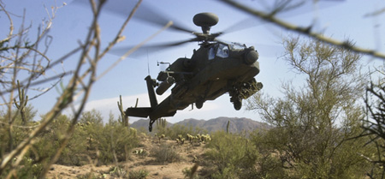
AH64D LONGBOW
WEAPON
MAX LOAD
MAX RNG
30 mm Chain Gun
2.75” Rockets
Hellfire Missile
(laser or RF)
1200 RNDS
19 PER POD(76)
8 PER SIDE(16)
4000m
9000m
8000m

