Slide 1
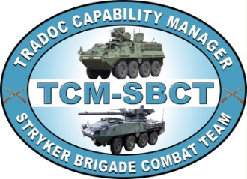
STRYKER TADSS
Reference
4 April 14

Slide 2
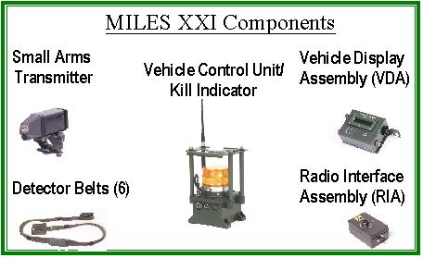
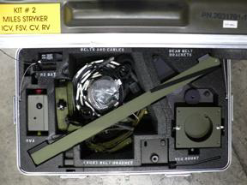
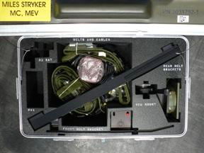
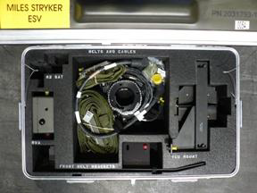
Miles XXI/Delta Kits
Purpose of Trainer:
This device is a component of the Multiple Integrated Laser Engagement System (MILES). MILES XXI is a family of training systems, accurately, and in real time, simulates the effect of direct and indirect fire (artillery, nuclear, or chemical weapons, and mines) as they would affect a vehicle/soldier in combat. This permits realistic combat training without the hazards of live ammunition. MILES XXI provides the capability for two-sided, real-time tactical engagement at unit sizes up to battalion and for realistic casualty assessments.
Physical Information:
The STRYKER Vehicle System Tactical Engagement Simulator System is equipped with a laser transmitter that is fired using normal operating procedures. Special detector belts on the vehicle’s exterior sense opposing forces fire. The STRYKER MILES XXI kit consists of 2 transit cases, one is a common kit and the second is a Delta Kit for the different variants of the STRYKER. All will require the common kit and then the Delta kit that supports that variant. The different variants of STRYKER are, Infantry Carrier Vehicle (ICV), Command Vehicle (CV), Fire Support Vehicle (FSV), Reconnaissance Vehicle (RV), Mortar Carrier (MC), Medical Vehicle (MEV), Engineer Support Vehicle (ESV), Anti Tank Guided Missile Vehicle (ATGM), and the Nuclear Biological Chemical Reconnaissance Vehicle (NBCRV). There are 5 different Delta Kits and they support (ICV,CV,FSV,RV), (MC and MEV), (ESV), (ATGM), and (NBCRV).

Slide 3
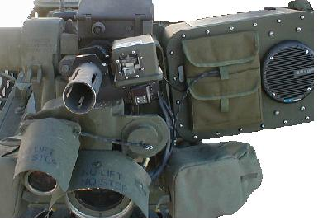
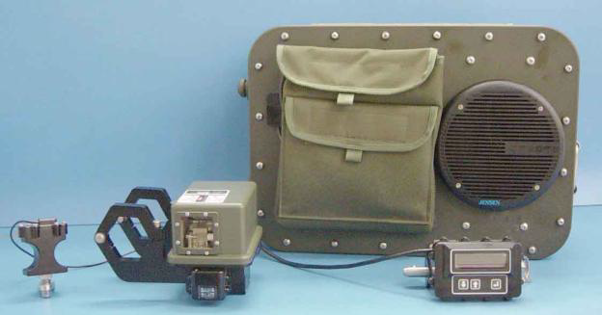
MK19
Simulation Player Unit
Purpose of Trainer:
The MK-19 Simulation Player Unit system supports realistic combat training exercises without using live ammunition. It provides a common approach for the Stryker Remote Weapon Station, M113 pintle mount, AAV, HMMWV and ground mount. The MK-19 SPU system consists of a Laser Module, Operator Module, Audio Cue Device (ACD), and Trigger Assembly. The MK-19 Simulation Player Unit incorporates a modular design resulting in an interoperable solution simulating the firing and actual effects of a MK-19 in a MILES environment.
Functional Description:
MK-19 SPU: The Laser Module emits visible flash cues
and an invisible (infrared) laser beam toward a target. A blue LED Laser Firing Indicator located on the rear of the Laser Module provides the gunner with a visible indication the laser has fired. A target is outfitted with a detector assembly that senses the laser beam from the Laser Module to cause a target KILL or NEAR MISS.

Slide 4
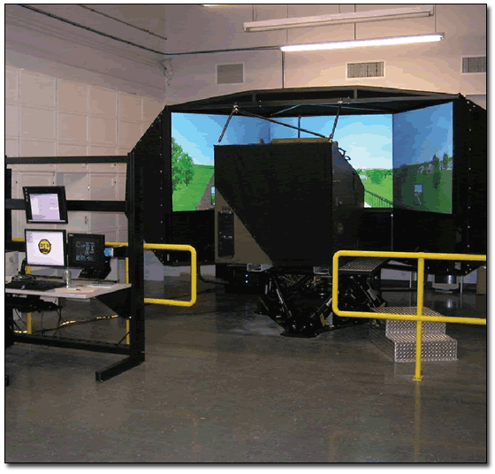
CDT/SV
Description:
The Common Driver Trainer(CDT) provides initial and sustainment driver training at training institutions and operational installations.
CDT/Stryker Variant is the first CDT application consists of a simulated vehicle cab, instructor-operator station (IOS), a visual system, a 6 Degree of Freedom (DoF) motion system and a computational system.
The CDT/SV will be the baseline of the Army Common Driver Trainer architecture.
The instructor, via the IOS will be capable of selecting a visual scene, viewing the scene, monitoring each trainee’s performance and introducing malfunctions and emergency control situations.

Slide 5
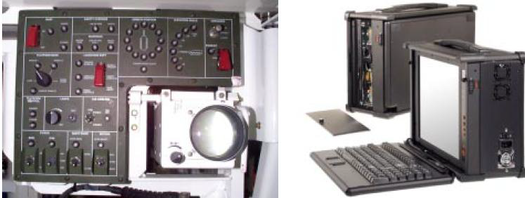
ATGM Basic Skills Trainer
Purpose of Trainer:
Its purpose is to provide the following gunner skills training: initial-entry ATGM basic gunner skills, basic and advanced individual gunnery, sustainment training in the unit, and formal qualification training.
Functional Description:
The Instructor Station software injects simulated terrains and targets into the ATGM launcher site, and the gunner uses the tactical ATGM launcher controls to engage the simulated targets. Terrain and target images are presented in both daylight and IR views. The exercises are interactive three-dimensional simulations of tactical engagements designed to train gunners in all aspects of target engagement. The gunner sees a variety of targets as he scans his sector of fire, and detects, classifies, identifies, and engages them or not as appropriate for a particular exercise.
Physical Information:
The ATGM Basic Skills Trainer is a PC-based appended training device installed inside the ATGM vehicle. During training, the ATGM Gunner Station components are disconnected from the tactical system and reconnected to the ATGM BST Interface
Assembly. The Interface Assembly is then connected to the BST Instructor Station (PC).

Slide 6
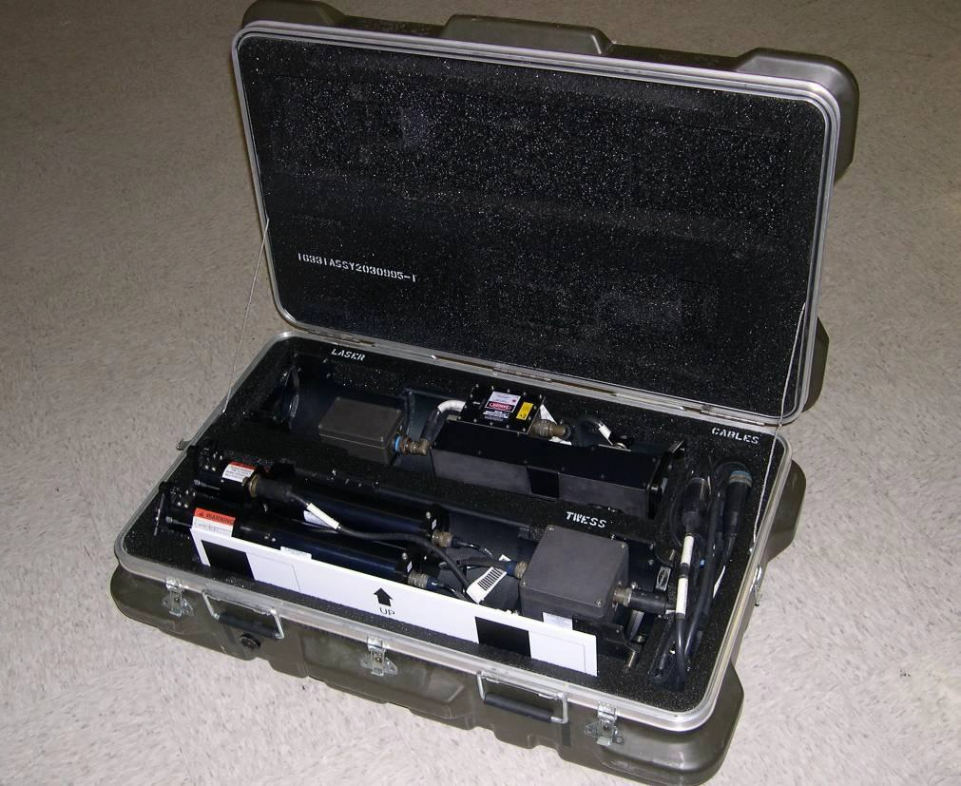
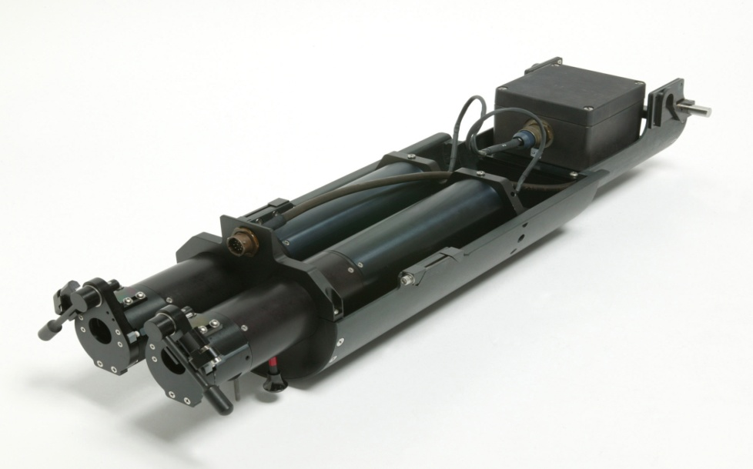
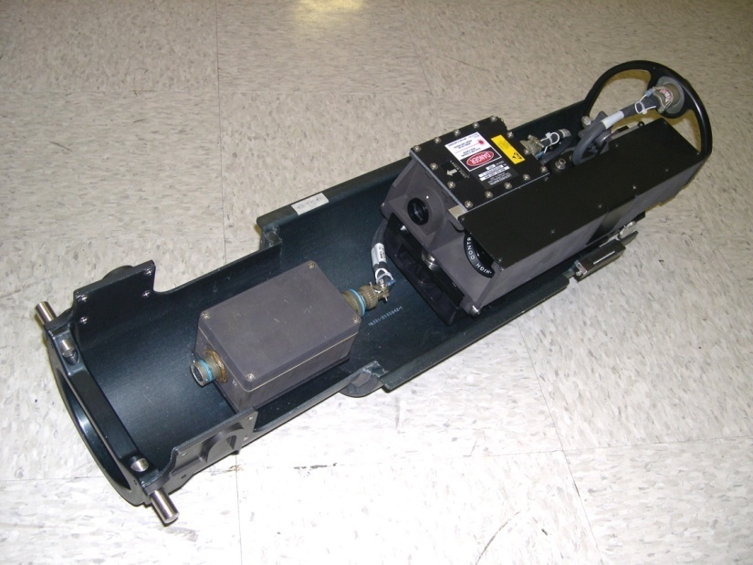
ATGM STRYKER TOW
SIMULATOR
Purpose of Trainer:
The STS is used for situational training exercises (STX) or field training exercises (FTX) in a MILES or TES force
on-force environment. The STS is designed to be used in conjunction with the MILES XXI Stryker Common Kit, P/N 2031790-1, and MILES XXI Stryker ATGM Delta Kit,
P/N 2031794-1, when installed on the M1134 Stryker ATGM Vehicle. The STS replaces the ATGM Field Tactical Trainer (FTT), previously used on this vehicle for force-on-force training applications.
Functional Description:
The STS is comprised of two main assemblies, the TOW
Laser Device (TLD) and TOW ATWESS Device (TAD).
Also included are three cables used to interface the STS to
the Stryker ATGM weapons system when used in MILES training exercises.
The TLD provides for the laser simulation of the TOW
missile round. The TLD is built in a ―tube‖ configuration
that is approximately half the length of a TOW missile
body, and is installed into the ATGM launch tube in a
similar manner.
The TAD fires Anti-Tank Weapons Effect Signature
Simulator (ATWESS) cartridges that replicate the initial
launch explosion of a TOW missile. The TAD is built in a
―tube‖ configuration that is approximately half the length
of a TOW missile body, and is installed into the ATGM
launch tube in a similar manner.
The STS system is fully interoperable with the MILES
XXI system, and receives configuration information such
as Player ID, and ammo load from the MILES XXI, as well
as vehicle casualty status which is used to determine if the
TOW weapon may be fired.

Slide 7
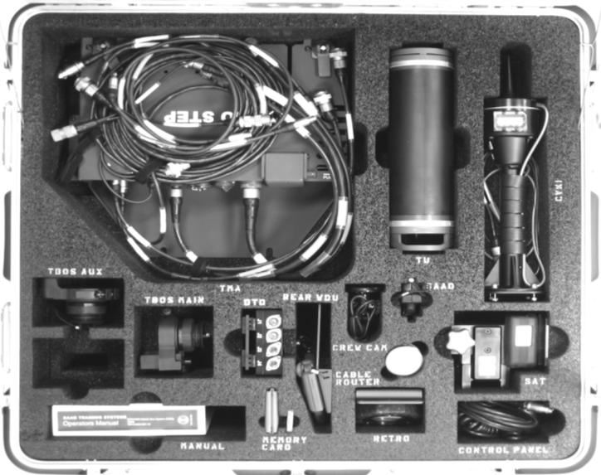
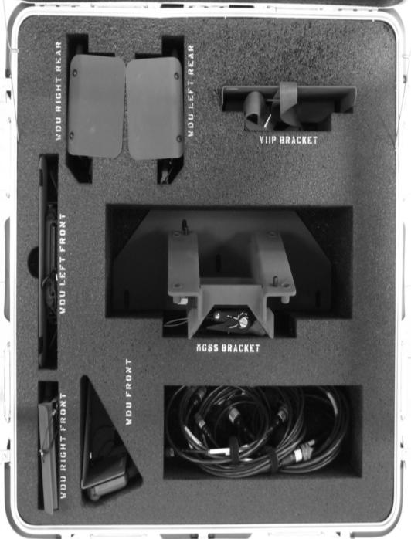
MGS-TESS
Purpose of Trainer:
MGS-TESS is designed to operate on the Stryker MGS during Force-on-Force (FOF) and gunnery training exercises.
Functional Description:
MGS-TESS provides laser based Precision Gunnery (PG) capabilities and FOF training for the U.S. Army Stryker MGS. The In-bore Device Stryker (IDS) is available as a cost saving alternative to main gun live fire. While utilizing the Vehicle Instrumentation Interface Package (VIIP) the system interfaces with instrumentation systems at Maneuver Combat Training Centers (MCTCs). MGS-TESS is a 28 Volts Direct Current (VDC) system powered by the vehicle and interconnecting cables. User replacement of batteries is necessary only for the Wireless Detector Units (WDU) and Commander’s .50 Caliber (Cal) Small Arms Transmitter (SAT). MGS-TESS simulates both the firing capabilities and the vulnerability of the vehicle. The main weapon and secondary weapon are simulated with the Transceiver Unit (TU) and the Commander's .50 Cal is simulated with the SAT. The simulator interfaces both to the vehicle and crew; to the vehicle with brackets and connectors and to the crew with audio and visual signals.
Physical Information:
The MGS-TESS system will be contained in two transit cases. Case 1 contains components, mounting hardware, cables, and manuals. Case 2 is only needed for Force on Force training. The Government Furnished Equipment is delivered in separate transit cases (MGSS, DIFCUE, In-bore Device, VIIP, AAR/Set-up Computer, Controller Gun).

Slide 8
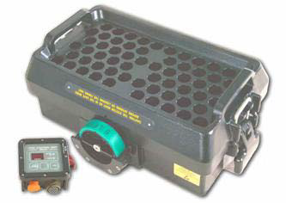
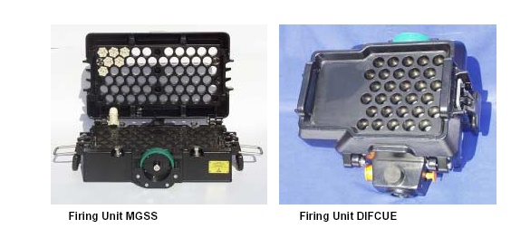
Main Gun
Signature Simulator
Purpose:
The Main Gun Signature Simulator replaces basic MILES systems at home-station due to age of technology and cost to maintain. The MGSS is a component of the MGS Tactical Evaluation Simulation System.
Description: The MGSS is mounted on the STRYKER Mobile Gun System (MGS) and simulates the main gun firing. The MGSS holds 60 pyrotechnics when fully loaded and is “keyless” for safety. When the main gun trigger is activated a signal goes to the MGSS and fires 1 pyrotechnic for each firing. The pyrotechnic creates the flash and bang of the main gun, triggering the Universal Laser Transmitter (ULT).

Slide 9
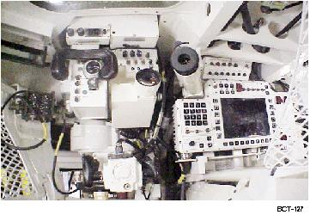
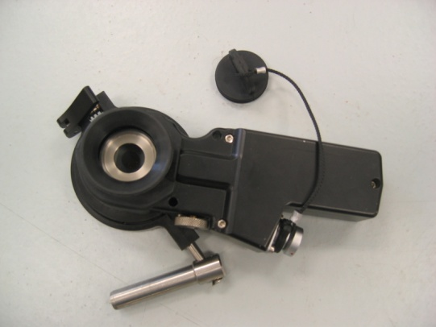
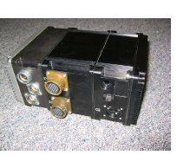
MGS Thru-Sight Video
DESCRIPTION:
The MGS TSV is a component of the MGS Tactical Engagement Simulator System. The Thru- Sight Video captures tracer effects, vehicle position and firing events. It also records video from Gunner’s Day, Gunner’s Thermal, Commander’s Panoramic Viewer and from the crew camera mounted in the turret to be used during AAR.
Hard optics camera
and visual effects
generator
Recorder

Slide 10
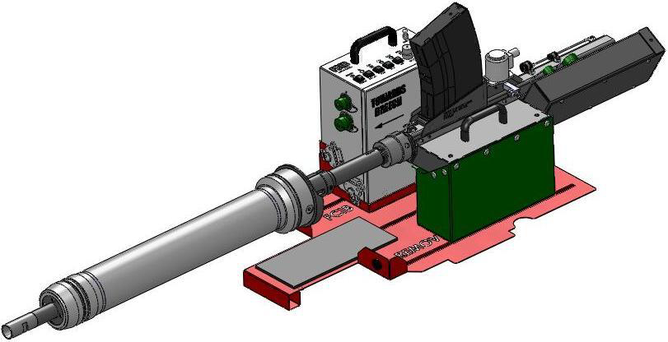
MGS In-bore Device
Purpose of Trainer:
Used in conjunction with MGS TESS to provide full and half scale, sub caliber live fire gunnery and urban (MOUT), warfare training.
Functional Description:
The IDS is designed for use with the Stryker MGS 105mm, M68A1E8 cannon. The IDS is intended for live fire gunnery or urban gunnery training with full or half scale targets. Maximum target engagements of 2000 meters are achieved using Cal. 50, M17 Trace. Urban training using M860 SRTA-T has a maximum effective range of 170 meters. Ballistic solution data for both M962 and M17 is incorporated into the ballistic computer of the STRYKER MGS vehicle.

Slide 11
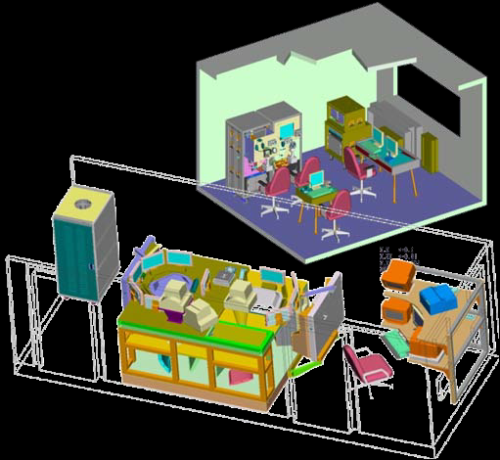
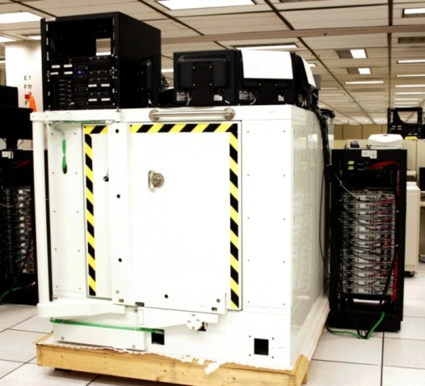
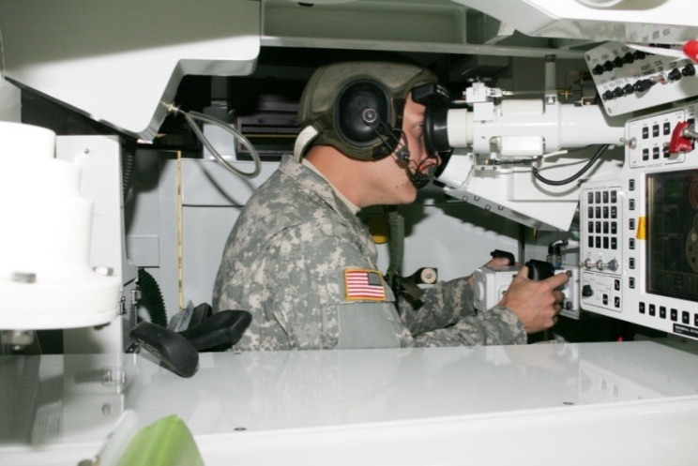
MGS AGTS
Purpose of Trainer:
The Stryker MGS AGTS provides gunnery simulation
training for MGS crew’s, MOS 19K. Stryker MGS AGTS trainers are setup in two configurations, institutional and mobile. In the institutional configuration, illustration 1 above, three crew stations are capable of being linked for MGS section or platoon training. In mobile configuration, illustration 2 above, the trainer is mounted and is capable of being linked for section and platoon training. These stand-alone crew trainers provide gunner and vehicle commander training in precision and degraded mode gunnery tasks. The instructor, via the instructor/operator station, is capable of selecting a gunnery exercise, starting, pausing and stopping the exercise, and monitoring each crew's performance. Malfunctions and battle damage are randomly induced in exercises.
Functional Description:
Each Stryker MGS AGTS consists of a crew station replicating the gunner's and vehicle commander's compartment; an instructor/operator station; a visual system; an aural/audio system; and a computer system. A computer generated image system provides visual presentations to the gunner and VC through the optical system. Stryker MGS AGTS has the ability to train
operational procedures, target acquisition, identification and engagement using either the primary or alternate fire control and sighting equipment. Stryker MGS AGTS provides a simulated battlefield environment with stationary and moving single and multiple target arrays presented in day, night and reduced visibility conditions. The instructor/operator station allows monitoring of the gunner and VC and selection of training scenarios to be conducted and provides a scoring system for evaluation of crew performance. A Pre-brief After Action Review (PAAR) capability is also provided for review of section and platoon training analysis.

Slide 12
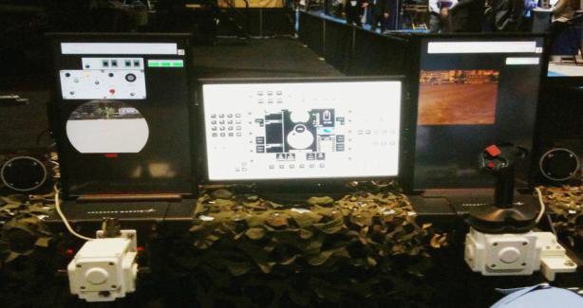
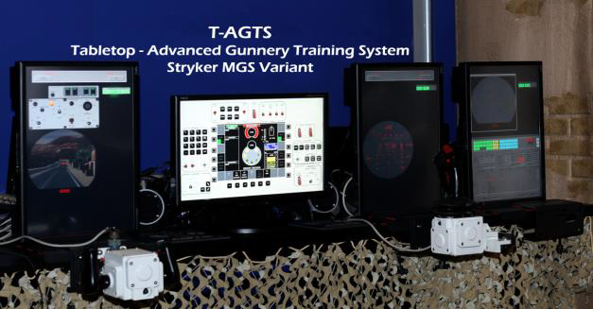
Table top-AGTS
Purpose of Trainer:
The Stryker MGS TAGTS provides virtual gunnery simulation training for MGS crews, MOS 19K. An instructor via a separate instructor/operator station (seen on the right-side of illustration 2), controls the training sessions by selecting gunnery exercise scenarios, and while monitoring each crew's performance, advances the crew through the different reticle aim levels of training to prepare them for their tasks in the actual vehicle.
Functional Description:
The Stryker MGS TAGTS is a crew training device based upon the Stryker MGS AGTS (Training Device 17-261). Using the same operating system software, databases and training exercises, these stand-alone tabletop versions of the full fidelity MGS AGTS trainer provide gunner and vehicle commander training in precision and degraded mode gunnery tasks.

Slide 13
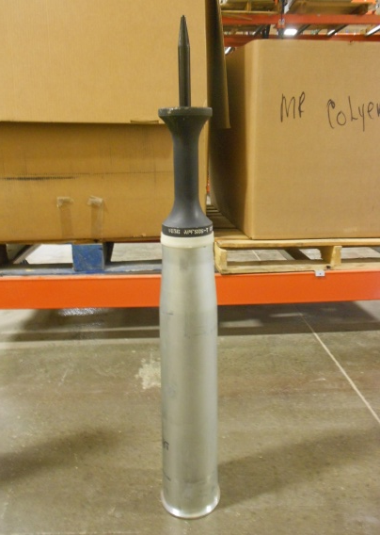
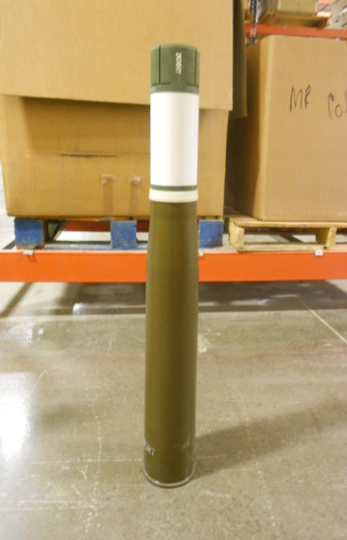
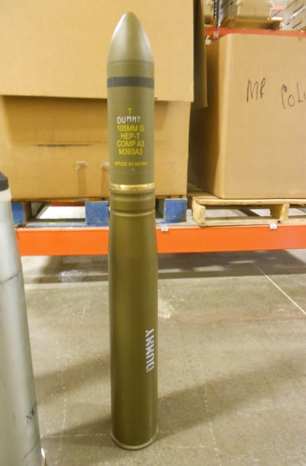
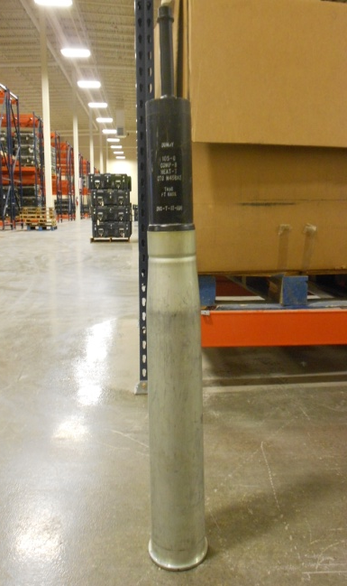
MGS Inert 105mm
Training Round
Purpose of 105mm Inert Round:
The Stryker MGS 105mm Inert Round allows the crew to train on handling, loading, and unloading MGS Ammunition. These 4 Inert Rounds replicate HEP, SABOT, HEAT, and CANISTER.

Slide 14
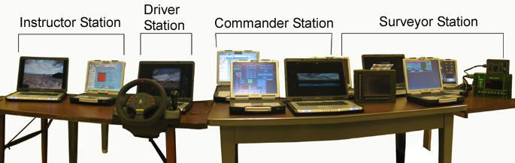
NBCRV-VCT
Purpose of Trainer:
The NBCRV trainer uses Chemical, Biological, Radiological and Nuclear (CBRN) Reconnaissance based scenarios to present the individual and crews with CBRN hazards that cannot be duplicated at the unit location due to various regulatory restrictions of using simulants. It can be configured to include 6 vehicles simultaneously or represent other mounted reconnaissance platforms such as the Nuclear, Biological and Chemical Reconnaissance System (NBCRS) M93A1 and M93A1P1 variants. The NBCRV Master Instructor Workstation (MIW) provides the capability for exercise generation and After Action Review (AAR) that permits performance and evaluation of individual and collective tasks identified using the Combined Arms Training Strategy (CATS) for CBRN Reconnaissance Platoons. All scenarios are written and conform to current doctrine IAW FM 3-11.19 (Multiservice Tactics, Techniques, and Procedures for Nuclear Biological and Chemical Reconnaissance), and FM 3-11.86 (Multiservice Tactics, Techniques and Procedures for Biological Surveillance). The trainer provides the instructor/leader the ability to manipulate the environment using the MIW by changing weather data, type of agent, type of release, and detection component – specific parameters (e.g., Joint Biological Point Detection System (JBPDS) provides a presumptive identification of a known bio agent; Chemical Biological Mass Spectrometer (CBMS) Block II can detect known and unknown chemical hazards).

Slide 15
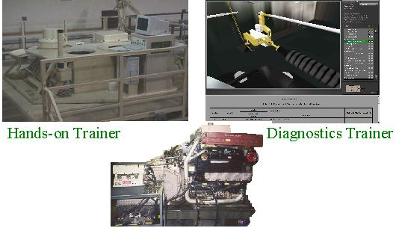
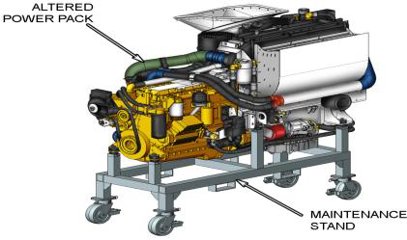
Maintenance Training
System (HOT/DTT/PTT)
Purpose of Trainer:
The Stryker Maintenance Training System (MTS) is a family of training devices that accurately simulate the configuration and operation of the Stryker Infantry Carrier Vehicle (ICV) and its Remote Weapons System (RWS). The Stryker MTS is used to support maintenance and troubleshooting training for MOS Series 63B, 45K and 91S mechanics assigned to maintain the Stryker Vehicle and the RWS.
Functional Description:
There are four classes of training devices used in the Stryker MTS: 1) Diagnostic Troubleshooting Trainers (DTTs), 2) Part Task Trainers (PTTs), 3 Hands On Trainers (HOTs), and 4) Training Management Systems (TMS).
The DTTs are computer-based virtual-reality, video-training devices that students operate to navigate through Stryker ICV troubleshooting and maintenance training. The HOT trainers integrate virtual training with physical hardware training, using replicated, instrumented ICV system components to form integrated vehicle subsystems. In a PTT, a specific subsystem is realistically duplicated to allow students to remove and replace Line Replaceable Units (LRUs). All MTS training devices allow instructors to monitor and score student performance during training. The TMS provides centralized support for classroom management functions, student record archiving, and lesson plan preparation and management.
MTS

Slide 16
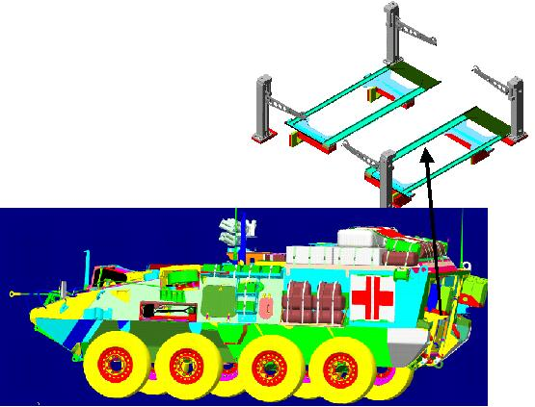
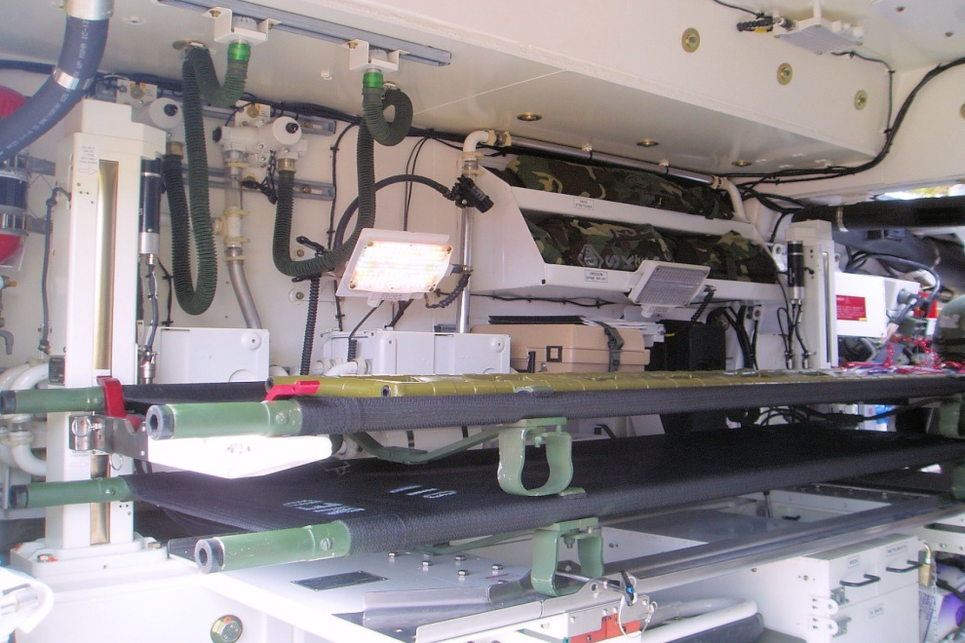
MEV RCTD
Purpose of Rear Cabin Training Device:
The Stryker Medical Evacuation Vehicle Rear Cabin Training Device was to be designed to allow Combat Medics to train on loading casualties onto the STRYKER MEV while attending initial and professional instruction at Fort Sam Houston.
The Rear Cabin Training Device was never built as it was determined that stationing 2 STRYKER MEV’s at Fort Sam Houston was more cost effective and achieved the same training outcomes as would the RCTD.
PM SBCT never funded the Rear Cabin Training Device and it remains only a concept at this time.

Slide 17
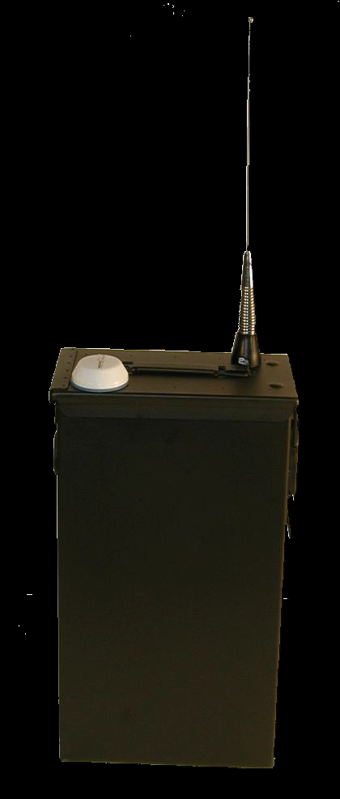
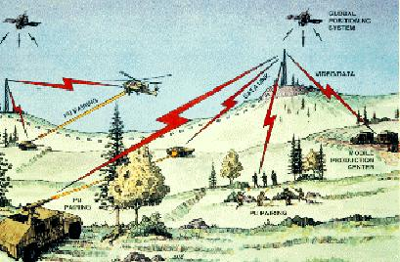
Vehicle Instrument
Interface Package
VIIP
Purpose of Trainer:
The Vehicle Instrument Interface Package (VIIP) provides the communications interface between vehicles and the instrumentation systems at maneuver Combat Training Centers (CTC) and the Alaska Range, Home station Instrumentation Training System (HITS), Deployable Instrumented Training System (DITS) and Deployable System for Training and Readiness (DSTAR). The VIIP appends to vehicles and allows for simulated direct and indirect-fire engagements. The VIIP instruments STRYKERs using the Multiple Integrated Laser Engagement System (MILES) XXI and the Mobile Gun System Tactical Engagement Simulation System (MGS TESS). VIIP provides brigade commanders and training exercise managers exercise oversight and capability for comprehensive After Action Review (AAR) production.
Functional Description:
The VIIP provides the communication interface between all of the STRYKER vehicle variants and the instrumentation systems at Joint Readiness Training Center (JRTC), National Training Center (NTC), and Combat Maneuver Training Center (CMTC). It enables the STRYKER Brigade Combat Team (SBCT) to conduct exercises. VIIP merges the communication between the MILES XXI (most current version of MILES) vehicle control unit (VCU) and the data communication interface (DCI).

Slide 18
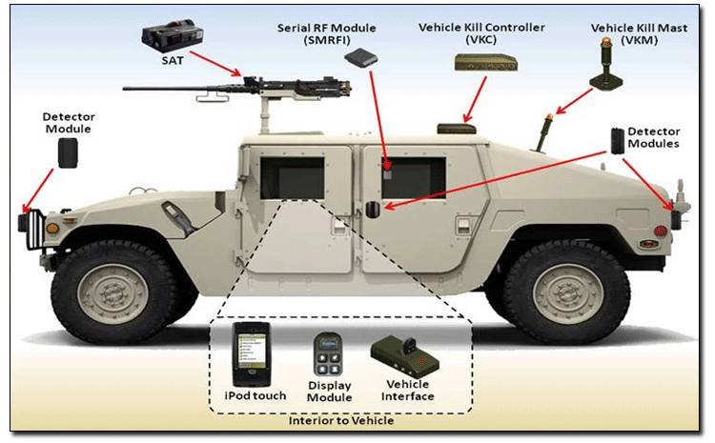
Tactical Vehicle System
DESCRIPTION:
IMILES TVS provides real-time casualty effects necessary for tactical engagement training in direct-fire, force-on-force training scenarios and instrumented training scenarios. It replaces all basic MILES systems currently fielded on non-turreted military vehicles, from commercial vehicles through MRAP and Stryker families of vehicles, and can be used independently on fixed structures, i.e. bridges. The TVS improves on the wireless function of WITS, permitting a “weapons link” between the system’s target detectors and the Small Arms Transmitter (SAT) used by personnel on board the tactical vehicle; adding the capability of killing both the vehicle and the on-board small arms weapon system. Instrumentation interface is provided for CTC use and includes GPS, crew-served weapons interface and battery eliminator functionality. IMILES TVS is fielded Army-wide in accordance with the MILES Basis of Issue Plan (BOIP).

Slide 19
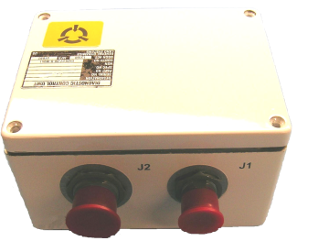
Embedded Trainer
(VDT/ETM and VDET)
VDT
ETM
VDET
DCU
VDET ~ 90 watts
vs..
VDT, ETM & DCU
~ 200 watts
VDET ~ 573 cubic in
vs..
VDT, ETM & DCU
~ 2030 cubic in
VDET ~ 22 lbs
vs...
VDT, ETM & DCU
~ 45 lbs
VDET ~ $21,000
vs..
VDT, ETM & DCU
~ $43, 000

Slide 20
TADSS Glossary
MK19 = Grenade Machine-gun Tactical Engagement Simulation
CDT/SV= Common Driver’s Trainer Simulator-STRYKER Version, 1ea in PA is a mobile system
BST = Basic Skills Trainer for ATGM, BOI 4 per SBCT
STS = Stryker TOW Simulator (Use to be FTT) The original requirement was 100.
TESS = Tactical Engagement Simulation System(includes: TES, MGSS, TSV, In Bore).
MGSS = Main Gun Signature Simulator (HUFMAN)
TSV = Through-Sight Video
In Bore = Additional capability to allow crew to fire sub-caliber gunnery tables
AGTS = Advanced Gunnery Training System (COFT-like crew / Plt virtual trainer)
Inert = 105mm practice rounds for crew load/transfer training (PM MAS funded)
IDAGTS = Interim Deployable Advanced Gunnery Training System
VCT = NBCRV Virtual Crew Trainer CBRNE replicator; qty does NOT include 2ea for Redstone for further development/testing) * JPM plans to provide 1 per SBCT (Use to be MIW) The original requirement was 143.
MTS = Maintenance Training Systems
DTT = Diagnostic Task Trainer (Desk-top), qty is number of student stations for 91S MOS (40 ea) & 6 for MGS Master Gunner Training
PTT = Part task trainers (5 Power pack, 1 brake, 1 suspension, 5 ATGM, 5 MC, 4 RWS and 1 driveline)
HOT = Hands on trainers (5 Hull, 1 RWS, 5 MGS Turret/AHS)
RCTD = **MEV Rear Cabin, ~Jan 04 decision was made to allocate 2 MEVs to AMEDD, more cost effective
VIIP = Vehicle instrumentation interface package, for CTC data collection
TVS = Tactical Vehicle System : Wireless MILES systems that can interface with CTC’s and Home station Instrumentation Training Systems (HITS)
VDT/ETM = Video Display Terminal/Electronic Training Module
VDET = Video Display Electronic Terminal

