Slide 1
Property Accountability
CPT REED C/3-47
SFC KUBAS 3/47 BN S-4 NCOIC

Slide 2
Property Accountability
WHY??!!!
Here we go again!!!
I already know this!!!!
I have better things to do!!!!
Didn’t we go over this already!!!
I’m a Captain I think I would know this already!!!
In all my years as a First Sergeant, I’m listening to this WHY??!!!

Slide 3
Property Accountability (Hand Receipts)
2
VS
7 or 8
FORSCOM FT Benning
PBO
IPBO
TASC (maybe)
PBO
FMO
TASC (Annual /cyclic)
Under 5K
Company Property
TMP
TA- 50
Weapons Tally- Annual / cyclic

Slide 4
Property Accountability (Tools)
FORSCOM
FT Benning
PBUSE (sub, sub, sub)
Company MAL
Sensitive Items Inventory (PBO initiated)
10% Cyclic (PBO initiated and is usually 99% of your property)
Shortage Annexes (in PBUSE)
-10s for every system
PBUSE – very little
Company MAL
Sensitive Items Inventory (Weapons Pool initiated – sometimes misses a tally)
10% Cyclic – (yes however it is a small % of property)
Shortage Annexes- we should 2062
-10s…sort of (but we need to generate them)

Slide 5
Property Accountability (Tools)
FORSCOM
FT Benning
PBO – Property Book officer
Property Book: freezes during CoC
TO&E
7 or 8 different agencies
Property Books: don’t really freeze
Pile of 2062’s ??? WRONG!
TDA? It is not very clear

Slide 6
Property Accountability (How do we fix this)
Enforce use of the PBUSE system!
Proper use of 2062’s
Proper use of 3161’S
Ref DA PAM 710-2
LIW Accounts for all Leadership and supply personnel.
-10’s for all LIN numbers on a property book.

Slide 7
ask ourselves 3 Questions
Where are we now?
Where do we want to be?
How do we get there?

Slide 8
Property Accountability (Where we are now)
What Property do we own?
What Accountability do we have (who OWNS it??? Commander, supply tech, XO, SDS)
What support do we have? What system is the accountability being conducted under? (PBUSE/ AMIS/2062/Spreadsheet paper copy)
Is all the property pushed down to the lowest user?? (TA-50)

Slide 9
Property Accountability (Where we want to be)
All Property is accounted for through PBUSE or an automated system.
All Sub HR are signed before every Cycle.
Company MAL completed NLT 24 Hours after pick up of tally!!
All supporting DOCS maintained by the commander/ supply SGT. (3161’s, working inventory docs, ect)

Slide 10
Property Accountability (How do we get there)
Development of a standardized property book that assists Commanders and supply personnel. (turn over, continuity)
Create our own -10s for off the shelf items before we issue them out.
Correct use of 2062, and 3161(Change Doc).

Slide 11
Property Accountability (Best Practices)
Create a detailed Commander’s Property Book
Create your own -10s if necessary (take pictures)
Light Sets, Cool Zones, Water buffalos, TMP vehicles, etc
Develop a 10% at your level over 12 month timeframe (BN or Company initiated).
Senior DS sub hand receipt to the trainees within the first 72hours.
Do not delegate authority on pick up inventory! (first one completed by the commander!)
Sensitive Item inventories (at pick up, monthly, before / after movement, before grad)
Sub HR property down to sub HR holders in one of 2 ways
By HR type (8-9 HRs)
One HR for everything

Slide 12
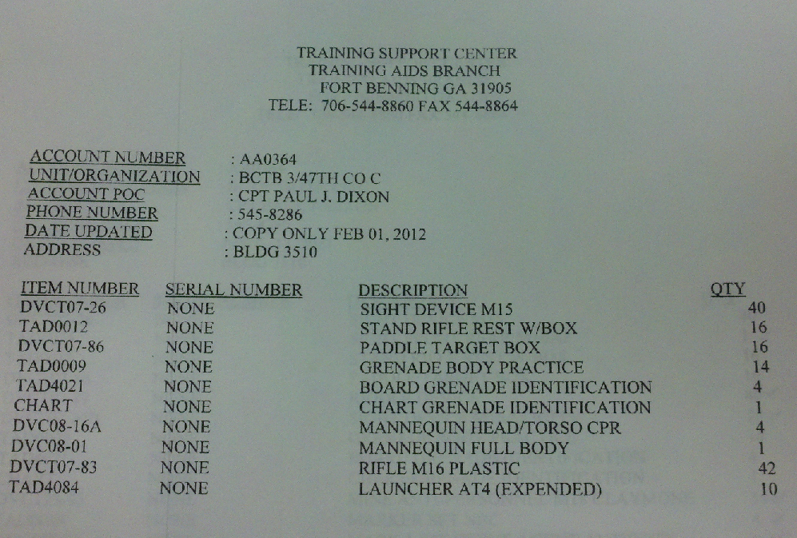
TASC Hand Receipt

Slide 13
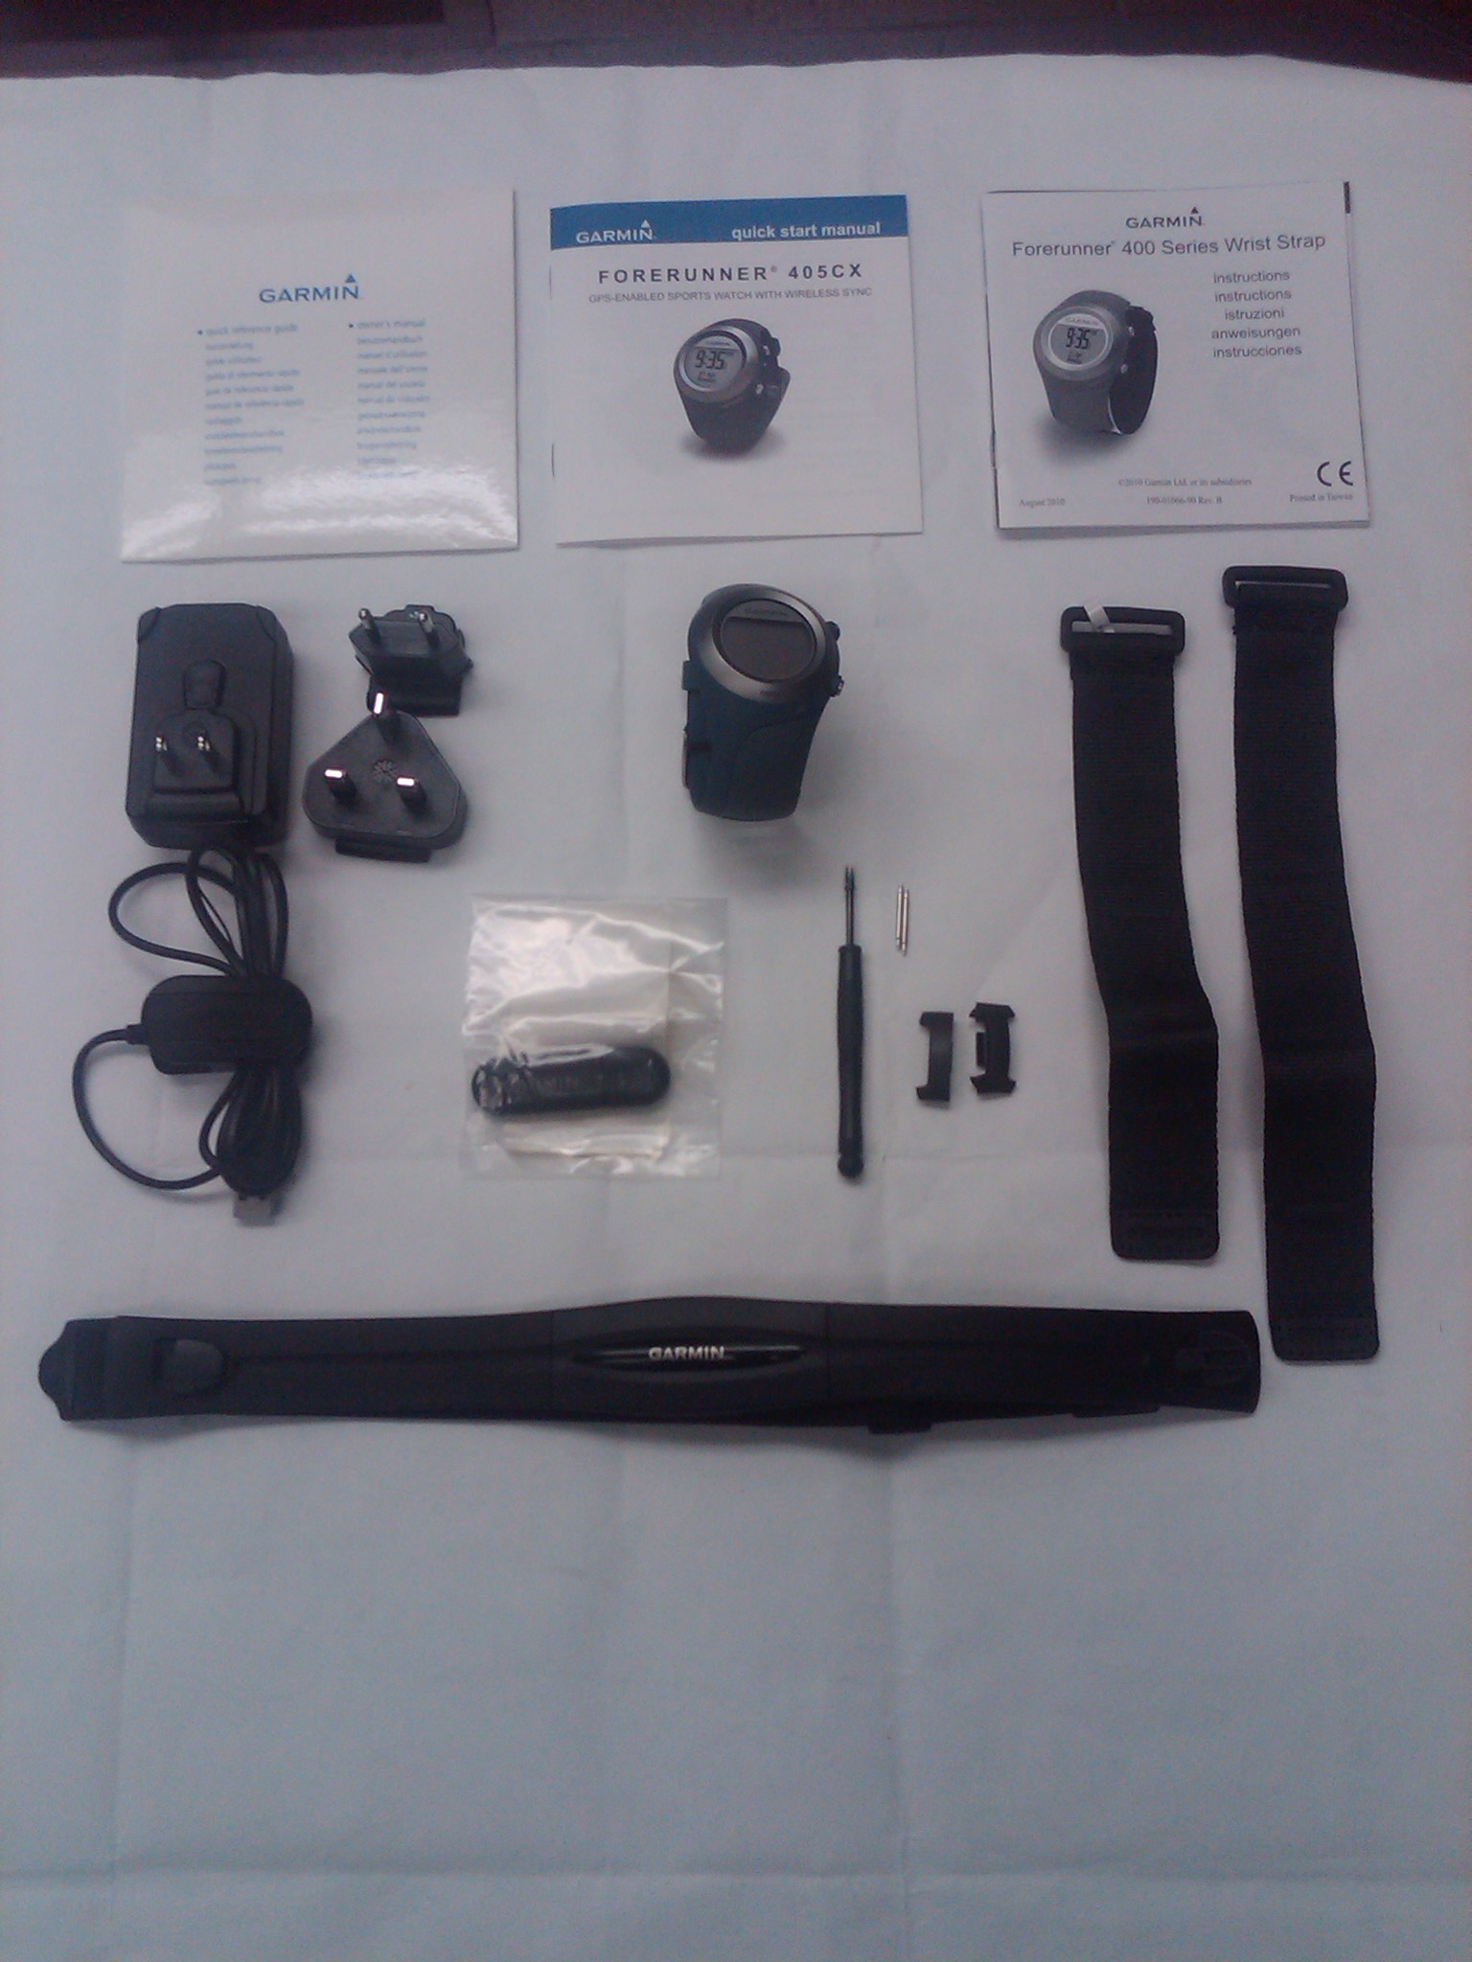
-10?????

Slide 14
AND NOW…
THE LONG AWAITED
INFAMOUS
COVETED
DREADED!!!!!
COMMANDERS PROPERTY BOOK!!!!

Slide 15
Property Accountability (Discussion)
Where are we now?
Where do we want to be?
How do we get there?
TTPS

