Slide 1
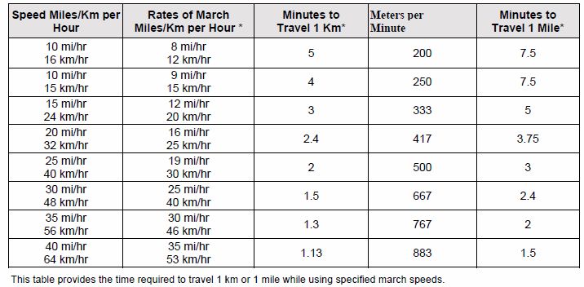
Time Required to Travel 1km/1Mi

Slide 2
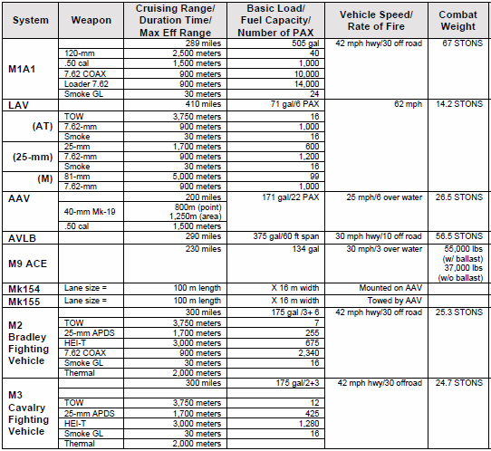
Vehicle Data

Slide 3
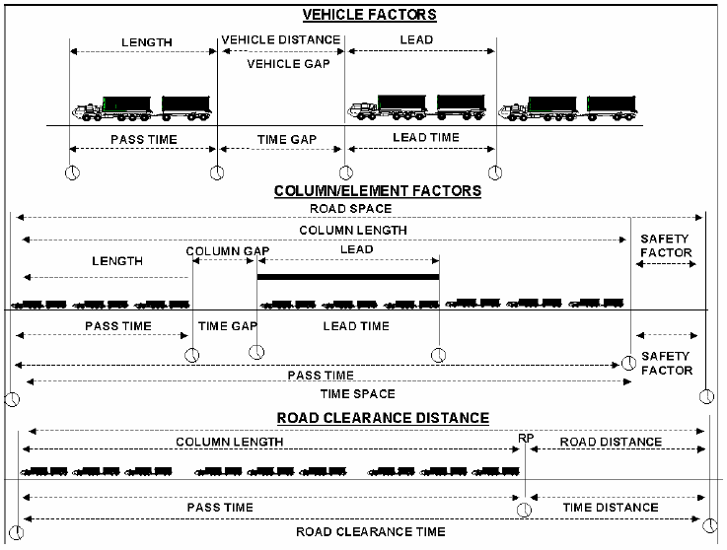
Vehicle Time and Distance

Slide 4
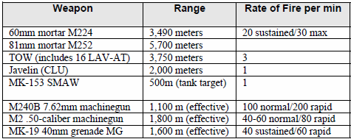
Crew Weapons

Slide 5
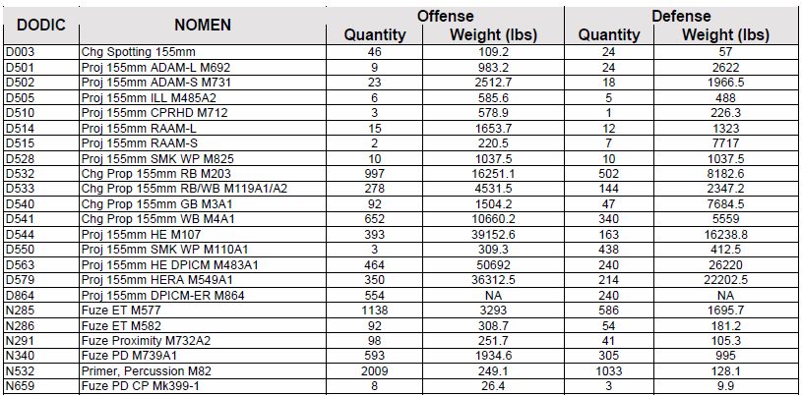
Artillery Requirements – Armor Hvy

Slide 6
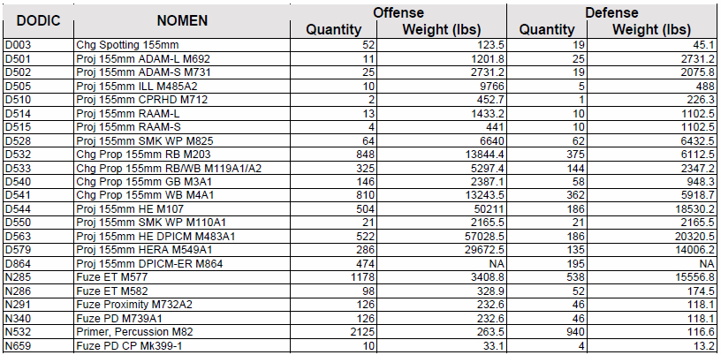
Artillery Requirements – Infantry & Armor

Slide 7
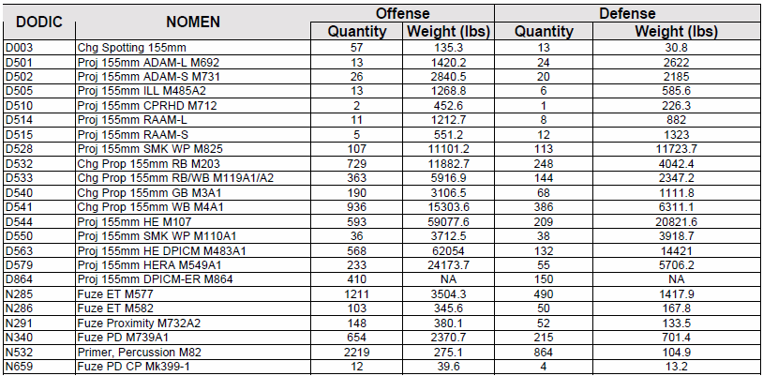
Artillery Requirements – Infantry Hvy

Slide 8
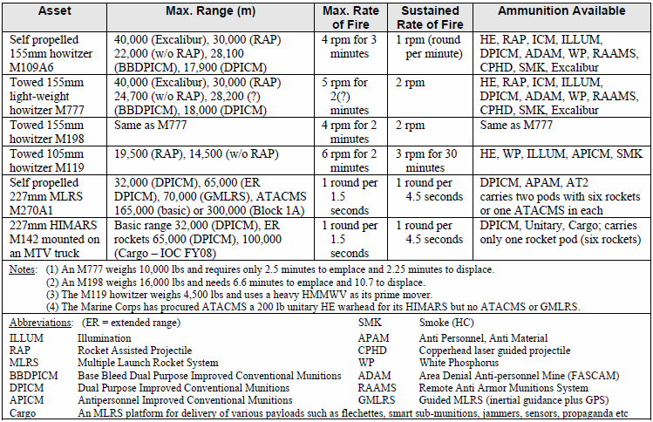
Cannon and Rocket Data

Slide 9
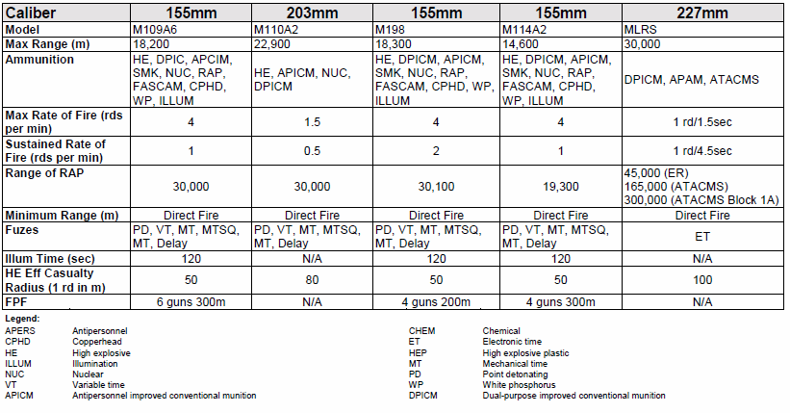
Indirect Fire

Slide 10
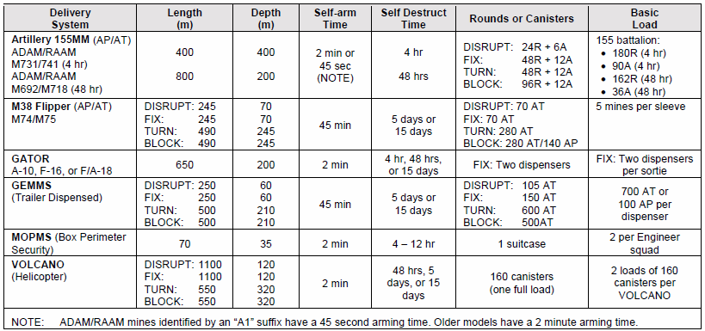
FASCAM Planning Factors
PLANNING AND EXECUTION RESPONSE TIME

Slide 11
Counter Battery Radar (1/2)

Slide 12
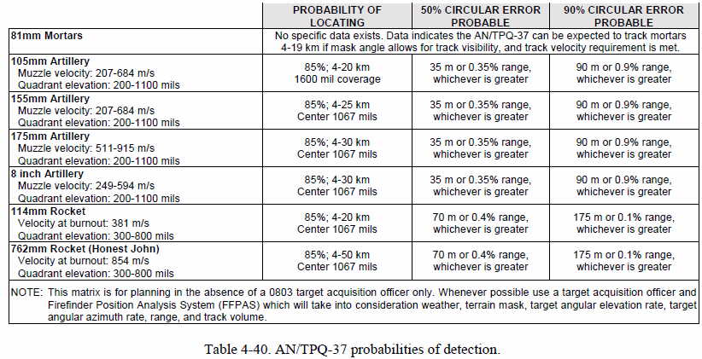
Counter Battery Radar (2/2)

Slide 13
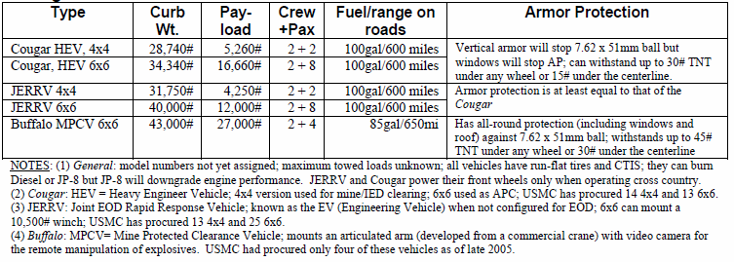
Counter Mine

Slide 14
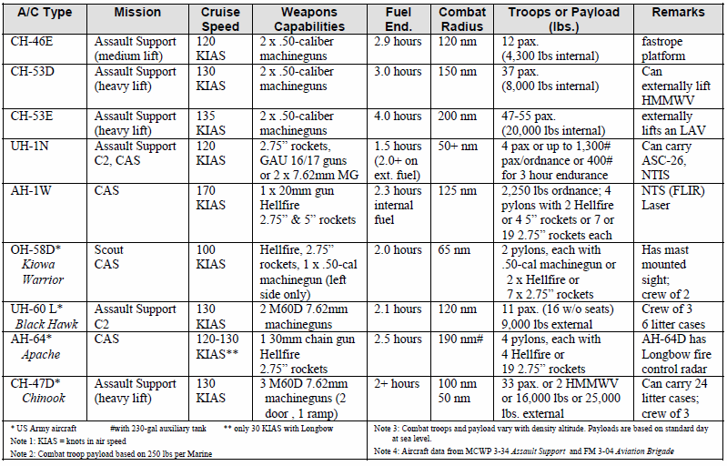
Rotary Wing

