Slide 1
MWO Overview
Hardware installations to be applied in order to configure the M88A2 to the latest configuration:
CREW II and CREW III
Automatic Fire Extinguishing System (AFES)
Blue Force Tracker (BFT) / FBCB2)
Split Engine Oil Access Door – (Applied to M88A2 Only)
Improved Main Winch Lower Guide Rail – (Applied to M88A2 Only)
Crew (Electrical) Distribution Panel (CDP)
LED Interior and Exterior Lighting
Interior and Exterior Stowage Enhancements
Removal of Smoke Generator Function

Slide 2
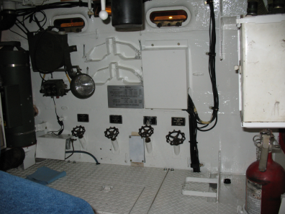
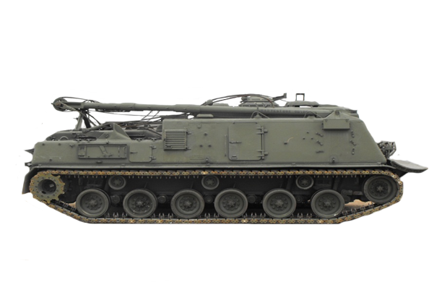
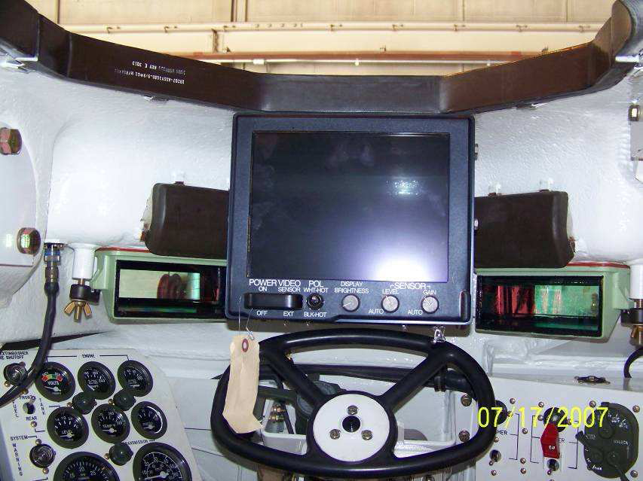
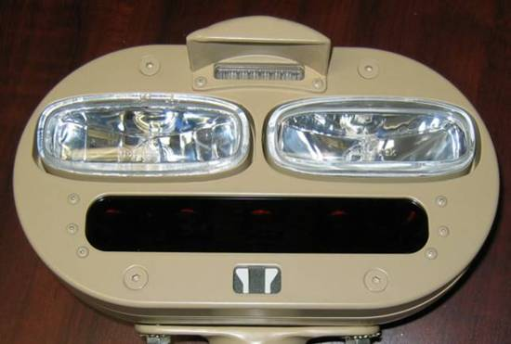
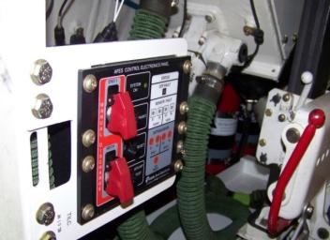
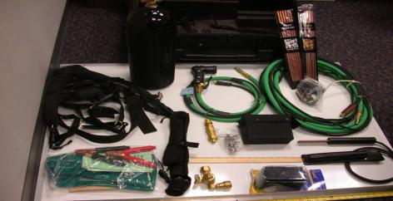
M88A1 Operational Modifications
Stowage Enhancements
Crew
Distribution Panel
BII/COEI
Supplemental Kit
DVE
(M88A1 only)
Lighting
Enhancements
BFT and
CREW II/III
A-kits
Exothermic
Cutter and Stowage
(M88A1 only)
Automatic Fire
Extinguishing System

Slide 3
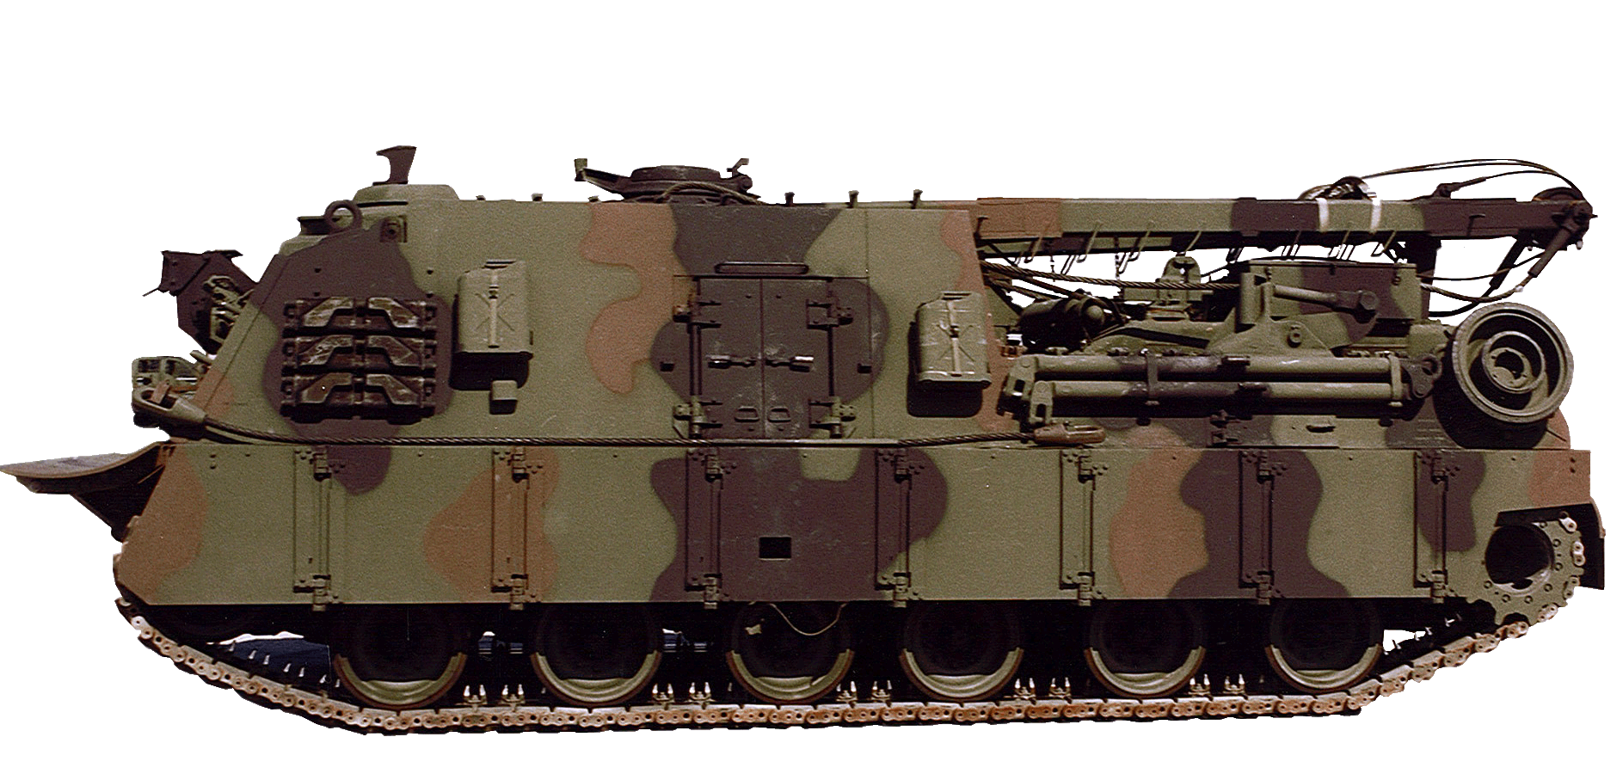
M88A2 Operational Modifications
Cupola Plate Mod Kit
BII/COEI
Supplemental
Kit
Crew Distribution Panel
Stowage
Enhancements
Lower Rail Replacement Kit (M88A2 unique)
Lighting
Enhancements
Smoke Generator Removal Kit
Automatic Fire
Extinguishing System
Split Engine Oil Access Door
BFT and CREW II/III
A-kits
AFES Test Set (12510436)

