Slide 1
Fires Center of Excellence Conference
UNCLASSIFIED/FOUO
GEN Dan Allyn
VICE CHIEF OF STAFF, ARMY
03 May 2016
The overall classification of this briefing is Unclassified/FOUO

Slide 2
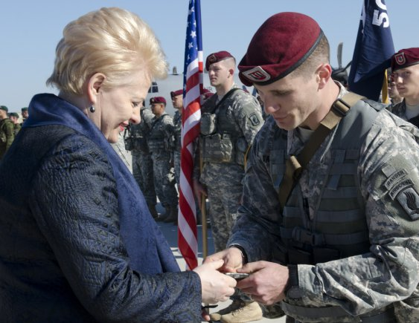
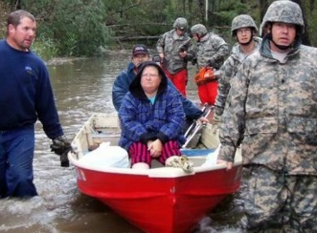
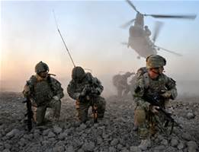
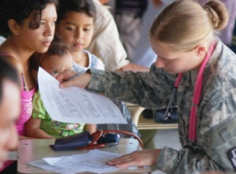
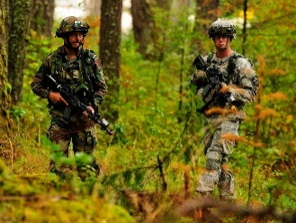
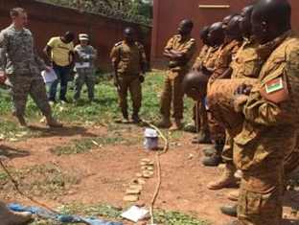
Our Army Today...
Regionally Aligned
Regionally Aligned: ~85K
Accessible, Tailorable, Scalable
Building Partner Capabilities
Sets the Theatre for CBT Cdrs
Globally Engaged
Support to Combatant Command: 187,560
Support to CT Operations Worldwide
Over 140 Countries
Across 6 Continents
SOF: ~4000 deployed, ~80 countries
Today’s Environment
8 Active and Guard DIV HQs Committed
3 Corps Headquarters Committed
2 National Guard BCTs Supporting Operations in SOUTHCOM, EUCOM, AFRICOM
Global Demand for Land Forces is Increasing
Integrate and Synch in Multi-Domains
Leading in the JIIM Environment
Ongoing
Leader Development; NCOES 2020; STEP
SHARP improvements; Expanded Gender Integration; Deployability
Army Operating Concept; RAF
Downsizing, Reorganization
Spectrum of Missions
Train, Advise, Assist: Afghanistan/Iraq
Humanitarian Disasters: Africa/Homeland
Rotational Forces to Korea; Europe; Kuwait
Building Warfighting Capabilities: CTCs
Regionally Aligned, Globally Engaged
UNCLASSIFIED/FOUO
2

Slide 3
Building the Army of the Future
The Army’s Missions :
Man:
Improving Personnel Readiness
Soldier for Life
Force of the Future
S2020/NCO2020
Talent Management Task Force
Gender Integration
2025 Design
Characteristics
Defend the Homeland
Defeat an Adversary
Provide a global stabilizing presence
Combat terrorism
Counter WMD
Deny an adversary’s objectives
Crisis/limited contingency operations
Military engagement/security coop
Stability Operations & COIN
Support to civil authorities
Conduct HADR
Optimized for Warfighting
READY TODAY
Train:
Decisive Action
Unified Land Operations
Adapt CTCs
High resolution HST
Equip:
Mobile Protected Firepower
BCT Redesign/ARI
Ground/Light Mobility Vehicle
Acquisition Reform
Divestiture
Expeditionary
Agile
Army Operating Concept
Functional/Operational/Organizational Concepts
Identify Required Capabilities
Think
Endurance
Force 2025 Maneuvers
Army Warfighting Challenges
Unified Quest Wargames/Unified Challenge Experiments
Learn
BUILD ARMY OF FUTURE
Adaptable
Total Army Analysis
Capability Needs Assessment
AWA/NIE → The BIG 8
Analyze
Implement
Interoperability
Integrated DOTMLPF-P Solutions: current and future force

Slide 4
UNCLASSIFIED/FOUO
Questions
?????
UNCLASSIFIED/FOUO
6

Slide 5
UNCLASSIFIED/FOUO
Back Ups
UNCLASSIFIED/FOUO
6

Slide 6
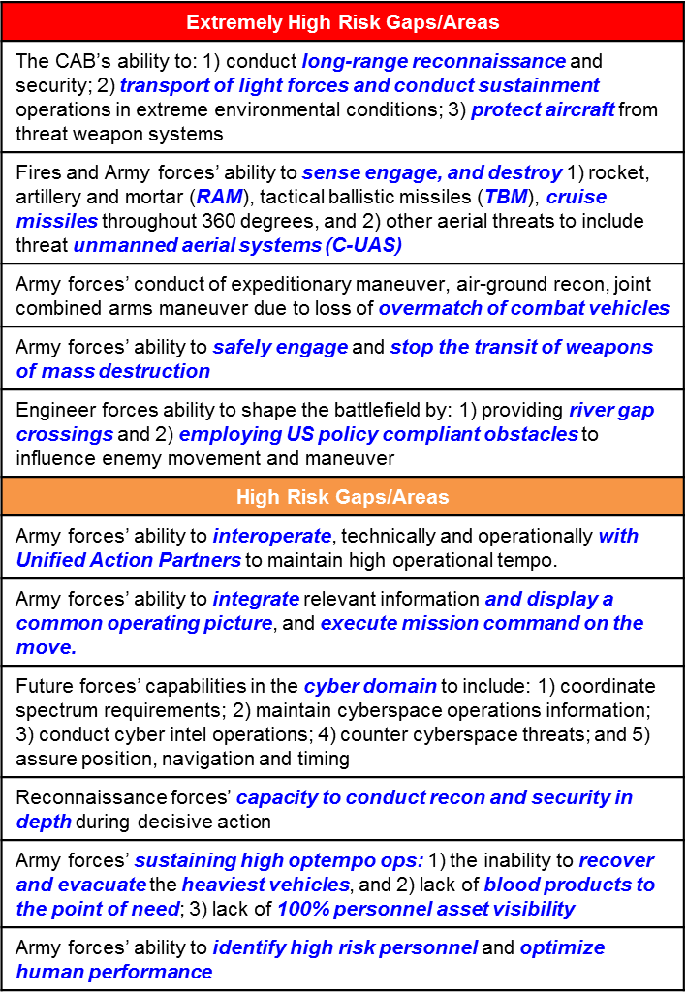
Concepts to Capabilities – The Big 8
Army Warfighting Challenges
Develop Situational Understanding
Shape the Security Environment
Provide Security Force Assistance
Adapt the Institutional Army
Counter WMD
Conduct Homeland Operations
Conduct Space and Cyber Electromagnetic Operations and Maintain Communications
Enhance Training
Improve Soldier, Leader and Team Performance
Develop Agile and Adaptive Leaders
Conduct Air-Ground Reconnaissance
Conduct Joint Expeditionary Maneuver and Entry Operations
Conduct Wide Area Security
Ensure Interoperability and Operate in JIM Environment
Conduct Joint Combined Arms Maneuver
Set the Theater, Sustain Operations, and Maintain Freedom of Movement
Integrate Fires
Deliver Fires
Exercise Mission Command
Develop Capable Formations
Future Vertical Lift
Advanced Protection
Cross Domain Fires
Combat Vehicles
Robotics / Autonomous Systems
Expeditionary Mission Command
Cyber Electromagnetic
Soldier / Team Performance & Overmatch
Incorporate Tech Imperatives: grow adaptive Army leaders; maximize demand reduction and improve reliability; maintain overmatch; conduct expeditionary maneuver; continuously upgrade, protect and simplify the network; medical science, develop situational understanding
9

