Slide 1


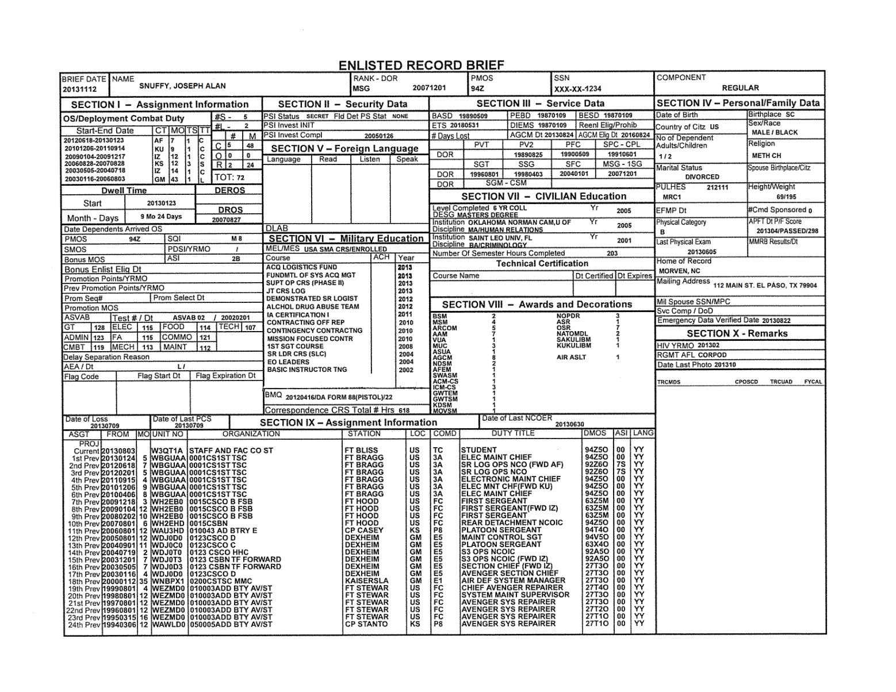
ENLISTED RECORD BRIEF
A QUICK REFERENCE GUIDE FOR THE REGULAR ARMY ERB
Notes:
This is an example of a standard ERB used by the Regular Army. The ERB is used by the Army for promotions and selections, future assignment considerations, and overall career management. Soldiers, Leaders and HR specialists should strive to keep it accurate and up-to-date at all times. The ERB is just that – a record brief; it is not all-inclusive of a Soldier’s military history.

Slide 2
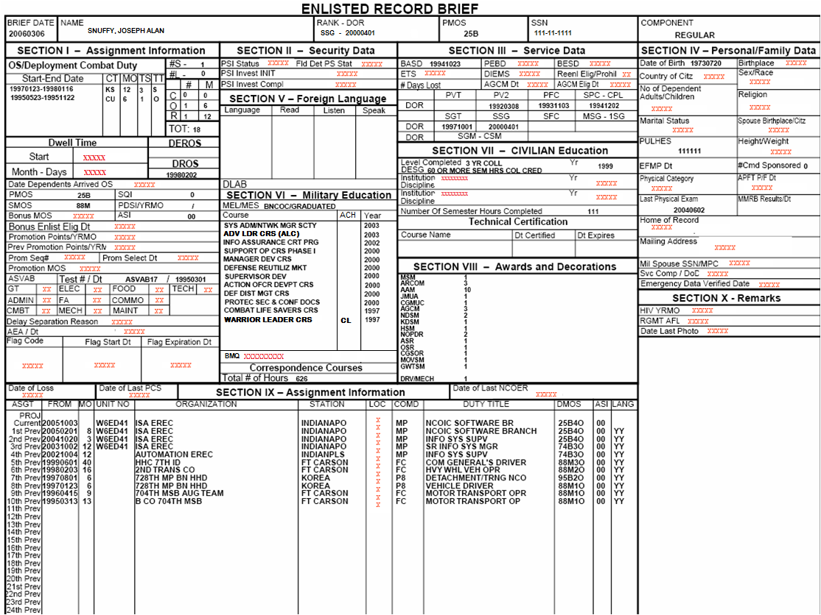
BOARD ERB
Note – Red X fields are blocked from board members
Notes:
BOARD ERB : “This is an example of the BOARD ERB. The red “X’s” indicate the areas of the ERB that are NOT shown to centralized promotion and selection board members. It is important for Soldiers to check the accuracy of their entire ERB. For board purposes however, Soldiers should specifically focus on the accuracy of the areas not filled in with x’s when validating their Board ERB.”

Slide 3
INDEX
HEADING – TOP LINE OF ERB (Page 4)
SECTION I – Assignment Information (Page 8)
(OS/Deployment/MOS/Prom/ASVAB/AEA/FLAG)
SECTION II – Security Data (Page 22)
SECTION III – Service Data (Page 23)
SECTION IV – Personal/Family Data (Page 29)
SECTION V – Foreign Language (Page 33)
SECTION VI – Military Education (Page 35)
SECTION VII – CIVILIAN Education (Page 39)
SECTION VIII – Awards and Decorations (Page 44)
SECTION IX – Assignment Information (Asgt) (Page 46)
SECTION X – Remarks (Page 50)
Notes:
The page numbers in the index are hyperlinked to the corresponding power point slide page. Right click on hyperlink and in the dropdown box select to ‘Open Hyperlink’.

Slide 4
HEADING
Brief Date – Date ERB was generated
RANK – DOR – i.e., SPC and YYYYMMDD
PMOS – Three character MOS code
SSN – Only last four digits will print
COMPONENT – i.e., REGULAR

Slide 5
Date of Rank and PMOS
Rank – Three-character abbreviation for the rank the Soldier is currently holding.
DOR - Date of rank for the grade in which the Soldier is currently holding on active duty. (Ref. AR 600-8-19, eMILPO Field User Guide and AR 600-20).
Corrections for Sergeant and above DOR cannot be made through eMILPO.
PMOS – duplicated from Section I PMOS block.

Slide 6
Name
Includes last name (surname), full first name, full middle name or middle initial (if no middle name, leave blank), and suffix designations such as "JR," "SR," "II" (2nd), or III (3rd) following the middle name or initial. (Ref. Emilpo Field User Guide, DA Pam 600-8-104). Combination last names can be entered with or without a space (can not use a hyphen or dash).
Max number of characters allowed is 27.
Transaction updates are input at MPD/BCT/S1 level with DA Form 4187 signed by the immediate Commander approving the name change. Source documents include SSA Card/printout reflecting new name, birth certificate, DD Form 4, marriage certificate, divorce decree, Citizenship certificate, etc. Changes will be made in eMILPO at the same time casualty documents are updated, and then the Soldier is directed to report to DEERS for a new ID card.
Send iPERMS a copy of approved DA Form 4187 for name change. A copy also needs to be sent to Fort Meade, MD (CCF). (Reference Emilpo Field User Guide, DA Pam 600-8-104).
Notes:
Legal name changes and corrections must be requested and processed on a DA Form 4187 for all Enlisted and Officers.

Slide 7
SSN and Component
SSN. Social Security Number. Will only show last 4 digits when printed.
SSN may be changed or updated at MPD/BCT S1 level with supporting documents. Source documents include approved DA Form 4187 and social security card or SSA printout. (Ref. eMILPO Field User Guide, DA Pam 600-8-104).
Component, (i.e. Regular, Reserve, National Guard). Can not be changed or updated in eMILPO. If incorrect, have S1 request PAS Chief submit a trouble ticket through to AHRS eMILPO Help Desk with a copy of enlistment contract.
Notes:
As a reminder, the ERB is designed for Regular Army Enlisted; although an ERB can be printed for other components, the ERB generated from eMILPO should not be updated for Army Reserve or ARNG enlisted personnel, as it will not update to their systems (i.e. awards, military education, assignment history, etc.). However, there are functions within eMILPO to use for other components (all Soldiers) when mobilized or activated, and for Regular Army officers and warrant officers.

Slide 8
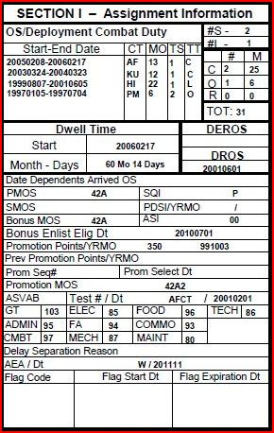
Section I – Assignment Information

Slide 9
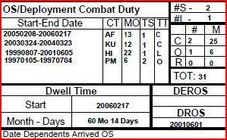
OS/Deployment Combat Duty

Slide 10
Overseas Duty
ALL OVERSEAS SERVICE, CURRENT AND PRIOR SERVICE, REGARDLESS OF BRANCH OR COMPONENT WILL BE ADDED TO THIS SECTION.
Year and month Soldier returned from overseas assignments. This entry allows for tours completed on regular assignment and for those tours while attached, including Temporary Change of Station (TCS) assignments to an OCONUS unit. (Ref. AR 614-30 Table 3-2, eMILPO Field User Guide).
Tour completion requirements are stipulated in AR 614-30, Table 3-2. 9 continuous months or 11 cumulative months within a 24 month period for TDY/TCS = short tour.
Overseas PCS tours must be within 60 days for tour completion credit with exceptions outlined in AR 614-30. 15 or more days are to be rounded up to a whole month.
The ERB can only reflect up to eight entries when printed, although more than eight can be entered and viewed within eMILPO.
MPD/BCT/S1 is responsible for entering the information based on supporting documentation. PCS/TCS orders, awards, EDAS deployment printout, DD Form 214 are examples.

Slide 11
Overseas Duty (Cont.)
CT (Country) Overseas area only. Indicates a 2-letter country code the Soldier served in during overseas assignment
MO (Month)
The number of months a Soldier served in overseas location.
TS (Tour Completion Status)
Code for type of PCS tour Soldier. Example: "1" represents normal tour completed, and "2" represents normal tour not completed. (Ref. AR 614-30, Table 3-2)
TT (TOUR TYPES):
SHORT - Number of short overseas tours Soldier completed (Korea, Iraq, Afghanistan).
LONG - Number of long overseas tours Soldier completed (Germany, Hawaii, Alaska).
Special Tours
Combat (Iraq, Afghanistan), Operational (Bosnia), and Restricted (Korea) will show number of occurrences and a total of months served. These entries will automatically affect Dwell Time. Ref. MILPER Messages
06-004, 08-070, 09-183, 12-171, 13-255, eMILPO Field User Guide and PERSTEMPO Instructions from the AHRS Web Portal listed in the Field user Guide/FAQs hyperlink https://emilpo.ahrs.army.mil/

Slide 12
Overseas Duty (Cont.)
DROS (Date Returned from Overseas)
DROS reflects date when Soldier signed out of losing installation upon returning from last overseas assignment. DROS update is only available if the Soldier actually had an overseas assignment within 30 days. (Ref. AR 614-30 Table 3-2)
Transaction may be updated at MPD/BCT/S1 level.
DEROS
The date eligible for return from overseas tour applies to personnel currently serving on an overseas assignment.
Transaction may be updated at MPD/BCT/S1 level (entered while overseas only).
DWELL TIME
Dwell time accumulates from end date of last overseas deployment or restricted tour. Resets to zero while deployed overseas or on an OS restricted tour (Milper Msg 08-070)
Date Dependents Arrived OS – Input by OS MPD/BCT
Notes:
NOTE – OS Tours (operational, combat and restricted) must be entered into EMILPO to update the dwell time for both Officer and Enlisted.

Slide 13
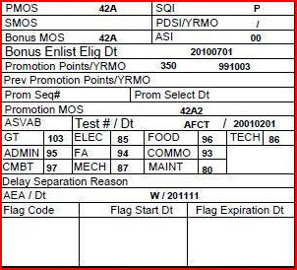
Section I (Continued)

Slide 14
Soldier Data
PMOS (Primary Military Occupational Specialty)
The military occupational specialty (MOS) designated as primary, i.e. 42A. It does not include Special Skill Identifiers (SQI's) and Additional Skill Identifiers (ASIs). (Ref. AR 611-1, DA PAM 611-21, AR 614-200 and eMILPO Field User Guide).
Transaction updates may be performed at MPD/BCT/S1 level, with a copy of valid MOS award orders from current enlistment.
NOTE: Certain MOS, ASI and SQI are now only added by HRC. Refer to Milper Message 14-312 for more information.
SQI (Special Skill Identifier)
The appropriate Special Qualification Identifier awarded which is associated with or related to the MOS.
Orders issuing SQI are required before entering into eMILPO (AR 614-200, para. 3-13 a (1), AR 600-8-105, fig. 5-1 p. 64).
The system will not display a SQI/ASI unless it is compatible with the Soldier’s grade and MOS (Ref. AR 614-200, DA PAM 611-21 and PAM XXI/Smartbook). https://www.milsuite.mil/book/groups/smartbookdapam611-21
Notes:
Right click on hyperlinks and select “Open Hyperlink” to use link.
Certain MOS, ASI and SQI are now only added by HRC. Refer to Milper Message 14-312 for more information.

Slide 15
Soldier Data (Cont.)
Soldier Data (Cont.)
SMOS (Secondary Military Occupational Specialty)
The Secondary Military Occupational Specialty (MOS) is shown, if authorized.
A Secondary MOS cannot be removed without withdrawing the related ASI and SQI first.
SMOS is issued in orders reflecting both the primary and secondary– prior service and prior MOS is not always retained – consult with Career Counselor for MOS qualifications.
ASI (Additional Skill Identifier)
The appropriate additional skill identifier awarded the Soldier which is associated with or related to the Primary Military Occupational Specialty (PMOS). (Ref. AR 611-1, DA PAM 611-21, AR 614-200)
Soldiers completing formal ASI training at Army service schools will be awarded the ASI upon successful completion of the course.
Orders issuing the ASI are required before entering into eMILPO.
The system will not display a SQI/ASI unless it is compatible with the Soldier’s grade and PMOS. Ref. AR 614-200 and DA Pam 611-21 Smartbook
Notes:
Right click on hyperlinks and select “Open Hyperlink” to use link.
Certain MOS, ASI and SQI are now only added by HRC. Refer to Milper Message 14-312 for more information.

Slide 16
Soldier Data (Cont.)
Soldier Data (Cont.)
PDSI/PDI (Project Development (Skill) Identifier)
Identifies Soldiers involved in the initial research or design of a system, including concept development, system design and development of a prototype
Can not be updated through eMILPO
HRC will enter PDSI and expiration date IAW DA PAM 611-21, paragraph 1-6.
A current list of authorized PDSIs can be found at:
https://www.milsuite.mil/book/groups/smartbookdapam611-21
Notes:
Right click on hyperlink and select “Open Hyperlink” to use link.

Slide 17
Soldier Data (Cont.)
Soldier Data (Cont.)
Bonus MOS
Indicates the primary military occupational specialty on which the selective reenlistment bonus or enlistment bonus is based. Cannot be updated in eMILPO.
Bonus Enlistment Eligibility Date
Date will be reflected if Soldier is eligible. Cannot be updated in eMILPO.
Promotion Points/YR/MO
For promotable SPC and SGT. Updated via automated Promotion Point Worksheet and eMILPO.
Previous Promotion Points/YR/MO
Self Explanatory. For historical purposes.

Slide 18
Soldier Data (Cont.)
Soldier Data (Cont.)
Promotion Sequence Number
A numeric sequence which uniquely identifies an NCO’s relative position from a HQDA centralized promotion list of peers to be advance to higher ranks. Cannot be updated in eMILPO.
Promotion Selection Date
The calendar date from a HQDA centralized promotion list announcing an NCO to be advanced to higher ranks. Cannot be updated in eMILPO.
Promotion MOS
The MOS and skill level designated in which an enlisted Soldier will be advanced to a higher rank.

Slide 19
Soldier Data (Cont.)
Soldier Data (Cont.)
ASVAB
ASVAB/AFCT scores will be updated from test results received from the Education Center to the MPD/BCT/S1. Do not delete previous test results already in the system. Only the most recent test is considered valid and will show. NOTE - Test results are not to be accepted directly from the Soldier – report any questionable test results to the Education Center for verification (Ref. AR 601-210, AR 611-5, eMILPO Field User Guide).

Slide 20
Soldier Data (Cont.)
Soldier Data (Cont.)
Delay Separation Reason
A code representing the reason for retaining a Soldier on active duty status beyond ETS.
AEA (Assignment Eligibility and Availability)
AEA codes are a management tool used to identify the Soldier’s eligibility and availability for reassignment. See Table 3-1, AR 614-200 to determine the proper AEA codes. (See also AR 614-5 and eMILPO Field User Guide)
Some AEA codes can only be added/removed by HRC.

Slide 21
Soldier Data (Cont.)
Soldier Data (Cont.)
FLAG
FLAGs suspend certain favorable personnel actions while FLAG is active. Refer to AR 600-8-2 for details.
Rules for initiating a flag begin in paragraph 1-11, AR 600-8-2. Paragraph 2-7 lists rules for removing FLAGs while paragraph 2-8 lists required actions.
HR specialist updates local flags according to direction of the Commander. (Ref. eMILPO Field User Guide).
NOTE - S1 Must contact HRC for HQDA ‘F’ (removal from promotion list) FLAGs.

Slide 22

SECTION II – Security Data
PSI (Personnel Security Investigation) - See your Security Manager or S2 Personnel to have this updated. Clearances are top fed from the Central Clearance Facility. Cannot be updated in eMILPO.
Field Determined Security Status - level of access allowed by the Commander/Agency Head for current duty responsibilities (updated by S1). DA Form 3180 is source document for Personnel Reliability Program (updated by MPD). Refer to eMILPO Field User Guide for more details.

Slide 23
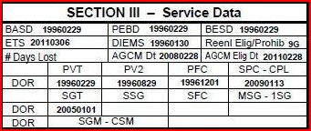
SECTION III – Service Data

Slide 24
Service Data
BASD (Basic Active Service Date)
BASD and PEBD cannot be changed in eMILPO. Transaction is input by DFAS after a DA Form 1506 is completed and submitted through local finance channels with all supporting documents (Ref. AR 37-104-4, DoD FMR Vol. 7, Ch. 1).
BASD indicates total active Federal service creditable for retirement. For personnel with no prior service, the BASD is the date of AD enlistment or induction. For personnel with prior service, the BASD is the date of enlistment or induction minus total Active Federal service.
Lost time listed on DA Form 1506 will affect BASD (i.e., AWOL, confinement, civil confinement, and sickness or injury not in line of duty).

Slide 25
Service Data (Cont.)
BESD (Basic Enlisted Service Date) will almost always be the same as the Soldier’s PEBD. This can be entered through eMILPO. (Ref. eMILPO Field User Guide, DA Pam 600-8-104).
DIEMS
DIEMS date is the date the Soldier initially entered any recognized US Military Service. It will be the earliest date and therefore will never change. This date determines what type of retirement plan a Soldier is eligible for. It also affects the ability to add prior service information into eMILPO. Certain information can not be entered in eMILPO if the date is earlier than the DIEMS date. (Ref. eMILPO Field User Guide and DA Pam 600-8-104 para 5-4).
DIEMS date cannot be changed in eMILPO by field users.
To correct enlisted DIEMS on ERB, the Soldier must submit request through S1 to PAS Chief at Bde BCT or installation level. Include name, rank, SSN, and copy of supporting documents.
Notes:
Right click on hyperlinks and select “Open Hyperlink” to use link.

Slide 26
Service Data (Cont.)
ETS and Re-Enlistment Eligibility Code
ETS and Reenlistment Eligibility Code can not be updated in eMILPO. Career Counselor updates these through RETAIN system. (Ref. AR 601-280, AR 601-210)
ARMY GOOD CONDUCT MEDAL
Army Good Conduct Medal (AGCM) Date is the date of the most recent award entered in eMILPO. This will be blank if the Soldier does not have an AGCM entered in eMILPO.
AGCM Eligibility Date is the date three years into the future from either the last award in eMILPO or from the date entered manually if Soldier has no previous award (listed as invalid on the AAA-199), from a break in service, or if was disqualified (court martial or memo signed by Commander posted to OMPF). Eligibility starts from the current period of continuous Active Federal Service, usually the same as the current enlistment contract. (Ref. AR 600-8-22, p. 56-59, eMILPO Field User Guide)
Do not use the BASD date on prior service Soldiers as that is usually an adjusted date!!! Only use the current enlistment DD Form 4/2 (or 4/3 for Delayed Entry Soldiers). Do not use prior service enlistment contracts or DD Form 214s except to determine eligibility for possible retroactive AGCM awards. Always check for disqualification memorandums posted to OMPF.
Breaks in service, Disqualified time (memo signed by Cdr posted to OMPF, court martial), inactive Reserve/ARNG (ARCAM) service, and other branches of service times are not creditable towards the AGCM.
Permanent orders must be issued before adding AGCM to ERB.

Slide 27
Service Data (Cont.)
# DAYS LOST
Number of days that Soldier was absent from organization as follows:
Desertion
Absent from organization, station, or duty for more than 24 hours without proper authority.
Confinement for more than 24 hours while awaiting trial and disposition of case, and whose conviction has not become final.
Confinement for more than 24 hours under a sentence that has become final.
Unable for more than 24 hours, as determined by competent authority, to perform duties because of intemperate use of drugs, alcoholic beverages, or because of injury resulting from misconduct.
When a soldier has lost time, the ETS and Date of rank must both be adjusted (ETS date adjusted by Career Counselor in RETAIN system). DA 1506 must be completed with AWOL/DFR documents (DA Forms 4187) showing start and end of lost time. Forward DA 1506 to Finance (Ref. AR 37-104-4, FMR Vol. 7A, Ch. 1, AR 630-10). eMILPO clerk adds number of lost days to reflect on ERB.

Slide 28
Service Data (Cont.)
DOR (Date of Rank) History
Date of rank for each grade Soldier was promoted to during current enlistment to include enlistment DOR. Other changes (demotion) will also be reflected.
DOR history data shall not be deleted to ‘hide’ demotions.
Prior service (including Reserve/ARNG) rank history will not be added or transferred to Regular Army ERB under current RA enlistment.
Rank history may be updated by the PSB/MPD/S1 with supporting documents (Ref. AR 600-8-19, AR 600-20, and eMILPO Field User Guide).

Slide 29
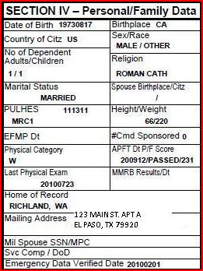
SECTION IV – Personal/Family Data

Slide 30
Personal/Family Data
NOTE - Changes made to the Soldier’s personal information (Sex, Race, Religion, etc.) must be accompanied by a DA Form 4187 and supporting documents. (Reference DA Pam 600-8-104 and eMILPO Field User Guide)
Date of Birth - source document is original birth certificate.
Birthplace – as listed on birth certificate
Country of Citizenship – source documents include Birth Certificate or Citizenship Certificate
Sex/Race – Self explanatory. Race is the anthropological definition. Choices are: Caucasian, Black, Asian, American Indian and Other.
Number of dependents – Can not be changed in eMILPO; updated from DEERS (use refresh button in Family Member module after update in DEERS).
Religious Preference – Self explanatory.
Spouse Birthplace/Citizenship – eMILPO will only show one or the other depending on what is entered in the Family Member module.
NOTE: Key Supporting documents must be uploaded to Soldier’s AMHRR/OMPF as outlined in Milper message 13-155.

Slide 31
Personal/Family Data (Con’t)
Marital Status – DD Form 1172 from DEERS, Marriage Certificate or Divorce Decree (must be finalized and signed by the court). Ensure DD Form 93 is also updated. Upload Marriage certificates and finalized divorce decrees to AMHRR/OMPF (Ref. DA Pam 600-8-104, eMILPO Field User Guide, Milper msg 13-155)
PULHES/MRC – Can not be updated in eMILPO; updated from MEDPROS. (Milper msg 12-249)
HT/WT and APFT Score – most recent height and weight and record APFT score card info from Training NCO /Bn S1 function (Ref. eMILPO Field User Guide, AR 600-8-19, and AR 350-51)
EFMP date – date EFMP enrollment will expire – cannot be updated in eMILPO. Have Soldier report to the respective Military Treatment Facility POC to initiate, renew, or change EFMP status on family member(s). (Ref. AR 608-75)
# Command Sponsored – Overseas Assignment Data Module (OS PCS Orders). Only reflected while on such orders (Ref. AR 55-46, AR 614-30).

Slide 32
Personal/Family Data (Con’t)
Physical Category – Entered through MEDPROS
Last Physical Exam – Entered through MEDPROS
MMRB Results/Dt – Enter the convening date and applicable determination documented in the memorandum of record from the MMRB Board proceedings (or other appropriate instrument authenticated by the brigade commander).
Home of Record (HOR) – the location (City and State) listed on the current enlistment contract (DD Form 4 and 1966 series).
NOTE - HOR cannot be updated in eMILPO. If ERB entry is blank or does not match Enlistment Contract, a trouble ticket must be sent to eMILPO Help Desk with a copy of the DD Form 4/1 or 1966/1. (Ref. eMILPO Field User Guide, DA Pam 600-8-104).
Mailing Address – Where the Soldier receives personal postal mail.
MIL Spouse SSN/MPC Svc Comp / DoD – self explanatory - for dual military. Updated from MACP enrollment procedure. Spouse SSN must be entered in Family Member module (Ref. eMILPO Field User Guide)
Emergency Data Verified Date – From DD Form 93 module (date reviewed).
Notes:
Right click on hyperlink and select “Open Hyperlink” to use link.

Slide 33
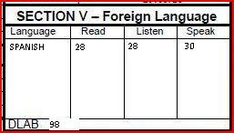
SECTION V – Foreign Language

Slide 34
Language
LANGUAGE
The update to the DLPT scores displayed on ERB (listen, read) is by automatic feed to HRC. Update to ERB cannot be accomplished in eMILPO. (Ref. AR 11-6). HRC is now utilizing an automated process to update eMILPO and TAPDB / EDAS. Info sheet is posted at S1Net: https://www.milsuite.mil/book/docs/DOC-148492
The SQI of "L" is awarded to linguists who score at least 2/2 on the current DLPT. Must be re-tested annually with passing score to keep SQI. (Ref. AR 11-6). Submit MOS orders and DA Form 330 to AMHRR/OMPF.
SQI “L” will be awarded to Soldiers who are qualified exclusively in a language and not in another SQI. Any other awarded SQI replaces SQI “L”; however, the Soldiers’ language identification code will be recorded in the eighth and ninth character of the MOSC even when it has been replaced by another SQI in the MOS. (Ref. AR 614-200, Para. 3-13).
Enter the lowest score number (example: 28) from the DA Form 330 into eMILPO using ‘Personnel Management Tests’ sub-module (will not affect ERB entry) (Ref. eMILPO Field User Guide).
DLAB (Defense Language Aptitude Battery)
Must be in the range of 012 through 164.
DLAB test scores may be updated by the MPD/BCT/S1 to reflect on ERB upon receiving authorized documentation from the Education Center (Ref. eMILPO Field User Guide).

Slide 35
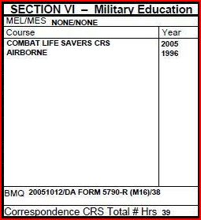
SECTION VI – Military Education
ACH

Slide 36
Military Education
MEL/MES (Military Education Level/Military Education Status)
Highest Military Education Level and Military Education Status
Military Education Statuses - Graduated, Constructive Credit, Enrolled, Deferred, Declined, Selected (Extension not needed), Withdrawn, None, or Denied Enrollment).
MEL/MES is top-fed from TAPDB, and may be updated by Noncommissioned Officers Education System (NCOES) Branch, HRC.
COURSE (RESIDENT COURSES, full-time attendance)
eMILPO does not include all courses that the Army conducted. Courses must be 40 hours or more, must be full time classroom instruction unless specifically identified as non-resident (i.e., ILE common core non-resident, Sergeant Major Course non-resident course, etc.).
NOTE - Do not add non-resident courses using resident course codes unless there is a specific non-resident code available for the course. A list of codes can be found in ATRRS Course Catalog https://www.atrrs.army.mil/atrrscc/ or through the HRC website code page (requires AKO account): https://hrcmetahelper.hrc.army.mil/TessSnameSearch.aspx
For qualifying courses not found in eMILPO, follow guidance in DA Pam 600-8-104.
Notes:
Right click on hyperlink and select “Open Hyperlink” to go to the website.
IAW DA Pam 600-8-104, only courses listed in ATRRS Course Catalog will be added to Record Brief
The following courses are not valid for the awarding of promotion points under military education:
(1) Completion of BCT, AIT, and new equipment training.
(2) ASI, SQI, or language identification codes (LIC) course required to hold qualification in or be awarded an MOS.
(3) ASI, SQI, or LIC received because of MOS restructuring instead of successful completion of the required course.
(4) Attendance at the USMAPS or the United States Military Academy.
(5) On-the-job training and on-the-job experience, including Sergeants Time Training.
(6) OCS, WOC Course, and ANCOC (SLC).
(7) Duplicate military correspondence and military education courses (For example, a Soldier attends Combat
Lifesaver Course and completes the Army Correspondence Course Program Combat Lifesaver Course. The Soldier
receives points for the one completed first.)
(8) Military courses completed in the other Armed Forces that were required to hold qualification in or be awarded a MOS/rate.
(9) Federal Emergency Management Agency courses (see DA PAM 350–59, para 4–54).

Slide 37
Military Education (Cont.)
Maximum of 16 military schools are displayed, although there is no limit within the system. eMILPO business rule for resident course periods do not allow entries that overlap or occur during another course (i.e., Army Combatives Course taken during ALC).
Transaction updates are input at MPD/BCT/S1 level. Source documents include the DA Form 1059, DA Form 87 (Certificate of Training) with FROM and THRU dates or number of hours/weeks. (Ref. AR 600-8-19, DA Pam 600-8-104, AR 635-5, paragraph 2-4 h (14) page 6 and eMILPO Field User Guide).
Academic Achievement (Only for NCOES schools: WLC, ALC, SLC, SMC) – (i.e., Dist Honor Grad, Commandant List, Dist Leader Grad, Commandant list and Dist Leader Grad)
Credit can only be given once for any type of course (i.e., Soldier has two Combat Lifesaver Training Certificates) .
Send a copy of training certificates to iPERMS for file in OMPF.
YEAR - Year military school/courses were completed based off entry in eMILPO module

Slide 38
Military Education (Cont.)
BMQ – Should reflect most recent qualification date, scorecard used, weapon type, and number of hits for weapons qualification. S1 updates.
TOTAL # OF HOURS (CORRESPONDENCE COURSES)
The source document to receive military correspondence course credit is the Soldier’s course completion printout from ATRRS and/or other similar documentation (i.e., ATIA, Army e-learning and ACCP certificates). NOTE – Most full courses completed since December 22, 2010 are automatically added to ERB from ATRRS.
NOTE - Sub-courses can no longer be entered into eMILPO. Hours up to 999 can only be entered for full course completions. Use codes listed in the database to add course completions prior to December 22, 2010: https://hrcmetahelper.hrc.army.mil/TessSnameSearch.aspx
NOTE – the code must be entered through eMILPO ‘ACCP/DL/eLearning’ sub-module for the full course completion, the number of course hours and the completion date for the hours to be reflected on the ERB.
Transaction updates are input at MPD/BCT/S1 level. (Ref. AR 600-8-19, eMILPO Field User Guide, DA Pam 600-8-104 and MILPER Messages 10-326, 11-033, 13-291).
Ensure credit is not duplicated – example: in cases when the course has been taken more than once.
Notes:
Right click on hyperlink and select “Open Hyperlink” or copy and paste into browser address bar to go to the website.

Slide 39
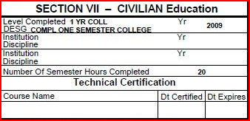
Section VII – Civilian Education

Slide 40
Civilian Education
Civilian Education LEVEL COMPLETED
Highest civilian education level attained at colleges or universities listed in the Accredited Institutions of Post Secondary Education Guide. Examples: 30 non-duplicated semester hours = 1 year of college, Associates Degree or 60 sem hrs = 2 years of College.
Entries format includes HS GRAD, 1 YR COLL, 6 YR COLL.
Transaction is input by the MPD/BCT/S1. Source documents include college transcripts with registrar’s signature and school seal visible. Colleges must be accredited (Ref. AR 600-8-19 and DA Pam 600-8-104). Accreditation can be checked by the local Army Ed Center, by http://www.ope.ed.gov/accreditation/Search.aspx or http://www.chea.org .
The following cannot be used for Civilian Education:
(1) Transcripts/courses from non-accredited education institutions (Ref. Milper msg 10-109, Milper msg 14-022)
(2) American or Army Council on Education Registry Transcript System transcripts.
(3) Continuing education units (CEU Hours). Example, from Health.edu.
(4) Foreign transcripts (except from those countries listed in AR 601–210, para. 2–8i).
(5) Basic Skills Education Program, Advanced Skills Education Program, English
as a Second Language and GT Improvement.
Civilian Education Update Instructions : Refer to the instructions posted in the AHRS Web Portal website listed in the “Field User’s Guide/FAQs” hyperlink. https://emilpo.ahrs.army.mil/
Notes:
Right click on hyperlinks and select “Open Hyperlink” to go to the website.

Slide 41
Civilian Education (Cont.)
YR (Year)
Year education completed or degree awarded.
Education Level Certificate:
Highest civilian education level attained at colleges or universities listed in the Accredited Institutions of Post Secondary Education Guide.
Common entry format includes: HS DIPL, COMPL ONE SEMESTER COLLEGE, 60 OR MORE SEM HRS COL CRED, ASSOCIATE DEGREE, BACCALAUREATE DEGREE and MASTERS DEGREE.
Transaction is input by the MPD/BCT/S1. Source Documents are Diploma with college transcripts with registrar’s signature and school seal visible. Ref. AR 600-8-19, DA Pam 600-8-104 and eMILPO Field User Guide.
Officers must have Career Manager update Masters and higher degrees.
Send a copy of diploma and official college transcripts to Soldier’s AMHRR/OMPF (Ref. AR 600-8-104, eMILPO Field User Guide)
NOTE – Army Education Center memo of total academic hours may only be used for the purpose of adding semester hours, and updating DESG and Level Completed. Official Transcript is required for updating Degree information.

Slide 42
Civilian Education (Cont.)
Education Major:
The education major (i.e. ENGINEERING) the Soldier has completed or pursuing.
Compl. Status:
C = Completed P = Pursuing
Degree:
The type of degree the Soldier has completed or pursuing.
SEMESTER HOURS
Number of non-duplicated semester hours the Soldier has earned towards the degree.
Hours on the transcript that are not semester hours must be converted prior to adding to ERB (i.e., Quarter Hours and Clock Hours). (Ref. AR 600-8-19, DA Pam 600-8-104).

Slide 43
Civilian Education (Cont.)
TECHNICAL CERTIFICATION
Technical Certification is based off of MOS related certifications – requires certification card or similar document that reflects both certification and expiration dates (example, Emergency Medical Tech cert. card).
If certification does not match up with the selections available in eMILPO, it can not be entered (Ref, eMILPO Field User Guide). Go to the Army COOL website for more information pertaining to credentialing: https://www.cool.army.mil/
Source documents are to be uploaded to Soldier’s AMHRR/OMPF (Ref. AR and DA Pam 600-8-104)
Notes:
Right click on hyperlinks and select “Open Hyperlink” or copy and paste into web browser address bar to go to the website.

Slide 44
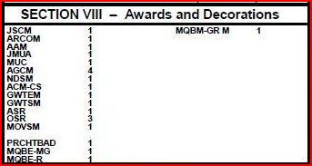
SECTION VII - AWARDS

Slide 45
Awards
Includes all authorized Federal decorations, campaign service awards, identification badges, unit awards (permanent), and combat/special skill badges. Some non-military decorations/awards can also be added as well (Ref. AR 600-8-19, AR 600-8-22, DA Pam 600-8-104, and eMILPO Field User Guide).
Certain awards cannot be added to RA ERB: (examples - ARNG state awards, most foreign awards, combat patch/stripes, regimental awards).
Transaction input by MPD/BCT/S1 upon receipt of applicable documentation: a) memorandums signed by proper authority for service and campaign medals; b) orders for unit awards, badges and AGCMs, c) Completed and signed DA Form 638 (Series) or award certificate containing the permanent order number and date.
Use most recent weapons qualification (Range) scorecards to add or update marksmanship badges only if BMQ information (Section VI) is not reflected on ERB or within eMILPO. Training NCO must update qualifications and/or submit to S1/MPD for updates.
Copies of supporting documents for most awards (including unit awards and DA 638) must be sent to iPERMS for posting on the AMHRR/OMPF.
NOTE: HRC Awards Policy Branch has determined that the DD Form 214 can not be used to add awards that require supporting documents (i.e. permanent orders, DA Form 638s and certificates).

Slide 46
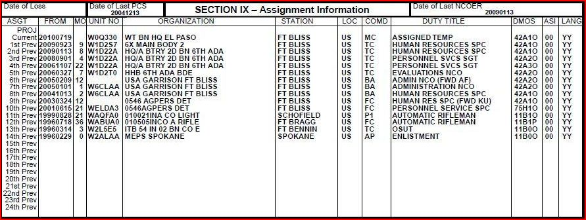
SECTION IX – Assignment Information

Slide 47
Assignment History
Previous All PCS assignments and overseas combat and operational deployments (TCS/TDY) to the present. Prior Army Active assignments (Title 10 mobilization for Army Reserve Components) can be added. Source documents include PCS/TCS orders, PCS awards, PERSTEMPO printout and NCOERs for SGT and above (Ref. eMILPO Field User Guide, AR 614-200, AR 614-30, DA Pam 600-8-104, Milper Msg 12-171). Upload all PCS and TCS orders to AMHRR/OMPF.
Current Assignment/Duty information is added/updated through Slotting per MTOE/TDA/JTD. (AR 600-8-6, DA Pam 600-8-104, Emilpo Field User Guide)
NOTE - The following are not authorized on the Regular Army ERB in Assignment History, Section IX: Army Reserve and ARNG (non-active duty), Prior duty assignments from other Branches of Service, attachments (not assigned) and non-combat/non-operational TDY/TCS.
NOTE - Refer to DA Pam 600-8-104, eMILPO Field User’s Guide, MILPER Messages: 09-183, 08-070, 06-004 (Deployments), 10-302 (Warrior Transition), 11-025 (AFPAK Hands), 12-171 for exceptions and additional guidance.

Slide 48
Assignment History (Cont.)
Date of Loss – Calendar date from current UIC slotted position.
Date of Last PCS - The calendar date on which an individual departs a permanent duty station for another and the move constitutes travel under the fiscal year limitations. To correct a Soldier's LPCS date, MPD/BCT/S1 should send the supporting PCS orders along with a sign in roster (Personnel Register), or CQ log to PAS Chief for eMILPO trouble ticket (Ref. eMILPO Field User Guide).
Date of Last NCOER – Self explanatory. If does not match EES, have your S1 contact your Brigade or MPD PAS Chief for assistance.
FROM- Effective date of assignment to organization and duty assignment. Eight (8) digit dates will be used, i.e. YYYYMMDD.
MO (Months)- Number of months Soldier served in duty assignment. Entry should be blank for current assignment.
UNIT NO (Unit Number) - UIC (Unit Identification Code) of unit Soldier is assigned to.
ORGANIZATION - Description of unit of assignment as associated with UIC
STATION - Station of assignment, i.e. Ft Lewis, Suwon, etc.

Slide 49
Assignment History (Cont.)
COMD (Command) - Major command in which Soldier is assigned (2-letter code). Current list can be found on HRC Meta Helper Code page.
DUTY TITLE - The title of the position to which the Soldier is assigned as reflected in the authorization document, Modification Table of Organization and Equipment (MTOE), Tables of Distribution and Allowances (TDA), or Joint Tables(s) of Distribution (JTD). For assignment history, should match the duty title found on the NCOER for SGT and above. Add FWD and two-letter country code in parenthesis after duty title for overseas deployments. (eMILPO Field User Guide, DA Pam 600-8-104, AR 614-200, DA Pam 623-3).
DMOS (Duty Military Occupational Specialty) - The Duty MOS specified in the MTOE, TDA or JTD. For assignment history, should match duty MOS on the NCOER for SGT and above. (eMILPO Field User Guide, AR 614-200, DA PAM 623-3, DA Pam 600-8-104)
ASI (Additional Skill Identifier) – The ASI specified in the MTOE, TDA, or JTD for that duty assignment. For assignment history, should match the ASI (if any) found in the Duty MOSC on the NCOER for SGT and above. (Ref. AR 614-200, DA Pam 600-8-104).
LANG (Language) - Reflects the Language Indicator Code (LIC) contained in the MTOE, TDA or JTD for the duty position (for example, language-based MOS). Should match the Duty LIC (if any) found on the NCOER for SGT and above. Default is YY (AR 11-6, AR 614-200, eMILPO Field User Guide, DA Pam 600-8-104).

Slide 50
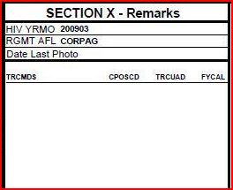
SECTION X - REMARKS

Slide 51
SECTION X - REMARKS
HIV YR/MO – updated in MEDPROS – cannot be updated through eMILPO.
Date Last Photo – updated by DAPMIS through photo lab – can not be updated in eMILPO (AR 640-30).
NOTE: Regimental Affiliation field is no longer updated or tracked on the Record Brief.

Slide 52
SECTION X – REMARKS CONT.
TROOP COMMAND SLATE DATA – (ELIGIBLE CSM/SGM). UPDATED BY HRC. NOTE – WON’T DISPLAY ON MYERB WITH DA PHOTO.
TRCMDS – TROOP COMMAND STATUS - THE STATUS OF A SERVICE MEMBER RELATIVE TO THE HEADQUARTERS DEPARTMENT OF THE ARMY (HQDA) CENTRALIZED COMMAND SELECTION PROCESS. NOTE: MEMBER OF CHAIN CMDTR.
1 = INELIGIBLE FOR COMMAND CONSIDERATION,
2 = PRINCIPAL COMMAND DESIGNEE DEFERRED,
3 = PRINCIPAL DESIGNEE,
4 = ALTERNATE DESIGNEE,
5 = DECLINED COMMAND,
6 = CURRENTLY COMMANDING A HQDA COMMAND DESIGNATED UNIT,
7 = PREVIOUSLY COMMANDED A HQDA COMMAND DESIGNATED UNIT,
8 = COMD PRIOR TO IMPLEMENTATION OF HQDA CENTRALIZED COMD SELN,
9 = COMMANDED IN FIELD GRADE TROOP POSITION,
A = DESIGNEE DELAYED HQDA,
B = DECLINED WITH PREJUDICE

Slide 53
SECTION X – REMARKS CONT.
CPOSCD – COMMAND POSITION TYPE CODE - AN ENCODED REPRESENTATION OF MILITARY ORGANIZATIONAL HIERARCHY OR STRUCTURE. 1 = BN, 2 = BDE, 3 = KEY BILLET
TRCUAD - TROOP COMMAND UNIT AUTHORIZATION BASIS - THE ROLE OF A UNIT RELATIVE TO THE UNIQUENESS OF ITS MISSION TO WHICH A SERVICE MEMBER WOULD BE DIRECTED TO COMMAND. NOTE: MEMBER OF CHAIN CMDTR. 1 = OPERATIONS, 2 = STRATEGIC SUPPORT, 3 = INSTALLATION, 4 = RECRUITING AND TRAINING, 6 = PRODUCT/PROJECT MANAGER, ARMY ACQUISITION CORPS, 7 = KEY BILLET, 9 = SPECIAL MISSION UNIT
FYCAL - FISCAL YEAR OF COMMAND ASSIGNMENT LIST - THE FISCAL YEAR OF THE COMMAND LIST ON WHICH AN INDIVIDUAL WAS SELECTED FOR A COMMAND POSITION. NOTE: EDIT IS YYYY

Slide 54
References and Publications
As deemed necessary, references are noted throughout the slides:
AHRS Web Portal Home Page: https://emilpo.ahrs.army.mil/
(includes links to Field User’s Guide, FAQs, release notes, etc.)
MILPER Messages, ALARACTs: http://hrc.army.mil/
HRC Meta Data Helper (Codes) https://hrcmetahelper.hrc.army.mil/
Army Regulations/Pamphlets, DA Memos: http://www.apd.army.mil
Army G-1: http://www.armyg1.army.mil/
S1NET: https://www.milsuite.mil/book/community/spaces/apf/s1net
DA PAM 611-21 Smartbook: https://www.milsuite.mil/book/groups/smartbookdapam611-21
IPPS-A: https://www.ipps-a.army.mil/
Notes:
Right click on hyperlink and choose Open Hyperlink to go directly to website

Slide 55
CAVEAT
Always refer to the most recent information by routinely checking the MILPER messages, ALARACTs, Regulations listed on Army Publications Division website, and official information published on the Army G1, HRC and S1NET websites.

Slide 56
Questions?
Please submit questions using the S1Net Portal sub-topic: eMILPO, Datastore and ERB/ORB updates: https://www.milsuite.mil/book/community/spaces/apf/s1net/emilpo__datastore_and_erb_orb_updates
Notes:
Right click on hyperlink and select “open hyperlink” to open webpage or copy and paste into web browser’s address bar

