Slide 1
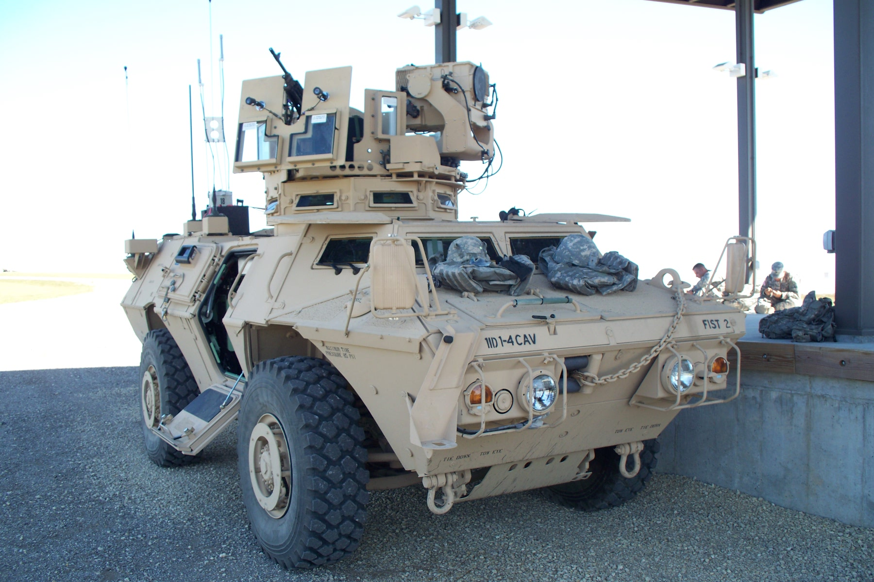
INTEGRATED PLAYER UNIT INSTALLATION GUIDE FOR THE M1200 PLATFORM AT THE DIGITAL MULTI-PURPOSE RANGE COMPLEX FORT RILEY, KS (September 2011)

Slide 2
M1200 PRE-INSTALLATION CREW ACTIONS
CLEAR ALL EXCESS MILITARY GEAR FROM THE FLOOR AND SEATS AROUND THE DRIVER, CO-DRIVER AND TURRET.
DURING THE INITIAL INSTALLATION PROCESS, ALL POWER TO THE VEHICLE MUST BE TURNED OFF.
Once the initial installation has been completed, any vehicle returning to the Install Pad for maintenance, batteries, etc., should have the radios on and operational.

Slide 3
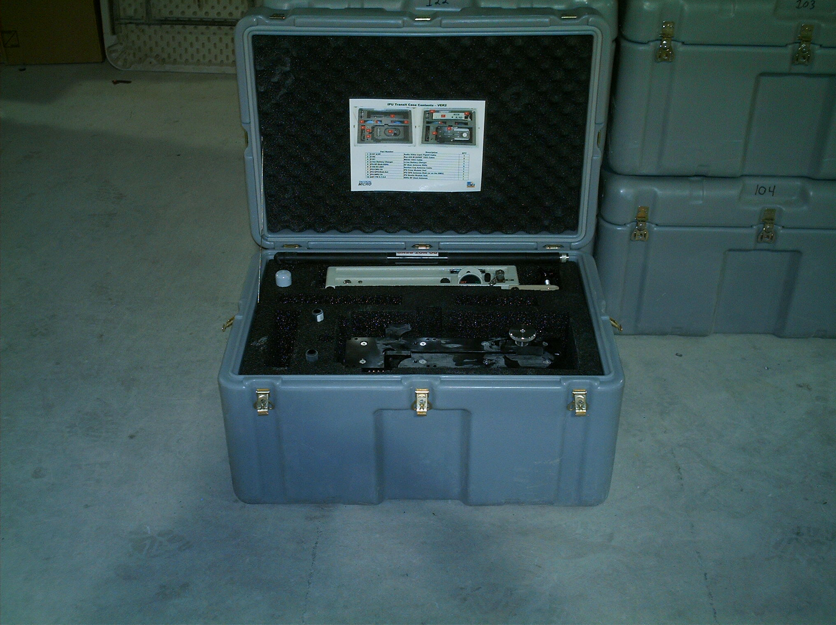
GRAY TRAVEL CASE FOR THE BUSTLE AND CREW MODULES FOR THE INTEGRATED PLAYER UNIT

Slide 4
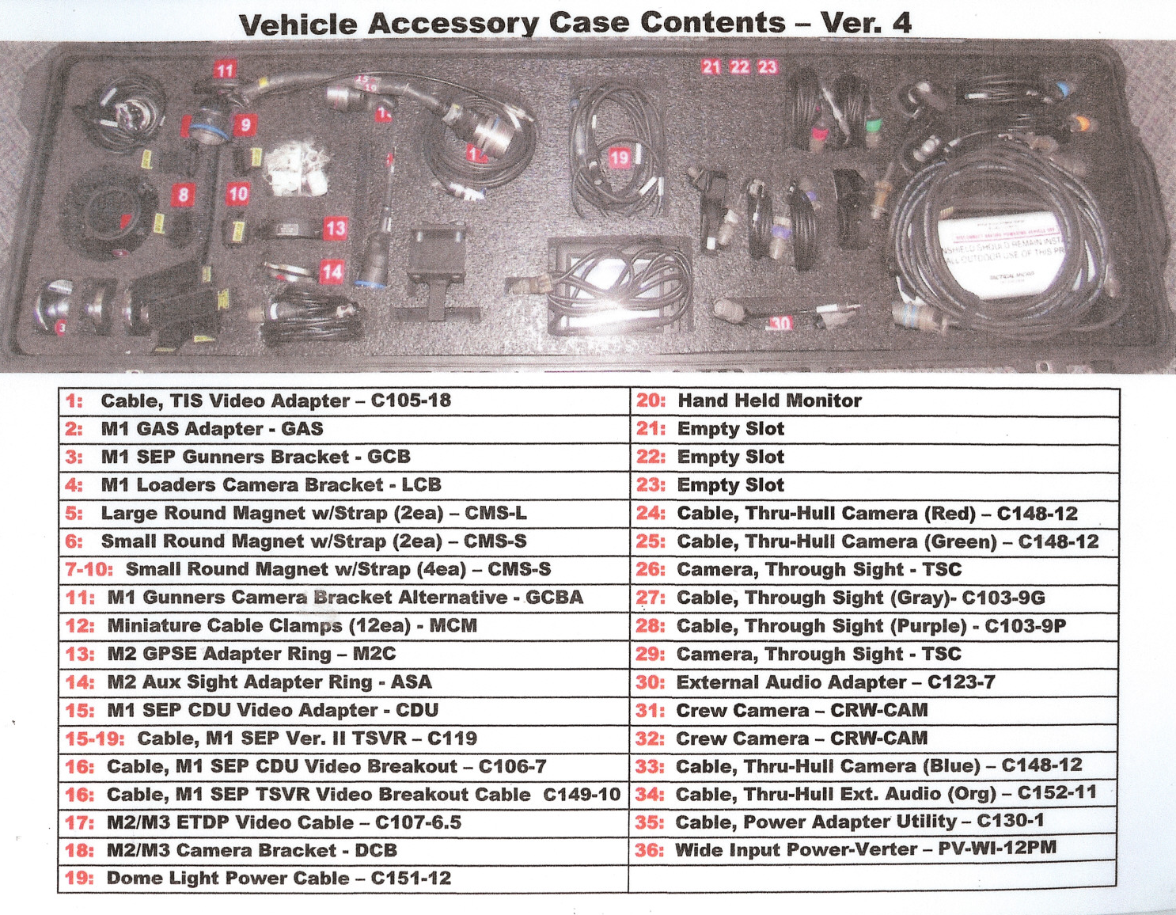
The black travel case houses various cables, connectors, cameras and mounting hardware for the IPU. The contents of the case are listed inside on the lid.

Slide 5
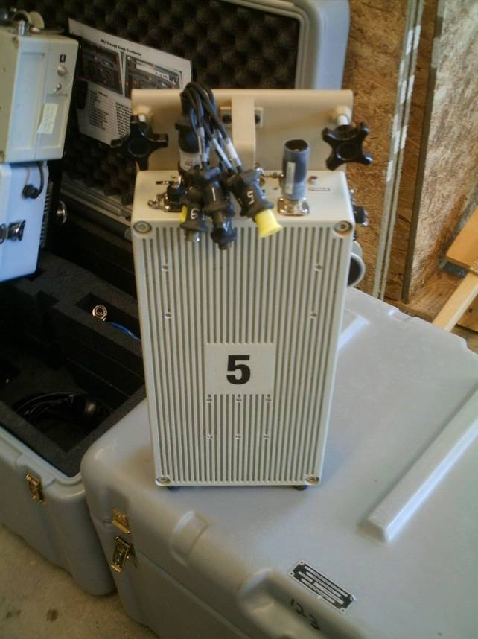
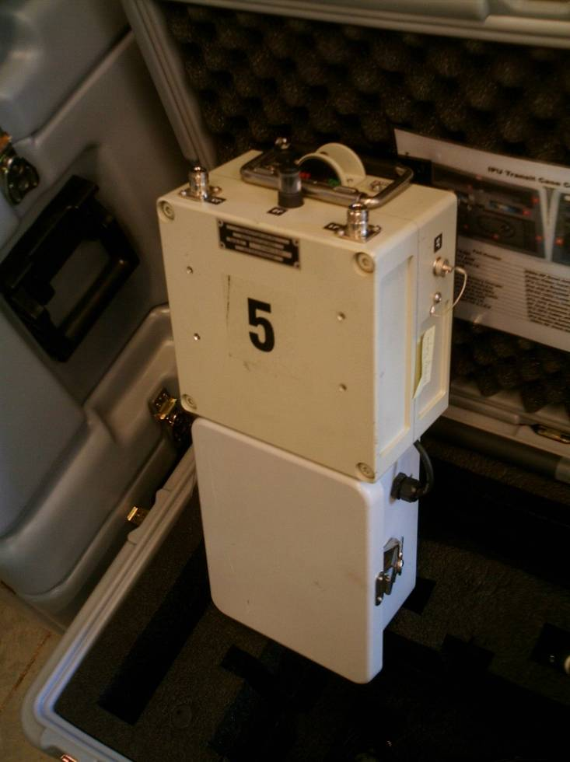
The Integrated Player Unit (IPU) consists of two main components. The Crew Module Unit (CMU) replaces the A/V Breakout Box, A/V Interconnect Cable, BIM and the Vehicle Power Supply box. It is designed to receive the Audio and Video input as well as the 1553 data from the vehicle and wirelessly transfer it to the Bustle Mounted Unit (BMU). The M1200 does not use the 1553 Data Cable. The BMU provides GPS tracking and sends data to the Tower via access points/nodes and relay points.
CMU
BMU

Slide 6
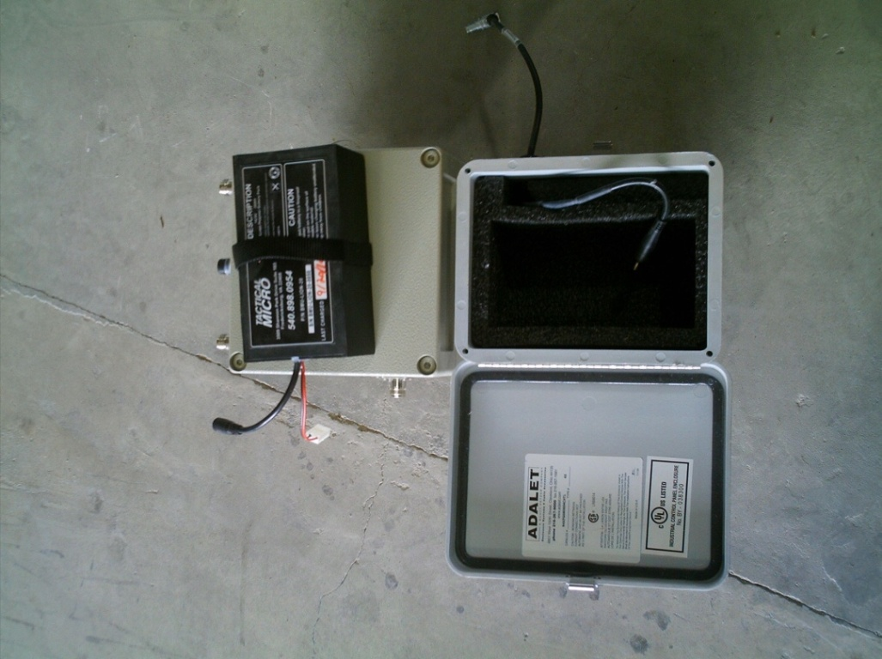
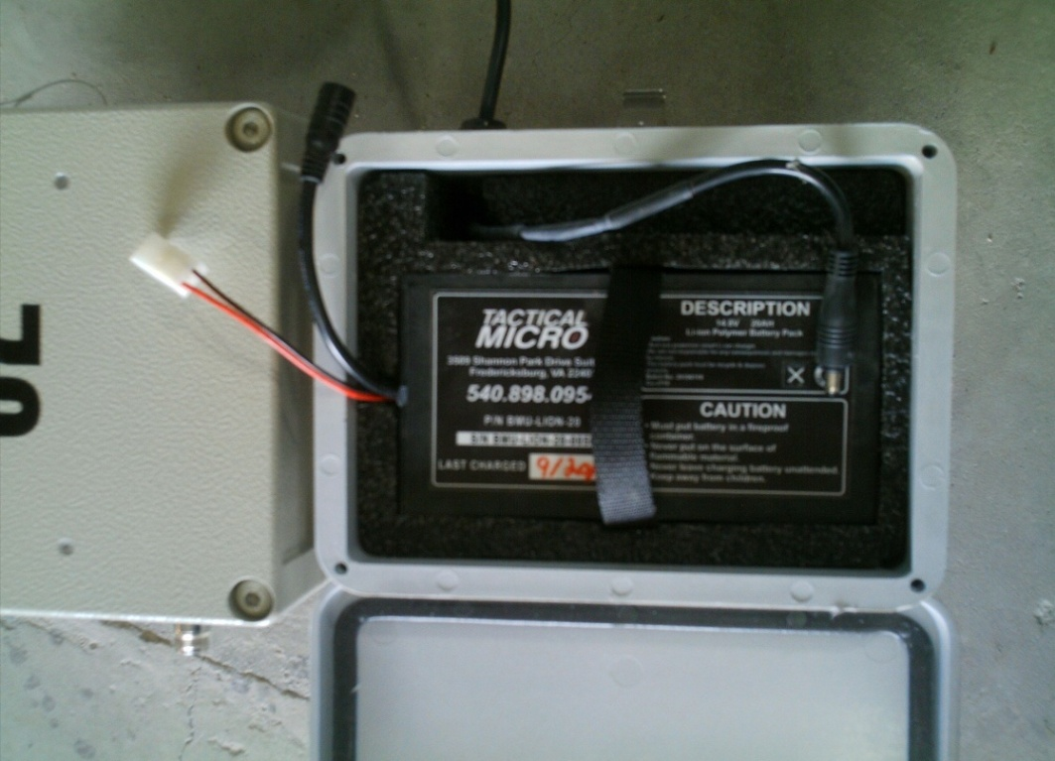
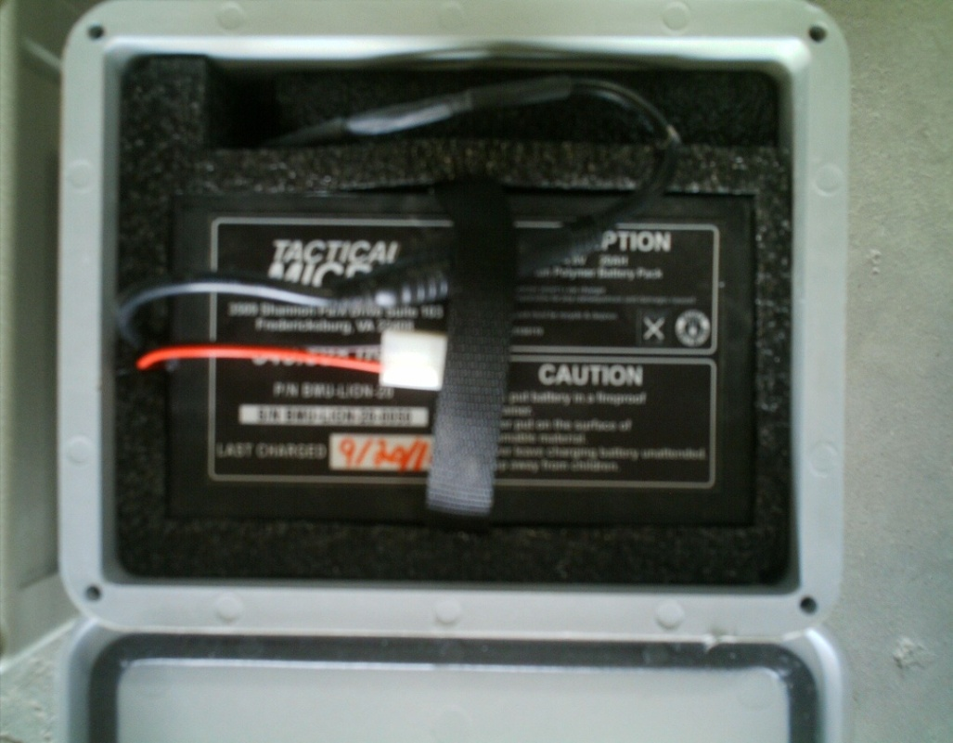
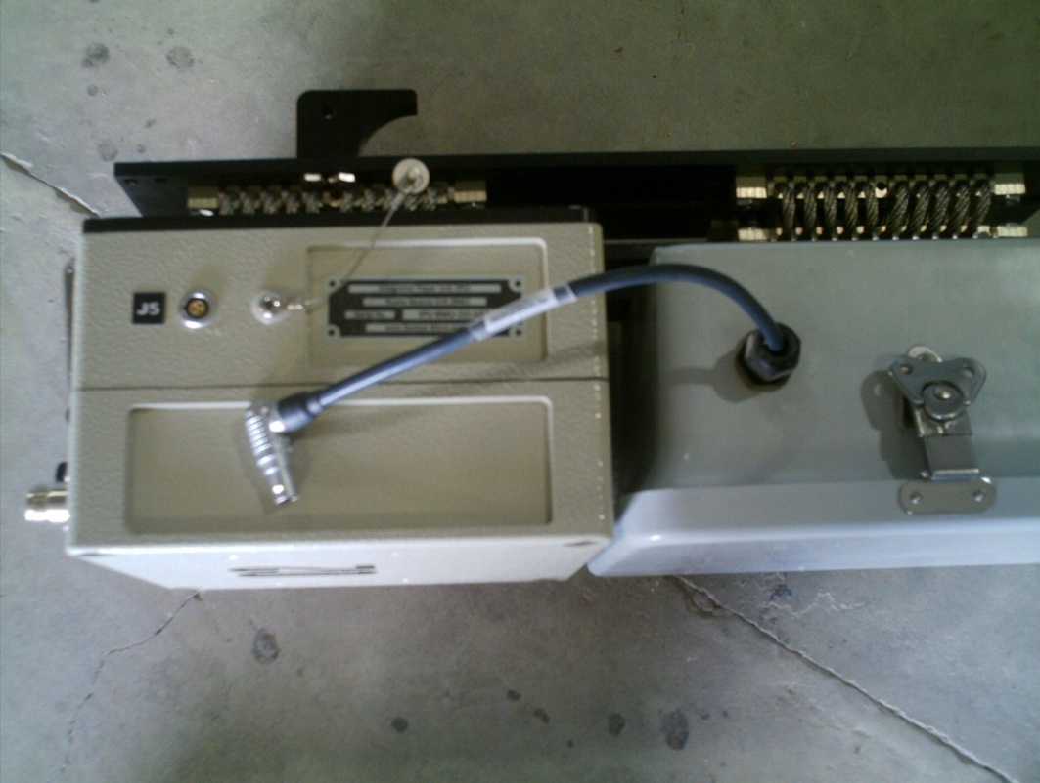
The BMU is powered by a 14.8V LI-ION Battery Pack
CAUTION: THE CABLE TO THE J5 PORT SHOULD BE DISCONNECTED WHEN NOT IN USE OR IN THE STORAGE CASE.

Slide 7
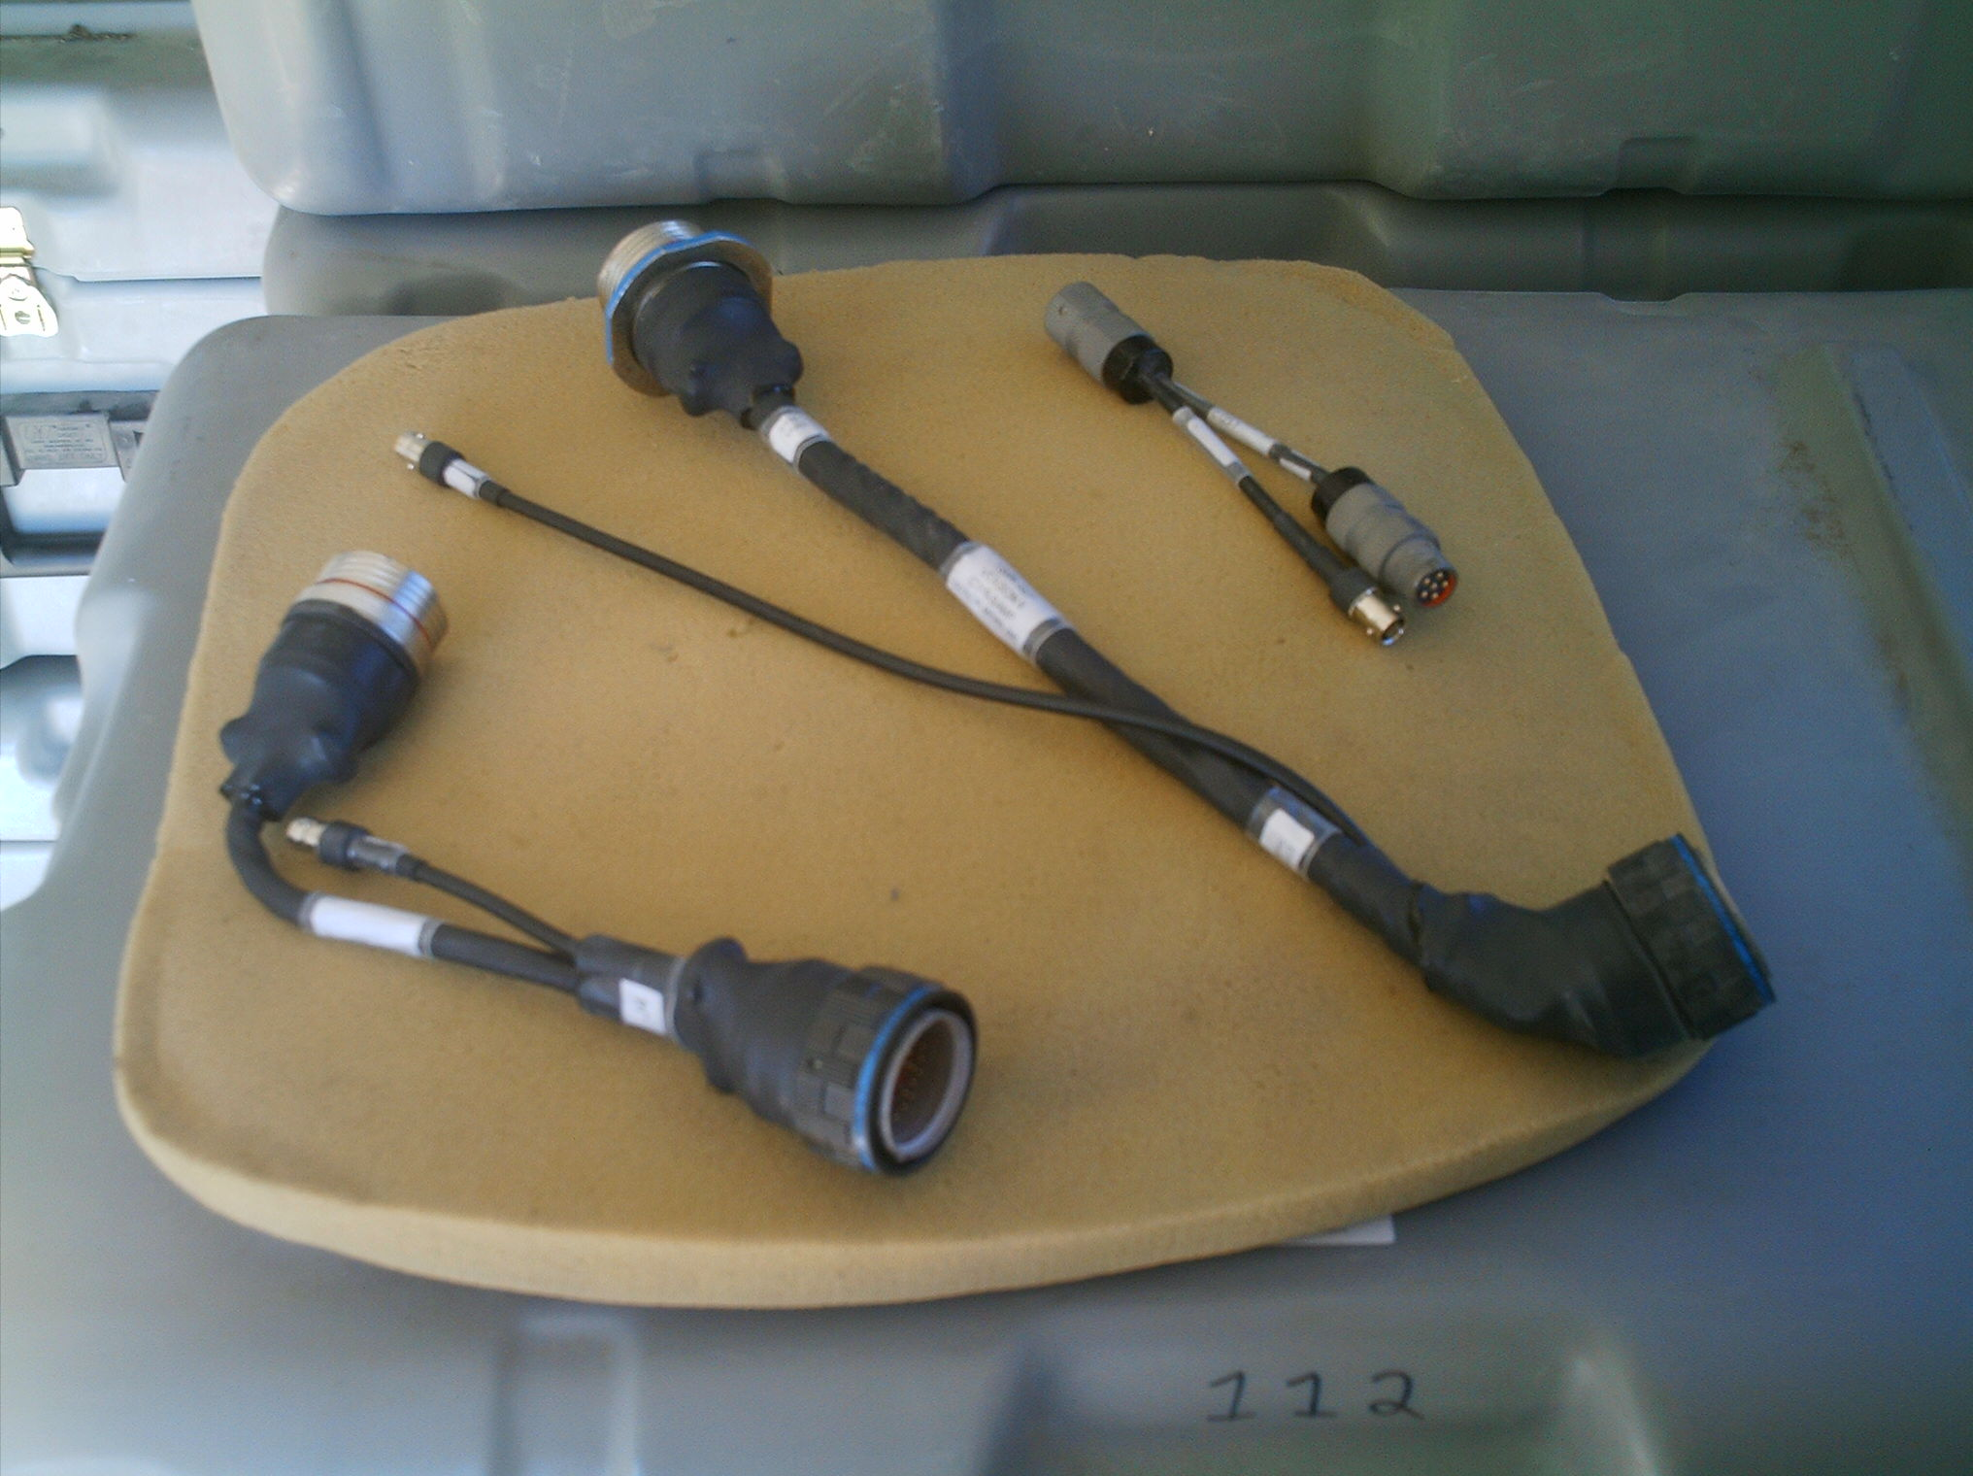
Left to right: CDU Adapter (new model), TSVR V2, and External Audio Adapter

Slide 8
C
E
A
B
D
F
A- M1 GAS Adapter for Gunner’s Through Sight B – M1 Crew Camera Loader’s Mounting Bracket C – M2/3Crew Camera Mount for Gunner and Commander’s Cameras D – M1 Gunner’s Camera Bracket Alternative E – M2/3 GAS Adapter for the Commander’s Auxiliary Through Sight F – M2 GPSE Mounting bracket for use on the M2 ODS (*Item B and D are the only mounts that are used on the MATV)

Slide 9
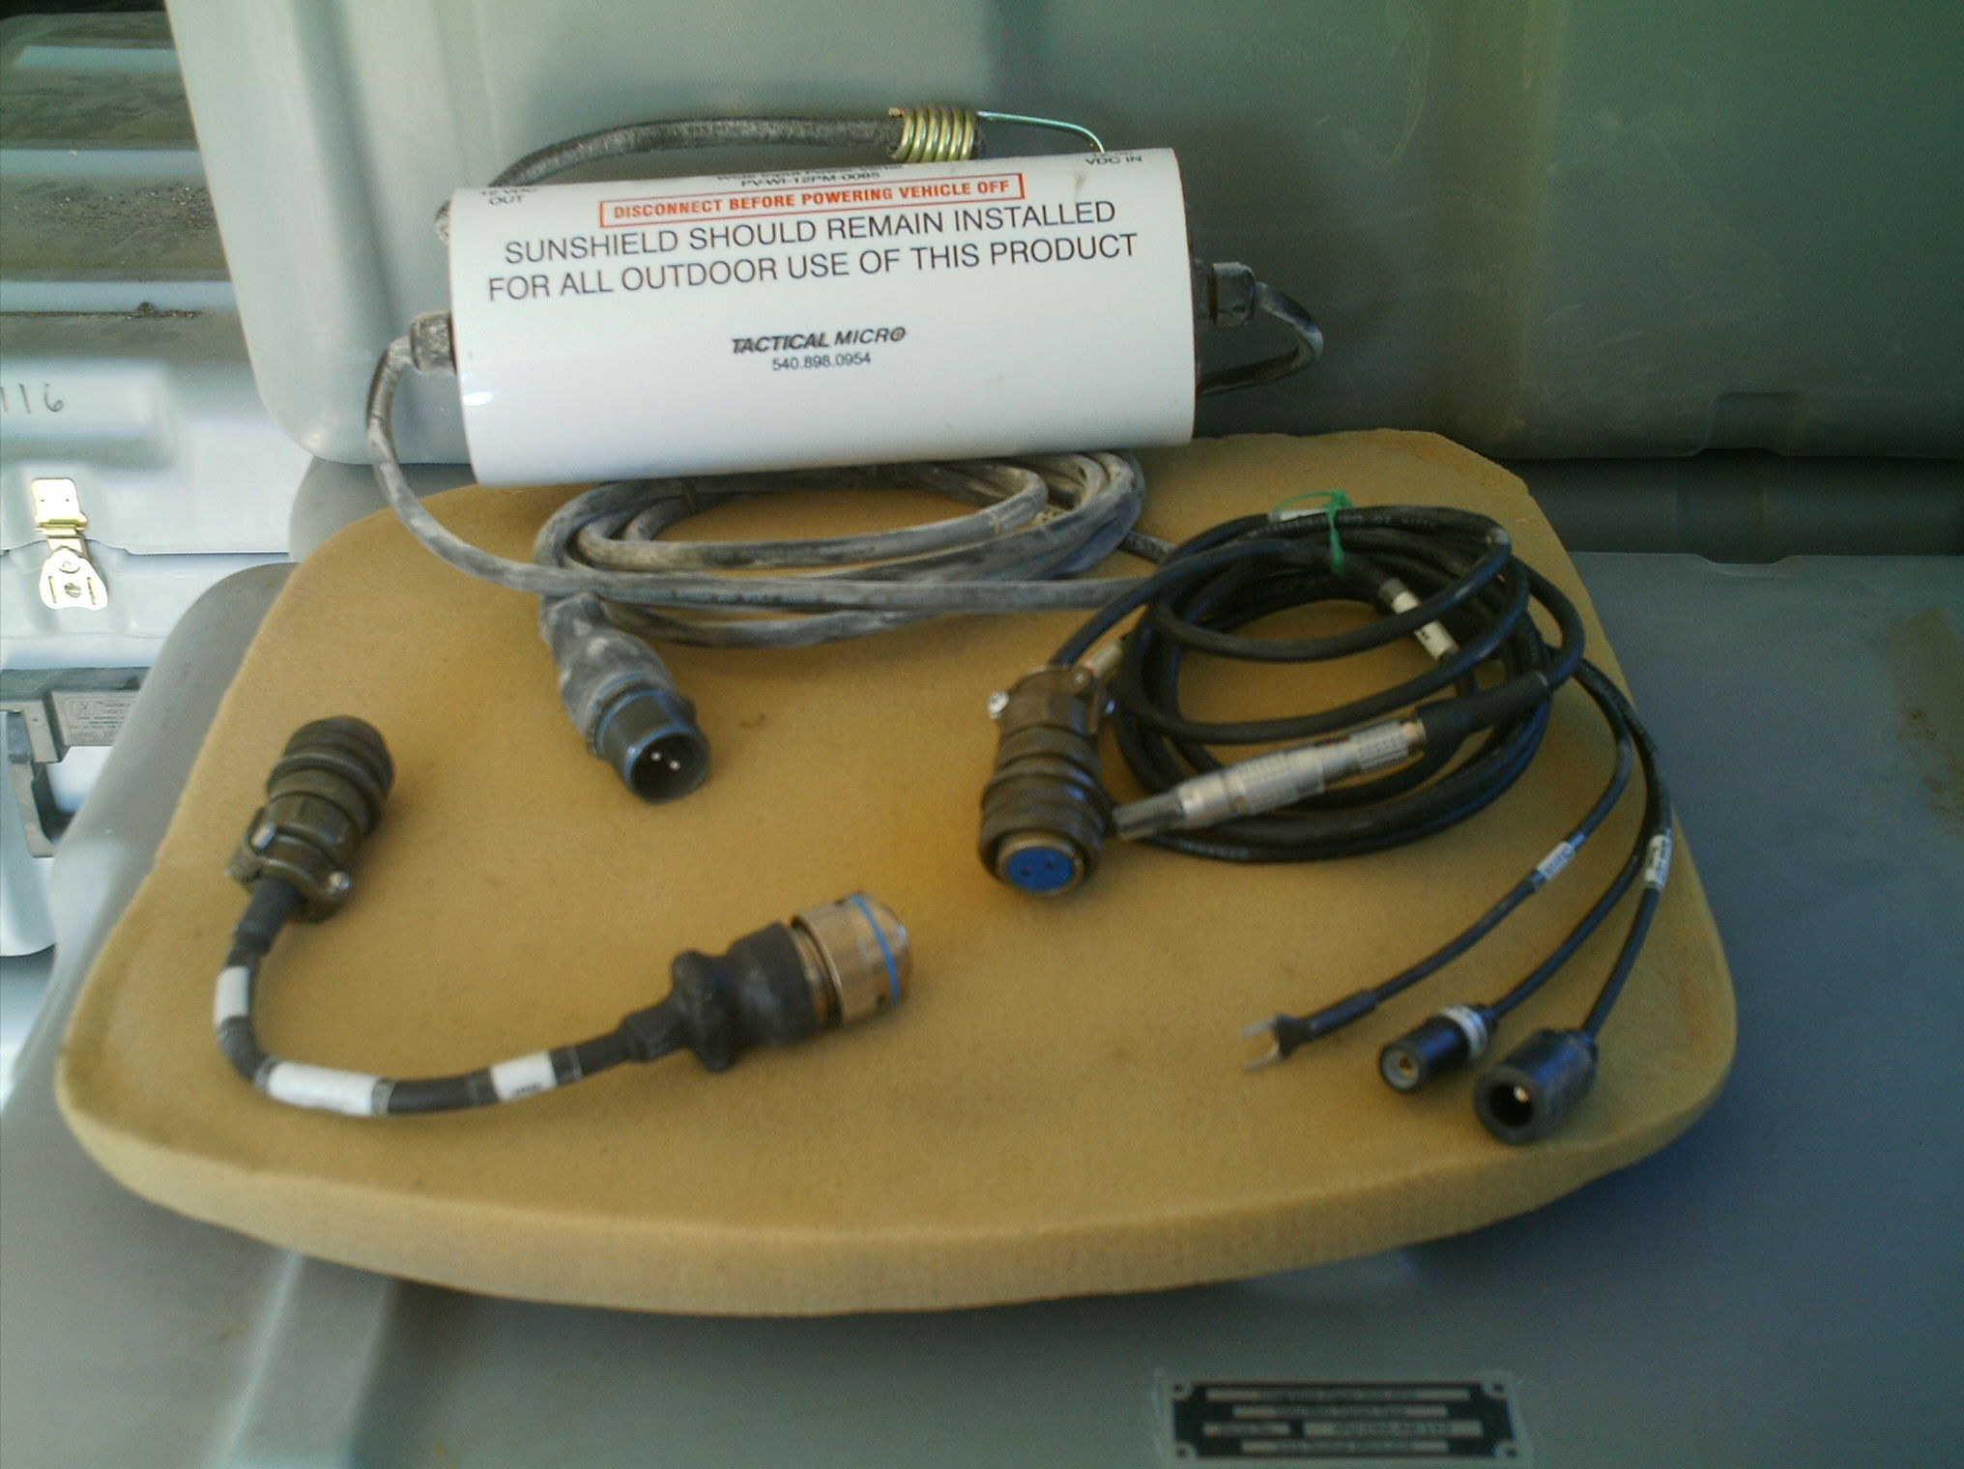
A
C
B
A - Voltage Regulator (Power-Verter) used with all IPU platforms
B – M1 Power Adapter
C – M2/3 Power Adapter & MATV

Slide 10
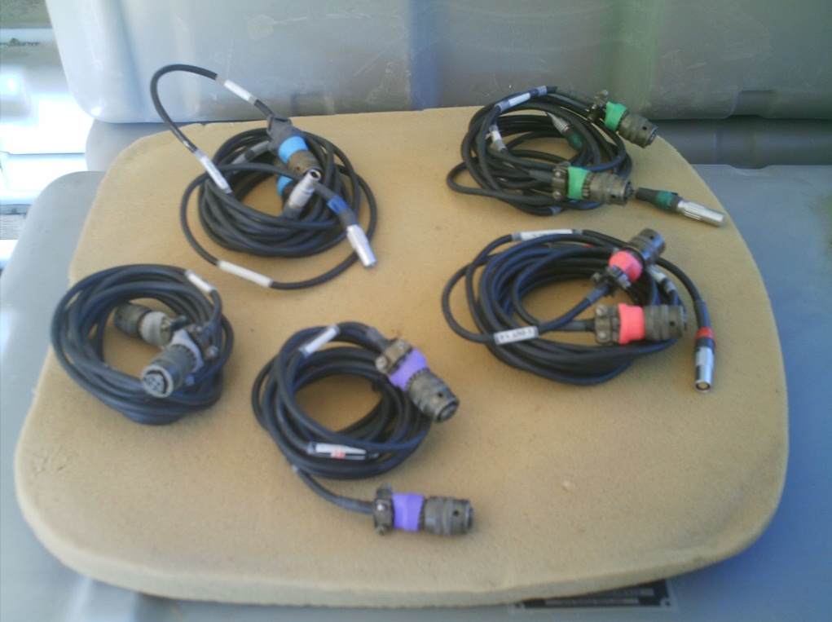
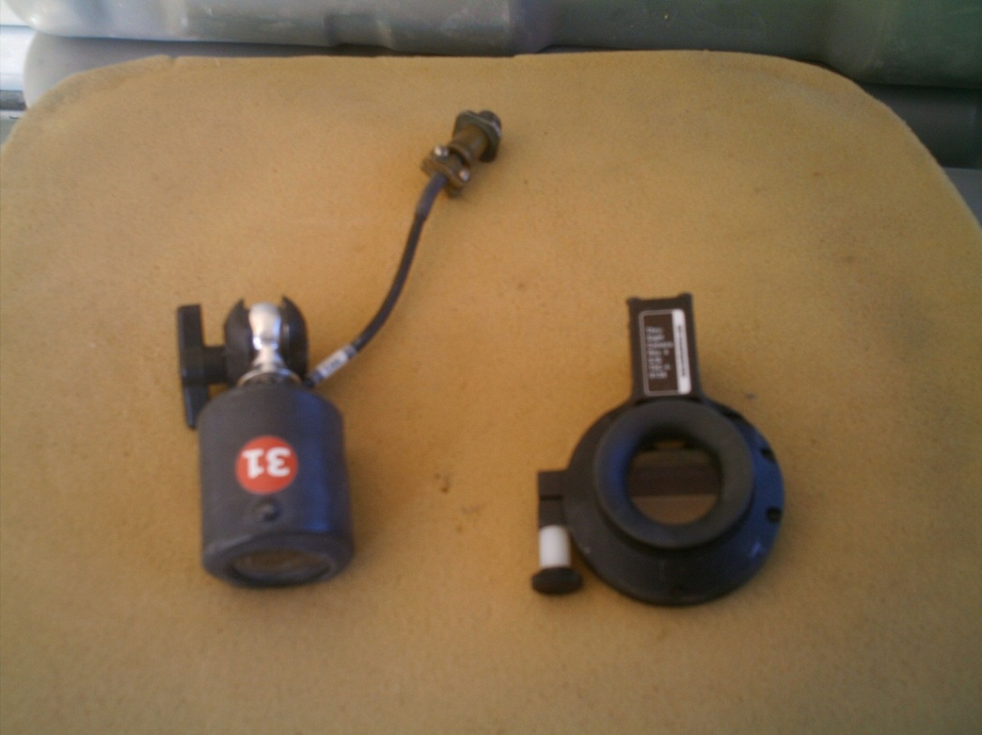
Five color coded camera cables are in each VAB.
Shown are The Crew and Through Sight Cameras. The Through Sight Cameras are not used on the MATV, only 1 Crew Sight Camera is used.
Crew
Through Sight

Slide 11
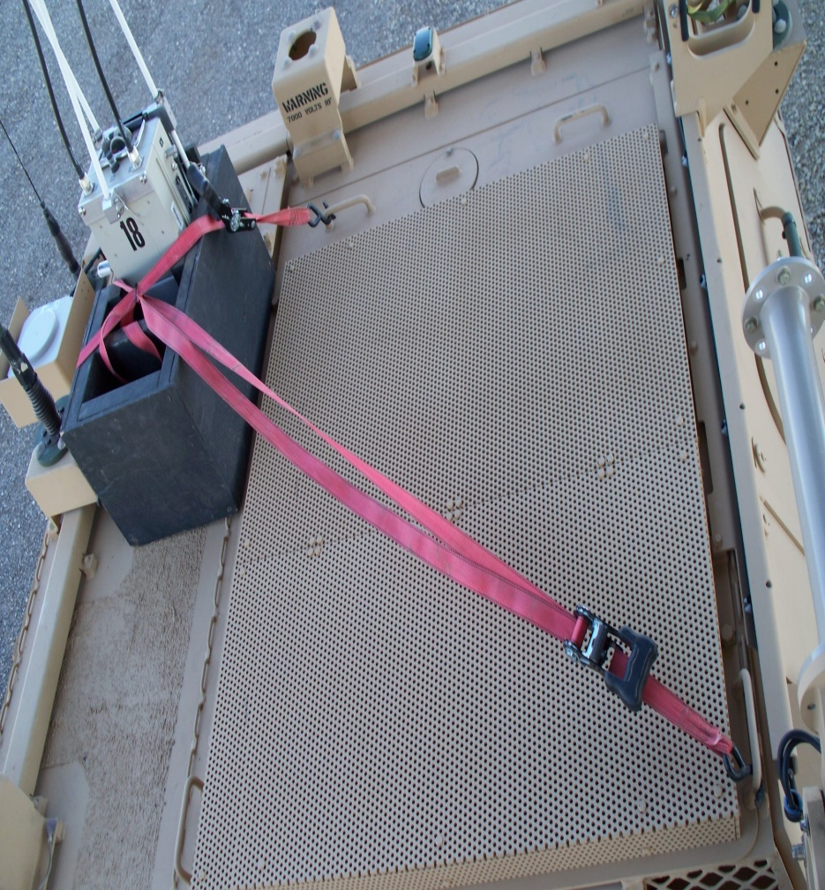
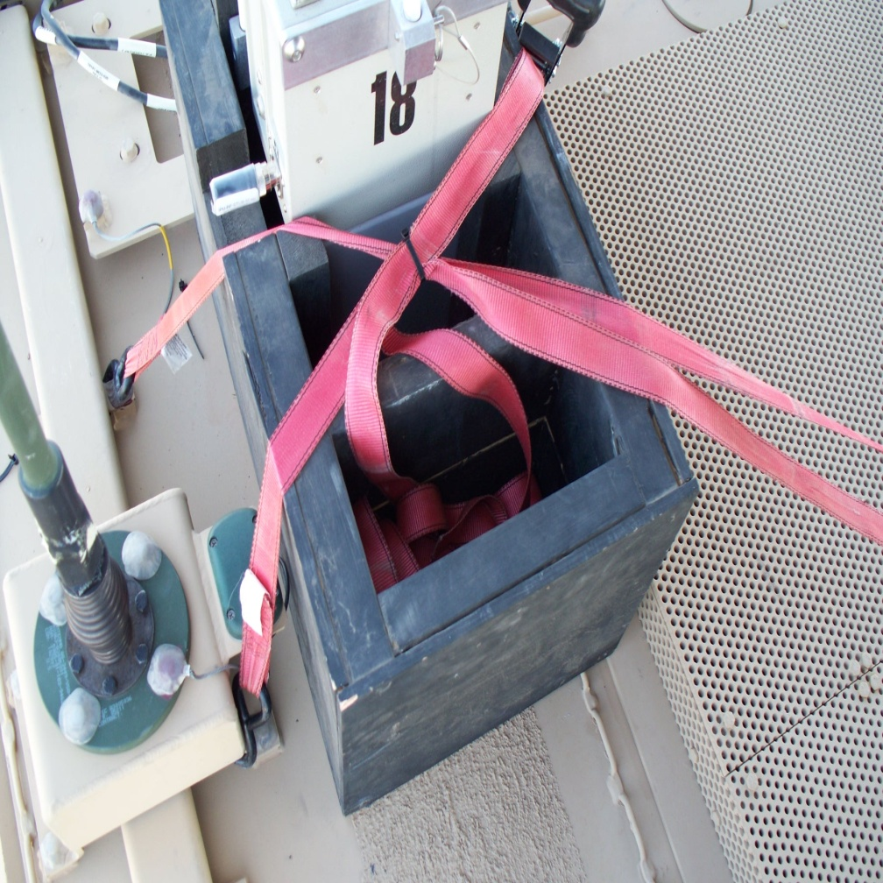
D
B
A
C
Mount Player Unit (A) on the passenger rear corner of the back deck. Mount a (B) 5 GHZ stubby antenna on the J4 connector on the BMU and insert the BMU into the box. Run a (C) ratchet strap from mount ring behind the Sincgars antenna across to the hand hold on the drivers’ side. Run another (D) strap from the base of the antenna mount to the hand grip rear center of the deck.

Slide 12
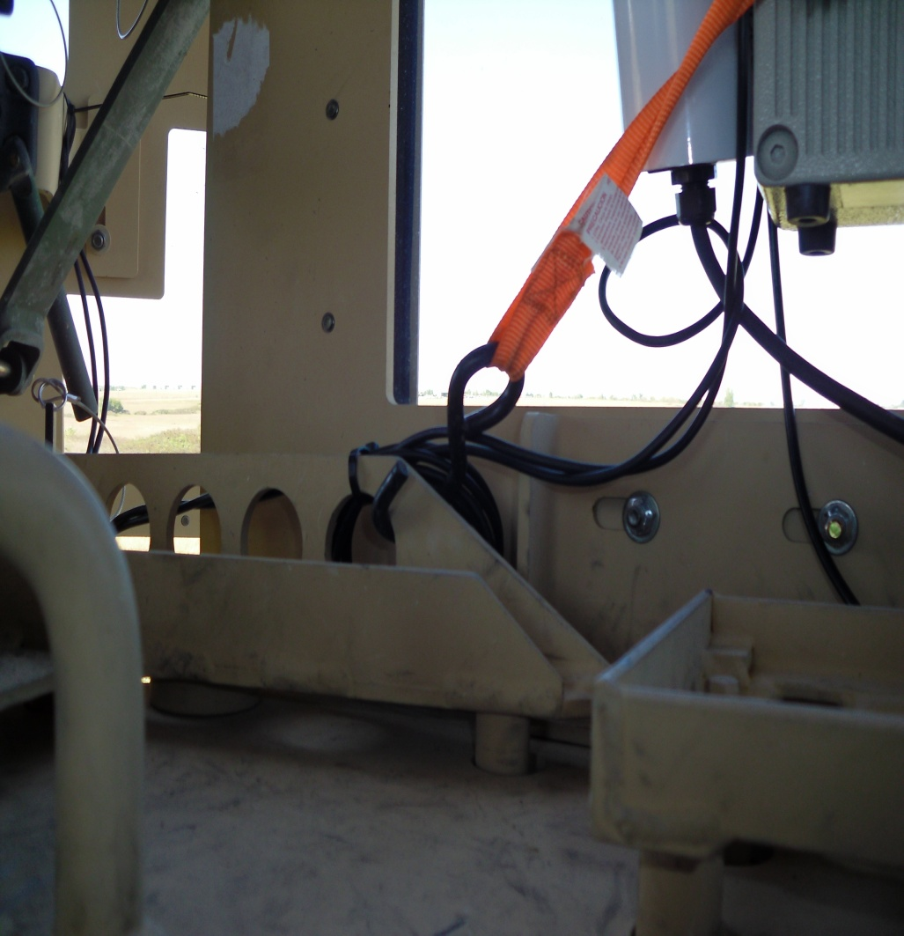
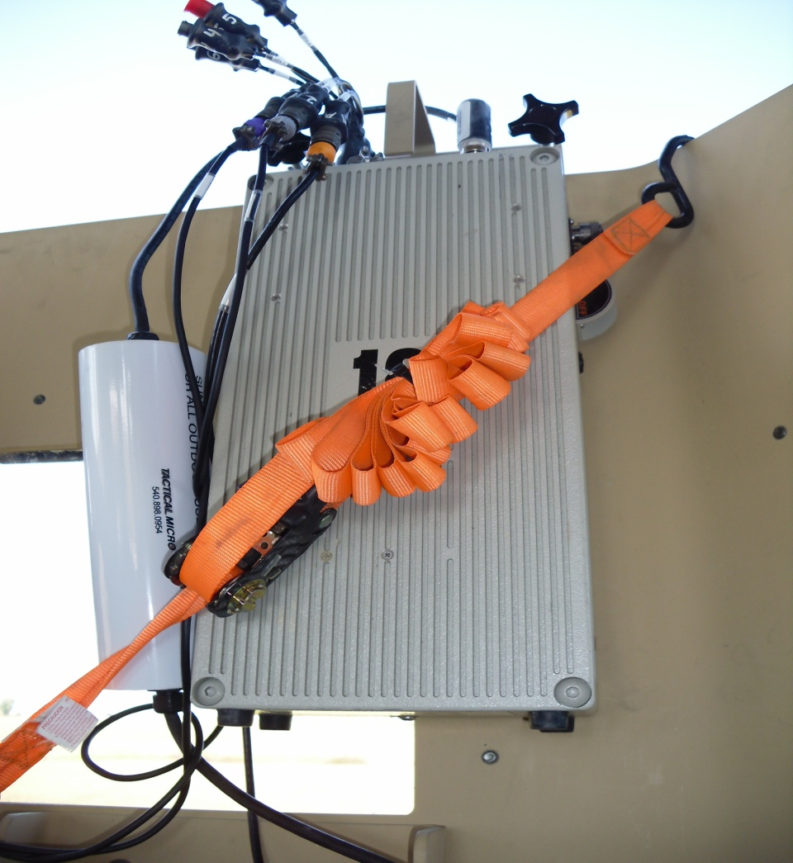
A
Mount the CMU to the right side of the turret. (Currently a ratchet strap is being used to secure the CMU. A bracket bolted to the holes in the turret and then the CMU mounted to the bracket is preferred and the bracket is being manufactured). Attach the (A) Wide Input Power-Verter to the turret using the supplied bungee cord.

Slide 13
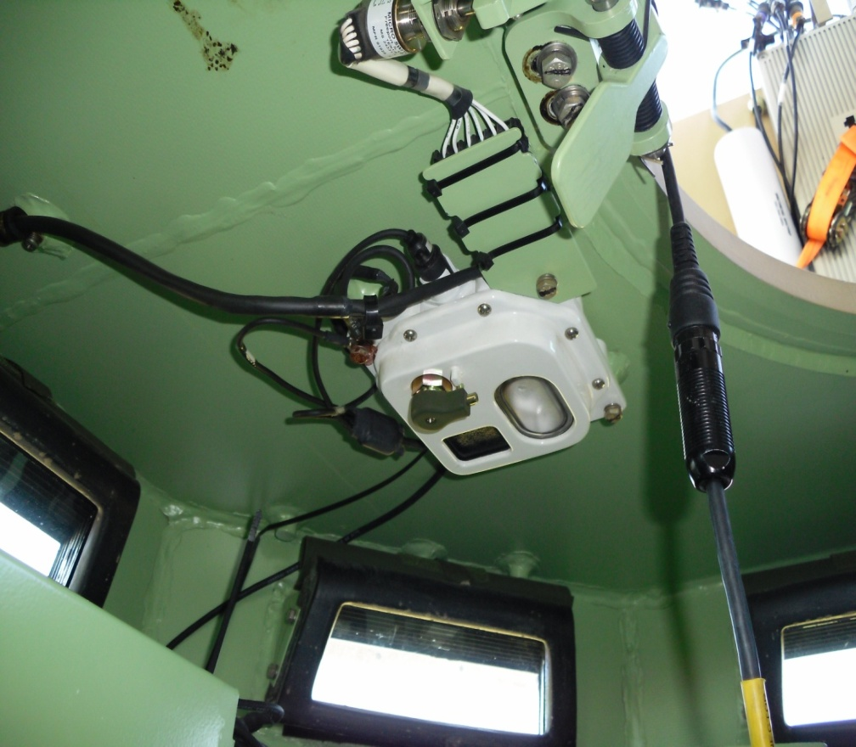
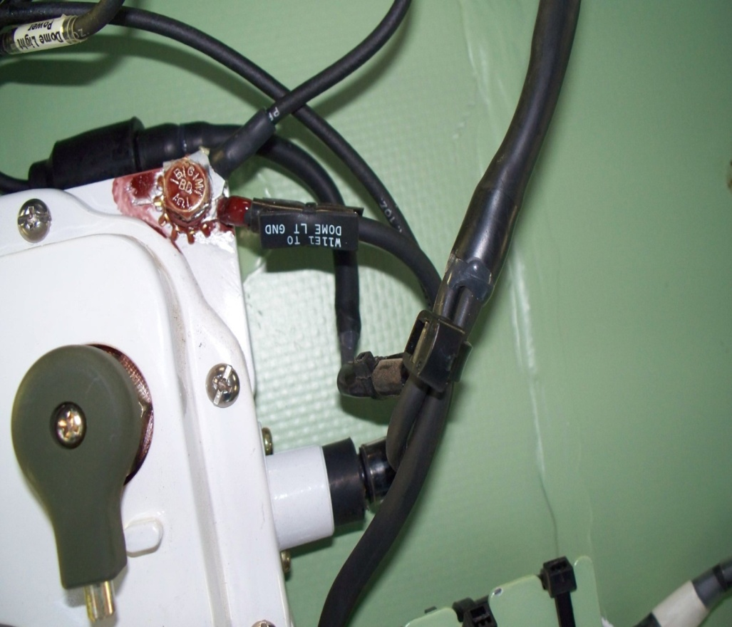
A
B
Power is supplied to the CMU using the Dome Light Power Cable and the Voltage Regulator (Power-Verter) used with all IPU platforms. On the turret Dome Light, (A) unplug the power cable. Attach the Dome Light Power Cable (C151-12) attach the vehicles dome light power cable and the attach the ground wire (B). Plug the other end of the Dome Light Power Cable to the input of the Wide Input Power-Verter. Plug the output of the Power-Verter into P1 of the CMU. Ensure cables are routed underneath the ammo can mounting bracket.

Slide 14
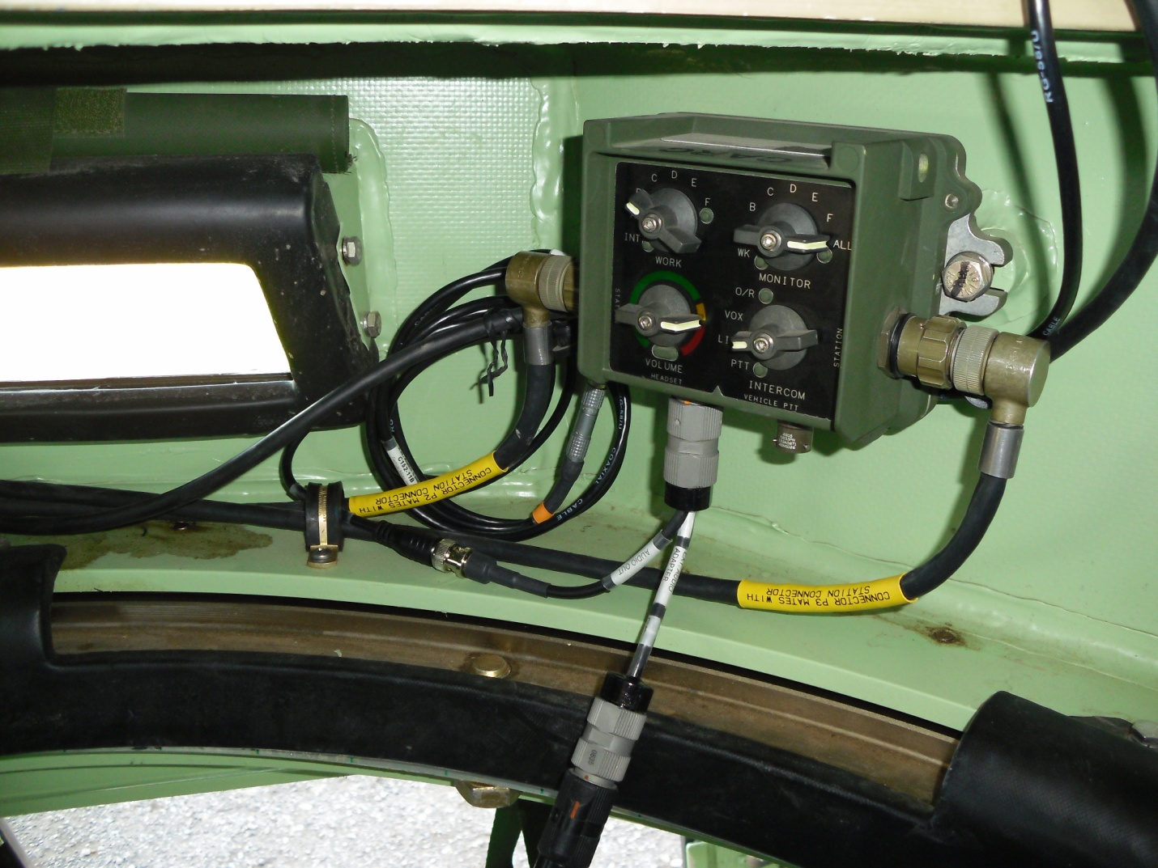
B
A
The External Audio Adapter (EAA) (A) attaches to the FFCS located in the turret. The crews headset audio cable then connects to our EAA Cable. Attach External Audio Cable (B) to the EAA, route the cable up thru the turret and connect it to Port 7 of the Spider Cable.

Slide 15
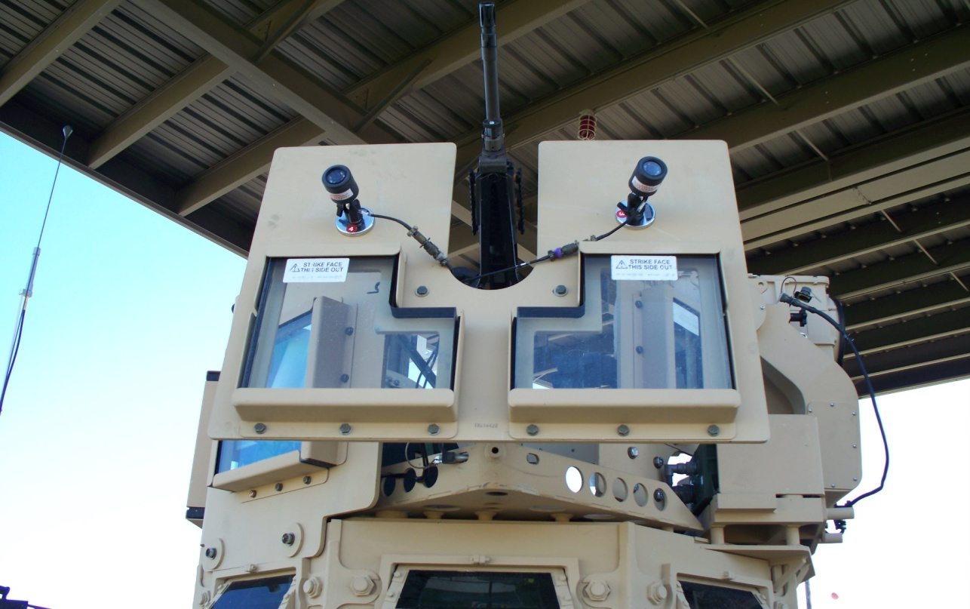
A
Mount the Magnetic Camera Mounts (GCB) on the left and right blast shields. Attach a Crew Camera (CRW-CAM) to each. Connect Video cable (C103-9P) to each camera. (or mount cameras where commander likes, for best view).

Slide 16
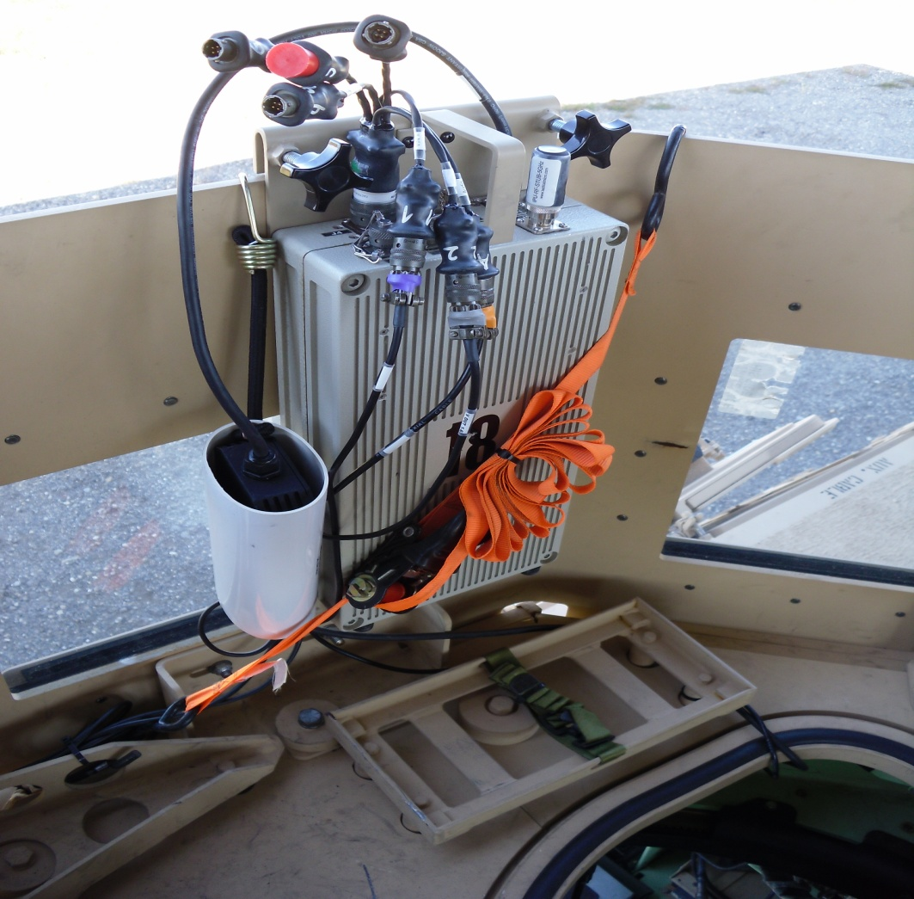
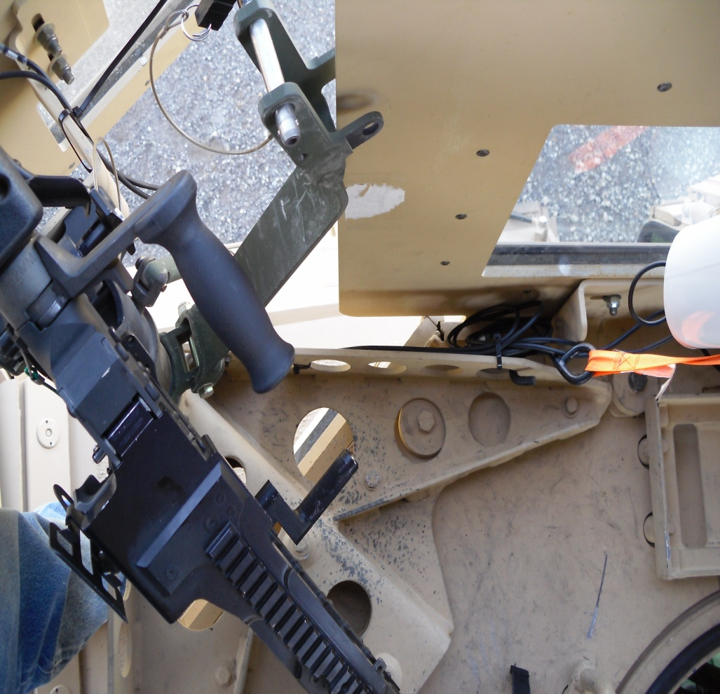
Route the cables from the CMU down to the machine gun mount and then out the center of the blast shields, ensuring to secure the cables out of the field of motion from the weapon.

Slide 17
Risk Assessment Considerations:
IPU mount is secure and proven with legacy system.
The Voltage Regulator (Power-Verter) is used as a protection for both the vehicle and the Player Unit. Ensuring any power surge from the vehicle would not be transferred to the Player Unit, Also it would prevent any electrical shorts from damaging the vehicles systems.
The risk is low to the vehicle and equipment due to the fuse system in the Voltage Regulator (Power-Verter) and the fuse on the CMU. The fuse on the CMU is accessible on the CMU without opening the box. The BMU is powered by its own battery system, therefore provides no risk on this family of vehicles due to power concerns.
With proper installation and education of the crew on the equipment, the instrumentation of this family of vehicles with the IPU poses no more risk to the crew or equipment than when this family of vehicle is instrumented with the legacy player unit.

