Slide 1
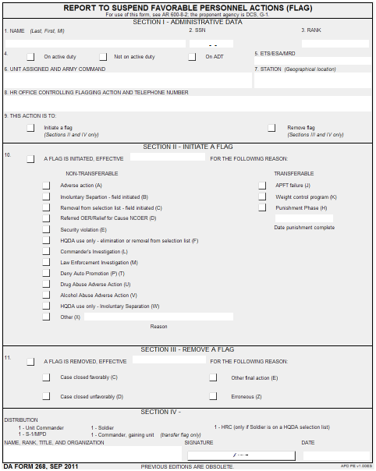
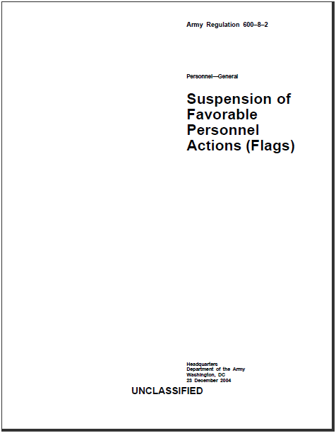
Adjutant General School
Administer Suspension of Favorable Personnel Actions
DISCLAIMER: Some of the content included in this training package is based on changes to AR 600-8-2 which is currently being staffed for approval and will be released at a later date.
Notes:
SHOW SLIDE: ADMINISTER SUSPENSION OF FAVORABLE PERSONNEL ACTIONS
INTRODUCTION: The suspension of favorable action (flag) function is the responsibility of commanding officers at all levels and the functional responsibility of the Brigade S-1 (BDE S-1), Battalion S-1 (BN S-1), and MPD.
MOTIVATOR: You over heard one of your former Soldier’s talking to another Soldier about his promotion party that took place on Saturday. It suddenly dawned on you that the Soldier should have been flagged, pending charges for DUI.

Slide 2
Terminal Learning Objective
Action: Administer Suspension of Favorable Personnel Actions (FLAG)
Conditions: In a classroom environment, given AR 600-8-2, DA Form 268, and awareness of Operational Environment (OE) variables and actors.
Standards: The student will have met the standards when they fully understand the processing and procedures for flagging actions listed below:
1. Communicate general policy and impact of flagging actions
2. Determine effective dates of flagging actions
3. Process initiation and removal of flags
Manage flagging actions at all levels
Notes:
Method of Instruction: Conference / Discussion
Instructor to Student Ratio is: 1:36
Time of Instruction: 10 mins
Media: Large Group Instruction
SHOW SLIDE: TERMINAL LEARNING OBJECTIVE (TLO)
Instructional Guidance
NOTE: Before presenting this lesson, instructors must thoroughly prepare by studying this lesson and identified reference material. Throughout this lesson, solicit from students the challenges they experienced in the current contemporary operational environment (COE) and what they did to resolve them. Encourage students to apply at least 1 of the 11 critical variables: physical environment, nature and stability of the state, sociological demographics, regional and global relationships, military capabilities, technology, information, external organizations, national will, time, and economics.
NOTE: Inform students of the following Terminal Learning Objective (TLO) requirements.
NOTE: FOR INSTRUCTOR PURPOSE ONLY: In a training environment, leaders must perform a risk assessment in accordance with FM 5-19, Composite Risk Management. Leaders will complete a DA Form 7566 COMPOSITE RISK MANAGEMENT WORKSHEET during the planning and completion of each task and sub-task by assessing mission, enemy, terrain and weather, troops and support available-time available and civil considerations, (METT-TC). Note: During MOPP training, leaders must ensure personnel are monitored for potential heat injury. Local policies and procedures must be followed during times of increased heat category in order to avoid heat related injury. Consider the MOPP work/rest cycles and water replacement guidelines IAW FM 3-11.4, NBC Protection, FM 3-11.5, CBRN Decontamination.
No food or drink is allowed near or around electrical equipment (CPU, file servers, printers, projectors, etc.) due to possible electrical shock or damage to equipment. Exercise care in personal movement in and through such areas. Avoid all electrical cords and associated wiring. In the event of an electrical storm, you will be instructed to power down equipment. Everyone is responsible for safety. A thorough risk assessment must be completed prior to every mission or operation.
Risk Assessment Level: Low - Safety Review=PT
Environmental Statement: Environmental protection is not just the law but the right thing to do. It is a continual process and starts with deliberate planning. Always be alert to ways to protect our environment during training and missions. In doing so, you will contribute to the sustainment of our training resources while protecting people and the environment from harmful effects. Refer to FM 3-34.5 Environmental Considerations and GTA 05-08-002 ENVIRONMENTAL-RELATED RISK ASSESSMENT.
NOTE: It is the responsibility of all Soldiers and DA civilians to protect the environment from damage. Recycle all appropriate courseware material. Environmental protection is not just the law but the right thing to do. It is a continual process and starts with deliberate planning. Always be alert to ways to protect our environment during training and missions. In doing so you will contribute to the sustainment of our training resources while protecting people and the environment from harmful effects.

Slide 3
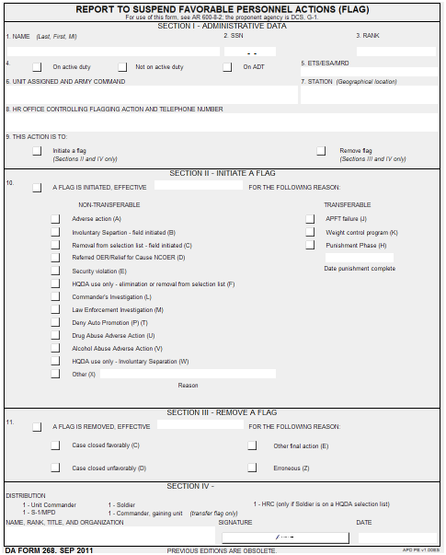
Purpose of Flag (1 of 2)
A Flag is an “administrative tool” used to prevent and/or preclude:
Execution of favorable actions
Movement of a Soldier
A Flag (DA Form 268) will be initiated immediately when a Soldier’s status changes from favorable to unfavorable.
Flags are not to be used for punishment or restriction.
Flags are not the final disposition.
AR 600-8-2, Para 2-1
Notes:
Learning Step / Activity 1. Communicate General Policy and Impact of Flagging Actions
Method of Instruction: Conference / Discussion
Instructor to Student Ratio: 1:36
Time of Instruction: 30 mins
Media: Large Group Instruction
SHOW SLIDE: PURPOSE OF FLAG (1 OF 2)
Execution of favorable actions regarding a Soldier who may be in an unfavorable status (not in good standing) when doing so would potentially embarrass the Army.
Movement of a Soldier when it is in the best interests of the Army for the Soldier to remain in their current unit or at their current location until cleared of ongoing actions.
A Flag should be initiated in a timely manner and removed as soon as practical after determination of the final disposition. A flag should only be emplaced during some type of disciplinary or administrative action until that action is concluded
A Flag is not a form of military justice and therefore, should not be used as such. Remember, Flag is an administrative tool used to prevent the execution of specified favorable personnel actions for Soldiers.
A flag will be removed as soon as practical after the Soldier’s status changes from unfavorable to favorable.

Slide 4
Purpose of Flag (2 of 2)
A Flag will not be removed for the purpose of allowing a Soldier to PCS.
A Flag is mandatory when an investigation is initiated by military or civilian authorities.
Commander establish internal controls:
“Need to Know”
Health Promotion, Risk Reduction and Suicide Prevention
Favorable actions are not granted
DA Form 268 is prepared to suspend favorable actions
DA Form 268 is prepared to removed flagging action
AR 600-8-2, Para 2-1 & 2-2
Notes:
SHOW SLIDE: PURPOSE OF FLAG (2 of 2)
Suspension of favorable actions is mandatory when an investigation (formal or informal) is initiated on a Soldier by military or civilian authorities. Commanders, general officer staff heads, and heads of HQDA staff agencies (to include the DA Suitability Evaluation Board) must ensure that favorable personnel actions are suspended in accordance with the criteria contained in this regulation.
b. Commanders and heads of HQDA agencies will establish internal controls, if necessary, to ensure the following requirements are met:
(1) Only those with a “need to know” of a flag are informed. A person has a “need to know” only if they must have access to knowledge, or possession of the flag, in order to perform their official duties.
(2) Flag information will support the Health Promotion, Risk Reduction, and Suicide Prevention policy for information sharing described in DA PAM 600-24, chapter 8.
(3) Favorable actions are not granted when prohibited by this regulation.
(4) DA Form 268 is prepared to reflect that favorable personnel actions are suspended with regard to the affected Soldier and the flag is input into HR systems. The MPD supporting personnel office, BDE S-1, or other authorized records custodian for the Soldier will also use appropriate reports or processes to guard against the execution of favorable personnel actions for flagged Soldiers.
(5) A DA Form 268 is prepared to remove a flag when the Soldier’s status changes from unfavorable to favorable and the flag is removed from the HR systems.

Slide 5
Favorable Actions Impacted by a Flag (1 of 2)
Appointment, reappointment, reenlistment, or extension
Unless authorized by AR 601-280, AR 135-180, AR 135-205, or AR 140-111
Reassignment
Additional guidance see paragraph 2-9
Promotion
Promotions in grade, lateral appointments, and frocking
Awards-Soldier may neither be recommended for nor receive awards
Awards and decorations for valor or heroism may be processed and presented to Soldiers who are flagged for AWCP or APFT failure (WITHOUT A WAIVER)
Attendance at military or civilian schools
Appearance before a semi-centralized promotion board
Overweight or APFT failure may be recommended and presented a posthumous award, decoration, or a badge without a waiver and assigned to a unit engaged in combat against hostile forces and Soldier dies a result of injuries sustained during combat
Waiver approval authority is Army G-3/5/7
AR 600-8-2, Para 3-1
Notes:
SHOW SLIDE: FAVORABLE ACTIONS IMPACTED BY A FLAG (1 OF 2)

Slide 6
Favorable Actions Impacted by a Flag (2 of 2)
USAR Soldiers flagged for not complying with the AWCP cannot participate as platform instructors IAW AR 140-1
Unqualified resignation, retirement, or discharge
Advance or excess leave, unless granted as an exception to policy by commanders in accordance with AR 600-8-0
Payment of enlistment bonus (EB) or selected reenlistment bonus (SRB)
Assumption of command (AR 600-20)
Family member travel
Command sponsorship of family members
AR 600-8-2, Para 3-1
Notes:
SHOW SLIDE: FAVORABLE ACTIONS IMPACTED BY A FLAG (2 of 2)

Slide 7
Non-Transferable Flags
Circumstances that may result in a Soldier requiring a Non-Transferable Flag. The flagged Soldier may not be transferred to another unit (except as provided for in paragraph 2-2). Ensure the correct reason code is being used IAW Table 2-1.
Non-Transferable
Adverse actions (A)
Involuntary separation/discharge (B)
Non-Transferable
Non-recommendation for automatic promotion (P) or (T)
Lautenberg Amendment (X)
Pending removal/consideration from a command, promotion, or school selection list-HQDA initiated (F)
Referred OER/ Relief- for-Cause NCOER (D)
Security violations (E)
Drug abuse adverse action (U)
Family Care Plan (X)
Army Medical Department (X)
Alcohol abuse adverse action (V)
Law enforcement investigation (M)
Commander’s Investigation (L)
Noncompliance with title 10 USC 10206 (X).
Removal from a selection list -Field initiated (C )
AR 600-8-2, Para 2-2
Notes:
SHOW SLIDE: NON-TRANSERABLE FLAGS
NOTE FOR INSTRUCTOR: Make student aware that there are exceptions to Non-Transferable Flags outlined in Paragraph 2-2.
NOTE FOR INSTRUCTOR: THE DRUG OR ALCOHOL FLAG SHOULD BE USED INSTEAD OF THE ADVERSE ACTION FLAG FOR ALL DRUG OR ALCOHOL OFFENSES.

Slide 8
Transferable Flags
Circumstances that may result in a Soldier requiring a Transferable Flag. The flagged Soldier may be transferred to another unit IAW Paragraph 2-3. Ensure the correct reason code is being used IAW Table 2-1.
Punishment phase (H)
Army Physical Fitness Test (APFT) (J)
Soldier who become pregnant after being flagged for failing an APFT, will remain flagged until successfully passing an APFT
Soldiers with a profile effective after the APFT will remain flagged until a record APFT is passed
Army Weight Control Program (AWCP) (K)
If a pregnant Soldier flag was initiated before pregnancy (as determined by a physician) the flag will remain in effect until the Soldier complies with AR 600-9.
A flag is not required for a Soldier who has a permanent or temporary profile that precludes taking the APFT or is unable to undergo an APFT because of conditions beyond the Soldier’s control (as determined by the commander).
Soldier fails a record APFT
Soldier fails to take the APFT within prescribed by regulation or when directed by commanding officer
When actions resulting from a court-martial, non-judicial punishment, or punishment from a civil court have moved into the punishment phase and punishment does not include confinement, restraint, or geographical travel restrictions imposed by civilian courts as a condition of parole, probation, or suspended sentence
Soldier was found to be in non-compliance with AR 600-9
The use of certain medication to treat an underlying medical disorder or the inability to perform all aerobic events may contribute to weight gain but are not considered sufficient justification for noncompliance with AR 600-9 and Soldier will be flagged.
AR 600-8-2, Para 2-3
Notes:
SHOW SLIDE: TRANSFERABLE FLAGS

Slide 9
Check on Learning
1. Q. CPT Myers just returned from three weeks of leave in Hawaii and therefore, was not able to take his APFT. The commander directed CPT Myers to take his APFT no later than Wednesday of the following week. CPT Myers failed to take his AFPT. What action should you take as the commander?
A. Initiate a Flag (Para 2-3d)
2. Q. SSG Brown is assigned to Co A, 1st Bn, 316th AR and is pending removal from the SFC list. There is a need for a qualified Battle Staff Operation NCO in one of the other battalion’s within the same Brigade. Can the brigade Commander direct SSG Brown be reassign with a pending flagging action?
A. Yes (Para 2-2)
3. Q. SPC Austin was enrolled in the AWCP and recently found out that she is pregnant. What action should you take as the commander?
A. No action is required, the flag will remain in effect until the soldier complies with AR 600-9 (Para 2-3e)
4. Q. SGT Harrison received his second DUI and was flagged pending administrative action. SGT Harrison’s commander recommended separation and his packet was submitted to the administrative separation board. The board recommended that the Soldier be retained. Can the commander remove the flag?
A. No, the flag may only be removed by the General Court-Martial Convening Authority. (Para 2-9b (2)
Notes:
SHOW SLIDE: CHECK ON LEARNING

Slide 10
Effective Dates (1 of 2)
The effective date of a flag, unless otherwise specified in this regulation, will be the date that the circumstance(s) requiring the flag occurred, not the date the flag was initiated (e.g. if the circumstance occurred on the 25th of March, but the flag was not initiated until the 3d of April, the effective date of the flag would still be the 25th of March).
Soldier is pending a non-punitive memorandum of reprimand, censure, or admonishment. Flag will be effective on the day the offense (leading to the memorandum) took place.
Soldier is absent without leave (AWOL), submit the initial flag on the second day of AWOL, with an effective date of the first day of AWOL.
The effective date of the flag will be the date the commander signs the intent to separate notification memorandum to the Soldier or the date HQDA initiates an involuntary separation action.
A flag is initiated based on the adverse action resulting from the alcohol or drug abuse-related incident. A flag may NOT be initiated based on referral, screening or enrollment into the Army Substance Abuse Program (ASAP).
Effective date of the flag is the date of offense, the date the commander directs the investigation, the date the commander appoints an investigation officer, or the date the investigating officer suspects the Soldiers may be subject to disciplinary action.
AR 600-8-2, Chap 2, Para 2-2 & 2-4
Notes:
Learning Step / Activity 2. Determine Effective Dates of Flagging Actions
Method of Instruction: Conference / Discussion
Instructor to Student Ratio: 1:36
Time of Instruction: 10 mins
Media: Large Group Instruction
SHOW SLIDE: EFFECTIVE DATES (1 OF 2)

Slide 11
Effective Dates (2 of 2)
The effective date of the flag will be the through date listed on the OER or NCOER, the date the decision was made to administer the referred OER, or the date of relief.
Effective date of the flag is the date of offense or the date law enforcement identifies or titles the Soldier as a subject or suspect.
A Soldier denied automatic promotion to PV2 thru SPC, they must flag the Soldier no later than the 20th day of the month preceding the month of automatic promotion in accordance with AR 600-8-19.
An officer denied automatic promotion to CW2 or 1LT, they must flag the officer. To ensure promotion orders are not erroneously cut, the flag must be input into HR systems no later than 90 days prior to the month of automatic promotion.
Lautenberg Amendment. Soldiers with a qualifying conviction under the Domestic Violence Amendment to the Gun Control Act of 1968 must be flagged as required by AR 600-20.
Soldiers who fail to provide and maintain an adequate Family care plan, as required by AR 600-20 must be flagged. Effective date of the flag will be the suspense date established by the commander for completion and approval of DA Form 5305 with attendant documents in accordance with AR 600-20
AR 600-8-2, Chap 2, Para 2-2 & 2-4
Notes:
SHOW SLIDE: EFFECTIVE DATES (2 OF 2)

Slide 12
Initiating a Flag
1
A Flag, DA Form 268 (Suspension of Favorable Personnel Actions) and HR system input, will be initiated immediately when a Soldier’s status changes from favorable to unfavorable. A separate flag will be initiated for each reason for flagging a Soldier listed in this regulation
CDR directs Flag
2
DA Form 268 prepared / authenticated
Unless otherwise specified in this regulation, only commanding officers, commandants, or an officer with specific authority to sign “For the Commander” (e.g. battalion or higher XO, Deputy Commander, or Adjutant) may authenticate a DA Form 268. The Commander, AHRC (AHRC-PDV-P) will authenticate adverse action flags or investigation flags initiated by HQDA
3
S-1 inputs
flag into HR system
4
Unit Cdr/1st Line Supervisor Counsels
Soldier
The flagging authority, unit commander or first line supervisor will counsel all Soldiers on active duty in writing upon initiation of any flag within two working days.
Soldiers not on active duty will be counseled regarding initiation of a flag prior to the conclusion of the first training period following the date the Flag was initiated.
Counseling should include reason for the flag, requirements for flag removal, and actions prohibited by the flag. All Soldiers will be provided a copy of the DA Form 268 initiating and removing a flag
TAPDB * reflects flag
5
Record File created
6
Coord. w/ Security & Retention NCO
7
ID impacts on favorable actions
Unit
S-1
Units will maintain DA Form 268s and supporting documentation on active flags for all Soldiers within their unit.
AR 600-8-2, Para 2-7
Notes:
Learning Step / Activity 3. Processing Initial and Removal Flagging Actions
Method of Instruction: Conference / Discussion
Instructor to Student Ratio: 1:36
Time of Instruction: 35 mins
Media: Large Group Instruction
SHOW SLIDE: INITIATING A FLAG
Step 1: Commander identifies a requirement for a flag (para 2-2 or 2-3); directs unit personnel or S1 to prepare a DA Form 268; and provides supporting documentation.
Step 2: Unit/S-1 prepares DA Form 268 for Commander’s signature/authentication (para 2-5); S-1 validates flag accuracy with supporting documentation.
Step 3: S-1 initiates flag in HR system; system updates Total Army Personnel Database (TAPDB);
Step 4: Commander or supervisor counsels Soldiers on reason for the flag, requirements for removal and actions prohibited by the flag; provides
Soldier a copy of the DA Form 268 (para 2-6).
Step 5: Unit maintains a copy of signed flag, supporting documentation, and counseling for flag records management (para 2-10).
Step 6: Unit /S-1 notifies Security Manager/S-2 and Retention NCO of flag for their assessment of security clearance and reenlistment eligibility.
Step 7: Unit/S-1 assesses flag impact on pending favorable actions (PCS/ETS; awards; schools; promotion, etc.). Advise commander to act quickly if PCS/ETS is pending; determine if orders need to be revoked or revised. Determine promotion status: does flag result in removal from a semi-centralized promotion list or coordination with HRC for flag removal? (chapter 3)
*Note: HRC/NGB has visibility on all flags posted to Total Army Personnel Database (TAPDB) until flag closed. HRC/NGB verifies Soldiers flag status when processing personnel actions (awards, retirements, schools, assignments, promotion) .

Slide 13
Removal Dates (Non-Transferable/Transferable) (1 of 3)
Charges, restraint, confinement, court-martial, nonjudicial punishment and AWOL- remove the flag when the Soldier is acquitted at court-martial or civilian trail and no other adverse action adverse action arising from the incident or charges is contemplated. (see para 2-9 a. (1) for additional dates)
Administrative reduction- remove the flag on the date of reduction
Memorandum of admonishment, censure, or reprimand not administered as nonjudicial punishment- Remove the Flag on the date the appropriate authority directs the filing of the signed memorandum (AR 600–37) or on the date the memorandum is rescinded without filing.
Commander’s Investigation-remove the flag when investigation results in no adverse findings against the Soldier (see para 2-9 a. (9) for additional dates)
Law enforcement investigation- remove the flag when the completed DA Form 4833, Commander’s Report of Disciplinary or Administrative Action, is submitted to the provost martial or USACIDC in accordance with AR 190–45.
AR 600-8-2, Para 2-9
Notes:
SHOW SLIDE: REMOVAL DATES (NON-TRANSFERABLE/TRANSFERABLE (1 OF 2)
Remove the flag when UCMJ action is closed or dropped without action; or when punishment from court-martial, civilian trial, or non-judicial punishment is completed.
If a court-martial has adjudged a punitive discharge, the individual will remain flagged until the conviction is final in accordance with Rules for Courts-Martial 1209, Manual for Courts-Martial.
If there is a suspension of punishment (for example under Article 15) or the imposition of probation or parole (usually for civilian misconduct), that individual will remain flagged until the suspension, probationary, or parole period is over. This does not include suspension of a driver’s license.
If the duration of punishment, suspension, probation or parole is over one month, the unit should consider if the adverse action flag should be converted to a transferable ‘punishment phase’ flag, if appropriate.
If the Soldier receives punishment and subsequently appeals, the flag will be removed when punishment is complete; the Soldier will only remain flagged if the appeal puts the punishment on hold or suspension until the adverse action is either revoked or the punishment is complete.
Commander’s investigation: remove the flag when the Soldier is flagged for pending court-martial, non-judicial or administrative punishment or the commander decides to take no action on substantiated findings.

Slide 14
Removal Dates (Non-Transferable/Transferable) (2 of 3)
Referred officer evaluation report or Relief-for-Cause noncommissioned officer evaluation report - remove the flag when the evaluation is accepted error-free by AHRC or State MILPO and uploaded to the Soldier’s Army Military Human Resource Record (AMHRR).
For first time drug offenses - remove the flag when Soldier is reassigned to the transition point for separation or, if separation authority retains the Soldier, remove the flag when punishment is complete.
For second-time or higher drug offenses - remove the flag when Soldier is reassigned to the transition point for separation. If a show-cause board, administrative separation board, or separation authority retains the Soldier, the flag must be removed by the General Court-Martial Convening Authority.
Involuntary separation or discharge-remove the flag when Soldier is reassigned to a transition point or retained.
Alcohol abuse adverse action- remove the flag when the punishment is complete.
Promotion to PV2 thru SPC- remove the flag no later than two working days following the date the Soldier would have been automatically promoted.
AR 600-8-2, Chap 2, Para 2-2 & 2-3
Notes:
SHOW SLIDE: REMOVAL DATES (NON-TRANSFERABLE/TRANSFERABLE (1 OF 2)

Slide 15
Removal Dates (Non-Transferable/Transferable) (3 of 3)
Promotion to 1LT - remove the flag when the officer is reassigned to the transition point or, if the denial for promotion to 1LT is held in abeyance for up to 6 months, remove the flag when the commander elects to promote the officer.
Lautenberg Amendment- remove the flag when conviction is expunged, pardoned or set aside by competent authority or when Soldier is transferred to transition point for separation.
Family care plan- remove the flag when the Family Care Plan is approved or recertified by the commander.
Punishment phase- remove flag upon completion of punishment.
Army Physical Fitness Test (Failure)-remove flag on date of compliance
Army Weight Control Program (Non-compliance) -remove the flag (code E) on date of compliance.
AR 600-8-2, Chap 2, Para 2-2 & 2-3
Notes:
SHOW SLIDE: REMOVAL DATES (NON-TRANSFERABLE/TRANSFERABLE) (2 of 2)

Slide 16
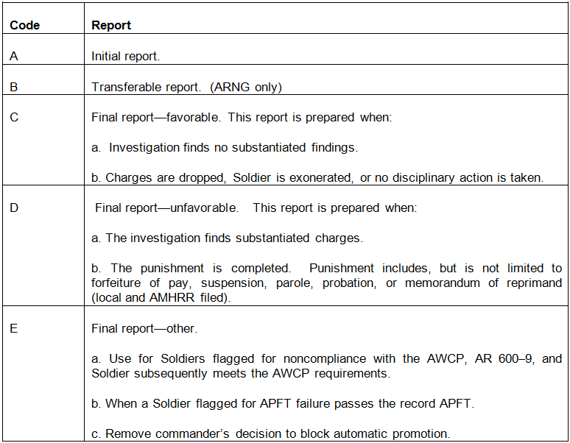
Report codes
AR 600-8-2, Table 2-2
Notes:
Show Slide: REPORT CODES

Slide 17
Removal of a Flag
Step 1
Cdr directs flag removal
Step 2
Unit/S-1
DA Form 268 prepared
authenticated
Promotable?
No
Step 3
S-1 removes flag from HR system/*TAPDB
Step 4
Unit/S-1
Coordinate w/Security & Retention NCO
Step 5
Unit/S-1
ID impacts on favorable actions
Step 6
Unit Counsels Soldier
Step 7
Maintain closed flags for 1 year
A flag will be removed as soon as practical after the Soldier’s status changes from unfavorable to favorable. Unit S-1s will maintain all DA Form 268s with supporting documentation on all closed flags for 1 year.
S-1
HRC
Is Promotion reconsideration warranted? NO
HRC
Flag removed from system by HRC and Promo orders cut on Promotion Eligibility Date
Step3a
Forward 268 to HRC without submitting transaction in HR system
Step 4a
Step 5a
Yes
Yes
Step 6a
If promotion reconsideration is warranted, HRC will initiate a HQDA flag for ‘Removal from a selection list’ and initiate a Promotion Review Board (PRB) or Standby Advisory Board (STAB) for promotion reconsideration. HRC will then authorized the unit to lift the locally initiated flag from the HR system
AR 600-8-2, Para 2-9
Notes:
SHOW SLIDE: REMOVAL OF A FLAG
Step 1: Commander identifies a requirement to lift a flag (para 2-9b); directs unit personnel or S1 to prepare a DA Form 268; and provides supporting documentation.
Step 2: Unit/S-1 prepares DA Form 268 for Commander’s signature/authentication (para 2-5); S-1 validates accuracy of lifting the flag with supporting documentation.
If Soldier is NOT on a DA Promotion List (centralized promotion list):
Step 3: S-1 removes flag from HR system; system updates Total Army Personnel Database (TAPDB).
Step 4: Unit /S-1 notifies Security Manager/S-2 and Retention NCO of flag removal for their assessment of security clearance and reenlistment eligibility.
Step 5: Unit/S-1 assesses flag removal impact on favorable actions on hold (PCS/ETS; awards; schools; promotion, etc.). Determine promotion status: does flag result in removal from a semi-centralized promotion list or coordination with HRC for flag removal?
Step 6: Commander or supervisor: counsels Soldiers on reason for lifting the flag, actions now authorized with flag removal, and impact if re-flagged (for example, weight control); provides Soldier a copy of the DA Form 268.
Step 7: Unit maintains a copy of flag record (signed DA Form 268 initiating and removing the flag, supporting documentation, and counseling documents) for one year (para 2-10).
If Soldier IS on a DA Promotion List (centralized promotion list):
Note: S-1s must verify in para 2-9b if the applicable flag type must be removed by HRC. If HRC removal is not required, go to step 3. If HRC removal is required, go to step 3a:
Step 3a: S-1 sends the DA Form 268 lifting the flag with supporting documentation to HRC Promotions Branch without lifting the flag in the HR systems.
Step 4a: Upon receipt of close-out flag with supporting documentation, HRC Promotions Branch determines if the results of the flag warrant the Soldier’s promotion status receiving a reconsideration.
Step 5a: If promotion reconsideration is not warranted, HRC will remove the flag from the TAPDB and will publish promotion orders on promotion eligibility date.
Step 6a: If promotion reconsideration is warranted, HRC will initiate a HQDA flag for ‘Removal from a selection list’ (code F) and initiate a Promotion Review Board (PRB) or Standby Advisory Board (STAB) for promotion reconsideration. HRC will then authorized the unit to lift the locally initiated flag from the HR system.

Slide 18
Check on Learning
1. Q. PV2 Bishop is scheduled to be automatically promoted to PFC on 1 April 2015, but was denied promotion and flagged by his commander on 18 March 2015. What is the earliest date that PV2 Bishop’s flag can be removed?
A. 2 April 2015 ( para 2-2 j. (1)
2. Q. SGT Nelson decided to do a self-referral into ASAP for alcohol before things got out of hand with his drinking. On 15 January SGT called and spoke to an ASAP coordinator and consequently was enrolled into ASAP that day. What will be the effective date of his FLAG?
A. A flag may not be initiated based on referral, screening or enrollment into the Army Substance Abuse Program (ASAP) (para 2-2 g).
3. Q. SSG(P) Allen received a letter of reprimand. The CG directed that it be filed in the NCO’s OMPF. Can the unit commander remove the adverse action flag from the HR system?
A. No. Because the NCO is on a centralized promotion list, the flag must be lifted by HRC
4. Q. 1LT Cummings was flagged pending an investigation for sexual harassment. After further investigation it was found there was no substantiated evidence. The investigation was closed and her flag was removed on 15 November 2015. What date can the DA Form 268 and supporting documentation be destroyed?
A. 14 November 2016
Notes:
SHOW SLIDE: CHECK ON LEARNING

Slide 19
Transfer a Flag
Step 1
Soldier receives RFO/orders
Step 5
Unit/S-1
Soldier signs out of unit
Step 6
S-1 scans & sends copy to
gaining unit
Step 2
Transferable Flag? Yes
Step 4
Copy provided to Soldier during out-processing
Step 3
Unit/S-1
collects 268 & associated documents
Step 9
Soldier inprocesses & unit IDs
flagged status
Step 12a
Counsel Soldier
Step 13
Unit creates flag
record file
Step 10
Flag documents received? YES
Step 11
Flag valid? Yes
Step 10a
Assess current status
No
No
Contact outgoing unit
Step 2a
Unit/S-1
Request waiver* or revocation of orders
Outgoing Unit
Incoming Unit
Step 8
Flag transfers digitally in HR system
No
Step 12
Unit lifts flag
Step 14
Unit/S-1
Coord. w/Security & Retention NCO
Step 7
Unit maintains copy of flag record 1 year
AR 600-8-2 Para 2-8
Notes:
Learning Step / Activity 4. Managing Flagging Actions at all Levels
Method of Instruction: Conference / Discussion
Instructor to Student Ratio: 1:36
Time of Instruction: 30 mins
Media: Large Group Instruction
SHOW SLIDE: TRANSFER A FLAG
Step 1: Soldier is issued a request for orders (RFO) or PCS orders.
Step 2: Unit/S-1 identify if Soldier is flagged and if the flag is transferable (para 2-2 and 2-1).
Step 2a: If flag is non-transferable, unit/S-1 assesses situation and requests a waiver for Soldier to PCS, a delay of report date, or a revocation of PCS orders (para 3-1b). *Note: if Soldier is on a HQDA centralized promotion list, waiver must receive prior approval of HRC Promotions Branch (2-8e).
Step 3: If flag is transferable (or waiver approved), unit/S-1 collects DA Form 268 initiating the flag and all associated and supporting documents (APFT cards, Body Fat Worksheets, counseling statements; punishment directives, etc.)
Step 4: Unit will provide Soldier a copy of DA Form 268 and supporting documents during out-processing; Unit will annotate documents on the DA Form 5123, In- and Out-Processing Records Checklist.
Step 5: The military personnel division (MPD) will verify transferable flag and supporting documents during Soldier’s final out. (para 1-4i)
Step 6: S-1 will scan DA Form 268 and supporting documents and email to gaining unit.
Step 7: Unit maintains a copy of flag record (signed DA Form 268 initiating the flag, supporting documentation, and counseling documents) for one year (para 2-10).
Step 8: Flag is digitally transferred to the Soldiers new unit by the HR system.
Step 9: Upon inprocessing new unit, Soldiers flag is visible to the unit in the Soldiers digital record and reflected on the unit’s flag report. Unit identifies if the flag documents have been received from the outgoing unit.
Step 10: If flag documents have not been received, the S-1 contacts the outgoing unit requesting a copy; if the are not available, unit must initiate a new record (APFT and/or weight control packet and DA Form 268).
Step 11: Unit validates accuracy flag with supporting documentation from outgoing unit and/or new documents upon inprocessing (for example: new APFT or Body Fat Worksheet); maintains a copy of signed flag and supporting documentation for flag records.
Step 12: If flag is no longer valid, unit will initiate removal of flag.
Step 12a: If flag is still valid, the commander or supervisor: re-counsels Soldiers on reason for the flag, requirements for removal and actions prohibited by the flag; provides Soldier a copy of the DA Form 268.
Step 13: Unit maintains a copy of signed flag, supporting documentation, and counseling for flag records management (para 1-10).
Step 14: S-1 notifies S-2 and Retention NCO of flag for their assessment of security clearance and reenlistment eligibility; assesses flag impact on pending favorable actions (retirement/ETS; awards; schools; promotion, etc.)

Slide 20
Unit Flag Management
Step 1
S-1 runs monthly flag report
Step 2
Flag Valid?
Yes
Step 5
New flags required?
No
Step 6
Cdr signs monthly flag report
Step 7
Unit/S-1
ID new impacts
Step 3
Flag more than 6 months old?
No
Step 4
Unit/S-1
Staff Coordination
Step 8
S-1 files signed report
Unit/S-1 Remove Flag
Continue with
Step 5
No
Bn Cdr reviews flag
Continue with
Step 4
Yes
Unit/S-1 Initiate flag
Continue with
Step 6
Yes
Notes:
SHOW SLIDE: UNIT FLAG MANAGEMENT
Step 1: S-1 runs flag report monthly and provides to unit commander.
Step 2: Unit commanders validate all flags on flag report and identifies any Soldier who should be flagged or should have flags removed. If flag is still valid, Unit/S-1 continues to monitor monthly (minimum), however, if flag is no longer valid, unit/S-1 initiates flag removal.
Step 3: Unit commander identifies any flags that are over six months old and forwards flag, with supporting documentation, to battalion commander for validation. Flags that are 6 months old must be reviewed and validated by the Battalion commander (para 1-9b).
Step 4: Unit/S-1 coordinate with staff sections to verify that all flags are valid and to identify any Soldiers who should be flagged. Staff sections include: Training (APFT, AWCP); Legal (investigations, adverse action, separations); S-2 (security violations); ASAP (drug and alcohol violations); S-1 (evaluations, family care plans) . Coordination with staff also includes situational awareness of additions and removals with Retention NCO (reenlistment eligibility), S-1 (promotion eligibility) and S-2 (security clearances). (para 2-7c)
Step 5: Commander identifies any Soldier who should be flagged. Unit initiates identified missing flag; S-1 enters flag into HR system.
Step 6: Unit commander signs flag report validating active flags and all changes annotating any DA Form 268s submitted removing and/or initiating flags (para 1-9b). Battalion commander also signs if any flag on the report is over 6 months old (para 1-9b).
Step 7: Unit/S-1 assesses if there are any new impacts on favorable actions for flagged Soldiers (PCS/ETS; retirements, awards; promotion, schools, assignments, etc.) (chapter 3).
Step 8: S-1 files flag report signed by commander until superseded by next months report (para 2-10).

Slide 21
Suspension of Favorable Actions Management Report (AAA-95)
Active flag cases will be reviewed at least monthly. Unit level commanders will review and validate the AAA-95 flag reports monthly. Battalion level commanders will review and validate all flags over 6 months old.
Check reason and report codes to ensure Soldier flagging action is coded correctly. See Table 2-1 and 2-2 for codes
Notes:
SHOW SLIDE: SUSPENSION OF FAVORABLE ACTIONS MANAGEMENT REPORT (AAA-95)
The AAA-95 Suspension of Favorable Actions Management Report is pulled down from eMILPO.

Slide 22
G-1 and Brigades S-1s Flag Oversight
G-1s
Reconcile w/CID AND ASAP ROSTER
Brigade S-1s
OIP Program
Reconcile flag reports with JAG, Retention NCO, S-2 and S-1
No PCSs w/non-transferable flags
Transferable flags forwarded to gaining command
Flags in Soldier’s Risk Reduction Program
Command & Staff
Internal Control Evaluations
Internal Control Evaluations
Notes:
SHOW SLIDE: G-1 AND BRIGADES S-1s FLAG OVERSIGHT

Slide 23
Check on Learning
Q. SPC Blackmon was flagged for a security violation. What should the reason code be on the AAA 95?
A. Code “E” Table 2-1
2. Q. What report code should be used when a soldier flagged for APFT failure passes the record APFT?
A. Code “E” Table 2-2
3. Q. Today is 15 November 2016 and CPT Richardson is reviewing the Suspension of Favorable Actions Management Report. He notices that there are several flagging actions with an effective date of 10 April 2015. What should be his course of action as the unit commander regarding the report?
A. Because the flagging actions are over 6 months old the report must be forward with supporting documentation to the Battalion commander for review and validation. (para 1-9b)
4. Q. SGT Surls’ flagging action is being removed. What are the responsibilities of the unit commanders and S-1s regarding removal flagging actions?
A. Unit Commander or First Line Supervisor counsel Soldier
Provide a copy of DA Form 268 removing flagging action
Remove flag from HR system
Notes:
SHOW SLIDE: CHECK ON LEARNING

Slide 24
Culminating Scenario
On 20 March 2015, the commander appointed an investigating officer to investigate an allegation of insubordination. SGT Cummings was notified of the pending investigation against him on 22 March 2015. The investigation was completed on 2 April 2015 substantiating the allegations . As a result of the investigation, SGT Cummings received an Article 15 on 30 April 2015. His punishment consisted of 2 weeks of extra duty and 2 months pay suspended for 6 months. SGT Cummings is PCSing in June to Ft Campbell KY.
Q. What is the effective date and reason code of flag?
A. 20 March 2015 and reason code “L”
2. Q. As a result of the investigation, an Article 15 was initiated against SGT Cummings. What course of action should you take if any?
A. Soldier should be flagged with a reason code of A effective 2 April. The L code flag should be lifted effective 2 April.
3. Q. SGT Cummings punishment consists of 2 weeks of extra duty and 2 months pay suspended for 6 months. What course of action should you take if any?
A. Soldier should be flagged with a reason code of H effective 30 April with an end date of 30 October. The A code flag should be lifted effective 30 April.
4. Q. Should SGT Cummings be allowed to PCS in June?
A. Yes, the punishment phase flag, code H, is a transferable flag.
Notes:
SHOW SLIDE: SCENARIO
NOTE: If the punishment was one month or less, the A code flag could have stayed in effected for the period of punishment. Because the period of suspension was over one month, the A code flag is converted to a H code flag during the period of punishment.

Slide 25
Terminal Learning Objective
Action: Administer Suspension of Favorable Personnel Actions (FLAG)
Conditions: In a classroom environment, given AR 600-8-2, DA Form 268, and awareness of Operational Environment (OE)/Contemporary Operational Environment (COE) variables and actors.
Standards: The student will have met the standards when they fully understand the processing and procedures for flagging actions listed below:
1. Communicate general policy and impact of flagging actions
2. Determine effective dates of flagging actions
3. Process initiation and removal of flags
Manage flagging actions at all levels
Notes:
SHOW SLIDE: TERMINAL LEARNING OBJECTIVE
Learning Step / Activity Summary
Method of Instruction: Conference / Discussion
Instructor to Student Ratio: 1:36
Time of Instruction: 5 mins
Media: Large Group Instruction

