Slide 1
MCoE LPD Operation Gothic Serpent
2 Oct 2015

Slide 2
Black Hawk down video

Slide 3
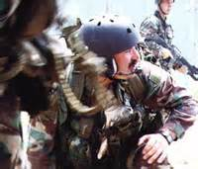
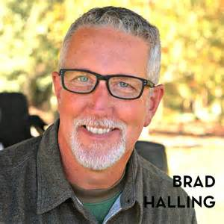
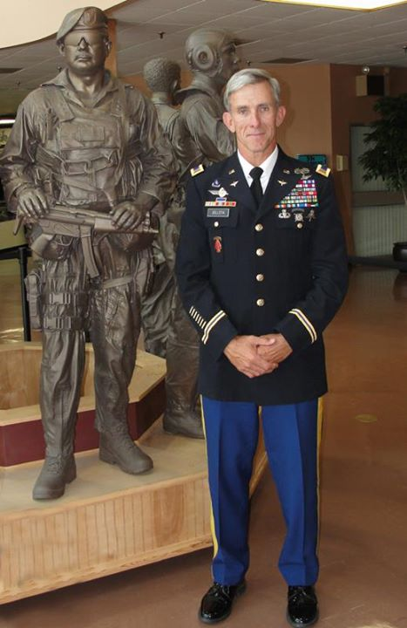
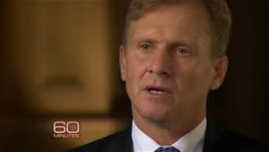
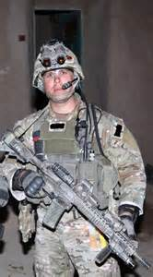
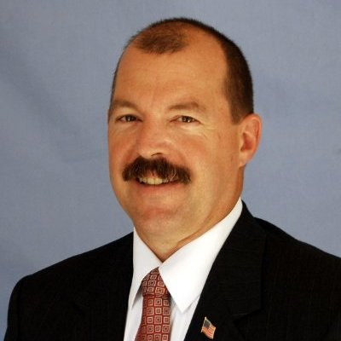
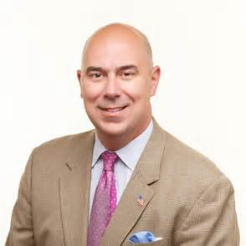
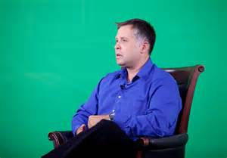
CW5 Dan Jollota- CW3 Jollota piloted the Combat Search and Rescue Blackhawk, Super 68. He completed the infiltration and was able to fly the damaged aircraft back to the airfield.
No image
Chief Warrant Officer Two (CWO-2) Tony Rinderer flew numerous missions in support of the rescue operations on 3-4 October
MSG (R) Norm Hooten- SFC Hooten was a member of the assault force.
MSG Brad Halling- Halling was a member of the assault force.
Rob Phipps, Spec. Rob Phipps, 22, a Ranger who roped in to Cliff Wolcott's crash site from the combat search-and-rescue Blackhawk.
No image
COL(R) Ron Russell - LTC Russell was a member of the assault force.
MSG(R) Matt Eversmann- Staff Sgt. Matt Eversmann, led Chalk Four
Stan Wood, volunteered for a daring resupply mission supporting the Ranger firefight in the streets of Mogadishu on 3 October.

Slide 4
Super 61

Slide 6
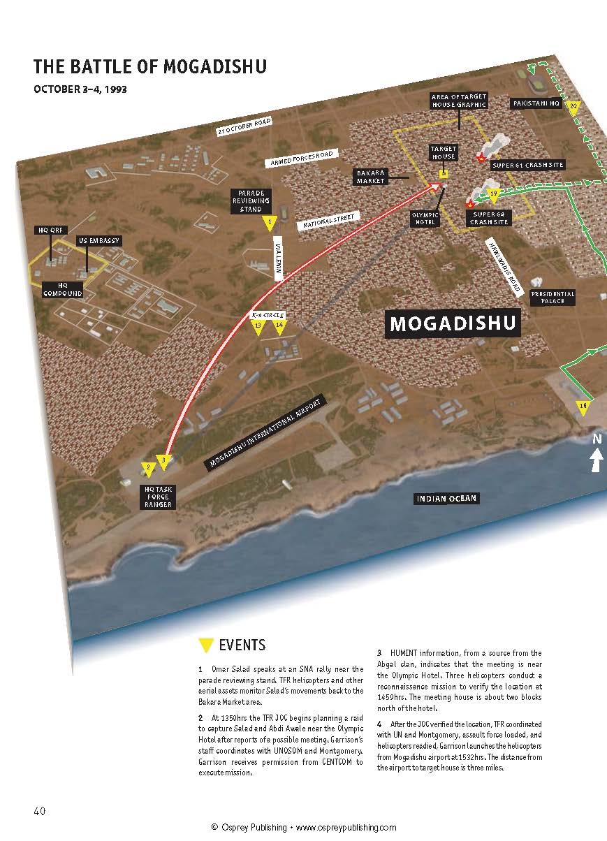
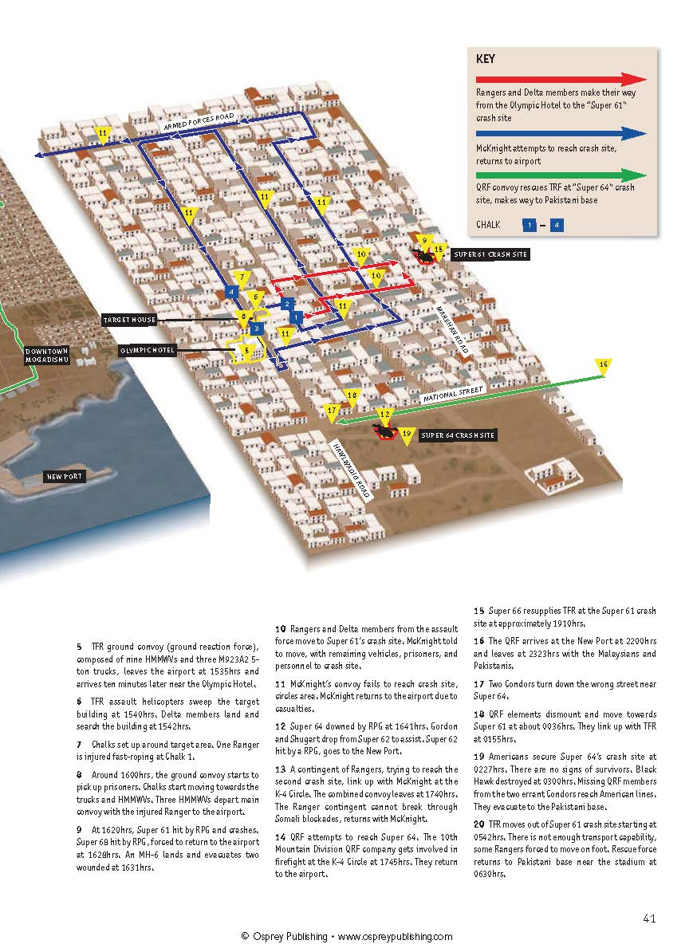
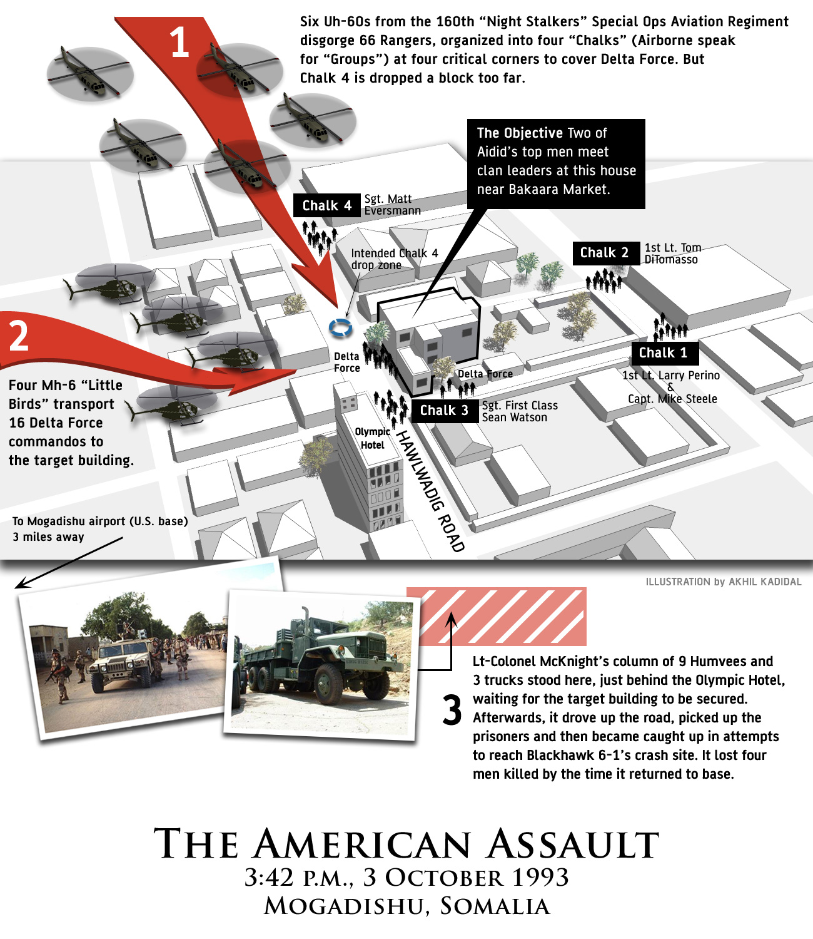
3 miles
Infiltration 3 miles to the Target House with LTC McKnight’s convoy of 9 Humvees and 3 trucks staged just south

Slide 7
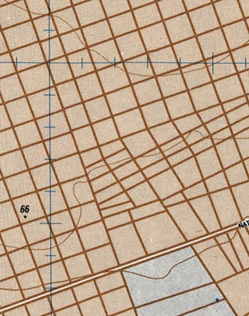
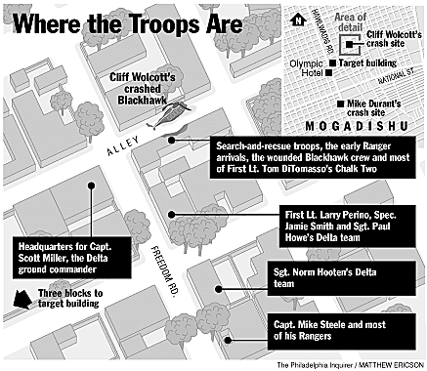
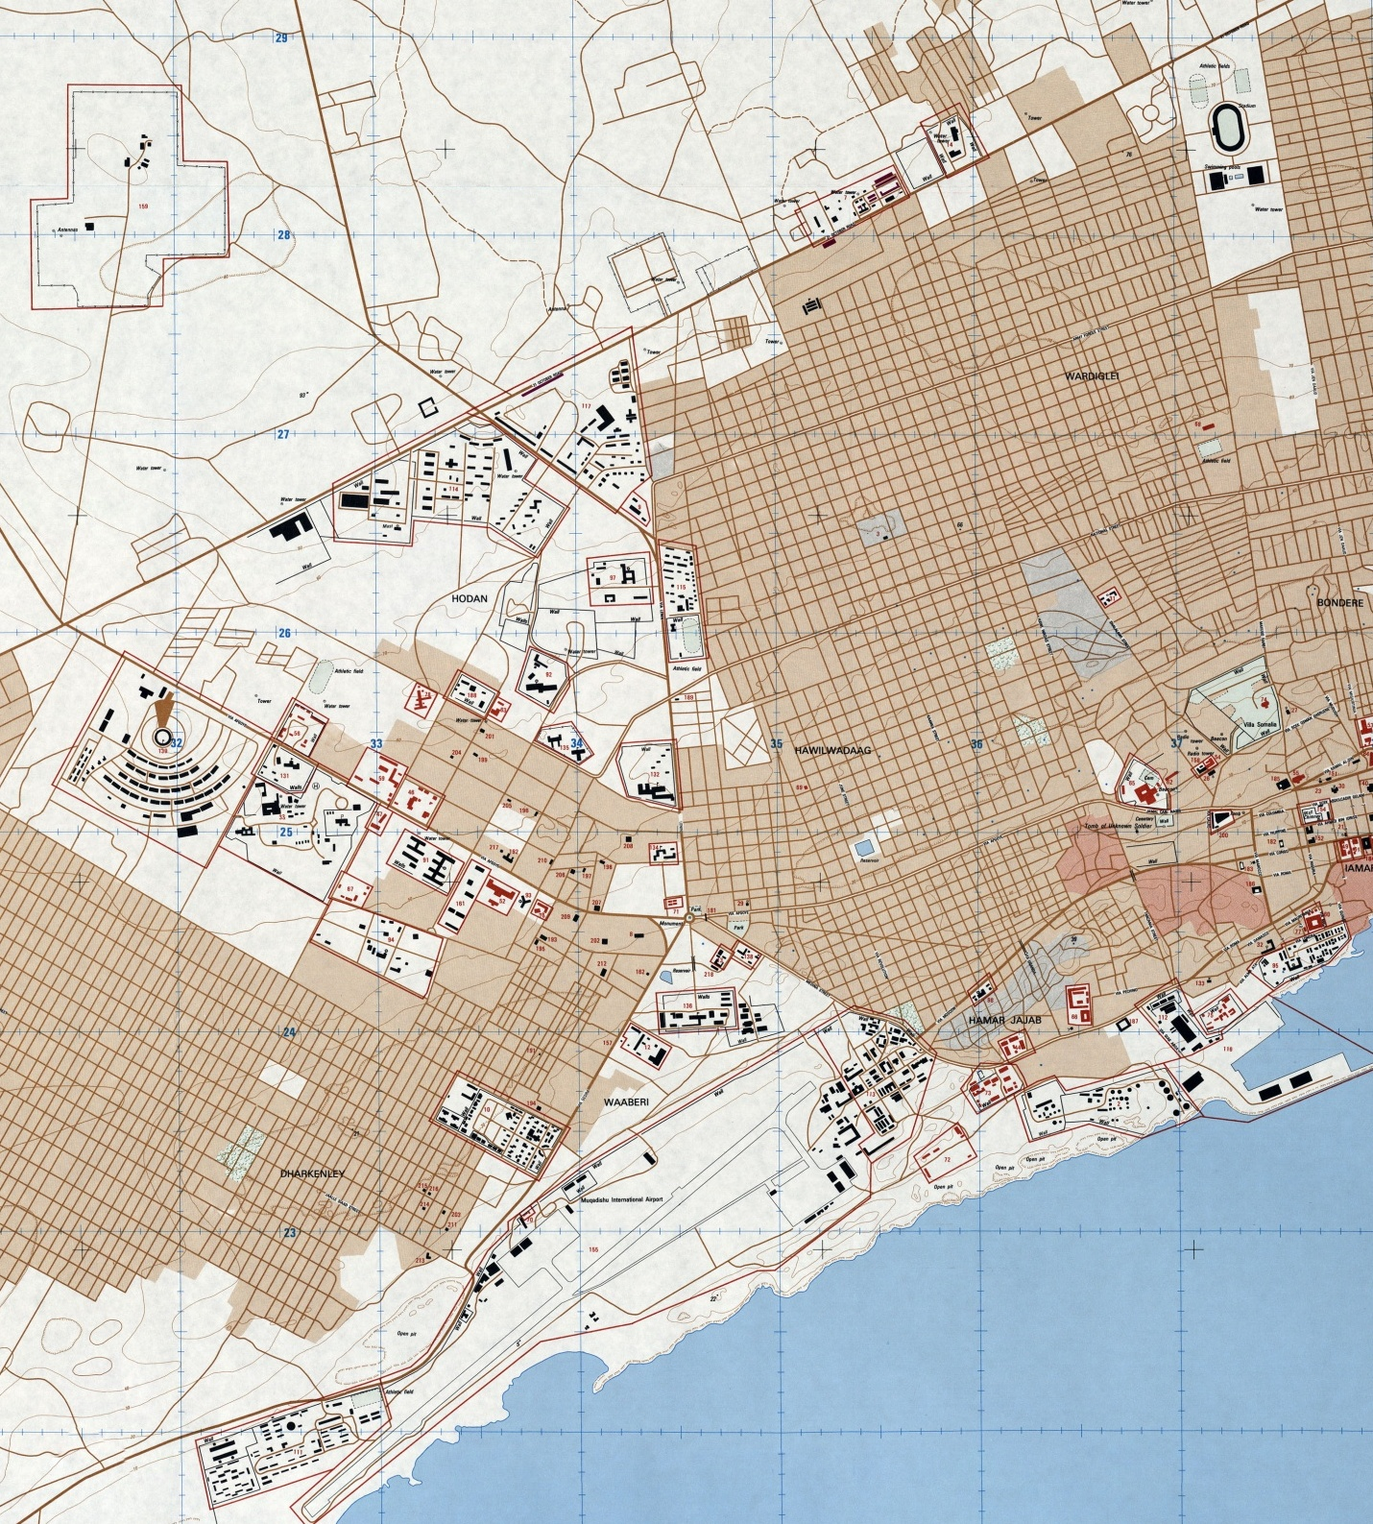
Pakistani HQ
Crash Site 1
TGT
Crash Site 2
10th MTN
TF Ranger

Slide 8
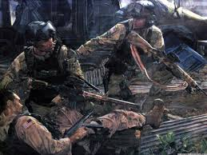
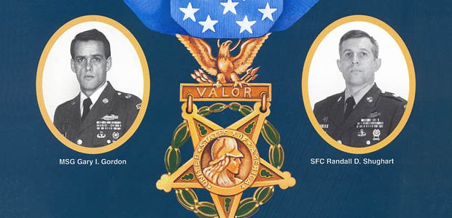
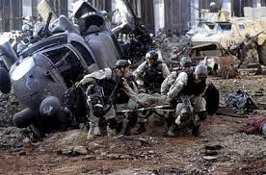
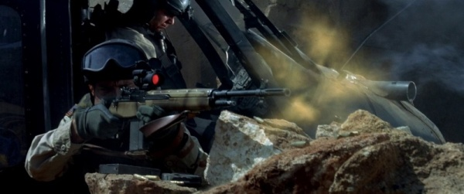
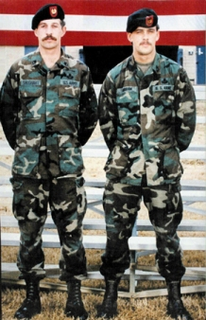
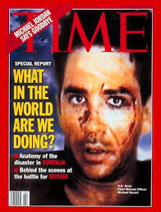
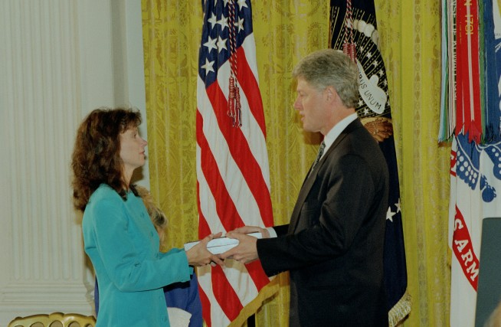
Casualty Assistance Officer (CAO) Duties

Slide 10
Backup Slides

Slide 11
My Lessons Learned
Being a Casualty Assistance Officer is an Honor NOT a Tasker!
Your Primary Duty- nothing is more important- drop what you’re doing and focus!
There are no brick walls- don’t take NO for an answer- you have top cover if needed!
High Visibility- all eyes are on you! Carry yourself with poise and confidence!
Strike a balance - compassion, empathy, and professionalism.
Include your family- their understanding is paramount to your ability to focus.
Take copious notes- keep records of all conversations. Organize your journal.
Seek out every possible benefit and entitlement- be relentlessly assertive.
Every event is an operation- details, details, details!
Your duties will extend well beyond the funeral/internment; multiple memorial events, services, ceremonies, MOH Ceremony, Ship Commissioning, Memorial Tributes, Memorial Chapters for various Associations, etc.
Logistics and Communications- multiple DVs, families, friends, meals, lodging, printing, uniforms, errands, Fisher House, planes, trains, and automobiles!
No Fail- you will earn or lose credibility based on how you handle the mission.
Maintain polite, professional distance – you’re not a counselor, family or friend!

Slide 12
Thanks!

Slide 13
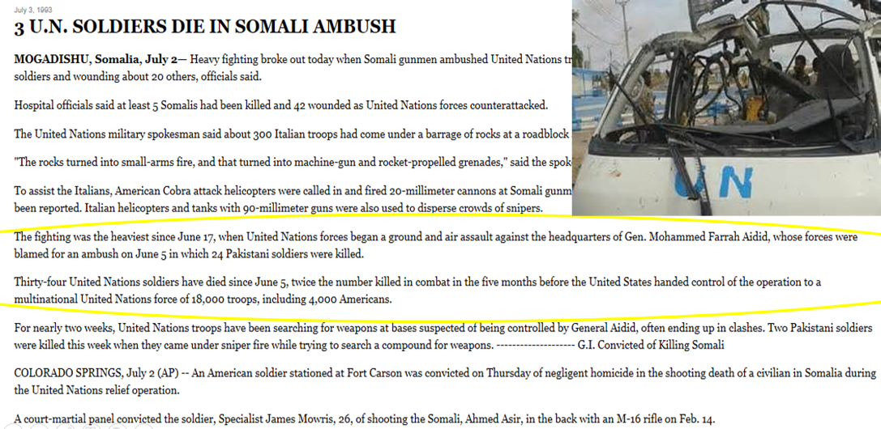
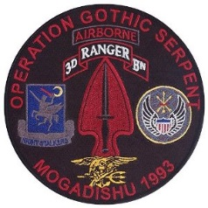
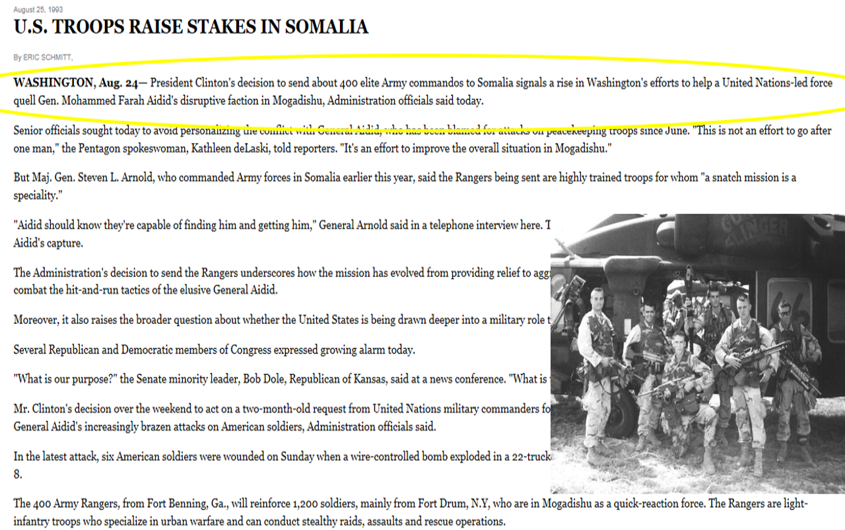
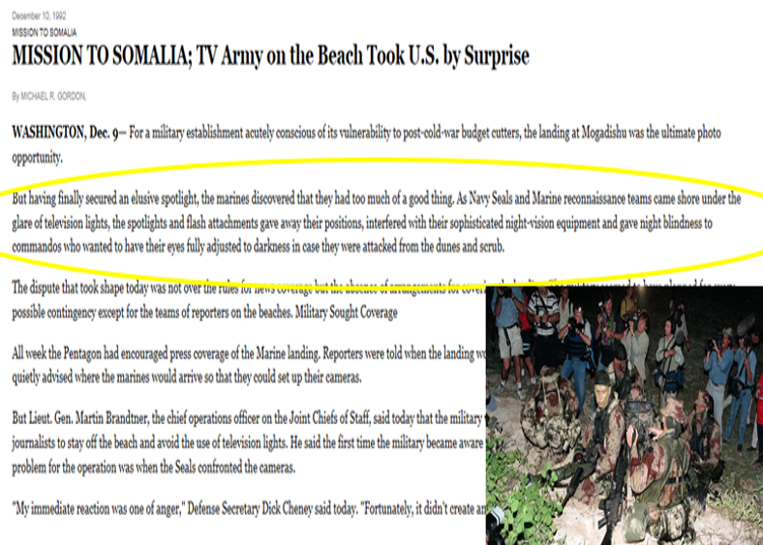
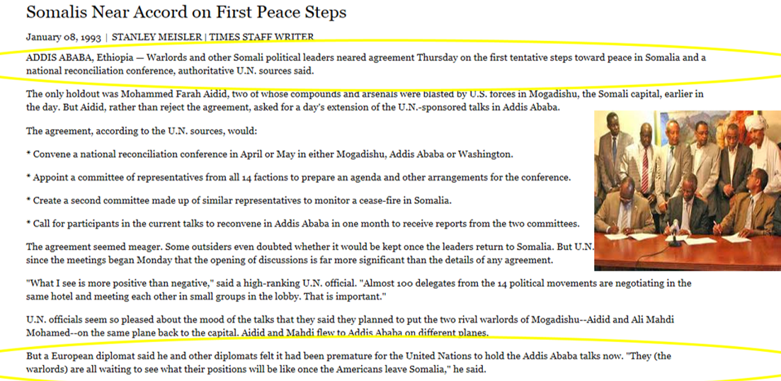
3 OCT 93
Assault on Olympic Hotel
29 AUG 93
TF Ranger flew into Mogadishu
July 93
Last sighting of Aidid shortly after UN Leader ordered arrest and offered reward for information
June – 8 AUG 93
Violence increases ending with 4 US MPs killed by remote-detonized mine
9 May 1993
US turns over operation to UN
MAR 93
USONSOM II begins, various nations support
15-28 MAR 1993 Addis Ababa Accords
JAN 93
Clinton inaugurated
9 DEC 92
US Marines land on beach
5 DEC 92
PRES Bush orders 25,000 Troops to Somalia
15 AUG 92
UNOSOM I
Notes:
August 15, 1992: U.N. humanitarian relief effort in Somalia (UNOSOM I), named Operation Provide Relief, began.
December 4, 1992: Due to U.N. inability to deliver food and secure delivery routes into Somalia, President George Bush responded to U.N. request for assistance by proposing U.S. combat troops lead security force.
December 5, 1992: U.N. accepted U.S. offer, President Bush ordered 25,000 U.S. troops to Somalia.
December 9, 1992: First U.S. Marines landed on beach.
December 1992: U.S. named mission “Operation Restore Hope.”
December 9, 1992: First U.S. Marines landed on beach.
December 1992: U.S. named mission “Operation Restore Hope.”
January 1993: President Bill Clinton inaugurated.
March 15-28, 1993: Addis Ababa Accords – led to agreement to end violence in Somalia.
March, 1993: UNOSOM II began.
March 28, 1993: Various nations deployed troops to Somalia to support UNOSOM II.
May 9, 1993: U.S. officially turned over operation to U.N.
June 1993: Only 1200 U.S. troops remained in Somalia.
June 5, 1993: 24 Pakistani soldiers ambushed and killed during inspection of Somalia arms weapons storage site.
June 12 – 16, 1993: U.S. and U.N. troops attacked targets in Mogadishu related to Aidid.
June 19, 1993: Admiral Howe ordered Aidid’s arrest and offered $2500 reward for information. Admiral Howe also requested counterterrorist hostage rescue force from Washington.
July 29, 1993: Last sighting of Aidid.
August 8, 1993: 4 U.S. Military Police killed by remote-detonized land mine set off by Somalis.
August 29, 1993: U.S. Army Task Force Ranger flew into Mogadishu, led by Maj. Gen. William Garrison.
September 1993: Clinton administration began clandestine initiative to negotiate with Aidid. September 1993: U.S. Defense Secretary Les Aspin denied request for armored reinforcements from Gen. Montgomery.
October 3 – 4, 1993: Task Force Ranger’s assault on Olympic Hotel

