Slide 1
CROWS BEST PRACTICES
Focus Areas for CROWS Operation
Ensure all gunners have been certified in a class by a CROWS FSR/instructor.
Do not load ammunition prior to leaving the FOB, clear all weapons upon mission completion.
Ensure the CROWS is in “Remote Safe” and the disabled light is off prior to opening the feed tray to load/unload weapon.
Gunners need to be aware of weapon status at all time. Has a ghost round been cycled (MK19)? Is there ammunition on the feed tray? Is my weapon on remote safe prior to unloading? Is my weapon pointed in a safe direction before going “Red”?
Proper inventory and accountability of CROW BII and COEI.
Weekly
PMCS and proper maintenance on the CROWS must be conducted after each mission however, a CROWS FSR/SME should be inspect any system with deficiencies or defaults.
CROWS certified personnel will conduct a weekly class on the system to ensure their knowledge of the system is current, as well as to continue to build the base for CROWS operators within the unit.
Installation
1. Ensure the CROWS system is operating with proper parts for its designated weapon system. This needs to be inspected by a CROWS qualified Soldier under direct Supervision of TC/SL.
2. Inspect proper installation of the weapon system itself. The weapon can be inspected by the TC/SL for the individual gunner. Conduct multiple dry fire iterations prior to loading ammunition to ensure system is functioning properly
Chain of Responsibility
Counsel gunners on proper use of the CROWS and the consequences of any negligent discharge.
Counsel TCs on their ownership of the vehicle. Anything that the vehicle does falls directly on their shoulders.
Ensure Weapon is cleaned and maintained regularly and ammunition is inspected for rust, excessive dirt or dust, or other faults
“What we do in life echoes in eternity…”
Unclassified // FOUO
Notes:
1

Slide 2
Installation Faults
Ensure weapon is properly installed on CROWS.
Pins not fully inserted can cause weapon malfunction
Improper tension on the trigger can cause an ND
Be cautious of manual firing mechanism when making adjustment to the weapon system.
1
2
3
2
3
1
“What we do in life echoes in eternity…”
Unclassified // FOUO
Notes:
2

Slide 3
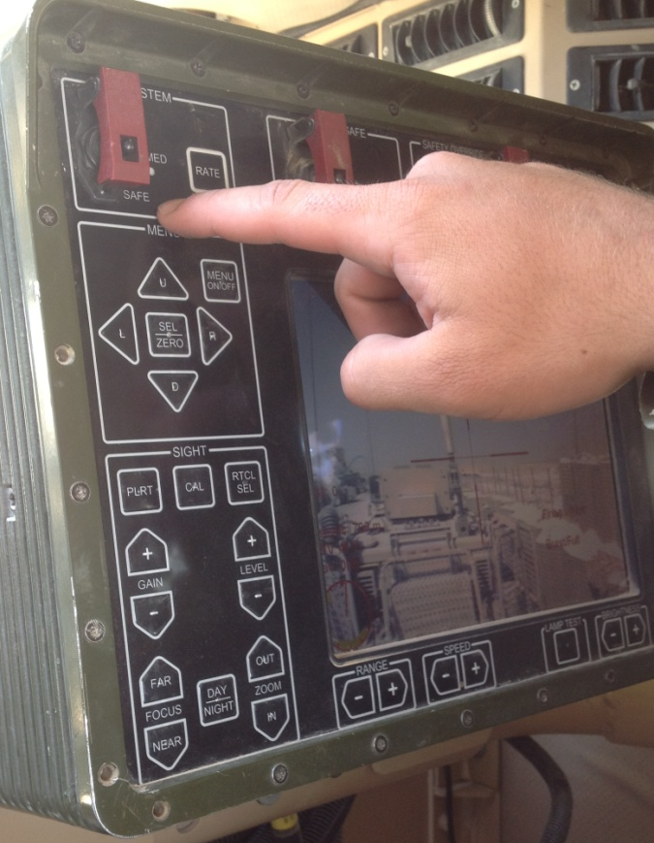
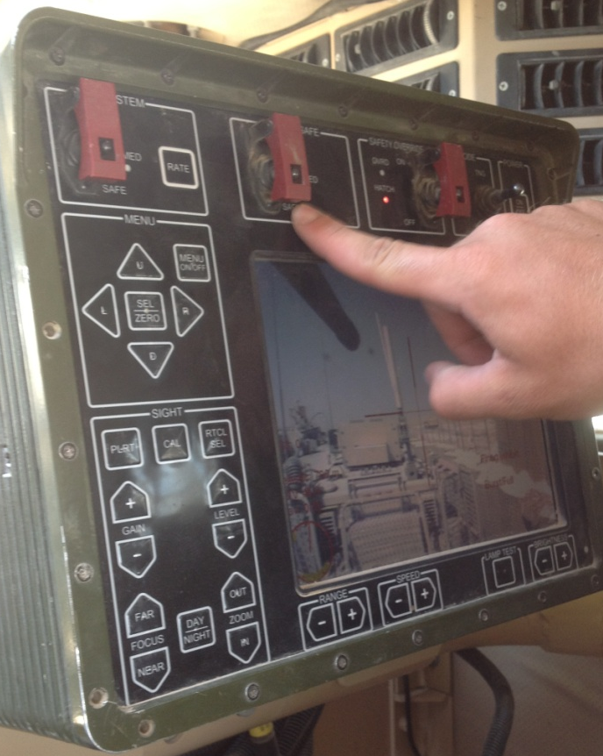
System Safe vs. Remote Safe
System Safe
System Safe is a digital safe that disables the trigger mechanism
Remote Safe
Remote safe is a mechanical safe that physically locks the bolt to the rear and prevents it from riding forward when the system is powered on
“What we do in life echoes in eternity…”
Unclassified // FOUO
Notes:
3

Slide 4
Remote Safe (Exterior)
System Safe
System Safe does not lock the bolt to the rear, it disables the trigger mechanism on the joystick
Remote Safe
Remote Safe physically locks the bolt to the rear and prevents it from riding forward as long as the system is turned on
“What we do in life echoes in eternity…”
Unclassified // FOUO
Notes:
4

