Slide 1

3BCT
S1 XOs class

Slide 2
OER
System Enhancement
Overview

Slide 3
Agenda
References
Purpose
Senior Rater Profile and the tools to be successful
OER changes
Army 360 and requirements
Counseling
New requirements for Change of Rater Reports
Memorandum of Input
Sample Format for Memorandum of Input
Summary

Slide 4
OER System Enhancement Overview
References:
a. AR 623-3 (Evaluation Reporting System), 10 Aug 07.
b. DA Pamphlet 623-3 (Evaluation Reporting System), 13 Aug 07
c. Army Directive 2011-16 (Changes to the Army Evaluation Reporting System)
d. Milper Message Number 11-282

Slide 5
OER System Enhancement Overview
Purpose:
To Make necessary changes to align the performance evaluation with the Army's current leadership doctrine, Field Manual 6-22 Army Leadership (12 Oct 06), and to accurately evaluate performance and potential, increase accountability and better inform a transparent leader development and talent management process. This directive provides guidance on the implementation of several enhancements and changes to the current Officer Evaluation Reporting System.

Slide 6
OER System Changes
Paragraph 3-11, AR 623-3 and paragraph 2-10, DA Pamphlet 623-3. Senior raters will complete Part Vllb of the OER for rated officers in grades second lieutenant through brigadier general and warrant officers in grades W01 through CW4. Senior Raters will assess the rated officer's potential compared with all officers of the same grade, regardless of component, by selecting one of the four available boxes in Part Vllb. The assessment should evaluate the rated officer's potential in terms of the majority of officers the Senior Rater has previously rated or currently has in his/her senior rater population. Profiles will track the rating history of each Senior rater for officers separated by grades, second lieutenant through brigadier general, and warrant officers separated by grade, W01 through CW4. Senior raters with existing profiles for grades second lieutenant through captain and W01 through CW2 will automatically restart as a result of this directive.

Slide 7
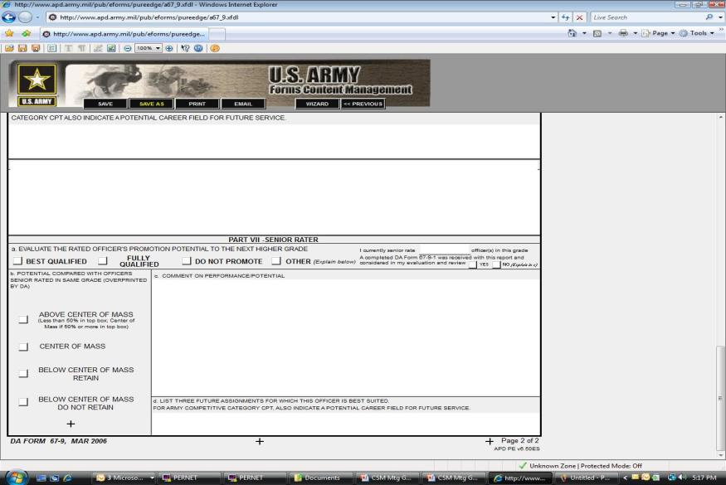
OER System Changes

Slide 8
OER System Changes
Tools for Senior Rater Profiles
Name |  | Type Rpt | Thru Date | Box Checks |  |  |  | Profile |  |  | Date Rec'd | # ACOM Rpts | Top Box Total
 |  | See SR OER | from OER | from OER |  |  | Current profile per |  |  |  | at DA | to be at 33% | Divided by
 |  | Mgt Plan |  | (Note - 3/4 Boxes |  |  | SR records. |  |  |  | Validate date | (See SR Profile | Profile Total
 |  | for Codes |  | combined for |  |  | SR should obtain new |  |  |  | received at | Chart page 31
 |  |  |  | tracking |  |  | profile periodically. |  |  |  | DA thru | of OER PAM
 |  |  |  | purposes.) |  |  |  |  |  |  | IWRS (if AC). | 623-105.) | (Note 2)
NAME | BN | REPORT TYPE | THRU DATE | Box Checks |  |  | Profile |  |  |  | DATE Rec'd | 33% Goal | % Total
 |  |  |  | 1 | 2 | 3/4 | 1 | 2 | 3/4 | Total | AT DA | # ACOM for cushion | 1st Block
 |  | COR | 20100205 | 1 | 0 | 0 |  |  |  | 0 | 20100307 |  | #DIV/0!
 |  | ANN | 20100526 | 1 | 0 | 0 |  |  |  | 0 | 20100526 |  | #DIV/0!
 |  | COD | 20090902 | 1 | 0 | 0 |  |  |  | 0 | 20091001 |  | #DIV/0!
 |  | ANN | 20100528 | 1 | 0 | 0 |  |  |  | 0 | 20100624 |  | #DIV/0!
 |  | COR | 20090903 | 1 | 0 | 0 |  |  |  | 0 | 20091120 |  | #DIV/0!
 |  | COD | 20100125 | 1 | 0 | 0 |  |  |  | 0 | 20100125 |  | #DIV/0!
 |  |  |  |  |  |  |  |  |  | 0 |  |  | #DIV/0!
 |  |  |  |  |  |  |  |  |  | 0 |  |  | #DIV/0!
 |  |  |  |  |  |  |  |  |  | 0 |  |  | #DIV/0!
 |  |  |  |  |  |  |  |  |  | 0 |  |  | #DIV/0!
 |  |  |  |  |  |  |  |  |  | 0 |  |  | #DIV/0!
 |  |  |  |  |  |  |  |  |  | 0 |  |  | #DIV/0!
 |  |  |  |  |  |  |  |  |  | 0 |  |  | #DIV/0!
 |  |  |  |  |  |  |  |  |  | 0 |  |  | #DIV/0!
 |  |  |  |  |  |  |  |  |  |  |  |  | #DIV/0!
 |  |  |  |  |  |  |  |  |  | 0 |  |  | #DIV/0!
 |  |  |  |  |  |  |  |  |  | 0 |  |  | #DIV/0!
 |  |  |  |  |  |  |  |  |  | 0 |  |  | #DIV/0!
 |  |  |  |  |  |  |  |  |  | 0 |  |  | #DIV/0!
 |  |  |  |  |  |  |  |  |  | 0 |  |  | #DIV/0!
1: OERs received at HQDA on the same day are processed as a batch and incremented against senior rater's profile
 |  | based on date of receipt at HQDA.
2: SR must stay below 50% for ACOM evaluations. Exception: of the first 4 OERs for any grade, any one but only one,
 |  | can be ACOM.
3: Officers will be evaluated and profiled at promotable grade if listed as (P) in the Part I.c. rank block of the OER.
 |  | (P) means officer is promotable and serving in an authorized position at the promotable grade.
Base on
Ranks

Slide 9
OER System Changes
Tools for Senior Rater Profiles
Thru Date | Date due to DA | Box Checks |  |  | Profile |  |  |  | Date Rec'd | DA Label | # ACOM Rpts | Top Box Total
from OER |  | from OER |  |  | Current profile per |  |  |  | at DA | when rpt(s) | to be at 33% | Divided by
 |  | (Note - 3/4 Boxes |  |  | SR records, (Note |  |  |  | (SR must check | process | (See SR Profile | Profile Total
 |  | combined for |  |  | SR should verify |  |  |  | with DA for | at DA. | Chart page 31
 |  | tracking) |  |  | with PERSCOM |  |  |  | DATE) | (Must check | of OER PAM
 |  |  |  |  | periodically) |  |  |  | (Note 1) | with DA) | 623-105.) | (Note 2)
Thru Date | Due DA |  | Box Checks |  | Profile |  |  |  | DATE Rec'd | DA | 33% Goal | % Total
 |  | 1 | 2 | 3/4 | 1 | 2 | 3/4 | Total | AT DA | Label | # ACOM for cushion | 1st Block | Remarks
25-May-08 | 23-Aug-08 |  | 1 |  | 0 | 1 | 0 | 1 | 24-Jun-08 | COM |  | 0.0
6-Jun-08 | 4-Sep-08 |  | 1 |  | 0 | 2 | 0 | 2 | 25-Jun-08 | COM |  | 0.0
1-Jul-08 | 29-Sep-08 |  | 1 |  | 0 | 3 | 0 | 3 | 8-Jul-08 | COM | 1 | 0.0
1-Jun-08 | 30-Aug-08 |  | 1 |  | 0 | 4 | 0 | 4 | 8-Jul-08 | COM | 1 | 0.0
23-May-08 | 21-Aug-08 |  | 1 |  | 0 | 5 | 0 | 5 | 8-Jul-08 | COM | 1 | 0.0
6-Jun-08 | 4-Sep-08 |  | 1 |  | 0 | 6 | 0 | 6 | 10-Jul-08 | COM | 2 | 0.0
6-Jun-08 | 4-Sep-08 |  | 1 |  | 0 | 7 | 0 | 7 | 10-Jul-08 | COM | 2 | 0.0
30-Jun-08 | 28-Sep-08 |  | 1 |  | 0 | 8 | 0 | 8 | 18-Jul-08 | COM | 2 | 0.0
30-Jun-08 | 28-Sep-08 |  | 1 |  | 0 | 9 | 0 | 9 | 18-Jul-08 | COM | 3 | 0.0
6-Jun-08 | 4-Sep-08 |  | 1 |  | 0 | 10 | 0 | 10 | 18-Jul-08 | COM | 3 | 0.0
23-Apr-08 | 22-Jul-08 |  | 1 |  | 0 | 11 | 0 | 11 | 18-Jul-08 | COM | 3 | 0.0
6-Jun-08 | 4-Sep-08 |  | 1 |  | 0 | 12 | 0 | 12 | 18-Jul-08 | COM | 4 | 0.0
11-Jun-08 | 9-Sep-08 |  | 1 |  | 0 | 13 | 0 | 13 | 18-Jul-08 | COM | 4 | 0.0
4-Jun-08 | 2-Sep-08 |  | 1 |  | 0 | 14 | 0 | 14 | 20-Jul-08 | COM | 4 | 0.0
31-May-08 | 29-Aug-08 |  | 1 |  | 0 | 15 | 0 | 15 | 20-Jul-08 | COM | 5 | 0.0
1-May-08 | 30-Jul-08 |  | 1 |  | 0 | 16 | 0 | 16 | 20-Jul-08 | COM | 5 | 0.0
4-Jun-08 | 2-Sep-08 |  | 1 |  | 0 | 17 | 0 | 17 | 20-Jul-08 | COM | 5 | 0.0
6-Jun-08 | 4-Sep-08 |  | 1 |  | 0 | 18 | 0 | 18 | 29-Jul-08 | COM | 6 | 0.0
11-Jun-08 | 9-Sep-08 |  | 1 |  | 0 | 19 | 0 | 19 | 29-Jul-08 | COM | 6 | 0.0
15-Jun-08 | 13-Sep-08 | 1 |  |  | 1 | 19 | 0 | 20 | 29-Jul-08 | COM | 6 | 5.0
8-May-08 | 6-Aug-08 | 1 |  |  | 2 | 19 | 0 | 21 | 29-Jul-08 | ACOM | 7 | 9.5
31-May-08 | 29-Aug-08 | 1 |  |  | 3 | 19 | 0 | 22 | 29-Jul-08 | ACOM | 7 | 13.6
1-Jun-08 | 30-Aug-08 | 1 |  |  | 4 | 19 | 0 | 23 | 29-Jul-08 | ACOM | 7 | 17.4
22-May-08 | 20-Aug-08 | 1 |  |  | 5 | 19 | 0 | 24 | 29-Jul-08 | ACOM | 8 | 20.8
19-Feb-10 | 20-May-10 | 1 |  |  | 46 | 55 | 0 | 101 |  |  | 33 | 45.5
19-Feb-10 | 20-May-10 | 1 |  |  | 47 | 55 | 0 | 102 |  |  | 34 | 46.1
19-Feb-10 | 20-May-10 | 1 |  |  | 48 | 55 | 0 | 103 |  |  | 34 | 46.6
19-Feb-10 | 20-May-10 | 1 |  |  | 49 | 55 | 0 | 104 |  |  | 34 | 47.1
19-Feb-10 | 20-May-10 | 1 |  |  | 50 | 55 | 0 | 105 |  |  | 35 | 47.6
28-Feb-10 | 29-May-10 | 1 |  |  | 51 | 55 | 0 | 106 |  |  | 35 | 48.1
 | 30-Mar-00 |  |  |  | 51 | 55 | 0 | 106 |  |  | 35 | 48.1
 | 30-Mar-00 |  |  |  | 51 | 55 | 0 | 106 |  |  | 35 | 48.1
 | 30-Mar-00 |  |  |  | 51 | 55 | 0 | 106 |  |  | 35 | 48.1

Slide 10
OER System Changes
Paragraph 3-9, AR 623-3 and paragraph 2-8, DA Pamphlet 623-3. Raters will verify if rated officers have initiated or completed a Multi-Source Assessment and Feedback (MSAF), also known as a 360 degree assessment, in accordance with AR 350-1 (Army Training and Leader Development, 18 Dec 09) and will make a specific comment indicating such in Part Vb of the OER. The last statement in Part Vb of the OER will indicate ''The rated officer has completed or initiated an Army Multi-Source Assessment and Feedback/360 as required by AR 350-1." Rating officials are reminded that the MSAF is a self-assessment tool. Although acknowledgement on the OER that a rated officer has initiated or completed an MSAF is required, the results of the MSAF will not be used as part of the formal evaluation of the rated officer.

Slide 11


Slide 12
OER System Changes
Section II, AR 623-3. Use of DA Form 67-9-1 (Officer Evaluation Report Support Form) and DA Form 67-9-1 a (Developmental Support Form) to document performance counseling are optional. While the requirement to conduct an initial discussion with the rated officer regarding the mission, goals, duties and objectives of their assigned duty position remains, the method or means for documenting that initial discussion, and any subsequent discussions, is at the discretion of rating officials.

Slide 13
OER System Changes
Paragraph 3-44, AR 623-3. To further reduce short-term evaluation reports, particularly in deployed situations, the rules for change of rater reports (Code 03) will permit officers who change raters, but continue to perform the same duties under the same senior rater, to receive a memorandum of input from their departing rater instead of a change of rater evaluation. At the senior rater's discretion, raters will complete a memorandum of input when the rated officer has served under the rater for at least 90 days.

Slide 14
OER System Changes
Use of Memorandum of Input in lieu of Change of Rater
Evaluations with THRU dates on or after 1 November 2011. Included in that directive was an enhancement designed to reduce the number of short term evaluation reports by relaxing the rules for Change of Rater and providing Senior Raters the option of using a memorandum of input from a departing Rater rather than completing a Change of Rater.
The memorandum of input will include the following information: date, grade, name, SSN of the rated officer, the period covered by the assessment, description of the rated officer’s duties and an assessment of his/her performance.
The memorandum of input will be submitted to the Senior Rater. Copies of the memorandum of input will be provided to the rated officer and the next Rater of Record by the Senior Rater. All final memorandums of input are to be used by the final Rater of Record when completing the final evaluation. Memorandum(s) of input will not be forwarded or attached to the final evaluation when submitting to HQDA.
Senior Raters should be aware of future changes in a rated officer’s duties to preclude a situation where a rated officer receives a memorandum of input from a departing Rater of Record only to change duties before his/her next Rater of Record meets minimum rating eligibility requirements.
In rare circumstances where the last Rater of Record does not meet minimum requirements to serve as a rater, the Senior Rater will prepare the final evaluation as both the Rater and Senior Rater.

Slide 15
OER System Changes
Use of Memorandum of Input in lieu of Change of Rater
If a rated officer has received memorandum(s) of input and his/her current Rater of Record dies, is declared missing, is relieved, or becomes mentally or physical incapacitated (whether that Rater of Record meets minimum rating eligibility requirements or not), the Senior Rater should act as both Rater and Senior Rater on the required rendered evaluation.
If the Senior Rater dies, is declared missing, is relieved, or becomes mentally or physical incapacitated, the provisions of paragraph 2-20a(2) of Army Regulation 623-3 dated 10 August 2007 will apply.
When an OER is rendered, the rating period will commence on the day following the last OER and end on the date of the event requiring the report to be rendered. The rated months should include all rated and non-rated time covered by the memorandum(s) of input. The “Rated Months” cannot exceed a total of 12 months.

Slide 16
Sample Timeline of Memorandum of Input
Example 1
THRU Date Last Report: 20111031
FROM Date
20111101
365 days
THRU Date
20121031
102 days
108 days
155 days
Rater of Record departs 20120210,
minimum qualification met;
Memorandum of Input
prepared and submitted to
Senior Rater
Rater of Record departs 2010528,
minimum qualification met;
Memorandum of Input
prepared and submitted to
Senior Rater
Type of Report: Code 02 Annual
Period Covered: 20111101-20121031
Rating Period 20111101-20121031
Number of Rated Months: 12
Nonrated Codes: None
Memorandum of Input(s) used by last Rater of Record who them uses them to completed Annual evaluation.

Slide 17
Sample Timeline of Memorandum of Input
Example 2
THRU Date Last Report: 20111031
FROM Date
20111101
365 days
THRU Date
20121031
102 days
108 days
110 days
Rater of Record departs 20120210,
minimum qualification met;
Memorandum of Input
prepared and submitted to
Senior Rater
Rater of Record departs 2010528,
minimum qualification met;
Memorandum of Input
prepared and submitted to
Senior Rater
Rated Soldier departs 20120915. Last Rater of
Record meet the minimum Rater qualifications
And uses prior memorandums of Input to
complete required final evaluation
Type of Report: Code 03 Change of Rater
Period Covered: 20111101-20120915
Rating Period 20111101-20120915
Number of Rated Months: 11
Nonrated Codes: None
Memorandum of Input(s) utilized by last Rater of Record who uses them to completed Change of Rater evaluation.

Slide 18
Sample Timeline of Memorandum of Input
Example 3
THRU Date Last Report: 20111031
FROM Date
20111101
365 days
THRU Date
20121031
102 days
108 days
31 days
Rater of Record departs 20120210,
minimum qualification met;
Memorandum of Input
prepared and submitted to
Senior Rater
Rater of Record departs 2010528,
minimum qualification met;
Memorandum of Input
prepared and submitted to
Senior Rater
Rated Soldier departs 20120628. Last Rater of
Record does not meet the minimum
Rater qualifications to serve as Rater. The Senior Rater will render the required evaluation serving as Rater and Senior Rater on final evaluation
Type of Report: Code 03 Change of Rater
Period Covered: 20111101-20120628
Rating Period 20111101-20120628
Number of Rated Months: 8
Nonrated Codes: None
IT is important for Senior Rater to monitor the rated Officer’s situation closely to prevent these rare situations from occurring.
Memorandum of Input(s) utilized by Senior Rater who will serve as both the Rater and Senior Rater using them to
complete the required evaluation.

Slide 19
Sample Timeline of Memorandum of Input
Example 4
THRU Date Last Report: 20111031
FROM Date
20111101
365 days
THRU Date
20121031
102 days
108 days
110 days
45 days
Rater of Record departs 20120210,
minimum qualification met;
Memorandum of Input
prepared and submitted to
Senior Rater
Rater of Record departs 2010528,
minimum qualification met;
Memorandum of Input
Prepared and submitted to
Senior Rater
Rater of Record departs 20120915 and minimum qualifications met, however less than 90 days remain prior to a required annual evaluations due and the following (last) Rater of Record will not meet minimum Rater qualification. An evaluation is prepared by the last qualifying Rater of Record who has met minimum rater qualification.
Type of Report: Code 03 Change of Rater
Period Covered: 20111101-20120628
Rating Period 20111101-20120628
Number of Rated Months: 8
Nonrated Codes: None
Memorandum of Input(s) utilized by last qualifying Rater of Record who uses them to complete the Change of Rater
evaluation.

Slide 20
Sample Timeline of Memorandum of Input
Example 5
THRU Date Last Report: 20111031
FROM Date
20111101
365 days
THRU Date
20121031
102 days
108 days
110 days
45 days
Rater of Record departs 20120210,
minimum qualification met;
Memorandum of Input
prepared and submitted to
Senior Rater
Rater of Record departs 2010528,
minimum qualification met;
Memorandum of Input
Prepared and submitted to
Senior Rater
Rater of Record departs 20120915 and minimum qualifications met, however less than 90 days remain prior to a required annual evaluations due and the following (last) Rater of Record will not meet minimum Rater qualification. An evaluation was not prepared by the last qualifying Rater of Record who met minimum rater qualification.
Type of Report: Code 03 Change of Rater
Period Covered: 20111101-20121031
Rating Period 20111101-20121031
Number of Rated Months: 12
Nonrated Codes: None
Memorandum of Input(s) utilized by Senior Rater who will serve as both Rater and Senior Rater using them to
complete the required evaluation.

Slide 21
Sample Timeline of Memorandum of Input
Example 6
THRU Date Last Report: 20111031
FROM Date
20111101
365 days
THRU Date
20121031
102 days
108 days
50 days
105 days
An evaluation is prepared by the last Rater of Record who met minimum Rater qualifications.
The 50 days for lack of rater qualification will be nonrated time on the final evaluation.
Rater of Record departs 20120210,
minimum qualification met;
Memorandum of Input
prepared and submitted to
Senior Rater
Rater of Record departs 2010717,
minimum qualification not met.
These 50 days became non rated time
When final evaluation is completed
by last qualifying Rater of Record
Rater of Record departs 2010528,
minimum qualification met;
Memorandum of Input
Prepared and submitted to
Senior Rater
Type of Report: Code 02 Annual
Period Covered: 20111101-20121031
Rating Period 20111101-20121031
Number of Rated Months: 11
Nonrated Codes: Q
Memorandum of Input(s) utilized by last qualifying Rater of Record who uses them to complete the final Annual evaluation.

Slide 22
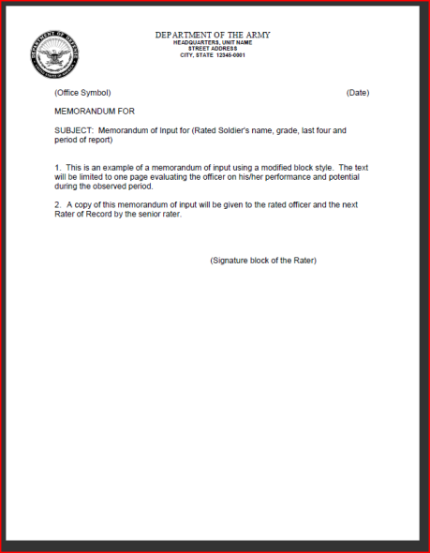
Memorandum of Input

Slide 23
Summary
References
Purpose
Senior Rater Profile and the tools to be successful
OER changes
Army 360 and requirements
Counseling
New requirements for Change of Rater Reports
Memorandum of Input
Sample Format for Memorandum of Input
Summary

Slide 24
Questions?

Slide 25









NCOER

Slide 26
Purpose of DA 2166-8-1
DA Form 2166-8-1 is mandatory for CPL thru CSM.
It is a working copy of an NCOER
It is the initial counseling given to an NCO within 30 days of rating period.
Contains instructions/guidance for preparing and conducting counseling
sessions and for writing duty descriptions
Provides sample bullets
Summarizes the counseling session
Serves as a record of counseling
Later counseling sessions conducted quarterly.
Duty description as means to evaluate.

Slide 27
Purpose of NCOER
Deigned to improve or maintain performance and professionally develop the rated NCO
Suppose to develop and communicate performance standards to the rated NCO at beginning of rating period
Provide feedback oh how to progress in meeting goals throughout rating period
Also provides evaluation information to ensure that sound personnel management decisions can be made and that an NCO's potential can be fully developed
    Do not dwell on past; consider how to improve your future

Slide 28
Rating Chain Consists of
Rater which is your immediate supervisor for 90 days
Senior Rater who is the direct line of supervision for at least two rated months
Reviewer who is usually an Officer, WO, E-9)

Slide 29
Rater Responsibilities
Counsel rated NCO
Prepare a DA Form 2166-8-1 for each rating period
Assess the performance of rated NCO
Prepare a fair and correct report
Notes:
29

Slide 30
Sample
NCO-ER
(page 1)

Slide 31
PREPARING A
DA FORM
2166-8

Slide 32
Part 1- Administrative Data
Line Ia (Name): Enter rated NCO's name (LAST, FIRST, MI) ALL CAPS.
Line Ib (SSN): Enter rated NCO's SSN (9 digit XXX-XX-XXX).
Line Ic ( Rank): Enter the three-letter abbreviation for the NCO's military rank,
not pay grade (for example, SSG, SFC).
If the rated NCO is frocked to 1SG, SGM, or CSM, enter the rank, date of rank, and PMOSC held prior to the frocking action. In addition to the NCO's rank in Part Ic, enter the appropriate frocked rank in parentheses immediately following the rank entry. The entries are SFC (1SG), MSG(SGM), or MSG(CSM).

Slide 33
Part I – Administrative Data
Line Id (Date of Rank): Enter the rated NCO's date of rank (YYYYMMDD). If the rated NCO is frocked enter the date of rank for the rank held prior to the frocking action.
Line Ie (PMOSC): Enter up to nine digits of the primary military occupational specialty (MOS) code (for example, 19E30, 42A5MA3, and 18Z5PW9LA). If an NCO does not possess an additional skill identifier or language identifier, only a five digit MOS is entered. An alpha or numeric entry may be used to denote the last digit of the skill level (0 or O).

Slide 34
Part I – Administrative Data
Line f1: Enter Unit, Org., Station, Zip Code, or APO and USAR
Line f2(Status Code): Enter data in the order listed on the form (for example, HHC, 1st Eng Bn, Fort Riley, KS 66442 (USAR Status Code)).
When an NCOER is completed on an NCO at a temporary duty/special duty (TDY/SD/TCS), the TDY/SD unit information may be entered in parentheses in Part If after the required parent unit data if space permits. If not, the TDY/SD/TCS unit data may be reflected in Part IIIc.

Slide 35
Part I - Administrative
Line Ig ( Reason for Submission): Enter the appropriate report code in the left-hand portion of the block and the type of report title in the right-hand portion of block.
Line Ih ( Period Covered): Enter the beginning date in the boxes, using a four-digit numerical identifier for year and a two-digit numerical identifier for month and two digit identifier for the day (for example, 20010903). Enter the Thru date which is the end date of the event causing the report (YYYYMMDD).

Slide 36
Reason for Submission
  Line Ig:
  02 Annual report
  03 Change of Rater
Rater or rated NCO is reassigned
  Rater or rated NCO depart on extended TDY or SD
  Rater or rated NCO is released from AD
  Rated NCO is reduced to CPL ↓
  Rater dies or is relieved
05 Relief for Cause
Used when an NCO is relieved based on personal or professional
characteristics
Reason for relief will be stated on the report.
Rated NCO must be notified.
Minimum rating period is 30 days.
06 Depart Temporary Duty, Temporary Change of Station,
09 Complete the Record
Rater submits a COR for NCO’s who are eligible for consideration
by DA Centralized Boards for:
Promotion
  School
  CSM selection
  Mandatory conditions the rated NCO must meet are:
  Be in the zone of consideration
  Have been under the same rater for six months
  Not have received a report for the same position

Slide 37
Period Covered
Line Ih : An NCO's first report period begins on the effective date of promotion to sergeant
The rated NCO has to serve in the same position under the same rater who is writing the report

Slide 38
Rated Months
Line Ii (Rated Months): Number of Months. The number of rated months is computed by dividing the basic rating period by 30. Do not use the "Period Covered" by the report, subtract all nonrated time. If 15 or more days are left after dividing by 30, they will be counted as a whole month. (For example, 130 days is 4 months and 10 days and is entered as 4 months; 140 days is 4 months and 20 days and is entered as 5 months.)

Slide 39
Non-Rated Code/Enclosures
Line Ij (Non Rated Codes): Enter the appropriate non rated codes. If there were no non-rated periods, leave blank. Entries in Parts Ij are not required for IMA Soldiers not on active duty.
Line Ik (Number of Enclosures): Enter number of enclosures. If there are no enclosures, enter 0.

Slide 40
Reason for Non Rated Time
        A AWOL/Desertion/unsatisfactory participant based on AR 135–91
        C Confinement in military or civilian detention facility
        D Temporary disability retirement list (TDRL)
        E Leave in excess of 30 days
        F Under arrest
        I In transit between duty stations, including leave, permissive
        (PTDY), and temporary duty (TDY )
        M Missing in Action
        P Patient (including convalescent leave)
        Q Lack of rater qualification
        S Student at military or civilian school
        T On TDY/Special Duty (SD)/Temporary Change of Station (TCS) l
        less than 90 calendar days
        W Prisoner of War

Slide 41
Email Addresses/UIC/CC/PSB
Codes
Line Il ( Rated Nco’s Email Address): Rated NCO's AKO e-mail address.
Line Im (UIC): Unit Identification Code (UIC) Enter the rated NCO's 6 character UIC beginning with “W”.
Line In (Command Code): Enter rated NCO's Command Code (Two digits). Do not use “CC” (Command Code) in this field.
Part Io (Personnel Service Battalion Code PSB) : Enter four character alphanumeric PSB code of the rated NCO's servicing Administrative Office.

Slide 42
PART II
AUTHENTICATION

Slide 43
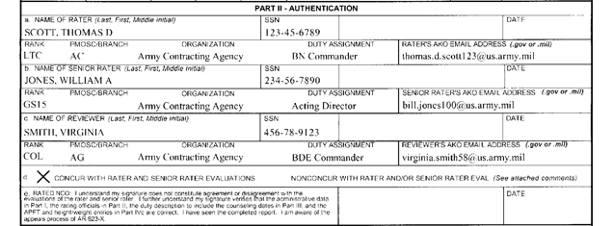
Part II- Authentication
Rater IIa: Enter Rater information:
LAST, FIRST, MI, SUFFIX - ALL CAPS
SSN (9 digit XXX-XX-XXX)
Digital Signature is the authorized method unless deployed
Rank, PMOS, Branch, Organization,
Duty Assignment and email address
Enter Rater’s AKO Email Address.

Slide 44
Part II- Authentication
Rater IIb: Enter Senior Rater information:
LAST, FIRST, MI, SUFFIX - ALL CAPS
SSN (9 digit XXX-XX-XXX)
Digital Signature is the authorized method unless deployed
Rank, PMOS, Branch, Organization,
Duty Assignment and email address
Enter Rater’s AKO Email Address.

Slide 45
Part II- Authentication
Line IIc: Enter Reviewer information:
LAST, FIRST, MI, SUFFIX - ALL CAPS
SSN (9 digit XXX-XX-XXX)
Digital Signature is the authorized method unless deployed
Rank, PMOS, Branch, Organization,
Duty Assignment and email address
Enter Rater’s AKO Email Address.

Slide 46
Part II- Authentication
Ensure rating officials are accurate and IAW AR 623-205
The reviewer's signature and date cannot be before the rater or senior rater.
The senior rater's signature and date cannot be before the rater's.
The rated Soldier may not sign or date the report before the rater, senior rater, or reviewer.

Slide 47
PART III
DUTY DESCRIPTION

Slide 48
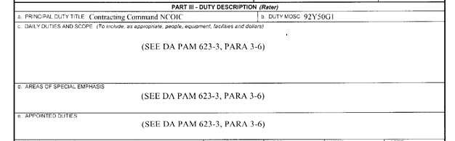
Part III- Principal Duty Title
Part IIIa (Principle Duty Title): Verify duty title and description is an accurate portrayal of NCO’s most significant duties and responsibilities
Part IIIb (Duty MOSC): Enter the enlisted DMOS (at least five characters but no more than nine).

Slide 49
Part III- Daily Duties and Scope
Part IIIc (Daily Duties and Scopes): Enter a series of phrases, starting with action words and separated by semicolons and ending in a period
You want to address the most important routine duties and responsibilities
Include the number of people supervised, equipment, facilities, and dollars involved and any other routine duties and responsibilities critical to mission accomplishment

Slide 50
Part III- Areas of Special Emphasis
Part IIId (Areas of Special Emphasis): Enter areas of special emphasis
Include a list of tasks/duties separated by semicolons and ending with a period
ex: command maintenance; physical fitness; location inventory
If you list any special duties, ensure you but a bullet for that duty

Slide 51
Part III- Appointed Duties
Part IIIe (Appointed Duties): These are duties that are not normally included
in the duty description
Ex: Chief or Firing Battery; Readiness NCO; Airborne Operations NCO

Slide 52
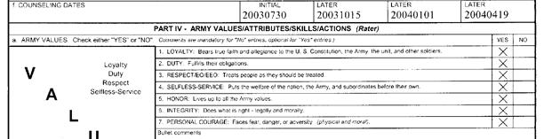
Part III- Counseling Dates
Part: IIIf (Counseling Dates): Enter the actual dates of the initial counseling obtained from the DA Form 2166-8-1 (YYYYMMDD).
Enter: Enter the actual dates of the later quarterly counseling's
* DO NOT FUDGE DATES

Slide 53
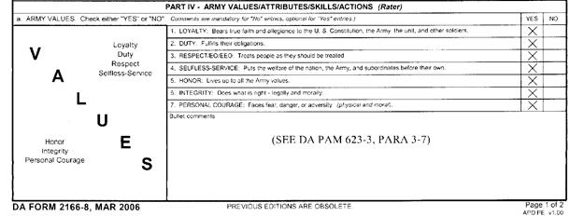
Part IV- Army Values/Attributes
o the NCO is short, concise, but to the point
Bullet comments must be short, concise, to the point
Bullets will not be longer than two lines, preferably one; and no more than one bullet to a line.
Mandatory specific bullet comments are required for all 'no' entries
There must be double-spaces between bullets.

Slide 54
Part IV
VALUES
NCO RESPONSIBILITIES

Slide 55
jimmy.crackle@
TIPS:
--Lead off
with your
strongest
excellence
bullet
Sample
NCO-ER
(page 2)
--S/R focus on
promotion,
schools,
assignments

Slide 56
When Writing an NCOER You want
Place strongest bullet up front
The rater will write the NCOER not the rated NCO
Bullet comments should be past tense for contributions/achievements and present tense for values
Use action words and avoid using personal pronouns and names
Bullets should be clear and concise, avoid vague comments
Paint clear and accurate portrait of rated NCO
Reflect significant accomplishments during rating period on report
Bullet comments should justify the rating in the checked box
*** DO NOT FUDGE BULLETS. NCO’s GET WHAT THEY DESERVE***
AMONG THE BEST = absolute top performers
FULLY CAPABLE = good performers but less than the best
MARGINAL = failed one or more standards
Render fair, accurate and unbiased reports

Slide 57
Interpretation of Ratings
EXCELLENCE: Exceeds Standards; demonstrated by specific examples and measurable results; special and unusual - achieved by only a few; clearly better than peers
ex: Received physical fitness badge
Qualified entire squad as expert with M-16
SUCCESS: Meets all standards; NCO is fully competitive for promotion and schooling
ex: Established comprehensive cross-training program
for his section
Shares experiences readily, constantly teach Soldiers
NEEDS IMPROVEMENT: NCO missed meeting some standards
ex: Was often unaware of whereabouts of subordinates
Unprepared to conduct formal training on three
occasions.

Slide 58
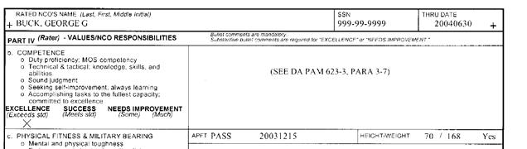
Part IV- Competence
Talk about duty proficiency and MOS competency
You can put the total number of semester hours the NCO has completed during the rated time
NCO won any level board competitions
Technical knowledge of the NCO

Slide 59
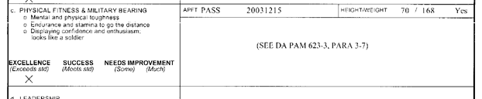
Physical Fitness/Military Bearing
The rater will enter one of the following APFT entries: “PASS" or "FAIL”
The rater will enter the date (YYYYMMDD) of the APFT results.
The APFT badge is awarded for scores of 270 and above with at least 90 in each of the three events which can constitute and excellent rating
Enter height/weight and APFT score from the last record APFT test that is on file for the rated NCO
NCO overall appearance and military bearing

Slide 60
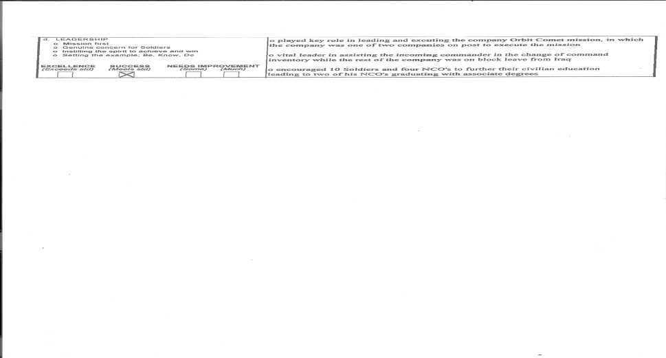
Part IV- Leadership
Talk about the NCO general concern for Soldiers
How the NCO puts mission first
How the NCO sets the example

Slide 61
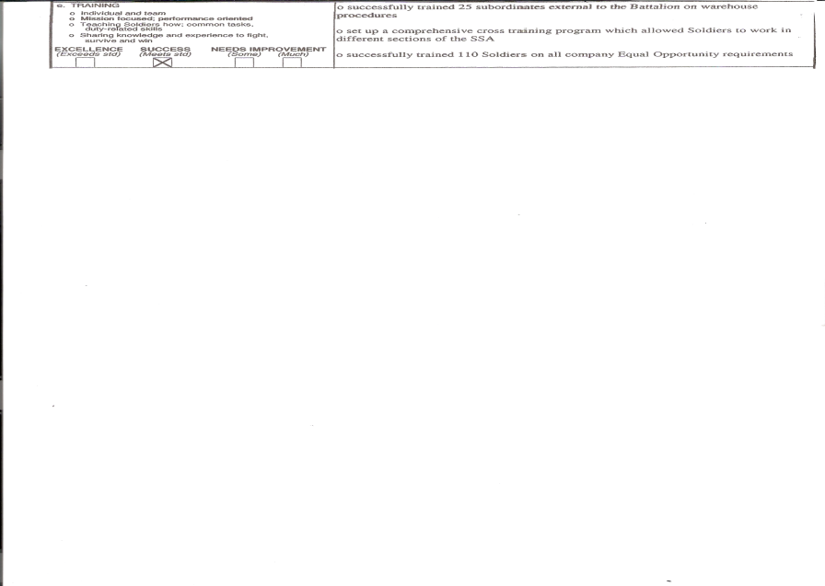
Part IV- Training
Enter bullets that pert
Address if and how the NCO shared his/her knowledge with peers and subordinates
If NCO conducted any Leaders Time Training and how many personnel
How NCO work as a team and

Slide 62
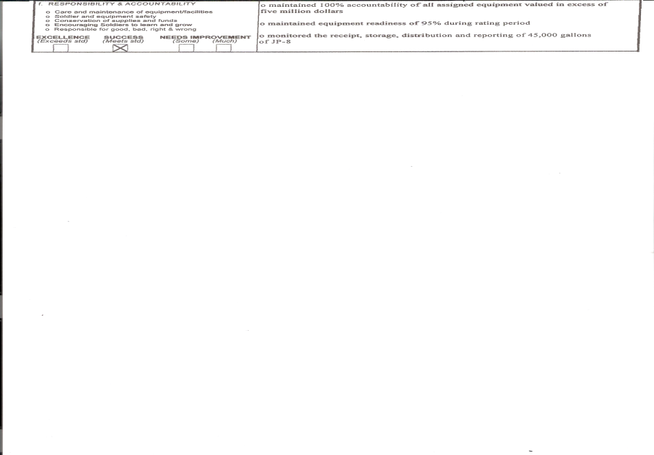
Part IV - Responsibility/Accountability
Care and maintenance of equipment
Try and put what types of equipment
Numbers and dollar amount is very important in this area
Talk about how NCO enforced safety standard

Slide 63
Part V
Overall Performance and Potential

Slide 64
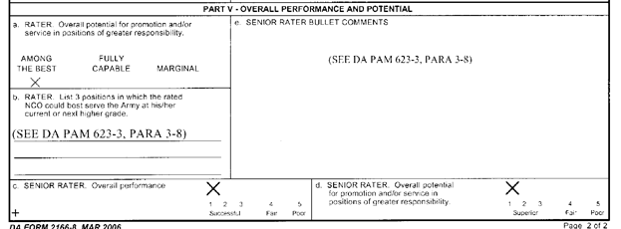
Part V- Rater
Line Va (Overall Potential for Promotion)
Among the best- NCOs who demonstrated a very good, solid performance and a strong recommendation for promotion and/or service in positions of greater responsibility.
Fully capable- NCOs who have demonstrated a good performance and strong recommendation for promotion should sufficient allocations be available.
Marginal- NCOs who demonstrated poor performance and should not be promoted at this time.

Slide 65
Part V- Rater
Line Vb (Future Assignments): Rater lists up to three (at least two) different future duty positions (job title) in which the rated NCO could best serve the Army at the current or next grade. When the rated NCO is being reduced to a lower grade, raters may enter duty positions of the lower grade.

Slide 66
Part V- Senior Rater
Line Vc(d) – Overall Performance and Overall Potential
1 = cream of the crop; promote immediately
2 = a solid soldier; strong recommendation for promotion
3 = a good performance; promote if allocations allow
4 = weak performer; do not promote
5 = poor performer; consider for QMP

Slide 67
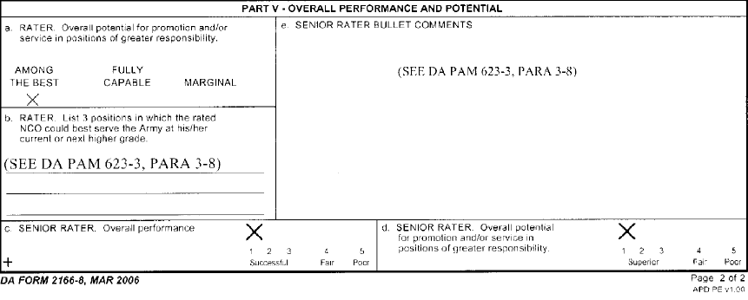
Part V – Senior Rater Bullet Comments
Line Ve (Senior Rater Bullet Comments): First bullet should focus on promotion
Second bullet should focus on school
Third bullet should focus on potential

Slide 68
Common Mistakes on NCOER
reports received with all five ‘excellence’ marks (a ‘max’ report) gives the impression NCO has overachieved in all areas. Leaves no room for improvement
too many NCO-ERs have ‘unjustified’ excellence marks - if there are no proven accomplishments then the board considers it only a ‘successful’ rating.
too many NCOs are receiving 1/1 senior rater marks without the bullet comments to support the rating
too many NCOs are receiving ‘Among the Best’ ratings by the rater -- boards have difficulty determining rater’s intent.
too many senior raters do not address potential in their bullets -- tell the board who they should promote, the type of assignments best suitable for the rated NCO, and the schooling the NCO should attend.
cannot check “among the best” block if there is a “needs improvement” bullet

Slide 69
NCOER Tips
Ensure counseling is happening
Justify Excellence Bullets - Tell the story …
If you give a Success box check, say something - Don’t leave it blank
Ensure Junior Officers and NCOs know system
Avoid generalities, begin bullets with action verbs
Want to be consistent in performance and rating throughout the entire file with particular focus on the last five NCOER
Best reports are those with three ‘clearly justified’ excellence ratings and two success ratings with strong bullet comments as opposed to five excellence check marks
Senior Rater markings of ‘1’ and ‘1’ standout, particularly when supported by strong bullet comments
S/R marking of ‘2’ is still good when sprinkled among several reports of ‘1’ ratings;
NCO-ER Quality Control - suggest using CSM to review the NCOER before being submitted

Slide 70
Reference
AR 623-3

Slide 71
QUESTIONS?
Presentation prepared by SFC Timothy M. Rake

Slide 72
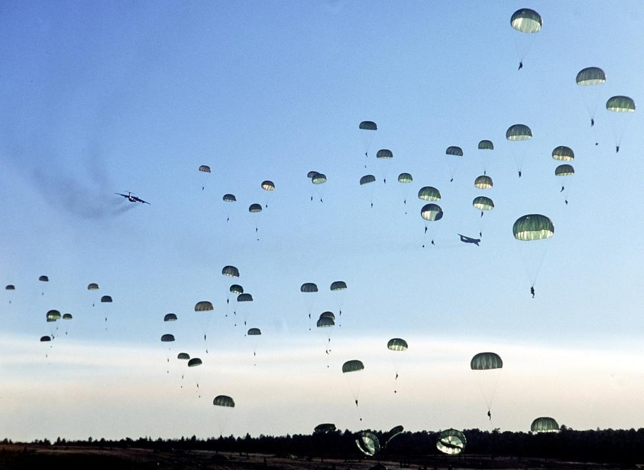
AWARDS
S1 AWARDS SOP
3BCT, 82D ABN DIV
SPC STRIMEL, AMANDA
600-8-22

Slide 73
AWARDS
All battalions will submit NLT 45 days prior to presentation date- AAM’S
All battalions will submit NLT 60 days prior to presentation date- ARCOM’S
All battalions will submit NLT 90 days prior to presentation date- MSM’S
All battalions will submit NLT 200 days prior to presentation date- LOM’S
FOLLOWING DOCs MUST BE ATTACHED WHEN SUBMITTED TO BRIGADE S1
DA 200/Email
ERB/ORB*
DA 638 with all signatures with NO ERRORS
LOL (if required)
Information Sheet**
Retirement Orders** (Only if for a RET Award Only for MSMs)
Narrative sheet (LOM Only)
*NEEDED WITH ALL AWARDS
**NEEDED WITH ALL MSM AWARDS

Slide 74
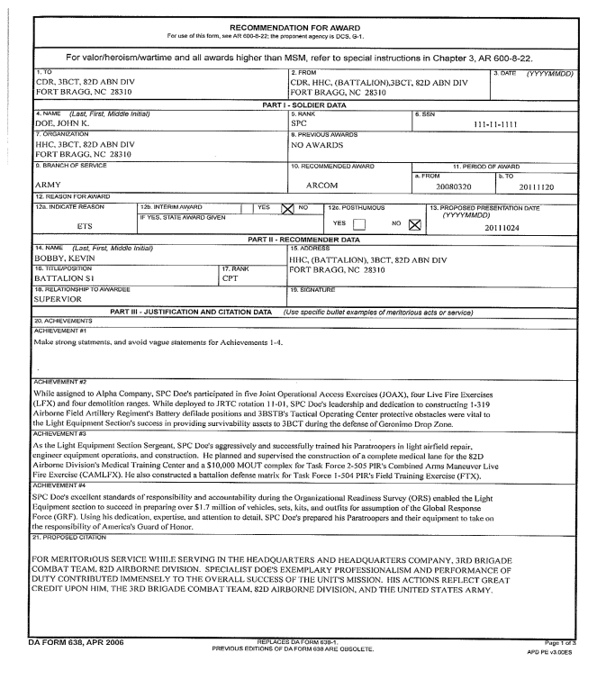
Make sure the award is going to the right place;
ARCOM - CDR, 3BCT, 82D ABN DIV
MSM - CDR, 82D ABN DIV
Include only AAM, ARCOM, MSM, etc, no service medals or ribbons
ARCOM
Insure if the SM has previous awards indicate; 1OLC or 3OLC ect….
1OLC
Indicate the right reason for the award.
Insure the Proposed Presentation Date meets the required days for submission to Brigade.
Ensure there’s a signature before submitting.
Use precise wording and completely describe achievement; avoid vague statements.

Slide 75
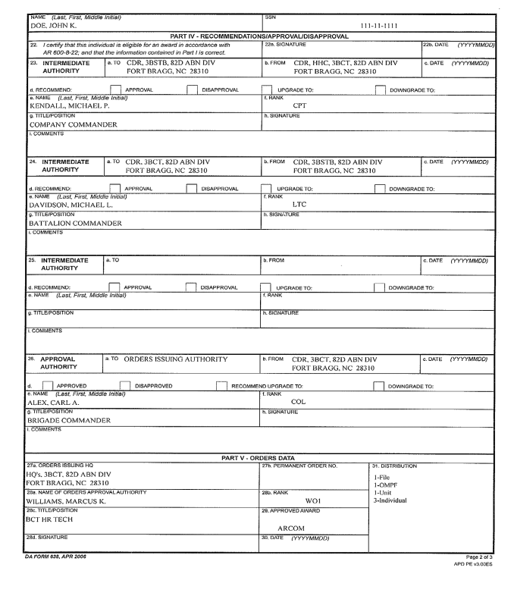
Company Commander
Battalion Commander
Brigade Commander
1OLC
Indicate the AWARD; 1OLC or 3OLC ect….

Slide 76
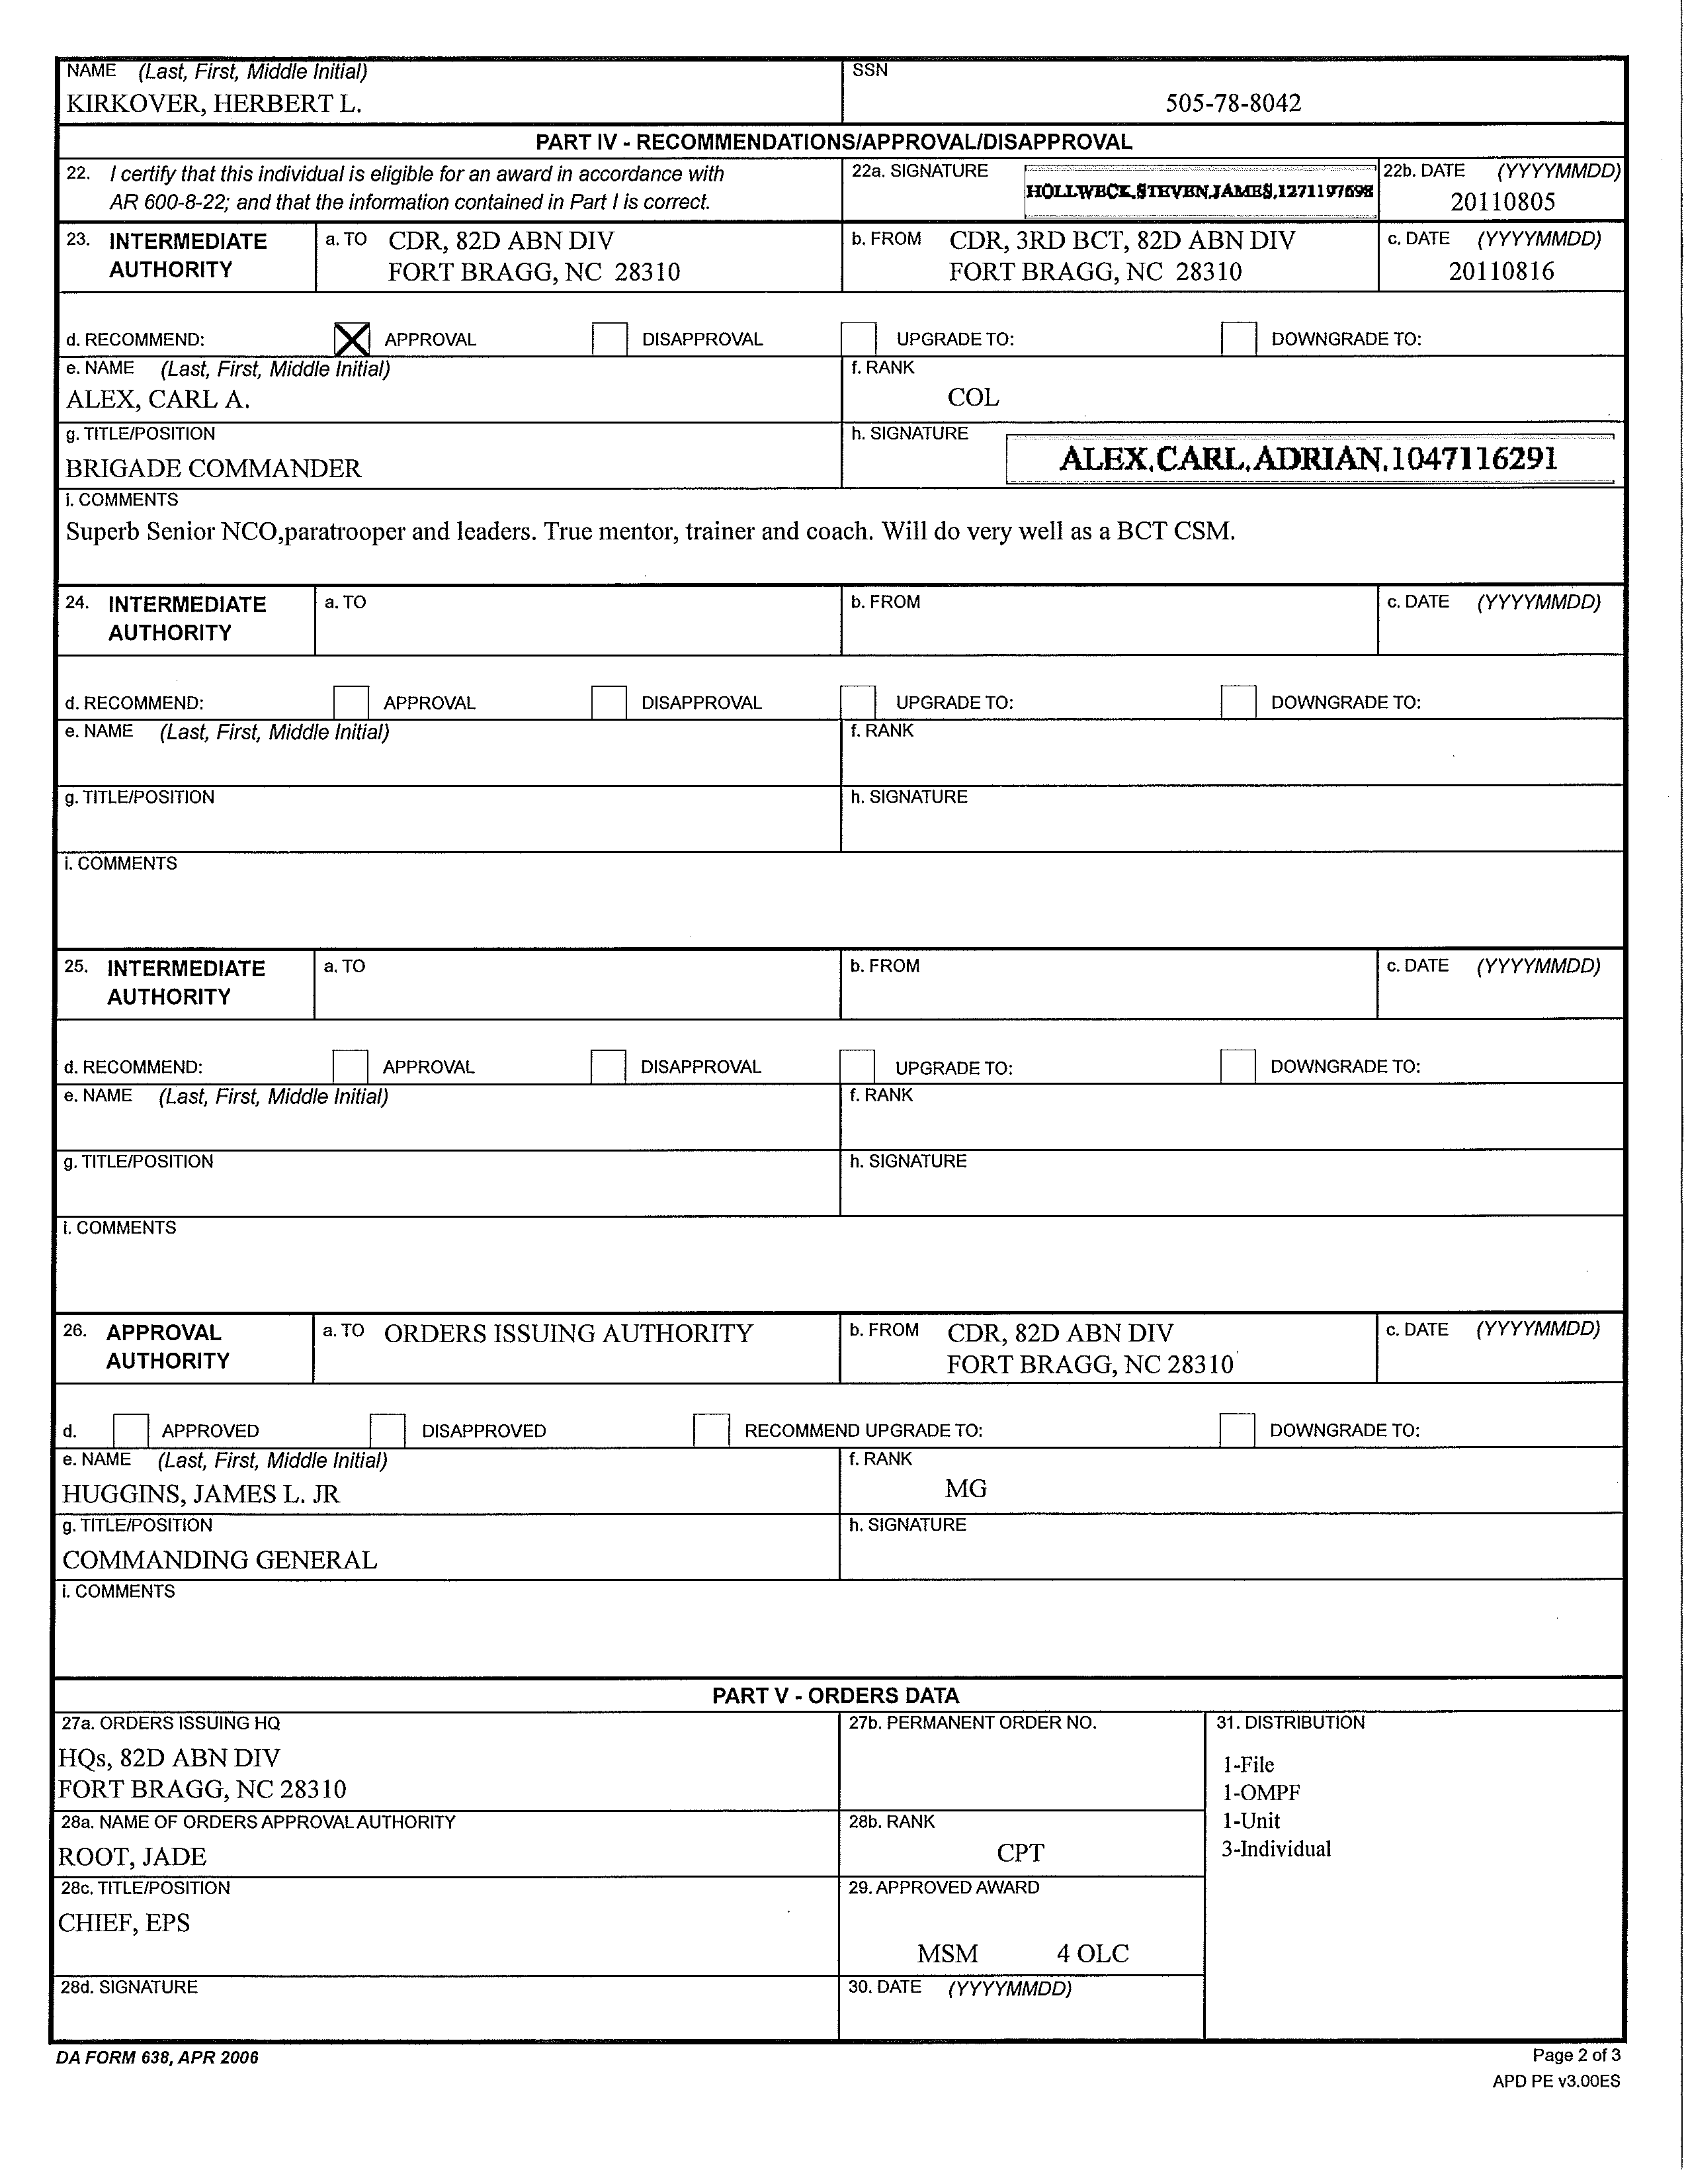
MSM

Slide 77
AWARDS
All battalions will submit NLT 45 days prior to presentation date- AAM’S
All battalions will submit NLT 60 days prior to presentation date- ARCOM’S
All battalions will submit NLT 90 days prior to presentation date- MSM’S
All battalions will submit NLT 200 days prior to presentation date- LOM’S
FOLLOWING DOCs MUST BE ATTACHED WHEN SUBMITTED TO BRIGADE S1
DA 200/Email
ERB/ORB*
DA 638 with all signatures with NO ERRORS
LOL (if required)
Information Sheet**
Retirement Orders** (Only if for a RET Award Only for MSMs)
Narrative sheet (LOM Only)
*NEEDED WITH ALL AWARDS
**NEEDED WITH ALL MSM AWARDS

Slide 78
COMMON / RECURRING ERRORS
Award being submitted late with no LOL!
The AWARD not going to the right place.
Dates not matching with the SMs ERB/ORB.
Block 12a; Wrong reason for award or no reason indicated.
GRAMMAR!
Spelling!
Not all SUP DOCs submitted with digital DA638; ERB/ORB, LOL, Info Sheet
Consistency with all blocks; 3BCT, 3RD BCT, 82D ABN DIV ect….
GRAMMAR!
SPELLING!
Not spelling out the numbers 1-10 on PART III – Justification and Citation Data

Slide 79
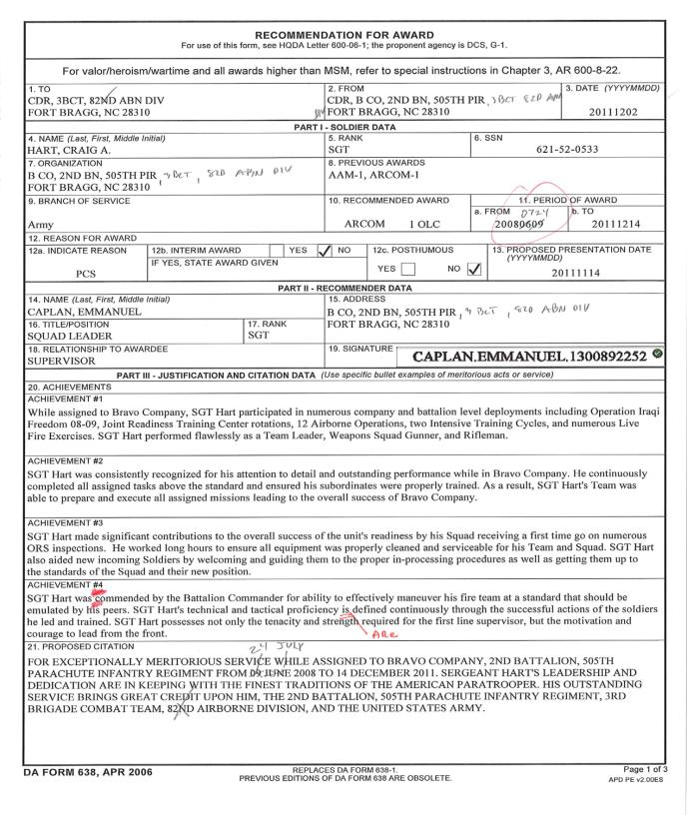
CDR, B CO, 2ND, 505TH PIR, 3BCT, 82D ABN DIV
82D ABN DIV
Dates don’t match ERB/ORB
Award is late
Grammar

Slide 80
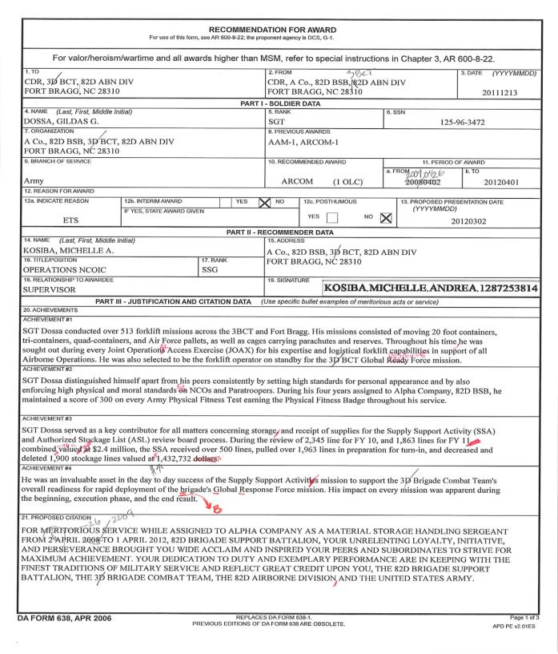
Consistency with 3BCT, 3RD BCT, 3D BCT through the entire award.
CDR, A CO., 82D BSB, 3BCT, 82D ABN DIV
Grammar
Correct wording for GRF; Global Response Force
Grammar
Capitalize
Dates not matching ERB/ORB

Slide 81
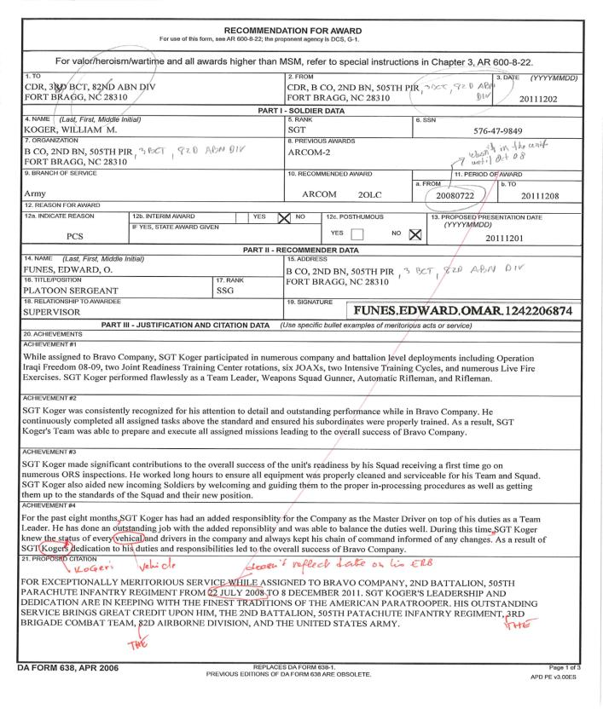
CDR, B CO, 2ND, 505TH PIR, 3BCT, 82D ABN DIV
82D ABN DIV
Dates don’t match ERB/ORB
CDR, B CO, 2ND, 505TH PIR, 3BCT, 82D ABN DIV
SPELLING
SPELLING
GRAMMAR

Slide 82
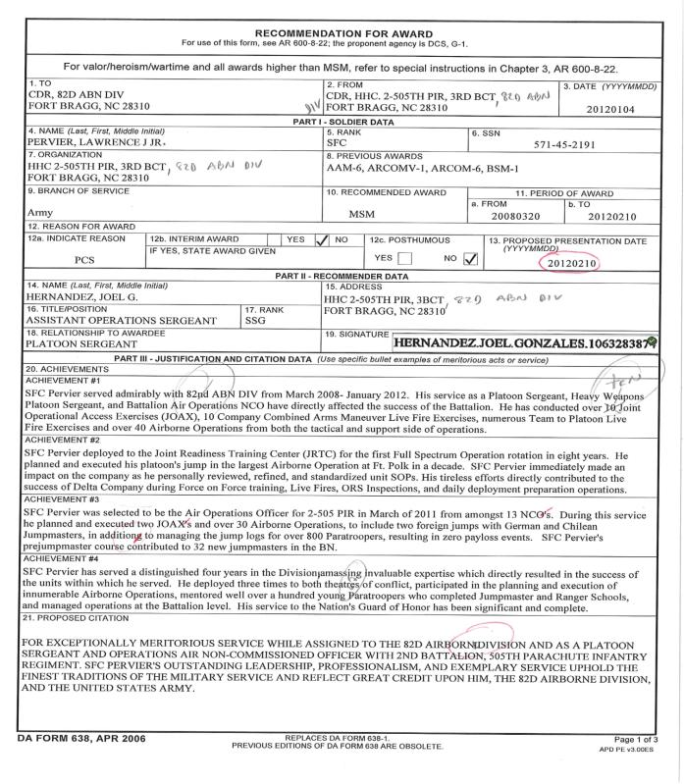
CDR, B CO, 2ND, 505TH PIR, 3BCT, 82D ABN DIV
82D ABN DIV
Award is late
82D ABN DIV
82D ABN DIV
Spell out numbers 1-10
GRAMMER
NO SPACE

Slide 83
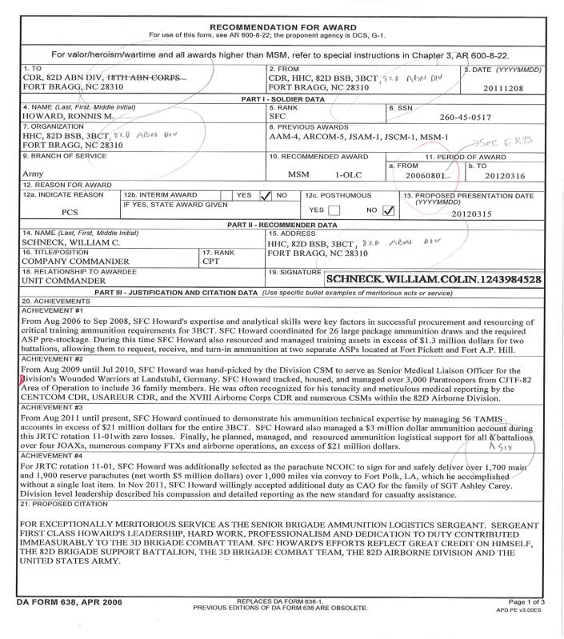
WRONG PLACE
82D ABN DIV
82D ABN DIV
Dates don’t match ERB/ORB
82D ABN DIV
CAPITALIZE
Spell out numbers 1-10

Slide 84
AWARDS
All battalions will submit NLT 45 days prior to presentation date- AAM’S
All battalions will submit NLT 60 days prior to presentation date- ARCOM’S
All battalions will submit NLT 90 days prior to presentation date- MSM’S
All battalions will submit NLT 200 days prior to presentation date- LOM’S
FOLLOWING DOCs MUST BE ATTACHED WHEN SUBMITTED TO BRIGADE S1
DA 200/Email
ERB/ORB*
DA 638 with all signatures with NO ERRORS
LOL (if required)
Information Sheet**
Retirement Orders** (Only if for a RET Award Only for MSMs)
Narrative sheet (LOM Only)
*NEEDED WITH ALL AWARDS
**NEEDED WITH ALL MSM AWARDS

Slide 85
AWARDS
S1 AWARDS SOP
3BCT, 82D ABN DIV
SPC STRIMEL, AMANDA
600-8-22

Slide 86
AWARDS
All battalions will submit NLT 45 days prior to presentation date- AAM’S
All battalions will submit NLT 60 days prior to presentation date- ARCOM’S
All battalions will submit NLT 90 days prior to presentation date- MSM’S
All battalions will submit NLT 200 days prior to presentation date- LOM’S
FOLLOWING DOCs MUST BE ATTACHED WHEN SUBMITTED TO BRIGADE S1
DA 200/Email
ERB/ORB*
DA 638 with all signatures with NO ERRORS
LOL (if required)
Information Sheet**
Retirement Orders** (Only if for a RET Award Only for MSMs)
Narrative sheet (LOM Only)
*NEEDED WITH ALL AWARDS
**NEEDED WITH ALL MSM AWARDS

Slide 87
Make sure the award is going to the right place;
ARCOM - CDR, 3BCT, 82D ABN DIV
MSM - CDR, 82D ABN DIV
Include only AAM, ARCOM, MSM, etc, no service medals or ribbons
ARCOM
Insure if the SM has previous awards indicate; 1OLC or 3OLC ect….
1OLC
Indicate the right reason for the award.
Insure the Proposed Presentation Date meets the required days for submission to Brigade.
Ensure there’s a signature before submitting.
Use precise wording and completely describe achievement; avoid vague statements.

Slide 88
Company Commander
Battalion Commander
Brigade Commander
1OLC
Indicate the AWARD; 1OLC or 3OLC ect….

Slide 89
MSM

Slide 90
AWARDS
All battalions will submit NLT 45 days prior to presentation date- AAM’S
All battalions will submit NLT 60 days prior to presentation date- ARCOM’S
All battalions will submit NLT 90 days prior to presentation date- MSM’S
All battalions will submit NLT 200 days prior to presentation date- LOM’S
FOLLOWING DOCs MUST BE ATTACHED WHEN SUBMITTED TO BRIGADE S1
DA 200/Email
ERB/ORB*
DA 638 with all signatures with NO ERRORS
LOL (if required)
Information Sheet**
Retirement Orders** (Only if for a RET Award Only for MSMs)
Narrative sheet (LOM Only)
*NEEDED WITH ALL AWARDS
**NEEDED WITH ALL MSM AWARDS

Slide 91
COMMON / RECURRING ERRORS
Award being submitted late with no LOL!
The AWARD not going to the right place.
Dates not matching with the SMs ERB/ORB.
Block 12a; Wrong reason for award or no reason indicated.
GRAMMAR!
Spelling!
Not all SUP DOCs submitted with digital DA638; ERB/ORB, LOL, Info Sheet
Consistency with all blocks; 3BCT, 3RD BCT, 82D ABN DIV ect….
GRAMMAR!
SPELLING!
Not spelling out the numbers 1-10 on PART III – Justification and Citation Data

Slide 92
CDR, B CO, 2ND, 505TH PIR, 3BCT, 82D ABN DIV
82D ABN DIV
Dates don’t match ERB/ORB
Award is late
Grammar

Slide 93
Consistency with 3BCT, 3RD BCT, 3D BCT through the entire award.
CDR, A CO., 82D BSB, 3BCT, 82D ABN DIV
Grammar
Correct wording for GRF; Global Response Force
Grammar
Capitalize
Dates not matching ERB/ORB

Slide 94
CDR, B CO, 2ND, 505TH PIR, 3BCT, 82D ABN DIV
82D ABN DIV
Dates don’t match ERB/ORB
CDR, B CO, 2ND, 505TH PIR, 3BCT, 82D ABN DIV
SPELLING
SPELLING
GRAMMAR

Slide 95
CDR, B CO, 2ND, 505TH PIR, 3BCT, 82D ABN DIV
82D ABN DIV
Award is late
82D ABN DIV
82D ABN DIV
Spell out numbers 1-10
GRAMMER
NO SPACE

Slide 96
WRONG PLACE
82D ABN DIV
82D ABN DIV
Dates don’t match ERB/ORB
82D ABN DIV
CAPITALIZE
Spell out numbers 1-10

Slide 97
AWARDS
All battalions will submit NLT 45 days prior to presentation date- AAM’S
All battalions will submit NLT 60 days prior to presentation date- ARCOM’S
All battalions will submit NLT 90 days prior to presentation date- MSM’S
All battalions will submit NLT 200 days prior to presentation date- LOM’S
FOLLOWING DOCs MUST BE ATTACHED WHEN SUBMITTED TO BRIGADE S1
DA 200/Email
ERB/ORB*
DA 638 with all signatures with NO ERRORS
LOL (if required)
Information Sheet**
Retirement Orders** (Only if for a RET Award Only for MSMs)
Narrative sheet (LOM Only)
*NEEDED WITH ALL AWARDS
**NEEDED WITH ALL MSM AWARDS

Slide 98
HR Systems
iPERMS/OMPF (Interactive Personnel Electronic Records Management System)
Interactive Personnel Electronic Records Management System (iPERMS) is a system used by Soldiers and HR professionals to maintain a secure (PKI) record of a Soldier’s Official Military Personnel File (OMPF). It provides web-based access with a unified user interface that provides encrypted, end-to-end, secure, remote access to, input to, and retrieval of, documents from a Soldier’s Military Human Resource Record (MHRR) and DA photo.
IWRS (Interactive Web Response System)
IWRS information is a tool for helping identify where evaluations are and when they are completed. It reflects information on evaluations in all HRC level status (i.e., working, completed, on hold for errors).
eMILPO (Electronic Military Personnel Office)
The Army Human Resource System (AHRS) Electronic Military Personnel Office (eMILPO) application allows unit users, personnel managers, and commanders visibility to military personnel services at all levels and across components.

Slide 99
HR Systems
DATASTORE (Electronic Military Personnel Office Data Query Tools and Reports)
The Army Human Resource System (AHRS) Electronic Military Personnel Office (eMILPO) application allows unit users, personnel managers, and commanders visibility to military personnel services at all levels and across component. Also allows the user to build and request queries for all military information.
CITRIX Platform
Topmis II / eTOPMIS (Total Officer Personnel Management Information System)
PERNET / EDAS (Enlisted Distribution and Assignment System) / MS51
Real time, interactive, automated system which supports the management of the Officer/Enlisted force. These systems allow HRC to process assignments, deletions, and deferments for Soldiers.
TPS (Tactical Personnel System)
The Tactical Personnel System is an automated tactical strength management system.
It provides the field with an application that can serve as a deployment-manifesting platform for all military personnel, civilians (DoD Federal, non-DoD Federal, Contractors), and Foreign Nationals.

Slide 100
REAR-D REPORT
 |  |  |  |  |  | Deployed or Deploying |  |  |  | Non-Deployers & Late Deployers |  |  |  |  |  |  |  |  |  |  |  |  |  |  |  |  |  |  | Not Deploying
eMILPO Availability Status |  |  |  |  |  | DEP |  | SIT |  | NAT | NAT | NAP | NAP / NAT | NAP | NAP / NAT | SPR | SPR |  |  | NAT | NAT | NAT | NAT | NAT | SPR | SIT | ARC |  | ARC | ARC | ARC
eMILPO Availability Reason / DA Pam 220-XX Codes |  |  |  |  |  |  |  | IN; PS |  | AW | LD; LI; LR; LZ | LA | MP | SS | CO | PC | RT; ET |  |  | CS | FP | PA; PD | TC; DP | LS; LT | SD | TS | DL |  | RC | RM | AR
OND and OEF | AUTH | ENL | W | OFF | ATACH | Deployed Unit Mission | Available (SRP Complete) | Available (Pending SRP) | Total Deployers | AWOL | Legal Processing | Lautenberg Amendment | Missing/Prisoner of War | Sole Survivor / Surviving Family Member | Conscientious Objector | PCS | Retirement / ETS | Medical Readiness Class 3A | Medical Readiness Class 3B | Soldier Under 18 | Family Care Plan | Parenthood | TCS / Deployed Other Mission | Leave / TDY | Dwell Time | TSIRT / IRT | Available Late Deployer | Total Non-Deployers & Late Deployers | Rear Detachment | Redeployed at End of Unit Mission | Assigned for RESET | Total Not Deploying | Total Assigned (Deployers + Non-Deployers & Late Deployers + Not Deploying) | ASGN % | DEPL % | DEPL% W/OUT 1P
Deployed
1-505 PIR W/ FSC | 815 | 740 | 1 | 67 | 0 | 612 | 0 | 101 | 713 | 0 | 1 | 0 | 0 | 0 | 0 | 0 | 1 | 6 | 22 | 0 | 0 | 0 | 2 | 4 | 0 | 0 | 0 | 36 | 8 | 0 | 51 | 59 | 808 | 99% | 88%
2-505 PIR W/ FSC | 815 | 782 | 1 | 59 | 0 | 0 | 0 | 742 | 742 | 1 | 7 | 0 | 0 | 0 | 0 | 0 | 0 | 29 | 61 | 1 | 0 | 0 | 0 | 0 | 1 | 0 | 0 | 100 | 0 | 0 | 0 | 0 | 842 | 103% | 88%
5-73 CAV W/ FSC | 490 | 492 | 1 | 20 | 0 | 0 | 0 | 470 | 470 | 0 | 4 | 0 | 0 | 0 | 0 | 0 | 0 | 23 | 16 | 0 | 0 | 0 | 0 | 0 | 0 | 0 | 0 | 43 | 0 | 0 | 0 | 0 | 513 | 105% | 92%
1-319 AFA W/ FSC | 380 | 337 | 3 | 38 | 0 | 0 | 0 | 339 | 339 | 0 | 3 | 0 | 0 | 0 | 0 | 0 | 0 | 17 | 18 | 0 | 0 | 0 | 1 | 0 | 0 | 0 | 0 | 39 | 0 | 0 | 0 | 0 | 378 | 99% | 90%
82D BSB | 396 | 320 | 8 | 39 | 0 | 0 | 0 | 307 | 307 | 0 | 6 | 0 | 0 | 0 | 0 | 0 | 0 | 22 | 32 | 0 | 0 | 0 | 0 | 0 | 0 | 0 | 0 | 60 | 0 | 0 | 0 | 0 | 367 | 93% | 84%
3BSTB | 392 | 363 | 1 | 33 | 0 | 0 | 0 | 351 | 351 | 0 | 4 | 0 | 0 | 0 | 0 | 0 | 0 | 17 | 25 | 0 | 0 | 0 | 0 | 0 | 0 | 0 | 0 | 46 | 0 | 0 | 0 | 0 | 397 | 101% | 90%
HHC BDE | 175 | 112 | 12 | 47 | 0 | 0 | 0 | 155 | 155 | 1 | 1 | 0 | 0 | 0 | 0 | 0 | 0 | 6 | 5 | 0 | 0 | 0 | 1 | 0 | 2 | 0 | 0 | 16 | 0 | 0 | 0 | 0 | 171 | 98% | 91%
DEPL TOTAL | 3463 | 3146 | 27 | 303 | 0 | 612 | 0 | 2465 | 3077 | 2 | 26 | 0 | 0 | 0 | 0 | 0 | 1 | 120 | 179 | 1 | 0 | 0 | 4 | 4 | 3 | 0 | 0 | 340 | 8 | 0 | 51 | 59 | 3476 | 100% | 89% | 82%
 |  |  |  |  |  |  |  |  |  |  |  |  |  |  |  |  |  |  |  |  |  |  |  |  |  |  |  |  |  |  |  |  |  |  |  | 18%
 |  |  |  |  |  |  |  |  |  |  |  |  |  |  |  |  |  |  |  |  |  |  |  |  |  |  |  |  |  |  |  |  |  | Non-Dep % | % Non Dep Admin | % Non Dep Medical
 |  |  |  |  |  |  |  |  |  |  |  |  |  |  |  |  |  |  |  |  |  |  |  |  |  |  |  |  |  |  |  |  |  | 11% | 3% | 9%
 |  |  |  |  |  |  |  |  |  |  |  |  |  |  |  |  |  |  |  |  |  |  |  |  |  |  |  |  |  |  |  |  |  | 89% | 97.1% | 91.4%

