Slide 1
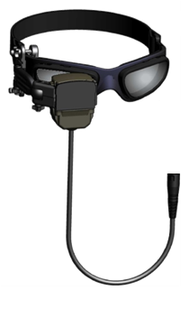
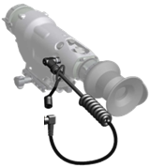
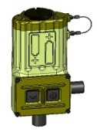
Head Mounted Display
(HMD)
Operator’s Course
DISTRIBUTION IS LIMITED TO U.S. GOVERNMENT AND NATO AGENCIES ONLY
Rev 10 4-Nov-11

Slide 2
Motivator
The Head Mounted Display (HMD) will allow the Soldier to use the TWS when placing the operator’s eye to the eyecup is not the best option. If used without proper training, the HMD can lead to injury to the individual or their fellow Soldiers. The HMD will increase a Soldier’s ability to operate TWS when mounted to crew served weapons on a vehicle platform.
Notes:
Paraphrase motivator: making the best of the tools provided to you by the Army.

Slide 3
Terminal Learning Objective
Action: Operate and maintain the HMD.
Condition: In a classroom environment given a HMD, video input, instructor guidance, student handout, and TM 11-5855-326-13&P.
Standard: The student will demonstrate the basic operations of the HMD in accordance with (IAW) TM 11-5855-326-13&P.
Notes:
Read slide and state the following: Overall what to expect at the end of training.

Slide 4
Training Considerations
Safety Requirements: Specific Safety Warnings applicable to the equipment covered in this course will be emphasized by the instructor at the appropriate points.
Risk Assessment Level: Conducted at the unit level prior to conducting training.
Environmental Considerations: Hazardous Waste.
Evaluation: None, however students will perform a practical exercise at the end of this lecture.

Slide 5
Safety and Hazard Awareness
All standard safety practices and procedures applicable to electronic equipment apply.
Specific Safety WARNINGS, CAUTIONS and NOTES references will appear in each lesson where applicable, will be preceded by the icons shown below and will be emphasized by the instructor at the appropriate points.
A comprehensive listing of the referenced Warnings, Cautions and Notes applicable to this course of instruction are contained in the back of the presentation materials.
Specific safety precautions and preventative measures for the HMD are contained in TM 11-5855-326-13&P. Personnel shall report all hazards, safety violations and environmental considerations observed to the appropriate local activity IAW local SOP.
Glossary Of Safety Terms:
Conditions, practices or procedures that must be observed to avoid personnel injury or loss of life.
WARNING
Conditions, practices or procedures that must be observed to avoid damage to equipment or destruction of equipment.
CAUTION
Essential information of special importance, interest or aid in job performance.
NOTE

Slide 6
ELO #1: Characteristics
Action: Identify characteristics of the HMD
Condition: In a classroom environment given a HMD, instructor guidance, student handout, and TM 11-5855-326-13&P.
Standard: IAW this lesson material students will demonstrate a basic understanding of the HMD characteristics.
Notes:
Read the slide

Slide 7
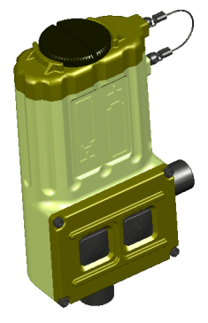
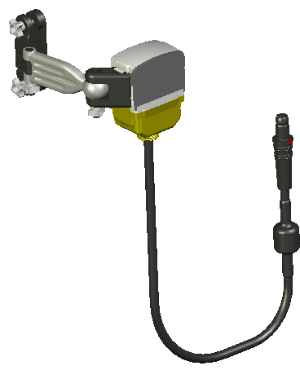
HMD Characteristics
The Head Mounted Display (HMD) is a hands- free video display for the AN/PAS-13 series Thermal Weapon Sight (TWS) used on crew- served weapons
The HMD accepts RS-170 video input from the TWS via one of three different interface cables and displays a black and white image
The HMD operates on two AA batteries
The HMD “cube” eyepiece provides an option for simultaneous “see-through” operation if desired
The HMD will mount to the following protective eyewear:
Wiley-X SG-1
Uvex XC
Oakley M Frame
The eyepiece may be mounted to the left or right eye based on the user preference (pre-mission set up)

Slide 8
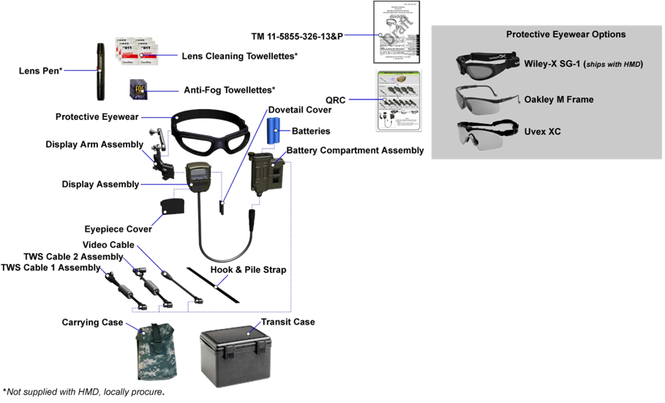
Characteristics: Components
*

Slide 9
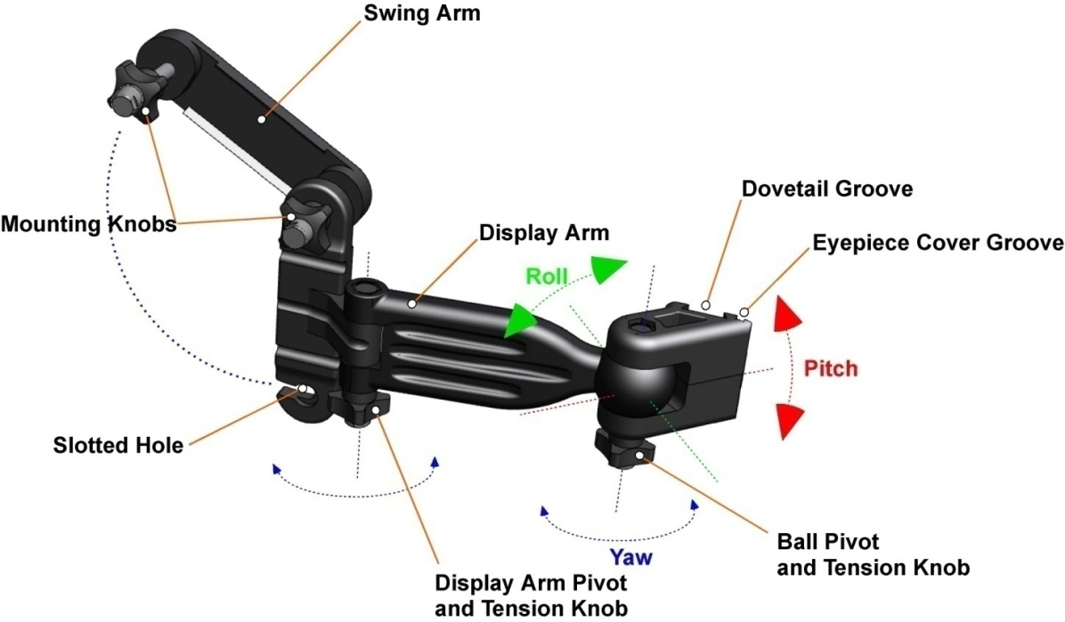
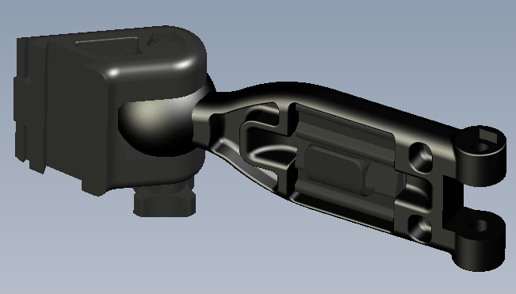
Characteristics: Display Arm Assembly
Retention Clip

Slide 10
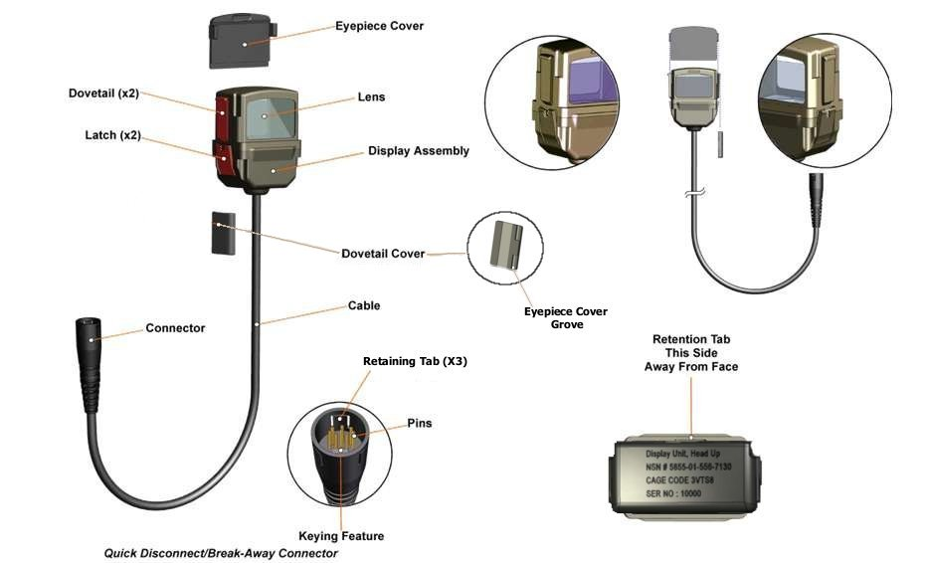
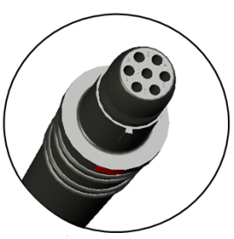
Characteristics: Display Assembly
Eyepiece Cover Groove

Slide 11
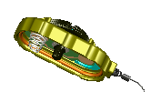
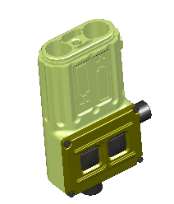
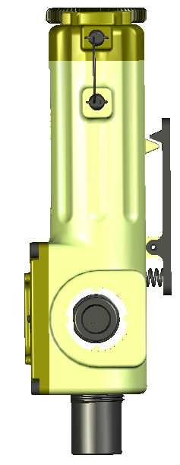
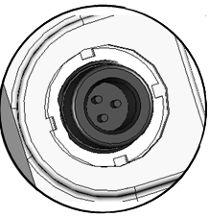
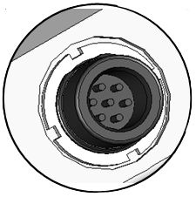
Characteristics: Battery Compartment
O-Ring
Door
Batteries
Knob
Lanyard
Mounting
Clip
Keying Feature
Connector
TWS/EPC
Springs x 2
Keying
Feature
Controls
Pins x 3
Connector
Display Assembly
Pins x 7
Notes:
Make note of the battery cover. It is oriented in a way as to prevent the negative from making contact to the copper plate, reversed batteries do not make a circuit.

Slide 12
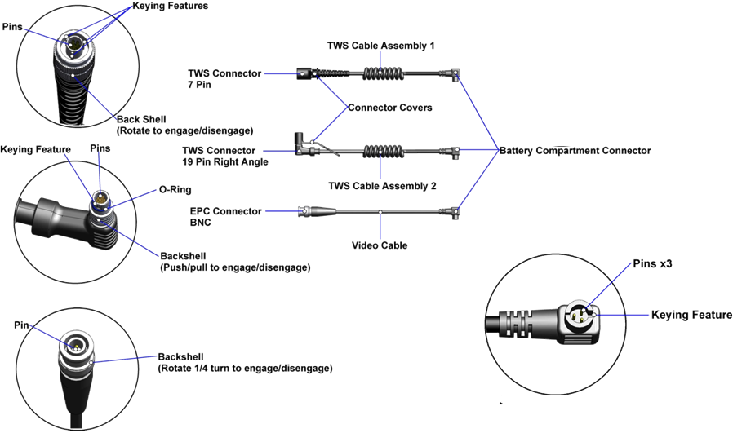
Characteristics: Cables

Slide 13
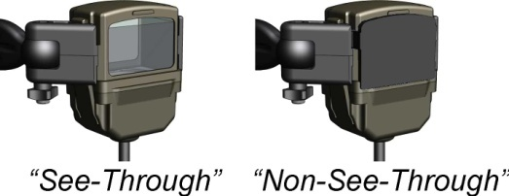
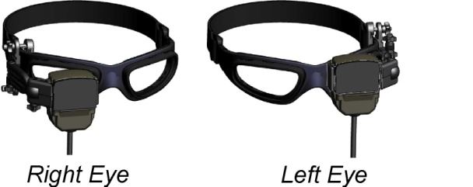
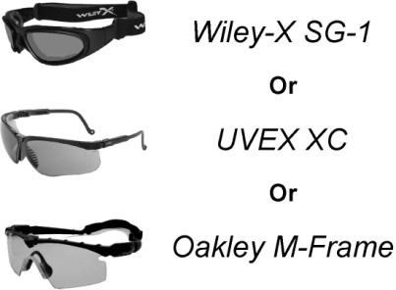
Characteristics: Configurations
The HMD may be used in a stand-alone mode with the TWS
The HMD may be used with the EPC powering the TWS
Protective Eyewear options
“See-through”/ “non-see-through” Operation
Left/right eye
WARNING
12
NOTES
3-5, 13, 39
Notes:
12 When used in the see-through image configuration (eyepiece cover removed):
Light will be emitted from the front of the HMD and may be visible to the enemy.
The thermal image will not directly overlay the visible (naked eye) image. The thermal image and visible image can be of two completely different scenes depending upon orientation of the operator’s head/eye and the TWS. The thermal image may slightly lag the visible image. These factors may result in operator disorientation, nausea and or targeting confusion particularly in the presence of relative scene motion.
________________________________________________________________
.3 Prescription eyewear users, see HMD Product Support Bulletin for more information.
4. If corrective lenses are required by the operator, they should be used with the HMD.
Corrective lenses are NOT supplied with HMD.
Protective Eyewear must be configured with the retaining strap and not the temple pieces when used with the HMD. The use of either clear, shaded or prescription lens inserts is at user discretion.
39. HMD is initially shipped from Manufacturer with Wiley-X SG-1 Protective Eyewear which may subsequently be substituted with Uvex XC, or Oakley M-Frame

Slide 14
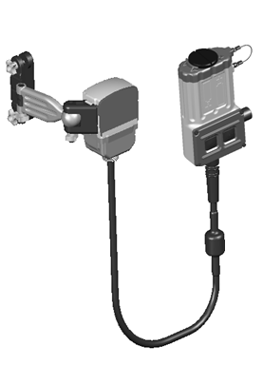
Characteristics: Compatibility
HMD may be configured for left or right eye use.
HMD may be used with the following protective eyewear:
Wiley-X SG-1 (NSN: 4240-01-504-0994)
(Note: this item is supplied by manufacturer)
Oakley 11-138 M-Frame (NSN: 4240-01-525-3095)
UVEX XC (NSN: 4240-01-516-5361)
Any other similar eyewear which provides a firm mount surface and head retention strap.
NOTES
2-5, 39
Notes:
2. TWS, as used in this course, refers collectively to all configurations. The specific configuration/variant nomenclature will be used when referring solely to specific configurations/variants (e.g., MWTS or AN/PAS-13C(V)2).
3. Prescription eyewear users, see HMD Product Support Bulletin for more information.
4. If corrective lenses are required by the operator, they should be used with the HMD.
5. Corrective lenses are NOT supplied with HMD.
During cold temperatures while in non-use, batteries should be kept close to the body to keep warm. Batteries will last longer if batteries are warm.
39. HMD is initially shipped from Manufacturer with Wiley-X SG-1 Protective Eyewear which may subsequently be substituted with Uvex XC, or Oakley M-Frame

Slide 15
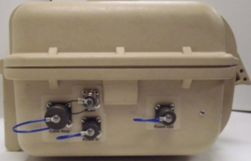
Characteristics: Compatibility
AN/PAS-13
Can also be used with B(V)1
A(V2) or (V3)
B(V2) or (V3)
Or
TWS I Cable Assembly PN: 7012-4008
AN/PAS-13
Can also be used with C - G(V)1
C(V2) or (V3)
D(V2) or (V3)
E(V2) or (V3)
F(V2) or (V3)
G(V2) or (V3)
Or
Or
Or
Or
TWS II Cable Assembly PN: 7012-4007
AN/PAS-13C units must have software version 3.9 or later
To TWS
per EPC TM
Video Cable PN: 7012-4009
NOTES
2-5, 39
Notes:
2. TWS, as used in this course, refers collectively to all configurations. The specific configuration/variant nomenclature will be used when referring solely to specific configurations/variants (e.g., MWTS or AN/PAS-13C(V)2).
3. Prescription eyewear users, see HMD Product Support Bulletin for more information.
4. If corrective lenses are required by the operator, they should be used with the HMD.
5. Corrective lenses are NOT supplied with HMD.
During cold temperatures while in non-use, batteries should be kept close to the body to keep warm. Batteries will last longer if batteries are warm.
39. HMD is initially shipped from Manufacturer with Wiley-X SG-1 Protective Eyewear which may subsequently be substituted with Uvex XC, or Oakley M-Frame

Slide 16
Characteristics: Equipment Data
Parameter | Units | Performance Value (Typical)
Weight (With Batteries)¹ | lbs | .830
Batteries AA | EA | 2
Primary |  | L91 LiFeS₂ (Non-Rechargeable)
Training |  | NiMH (Rechargeable)
Alternate |  | Alkaline (Non-Rechargeable)
Display Resolution (HxV) | Pixels | VGA 640x480
Operating Temperature Range | ° | -40°C (-40°F) to 49°C (120°F)
Storage Temperature Range | ° | -46°C (-51°F) to 71°C (160°F)
Field Rate | Hz | 60 (interlaced RS-170)
Video Input | N/A | RS-170 (NTSC) Monochrome
NOTE: AN/-PAS-13C software REV < 3.9 will require a software update.
Excludes Protective Eyewear
NOTES
14-17
Notes:
14. Battery-life performance will degrade significantly under cold temperatures. NiMH and alkaline batteries may not function or may provide unacceptable battery life performance under extreme cold conditions.
15. The Low Battery Indicator is calibrated for the primary (L91) battery and may not function accurately when using NiMH or Alkaline batteries.
During cold temperatures while in non-use, batteries should be kept close to the body to keep warm. Batteries will last longer if batteries are warm.
Use L91 Batteries when operating at cold temperatures.

Slide 17
Characteristics: Battery Life
100% On Battery Life (Hours) ¹
Ambient Temperature | -40°C (-40°F) | 21 °C (70°F) | 49°C (120°F)
Primary: LiFeS₂ (L91) ² | 10 | 36 | 40
Training: NiMH ³ | note⁴ | >8 | >8
Alternate: Alkaline ³ | note⁴ | 28 | 30
Battery Life may vary significantly depending upon ambient temperature, battery type/manufacturer/lot/age, HMD, brightness setting and other operational variables.
Low Battery Indicator (LBI) will illuminate a minimum of 10 minutes prior to HMD shut down with the primary (L91) battery.
When using batteries other than the primary (L91), unacceptable battery life may result at colder ambient temperatures and LBI may be significantly inaccurate.
Not recommended.
WARNINGS
2-9
NOTES
14-17
Notes:
2. Do not open, crush, puncture or otherwise mutilate batteries. Handle leaking batteries with rubber or plastic gloves. Get medical attention for any skin or respiratory irritation.
3. Batteries contain materials that are potentially hazardous and harmful to the environment. Turn depleted, leaking or damaged batteries in to next higher level of maintenance for disposal in accordance with unit Standard Operating Procedures (SOP).
4. Do not expose batteries to open flame or high temperatures. Batteries may explode or leak and cause personnel injury.
5. Do not expose batteries to water. Batteries may short circuit and/or flammable or noxious gas may be released that may cause a fire or injury to personnel.
6. Do not install batteries backwards, mix types of batteries, or mix used/new batteries. Batteries may explode or leak and cause personnel injury and/or equipment damage.
7. When using batteries other than the AA L91 (LiFeS2), the low battery indicator may not activate in time to provide sufficient warning to change batteries.
8. Do not recharge AA L91 (LiFeS2) or alkaline batteries. Batteries may explode or leak and cause personnel injury. Refer to the Universal Battery Charger technical manual for directions on how to safely recharge the AA NiMH battery.
9. Do not short-circuit battery terminals. Batteries may explode or leak flammable or noxious gas, causing injury to personnel or damage to equipment
14. Battery-life performance will degrade significantly under cold temperatures. NiMH and alkaline batteries may not function or may provide unacceptable battery life performance under extreme cold conditions.
15. The Low Battery Indicator is calibrated for the primary (L91) battery and may not function accurately when using NiMH or Alkaline batteries.
During cold temperatures while in non-use, batteries should be kept close to the body to keep warm. Batteries will last longer if batteries are warm.
Use L91 Batteries when operating at cold temperatures.

Slide 18
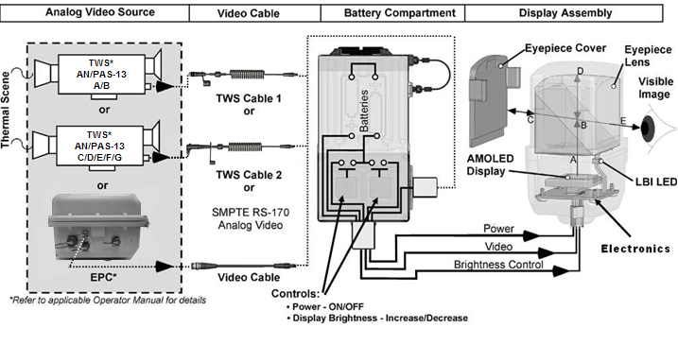
Characteristics: Simplified Function
NOTES
3-5, 7, 8
Notes:
3. Prescription eyewear users, see HMD Product Support Bulletin for more information.
4. If corrective lenses are required by the operator, they should be used with the HMD.
Corrective lenses are NOT supplied with HMD.
7. Refer to TM 11-5855-326-13&P ｶ2-3.2.3 for selection of cable applicable to each TWS configuration.
8. The TWS is separately powered. The TWS will not power the HMD and the HMD will not power the TWS.

Slide 19
Check On Learning
Question: What type of video feed will the HMD accept?
Answer: TWS video output, or any standard RS-170 source.
Question: What Protective Eyewear will the HMD work with?
Answer: Wiley-X SG-1, Uvex XC, and Oakley M-Frame.
Or, anything you can attach to.
Question: What is the Primary Battery type?
Answer: AA Lithium (L91).
Notes:
Advance one question at a time to ensure that the answer is hidden until you are prepared to show it.

Slide 20
Summary
In this lesson you have learned:
The purpose of the HMD
The characteristics of the HMD
The configuration options of the HMD
In the next lesson we will learn to prepare the HMD for operation
Notes:
Read the slide

Slide 21
ELO #2: Preparation For Operation
Action: Prepare the HMD for operation.
Condition: In a classroom environment given a HMD, video input, instructor guidance, student handout, and TM 11-5855-326-13&P.
Standard: The student will prepare the HMD for use IAW TM 11-5855-326-13&P.
Notes:
Read slide.

Slide 22
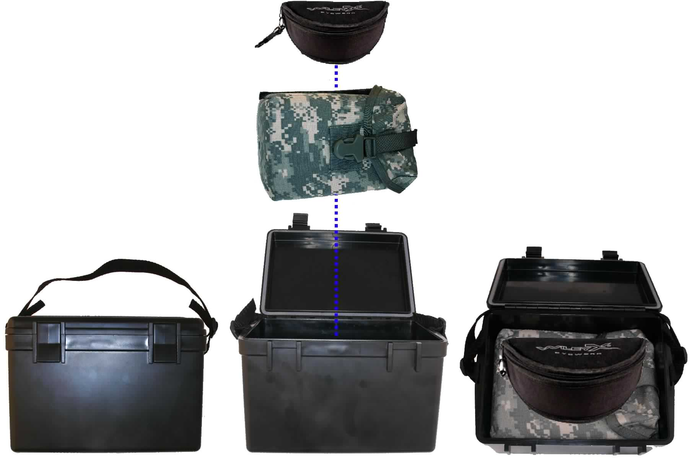
Prepare for Operation: Unpack Transit Case
Release latches on Transit Case and open cover.
Remove Protective Eyewear Case from Transit Case.
Remove Carrying Case from Transit Case.
Close cover on Transit Case and secure latches.

Slide 23
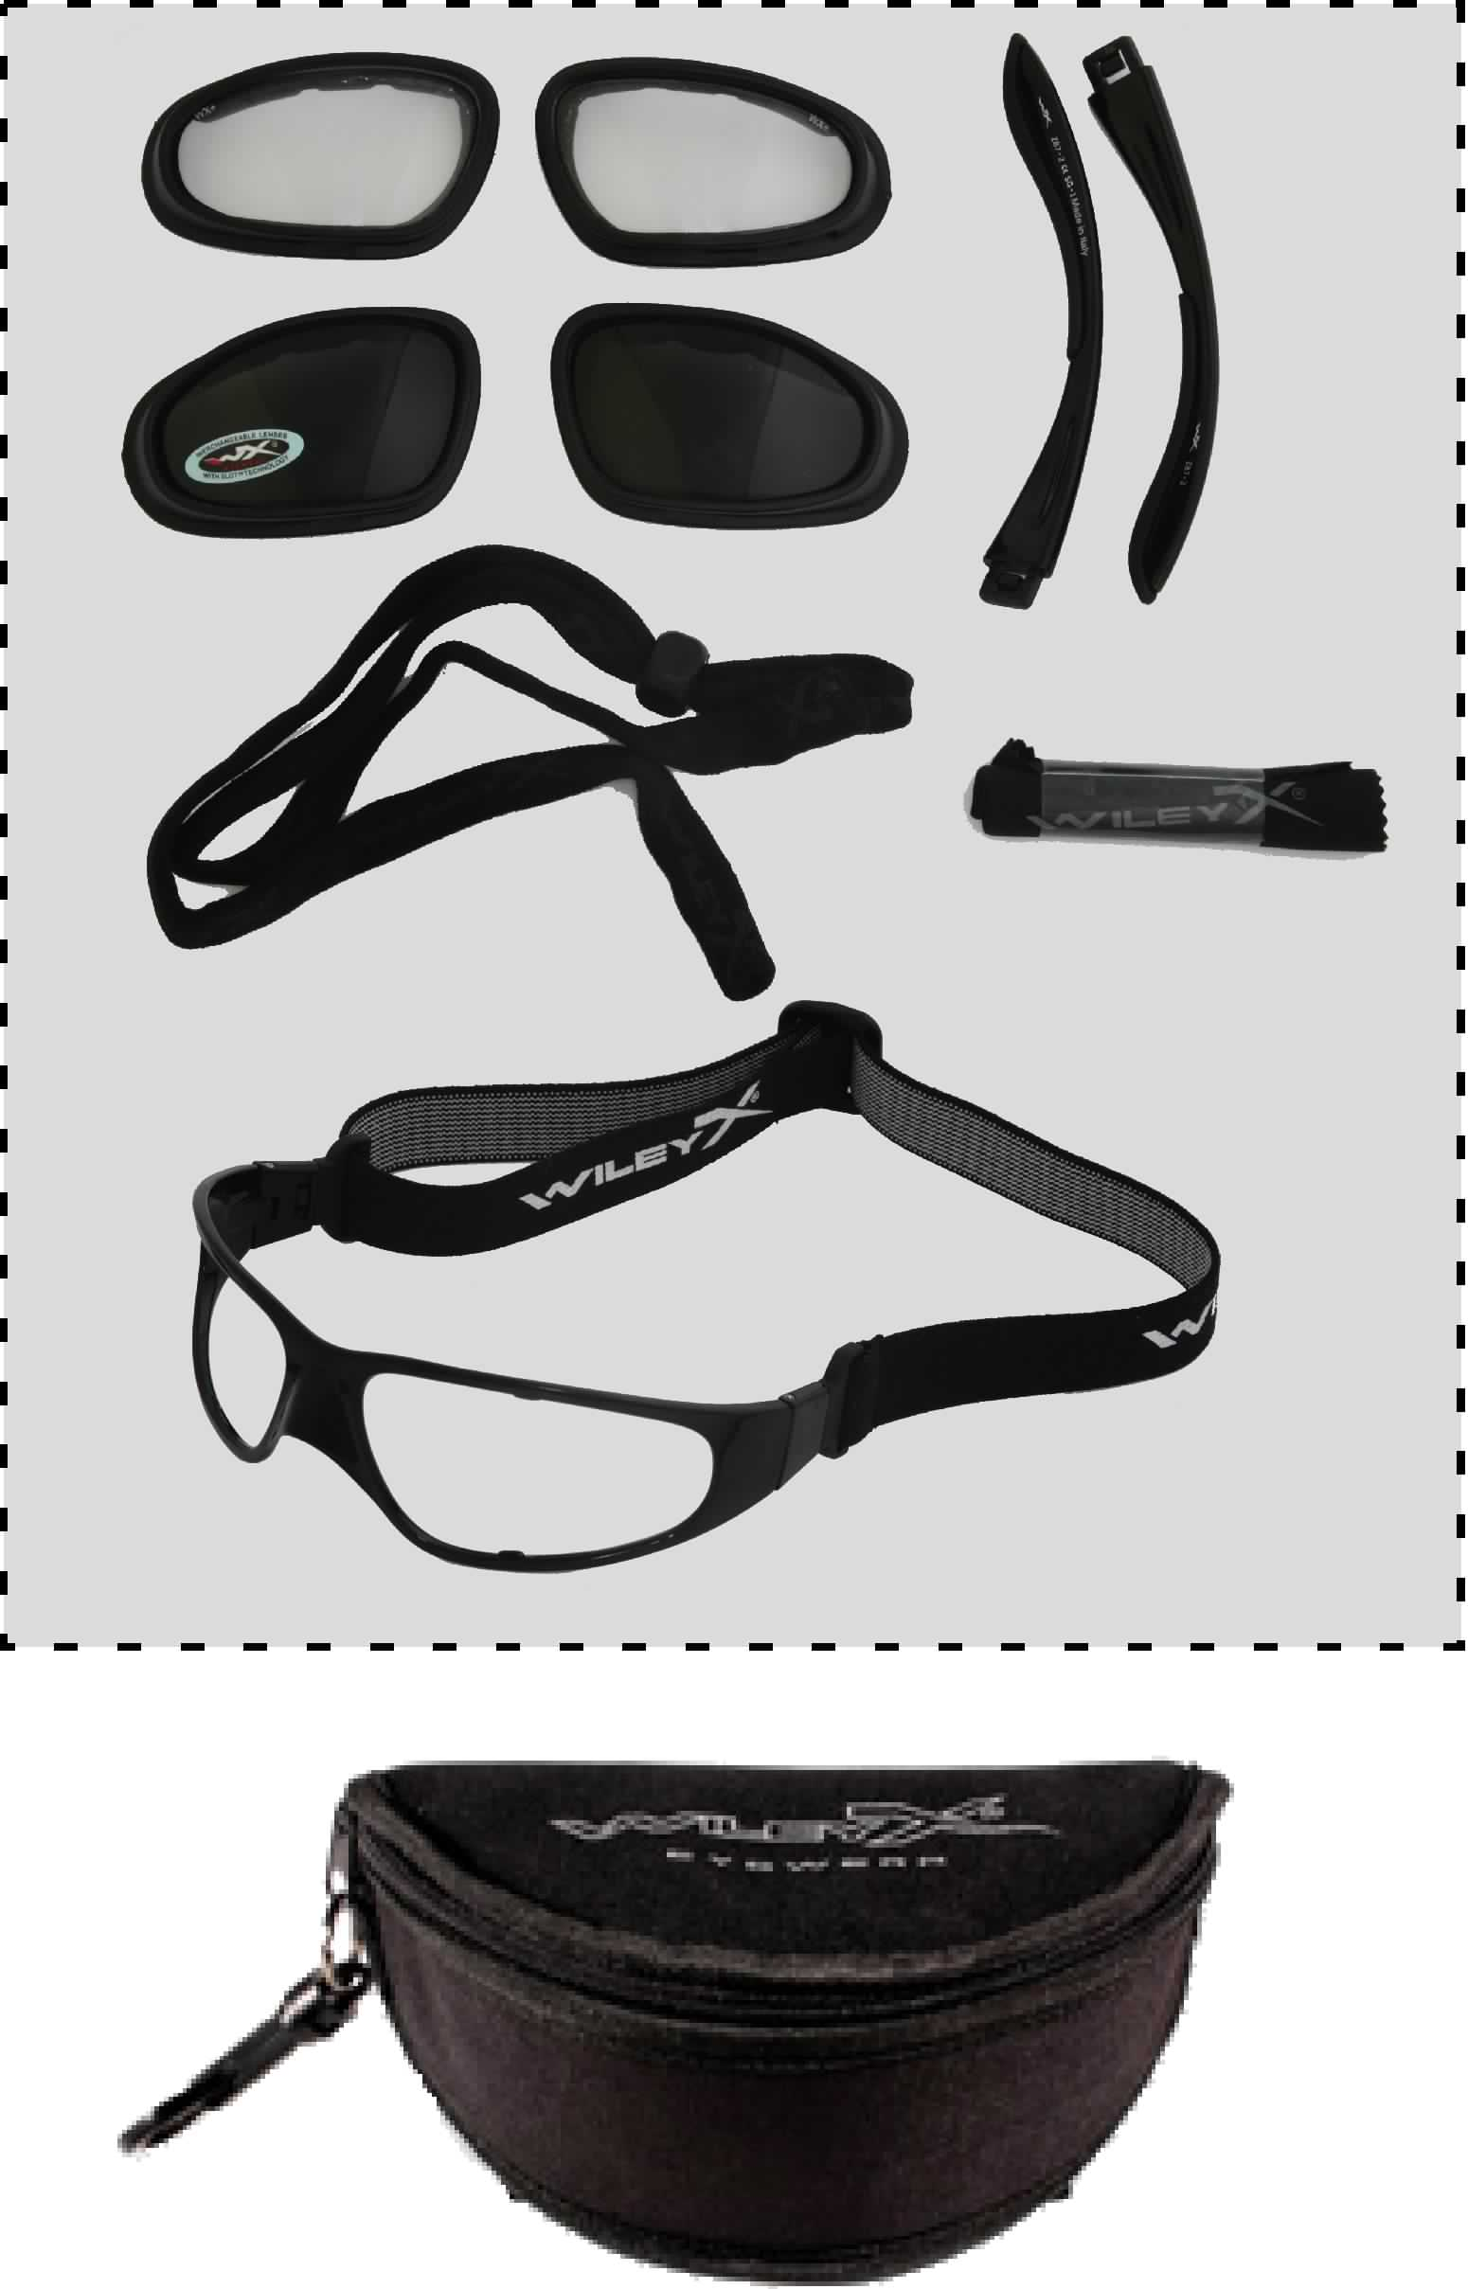
Prepare for Operation: Unpack and Configure Protective Eyewear
Open the Protective Eyewear Case and remove components.
Inspect for missing/damaged components.
Configure the Protective Eyewear IAW Protective Eyewear documentation.
Eyewear should have the eyewear strap.
Return unused components to Protective Eyewear Case and close.
NOTES
3-5, 13, 39

Slide 24
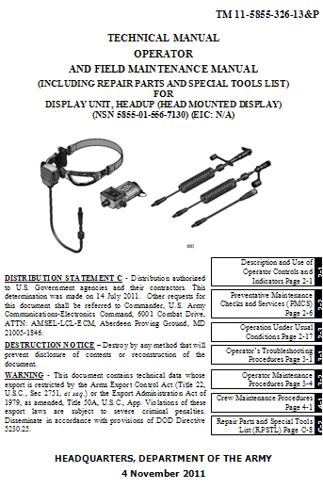
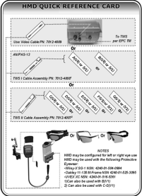
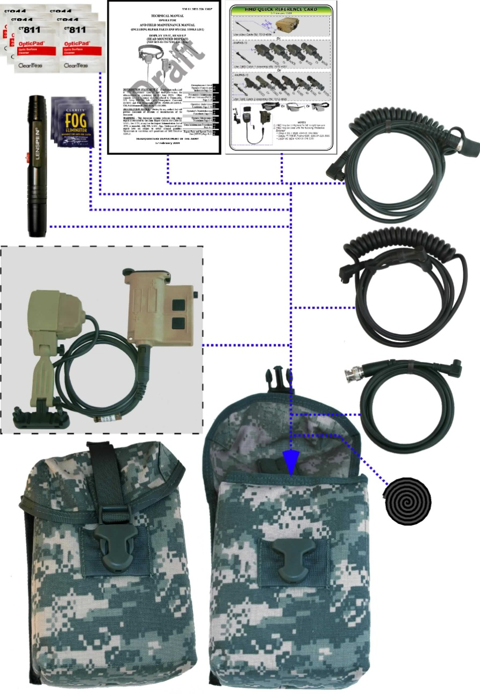
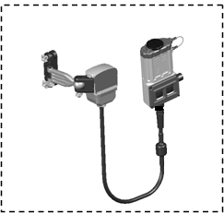
Prepare for Operation: Unpack Carrying Case
Disengage the plastic buckle and open the Carrying Case Cover.
Remove components from Carrying Case.
Inspect for missing or damaged Components.
Select the interface cable applicable to the TWS/EPC to be used (refer to TM 11-5855-326-13&P Table 2-3).
Return unused components to Carrying Case, close the cover and engage the plastic buckle.
Not supplied with HMD. Locally procured.
CAUTION
1
NOTES
11-12
Notes:
Avoid handling or carrying HMD by the Cables.
11. Lens Cleaning Pen, Lens Cleaning and Anti-Fog Towelettes are not included with the HMD when initially shipped and must be requisitioned from the supply system if not present. Refer to TM 11-5855-326-13&P EDIL (Appendix F-2) for ordering Information.
12. Display Assembly, Dovetail Cover, Eyepiece Cover, Display Arm Assembly, Battery Compartment are originally shipped assembled for right eye use.

Slide 25
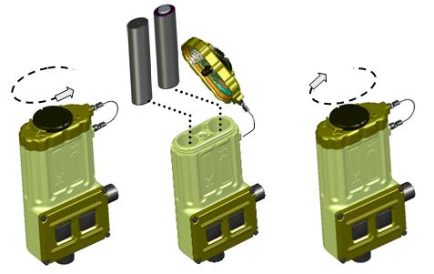
Prepare for Operation: Install Batteries
Loosen the Knob on the Battery Compartment cover.
Open the Battery Compartment cover.
Inspect the Battery Housing O-ring, Upper and Lower Contacts, and Lanyard.
Install two new AA Lithium L91 batteries in the Battery Compartment oriented as shown in the figure and as marked on the Battery Compartment.
Close the Battery Compartment cover and tighten the Knob snugly.
WARNINGS
2-9
CAUTIONS
2, 3
NOTES
14-17

Slide 26
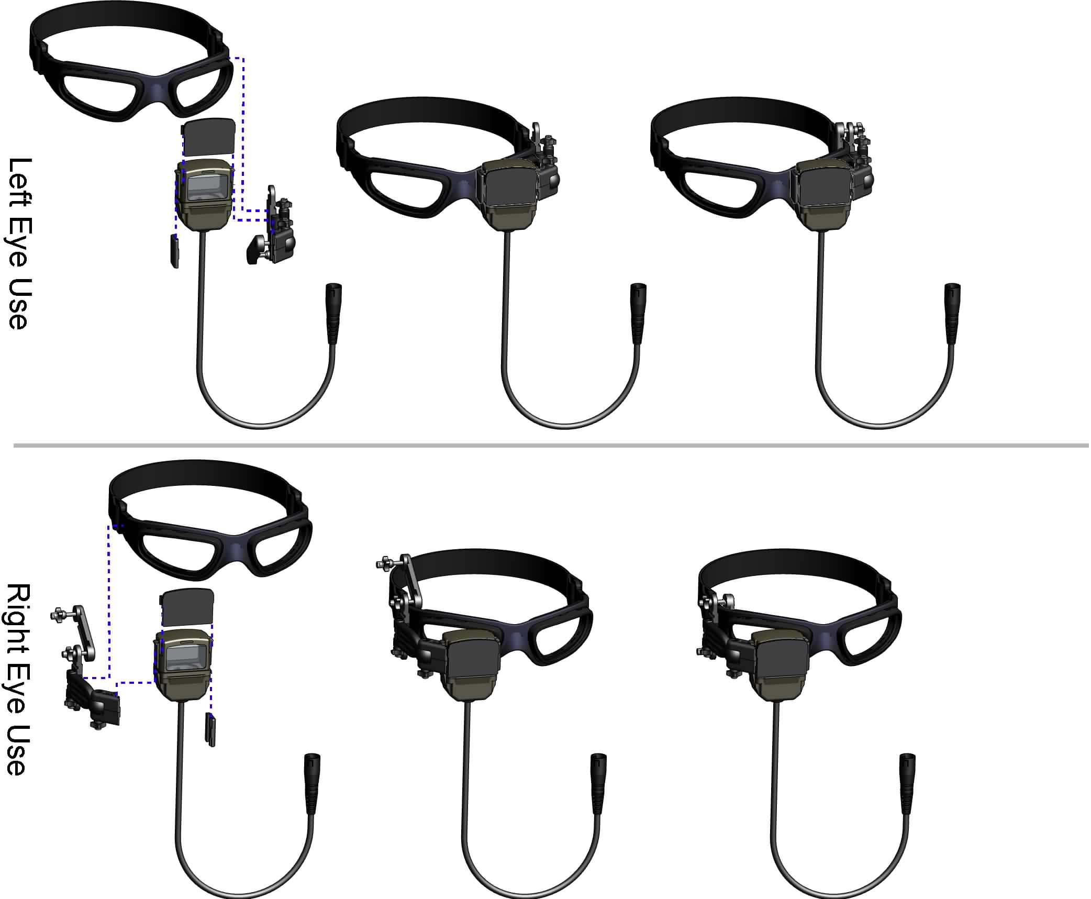
Prepare for Operation: Select Left/Right Eye Usage
The HMD may be mounted to the protective Eyewear for left or right eye use.
CAUTION
1
NOTES
18-19

Slide 27
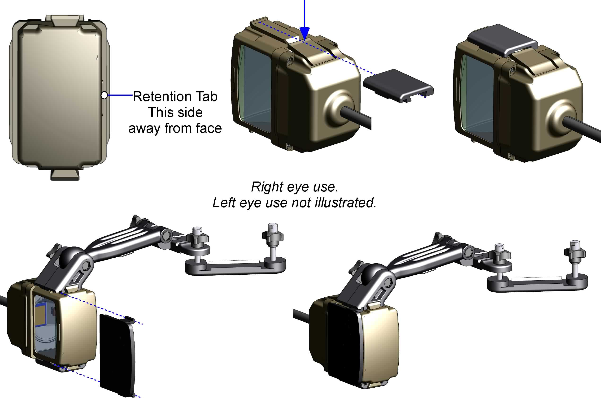
Prepare for Operation: Configure Eyepiece Assembly
Remove the Eyepiece Cover by sliding up, until free.
Remove the Dovetail Cover from the dovetail rail, by pressing the latch while slowly sliding the Dovetail Cover down until free. (Sliding too fast risks uncomfortable sensation in hands.)
Remove the Display Arm Assembly from the dovetail rail, by pressing the latch while slowly sliding the Display Arm Assembly down until free.
Attach the Dovetail Cover on the appropriate dovetail rail by pressing the latch, and sliding the Dovetail Cover up on the dovetail rail until the latch snaps up securing it in place.
Attach the Display Arm Assembly on the appropriate dovetail rail by pressing the latch, and sliding the Display Arm Assembly up on the dovetail rail until the latch snaps up securing it in place.
Attach the Eyepiece Cover by sliding it into the grooves on the Display Arm
Assembly and Dovetail cover.
Retention Tab This side away from face
Display Unit, Head Up
NSN xxxxxxx
Cage Code 3V158
S/N 020000
Display Unit, Head Up
NSN xxxxxxx
Cage Code 3V158
S/N 020000
Eyepiece Cover grove
NSN xxxxxxx
Cage Code 12345
S/N 020000
Unit serial is right side up this way
NSN xxxxxxx
Cage Code 12345
S/N 020000
NOTES
18, 40-41
Notes:
Make note of dove tail cover, and correct orientation to accept eyepiece cover (Slot).

Slide 28
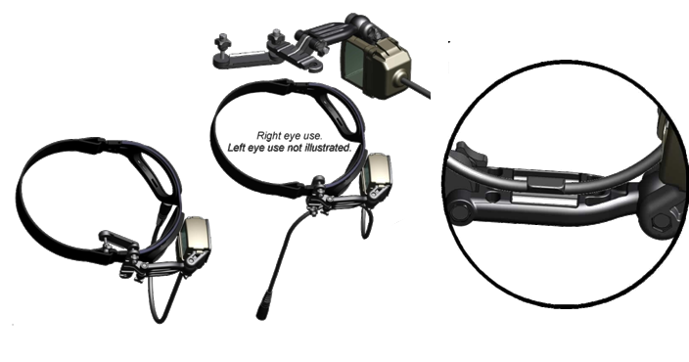
Prepare for Operation: Protective Eyewear Mounting
As required, loosen two clamp nuts by turning Counter Clock Wise (CCW).
Rotate Swing Arm out of slotted hole to a position approximately 180° from closed position.
Position Display Arm Assembly as illustrated for applicable eye.
Rotate Swing Arm to closed position (slotted hole engaged) so the Protective Eyewear frame is sandwiched between the Swing Arm and the rest of the Display Arm Assembly.
Route and snap Display Assembly Cable into retention clip on inside of Display Arm, allow wire to hang down in whatever way is comfortable.
Adjust position of Display Arm Assembly on Protective Eyewear and secure by turning clamp nuts CW.
NOTES
18-19

Slide 29
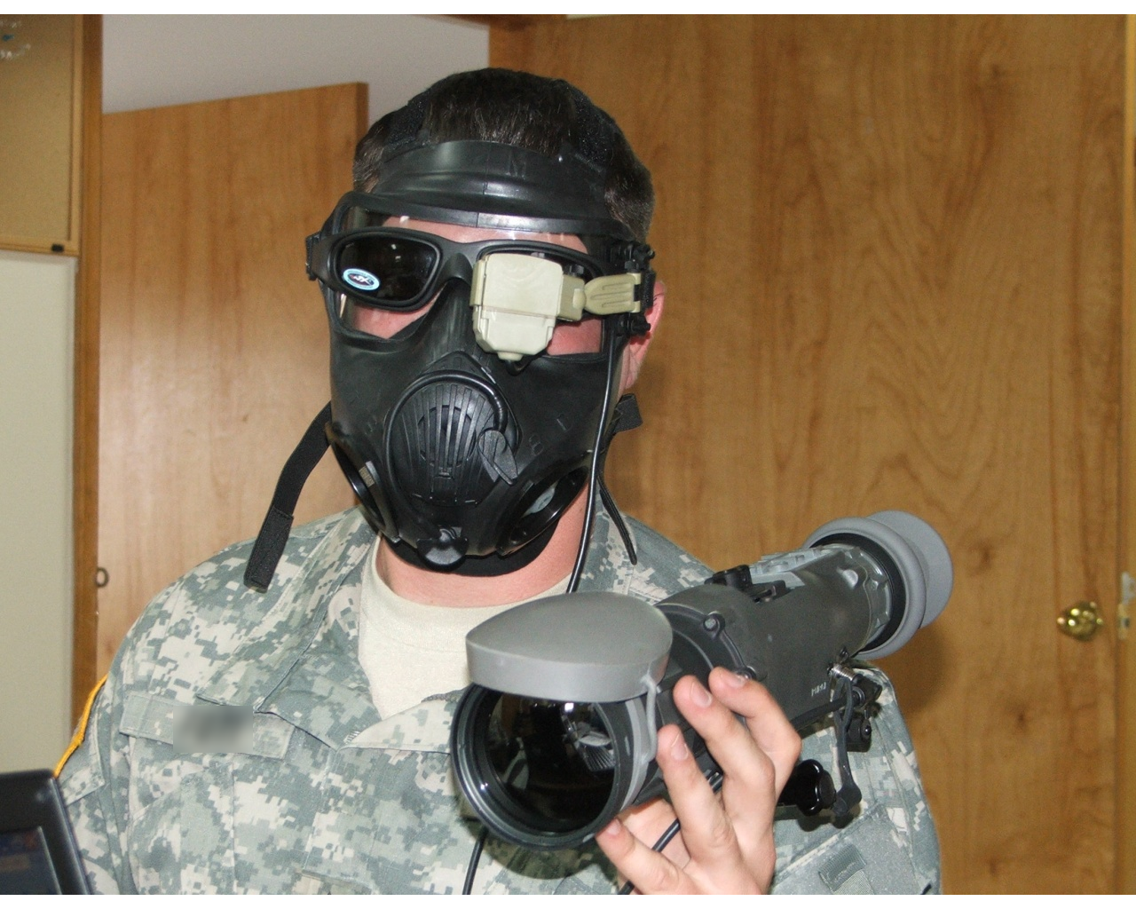
Prepare for Operation: Protective Eyewear Mounting
Note:
The Wiley-X goggle is flexible enough to conform to the mask while maintaining a stable position for the eyepiece.
Some other goggles may not allow for stable positioning over the mask.

Slide 30
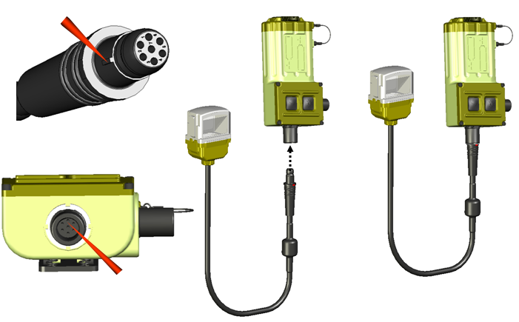
Prepare for Operation: Connect Display Assembly to Battery Compartment
To connect, align the Display Assembly cable connector keying lug with the matching Battery Compartment plug keying slot as illustrated, and press together until locking tabs engage with a snap.
NOTES
20-21
Notes:
Note: Don’t twist the connector! Align the tab and then connect. Damage to pins may occur!

Slide 31
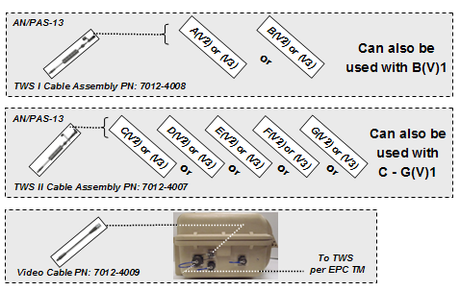
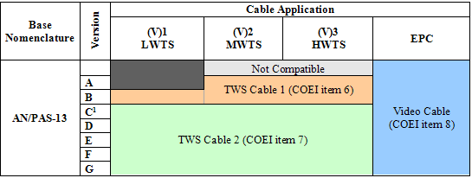
Prepare for Operation: Cable Selection
Select applicable interface cable for TWS variant/EPC being used from table.
HMD may be configured for left or right eye use.
HMD may be used with the following protective eyewear:
Wiley-X SG-1 NSN: 4240-01-504-0994 (included with factory issued HMD units)
Oakley 11-138 M-Frame NSN: 4240-01-525-3095
UVEX XC NSN: 4240-01-516-5361
Any other similar eyewear which provides a firm mount surface & head retention strap.
CAUTION
4
NOTE
21

Slide 32
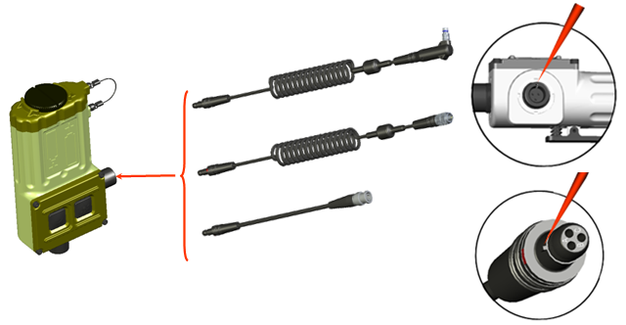
Prepare for Operation: Connect Cable to Battery Compartment
To connect, align the Display Assembly cable connector keying lugs with the matching Battery Compartment plug keying slots as illustrated, and press together until connector engages with a snap.
NOTE
21

Slide 33
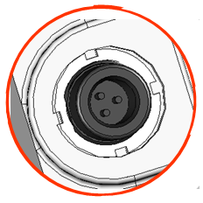
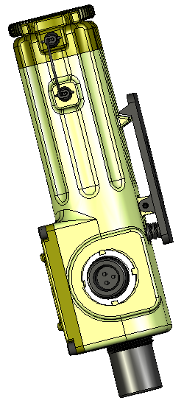
Prepare for Operation: Connect Cable to Battery Compartment
Caution: If the Display Assembly Cable Connector “Broke Away” from the Battery Compartment Plug via the quick disconnect capability, inspect the pins for bending or damage before reconnection. If a pin is bent, try to straighten the pin.
If damaged, return the HMD to next level of maintenance.
NOTE
21

Slide 34
Prepare for Operation: Connect the (7 Pin) TWS Cable 1 to TWS
Using TWS cable I .
Connection.
To connect, pull connector cover off of TWS Cable 1 connector. Remove TWS I/O connector cover IAW applicable TWS Operator Manual. Align the (7 pin) TWS Cable 1 connector plug keying lugs with the TWS connector receptacle keying slots as illustrated, press together, then turn connector sleeve CW until threads engage and tighten.
Route TWS interface cable to preclude interference when operating weapon and secure using hook and pile strap or equivalent means.
NOTES
42-44

Slide 35
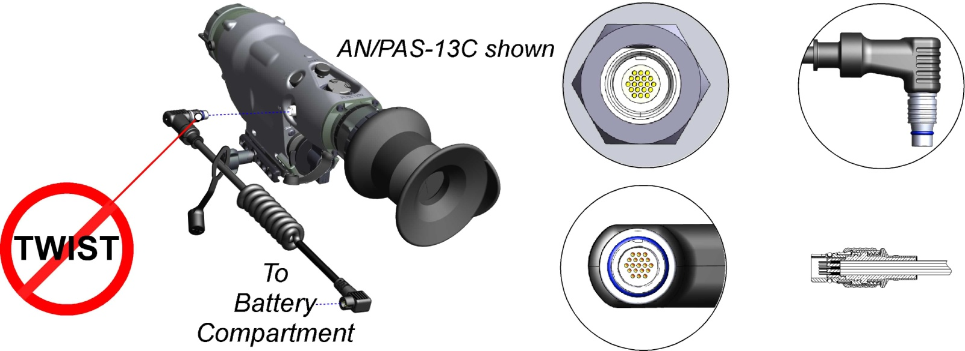
Prepare for Operation: Connect the (19 Pin) TWS Cable 2 to TWS
Using TWS cable 2.
Pull connector cover off of the TWS Cable 2 connector. Remove TWS I/O connector cover IAW applicable TWS Operator Manual. Align the (19 pin) TWS Cable 2 connector plug keying lugs with the TWS connector receptacle keying slots as illustrated until locking feature engages
Route TWS interface cable to preclude interference when operating weapon and secure using hook and pile strap or equivalent means.
When connected to the TWS AN/PAS-13D it will require greater effort to disconnect.
Connection.
CAUTION
4
Key
NOTES
42-45

Slide 36
Prepare for Operation: Connect Video Cable to EPC
Using Video Cable.
Connection.
Remove connector cover off of EPC video connector by rotating 1/4 turn CCW. Align the Video Cable BNC connector with the EPC video connector receptacle, press together and rotate 1/4 turn CW until locking feature engages.
Connect the EPC to the TWS IAW the EPC TM.
To TWS Per EPC Operator Manual
NOTES
43-44

Slide 37
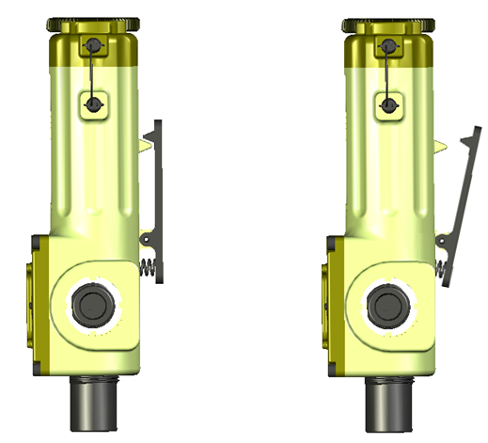
Prepare for Operation: Attach Battery Compartment to Apparel
Depress the spring-side of the clip.
The “tooth” side of the clip will pivot outwards from the back of the Battery Compartment.
Attach the clip to outerwear or any MOLLE webbing as desired.
Route the cables as desired.
CAUTION
1

Slide 38
Check On Learning
Question: How do you determine which side of the Display Assembly is toward face?
Answer: Retention tab for Eyepiece Cover is away from face & serial number is in readable orientation in front of eye.
Question: Following a quick disconnect of the 3 pin connector, what must be done before reconnecting it?
Answer: Inspect the connector for bent pins, straighten the pins if required.
Question: Which interface cable should be used with the TWS AN/PAS-13B?
Answer: (7-pin).TWS Cable 1.
Question: What should you be careful of when connecting and disconnecting the (19-pin) TWS Cable 2?
Answer: Do not twist the connector during mating/de-mating!

Slide 39
Summary
In this lesson you have learned to prepare the HMD for operation:
Battery installation
Configuring for left/right eye
Mounting to Protective Eyewear
Selection and connection of cables
In the next lesson we will learn to operate the HMD

Slide 40
ELO #3: Put HMD Into Operation
Action: Put HMD into operation.
Condition: In a classroom environment given a HMD, video input, instructor guidance, student handout, and TM 11-5855-326-13&P.
Standard: IAW this lesson material the student will demonstrate the ability to put the HMD into operation.

Slide 41
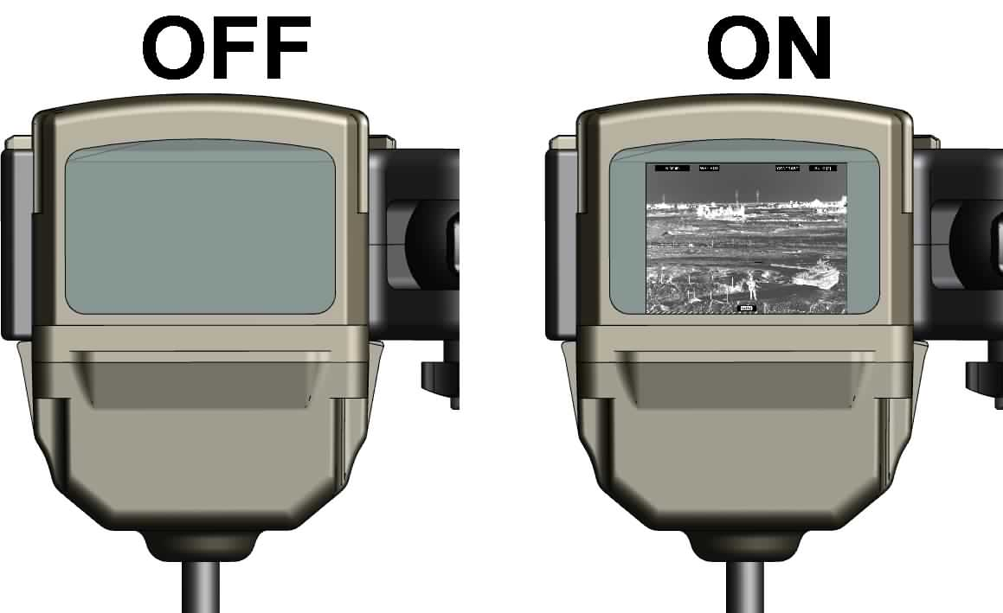
Put HMD Into Operation: Turn On
Turn on TWS and make initial adjustments and control settings to obtain video output to the HMD IAW the applicable TWS Operator’s TM. Verify TWS image is present and correct on the TWS display.
Hold eyepiece in hand so you can see into the optics.
Turn HMD On (press either the sun “☼”or moon “☽” buttons once) & verify video signal presence.
Adjust display brightness as required. Click/press, multiple times, the sun “☼” button to increase brightness or the moon “☽” button to decrease brightness.
Don the Protective Eyewear and HMD.
Adjust Eyepiece position as required.
WARNING
11
NOTES
22-27

Slide 42
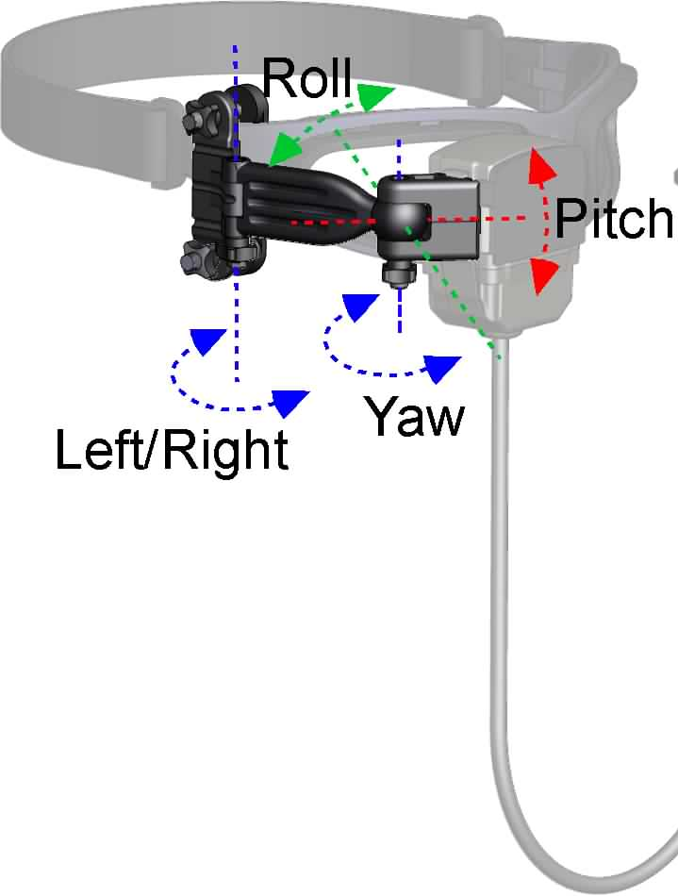
Put HMD Into Operation: Adjust Eyepiece Position
Adjust left/right position:
Loosen the Display Arm Pivot Tension Knob.
Adjust the Display position left and right as required.
Tighten the Tension Knob.
Adjust yaw, fine roll and fine pitch:
Loosen the Display Ball Pivot Tension Knob.
Make fine adjustments for display roll, pitch and yaw as required.
Tighten the Tension Knob.
If necessary, loosen arm clamp nuts and position entire arm as desired relative to the Protective Eyewear, then repeat steps 1 & 2.
When properly adjusted, the image should be in a comfortable viewing position. The entire image should be visible and in focus.
NOTES
28-29

Slide 43
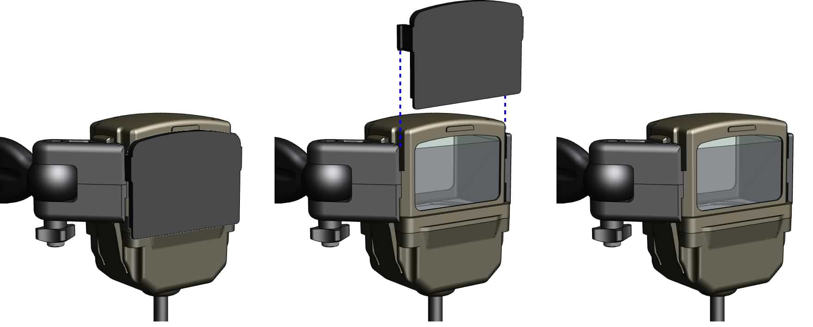
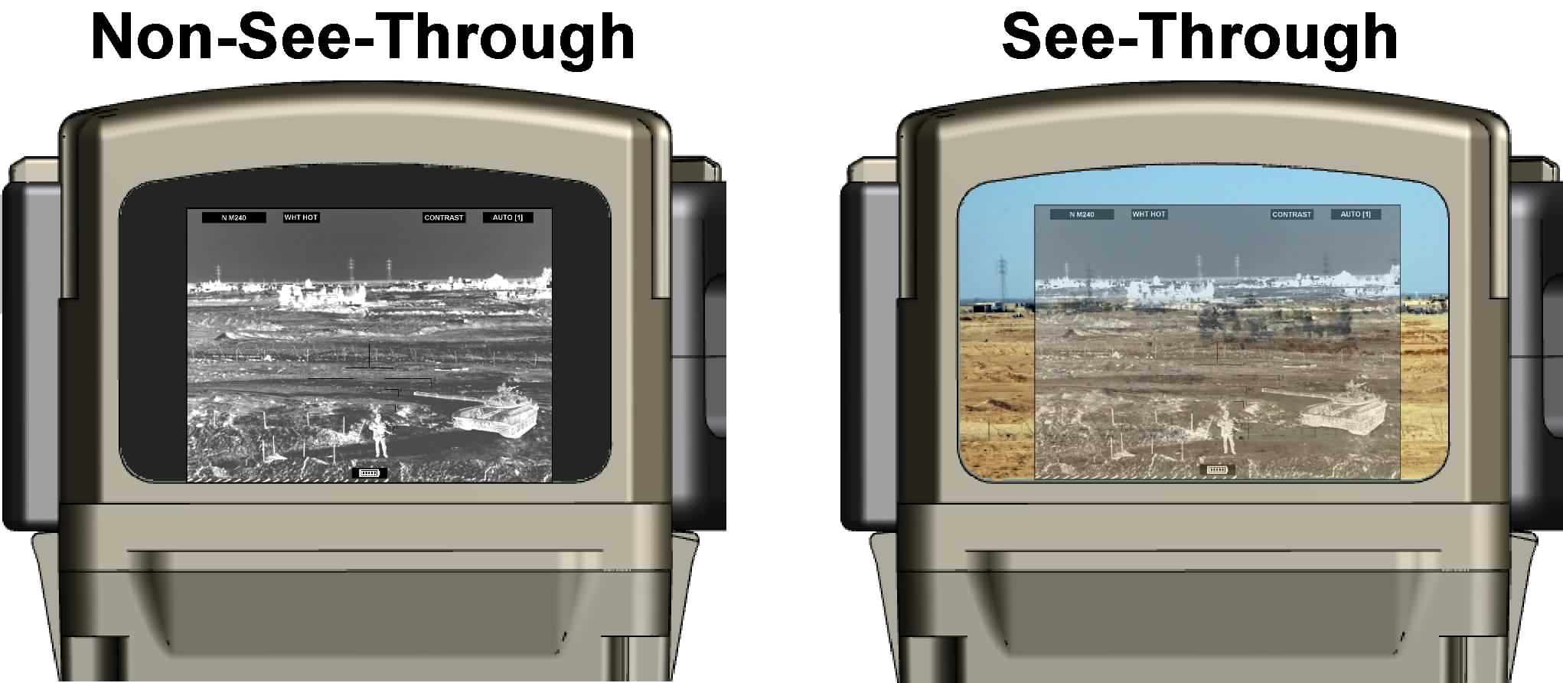
Put HMD Into Operation: Viewing Modes
To operate the HMD in the optional see-through image mode, remove the Eyepiece cover by sliding it up and out. Retain removed Eyepiece cover.
Display scene
Mode:
Day
Night
WARNINGS
11, 12

Slide 44
See-Through Viewing Mode Warning
The HMD is not light secure.
Without the eyepiece cover in place, the HMD emits visible light out into the field!
Amount of light depends on the brightness setting.
Front view of eyepiece w/o cover
1. The HMD is not light secure. Light emissions may be visible to the enemy and are significantly increased in the see-through configuration (eyepiece cover removed).
2. When used in the see-through image configuration (eyepiece cover removed):
Light will be emitted from the front of the HMD and may be visible to the enemy.
The thermal image will not directly overlay the visible (naked eye) image. The thermal image and visible image can be of two completely different scenes depending upon orientation of the operator’s head/eye and the TWS. The thermal image may slightly lag the visible image. These factors may result in operator disorientation, nausea and or targeting confusion particularly in the presence of relative scene motion.
WARNINGS
11, 12

Slide 45
Put HMD Into Operation: Low Battery Indicator (LBI)
A red LED will glow visibly at the bottom of the display if the power is on but the battery voltage drops below a threshold. Approximately 10 minutes of operation remain from the batteries.
If the red warning light is visible, replace the batteries as soon as possible.
Battery life may vary significantly dependent upon ambient temperature and screen brightness settings. Lower brightness settings typically used during night operations will increase battery life.
LED
WARNING
7

Slide 46
Put HMD Into Operation: Shutdown and Disassembly
Turn off HMD by simultaneously pressing both the sun “☼”and moon “☽” buttons once.
Disassemble in reverse order of assembly.
Use care when removing the 19-pin TWS Cable 2 connector. Grasp the connector sleeve and pull straight out of the TWS receptacle. DO NOT twist the connector when removing, damage will occur!
Removal from the TWS AN/PAS-13D requires additional effort.
NOTES
The HMD has a power-save feature which automatically shuts down power if the video signal input is disconnected for a period of approximately 1 minute.
Either removing the batteries or disconnecting the Display Assembly cable from the battery box will also result in shutdown.
NOTE
25

Slide 47
Check On Learning
Question: How do you turn the HMD on? How do you turn the HMD off?
Answer: Press either the “Sun” or “Moon” button to turn it on. Press both buttons simultaneously to turn it off.
Question: A red light appears at the bottom of the image, what does this mean?
Answer: Batteries are low and should be replaced - approximately 10 minutes of operation remain from the primary batteries.
Question: What must be done to the TWS in order to view an image in the HMD?
Answer: The TWS must be configured for video output.
Notes:
Advance one question at a time to ensure that the answer is hidden until you are prepared to show it.

Slide 48
Summary
In this lesson you have learned to put the HMD into operation, including:
Power on/off
Adjusting brightness
Adjusting display position
Selecting viewing modes
Low Battery Indicator & Power Save Mode
In the next lesson we will learn to perform HMD PMCS
Notes:
Read the slide

Slide 49
ELO #4: PMCS
Action: Perform PMCS.
Condition: In a classroom environment given a HMD, video input, instructor guidance, student handout, and TM 11-5855-326-13&P.
Standard: The student will perform PMCS IAW TM 11-5855-326-13&P.
Notes:
Read slide.

Slide 50
PMCS: Operator Maintenance and Cleaning
PMCS IAW TM 11-5855-326-13&P
Inspect HMD components
Inspect Display Assembly
Inspect Battery Compartment
Inspect Cables
Inspect TWS I/O Port & perform TWS PMCS
Inspect Display Arm Assembly
Verify controls and indicator functionality
Monitor for LBI
Lens fogging action
Operator maintenance tasks IAW TM 11-5855-326-13&P
Troubleshooting
Exterior cleaning
Lens cleaning
Anti-fog compound application
Battery compartment and contact cleaning
WARNINGS
1-10, 13
CAUTIONS
7, 9-10
NOTES
33-38

Slide 51
Operator Troubleshooting
Refer to TM 11-5855-326-13&P
HMD does not turn on:
Inspect Cable connections.
Inspect Battery Contacts for corrosion.
Install fresh new AA Lithium L91 batteries correctly with cover sealed shut and turn HMD on.
Return HMD to next higher level of maintenance.
HMD powered on but after a brief flicker, no video:
Inspect cable connections to TWS.
Verify TWS is on (image on TWS display, and TWS settings have been made to enable video output.
Install fresh AA Lithium L91 batteries and seal the battery cover.
Return HMD to next higher level of maintenance.
LBI Illuminated:
Install fresh AA Lithium L91 batteries and seal the battery cover.
Inspect battery contacts for corrosion.
Return HMD to next higher level of maintenance.
WARNINGS
1-10

Slide 52
Operator Troubleshooting
Refer to TM 11-5855-326-13&P
4. TWS imagery not visible
Inspect Cable connections.
Check HMD brightness setting.
Verify TWS is on (image on TWS display, and TWS settings have been made to enable video output.
Ensure TWS is on and TWS settings have been made to output video.
Troubleshoot TWS IAW applicable TWS Operator Manual.
Return HMD to next higher level of maintenance.
5. Image blurry or distorted.
Verify TWS settings are correct and image on TWS display is clear.
Troubleshoot TWS IAW applicable TWS Operator Manual.
Check HMD lens for dirt, fogging, fingerprints, or other contaminants. Clean as appropriate.
Check HMD lens for scratches, cracks, chips, or other damage.
Return HMD to next higher level of maintenance.
WARNINGS
1-10

Slide 53
Operator Troubleshooting
Refer to TM 11-5855-326-13&P
6. Image noise
Inspect Cable connections.
Inspect cables for damage.
Troubleshoot TWS IAW applicable TWS Operator Manual.
Return HMD to next higher level of maintenance.
Cable connector does not plug in
If Battery Compartment connector pins are bent, attempt to straighten using whatever is available.
Return HMD to next higher level of maintenance.
NOTE
Do not try to straighten a bent pin in the 19 pin TWS Cable 2 Assembly. The pins are too small.

Slide 54
Check On Learning
Question: What should be done if the HMD will not power up?
Answer: 1. Battery power expired - Install new batteries.
2. Batteries installed incorrectly – Realign them & be sure
the Battery Compartment cover is sealed all the way.
3. Eyepiece cable has become disconnected from the
battery box – reconnect.
Question: During a mission you loose your thermal scene and symbology, what do you do?
Answer: Check cables/connections from the HMD back to the TWS. Examine TWS operating status through its own eyepiece.
.
Question: What actions are to be taken in the event the HMD display comes on but no video is present?
Answer: Check cable connections. Check TWS video output. Check batteries.
Notes:
54
Advance one question at a time to ensure that the answer is hidden until you are prepared to show it.

Slide 55
Summary
In this lesson you have learned to perform HMD PMCS
In the next lesson we will learn to perform HMD Crew maintenance
Notes:
55
Read the slide

Slide 56
ELO #5: Crew Maintenance
Action: Perform Crew maintenance.
Condition: In a classroom environment given a HMD, video input, instructor guidance, student handout, and TM 11-5855-326-13&P.
Standard: The student will perform Crew maintenance IAW TM 11-5855-326-13&P.
Notes:
56
Read slide.

Slide 57
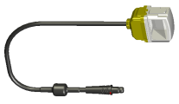
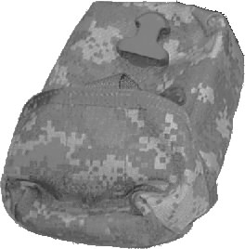
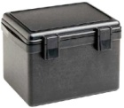
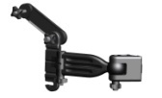
Crew Maintenance
Crew Maintenance
The HMD is repaired at the Crew level by removing and replacing the following components.
Display Assembly
Dovetail Cover
Eyepiece Cover
Display Arm Assembly
Battery Compartment Assembly
O-ring (battery door)
TWS Cable 1 Assembly (7 pin)
Connector Cover
TWS Cable 2 Assembly (19 pin)
Connector Cover
Video Cable (BNC)
Hook and Pile Strap
Cover/Lanyard assembly
Carrying Case
Transit Case
Protective Eyewear
Quick Reference Card
TM 11-5855-326-13&P
WARNINGS
1-10, 13
CAUTIONS
1, 11

Slide 58
Crew Troubleshooting
Refer to TM 11-5855-326-13&P
Physical Damage
Replace damaged component.
HMD does not turn on
Verify the problem reported by Operator troubleshooting.
Replace batteries.
Inspect and replace any component with a damaged connector/pin.
Repair/replace Battery Compartment.
Replace Display Assembly.
HMD powered on but after a brief flicker, no video:
Inspect cable connections to TWS.
Verify TWS is on (image on TWS display, and TWS settings have been made to enable video output.
Install fresh AA Lithium L91 batteries and seal the battery cover.
Replace TWS/Video Cable.
Replace Display Assembly.
Replace Battery Compartment.
WARNINGS
1-10

Slide 59
Crew Troubleshooting
Refer to TM 11-5855-326-13&P
LBI Illuminated
Verify the problem reported by Operator troubleshooting.
Replace Batteries
Replace Battery Compartment.
Replace Display Assembly.
TWS imagery not visible
Replace TWS/Video cable.
Replace Display Assembly.
Replace Battery Compartment.
Image blurry, distorted, jumps or flashes, exhibits column or row outages
Replace TWS/Video cable.
Replace Display Assembly.
Replace Battery Compartment.
WARNINGS
1-10

Slide 60
Crew Troubleshooting
Refer to TM 11-5855-326-13&P
Unable to vary display brightness
Replace Battery Compartment.
Replace Display Assembly.
Cable Connector does not plug in
If pin is bent, straighten it.
If damaged, replace it.
WARNINGS
1-10

Slide 61
Check On Learning
Question: What level of maintenance is authorized to replace the Battery Compartment cover o-ring?
Answer: Crew.
Question: What level of maintenance is authorized to disassemble the display assembly?
Answer: None - this is an unauthorized maintenance action, the Display Assembly is a throw away item.
Question: If the LBI is illuminated and Operator level troubleshooting fails to resolve what is the first recommended Crew level maintenance action?
Answer: Verify problem reported by operator troubleshooting method.
Notes:
61
Advance one question at a time to ensure that the answer is hidden until you are prepared to show it.

Slide 62
Summary
In this lesson you have learned to perform HMD Crew level maintenance
Notes:
62
Read the slide

Slide 63
TLO Check On Learning
Question: What allows for separation of the cables during emergency situations?
Answer: The quick disconnect allows the Display Assembly and Battery Compartment to separate in emergency situations.
Question: What is the proper way to remove a TWS Cable 2 (19 pin)?
Answer: Do not twist the connector to remove from TWS. Pull up on connector sleeve to remove.
Question: How many ways can the HMD be turned off?
Answer: 1. Press both Battery Compartment buttons simultaneously.
2. Auto power off after 1 minute of lost video input.
3. Remove the batteries.
4. Disconnect Display Assembly cable from Battery Compartment.
Notes:
Advance one question at a time to ensure that the answer is hidden until you are prepared to show it.

Slide 64
TLO Check On Learning
Question: What factors will determine if protective eyewear is compatible to the HMD?
Answer: Will mount securely to the eyewear frame and has an eyewear strap.
Question: What are the Pros and Cons of see through/non see through mode?
Answer: Group discussion.
Notes:
Advance one question at a time to ensure that the answer is hidden until you are prepared to show it.

Slide 65
TLO Summary
In this lesson you have learned to operate and maintain the HMD.

Slide 66
Warnings Summary
1. Do not touch, ingest, or inhale particles of a broken lens. Fragments may be sharp enough to cut personnel if touched.
2. Do not open, crush, puncture or otherwise mutilate batteries. Handle leaking batteries with rubber or plastic gloves. Get medical attention for any skin or respiratory irritation.
3. Batteries contain materials that are potentially hazardous and harmful to the environment. Turn depleted, leaking or damaged batteries in to next higher level of maintenance for disposal in accordance with unit Standard Operating Procedures (SOP).
4. Do not expose batteries to open flame or high temperatures. Batteries may explode or leak and cause personnel injury.
5. Do not expose batteries to water. Batteries may short circuit and/or flammable or noxious gas may be released that may cause a fire or injury to personnel.
6. Do not mix types of batteries or mix used/new batteries. Batteries may explode or leak and cause personnel injury and/or equipment damage.
7. When using batteries other than the AA L91 (LiFeS2), the low battery indicator may not activate in time to provide sufficient warning to change batteries.
8. Do not recharge AA L91 (LiFeS2) or alkaline batteries. Batteries may explode or leak and cause personnel injury. Refer to the Universal Battery Charger technical manual for directions on how to safely recharge the AA NiMH battery.
9. Do not short-circuit battery terminals. Batteries may explode or leak flammable or noxious gas, causing injury to personnel or damage to equipment.
10. Unit deliberate decon SOP must be followed as the following procedures do not provide total decontamination. Protective mask and gloves should be worn when handling until total decontamination is completed by the decon lab.
11. The HMD is not light secure. Light emissions may be visible to the enemy and are significantly increased in the see-through configuration (eyepiece cover removed).
12. When used in the see-through image configuration (eyepiece cover removed):
Light will be emitted from the front of the HMD and may be visible to the enemy.
The thermal image will not directly overlay the visible (naked eye) image. The thermal image and visible image can be of two completely different scenes depending upon orientation of the operator’s head/eye and the TWS. The thermal image may slightly lag the visible image. These factors may result in operator disorientation, nausea and or targeting confusion particularly in the presence of relative scene motion.
13. Isopropyl alcohol vapors are harmful. Avoid prolonged or repeated breathing of vapors or solvent contact with skin. Use only with adequate ventilation. Isopropyl alcohol is flammable and should not be used near open flame. In the event of ingestion seek medical assistance.

Slide 67
Cautions Summary
1. Avoid handling or carrying HMD by the Cables.
AA batteries are not keyed. It is possible to install batteries backwards.
Do not over-tighten the knob.
4. Do not twist or turn the connector on the TWS end of the TWS 2 Cable Assembly during mating/demating. The Cable and TWS may be damaged.
Do not store batteries in HMD or in a location above 140ｰF. Batteries may leak and corrode the Battery Compartment contacts.
Avoid storing HMD at high temperatures for extended periods of time, the life of the HMD will be shortened.
Ensure CLP and other foreign matter are removed from HMD components before placing HMD in the carrying case. Extended contact with CLP may damage components.
Ensure HMD components and Carrying Case are clean and dry before packing.
Do not use the Lens Cleaner Pen for cleaning anything but the lens. Brush/felt pad may become contaminated and scratch lenses.
Unnecessary rubbing of battery contacts with an eraser or excessive pressure when rubing may abrade corrosion resistant platings increasing risk of future corrosion/reducing contact life.
Do not pry against o-ring groove edges with hard tools, the groove edge may be damaged.

Slide 68
Notes Summary
1. This warranty does not cover any product that has been subject to misuse, neglect, accident, installation, or maintenance in violation of the instructions in TM 11-5855-326-13&P.
2. TWS, as used in this course, refers collectively to all configurations. The specific configuration/variant nomenclature will be used when referring solely to specific configurations/variants (e.g., MWTS or AN/PAS-13C(V)2).
3. Prescription eyewear users, see HMD Product Support Bulletin for more information.
4. If corrective lenses are required by the operator, they should be used with the HMD.
5. Corrective lenses are NOT supplied with HMD.
6. Refer to the applicable TWS Operator Manual for details on how to configure each TWS configuration to output a video signal.
7. Refer to TM 11-5855-326-13&P ｶ2-3.2.3 for selection of cable applicable to each TWS configuration.
8. The TWS is separately powered. The TWS will not power the HMD and the HMD will not power the TWS.
9. Depending upon the ambient lighting (i.e., night or day), it may take a few button clicks to see a noticeable change in brightness.
10. The HMD video display will flicker at power-up. If no video signal is present, it will immediately show a blank screen. This is a power saving feature. To avoid confusion, be sure the TWS is already active before powering on the HMD system.
11. Lens Cleaning Pen, Lens Cleaning and Anti-Fog Towelettes are not included with the HMD when initially shipped and must be requisitioned from the supply system if not present. Refer to TM 11-5855-326-13&P EDIL (Appendix F-2) for ordering Information.
12. Display Assembly, Dovetail Cover, Eyepiece Cover, Display Arm Assembly, Battery Compartment are originally shipped assembled for right eye use.
13. Protective Eyewear must be configured with the retaining strap and not the temple pieces when used with the HMD. The use of either clear, shaded or prescription lens inserts is at user discretion.
14. Battery-life performance will degrade significantly under cold temperatures. NiMH and alkaline batteries may not function or may provide unacceptable battery life performance under extreme cold conditions.
15. The Low Battery Indicator is calibrated for the primary (L91) battery and may not function accurately when using NiMH or Alkaline batteries.
During cold temperatures while in non-use, batteries should be kept close to the body to keep warm. Batteries will last longer if batteries are warm.
Use L91 Batteries when operating at cold temperatures.
Left and right are as viewed from the face side of the display.
When configured for right eye use, the Display Arm Assembly pivot point tensioning knobs will be oriented downward. When configured for left eye use, they will be oriented upward.
For normal operation and storage, leave the Display Assembly attached to the Battery Compartment.
The Display Assembly and TWS/Video Cable attachments to the Battery Compartment employ a quick-disconnect/break-away connector. Sufficient force applied to these connectors will cause them to disengage/separate. If this occurs inadvertently, reconnect.
All controls are accessed via two buttons on the Battery Compartment. All controls are activated by clicking on the appropriate button(s). Continuously holding a button down will have no effect beyond the first click.

Slide 69
Notes Summary (cont’d)
The Operator should occasionally check the display for the Low Battery Indicator. Dying batteries could cause the HMD to shut down without the user knowing.
The HMD always powers up at a mid-scale brightness level.
The HMD display will flicker at power-up, but if no video signal is present, it will immediately show a blank screen. This is a power saving feature. To avoid confusion, be sure the TWS video output is already active before powering on the HMD.
TWS control settings required to output video to the HMD vary, refer to applicable TWS Operator TM.
TWS imagery and symbology vary, refer to applicable TWS Operator TM.
The Display Arm itself provides a coarse adjustment of eyepiece position when it is first installed on the Protective Eyewear. Once installed, it is possible to make finer adjustments.
The Tension Knob nuts are captive. They will loosen for adjustment but will not separate from the Display Arm Assembly. Do not attempt to forcibly remove them.
HMD should be installed in Carrying Case for Operator level transport (when not in use) and when packed in the Transit Case.
Display Assembly, Display Arm Assembly and Battery Compartment should be packed in the Carrying Case in an assembled state.
Lens Cleaning Pen, Lens Cleaning and Anti-Fog Towelettes are not included with the HMD when initially shipped and must be requisitioned from the supply system if not present. Refer to TM 11-5855-326-13&P EDIL (Appendix F-2) for ordering Information.
Avoid exposing lenses to any source of moisture during cold weather. Lens may fog up or frost over.
The HMD may be used while wearing MOPP IV (Mission Oriented Protective Posture) gear. Discard the entire carrying case if it is contaminated.
Using too fast a wiping motion will result in puddling of the Lens Cleaning Towelette’s alcohol which will leave spots when it evaporates.
The Anti-fog Towelette is reusable. Following application, seal it in its pouch and retain for future use.
Do not apply the Anti-fog compound to a dirty lens surface.
Anti-Fog compound effectiveness may be degraded by lens cleaning actions subsequent to application.
HMD is initially shipped from Manufacturer with Wiley-X SG-1 Protective Eyewear which may subsequently be substituted with Uvex XC, or Oakley M-Frame.
To use the HMD with the right eye, attach the Dovetail Cover on the left dovetail rail.
To use the HMD with the left eye, attach the Dovetail Cover on the right dovetail rail.
When loading, unloading or clearing the crew served weapon operators should make sure the TWS cable does not become caught in the ammunition feed tray. A 12" strip of hook and pile tape is provided with every unit which can be used to tether the TWS video cable to the TWS eyepiece to keep the cable away from the feed tray.
Ensure cables and connectors are free of damage, dust, and debris before use. Failure to do so may result in equipment damage.
All connectors are keyed for proper installation. Never force connectors into their receptacles or damage may occur.
Orientation of Cable/Connector may vary with TWS.

Slide 70
Pack Carrying Case
Remove Batteries from HMD and temporarily store in top flap compartment.
Ensure HMD and Carrying Case are clean and dry.
Disengage the plastic buckle and open the Carrying Case cover.
Insert components in Carrying Case.
Close cover and engage plastic buckle.
CAUTIONS
5-8
NOTES
30-32

Slide 71
Pack Transit Case
Use Transit Case for shipping and/or extended storage
Pack Carrying Case.
Pack Protective Eyewear Case.
Ensure Carrying Case, Protective Eyewear Case and Transit Case are clean and dry.
Release latches on Transit Case and open cover.
Insert Protective Eyewear Case and Carrying Case in Transit Case.
Close cover on Transit Case and secure latches.
CAUTIONS
6, 8

