Slide 1
NOTE. DO NOT SHOW THIS SLIDE (You may need 2.5 hours for this class)
TWO (2) options for teaching this class:
OPTION 1. Instructor facilitates the entire class as depicted in PPT presentation
EXPLANATION
Instructor facilitates the entire class as depicted in PPT presentation
Four suggestions on how to use the 16 minutes -
How to Plan & Conduct a Unit Training Event (video) (Video covers planning training using the 8 steps of TLP)
1. Assign the video as homework
2. Show the entire 10 minutes video at the beginning of the class
3. Show the entire video interactively as you conduct the class (pause- ask guided questions – play, etc.)
4. Show the entire 10 minutes video at the end of the class in lieu of the summary.
OPTION 2. Instructor do INTRO, & summary – Students present TLP steps 1-8
EXPLANATION
Instructor do the introductory part of the class, the check on learning, and summary
Have students present TLP steps 1-8
-Divide students in four (4) groups – and have them present TLP Steps 1-8. Give them time to prepare and time to present.
GROUP 1 Task. Brief TLP Step 1 and Step 2.
GROUP 2 Task. Brief TLP Step 3 (Mission Analysis).
GROUP 3 Task. Brief TLP Step 3 (Course of Action – development – Analysis - Approval).
GROUP 4 Task. Brief TLP Step 4 thru step 8
See LP Timeline in the note page
Notes:
NOTE FOR INSTRUCTOR/FACILITATOR
Students HOMEWORK. Prior to this class, students should review:
a. Develop a Unit Training Program (UTP) Rubric.
b. Chapter 4 of the Leader's Guide to UTP found in the course CD and in Unit Training Management (UTM) website.
c. The ADRP 7-0, Training Units and Developing Leaders, chapter 3, paragraph 3-36 to 3-68.
=======================================
OPTION 1, estimate at least 2 hours to teach the class
OPTION 2, estimate at least 2.5 hours to teach the class
=======================================
Option 1 Timeline
1st HOUR
30 Min – Introduction, present TLO/ELOs, UTP (4min) & TLP(16min) Videos and UTP slides
Min – Instructor guided/facilitates class material
10 Min – Break
2d HOUR
35 Min – (Cont) Instructor guided/facilitates class material
10 Minutes AAR Video
5 min summary
=======================================
Option 2 Timeline
1st HOUR
30 Min – Introduction, present TLO/ELOs, UTP Video and UTP slide
Min – Group research assigned TLP step material and prepare to present
10 Min – Break
2d HOUR
10 Min – (Cont) Group research assigned TLP step material and prepare to present
40 Min – Student presentation of assigned TLP Steps (10 min per group x 4 groups = 40 min)
10 Min - Break
2.5 HOUR
15 min – Instructor comments/ input on student presentations
10 Minutes AAR Video
5 min summary

Slide 2
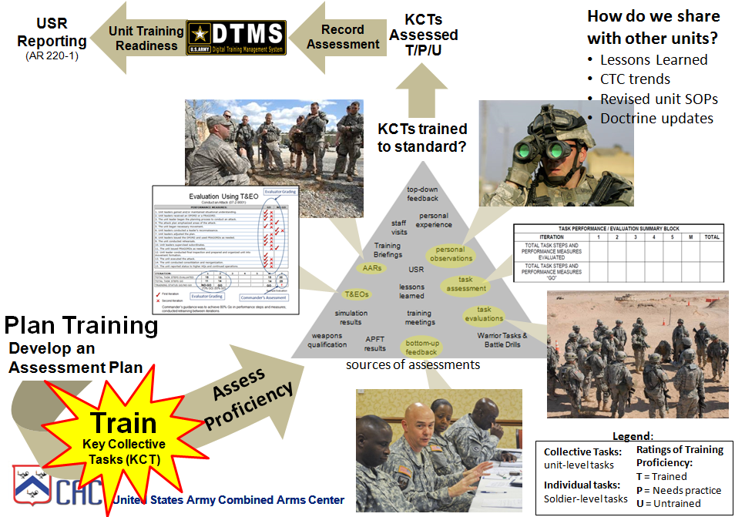
Conduct Unit Training
IAW Troop Leading Procedures (TLP)
Notes:
NOTE FOR INSTRUCTOR/FACILITATOR
The information contained in this class comes out of a TWO day MTT Course compressed into a two hour class.
You can prepare by login into:
UTM Tutorial for Company and Below Training:
https://atn.army.mil/dsp_template.aspx?dpID=461

Slide 3
Terminal Learning Objective
ACTION: | Recommend Dismounted Counter-IED Training to Unit Leaders
CONDITION: | In a classroom or field environment, acting as a CIED member of a team tasked to prepare a unit maneuver training plan. Also tasked to plan a tactical mission. Given proper Counter IED enablers. Given multimedia presentation, with references including ADP and ADRP 7-0 Training Units and Developing Leaders, rubrics, and access to DTMS, UTM and ATN.
STANDARD: | Recommend D-CIED training IAW Chapter 10, ATTP 5-0.1, Ch. 6, ADRP 6-22, Instructor facilitation skills rubric, ADRP 7-0, Ch. 3, paragraph 3-33 to 3-68 including the eight steps of the TLP and tactical missions must be planned IAW TLP as listed in Ch. 10, FM 6-0 and must score 80% or better on examinations/tests and includes: 1. Apply Instructor/Facilitator Facilitation Skills. 2. Conduct a Unit Mission. Learning Domain: Cognitive Level of Learning: Synthesis
3
Notes:
NOTE.
The standard reflects the lesson ELOs:
ELO A = 1. Apply Instructor/Facilitator Facilitation Skills.
ELO B = 2. Conduct a Unit Mission.
This presentation covers ELO A only.

Slide 4
ELO B – LSA 1
ACTION: | Plan a Unit Mission
CONDITION: | In a classroom or field environment, acting as a CIED member of a team tasked to prepare a unit maneuver training plan. Also tasked to plan a tactical mission. Given proper Counter IED enablers or equipment. Given multimedia presentation, with references including ADP and ADRP 7-0 Training Units and Developing Leaders, rubrics, and access to DTMS, UTM and ATN.
STANDARD: | Plan unit training missions and unit tactical missions IAW ADRP 7-0, chapter 3, paragraph 3-33 to 3-68 including the eight steps TLP, chapter 10 of FM 6-0, and chapter 6 of ADRP 6-22 and must score a minimum of 80% in tests assessed with rubrics and includes: 1. Conduct Unit Training IAW TLP. 2. Plan a Tactical Mission IAW TLP. Learning Domain: Cognitive Level of Learning: Analysis
4
Notes:
NOTE.
This presentation only covers LSA 1 of ELO B only (Conduct Unit Training IAW TLP).

Slide 5
Plan Company-level Training
What is a Unit Training Plan (UTP)?
The UTP lays out a series of training events, a road map, that leads the unit to achieve the objective of training proficiency in select collective tasks.
In training, the UTP aims at achieving unit training proficiency and leader development within a given period.
It may include a unit training calendar that depicts the unit’s major training events and the sequence in which they will be executed
The written plan resulting from TLP Step 3 –COA becomes the UTP
NOTE. May show a 4 minute Unit Training Plan UTP Video included in the CD
Reference ADRP 7-0, page 3-6
Notes:
NOTE. You may show the 4 minutes Unit Training Plan video prior to covering this PPT slide. Find the video is under video tab of the course CD also at:
https://atn.army.mil/dsp_template.aspx?dpID=446
This video presents and overview of what a Unit Training Plan is.
What is your understanding of a Unit Training Plan (UTP)?
Reference ADRP 7-0, peg. 3-6, paragraph 3-30.
The written plan resulting from COA development is the unit training plan. The UTP is similar to
planning a major operation in that it is aimed at achieving strategic and operational objectives within a
given time and space. In training, the UTP aims at achieving unit training proficiency and leader
development within a given period. The UTP lays out a series of training events—a roadmap—that leads
the unit to achieve the objective of training proficiency in select collective tasks. As part of the UTP, the
unit can include a unit training calendar that depicts the unit’s major training events and the sequence in
which they will be executed.
We will talk about the Eight Steps of the Troop Leading procedures next..

Slide 6
Eight Step Troop Leading Procedures (TLP)
TLP is the planning process at company & below
Informal compared to MDMP used at BN & Higher
Troop Leading Procedures 4 PHASES OF UNIT TRAINING EVENTS
Receive the Mission
Issue a Warning Order
Make a tentative plan
Initiate movement
5. Conduct reconnaissance
6. Complete the plan
7. Issue the order
8. Supervise and refine
PLAN
PREPARE
EXECUTE & ASSESS
NOTE. May show a 10 minute Plan and Conduct Training Video included in the CD
Notes:
NOTE. The following information is the TLP a summary for instructor preparation purposes
1. You may show the 10 minutes Unit Training Plan video prior to covering this PPT slide. Find the video is under video tab of the course CD also at:
https://atn.army.mil/dsp_template.aspx?dpID=446 . This video presents and overview of how companies conduct training event using the 8 step TLP.
2. As you Recall, TLP is the process used at company and below.
3. Depicted in this slide are the eight steps of the TLP.
4. We will cover each TLP step in detail during this class. Keep in mind that this class covers all of the information listed in the “Develop a Unit Training Program” Rubric.
5. At the end of this class we will talk some more about a homework and the rubric associated to evaluate the same.
6. The Eight steps TLP for developing a UTP are:
STEP 1. Receive the Mission: Usually received as a WARNORD via DTMS. Confirmation brief to higher. Specified and implied tasks, time available, commander's intent. Ensure subordinates have adequate training time. (1/3-2/3 rule, for example)
STEP 2. Issue WARNORD: As detailed as necessary. Provided subordinates the mission and collective tasks to train. Five paragraph OPORD format.
STEP 3. Make a Tentative Plan: Mission Analysis - Tasks to train, OE to replicate, resources needed, training limitations. COA Development - Using mission analysis and strategies (CATS). Stored in DTMS, sent to subordinates as needed. Conduct leader dialogue. Higher commander approves or modifies plan.
STEP 4. Initiate Movement: Once plan is approved, unit begins actions to execute.
STEP 5. Conduct Reconnaissance: Ranges, maneuver space, simulations, simulators, and facilities.
STEP 6. Complete the Plan: Leaders make final updates. This is done before sending final plan to subordinates.
STEP 7. Issue the Order: Small units issue verbally, use FRAGORDs as necessary. Companies use DTMS. Orders follow five paragraph format.
STEP 8. Supervise and Refine: Training meetings ensure plans are on track.

Slide 7
Group Work Instructions – Option 2
Allow 30 minutes to research assigned TLP step material & prepare to present. (Be prepared to present at ________ hour)
2. Each group has10 minutes total to present the assigned step/s
GROUP 1 Task. Brief TLP Step 1 and Step 2
GROUP 2 Task. Brief TLP Step 3 (Mission Analysis)
GROUP 3 Task. Brief TLP Step 3 (COA development – Analysis – Approval)
GROUP 4 Task. Brief TLP Steps 4 thru Step 8
References: (SEE YOUR CDs)
PPT presentations 2. RUBRIC - Unit Training Program 3. ADRP 7-0, page 3-7 to 3-1
4. FM 6-0 CH 10 5. Leaders Guide to Unit Training Meetings
Notes:
NOTE.
Use this slide ONLY if you chose OPTION 2 to conduct the class.
Make sure that you have on hand hard copies of the slides for each team. Also ensure that they have access to the other references listed in the course CD.
Option 2 Timeline
1st HOUR
30 Min – Introduction, present TLO/ELOs, UTP Video and UTP slide
Min – Group research assigned TLP step material and prepare to present
10 Min – Break
2d HOUR
10 Min – (Cont) Group research assigned TLP step material and prepare to present
40 Min – Student presentation of assigned TLP Steps (10 min per group x 4 groups = 40 min)
10 Min - Break
2.5 HOUR
15 min – Instructor comments/ input on student presentations
10 Minutes AAR Video
5 min summary

Slide 8
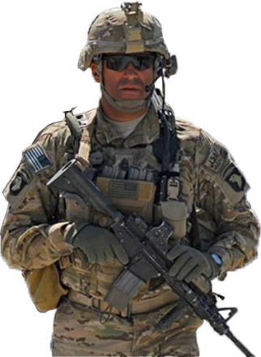
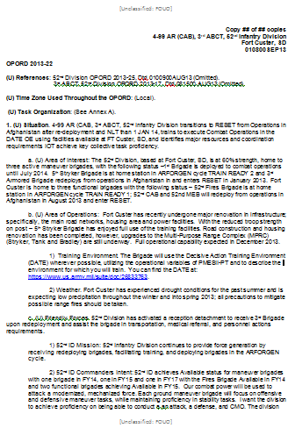
TLP Step 1 - Receipt of Mission
The commander receives a FRAGO, WARNO or OPORD from higher
Battalion OPORD (UTP)
What actions must be completed during step 1?
  Confirm the Key Collective Tasks to train (KCT)s
  Parallel planning 1/3, 2/3 rule
  Identify Resources needed
  Gather tools
Notes:
What actions must be completed in TLP Step 1?
The tasks that must be completed during this step in the process are the following:
Confirm the Key Collective Tasks to train (KCT)s
Conduct Initial Assessment (review KCTs and Assessments)
Issue the Commander’s Initial Guidance
NOTE. The following information is the TLP a summary for instructor preparation purposes.
Reference. 2013 Leaders Guide to Unit training, paragraph 2-3 to 2-10.
On this condensed timeline, the commander initiates this step at about T-12 to T-8 in order to ensure all resources are coordinated for the event.
The commander and selected leaders begin the mission analysis process by reviewing and analyzing the tasks the unit must be able to perform with enough time to adequately plan and prepare for the event.
On this condensed timeline, the commander initiates this step at about T-12 to T-8 in order to ensure all resources are coordinated for the event.
The commander, and selected leaders begin the mission analysis process by reviewing and analyzing the tasks the unit must be able to perform with enough time to adequately plan and prepare for the event.

Slide 9
TLP Step 1, Receipt of Mission (cont.)
From the initial event training objective (from UTP) – confirm the key collective task(s) to train.
The actions that must be completed during step 1 are:
  Confirm the Key Collective Tasks to train (KCT)s
  Parallel planning 1/3, 2/3 rule
  Identify Resources needed
  Gather tools
17 – 21 February 2015
STX, Reconnaissance Troop, Training Objective
Task Focus (KCT)s:
Conduct Route Reconnaissance (17-2-4000)
Integrate Indirect Fire Support (07-2-3036)
Conditions: A ‘walk’ event, the troop demonstrates proficiency in tactics, techniques, procedures and SOP for route reconnaissance in a live environment. The environment is continuous, in both day and night, and in various MOPP levels.
Standard: The company conducts operations IAW SOP, the order, and higher guidance. Achieve satisfactory performance (85% T&EO go) on KCTs.
Evaluation: Company Internal (Commander or designate representative).
Individual: Demonstrated ability to perform Warrior Tasks and Battle Drills as part of a team.
Collective: Achieve 85% ‘go’ on the KCT Training and Evaluation Outline (T&EO) performance standards.
Leader: Demonstrated ability to make sound tactical decisions enabling unit battlefield success.
Example Training Objectives
Notes:
NOTE. The following information is the TLP a summary for instructor preparation purposes.
Reference. 2013 Leaders Guide to Unit Training Management, paragraph 2-16.
Key Collective Tasks (KCT) are those essential tasks expressed as collective tasks that the unit must perform to the Army standard to achieve the desired training mission end-state. KCTs are derived through mission analysis, approved by the higher commander and provide the unit focus for attaining training proficiency.

Slide 10
TLP Step 1, Receipt of Mission (Cont)
Parallel Planning
Use no more 1/3 of the time for planning and issuing subordinate WARNO
Allocate 2/3 of the time for subordinates to plan their own training
The actions to be completed in step 1:
  Confirm the Key Collective Tasks to train (KCT)s
  Parallel planning 1/3, 2/3 rule
  Identify Resources needed
  Gather tools
Identify Resources
Facilities
Vehicles
Weapons
TADSS
Ammunition types/quantities
Projected fuel consumption
Observer controller
OPFOR
Gathered the tools needed
i.e. SOPs, manuals, online resources, CIED resources, etc.
Notes:
TADSS = Training Aids, Devices, Simulators, and Simulations
NOTE. The following information is the TLP a summary for instructor preparation purposes.
1. Parallel Planning: Reference ADRP 7-0, paragraph 3-38. Generally, leaders at all levels use no more than one-third of the training time available for planning and issuing their operation order (OPORD).
They allocate two-thirds of the time remaining for subordinates to plan their own training.
2. One-Third, Two Thirds Planning Method: Reference Dec 2013 Leaders Guide to Unit training, paragraph 2-9.
This assessment primarily identifies an initial allocation of available planning time. The commander and staff balance the desire for detailed planning against the need for immediate action. The commander provides guidance to subordinate units as early as possible to allow subordinates the maximum time for their own planning and preparation of operations. As a rule, commanders allocate a minimum of two-thirds of available time for subordinate units to conduct their planning and preparation. This leaves one-third of the time for commanders and their staff to do their own planning. They use the other two-thirds for their own preparation. Time, more than any other factor, determines the detail to which the commander and staff can plan. Based on the commander’s initial allocation of time, the COS (XO) develops a staff planning timeline that outlines how long the headquarters can spend on each step of the MDMP.
3. Identify Unique or Scarce Training Resources: Reference Dec 2013 Leaders Guide to Unit training, paragraph 2-32.
After identifying, analyzing and assessing the proposed KCTs, commanders determine the availability of scarce or unique training resources required to train the KCTs to a “T” assessment. An excellent source for this information can be found in CATS. In the CATS report (the Combined Report on ATN, or the AC or RC report for a Task Selection (TS) on DTMS) generalized figures are provided for equipment, classes of supply, etc that support specific training events. These figures provide a starting point to apply the realities of the local, home station training environment.
4. Gather the Tools: Reference Dec 2013 Leaders Guide to Unit training, paragraph 2-5.
Once notified of the new planning requirement, the staff prepares for mission analysis by gathering the necessary “tools”. These tools include, but are not limited to:
Appropriate manuals, including ADP 7-0, ADRP 7-0, The Leader’s Guide to Unit Training Management (UTM), etc.
All documents related to the training mission including the higher headquarters” WARNO, etc.
Both their own and the higher headquarters’ training SOPs.
Access to training enabler websites – as a minimum ATN, CATS (to include the CATS planning tool on DTMS), DTMS, and HQ DA Standardized METL Viewer.

Slide 11
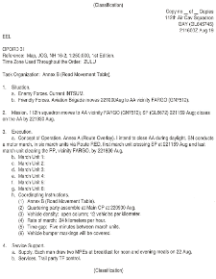
TLP Step 2, Issue a Warning Order
What should the Warning Order include?
  The training mission, OE and the KCTs to train
  The time and place for issuing the order
  Units/elements participating in the training
  Specific tasks not addressed by unit standard operating procedures (SOP)
  The Commander / Platoon Leader Initial Guidance (Planning timelines and guidance)
The WARNO facilitates parallel planning
Company
WARNO
Notes:
What should the Warning Order include?
The training mission, OE and the KCTs to train
The time and place for issuing the order
Units/elements participating in the training
Specific tasks not addressed by unit standard operating procedures (SOP)
The Commander / Platoon Leader Initial Guidance (Planning timelines and guidance)
Why is it important to issue a warning order to subordinated as soon as possible?
The WARNO facilitates parallel planning, enabling subordinate units to gather information, start TLP and enable planning coordination and collaboration.
NOTE. The following information is the TLP a summary for instructor preparation purposes.
1. Issue a warning order: Reference ADRP 7-0 paragraph 3-39. As soon as leaders complete their initial assessment of the situation and available training time, they
issue a WARNO to subordinate elements. The WARNO is as detailed as needed. It provides subordinates
the unit training mission as well as the collective tasks that the unit will need to train. It will also include
the training timeline to attain unit task proficiency. As more information becomes available, leaders may
issue additional WARNOs to provide better details to aid in subordinate element training plans.
2. WARNOs follow the five-paragraph OPORD format.

Slide 12
TLP Step 3, Make a Tentative Plan
  Assess the KCTs (Analyze BN WARNORD)
  Identify the Operational Environment (OE)
  Identify unique/scarce resources
  Identify the Planning Horizon
  Identify training risks
  Unit restated mission (using CDR’s Dialogue)
  Course of Action Development
  Course of Action Analysis
  Obtain COA Approval
Notes:
NOTE. The following information is the TLP a summary for instructor preparation purposes.
We will cover each of the nine bullets in the next few slides

Slide 13
How are Key Collective Tasks (KCT)
Assessed?
Determine
Specified Tasks
Written in the order
Implied Tasks
Essential Tasks
Additional tasks not written, but implied (must do also)
The few, specified/implied tasks that must be done to achieve the mission
WARNORD
Analysis
Analysis
Essential tasks become the unit’s Key Collective Tasks
    Derive task name and number for KCT
The remaining specified and implied tasks are supportive to the essential tasks (now KCTs)
Notes:
NOTE. The following information is the TLP a summary for instructor preparation purposes.
1. IOT to determine what tasks a unit must train, commanders analyze the higher WARNORD or OPORD just as they would during operations.
2. First, Identify the specified tasks. A specified task is a task specifically assigned to a unit by its higher headquarters. Paragraphs 2 and 3 of the higher headquarters WARNORD and estimates state specified tasks. Some tasks may be in paragraphs 4 and 5. Specified tasks may be listed in annexes and other attachments. They may also be assigned verbally during collaborative planning sessions or in directives from the higher commander.
3. Further analysis is required to identify implied tasks. An implied task is a task that must be performed to accomplish a specified task or mission but is not stated in the higher headquarters order. Implied tasks are derived from a detailed analysis of the higher headquarters order, the projected operational environment, the terrain, and civil considerations. Additionally, analysis of doctrinal requirements for each specified task might disclose implied tasks.
4. Once staff members have identified specified and implied tasks, they ensure they understand each task’s requirements and purpose. Once accomplished, the staff then looks for essential tasks. An essential task is a specified or implied task that must be executed to accomplish the mission. Essential tasks are always included in the unit’s mission statement.
5. Essential tasks now become the units are Key Collective Tasks (KCT) and are used to focus training and achieve the proficiencies required for mission success.
6. It is important to note that the remaining specified and implied tasks must be dealt with in the unit’s order, in the tasks to subordinate units, coordinating instructions, etc.., but also serve well as supportive tasks to the KCTs
7. Assess the KCTs (Analyze BN WARNORD): Reference Dec 2013 Leaders Guide to Unit training, paragraph 3-4. When developing COAs, commanders begin by assessing the KCTs. This includes making a current assessment now, again when training begins, and then project assessments at critical points on the planning horizon. This provides the commander an understanding of KCT proficiencies at selected points along the planning horizon. For example, an ARFORGEN unit redeploying will consider the state of the KCTs at the end of the RESET cycle, at TRAIN/READY, etc which may be months away.

Slide 14
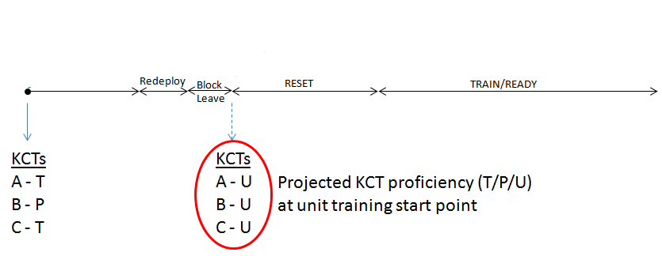
Assess the KCT (cont.)
Commander conducts an initial assessment of the selected KCTs
  Conducts a current and projected assessment of the KCTs
  (now and at the projected training start point)
Helps frame the current state of KCT proficiencies now
and what they may be when unit training begins
14
Notes:
NOTE. The following information is the TLP a summary for instructor preparation purposes.
Reference Dec 2013 Leaders Guide to Unit training, paragraph 2-29.
1. For the current assessment, the commander, using bottom-up feedback from subordinates, personal experience and observations, inspection results, and other inputs makes an assessment [T (Trained), P (Needs Practice), or U (Untrained)] of each of the proposed KCTs. This gives the commander a sense of where the unit stands with regard to current training readiness. It also gives him a sensing of the effort, time and resources it will take to get the unit to a “T” assessment at the end of the planning horizon.
2. Paragraph 2-30. The projected assessment is the commander’s “best guess” at the T-P-U rating of the KCTs when training is anticipated to begin and at various point along the planning horizon. Proficiency in the KCTs may be significantly different now than at the start of training. Weeks and months may separate the training readiness of the KCTs in that time. Keeping in mind that at this point in mission analysis, the KCTs have not yet been approved by the higher commander. Once the KCTs are approved in the Commanders’ Dialogue, the projected assessment of the KCTs represents a bench mark for the further development of a Course of Action (COA).
3. Paragraph 2-32. After identifying, analyzing and assessing the proposed KCTs, commanders determine the availability of scarce or unique training resources required to train the KCTs to a “T” assessment. An excellent source for this information can be found in CATS. In the CATS report (the Combined Report on ATN, or the AC or RC report for a Task Selection (TS) on DTMS) generalized figures are provided for equipment, classes of supply, etc that support specific training events. These figures provide a starting point to apply the realities of the local, home station training environment.
4. Paragraph 2-34. Training risk is not a consideration of personnel safety, but determining the risk in not having sufficient training time, or not having the unique or scarce resources necessary to achieve KCT proficiency. Identifying these “show stoppers” during mission analysis is important because it represents potentially significant road blocks to accomplishing mission proficiency.

Slide 15
TLP Step 3 Make a Tentative Plan (cont.)
  Assess the KCTs (Analyze BN WARNORD)
  Identify the Operational Environment (OE)
  Identify unique/scarce resources
  Identify the Planning Horizon
  Identify training risks
  Unit restated mission (using CDR’s Dialogue)
  Course of Action Development
  Course of Action Analysis
  Obtain COA Approval
Notes:
NOTE. Next we will talk about Identifying the Operational Environment (OE)

Slide 16
What do you understand as
Operational Environment (OE)?
1) Training Environment. The battalion will use the Decisive Action Training Environment (DATE) wherever possible, utilizing the operational variables of PMESII-PT and to describe the environment for which you will train.
OE encompasses all the variables that affect where Soldiers will train or fight
Must be appropriate for the training objectives
The goal is to create training conditions that replicate as closely as possible actual conditions of the specific OE
The unit may need to train in any of a number of possible OEs IOT accomplish its core capabilities
Ref. TC 7-101, Exercise Design Chapter 3
https://www.us.army.mil/suite/doc/26833763
Notes:
NOTE. The following information is the TLP a summary for instructor preparation purposes.
Reference. TC 7-101, Exercise Design Chapter 3.
Para. 3-1. An OE is the complete set of conditions, circumstances, and influences that affect the decisions of the unit commander and the deployment and employment of military forces, as well as other instruments of national power. It encompasses all the variables that affect where Soldiers will train or fight.
Para. 3-2. The OE represented in a training event must be appropriate for the training objectives. What constitutes a realistic and relevant OE for a particular training event depends on how much the unit knows about where it can expect to be deployed. On the one hand, the unit may know the specific area of operations (AO) where it will deploy or be able to anticipate such a specific deployment. In that case, the goal should be to create training conditions that replicate as closely as possible the actual conditions of the specific OE associated with that AO. On the other hand, the unit may need to train to accomplish its core capabilities in any of a number of possible OEs. In that case, it is appropriate to design an OE that represents a composite of the types of conditions that might exist in a number of actual OEs in which the unit might find itself involved in full spectrum operations.

Slide 17
TLP Step 3 Make a Tentative Plan (Cont)
  Assess the KCTs (Analyze BN WARNORD)
  Identify the Operational Environment (OE)
  Identify unique/scarce resources
  Identify the Planning Horizon
  Identify training risks
  Unit restated mission (using CDR’s Dialogue)
  Course of Action Development
  Course of Action Analysis
  Obtain COA Approval

Slide 18
What are some examples of resources?
Is described in the higher unit order
  Unique resources necessary to train to KCT proficiency:
Situation
b. (U) Area of Operations: Fort Custer has recently undergone major renovation in infrastructure; specifically, the main road networks, housing area and power facilities. Upgrades to the Multi-Purpose Range Complex (MPRC) (Stryker, Tank and Bradley) are still underway. Full operational capability expected in March 2014.
  MPRC
  Role players
  DATE train the trainer
  instructors
  MOUT Site
  Rail Spur – rail operations training
1) Training Environment. The Battalion will use the Decisive Action Training Environment (DATE) wherever possible, utilizing the operational variables of PMESII-PT and to describe the environment for which you will train.
Intelligence Running Estimate
6) Infrastructure: While the region’s five countries have a significant number of rural residents, the majority of each country’s population lives in urban areas.
**Does not include normal classes of supply
Concept of Operations
b. (U) Concept of Operations. The UTP will follow the ARFORGEN cycle beginning at RESET and ending when the Battalion enters AVAILABLE. The training end state is achieved when the battalion is KCT proficient, manned, equipped, trained and prepared to deploy and conduct combat operations. The decisive operation for the unit is when we execute the Culminating Training Event (CTE)at the National Training Center NLT December 2015.
18
Notes:
NOTE. The following information is the TLP a summary for instructor preparation purposes.
1. Start identifying resources that are described in the higher unit order
Critical to achieving KCT proficiency. Typically unique or scarce resources are those not readily available, or difficult to secure.
2. Categories of unique/scarce training resources:
Not on home station
Not easy to obtain (schedule)
Special ranges and facilities
3. Does not include normal classes of supply - assuming these are readily available and ordering/scheduling is done in time for training to begin. These will be accounted for as the unit identifies and plans individual training events.

Slide 19
TLP Step 3 Make a Tentative Plan (Cont)
  Assess the KCTs (Analyze BN WARNORD)
  Identify the Operational Environment (OE)
  Identify unique/scarce resources
  Identify the Planning Horizon
  Identify training risks
  Unit restated mission (using CDR’s Dialogue)
  Course of Action Development
  Course of Action Analysis
  Obtain COA Approval
Notes:
NOTE. Next we will talk about Identifying the Planning Horizon

Slide 20
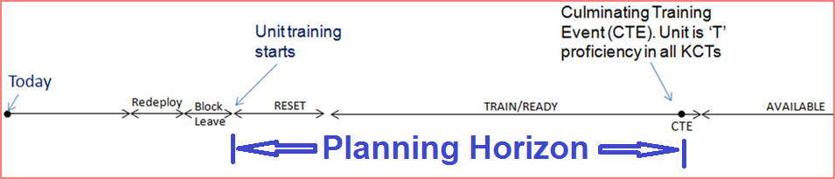
Determine the Planning Horizon
Concept of Operations.
Once the battalion has achieved AVAILABLE in the ARFORGEN cycle, anticipate receipt of deployment guidance – we will issue OPORDs and FRAGORDs as required
(1) Timelines:
a. Planning: MDMP complete and battalion UTP OPORD issued NLT 1 DEC 13.
b. ARFORGEN (Planning horizon): Cycle begin dates:
RESET – 1 JAN 14
TRAIN/READY - 1 APR 14
AVAILABLE – 1 JAN 15
Defines how long the unit has to train to become KCT proficient
A simple calendar format depicting the planning horizon is an excellent starting point to begin this process
20
Notes:
NOTE. The following information is the TLP a summary for instructor preparation purposes.
1. Lay-out the Planning Horizon Reference Dec 2013 Leaders Guide to Unit training, paragraph 3-6. Understanding the planning horizon is extremely important as planning begins. Once planners begin to apply the actual days available to train a COA, it will become evident that time is the greatest restricting factor when it comes to planning unit training. Planners have to contend with installation/command time management cycles, resource and facilities constraints, limited classes of supply, etc. Additionally, the unit will have to compete with other units on the installation, all vying for the same limited resources. A simple calendar format depicting the planning horizon is an excellent starting point to begin this process. The CATS planning tool in DTMS can help visualize the planning horizon across time.
2. Planning Horizon (the time available to train (i.e., ARFORGEN cycle, or as directed by the commander)
An ARFORGEN unit’s generic planning horizon is outlined by type-unit in it’s ARFORGEN Training Template (available on ATN)
In ARFORGEN unit’s the time to train is dictated by the Army’s standardized ARFORGEN time cycle
In Non-ARFORGEN units the commander determines when he would like the unit to be proficient in the selected KCTs

Slide 21
TLP Step 3 Make a Tentative Plan (cont.)
  Assess the KCTs (Analyze BN WARNORD)
  Identify the Operational Environment (OE)
  Identify unique/scarce resources
  Identify the Planning Horizon
  Identify training risks
  Unit restated mission (using CDR’s Dialogue)
  Course of Action Development
  Course of Action Analysis
  Obtain COA Approval
Notes:
NOTE. Next we will talk about Identifying training risks

Slide 22
What type of risk assessment should be identified?
Situation
(U) Area of Interest: The 52nd Division, based at Fort Custer, SD, home to three active maneuver brigades, with the following status –1st Brigade is deployed to combat operations until July 2014. 5th Stryker Brigade is at home station in ARFORGEN cycle Train Ready. 3rd Armored Brigade redeploys from operations in Afghanistan in and enters RESET in January 2014.
(U) Area of Operations: Fort Custer has recently undergone major renovation in infrastructure; specifically, the main road networks, housing area and power facilities. Road construction and housing renovation has been completed, however, upgrades to the heavy range complex (Stryker, Tank and Bradley) are still underway. Full operational capability expected in March 2014. The Mission Command Training Center (MCTC) is undergoing construction, and simulations will not be available – completed NLT February 2015.
  EXAMPLE
  Non-availability of training sites may impact the time available to train certain KCTs/ supporting tasks
  Risk involved with insufficient training time or resources necessary to achieve KCT proficiency
  **These are not safety risk considerations
22
Notes:
NOTE. The following information is the TLP a summary for instructor preparation purposes.
Determine Training Risk. Reference. 2013 Leaders Guide to Unit Training Management, paragraph 2-34. Training risk is not a consideration of personnel safety, but determining the risk in not having sufficient training time, or not having the unique or scarce resources necessary to achieve KCT proficiency. Identifying these “show stoppers” during mission analysis is important because it represents potentially significant road blocks to accomplishing mission proficiency.

Slide 23
TLP Step 3 Make a Tentative Plan (cont.)
  Assess the KCTs (Analyze BN WARNORD)
  Identify the Operational Environment (OE)
  Identify unique/scarce resources
  Identify the Planning Horizon
  Identify training risks
  Unit restated mission (using CDRs’ Dialogue)
  Course of Action Development
  Course of Action Analysis
  Obtain COA Approval
Notes:
NOTE. Next we will talk about Unit restated mission using the CDR’s Dialogue.

Slide 24
TLP Step 3 Make a Tentative Plan (cont.)
Commanders’ Dialogue
  Step 3 Make a Tentative Plan
  Assess the KCTs (Analyze BN WARNORD)
  Identify the Operational Environment (OE)
  Identify unique/scarce resources
  Identify the Planning Horizon
  Identify training risks
A CO KCT |  | Current Assessment | Projected Assessment
Task Name | Number
Conduct Area Security (Platoon – Company) | 07-2-1324 | P | U
Conduct an Attack (Platoon - Company) | 07-2-9001 | P | U
Conduct a Defense (Platoon - Company) | 07-2-9003 | P | U
Planning Horizon:
a. Planning: UTP OPORD issued NLT 1 DEC 13; Co UTP
NLT 10 DEC 13.
b. ARFORGEN (Planning horizon): Cycle begin dates:
RESET – 1 JAN 14
TRAIN READY – 1 APR 14
Available – 1 JAN 15
  Risks:
  Risks involved with insufficient training time or resources necessary to achieve task proficiency:
  Availability of MPRC may reduce time available to train
  Experience Based Risk Considerations:
  Sufficient time due to lack of experience in attack and defend tasks
  De-synchronization of NET and NEF
  Personnel turmoil
  Unit restated mission
  (using CDR’s Dialogue)
  Training Environment to replicate the Operational Environment.
  Replicate DATE Scenarios
  Utilize Role Players
  Utilize Live, Virtual, Constructive and Gaming (L,V,C,G) environments to maximize training
Unique resources necessary to train to achieve task proficiency:
MPRC
Role players
DATE train the trainer instructors
MOUT Site
Rail Spur – Rail Operations Training
Next step is to develop a plan to train the unit
Notes:
NOTE. The following information is the TLP a summary for instructor preparation purposes.
Unit restated mission using the Commanders’ Reference. 2013 Leaders Guide to Unit Training Management,
1. Paragraph 2-37. The Commanders’ Dialogue is the back-brief and discussion of the results of mission analysis to the higher commander. It is the briefing in which the two commanders agree to the tasks the unit will train to meet mission requirements. At the conclusion of this briefing, the higher commander approves or modifies the proposed KCTs. Specifically, the two commanders discuss:
Proposed KCTs
Current & future KCT assessments
Review planning horizon (time available to train)
Operational Environment (OE) to replicate in training
Unique, or scarce resources needed to train
Potential training risks (not safety risk)
Any training readiness issues
Now its time for the unit’s RESTATED MISSION
Paragraph 2-38. The dialogue can often take up to two hours. The majority of the time will focus on the KCTs and identified training risks since those areas will require mutual understanding between the two commanders. Formal dialogues are conducted at the company-level and above. Below company-level, a dialogue occurs between the company commander and platoon leaders, and between platoon leaders and squad leaders. At these levels, the dialogue should cover the same discussion points.
3. Paragraph 2-39. Now that the Commanders’ Dialogue is complete and the unit KCT’s are approved by the higher commander, the next step in the UTM process is to develop a plan to train the unit.

Slide 25
Restated Company Mission
A mission statement is?
A clear short sentence or paragraph
Describes the organization’s essential tasks-KCT & purpose
Answers the 5Ws: Who; What; When; Where; Why
EXAMPLE OF A MISSION STATEMENT
(when) NLT 020400OCT15, (who) 1-32 CAB trains (where) at Fort Custer in a Decisive Action Training Environment (DATE) (why) to achieve proficiency in selected KCTs; (what) Conduct MTC, Conduct an Attack, and Conduct a Defense IOT deploy NET 02OCT16 to conduct operations.”
Ref. Ldrs Guide to UTM
Notes:
NOTE. The following information is the TLP a summary for instructor preparation purposes.
Unit restated mission using the Commanders’ Reference. 2013 Leaders Guide to Unit Training Management page 58. Mission. State the unit’s mission – a short description of the, who, what (task), when, where, and why (purpose) that clearly indicates the action to be taken and the reason for doing so (always include the KCTs in the mission statement, as they are the essential tasks to be trained). Seldom specifies the “how”

Slide 26
TLP Step 3 Process
Step 3: Make a Tentative Plan
  Analyze the Battalion WARNORD
  Assess the KCTs
  Identify the Operational Environment (OE)
  Identify the Planning Horizon
  Identify unique/scarce resources
  Identify training risks
  Commanders’ Dialogue
  Unit restated mission
  Course of Action Development
  Course of Action Analysis
  Obtain COA Approval
Notes:
NOTE. Next we will talk about Course of Action Development.

Slide 27
COA Development
COA development focuses on answering three fundamental questions:
  What training events to train?
  What sequence should those events occur?
  At what frequency should the events be trained?
27
Notes:
NOTE. The following information is the TLP a summary for instructor preparation purposes.
Unit restated mission using the Commanders’ Reference. 2013 Leaders Guide to Unit Training Management:
Chapter 3, Develop a Plan to Train the Unit . This chapter describes how training managers develop the best Course of Action (COA) to train the unit. At the conclusion of COA development, the unit commander selects the best COA to train and briefs the plan to the higher commander who approves it at the Training Briefing (TB). The approved COA then becomes the Unit Training Plan
Paragraph 3-25. COA development not only focuses on the KCTs which are directly tied to the mission, but is built around multiechelon training. The primary goal of each COA is about training the entire organization to KCT proficiency over time (planning horizon). Multiechelon training is described as a technique that allows for the simultaneous training of multiple echelons during a training event. Because of this, COA development does not focus on the internal tasks, or training that a single unit chooses to train. COA development from top to bottom, COA development creates a “cascading” effect, depicting only those training events subordinate units are required to participate in. For example, the inclusion of unit internal training events in a COA will visually consume all potential ‘white space’ on a planning calendar. This significantly limits the available training time for subordinate units to plan and develop their own COAs causing a “cluttered” effect at each succeeding echelon. (UTP). The product of this process answers the question: “how will the unit train?”
Paragraph 3-45. When it has been decided which events the unit will train and the recommended frequency of each, the staff can begin to chronologically sequence/arrange those events on a base training calendar (depiction of the planning horizon). The planning concepts and considerations discussed in Section I guide the planner through this process. The calendar provides a visual representation of the developing training COA. The calendar is also invaluable to subordinate units who can visually identify not only the higher HQ multiechelon training events they must participate in, but also visually identifies the available “white space” they can schedule their own unit training.

Slide 28
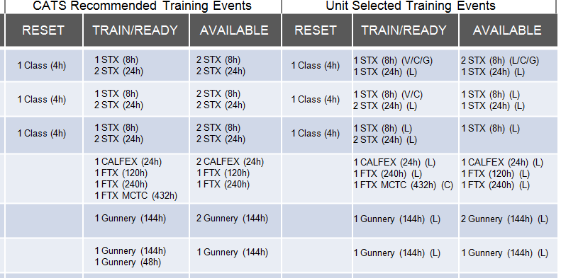
COA Development (cont.)
Determine the events you will and will not train
Determine the multi-echelon training events that train the KCTs
Determine the multi-echelon training events frequency
Virtual & Constructive
Live
Note: The Combined Arms Training Strategies (CATS) is a tool for developing training COAs
Notes:
NOTE. The following information is the TLP a summary for instructor preparation purposes.
Determine the events you will and will not train based on CATS recommended events, your experience, unit needs, scheduling requirements and what makes sense,. For example, 2 x STXs are recommended, but you believe that 1 x STX is sufficient. You make the call
Consider also that you may not be able to execute all events in a live training environment. This may be due to time available, resources available, or scheduling constraints. Live, Virtual, Constructive or Gaming (LVC-G) are the training environment options

Slide 29
TLP Step 3 Process
Step 3: Make a Tentative Plan
  Analyze the Battalion WARNORD
  Assess the KCTs
  Identify the Operational Environment (OE)
  Identify the Planning Horizon
  Identify unique/scarce resources
  Identify training risks
  Commanders’ Dialogue
  Unit restated mission
  Course of Action Development
  Course of Action Analysis
  Obtain COA Approval

Slide 30
COA Analysis (War Game)
What is the purpose of COA analysis?
  Identify major resources that require immediate coordination and/or
  Help from higher (includes the major resources to replicate the OE)
  Identify possible resource shortcomings
  Identify and de-conflict scheduling issues
  Identify decision points for the commander
NOTE. CATS is the best starting point to understand the resources needed to train the KCTs - and other training events
30
Notes:
NOTE. The following information is the TLP a summary for instructor preparation purposes.
1. COA Analysis Process
The purpose is primarily to synchronize the events to resources:
Focus on the major resources that require immediate coordination and/or help from higher headquarters to secure, identify when resource shortfalls may occur IOT recommend decision points to the commander.
2. Consider the major resources:
Land, facilities, ranges
Ammo, TADSS and other major resources
OPFOR, Role Players, MSELs
Units availability (Red-Amber-Green) (Reset, TR1, TR2, available)
3. You can also consider:
Training Objectives (Are they being met or included for each event)
Information Requirements – (What are the decisions the commander needs to make and when)
WFFs (Coordination or resource considerations)
Mission Command
OE
4. Use the CATS events viewer and resourcing tool to gather information.

Slide 31
TLP Step 3 Process
Step 3: Make a Tentative Plan
  Analyze the Battalion WARNORD
  Assess the KCTs
  Identify the Operational Environment (OE)
  Identify the Planning Horizon
  Identify unique/scarce resources
  Identify training risks
  Commanders’ Dialogue
  Unit restated mission
  Course of Action Development
  Course of Action Analysis
  Obtain COA Approval
Notes:
NOTE. Next we will talk about Course of Action Approval.

Slide 32
COA Approval
What occurs at the Training Briefing (TB)?
CO CDRs brief the BN CDR to obtain approval of their company’s COA
The BN CDR then briefs Brigade CDR
Results in a ‘contract’:
The subordinate commander agrees to execute the COA
The higher commander agrees to support the COA with the resources necessary to train
32
Notes:
NOTE. The following information is the TLP a summary for instructor preparation purposes.
The Training Briefing results in a ‘contract’ between the higher commander and the subordinate commander. This ‘contract’ is a concurrence by the higher commander on the following:
The key collective tasks to train (with assessment)
Risks and mitigation (as necessary)
Concept of the operation-Training COA
Collective Training
Leader Development
Unique resources and coordination required
Planning horizon
Typically, company command teams brief the battalion commander to obtain approval of the company COA.
The battalion commander provides the formal brief to the senior commander (brigade or higher). All company command teams are present at the TB.
Most units do QTB/YTBs to manage execution and resourcing after the plan is approved at the Training Briefing- the frequency is the call of the commander

Slide 33
COA Approval (cont)
What is the purpose of the Training Brief?
Primary focus is on how the unit will attain mission (KCT) proficiency within the planning horizon
All other training issues are secondary and briefed at the discretion of the commander(s)
See The Leader’s Guide to UTM, chapter 3, section II
33
Notes:
NOTE. The following information is the TLP a summary for instructor preparation purposes. See The Leader’s Guide to UTM, chapter 3, section II
This is an example of what is briefed:
Higher headquarters mission
Operational Environment (OE)
Unit mission
Key Collective Tasks (KCT)
Commander’s intent
Concept of the Operations
Decisive Operations (COA)
Shaping Operations #1 (individual training)
Shaping Operations #2 (leader development)
Key training events
Time management cycle
Tasks to subordinate units
Assessment plan
Key resources required
Training risk (time/resources to train)
Training challenges
CSM/1SG briefs the current and projected status of:
The unit’s individual through section training
Tasks nested with the unit’s collective tasks
MOS training
NCOES
Low Density MOS training
Other training topics specified by the higher commander.

Slide 34
TLP, Step 4 Initiate Movement
Begin Actions to Facilitate execution of the Plan
Planned pre-execution checks to ensure that:
Equipment is ready
Trainers are prepared (Rehearsals)
Prerequisite training
Training resources are coordinated
Leaders conduct initial risk management checks
Notes:
NOTE. The following information is the TLP a summary for instructor preparation purposes.
Step 4 – Initiate Movement (Reference - page 3-8, ADRP 7-0)
1. Paragraph 3-48. Once the higher unit commander has approved the plan, the commander directs subordinates to begin actions that facilitate execution of the plan.
2. Pre-Execution Checks (Reference - page 3-10, ADRP 7-0) . Paragraph3-63. Similar to pre-combat checks, pre-execution checks ensure that equipment is ready and serviceable, trainers are prepared, training support resources are coordinated and available, and leaders have conducted initial risk management checks. The training plan must allocate time for pre-execution checks.
3. Prerequisite Training. Commanders and leaders must determine the prerequisite training required to be proficient enough in the supporting and associated tasks required to conduct the training event. Once the plan is developed and prerequisite training is identified and assessed – the unit begins to train on the prerequisite tasks as needed.
4. Inventory Equipment. Subordinate leaders inventory and prepare weapons and equipment for the coming event. Equipment should be inventoried far enough out to provide some reaction time as necessary to coordinate for additional equipment if not on hand or unserviceable.

Slide 35
TLP Step 5 Conduct Reconnaissance
From Commanders Dialogue
  Unique resources necessary to train to achieve task proficiency:
  MPRC
  Role players
  VISMOD Kits
  MOUT Site
The installation TADSS (Training Aids, Devices, Simulators and Simulations) availability must be assessed to ensure unique resources are available. Training options include Live, Virtual, Constructive (LVC), as well as blended and integrated training environments.
Notes:
NOTE. The following information is the TLP a summary for instructor preparation purposes. Reference. 2013 Leaders Guide to Unit Training Management,
1. Paragraph 4-59 Execute Reconnaissance and Lock-in Resources. After determining the training environment and required training support resources, an initial reconnaissance of the training site(s) and facilities must be conducted. The purpose of this reconnaissance is to ensure that the training environment provides the necessary conditions to allow the training of the collective tasks to the level of fidelity needed. This will facilitate identification of details to complete the plan, specifically the TADS architecture possibilities and limitations. This reconnaissance helps identify any previously overlooked resources and other issues – to include security issues, traffic control and possible route concerns. Minimum personnel required on a recon are: leaders, evaluators, trainers, Observer-Controllers/Trainers (OCTs), and OPFOR. Below is a sample of common questions that should be answered during the initial recon:
Admin:
2. Training Area Reconnaissance Questions:
Are reconnaissance personnel familiar with the OPORD and commander’s guidance?
Are there safety-related environmental factors (flash flood area, electric hazards, wildlife)?
How does the terrain support administrative employment of equipment and personnel?
Where will sleep areas be located?
Where is the maintenance area?
3. See Leaders Guide to Unit Training Management, Paragraph 4-59 for a complete list of questions.

Slide 36
TLP Step 6
When is the company commander ready to complete the plan?
Once the higher commander approves the COA at the training briefing
The approved COA ultimately becomes the Unit Training Plan (UTP)
The command team develops the UTP and communicates it to the platoons
May include the Unit Training Calendar
See The Leader’s Guide to UTM, chapter 3, section III
Notes:
NOTE. The following information is the TLP a summary for instructor preparation purposes.
1. Step 6 may include the Unit Training Calendar (remind the students that they will be required to provide DCIED - training input to a company level Unit Training Calendar)
2. Once the higher commander approves the COA at the training briefing, the approved COA ultimately becomes the UTP. The staff begins to organize the COA along with the guidance given by the higher commander and all additional clarifying information into a five paragraph field order. When completed, it is communicated to subordinate and higher units as appropriate and posted to DTMS.
3. Because the UTP is the written and graphical representations of how the commander wants to train for the assigned mission and throughout the period planned, it should include any and all training guidance. Commanders have often published training guidance as a separate document, but this is no longer required.
4. Refer to Unit Training Management (UTM) on ATN (Para 3-75) for a specific example.

Slide 37
Step 7 Issue the Order
The plan is approved by the higher commander and the order is published.
What format should the company use to issue the order?
Example OPORD Format
Situation
Mission
Execution
a. Commander’s Intent
b. Concept of the Operation
c. Tasks to Subordinate Units
d. Coordinating Instructions
Sustainment (Logistics Support Plan)
Command and Signal
Annex A. Task Organization
Annex B. Intelligence (Training Environment)
Annex C. Operations
a. Leader Development Plan
b. Evaluation Plan
c. Observer / Controller Plan
Notes:
NOTE. The following information is the TLP a summary for instructor preparation purposes.
Slide 36.
NOTE. The following information is the TLP a summary for instructor preparation purposes.
The plan is approved by the higher commander and the OPORD is published:
Using standard five paragraph OPORD format with training specific requirements.
Posted on DTMS (preferred) or sent out as some other form (Usually sent according to unit SOP: email, hard copy or shared drive).
As part of the administrative order, both the BLUFOR (training audience) and the OPFOR troop list must be published.
Additional areas of emphasis:
The leader development plan should be part of the order and include:
Pre-requisite leader training required prior to the event
Leader training during the event
Required follow-on post event reviews
The observer controller plan should address who are the OCs and the After Action Review (AAR) schedule. It should also:
The OC support plan (Required supplies and who supports them)
Prescribe the OC duties
Prescribe the contents of the OC packets (unit SOPs, T&EOs, doctrinal manuals, ROE), pyrotechnics (class V) on hand, control guns, etc.

Slide 38
Step 8, Supervise and Assess
What are commanders focusing on during this step?
  Leader Certification and Responsibilities
    Rehearsals
    Final Preparation for Training
    Conduct of Training
    After Action Review
    Retraining
    Recovery
Notes:
NOTE. The following information is the TLP a summary for instructor preparation purposes.
1. This is a good time to show the 10 min AAR Video
2. Commanders ensure training is conducted to standard using mission command and by ensuring that the T&EOs, unit SOPs and TTPs are available and enforced. Leaders at every level, including evaluators, OCs and OPFOR, provide feedback to the commander that the training is being conducted to standard or how and why it is not.
3. Informal After Action Reviews (AAR)s
Commanders oversee the planning and conduct of all AARs. (See UTM Chapter 5 and Annex E for more in-depth understanding)

Slide 39
Check on Learning
What are the TLP subparts of step 1, 2 & 3?
Step 1: Receipt of Mission
  Initial assessment
  Gather the tools
Step 2: Issue Warning Order (WARNORD)
  Initiate collaborate planning w/platoons
  Commanders initial planning guidance
Step 3: Make a Tentative Plan
  Mission Analysis (analyze the battalion WARNORD)
    Identify specified, implied, and essential tasks
  Assess the KCTs (current and projected)
  Identify the Operational Environment (OE)
  Identify the Planning Horizon (time available to train)
  Identify unique/scarce resources
  Identify training risks
  Commanders’ Dialogue
  Unit restated mission
  Course of Action Development
  Course of Action Analysis
  Obtain COA Approval
Notes:
NOTE. The following information is the TLP a summary for instructor preparation purposes.
This is a good time to show the AAR Video

Slide 40
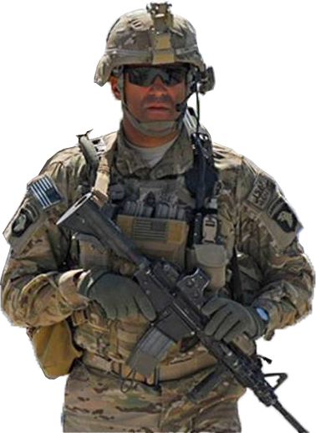
Who can summarize what we just covered?
The 8 Steps TLP is the process that company & below units use to plan training
Identifying the correct Key Collective Tasks (KCT), is vital to the planning process - and mission success
The Cdrs’ Dialogue is conducted at the end of mission analysis to gain the higher commanders approval of the KCTs and other planning considerations (training risk, planning horizon, etc)
The company restated mission (who, what, when, where, why) includes the approved KCTs (what)
Once the higher commander approves the COA at the training briefing, the approved COA ultimately becomes the UTP
Notes:
NOTE. The following information is the TLP a summary for instructor preparation purposes.
TLP is the process that Company and below units use to plan training. The first half of Step 3 of the TLP is when Mission analysis and the Commanders’ Dialogue occur. Mission analysis is the step where commanders:
Conduct detailed analysis required for the Commanders’ Dialogue
Determine their key collective tasks to train
Conduct their current assessment of those tasks
Determine/finalize their training OE
Determine their planning horizon (Time to Train)
Gather their facts, assumptions, constraints, and limitations (Resources)
Commanders' seek to train fewer key collective tasks – better.
Commanders’ Dialogue is conducted at the end of mission analysis to gain the higher commanders' concurrence of the key collective tasks to train and gain concurrence on major/unique resources that may be required to train.
In this lesson we will discussed the basic concept of determining what to train and the TLPs that are involved in this task.
It took us from step 1, ½ way through step 3, culminating with the commanders’ dialogue.
Once the higher commander approves the COA at the training briefing, the approved COA ultimately becomes the UTP. The staff begins to organize the COA along with the guidance given by the higher commander and all additional clarifying information into a five paragraph field order. When completed, it is communicated to subordinate and higher units as appropriate and posted to DTMS.
Because the UTP is the written and graphical representations of how the commander wants to train for the assigned mission and throughout the period planned, it should include any and all training guidance. Commanders have often published training guidance as a separate document, but this is no longer required.

Slide 41
Homework Instructions
NOTE.
At this time go over the “Develop a Unit Training Program” rubric and issue instructions to the students regarding:
Group Work (70 points) – Completing a Unit Training Plan
Individual work (30 points) - Provide D-CIED training input to a Company training calendar
This includes issuing:
A Battalion level WARNO
Company level eight weeks training calendar
Let students know:
When the assignment is due
And if it is to be turn-in in writing or briefed

Slide 42
BACK-UP
Notes:
What is the purpose of the Training Brief?
This is an example of what is briefed:
Higher headquarters mission
Operational Environment (OE)
Unit mission
Key Collective Tasks (KCT)
Commander’s intent
Concept of the Operations
Decisive Operations (COA)
Shaping Operations #1 (individual training)
Shaping Operations #2 (leader development)
Key training events
Time management cycle
Tasks to subordinate units
Assessment plan
Key resources required
Training risk (time/resources to train)
Training challenges
CSM/1SG briefs the current and projected status of:
The unit’s individual through section training
Tasks nested with the unit’s collective tasks
MOS training
NCOES
Low Density MOS training
Other training topics specified by the higher cdr

Slide 43
Step 3, Make a Tentative Plan (Cont)
Develop a Plan
The commander must visualize the desired event end state and backward plan the event to achieve the results. Identifying the training environment (live, virtual or constructive) to be used will drive the resource requirements necessary to train (See Chapter 4 of the UTM).
STX for Conduct an Attack (Live) (Walk Event)
Event Concept: Company conducts planning (company – platoon) in a constructive training environment (multi-echelon).
Company conducts Attack STX (walk) in a live environment (multi-echelon).
Current Proficiency: Company is a (U) in Attack. Has conducted classes and prepared for “walk” STX.
Start Here
End state: Company achieves 90% “GOs” on T&EO (Attack); (P) proficiency and prepared to conduct a “run” event.

Slide 44
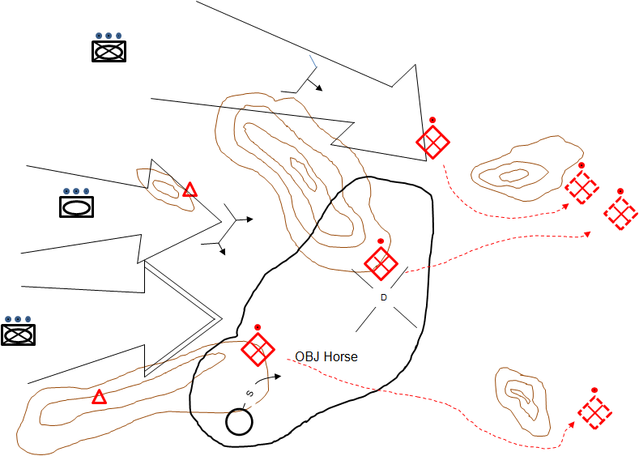
Step 3, Make a Tentative Plan (cont.)
Once the training environment is chosen, the commander should conduct counter task analysis: analysis of what is required to train the tasks selected for the event. The commander determines if the tasks chosen to train require actions by an OPFOR. Use Counter-Task Analysis (TC 7-101, Appendix B) to assist in determining the OPFOR tasks.
STX for Conduct an Attack (Live) (Concept)
Training Audience
Task:
Attack (KCT)
Force:
Company
Multi-Echelon
Opposing Force
Counter-task:
Defend
Force:
Infantry Platoon
Reconnaissance Team

Slide 45
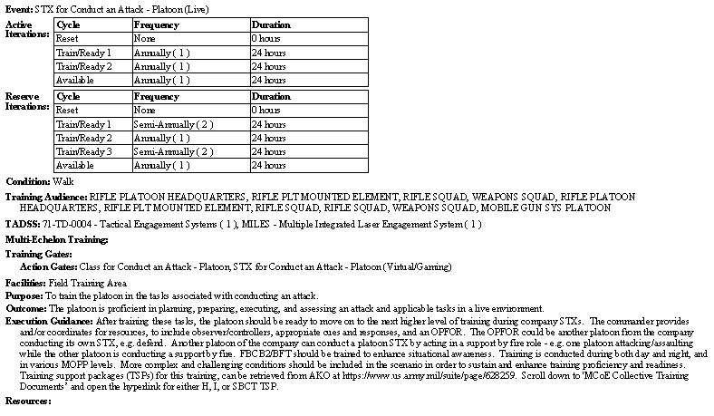
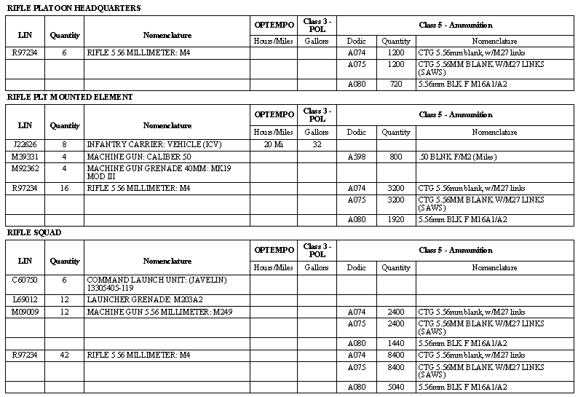
Step 3, Resources (T-9)
Combined Report Extract
Initiate coordination for key resources: Land, Ammo, Ranges, TADSS, etc….)
Review recommended resources from the Combined Report in CATS, and confirm that requested resources are available and on hand. Resource “lock-in” is based upon your unit SOP and installation, normally this occurs about T-6.
Review TADDS recommendations and coordinate for these resources as soon as possible.
TADSS
Resources

Slide 46
TLP, Step 5
Why should we conduct reconnaissance?
To ensure that the training environment provides the conditions to allow the training of KCTs
To identify any overlooked resources and other issues to include:
  Security issues
  Traffic control
  Route concerns etc
Notes:
STEP 5: CONDUCT RECONNAISSANCE (Reference - page 37 of the Ldrs Guide to Company Tng meetings)
T-8 - Execute Reconnaissance and Lock-in Resources
After determining the training environment and required training support resources, an initial reconnaissance of the training site(s) and facilities must be conducted. The purpose of this reconnaissance is to ensure that the training environment provides the necessary conditions to allow the training of the collective tasks to the level of fidelity needed. This will facilitate identification of details to complete the plan, specifically the TADS architecture possibilities and limitations. This reconnaissance helps identify any previously overlooked resources and other issues – to include security issues, traffic control and possible route concerns. Minimum personnel required on a recon are: leaders, evaluators, trainers, Observer-Controllers/Trainers (OCTs), and OPFOR. Below is a sample of common questions that should be answered during the initial recon:
Admin:
Training Area Reconnaissance Questions
• Are reconnaissance personnel familiar with the OPORD and commander’s guidance?
• Are there safety-related environmental factors (flash flood area, electric hazards, wildlife)?
• How does the terrain support administrative employment of equipment and personnel?
• Where will sleep areas be located?
• Where is the maintenance area?
• What is the distance from garrison?
• How much fuel is required?
• Is heavy equipment transport an option?
• Are maps available?
• Is satellite imagery updated?
• Where is or should the resupply point located? Is it acceptable?
• Can roads and bridges support heavy vehicle crossing? Confirm.
• Is the road network in the AO sufficient to support the operation?
• Does the traffic flow inside the AO need to be marked?
• Is there an area sufficient for aerial MEDEVAC?
• Are civilians in the area or cleared from the area?
Note. See reference listed above for additional questions.

Slide 47
Step 8, Supervise
Retraining (T-Week – T+1)
Plan time for retraining during or after training events.
It is best to retrain immediately while lessons learned are fresh and to conserve resources like equipment, personnel and resources on hand.
Training should not progress to the next proficiency level unless training objectives are met.

Slide 48
T-Week
Chronology
UTP Approval
Receive the mission & Issue a WARNORD
Weeks to Event (T)
T-21 to T-13 Identify major training facilities
T-12 Make a Tentative Plan; issue a WARNORD
(Mission analysis; Course of Action (COA) development;
Analyze COA)
T-11 to T-10 Conduct Reconnaissance
Refine resource requirements and submit requisitions as necessary
Conduct pre-execution checks
T-9 Complete the Plan; COA Comparison & Selection (Cdr approves plan)
Verify resource requests are submitted and acknowledged
T-8 to T-7 Lock-in all resources
Issue the Order
T-6 Lock-in training; publish training schedules
T-5 Complete tactical plan and supporting products
T-4 Issue the tactical plan
Identify and conduct leader/OC/OT certifications and Complete prerequisite training
T-3 Conduct rehearsals and secondary reconnaissance
T-2 Finalize administrative support requirements and conduct OPFOR rehearsal
T-1 Draw equipment and supplies
conduct final rehearsals
Conduct Pre-Combat Checks and Inspections (PCC/PCI)
T Initiate Movement; Supervise & Refine (Train);
Retrain and retry tasks as necessary to proficiency
T+1 Recover, conduct final AARs, and assess training
Unit Training Calendar
Note:
Bold items are Troop Leading Procedures (TLP) steps.
Resource identification, requisitioning and verification is a continuous process through execution. Planners must understand local installation resourcing cycles and procedures.
Tailor the T-Week to your unit and installation requirements.
See The Leader’s Guide to Unit Training Management (UTM)
Notes:
REFERENCE: The Leader’s Guide to UTM, Chapter 4
INSTRUCTOR NOTES:
Illustrated here is the T-Week chronology, described in The Leader’s Guide to Unit Training Management and “Leader’s Guide to Company Training Meetings.”
Use this chronology to backwards plan your events to maximize your time and identify both resourcing requirements and the suspenses for having them projected and locked in.
By using this approach you can identify requirements that may have otherwise overlooked. Example: For week T+1 you will need to schedule a time and location to gather key leader’s, OCs, and OPFOR to gather input for a final AAR so the commander can assess KCTs proficiency.
The T-Week concept can be used as a checklist for upcoming events during weekly training meetings.

