Slide 1
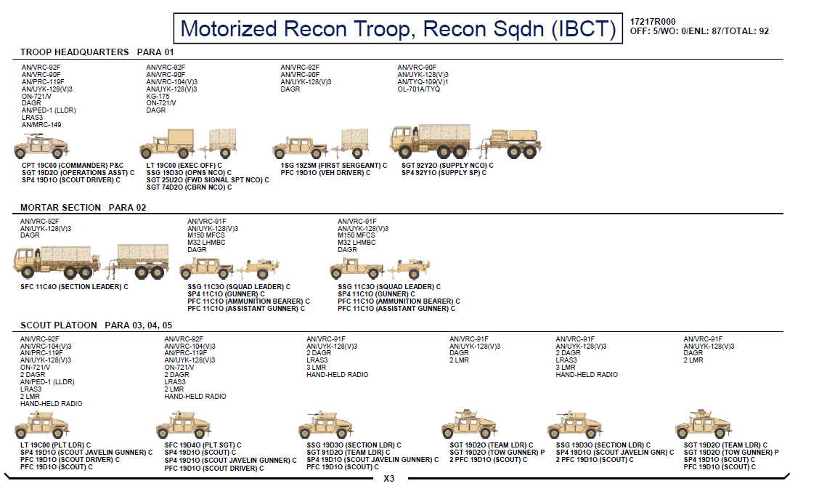

Slide 2
800 gal “Camel” Water tank
Ammo:
.50 cal- 500
25 gal
250 mi/ 402 km
25 gal
250 mi/ 402 km
25 gal
250 mi/ 402 km
58 gal
300 mi/ 483 km
Fuel Total:
182
Ammo:
Mortar- 72
Fuel Total:
158
58 gal
300 mi/ 483 km
25 gal
250 mi/ 402 km
25 gal
250 mi/ 402 km
3x SCT PLTs
25 gal
250 mi/ 402 km
25 gal
250 mi/ 402 km
25 gal
250 mi/ 402 km
25 gal
250 mi/ 402 km
25 gal
250 mi/ 402 km
25 gal
250 mi/ 402 km
PLT Ammo:
.50 cal- 1,000
TOW- 8
Mk-19- 1,000
Javelin- 9 CLU
Class I (Per day)
Class V
Class III
Water: 461 gal
(5gal per soldier)
Meals: 276
(3 per soldier)
TOW- 24
.50 cal- 3,500
40mm- 1,000
Mortar- 72
Troop Fuel Total: 790
Fuel Total:
150

Slide 3
Typical Attached Support Assets
2,500 gal
Medic
25 gal
250 mi/ 402 km
Fueler
154 gal
300 mi/ 483 km
25 gal
250 mi/ 402 km
58 gal
300 mi/ 483 km
Field Maint Section
58 gal
300 mi/ 483 km
Fire Support Vehicle
197 gal
300 mi/ 483 km
25mm- 1,500
7.62mm- 4,400

