Slide 1
Non-academic Subjects for Dismounted Counter-IED Tactics Master Trainer Course
Notes:
Welcome students to the course

Slide 2
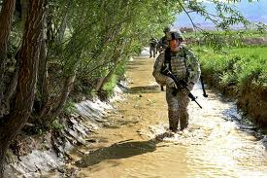
Course Administrative Information
Notes:
Course introduction.
Set Welcome students to the Dismounted C-IED Tactics Master Trainer Course.
Before we start with a course introduction and officially start the course we need to go through some admin points.

Slide 3
Terminal Learning Objective
ACTION: | Perform administrative actions.
CONDITION: | In a classroom environment with pen, paper, required documents, and given course administrative forms.
STANDARD: | Perform actions to in-process, participate in orientation, graduation ceremony, AAR, and out-process the course. Domain: Cognitive Level: Knowledge
Notes:
Introductions – Instructors give brief introduction on who they are, what they have done and their role during the course.
Adult learning environment - Big boy rules. You will be treated like adults to get a very important job done, please respect the instructors. Any issues or problems let the instructors know ASAP.

Slide 4
Enabling Learning Objectives
At the completion of this lesson, you will be able to:
Conduct in-processing
Complete Personal Data sheet
Discuss Course Information/Classroom rules
Discuss 3 Written Examinations and Test Standards
Discuss completion of Course surveys
Discuss Out-processing and Graduation ceremony
Notes:
Complete Personal Data Sheet – student is required to complete the personal data sheet and hand into the Instructor.

Slide 5
Course Information, Guidance, and Rules
Cell Phones
Course Attendance
Class Leader Responsibility
Fire Evacuation Plan
Medical
Latrines
Safety
Take Notes
No Dipping & Tobacco use
Uniform dress code
Clean-up/taking out trash
Notes:
1. Cell phones will be turned off during training (includes no texting or emailing, but can
be used during break periods and at lunch break.
2. Course Attendance: Ensure each Soldier is in attendance, on time, and not late for class each day.
Students are allowed to miss up to 4 hours of training during
the course. After 4 hours of absence the student will be dismissed from the course.
The NCOIC will make the determination for all administrative actions.
3. Class Leader Responsibility: A Class Leader will be appointed daily. The Class
Leader will be the main POC for the course if we need to get a message to anyone in
the course.
4. Fire evacuation plan: Explain the fire exits and the assembly area for your location.
5. Medical: If for any reason you have to see a medic let the instructors know
immediately. You can’t miss more than 4 hours of training. If you miss 4 hours or more
you will be dismissed from the course.
6. Restroom locations: Point out the location of the restrooms for the period of training.
7. Safety: Everyone is responsible for safety, please let an instructor know of any
potential safety issues in advance so they can be addressed ASAP.
8. Smoking is prohibited in any government building to include dipping, chewing, and
spitting of tobacco while in the classroom (exception when on break, lunch, or in a field
environment) per AR 600-73, 7 MAY 2007, Section 7-3(a), Policy for controlling
tobacco use.
9. Take notes: There is a great deal of information to absorb. You have all been provided with the latest Dismounted smart book, please take notes.
10. Uniform: The uniform of the day is specified in the training schedule.
11. Class Leader will be responsible for ensuring the classroom is clean and trash
emptied at the end of each day.
12. Reinforce and stress to Soldiers the safety factors and the need for proper
equipment preparation prior to outdoor PEs and STX. Due to changing weather
conditions (heat, cold, rain, wind) all Soldiers will have the following equipment:
wet/cold weather gear (parkas, gloves, rain gear, etc.), hydration (camelback,
canteens), and proper skin protection (suntan lotion, bug spray, lip balm).
Recommendation to include a standard packing list with PDSS documentation.

Slide 6
Testing Overview
Each student will take 3 written tests the first week of training consisting of multiple choice questions.
Students must achieve a score of 80% or greater on each course examination.
Failure on any test will result in a retest.
Notes:
Point out that failure of a retest will result in not receiving a course certificate.

Slide 7
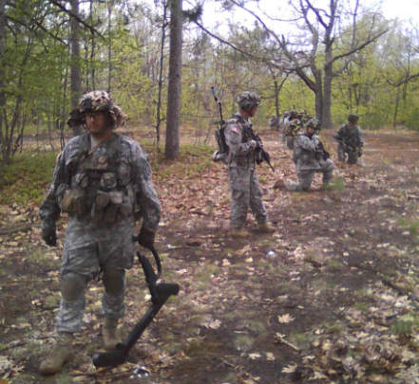
Team Situational Training Exercise (STX) Evaluation
Each student will be assigned to a squad with an assigned position.
The squad will be assessed and must receive a positive evaluation to pass the STX portion to graduate from this course.

Slide 8
Course Surveys
Two surveys must be completed for this course:
Initial Course Survey completed on Day 1
End of Course Survey at completion of course
Be honest when filling out each form.
Take notes daily on your comments for the survey.
Leave your contact information and details for reach back.
Complete Initial Course Survey before leaving classroom.
Notes:
Be honest; fill out daily so the information is fresh in your heads.
This will help adjust the course to support subsequent courses.
Note: Student must complete and turn in survey before leaving classroom.

Slide 9
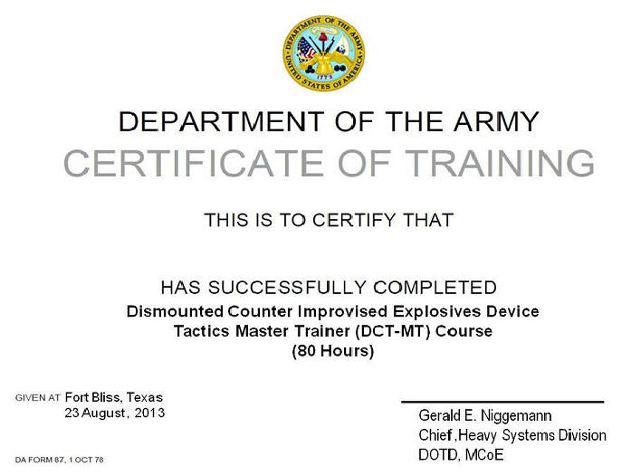
Graduation
Conduct out-processing and graduation
RANK / NAME

Slide 10
Summary
Lesson: Non-academic Subjects for Dismounted Counter - IED Tactics Master Trainer Course
You will be able to:
Conduct in-processing
Complete Personal Data sheet
Discuss Course Information/Classroom rules
Discuss 3 Written Examinations and Test Standards
Discuss completion of Course surveys
Discuss Out-processing and Graduation ceremony

Slide 11
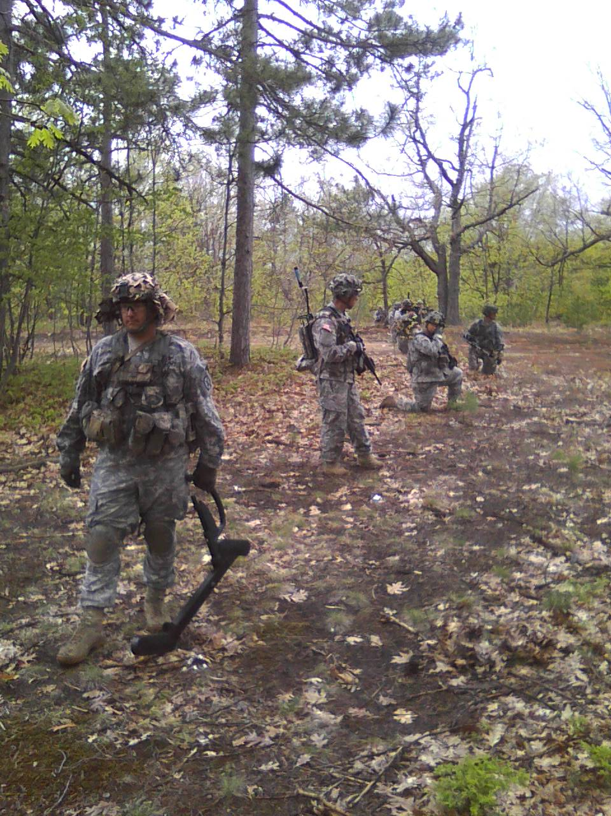
Questions?

