Slide 1
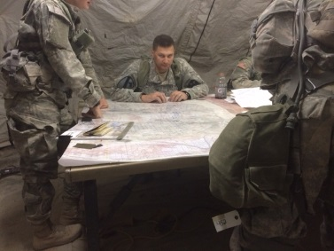
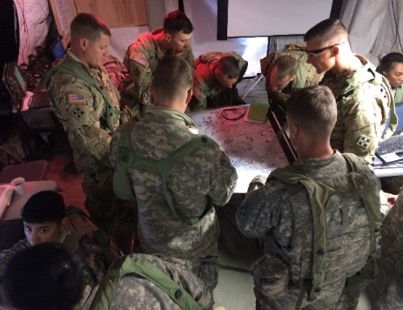
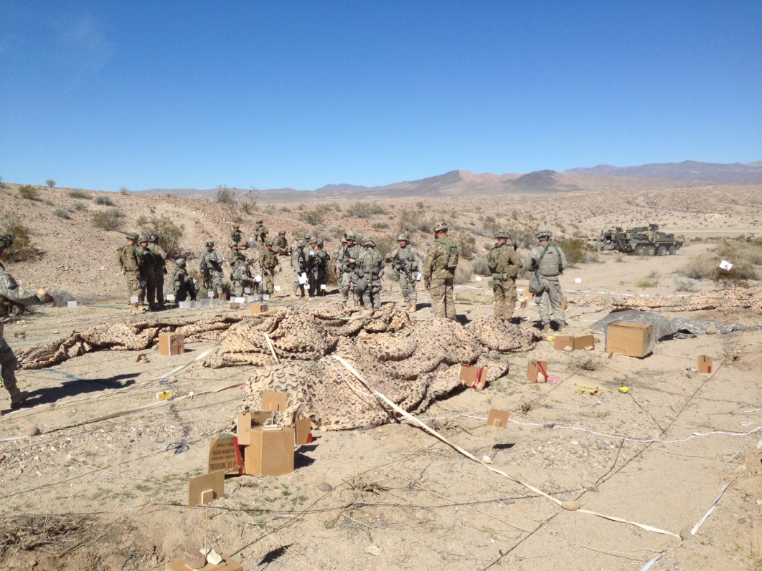
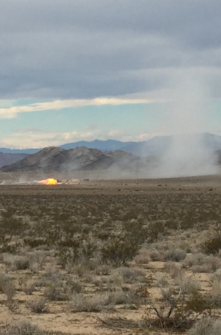
Fire Support Observations at the NTC
Road to Effective Fire Support
Begins with…
Articulated through…
Reinforced With…
Results in…
Commander’s Guidance for Fires
Integrated Fires Planning
Shared Understanding
Focused/Prioritized and Effective Joint Fires
Observation:
Maneuver Commanders and their FSCOORDs are often challenged to provide clear guidance describing how and where joint fires will be employed to shape the BCT fight.
Observation:
Units struggle to effectively develop a fire support plan, disseminate the plan across the formation, and manage the target refinement process.
Observation:
Units do not conduct Fire Support Tactical and technical rehearsals prior to operations or
Rehearsals do not reach a level of detail to improve shared understanding
The End-state:
Joint Fires are timely, accurate and synchronized at the Brigade’s decisive point, shaping the BCT fight and accomplish the commander’s intent.
Enabling…
Brigade Combat Teams to dominate the combined arms fight in the execution of decisive action through the application of Joint Fires.
The Fix:
Issue clear commander’s guidance during mission analysis
Describe the decisive point where and how joint fires are to be employed to shape the BCT fight
The Fix:
Codify fire support products in unit SOP
Complete Draft FS products during BDE MA
Distribute the draft plan upon completion of MA
Establish and enforce Target cutoff times
The Fix:
Use a rehearsal script to focus efforts and set expectations
Rehearse technical and tactical triggers from sensor to shooter
Inject friction to test the plan’s flexibility
Have a system to capture changes to the plan

Slide 2
Role of the Maneuver Commander
The maneuver commander must provide a clear and concise guidance on effects he expects from fires. His emphasis must focus fires within the scheme of maneuver to achieve his objectives. Fire support personnel must thoroughly understand the commander’s intent, scheme of maneuver, and guidance for fire support. Commanders must ensure fire support personnel understand the larger picture of the battle. Commander's guidance for fire support emphasizes in broad terms when, where, and how the commander intends to synchronize the effects of fire support with the other elements of combat power to accomplish the mission. It provides the staff and subordinate units with the general guidance and restrictions for the employment of fires, desired effects and the planning and execution of targeting functions. Commander’s guidance for fire support should include his priority of fires. Priority of fires is the commander’s guidance to his staff, subordinate commanders, fire support planners, and supporting agencies to organize and employ fire support in accordance with the relative importance of the unit’s mission (ADRP 3-09). Mission orders for supporting field artillery brigades and field artillery battalions should include the supported commander’s intent, concept of operations, priority of fires, fire support tasks, and coordinating instructions.

Slide 3
Commander’s Intent For Fires Checklist
CDR’s intent must focus on how fire support will influence and support the scheme of maneuver.
Ground scheme of maneuver.
Guidance for FSTs.
Purpose of fires. How FS will support scheme of maneuver.
Use Fires BN to neutralize the threat’s dismounted attack forward of PL PURPLE.
Cover all obstacles with observation and fires.
Mass artillery, CAS, and attack aviation into EA SCRUM to disrupt the threat’s mounted attack.
Conceal TM ARMOR’s movement to attack-by-fire positions.
Priority of fire. Which unit has FS priority by phase.
Initially to TF 1, 2, then 3, in order.
When the fixing force penetrates PL GREEN, priority of fire (POF) shifts to TF 2, 3, then 1, in order.
Upon commitment of the reserve, POF shifts to TM ARMOR.
Priority targets. Which targets and length of priority status.
Effects of fires
Suppression – Prevent effective fire on friendly forces.
Neutralization – Target combat ineffective/unusable for a temporary period.
Destruction – Target permanently combat ineffective.
Harassing – Disturb the rest of threat troops, curtail movement, lower morale.
Employment of mortars, air-delivered weapons and NGF.
Special munitions employment.
Force protection priorities (FSCM).
Restrictions:
Establish NFAs for all population centers and sensitive places.
Do not employ cratering munitions on MSRs, LZs and/or air strips.

Slide 4
Overview: Fire Support Observations at the NTC
Commander’s Guidance for Fires - BCT FSO and the FSCOORD lack a shared understanding of how they will employ joint fires to shape the BCT deep fight before the BCT FSO begins with the fires plan. The battalion staff (with the Commander’s approval) are not further developing the initial fire support tasks (FSTs) as the military decision-making process (MDMP) progresses. (TC 3-09.31)
FSCM Management - FSCMs are not uniform throughout the BCT. There is frequently an absence of a FS battle rhythm, to include a FS synchronization meeting & FSCM scrub. A shortfall of data distribution list synchronization prevents synergy. SCUs and LFEDs are rarely used or operational, which results in units having to manually update FSCM tracking systems. FSEM is not distributed down to the CO level. (ADRP 3-09)
FS Planning/Prep - S2 and S3 are not often involved in the planning of fire support or the integration of an observation plan; the 1/3-2/3 planning rule is not enforced on a predictable basis. TAIs are rarely used effectively. Line of sight analysis is very useful. (ADRP 3-09)
Execution – Units do not effectively clear ground for fire missions, establish NFAs, or update graphics. Units have an unclear understanding of the benefits of collocating the CDR, FSO, JTAC with the TAC to mass fires and improve de-confliction of assets. Units have an under-appreciation for the effect of massing fires. There is a common absence of a clearance of fire battle drill. Units that do not have a disciplined PACE plan struggle with the vast array of potential means to communicate with the BCT. (TC 3-09.31)
FS Rehearsal – Units frequently lack the understanding of who needs to attend, the scheme of maneuver, and fires by phase. Challenges include priority of fires by phase, de-confliction of assets, locations of and ability to execute pre-planned targets. Changes to the plan after the rehearsal are frequently not annotated in a FRAGORD. A FS rehearsal script clearly annotated in a SOP is needed for predictable SA. (CALL Publication 13-07, Fires Rehearsals)
Fires Integration – Fires are not effectively integrated with the scheme of maneuver. Unsynchronized FA fires result in the Battalions defaulting to mortars for primary delivery systems for indirect fires. Joint Fires synchronization at the BCT level is very important. Planned and rehearsed technical and tactical triggers continue to be a challenge resulting in untimely fires in support of maneuver. (ATP 3-09.34)
Targeting – Units rarely effectively manage the targeting process, develop triggers for fires, or incorporate D3A methodology. TSS/AGMs are not being enforced or distributed. Target blocks are not managed or enforced by subordinate units. Enabler coordination is needed to synchronize. (FM 3-60)

Slide 5
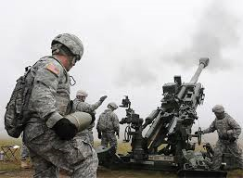
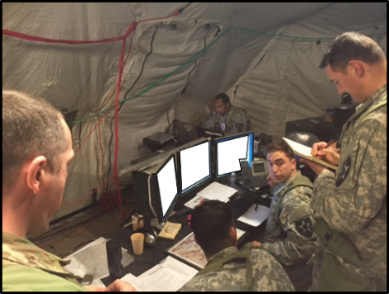
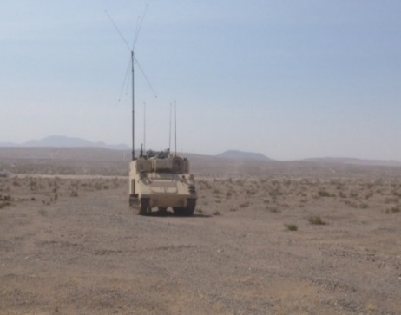
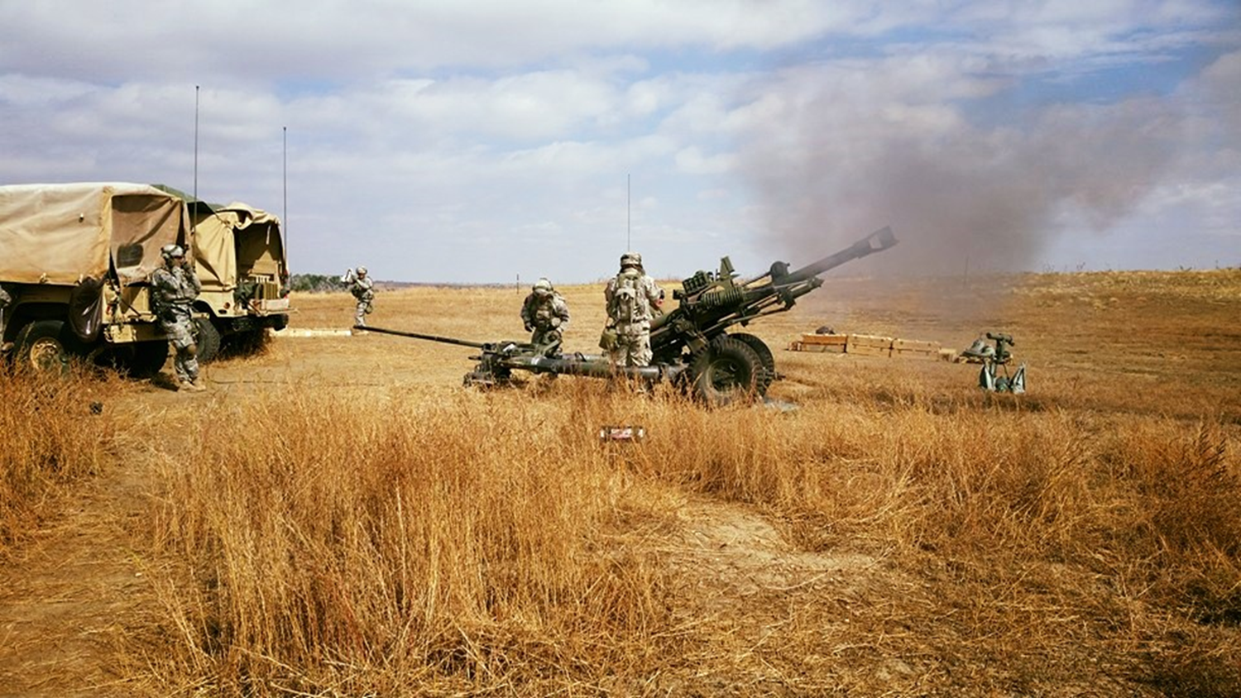
Direct Support FA Battalion Observations at the NTC
Road to Effective Delivery of Fires
Begins with…
Driven by…
Enabled through…
Results in…
Field Artillery Support Plan
Effective Fire Mission
Execution
Redundant Communications
Timely and
Accurate Fires
Observation:
Units often struggle with developing a comprehensive/collaborative FASP that is nested with the BCT maneuver plan. Ammo forecasting, PAA selection, and logistical resupply remain a challenge.
Observation:
FA BNs struggle with timely fire direction, adversely impacting target execution. The average processing time from receipt of mission by the FA BN to first round fired was 11:05 during FY16.
Observation:
FA BNs are often challenged to develop a communications plan that provides flexibility. Many units are uncomfortable using digital FM comms and over rely on JCR communications.
The Goal:
Timely, accurate, responsive direct support fires leveraged by the BCT to shape and dominate the brigade’s deep fight
Enabling…
Brigade Combat Teams to dominate the Decisive Action combined arms fight through the application of direct support cannon fires.
The Fix:
Conduct Line of Sight analysis during MDMP to facilitate planning of mission command node and retrans positions
The Fix:
Enforce distribution of planning products in a timely fashion
Ensure planning is collaborative
Ensure quality rehearsals are conducted to increase shared understanding
The Fix:
Conduct rigorous home station training focused on meeting time standards IAW TC 3-09.8 (FA Gunnery)
Rehearse clearance of fires battle drill during CPXs

Slide 6
Overview: FA Observations at the NTC
TOC/TAC/JTOC – Units struggle with roles and responsibilities of TOC personnel and have an unclear understanding of Command Support Relationships. (FM 3-09.21)
Communications – PACE Plans are often not utilized or planned in detail. FA units often lack an understanding of tactical site selection and line of sight analysis for communication nodes. (ATP 3-09.30)
Staff Sections – Units lack fundamental SOPs (TACSOP/TOCSOP/PSOP) that include PCC/PCI checklists, Battle Drill rehearsals, tracking systems, FSCM management, and common graphics. Minimal understanding of common graphics and equipment capabilities limit efficiency. (FM 3-09.21)
Radar Management – Planning for maintenance, cueing schedules, and survivability moves are enduring friction points. Units often struggle with identifying the CF HQ, and the CF Battle Drill is seldom rehearsed and understood to the lowest level. (ATP 3-09.12)
Gunline Standards – Friction points include TAA occupation, use of quartering party, PAA security, emplacement/displacement times, defensive diagrams, range cards, sector sketches, incorporating adjacent units into defensive planning, and survivability move criteria. ATP (3-09.70)
Ammo Management – BN re-supply triggers and tracking DA 581 flow continue to be challenges. (ATP 3-09.70)
Quality Rehearsals – FA technical rehearsals are rarely executed from sensor to shooter, and PACE plan is not exercised within the rehearsal. Most rehearsals become back briefs to the Commander. (FM 3-09.21)
Excalibur/PGK – Recommend units request a MTT prior to NTC, and to incorporate into BN DST at home station. Issues include loading black keys, having necessary software loaded, and overall system competency. (ATP 3-09.30)
5 RAF – MET schedule to the batteries and applying updated MET is commonly the reason most units don’t achieve the 5RAF, Batteries infrequently use a 5 RAF tracker. MET/Survey/Profiler often seem to be an issue. Alternate means of obtaining MET are infrequently practiced. (TC 3-09.8)

