Slide 1
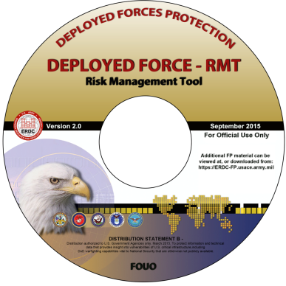
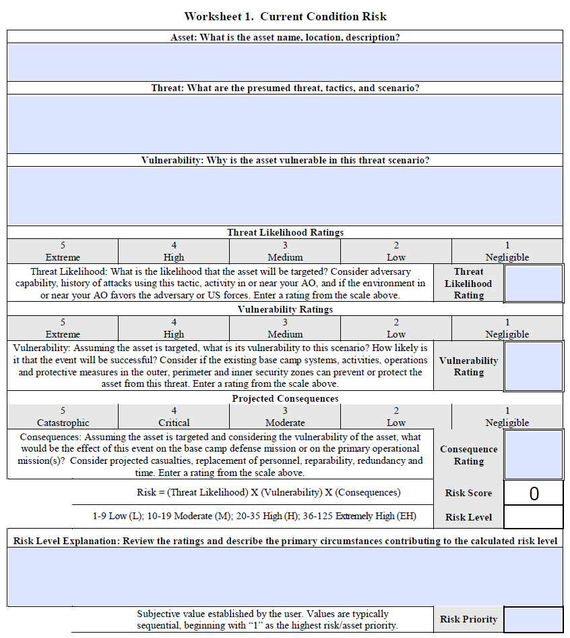
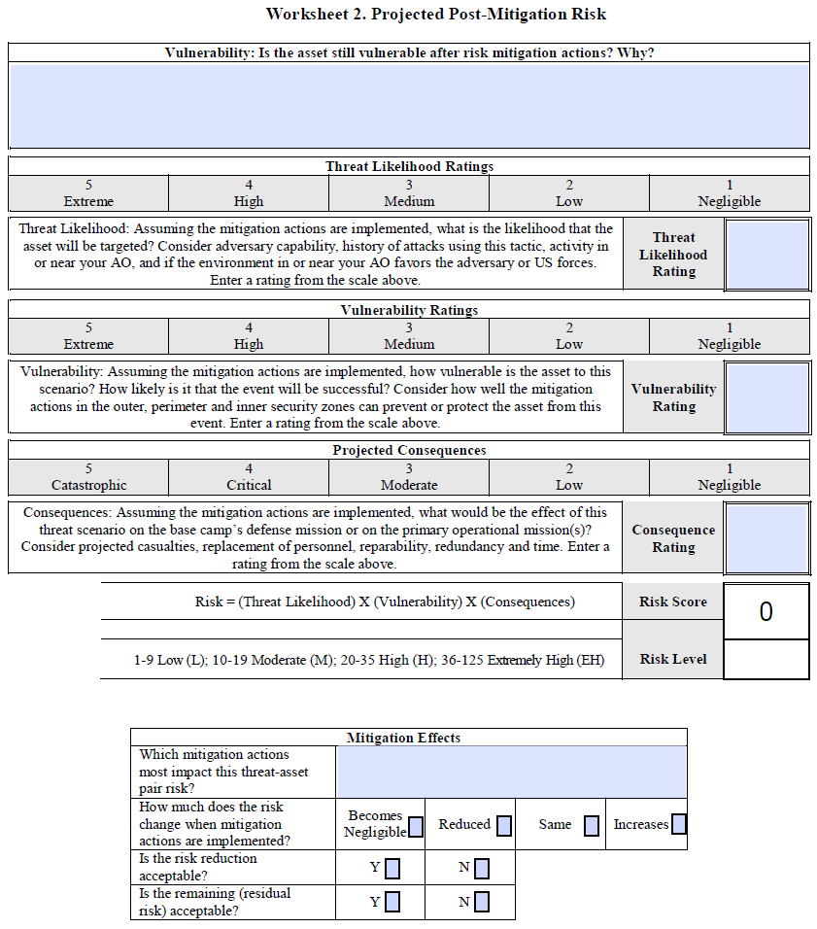
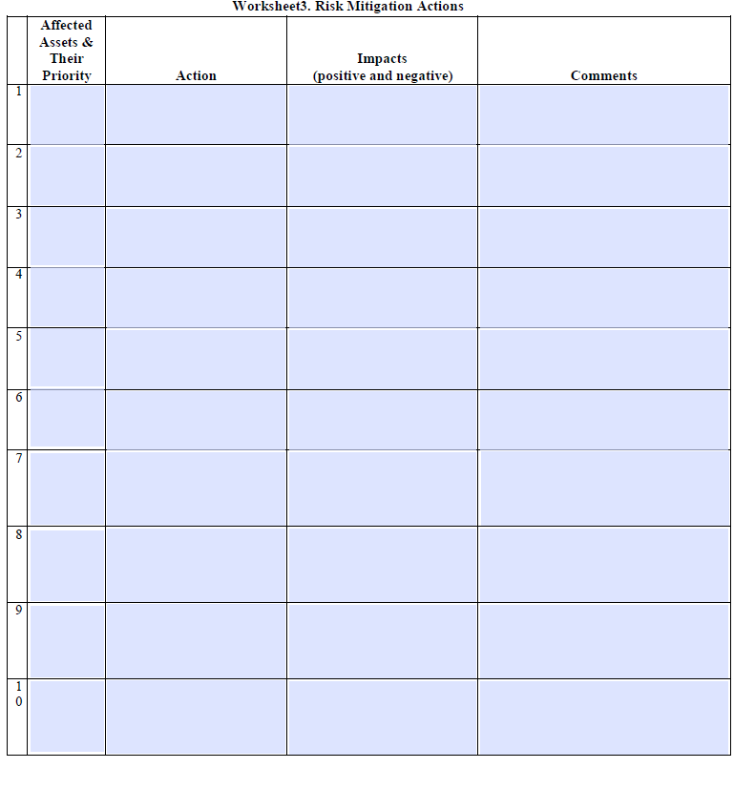
Field Expedient Manual Version of the
Deployed Force – Risk Management Tool (DF-RMT)
The Deployed Force-Risk Management Tool (DF-RMT) has been converted into a
DF-RMT Field Expedient Manual Version:
This version is intended to replace the Manual Risk Management Tool provided in Appendix B of the Joint Forward Operations Base (JFOB) Protection Handbook, v6
The Manual Version can be used to annotate findings/decisions while conducting risk
assessments, these findings/decisions can later be entered into the DF-RMT
Worksheets can be printed out and filled in by hand. There is also a .PDF fill-in version
Consists of three worksheets (along with instructions and additional informational tables)
First worksheet for estimating the original or current risk for an asset/threat
Second worksheet describes actions to reduce the risk
Third worksheet estimates the projected post-
mitigation risks assuming the actions are implemented
The Manual Version is provided in the references and tools
sections of the full-blown version of the DF-RMT program
The Manual Version may also be downloaded from the ERDC
Force Protection Portal at: https://erdc-fp.usace.army.mil

