Slide 2
OUTLINE
-Introduction
-TC3
-CCP

Slide 3
Introduction
-Handouts???
-NTC

Slide 4
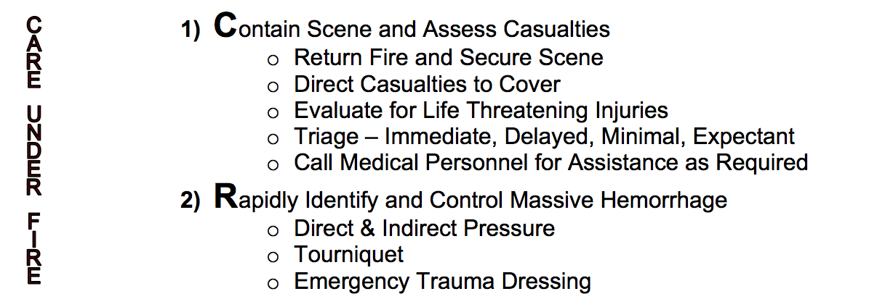
-Introduction
-MEDPROS
-Eprofile
-MEB
-Appointments
-BCT Providers
-Future Changes

Slide 5
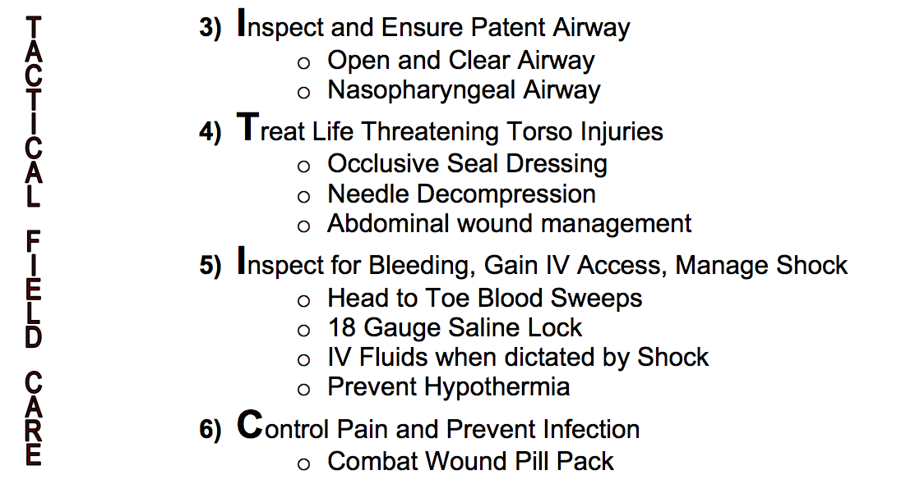
-Introduction
-MEDPROS
-Eprofile
-MEB
-Appointments
-BCT Providers
-Future Changes

Slide 6
OUTLINE

Slide 7
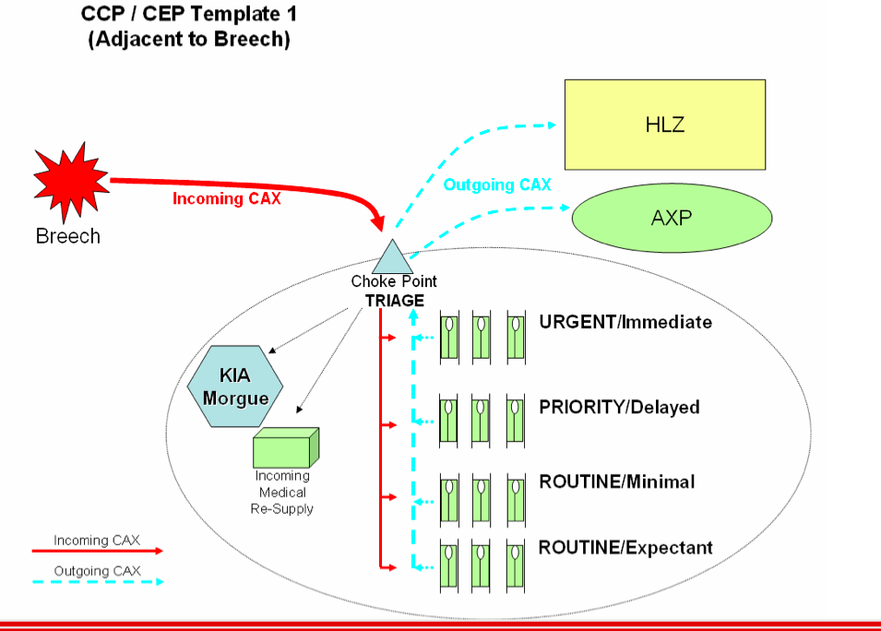
CCP

Slide 8
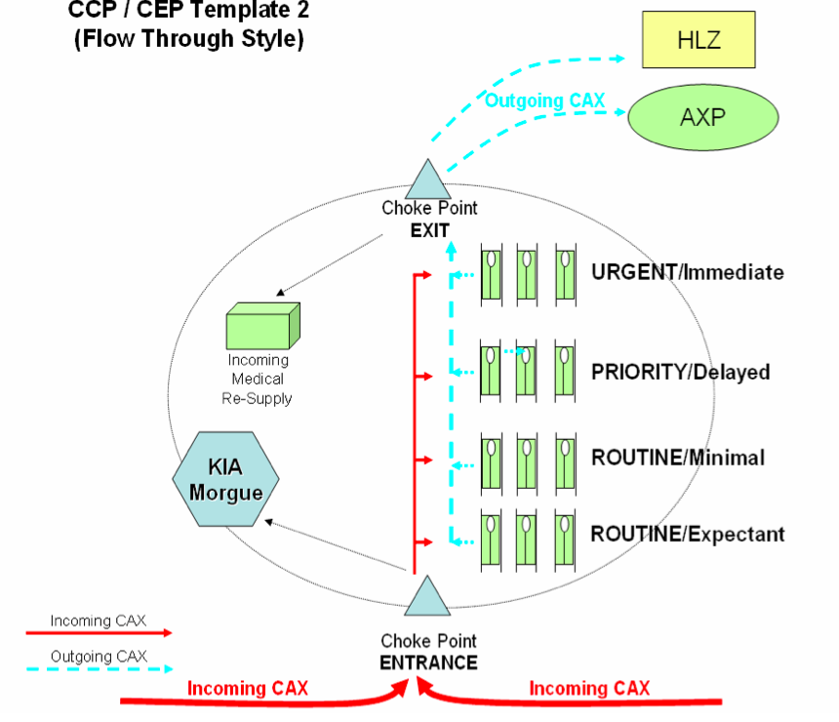
CCP

Slide 9
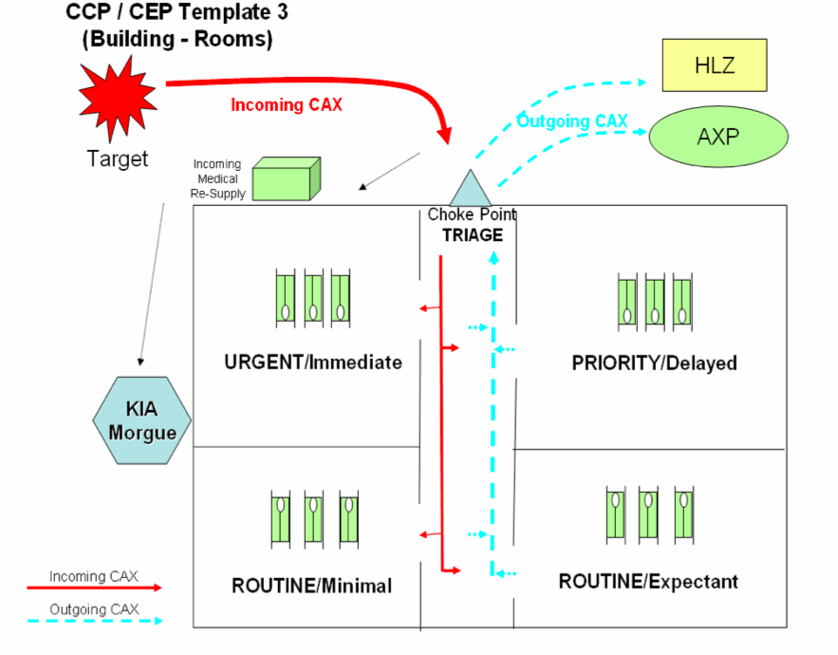
CCP

Slide 10
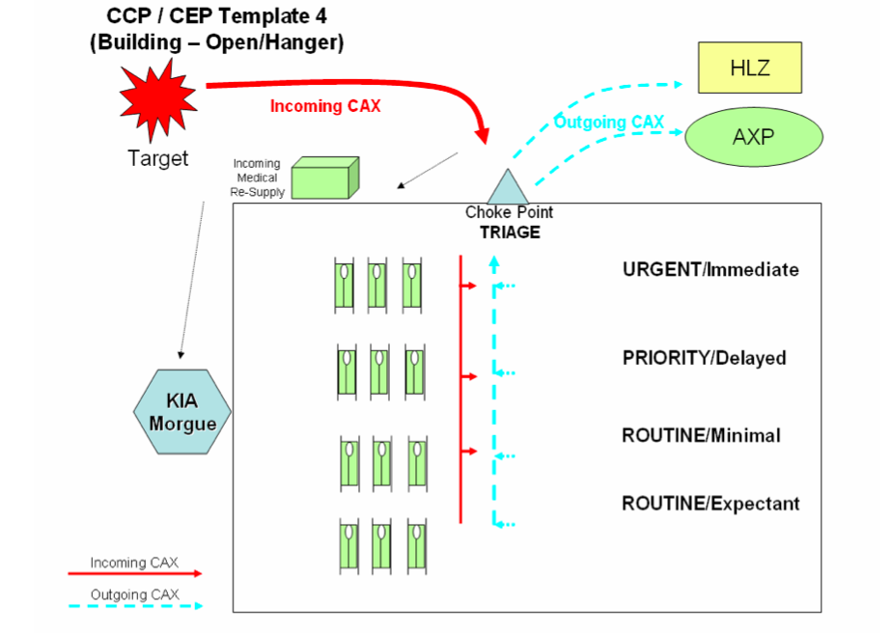
CCP

Slide 11
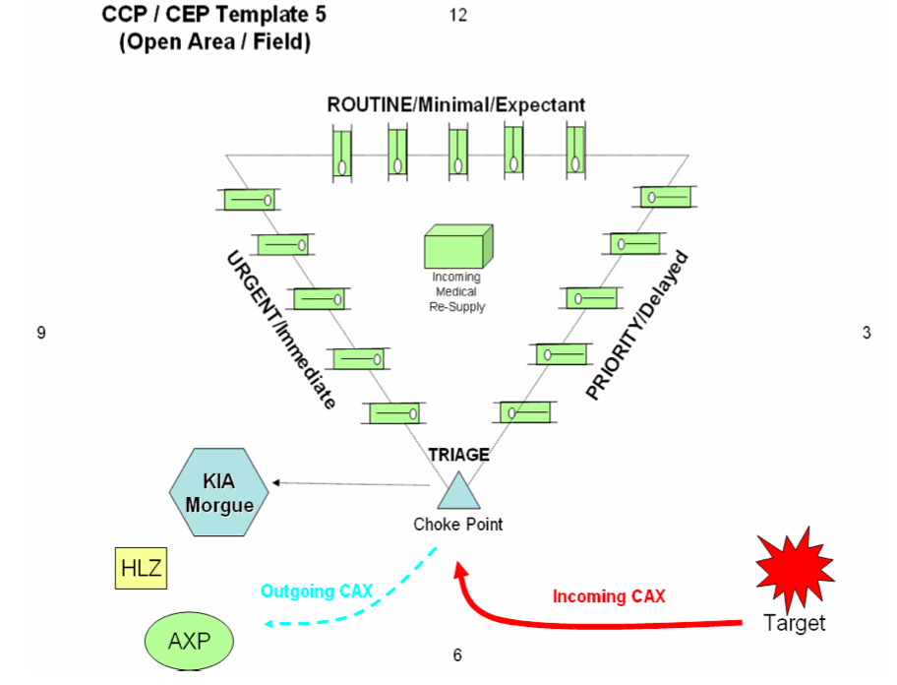
CCP

Slide 12
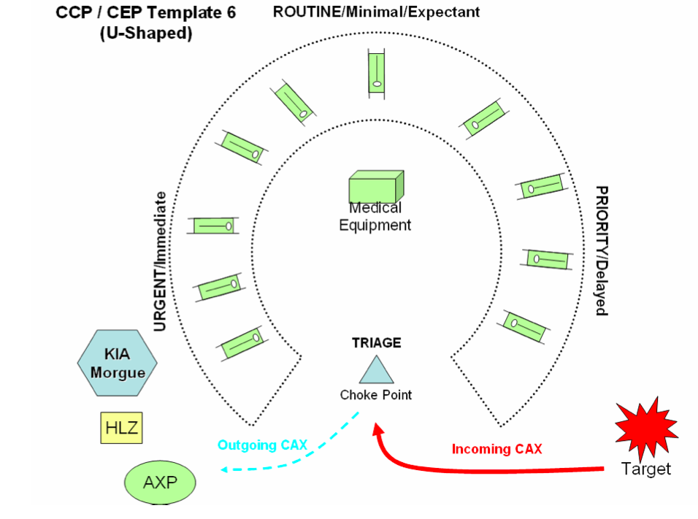
CCP

