Slide 1
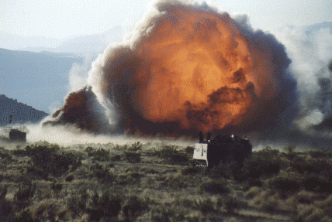
Combined Arms Breaching Terms of Reference
References:
ATTP 3-90.4 Combined Arms Mobility Operations
USAES Engineer Planning Factors

Slide 2
Terms of Reference
Mobility Operations: Combined arms activities that mitigate effects of natural and man-made obstacles to enable freedom of movement and maneuver. Mobility operations included the following six primary tasks:
-Conduct breaching operations
-Conduct clearing operations
-Conduct gap-crossing operations
-Construct and maintain combat roads and trails
-Construct and maintain forward airfields and LZs
-Conduct traffic operations
Breaching Operations: Breaching operations are conducted to allow maneuver despite the presence of enemy reinforcing obstacles that are covered by fire. Obstacle breaching is the employment of a combination of tactics and techniques to advance an attacking force to the farside of an obstacle covered by fire. Breaching is a synchronized combined arms operation under the control of the maneuver commander.
Clearing Operations: Clearing operations are conducted to completely eliminate the enemy’s obstacle effort or residual obstacles affecting the operational area. Commanders may order clearing operations to facilitate mobility within an AO based on an analysis of mission variables (METT-TC). They may also order a critical route or area cleared of mines, explosive hazards, or other obstacles. The operation could be conducted as a single mission to open or reopen a route or area, it may be conducted on a recurring basis in support of efforts to defeat a sustained threat to critical route.
Under the 12-05 scenario construct, breaching operations will occur in support of combined arms
maneuver (CAM) while clearing operations are conducted to support wide area security
(WAS).
Reference: AATP 3-90.4, Pg. 1-3

Slide 3
Breaching Terms
Reduction: Creation of lanes through a minefield or obstacle to allow passage of the attacking ground force.
Lane: Route through, over, or around an enemy or friendly obstacle that provides safe passage of a passing force. The route may be reduced and proofed as part of a breaching operation, constructed as part of the obstacle, or marked as a bypass.
Proof: The verification that a lane is free of mines or explosive hazards and that the width and trafficability at the point of breach are suitable for the passing force.
Breach Area: Area where a breaching operation occurs. It is established and fully defined by the higher headquarters of the unit conducting breaching operations.
Point of Breach: Location at an obstacle where the creation of a lane is being attempted.
Farside Objective: Defined location on the farside of an obstacle that an assaulting force seizes to eliminate enemy direct fires and observed indirect fires onto a reduction area or a crossing site to prevent the enemy from interfering with the reduction of the obstacle and allow follow-on forces to move securely through the created lanes.
Point of Penetration: Location, identified on the ground, where the commander concentrates his efforts at the enemy’s weakest point to seize a foothold on the farside objective.
Reference: AATP 3-90.4, Ch. 3

Slide 4
Breaching Terms
Types of Breaching Operations
Deliberate Breach: The creation of a lane through a minefield or a clear route through a barrier or fortification, which is systematically planned and carried out.
Hasty Breach: The creation of lanes through enemy minefields by expedient methods such as blasting with demolitions, pushing rollers or disabled vehicles through the minefields where the time factor does not permit detailed reconnaissance, deliberate breaching, or bypassing the obstacle.
In-Stride Breach: Type of hasty breach used to describe the situation when a subordinate unit is expected to be able to organize for and conduct hasty breach with its organic or task-organized assets, without impacting on the higher unit’s scheme of maneuver or commander’s intent.
Covert Breach: Creation of lanes through minefields or other obstacles that is planned and intended to be executed without detection by an adversary. Its primary purpose is to reduce obstacles in an undetected fashion to facilitate the passage of maneuver forces.
“Bulling” or “Forcing through”: Not a breaching operation, but a decision made when a commander must react immediately to extricate his force from an untenable position within an obstacle and no other breaching operations are possible.
NOTE: During 12-05 Decisive Action, the RTU unit will conduct deliberate TF-level breaches.
Reference: AATP 3-90.4, Ch. 3

Slide 5
Breaching Tenets | Actions
Intelligence | • Template enemy obstacles on the SITEMP for each enemy COA during IPB based on— -The enemy’s ability to emplace obstacles based on its capabilities (manpower, equipment, and materials) and time available. -The effects of terrain and weather. -The range of enemy weapon systems covering obstacles and emplacing scatterable mines. • Develop IR on enemy engineer units, equipment, activities, and obstacles (location, composition, and types of mines). • Integrate IR and engineer reconnaissance capabilities into the ISR plan to develop OBSTINTEL.
Breaching Fundamentals (SOSRA) | • Implement fire control measures to allow the support force to provide effective direct and indirect suppressive fires (suppress). • Determine the placement (wind condition), density, and timing of obscuration smoke on enemy positions and screening smoke between the enemy and the reduction area (obscure). • Resource the breach force based on the combat power of enemy forces overwatching the obstacle (secure). • Determine number and width of lanes based on the scheme of movement and maneuver (one lane per company and two lanes per battalion), determine reduction methods (explosive, mechanical, or physical), and establish a lane-marking system (reduce). • Complete the breach by destroying the enemy on the farside of the obstacle (assault).
Breaching Organization | • The support force— -Suppresses enemy direct fire and observed indirect fires on the reduction area. -Controls indirect fires and obscuration within the breach area. -Prevents the enemy from repositioning or counterattacking to place direct fires on breach force. • The breach force— -Creates and marks lanes (reduction element – comprised mainly of reduction assets. Allocate assets by # lanes required). -Secures the obstacle nearside and farside (security element- comprised mainly of maneuver forces). -Reports lane status and location. • The assault force assaults through the obstacle and destroys enemy on the farside.
Mass | • Mass combat power to create enemy weakness at the POB. • Prevent enemy from massing combat power at the POB.
Synchronization | • Conduct detailed reverse planning. • Communicate clear instructions to subordinate units. • Provide effective command and control. • Perform combined arms rehearsals.
Reference: AATP 3-90.4, Table 3-1

Slide 6
Breaching Fundamentals | Planning Considerations
Suppress and Secure | • Identify enemy elements that can place direct and indirect fires onto the proposed reduction area or that can reinforce or counterattack into the breach area (based on the SITEMP developed during IPB). • Identify direct and indirect fire capabilities needed by the support force to suppress the breach area and achieve desired effects on the enemy. • Determine where best to position the support force so that it can support (both the breach and assault forces) by fire, based on observation and fields of fire, and cover and concealment, while avoiding its fires being masked by friendly forces. • Establish CFZs for SBF positions and the reduction area.
Obscure | • Identify available assets that can employ obscuration and determine where best to position them to achieve desired results. • Determine where best to employ obscuration based on the SITEMP; predicted wind conditions; planned reduction area; and positioning of the support, breach, and assault forces.
Reduce | • Determine obstacle composition through ISR asset reporting and produce OBSTINTEL. • Allocate breaching assets (plan for redundancy) to the breach force based on lane requirements (number and width) and the composition of the obstacle. • Allocate maneuver forces to the breach force security element based on the SITEMP and the ability of the support force to eliminate enemy direct fires on the reduction area based on fields of fire.
Assault | • Designate a farside objective based on the SITEMP, the terrain, and the necessary maneuver space on the farside of the obstacle. • Determine size and composition of the assault force based on the SITEMP or the size of the farside objective (if terrain oriented). • Identify secondary tasks for the assault force, such as reinforcing fires for the support force or blocking enemy counterattacks into the breach area.
Reduce: A mobility task to create and mark lanes through, over, or around an obstacle to allow the attacking force to accomplish its mission. Reduction assets include Assault Breaching Vehicles (ABVs), MICLICs, Mine-clearing blades (MCBs), ACEs, and dismounted Sapper Squads.
Proof: The verification that a lane is free of mines or explosive hazards and that the width and trafficability at the point of breach are suitable for the passing force. Proofing assets include ABVs, MCBs, Mine-clearing rollers (MCRs), ACEs, and dismounted Sapper Squads.
Reference: AATP 3-90.4, Table 3-1

Slide 7
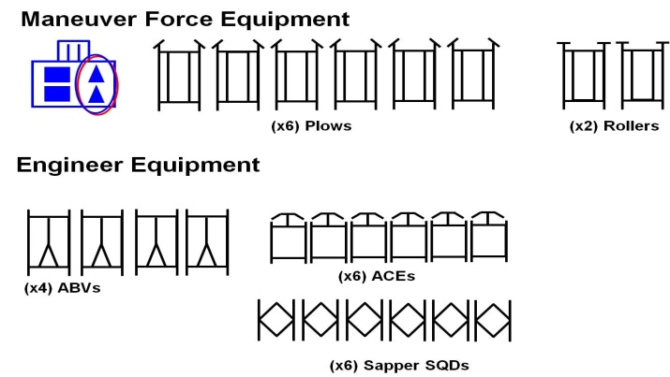
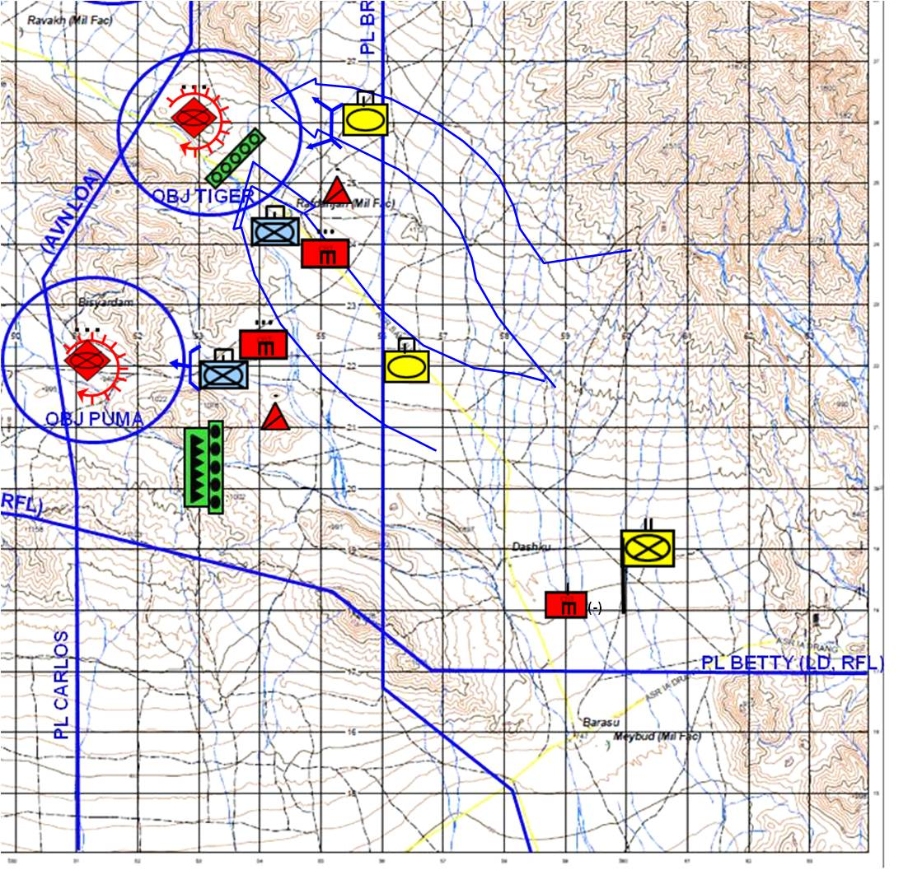
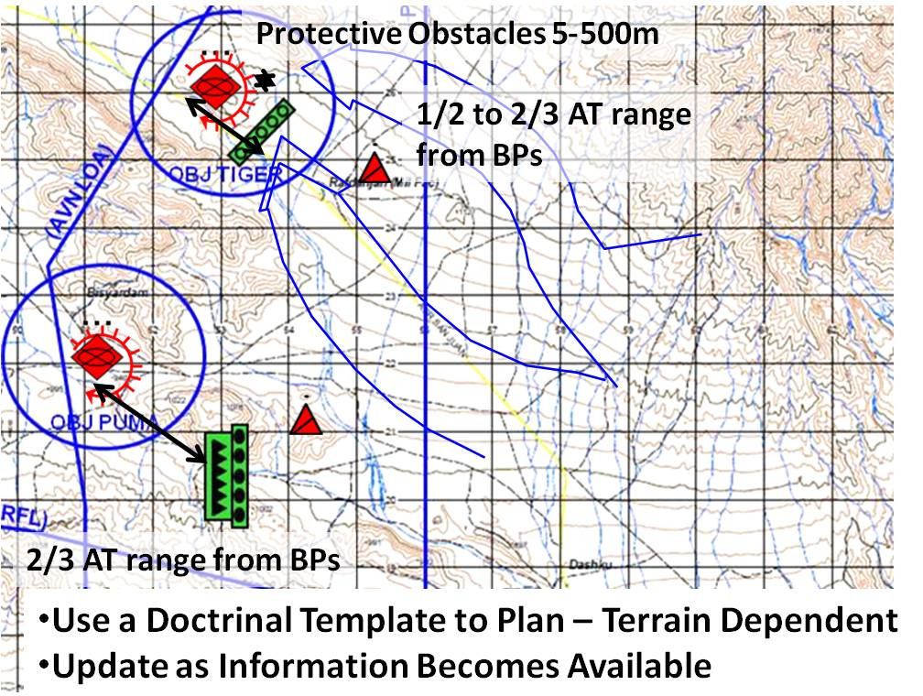
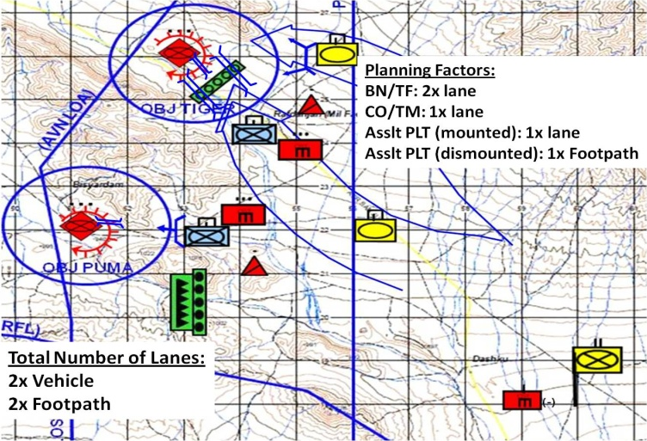
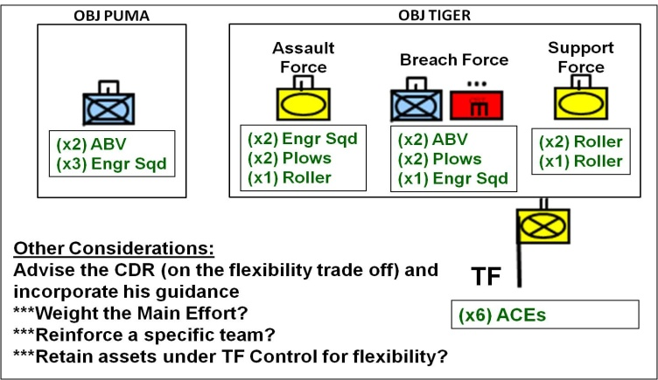
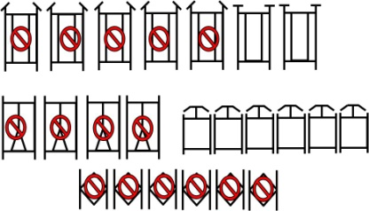
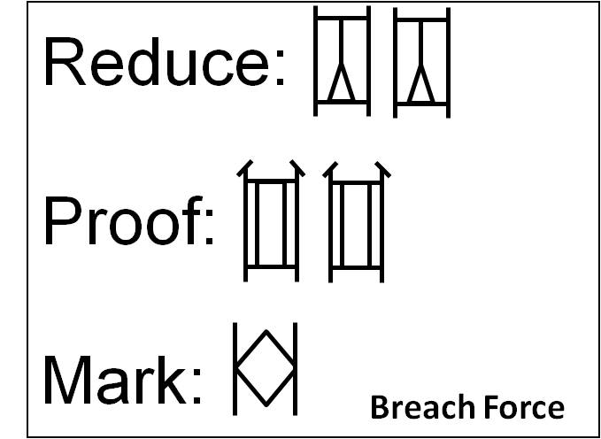
Reverse Breach Planning “A Way”
Step #1 Identify Available Breach Assets (EBA)
Step #2 Understand the Scheme of Maneuver
Step #3 Doctrinally Template Enemy Obstacles
Step #4 Identify type of breach and number of lanes required from OBJ back to the LD
Step #5 Identify assets required to Breach / Proof / Mark, type of breach, and redundancy
Step #6 Identify Task Organization

Slide 8
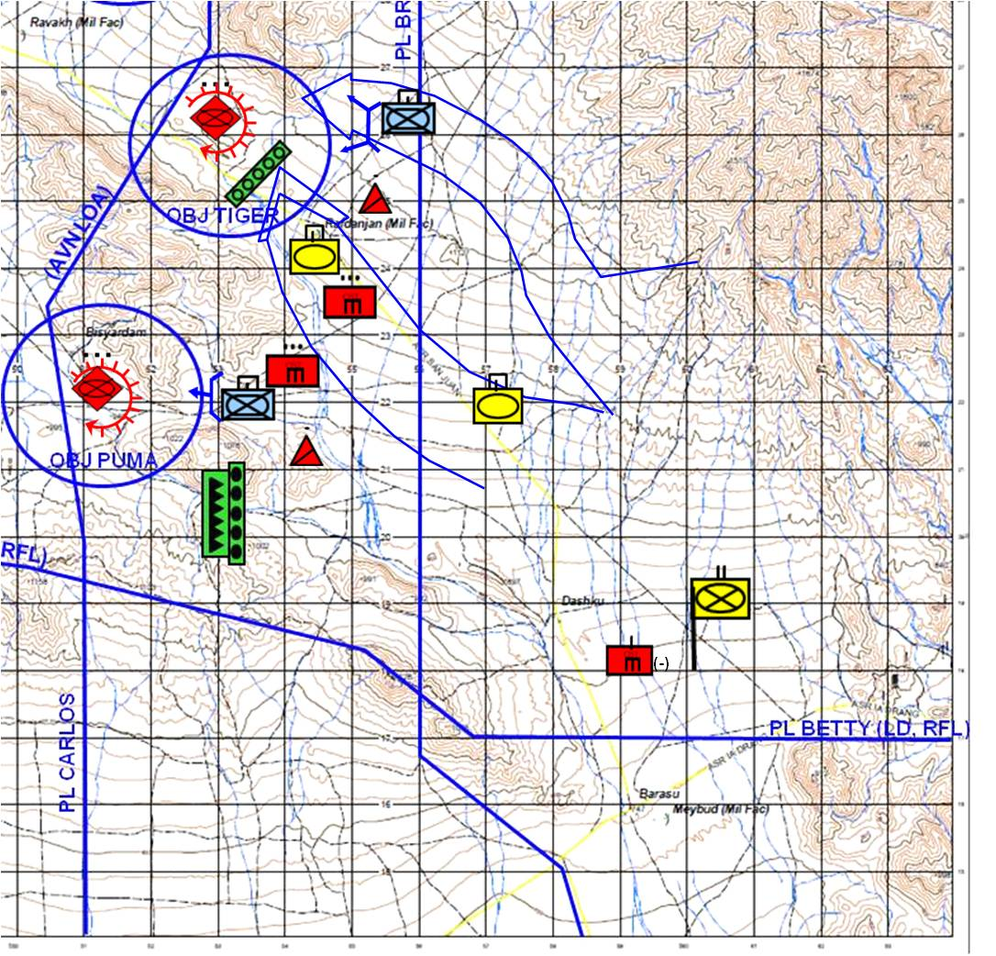
Breaching Operations-”A Way”
SIZE OF
SUPPORT
FORCE
AMOUNT OF
SUPPRESSION
& OBSCURATION
SIZE OF
BREACH
FORCE
NUMBER &
LOCATION
OF LANES
ACTIONS
AT
OBSTACLES
SIZE OF
ASSAULT
FORCE
ACTIONS
ON THE
OBJECTIVE
* ISOLATE * SUPPRESS * OBSCURE
* SECURE * REDUCE
* ATTACK * EXPLOIT
SUPPORT FORCE
(Achieves 5 : 1)
BREACH FORCE
WITH 50% REDUNDANCY
AND LOCAL SECURITY
ASSAULT FORCE
(Achieves 3 : 1)

Slide 9
Reduction Planning Times
Lane Reduction Asset (# of Assets Required) | Time Required
Mechanical Breach of MF (120m) (2x ABV or 2x Plow or 2x ACE) | 10 min
Manual Breach of surface laid MF (120m) (1x Sqd) | 10 min
Breach ATD with ACE Team (2x ACE) | 10 min
Lane Requirements (Size of Assaulting Force) | # of Lanes
Task Force | 2 Vehicle Lanes
Company/Team | 1 Vehicle Lane
Assault Platoon (mounted) | 1 Vehicle Lane
Assault Platoon (dismounted) | 1 Assault Footpath
Reduction Resources | Assets
Mechanical/Explosive Reduction (per vehicle lane)
-Reduce | MICLIC, Plow, ACE, ABV
-Proof | Roller, Plow, ACE, ABV, Sqd
-Mark | ABV, Squad
Manual Reduction (per vehicle lane) | Platoon
Manual Reduction (per platoon assault footpath) | Squad
Reference: USAES Planning Factors

Slide 10
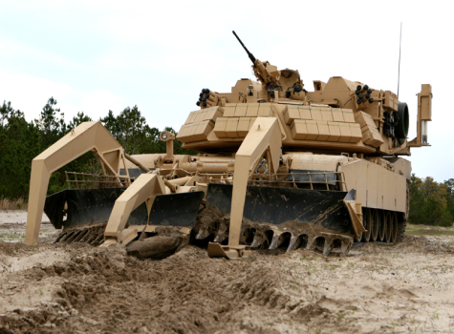
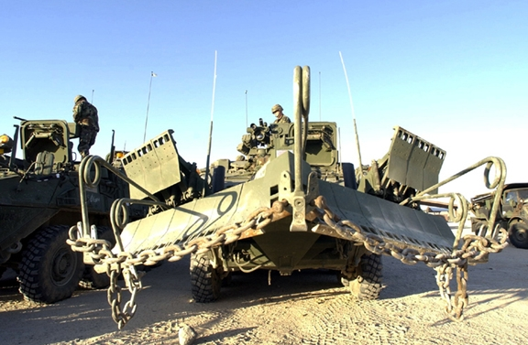
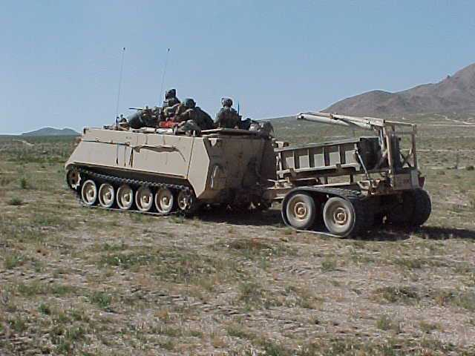
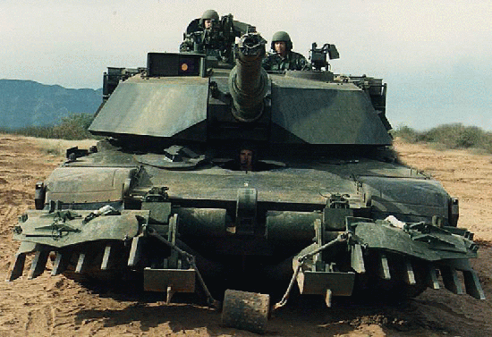
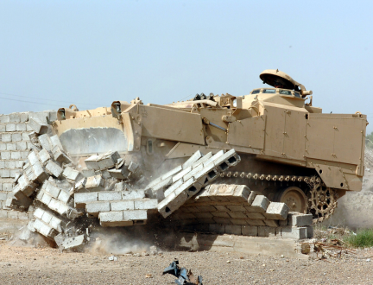
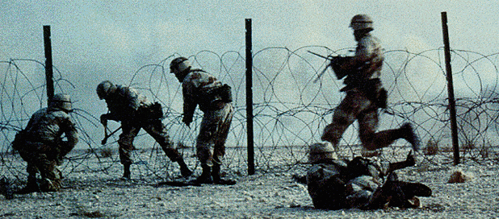
Reduction Assets
Assault Breacher Vehicle – Full Width Mine Plow Attached
Engineer Stryker Plow
M113 with MICLIC
The full-width mine plow is designed to
dampen and survive the blast of pressure-fuzed AT mine. The plow can take 3x AT mine strikes before NMC. (Note 1)
MICLIC gives unit 14m x 200m reduced lane (Note 2). (2 MICLICs/ABV)
1x AT mine strike per side of plow before NMC. (Note 1)
MICLIC gives unit 14m x 100m reduced lane (Note 2)
MICLIC gives unit 14m x 100m reduced lane (Note 2)
M1 Plow
M9 ACE
Engineer Squad
1x AT mine strike per side of plow before NMC . If the Mine-clearing blade (MCB) does not maintain appropriate spoil on the blades (up to the moldboards), the first mine that comes in contact with the MCB will destroy the blade on the appropriate side of the tank. The second mine that comes in contact with the MCB on that side of the tank will destroy the tank. If the MCB comes completely off the ground the tank will be assessed as a catastrophic kill if a mine is encountered by the tank. (Note 2)
The blade must maintain enough spoil to prevent blade to mine contact. If appropriate spoil is not maintained and a mine contacts the blade, the blade is destroyed and the vehicle can longer be used for breaching operations. (Note 2)
Manual reduction techniques will be conducted IAW unit SOP. When grapelling, if a grapnel hook hits a TM-89 or OZM-3 mine, OC/Ts will assess the mine as destroyed along with the grapnel hook and a small portion of rope. Soldiers must take proper safeguards against anti-handling devices or they will be assessed as casualties. (Note 2)
Note 1: Needs addition to or refinement of existing EXOP standards.
Note 2: Covered in current edition of EXOP, no additional action needed.

Slide 11
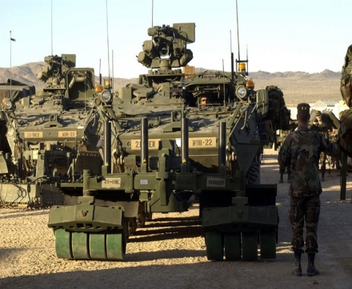
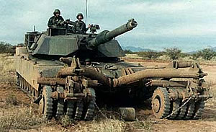
Proofing Assets
Assault Breacher Vehicle – Full Width Mine Plow Attached
Engineer Stryker Plow
M1 Plow
The full-width mine plow is designed to
dampen and survive the blast of pressure-fuzed AT mine. The plow can take 3x AT mine strikes before NMC. (Note 1)
**An ABV with the Combat Dozer Blade attached shouldn’t be used to proof lanes due to an inability to proof buried mines and the CDB not being the full track-width of the ABV (Note 1)
1x AT mine strike per side of plow before NMC (Note 1)
Each MICLIC gives unit 14m x 100m cleared lane (Note 2)
1x AT mine strike per side of plow before NMC . If the Mine-clearing blade (MCB) does not maintain appropriate spoil on the blades (up to the moldboards), the first mine that comes in contact with the MCB will destroy the blade on the appropriate side of the tank. The second mine that comes in contact with the MCB on that side of the tank will destroy the tank. If the MCB comes completely off the ground the tank will be assessed as a catastrophic kill if a mine is encountered by the tank. (Note 2)
Engineer Stryker Mine Roller
M1 Mine Clearing Roller
Engineer Squad
1x AT mine strike per roller bank before NMC. If the ESV continues, the 2nd strike will destroy the MCR and ESV. The MCR can clear 150 M of FASCAM, if it proceeds further it will be assessed as a catastrophic kill. (Note 1)
Note: Though not recommended, a MCR can conduct reduction. MCR will not clear a full track width path.
2x AT mine strike per roller bank before NMC. If the tank continues, the 3rd strike will destroy the MCR and tank. The MCR can clear 200 M of FASCAM, if it proceeds further it will be assessed as a catastrophic kill. The tank attached to the MCR will be assessed as a firepower kill if the tank turret is not traversed when a mine is struck. (Note 1)
Dismounted Sapper squads can visually proof surface minefields and electronically proof buried minefields using dismounted mine detection assets. (Note 2)
Note 1: Needs addition to or refinement of existing EXOP standards.
Note 2: Covered in current edition of EXOP, no additional action needed.

Slide 12
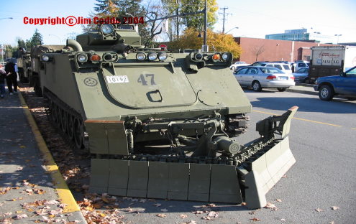
Royal Canadian Army Engineer Assets
Engineer LAV - 5x with 23rd Field Squadron
MTVE – 2x with 23rd Field Squadron
MTVE – 2x with 23rd Field Squadron
Can be configured with dozer blade. Blade can be used to reduce or proof mined obstacles. Recommend using the same EXOP rules as the ACE for adjudication.
Can be configured with surface mine plow. Not effective versus subsurface minefields. Can be used to reduce or proof mine obstacles. Recommend using the same EXOP rules as the M1A1 plow for adjudication.
Blade can be used to reduce or proof mined obstacles. Recommend using the same EXOP rules as the ACE for adjudication.

Slide 13
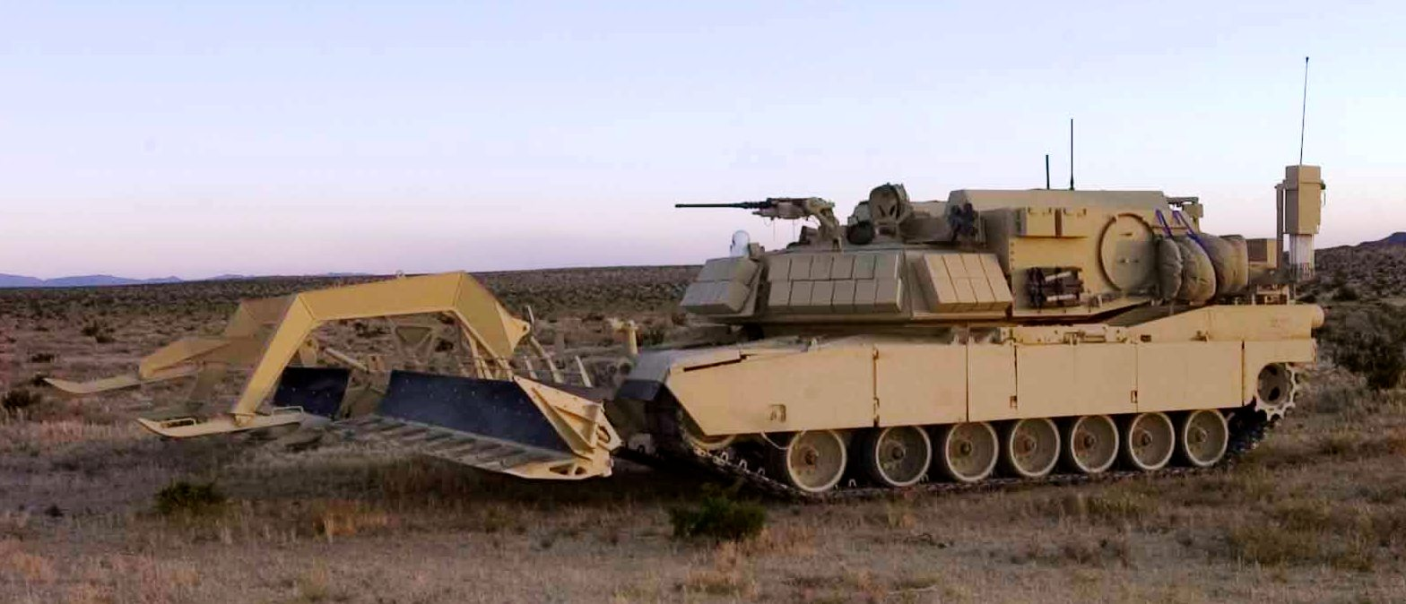
Explosive Minefield Breach with ABV and MICLIC
MICLIC employment from Assault Breacher Vehicle (ABV) in a minefield of uncertain or greater than 100 meters in depth
Assault Breacher Vehicle (ABV) with mine plow
62 m
100 m
ABV w/Plow
employs
1st MICLIC
Support force suppresses enemy direct fire and observed indirect fire on the breach site.
FA delivered smoke obscures the breach site.
ABV begins plowing 100m from lead edge of the suspected minefield.
62m from lead edge, the ABV employs MICLIC #1 then moves forward proofing lane with plow and deploying lane marking system (LMS) poles.
35-40m into the breach lane, the ABV employs MICLIC #2 creating an overlap in the cleared zones (depicted in the diagram to the left).
ABV continues plowing through the far side of the minefield to proof the lane and mark using LMS.
Assault force follows ABV through breach lane and destroys enemy on far side of the breach.
ABV plows
100 meters
before obstacle
62 m
100 m
ABV w/Plow
employs
2nd MICLIC
First line charge
Second line charge

Slide 14
Explosive Minefield Breach with Towed MICLIC
MICLIC employment from towed trailer in a minefield of uncertain or greater than 100 meters in depth
M113 employs
1st MICLIC
62 m
100 m
1
Support force suppresses enemy direct fire and observed indirect fire on the breach site.
FA delivered smoke obscures the breach site.
M1 begins plowing 100m from lead edge of the suspected minefield.
62m from lead edge, the M113 employs MICLIC #1 then M1 with plow begins proofing lane
35-40m into the breach lane, the M1 halts and a second M113 employs MICLIC #2 creating an overlap in the cleared zones (depicted in the diagram to the left).
M1 continues plowing through the far side of the minefield to proof the lane. Dismounted Sapper squad follows to mark lane through minefield.
Assault force follows through breach lane and destroys enemy on far side of the breach.
M1 plows
100 meters
before obstacle
M1 w/Plow
proofs lane
62 m
100 m
2
M113 employs
2nd MICLIC
First line charge
Second line charge

