Slide 1
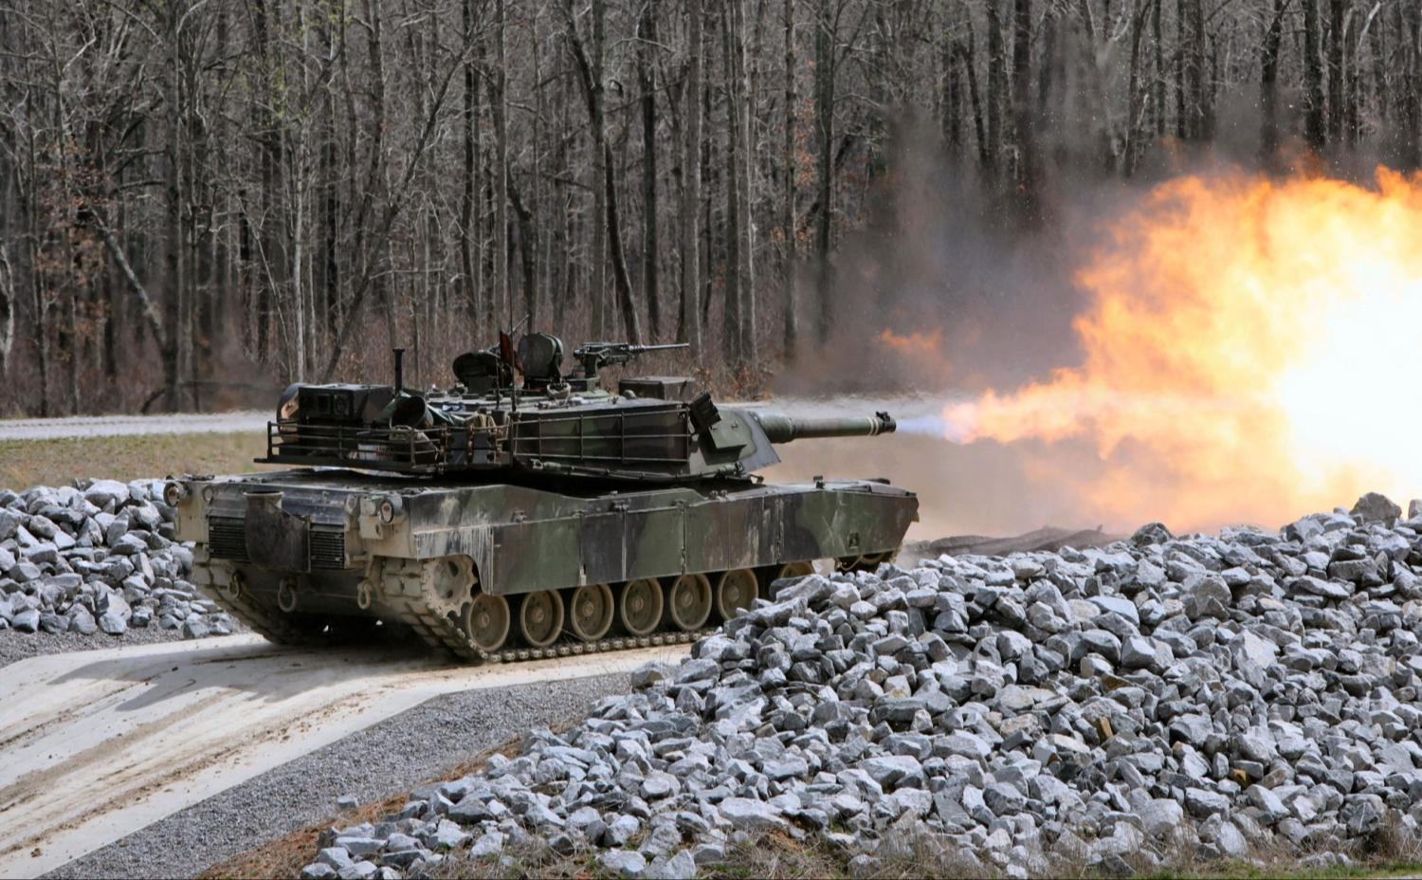
Operation Instructions
Abrams Installation

Slide 2
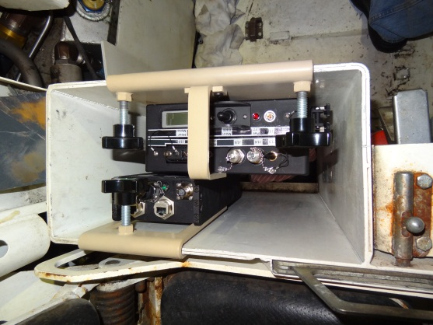
Abrams CMUR Installation
8 Channel Encoder Installation

Slide 3
NOTE
When installing the CMUR and 8-Channel Encoder do not tighten locking knobs until all cables have been
connected. It may be necessary to lift or adjust the CMUR and/or the 8-Channel Encoder out of the .50 Cal
Ammo Stowage Box throughout the install process.
Notes:
Ensure Students are on page 0017-3 of OUM-71-6920-924-10

Slide 4
1. Remove the 8-Channel Encoder and CMUR from the Transit Case (item #1 and #3).
2. Mount the Encoder (item #3) inside the .50 Cal Ammo Stowage Box. See Figure 4-3.
3. Place CMUR (item #1) on top of .50 Cal Ammo Stowage Box for Solid State Drive (SSD) inspection. See Figure
4-4.
4. Unscrew the Solid State Drive (SSD) thumb screws and open the SSD Drive Bay Door. See Figure 4-5.
5. Press latch release button and ensure that the SSD has been installed. See Figure 4-5.
6. Re-seat SSD.
7. Close the bay door and tighten thumb screws.
Notes:
Have Students read from their manual and show them the components they are talking about

Slide 5
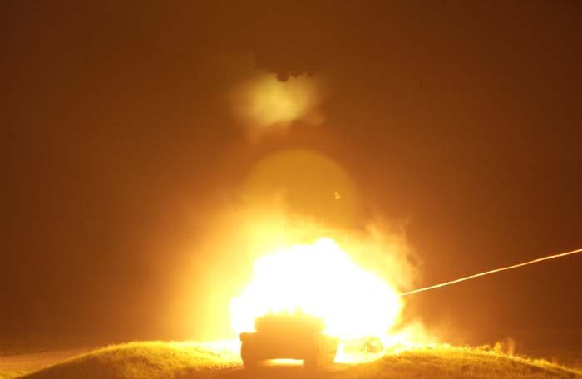
NOTE
The units are stored with a SSD installed however, if one is not present, obtain an SSD and insert it in the
SSD bay.
Notes:
Talk about the importance of ensuring the SSD in inserted and how it could be misplaced during a training exercise.

Slide 6
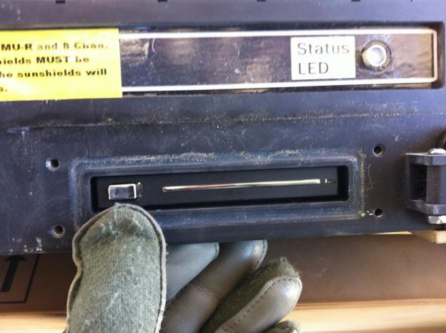
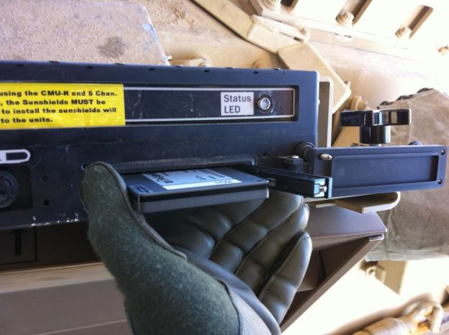
CAUTION
Failure to close the CMUR SSD bay door and tighten the thumb screws will expose the SSD
slot to dust, moisture and debris, which could cause damage to the CMUR.
Notes:
Talk about the possibility of damage when running a range and “hot-bedding” vehicles.

Slide 7
8. Verify CMUR (item #1) power is set to OFF position.
9. Loosen the locking knobs of the CMUR (item #1).
10. Remove CAT5 cables from Transit Case (item #8).
11. Connect CAT5 cable (item #8) from the J3 connector on the CMUR (item #1) to the J11 connector on the Encoder
(item #3). See Figure 4-6.
12. Connect CAT5 cable (item #8) from the J4 connector on the CMUR (item #1) to the J12 connector on the Encoder
(item #3). See Figure 4-6.
13. Remove GPS Receiver from Transit Case (item #9).
Notes:
Ensure Students are on page 0017-5 of OUM-71-6920-924-10.

Slide 8
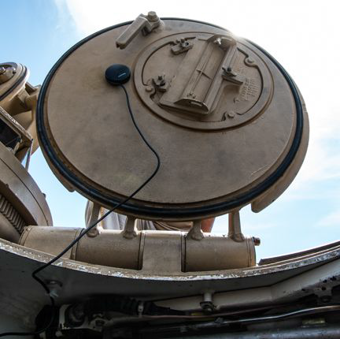
CAUTION
Ensure that GPS Receiver cable routing does not interfere with crew operation and allows for
the opening and closing of hatches with no crimping of cable. If not followed damage to the
GPS Receiver Cable will result.
Notes:
Explain to the Students that For CBRN Engagements, UNIT SOP will dictate if hatches are closed while using the CMUR. Explain that the temporary loss of GPS data will not effect the AAR Video or Audio recording.

Slide 9
14. Connect GPS (item #9) to port J17 on the CMUR (item #1). See Figure 4-7.
15. Route the GPS cable (item #9) from the CMUR (#1) between the Loader’s and Tank Commander’s positions.
NOTE
Ensure the GPS cable does not impede the PM-3C Fire Sensor.
16. Attach the GPS Receiver (item #9) to the inside of the Loader’s hatch using its magnetic base. See Figure 4-8.
17. Remove color coded camera cables from VAK (item #24, #25, #27, and #28).
Notes:
Page 0017-6 of OUM-71-6920-924-10

Slide 10
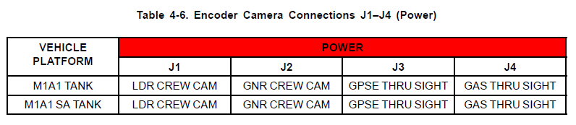
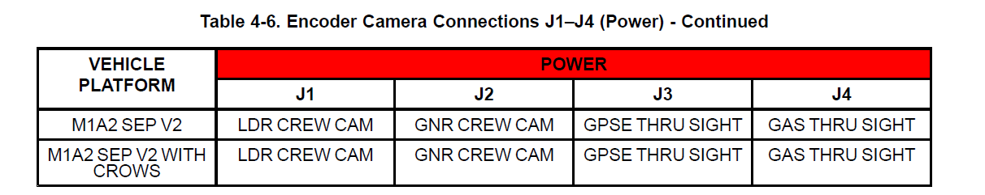
18. Connect short end of each camera cable (item #24, #25, #27, and #28) to Encoder (item #3) as shown in Table
4-6.
Notes:
Pages 0017-7 and 0017-8 of OUM-71-6920-924-10.

Slide 11
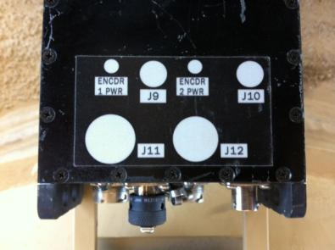
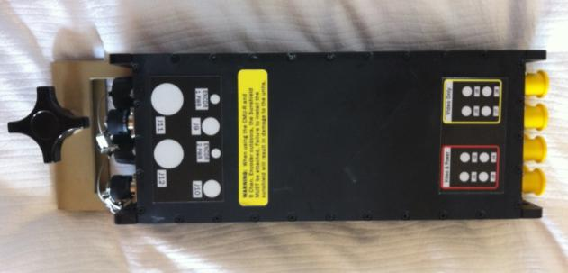
NOTE
The camera cable connectors are located on the bottom of the 8-Channel Encoder, the unit will have to be
removed from its mounting location to connect each camera cable.
Encoder will be tightened down and secured inside the .50 Cal Ammo Stowage Box when all hardware is
mounted and all cables have been routed in the vehicle.
Notes:
Page 0017-7 of OUM-71-6920-924-10.

Slide 12
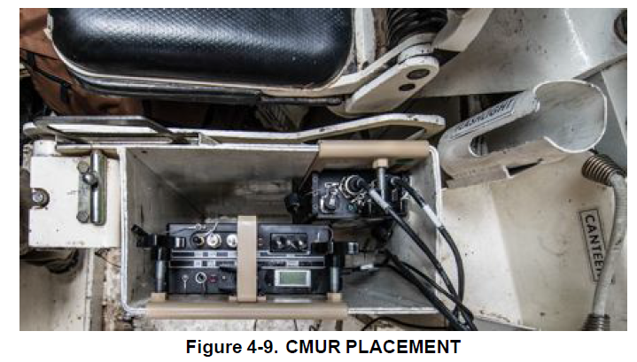
19. Place CMUR (item #1) in .50 Cal Ammo Stowage Box. See Figure 4-9.
20. Clean up excess cabling and place neatly out of the way.
Notes:
Talk about the locking knobs again and future placement of camera cables.

Slide 13
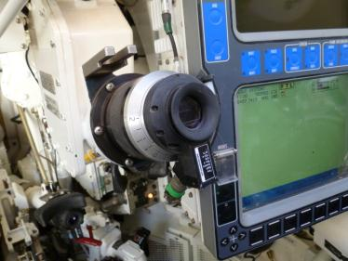
Operation Instructions
Abrams Installation (CONT’D)
Gunner’s Primary Sight Extension (GPSE)
Thru-Sight Camera (TSC)
Notes:
Bottom of Page 0017-8 of OUM-71-6920-924-10.

Slide 14
GPSE Thru-Sight
CAUTION
Do not over tighten the locking screw. Excessive force could cause screw to strip and break.
1. Remove the brow pad from the GPSE. See Figure 4-10.
2. Remove the TSC from VAK (item #26).
NOTE
Ensure that the TSC is mounted so that the cable connector is at the 6 o'clock position. See Figure 4-10.

Slide 15
GPSE Thru-Sight
3. Install the TSC (item #26) on the GPSE:
a. Loosen the locking screw on the TSC (item #26). See Figure 4-10.
b. Place TSC (item #26) over the sight.
c. Tighten the locking screw to secure the TSC (item #26). See Figure 4-10.
4. Route camera cable from the encoder (item #3) and along the turret wall to the GPSE TSC (item #26). Refer to
Table 4-6.
NOTE
Do not use zip ties or secure cable magnets until the system has been tested and everything is installed.

Slide 16
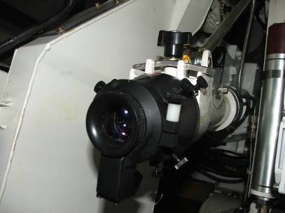
Operation Instructions
Abrams Installation (CONT’D)
Gunners Auxiliary Sight (GAS)Thru-Sight Camera (TSC)

Slide 17
Gunners Auxiliary Sight (GAS)Thru-Sight Camera (TSC)
CAUTION
Do not over-tighten the locking screws. Excessive force could cause screws to strip and break.

Slide 18
Gunners Auxiliary Sight (GAS)Thru-Sight Camera (TSC)
NOTE
Ensure that GAS Adapter is installed with the Arrow indicator in the 12 o'clock position. See Figure 4-12.
The GAS Adapter locking screws may need additional adjustment to properly align the camera.
Notes:
Tell Students to look at Figure 4-12 on page 0017-11 in OUM-71-6920-924-10.

Slide 19
Gunners Auxiliary Sight (GAS)Thru-Sight Camera (TSC)
1. Remove the GAS brow pad. See Figure 4-11.
2. Remove the GAS Adapter and TSC from the VAK (item #2 and #29).
3. Focus the TSC (item #29).
4. Install the GAS Adapter (item #2) over the GAS by securing with the locking screws.
5. Install the TSC (item #29) on the GAS Adapter (item #2):
a. Loosen the locking screw.
b. Place the TSC (item #29) on the GAS Adapter (item #2).
c. Tighten the locking screws. See Figure 4-24.
6. Route the camera cable from J4 on the Encoder (item #3) along the turret wall to the GAS TSC (item #29).
7. Use the large cable magnets from the VAK (item #5) to secure the camera cable along the turret wall.
8. Replace the brow pad.
Notes:
Direct the Students to Figure 4-11 in OUM-71-6920-924-10 (page 0017-10) and Figure 4-24 (page 0017-27) as needed.

Slide 20
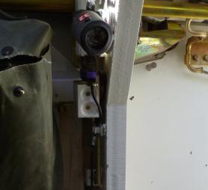
Operation Instructions
Abrams Installation (CONT’D)
Loader’s Crew Camera
NOTE
Keep the camera and all cables clear of the ammo door. Failure to do so could result in damage
to equipment.
Notes:
Have Students Read Cautions and Warnings on page 0017-12 of OUM-71-6920-924-10.

Slide 21
Loader’s Crew Camera
1. Obtain the Loaders crew camera from VAK and the Loaders camera bracket from the VAK (item #4 and #31).
2. Turn the locking knob on the camera counter clockwise to loosen the locking knuckle on the crew camera.
3. Attach the loader’s crew camera (item #31) to the magnetic camera mount (item #4) and tighten the locking knob
to secure.
4. Place the camera and its mount on the Tank Commander’s side of the upper crew compartment by the Fire Sensor
oriented on the Breech of the 120mm Main Gun. See Figure 4-13.
Notes:
Page 0017-12 of OUM-71-6920-924-10.

Slide 22
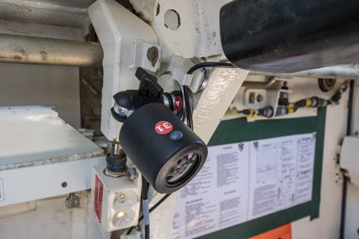
Loader’s Crew Camera
5. Route the camera cable from the loader’s crew camera (item #31) to the J1 on the 8-Channel Encoder (item #3),
ensuring that the cable stays clear of the Ammunition Doors and the Tank Commander’s seat.
Notes:
Page 0017-13 of OUM-71-6920-924-10. Point out how some Military Work Orders and modifications to the tank can cause adjustment to the placement of the camera but that the important thing is obtaining the view and not hindering gunnery operations of the crew and vehicle.

Slide 23
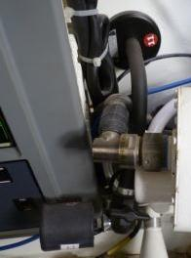
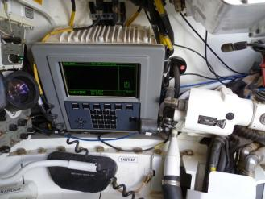
Operation Instructions
Abrams Installation (CONT’D)
Gunner’s Crew Camera
Notes:
Have Students Read Cautions and Warnings on page 0017-13 of OUM-71-6920-924-10.

Slide 24
Gunners Crew Camera
1. Obtain the Gunner’s crew camera and the Alternative Gunners Camera Bracket from the VAK (item #11 and #32).
2. Orient camera (item #32) in a manner that provides the best view of the Gunner's lower panel for AAR purposes.
3. Turn the locking knob on the camera (item #32) counter clockwise to loosen the locking knuckle on the crew
camera.
4. Attach the Gunner’s crew camera (item #32) to the camera mount (item #11) and tighten the knuckle to secure.
5. Place the magnetic camera mount (item #11) to the right of the Gunner’s Control Display Panel. See Figure 4-14.
Notes:
Bottom of Page 0017-13 of OUM-71-6920-924-10. Point out how some Military Work Orders and modifications to the tank can cause adjustment to the placement of the camera but that the important thing is obtaining the view and not hindering gunnery operations of the crew and vehicle.

Slide 25
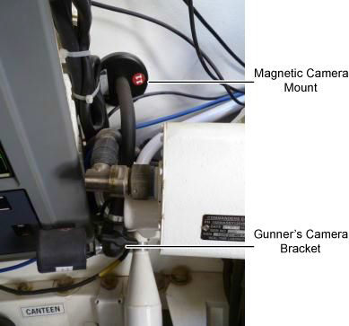
Gunners Crew Camera
6. Orient Gunner’s crew camera (item #32) on GPS lower panel.
7. Route the camera cable from the Gunner’s camera (item #32) to the short end of the camera cable at J2 on the
8-Channel Encoder (item #3) along the turret wall.
Notes:
Bottom of Page 0017-14 of OUM-71-6920-924-10. Discuss the differences between the Computer Control Panel (CCP) on the M1A1 and the Gunner’s Control and Display Panel (GCDP) on the M1A2 and that the procedures are identical.

Slide 26
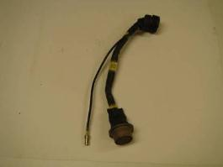
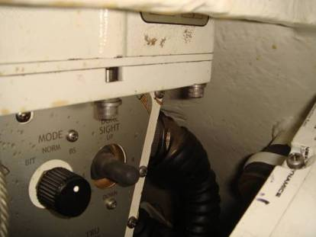
Operation Instructions
Abrams Installation (CONT’D)
TSVR Video Adapter and Cable
Notes:
Ensure students are on page 0017-14 of OUM-71-6920-924-10. Explain the purpose of the cable and the view that it provides for AAR purposes.

Slide 27
1. Locate and remove the TSVR Video Adapter (item #16) from the Vehicle Accessory Kit. See Figure 4-15.
2. Identify and disconnect the J2 cable connector from the Thermal Receiving Unit (TRU) located between the upper right of the Gunner's Station and the Turret Wall.
CAUTION
Ensure that the keyways and pins are properly aligned prior to connecting the cable; failure to align the keyways and pins will result in damage to the cable pins.
3. Connect the J2 cable to the TSVR Video Adapter (item #16).
4. Connect the male end of the TSVR Video Adapter (item #16) to the TRU J2.
5. From the VAK, locate and remove the Universal Video Breakout cable (item #16A).
6. Connect the Universal Video Breakout cable (item #16A) to the TSVR Video Adapter (item #16).
7. Route the Universal Video Breakout cable (item #16A) along the Turret wall behind the Tank Commanders seat
to the TSVR Video Adapter (item #16); secure using existing cable magnets.
8. Connect the other end of the camera cable to the 8-Channel Encoder (item #3). See Table 4-7 to determine which connector to use.
Notes:
Page 0017-15 of OUM-71-6920-924-10. Again, have students read from their manual to gain confidence in the document in preparation for the Practical Exercises.

Slide 28
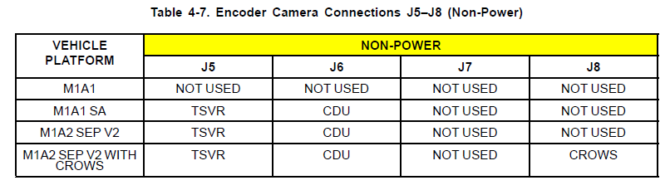
Notes:
Discuss Figure 4-7 and the Non-Power connections and what they mean.

Slide 29
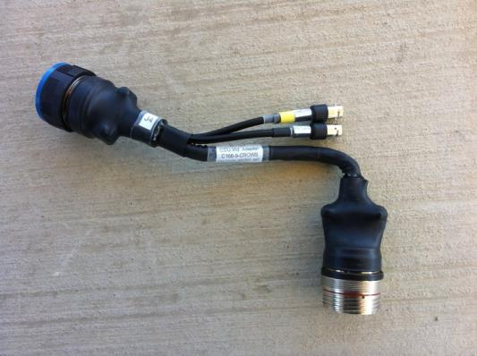
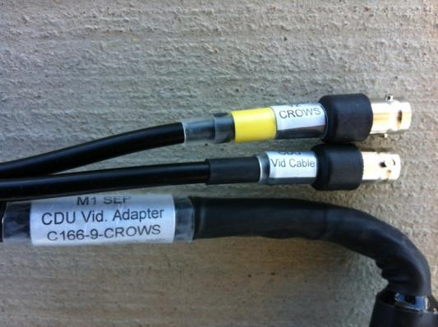
Operation Instructions
Abrams Installation (CONT’D)
CDU Video Adapter and Cable
Notes:
Explain that the procedures for installing the CDU cable on a CROWS Equipped tank are identical to a non-CROWS equipped tank with the exception of the added video cable connected to the CDU Video Adapter Cable.

Slide 30
1. Disconnect the J4 cable from the rear of the CDU by turning the J4 cable head counterclockwise and pulling back until free of J4 connector.
2. Remove the M1 SEP CROWS video adapter from the VAK (item #15).
NOTE
When connecting the M1 SEP CROWS Video Adapter to the rear of the CDU, ensure to line up the adapter key with the connector key before tightening the cable. The adapter key is usually positioned at 12 o’clock position but may differ from vehicle-to-vehicle.
3. Connect the male end of the M1 SEP CROWS video adapter (item #15) to connector J4 on the rear of the CDU.
4. Turn the video adapter head clockwise until firm. Do not over tighten.
5. Connect the CDU J4 cable to the M1 SEP CROWS video adapter.
6. Remove the video extension cable from the VAK (item #15b).
7. Route the video extension cable along the turret wall behind the Commander’s seat to the CDU and secure with cable magnets.
8. Connect the CDU video cable to video jack located on the CDU video adapter.
9. Connect CROWS Video Cable to CROWS video jack located on the CDU Video Adapter (CROWS only).
Notes:
Page 0017-16 of OUM-71-6920-924-10. Again, have students read from their manual to gain confidence in the document in preparation for the Practical Exercises.

Slide 31

10. Connect camera cable to the 8-Channel Encoder (item #3). See Figure 4-16.
11. If CROWS is present, connect the CROWS connector to the 8-Channel Encoder (item #3). See Table 4-8 to determine which connector to use.
Notes:
Page 0017-17 of OUM-71-6920-924-10.

Slide 32
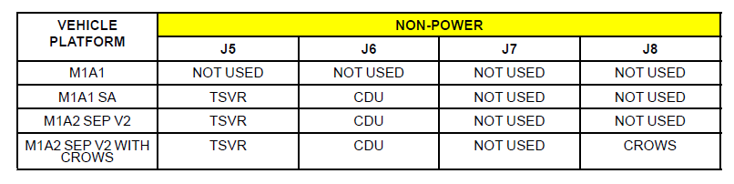
Notes:
Page 0017-17 of OUM-71-6920-924-10. Again, Discuss the Table, its function, and importance of hooking up the encoder in the proper sequence for AAR purposes.

Slide 33
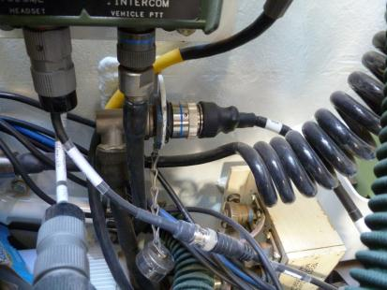
Operation Instructions
Abrams Installation (CONT’D)
External Audio Adapter and Cable
Notes:
Ensure students are on correct page in their manuals. (page 0017-18)

Slide 34
External Audio Adapter and Cable
NOTE
If a CVC is connected to Commanders FFCS remove until the External Audio Adapter is installed. The External Audio Cable can be connected to any FFCS in the turret, however the Commander’s FFCS is recommended.
1. Remove the External Audio Adapter from the VAK (item #30).
2. Attach the External Audio Adapter connector (item #30) end labeled Headset to Commander’s FFCS CVC connector. See Figure 4-17.
Notes:
Page 0017-18 of OUM-71-6920-924-10.

Slide 35
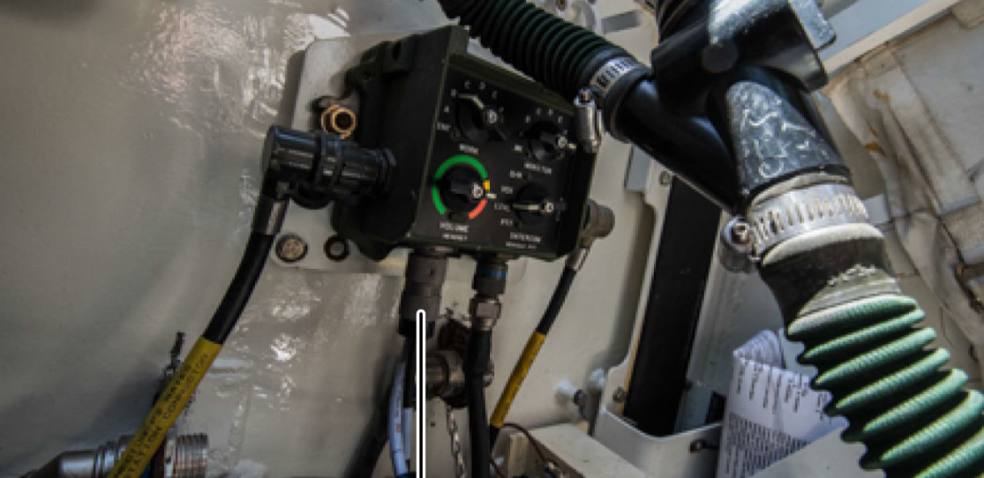
External Audio Adapter and Cable
3. Connect the CVC to the External Audio Adapter connector (item #30) end labeled CVC.
Notes:
Page 0017-18 of OUM-71-6920-924-10.

Slide 36
External Audio Adapter and Cable
4. Remove the orange External Audio Cable from the VAK (item #34).
5. Connect the orange External Audio Cable (C132–11 A; item #34) to the connector on the External Audio Adapter (item #30) labeled Audio Out.
6. Connect the External Audio Cable (C132–11 B; item #34 Part B) to the 8-Channel Encoder (item #3) J10 connector.
Notes:
Page 0017-19 of OUM-71-6920-924-10.

Slide 37
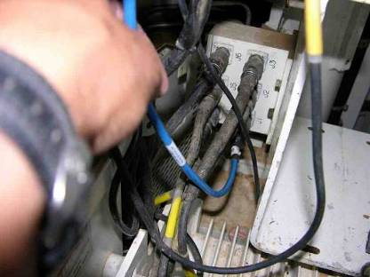
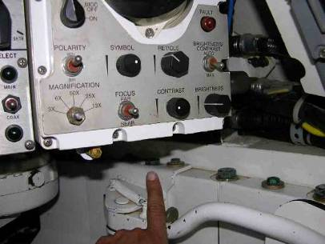
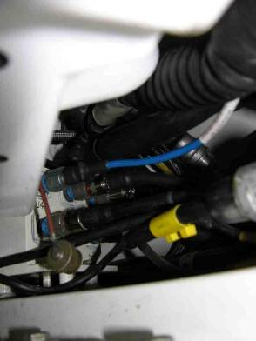
Operation Instructions
Abrams Installation (CONT’D)
1553 Data Bus A Cable
1553 Data Bus B Cable
Notes:
Ensure that Students look at the bottom half of page 0017-19 of OUM-71-6920-924-10. Give an overview of 1553 Data and what it provides to the After Action Review and its specific importance in preliminary gunnery training of new gunner’s.

Slide 38

Loader’s 1553 Data A Cable
1. Remove Data Bus Cable from Transit Case (item #6).
2. Connect Data Bus Cable A (item #6) to the 1553 connector J1 located in the Loader’s Station. See Figure 4-18.
Notes:
Page 0017-19 of OUM-71-6920-924-10.

Slide 39
Loader’s 1553 Data A Cable
3. Route the cable along the turret wall and ring to the CMUR using two small magnets from the VAK (item #12).
4. Connect the end labeled to CMUR Data Bus to the CMUR (item #1) J14 connector.
Notes:
Page 0017-20 of OUM-71-6920-924-10. Again, talk about routing and avoiding the Ready Ammunition Door

Slide 40
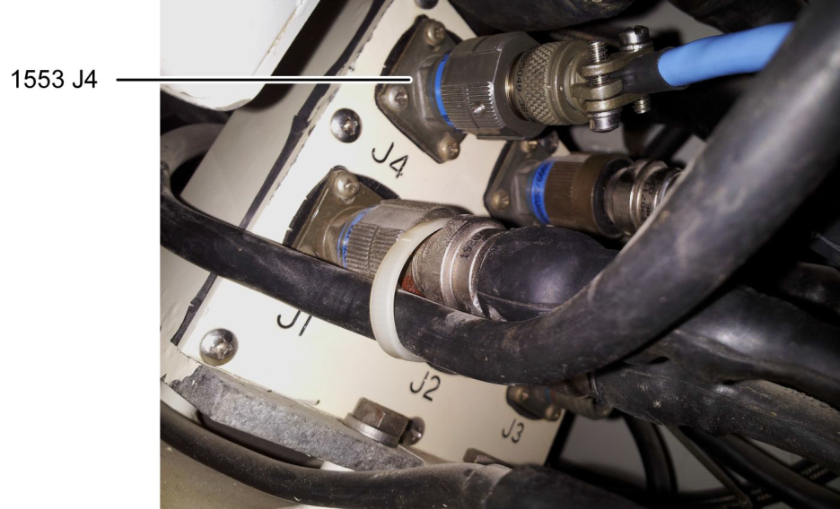
Gunner’s 1553 Data B Cable
1. Locate the 1553 J4 connector between the lower right of Gunner's Station and the Turret Wall. See Figure 4-19.
Notes:
Page 0017-20 of OUM-71-6920-924-10. Again, talk about routing and avoiding the Ready Ammunition Door

Slide 41
Gunner’s 1553 Data B Cable
2. Connect the data bus cable (item #6) to the 1553 connector J4 located in the Gunner’s station.
3. Route the cable along the turret wall and ring behind the Commander’s seat and to the CMUR, securing cable
with clamps from VAK (item #12).
4. Connect the end labeled to CMUR Data Bus to the CMUR J15 connector (item #1).
Notes:
Page 0017-20 of OUM-71-6920-924-10. Again, talk about routing and avoiding the Ready Ammunition Door

Slide 42
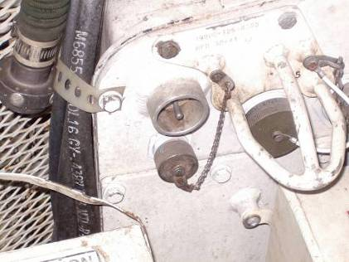
Operation Instructions
Abrams Installation (CONT’D)
CMUR Power Cable and Utility Adapter
CMUR Power Cable (All Models)
Notes:
Explain that the pictures are of the Utility Outlet on the Turret Networked Box of an M1A1 and the Utility Outlet on a M1A2 in the Tank Commander’s Position. Ensure the students understand that on an M1A2 the Utility Power must be turned on through the Commander’s Display Unit.

Slide 43
CMUR Power Cable and Utility Adapter
1. Identify and remove the CMUR 24V Power cable and the Power Adapter Utility cable from the Vehicle Accessory
Kit (item #35 and #39).
2. Connect the Power Adapter Utility cable (item #35) to the CMUR 24V Power cable (item #39).
3. Connect the 24V out connector on the CMUR power cable (item #39) to the CMUR J1 Connector (item #1).
4. To connect to vehicle power, route the cable along the ledge of the turret behind the Loader’s Seat (staying clear of
the Ready Ammunition Door) and to the Turret Utility Outlet Connector located on the Turret Network Box (TNB)
or Re-worked Turret Network Box (RTNB). See Figure 4-20.
Notes:
Page 0017-21 of OUM-71-6920-924-10.

Slide 44
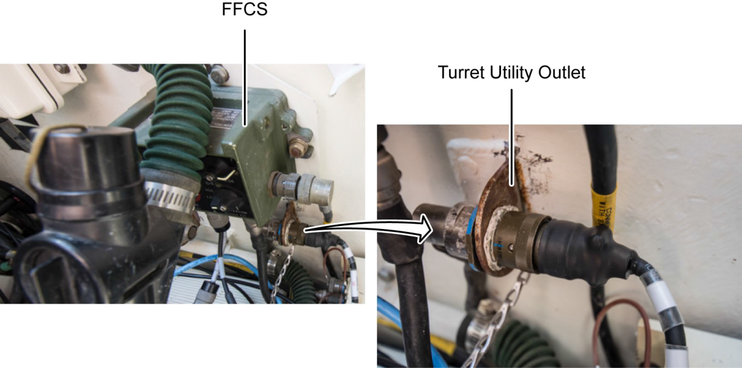
Notes:
Page 0017-21 of OUM-71-6920-924-10. Ask Students what FFCS stands for. (Fully Functional Crew Station)

Slide 45
CMUR Power Cable and Utility Adapter
NOTE
Without CROWS, the Turret Utility Outlet maybe be on the Gunners side.
5. On the M1A1 D or M1A1 SA route the cable the same but from the Loader’s side and input into the Turret Utility Outlet Connector on the RTNB.
6. Ensure the test utility outlet switch is in the ON position on the RTNB.
Notes:
Page 0017-21 of OUM-71-6920-924-10.

Slide 46
CMUR Power Cable and Utility Adapter
1. Identify and remove the CMUR 24V Power cable and the Power Adapter Utility cable from the Vehicle Accessory
Kit (item #35 and #39).
2. Connect the Power Adapter Utility cable (item #35) to the CMUR 24V power cable (item #39).
3. Connect the 24V out connector on the CMUR power cable (item #39) to the CMUR J1 Connector (item #1).
4. Route the cable behind the Tank Commander’s seat and connect to the Turret Utility Outlet Connector cables. On the M1A2, the Turret has to be powered up to access the Menu to turn on the Turret Utility Outlet. Its Default is OFF.
5. Mount the CMUR Encoder (item #3) by placing it into the .50 Cal Ammo Box.
6. Tighten locking knob.
7. Route and cleanup the cables.
Notes:
Page 0017-22 of OUM-71-6920-924-10.

Slide 47
Operation Instructions
Abrams Installation (CONT’D)
FINAL INSPECTION
1. Check for loose or hanging cables that may interfere with the operation of the tank or impede crew duties during normal operations of the vehicle.
2. Visually inspect cable connections to ensure that they are tight.
3. Visually check cameras to ensure they are mounted securely.
4. Using magnets or cable ties, ensure extra components are in cases and secure within vehicle.

Slide 48
Operation Instructions
Abrams Installation (CONT’D)
FINAL INSPECTION (CONT’D)
5. Visually ensure that the CMUR (item #1) and the 8-Channel Encoder (item #3) are securely mounted to the vehicle and that all cables inside and outside are tied down.
6. Turn the turret utility power on at the CDU in order to power the CMUR (SEP only).
7. Power on the CMUR (item #1). See WP 0008 OPERATION UNDER USUAL CONDITIONS — CREW MODULE
UNIT RECORDER (CMUR) START UP.
8. Have the Gunner sit in the Gunner’s position and check the view with the FSE while the Gunner adjusts the camera as needed.
Notes:
ENSURE THAT THE TANK COMMANDER VERIFIES THAT INSTALLATION WILL NOT ADVERSELY EFFECT THE OPERATION OF THE TANK.

Slide 49
Operation Instructions
Abrams Installation (CONT’D)
Power-Up the CMUR
CAUTION:
Do not turn on Vehicle Master Power until all CMUR installation steps are completed.

Slide 50
Operation Instructions
Abrams Instructions
Power Down the CMUR
CAUTION:
Do not turn off CMU-R power until the PC Power Button LED has shut off.

Slide 51
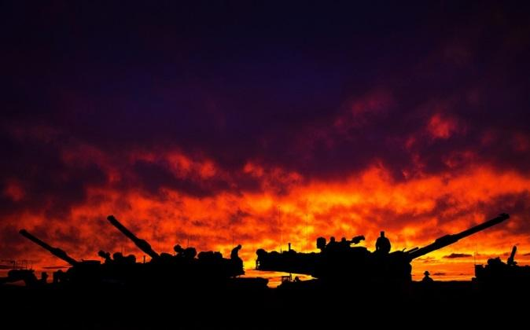
BREAK TIME!
Notes:
Ensure students have a SPECIFIC time to be back seated in class.

