Slide 1
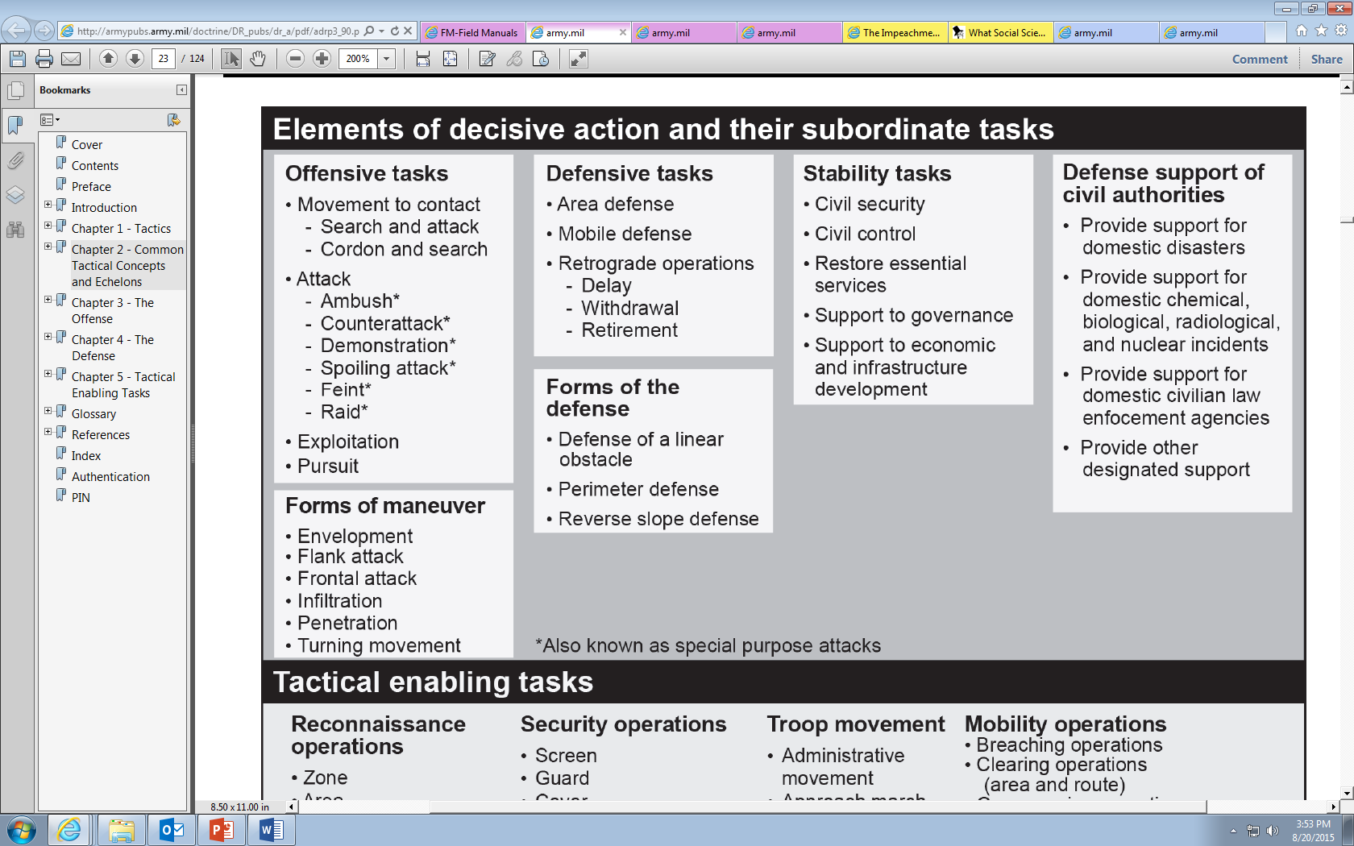
Mission Statement: [Who] [method]s to [task] [where and when] in order to [purpose].
The methods step is optional
Which element of decisive action?
Offense? Choose an offensive method
Defense? Choose a defensive method
Stability? Choose a Stability method
Defense Support of Civil Authorities? Choose a DSCA method
Mission Statement: 7-17 CAV attacks to [task] [where and when] in order to [purpose].
Mission Statement: 7-17 CAV [omitted] to [task] [where and when] in order to [purpose].

Slide 2
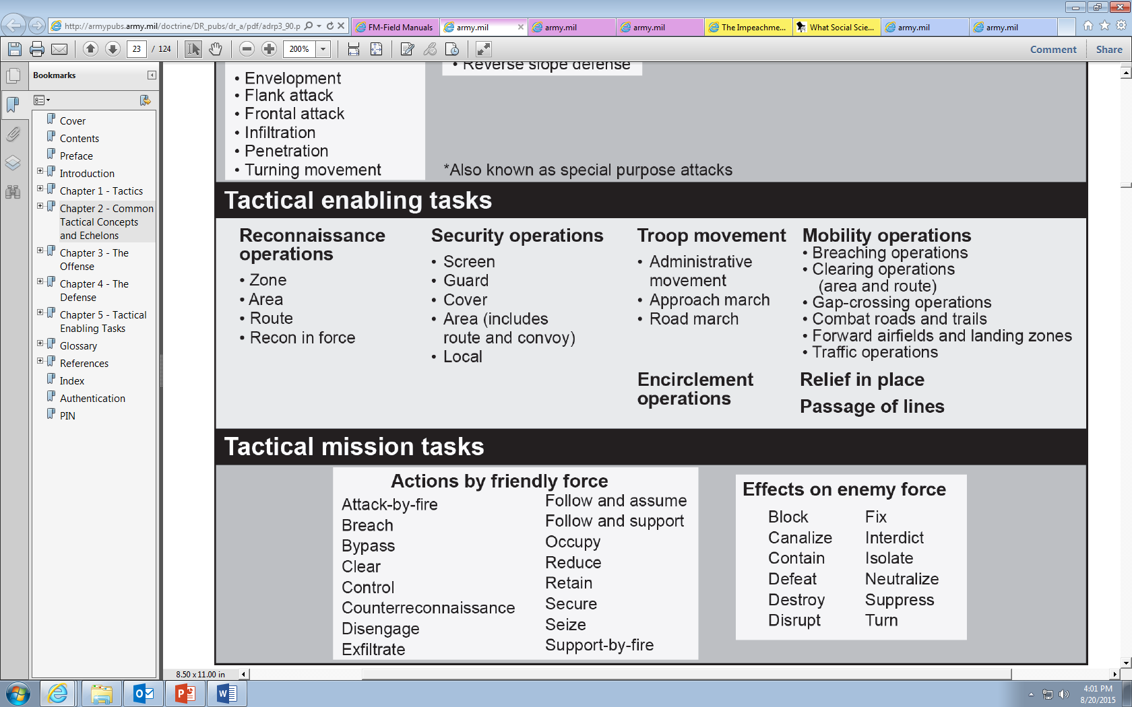
Mission Statement: [Who] [method]s to [task] [where and when] in order to [purpose].
Enabling Mission
or
Tactical Mission?
Tactical Mission
Enabling Mission
*Tactical Enabling Tasks may not require a method
Does my purpose require
an effect on the enemy
OR
actions by friendly forces?
How am I enabling the force?
ADRP 3-90: 2-7. The commander conducts tactical enabling tasks to assist the planning, preparation, and execution of any of the four elements of decisive action. Tactical enabling tasks are never decisive operations in the context of the conduct of offensive and defensive tasks. (They are also never decisive during the conduct of stability tasks.) The commander uses tactical shaping tasks to assist in conducting combat operations with reduced risk.
Mission Statement: 7-17 CAV attacks to destroy 112 BTG [where and when] in order to [purpose].
Mission Statement: 7-17 CAV [omitted] screens 1 BCT’s left flank [where and when] in order to enable the DO to attack OBJ Bull.

