Slide 1
Danger Areas (Vulnerable Point/Vulnerable Area) Search Techniques
Notes:
Instructor/Facilitator’s (I/F) Note
1. Introduce yourself. Only needed for the first time you deliver instruction to these students.
2. Present the following Motivator. As a Leader of Soldiers, you must express to your Soldiers the importance of various search tactics, techniques and procedures (TTPs) and ensure they understand the emerging threats the enemy are using to wound or kill coalition forces. Knowing how they think and countering against the attack has proven beneficial in saving many lives.
3. There is a PE associated with this exercise. Review Appendix C of the lesson plan prior to conducting this lesson.

Slide 2
Terminal Learning Objective
ACTION: | Demonstrate patrol formations that mitigate the threats in Danger Areas (VP/VA)
CONDITION: | In a classroom setting and/or training area, given a presentation, student resources, instruction on VP/VA search techniques, and current reference materials
STANDARD: | Demonstrate patrol formations during STX IAW Ch. 5 of FM 3-24.2, Ch. 2-3, FM 3-21.10 and Ch. 3, FM 3-21.8 and achieve a grade of 80% or greater on examination rubrics and includes: 1. Identify the fundamentals of danger Areas (VP/VA) 2. Conduct dismounted patrol formations search techniques Learning Domain: Cognitive Learning Level: Application
2
Notes:
Instructor/Facilitator’s (I/F) Note
1. Tell the students that at the end of this class they should be able to Demonstrate patrol formations that mitigate the threats in Danger Areas (VP/VA) and that includes:
a. Identify the fundamentals of danger Areas (VP/VA)
b. Conduct dismounted patrol formations search techniques
2. This lesson includes a practical exercise listed in appendix C of this lesson plan.

Slide 3
Identify the fundamentals of danger Areas (VP/VA)
Dismounted Operations
Dismounted Operations are the most effective way of finding IEDs
Over half of all IEDs are found and cleared prior to detonation
Search techniques used in Dismounted Operations in Danger Areas (VP/VA):
VP 360
4-Man Drill
2-Man Drill
V Sweep
Notes:
Instructor/Facilitator’s (I/F) Note
Inform these are the formations that will be used during the course.
These formation will be discussed in detail later during the lesson.

Slide 4
How would you define Danger Areas (VPs/VAs)?
VPs are those points where it is particularly advantageous for the enemy to position an IED.
VAs are those areas where pattern setting allows the insurgent to predict with a degree of certainty that troops will use them again.
Notes:
Instructor/Facilitator’s (I/F) Note
Reinforcement from previous class for terms.
Conduct check on learning and ask for examples.

Slide 5
Spacing and Depth
Standoff is the best protection from an explosion.
The farther apart Soldiers are from each other at the moment of detonation, the fewer casualties will be taken.
When possible depth can be achieved by patrolling with more than one maneuver unit.
Base and organic reconnaissance and surveillance can also provide depth to a patrol by providing early warning and situational awareness.
Notes:
Instructor/Facilitator’s (I/F) Note
The best mitigation from an explosion is standoff. The further apart Soldiers are from each other at the moment of detonation, the fewer casualties will be taken.
Commanders should try, wherever possible, to achieve depth by patrolling with more than one maneuver unit.
This will not only make the patrol more resilient to attack but will also put doubt in the mind of the Enemy Forces (EF) as to where all elements of the patrol are and therefore potentially deny him the opportunity to attack.
Base and/or organic ISR can also provide depth to a patrol by providing early warning and situational awareness.

Slide 6
Deception
Deception as part of conducting VP/VA search should be encouraged at every level to preclude the enemy from identifying our current TTP
Consider conducting deception actions in areas other than those deemed to be VP/VA
Notes:
Instructor/Facilitator’s (I/F) Note
1. In an attempt to avoid setting patterns consider conducting VA/VP search in areas not necessarily VA/VP.

Slide 7
CREW
VP/VA searches must be conducted under CREW coverage
If using vehicle mounted CREW, ensure the CREW is at least 10 meters from the dismounted team’s HHDs
VP 360 Check should always be conducted with Dismounted CREW (THOR III)
Notes:
Instructor/Facilitator’s (I/F) Note
VP/VA searches must be conducted under CREW coverage.
If using vehicle mounted CREW, ensure the CREW is at least 10m from the dismounted team’s HHDs.
VP 360 Check should always be conducted with Dismounted CREW (THOR III).

Slide 8
LOSS
L
O
S
S
LANE COVERAGE
OPERATOR STANCE
SEARCH HEAD POSITION
SWEEP SPEED
Notes:
Instructor/Facilitator’s (I/F) Note
1. Show or explain each in detail

Slide 9
Search Areas
Visual search for evidence of markers, CW, and RC antennae.
Visual search for evidence of buried devices or dug in CW.
Metal Detector Distance 10m
Secondary Search Area
Primary Search Area
Detector sweep to detect VOIED, mines, and main charges. Detectors must overlap .
Detector Sweep
Safe Lane Marking
Spare detector
Notes:
Instructor/Facilitator’s (I/F) Note
Show and explain diagram.
If patrolling in an area with an increased IED threat, the Commander should deploy two detector men at the head of the patrol. They should be staggered (10m) and overlap sweeps. The MD Control and Cover Man monitors the overlap, and if necessary provide cover. A spare MD should be carried at the rear of the patrol to provide redundancy, enable the patrol to change direction rapidly, and present the commander with options during an incident, such as a casualty extraction.

Slide 10
Safe Lane Marking
Reasons for Marking
Mark to inform
Employed to inform troops on the ground, follow-on agencies, or locals
A more detailed and visual means of marking and is primarily used for marking safety lanes and IEDs
Mark to avoid
Doesn’t require any visible marking system; at a minimum it should be recorded electronically
May include a visible marking system to inform of a safe route around danger or hazards
Notes:
Instructor/Facilitator’s (I/F) Note
1. Marking systems utilized will be decided according to operational tempo, situational awareness, threat to life and availability of equipment.

Slide 11
Safe Marking (cont.)
Marking of Safe Lanes
The lead searcher must mark the safe route, this will avoid any confusion if an area has been searched
If markers are semi-permanent, the last person will pick up the markers without stepping outside of their safe route *(threat dependant)
Everyone on the patrol must understand what type of marking system they are using
Lanes should be marked on both sides, unless they are utilizing linear features, then only one side is needed
Regularly used routes should use temporary markers like powder, paint, or shaving cream
GPS technology should be used on every patrol for the purpose of honesty traces
Notes:
Instructor/Facilitator’s (I/F) Note
A number of incidents have occurred resulting in casualties where personnel or vehicles have strayed outside of searched areas. The following points should be adhered to in order to minimize further casualties.
The lead searcher must mark the safe route. This will avoid confusion as to which area has been searched, ensuring safe passage for the remainder of the team moving along the route.
Markers, where possible, are to be picked up by the last person or vehicle moving along the safe route. They must however, ensure they do not leave the safe route themselves. This will ensure minimum confusion with any subsequent or other patrol in the area.
There should be clear markers for safe lanes and suspect danger areas. Everyone in the patrol must understand the system being used. The markers must be clear to personnel who may have to move back along the cleared route.
Lanes should be marked on both sides unless they are avoiding an obvious linear feature, when only one side needs to be marked. When placing markers they should be a maximum of 10m apart.
Regularly used routes are to be marked with temporary markers and not overt paint. This is to avoid confusion on subsequent use of the route.
Patrols should adopt a standard marking system that best suits the terrain of their AO. Although this will set patterns, the risk will be mitigated by following the procedures laid down in this document.
Tactical Ground Reporting (TiGR) or alternative GPS technology is to be utilized with every patrol. This will keep a detailed patrol trace that will help avoid pattern setting. This technology can be utilized for both Mark to Inform and Mark to Avoid.

Slide 12
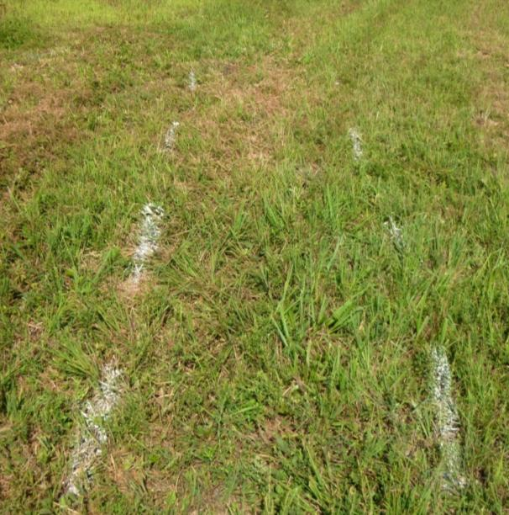
Safe Lane Marking (cont.)
Spray Paint
Flour
Notes:
Instructor/Facilitator’s (I/F) Note
Same marking system used but the spray paint is more of a permanent feature.
Flour will dissipate with moisture and is easily destroyed. Possible IEDs should be marked with mine marking cones or red markers 1m from the device on a safe path.
Alternatively spray paint markers approximately 1m back from possible IED.
Straight line marking limit of advance followed by arrow pointed at area of the device.
The safety lane should be marked back to the ICP, marked on both sides and approx 1‐2 m wide.

Slide 13
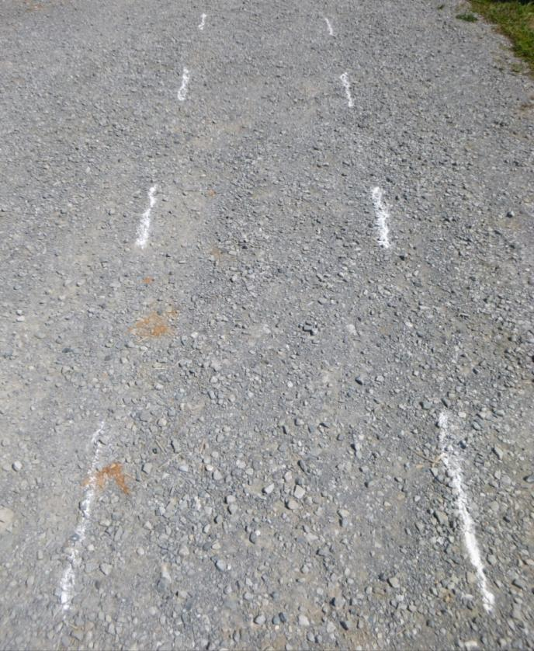
Safe Lane Marking (cont.)
Make the path wide enough so personnel or vehicles can clearly see a safe route
When marking a lane it is essential that you take into account the agencies that need to work in that area and the equipment the patrol must carry
Its important to remember that the lane is wide enough for a Soldier to go down on one knee to take up a firing position
Notes:
Instructor/Facilitator’s (I/F) Note
Reinforce the two below.
When marking a lane it is essential that you take into account the agencies that need to work in that area and the equipment the patrol have to carry.
Its important to remember that the lane is wide enough for a Soldier to go down on one knee to take up a firing position

Slide 14
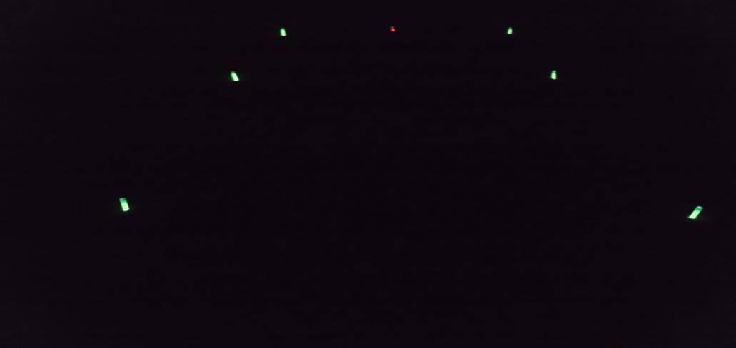
Safe Lane Marking at Night
If marking is to be used at night, the lane must be indicated by a light and have a different color to indicate the IED
This picture shows a green safe path using light sticks and a red light stick indicating an IED
Notes:
Instructor/Facilitator’s (I/F) Note
If marking is to be used at night, the lane must be indicated by a light and have a different color to indicate the IED.
This picture shows a green safe path using light sticks and a red light stick indicating an IED

Slide 15
Check on Learning
__________ are where it is particularly advantageous for the enemy to position an IED.
Vulnerable Points
___________ are where pattern setting allows the insurgent to predict with a degree of certainly that troops will use them again.
Vulnerable Areas
VA/VP searches must be conducted under CREW coverage. True or False?
TRUE
Notes:
Instructor/Facilitator’s (I/F) Note
- Answer any questions that students may have.

Slide 16
Single File Formation
Conduct dismounted patrol formations search techniques
Secondary Search Area
Primary Search Area
Detector Sweep
Notes:
Instructor/Facilitator’s (I/F) Note
In areas where the ground forces the patrol into single file, it should first be considered if the patrol can avoid the area entirely or if VP 360 drills are possible.
Where not, the gap between MDs should be a maximum of three men.
It is recommended that the lead man marks the safe lane. In larger sections/multiples the spare MDs can be used to ensure coverage.

Slide 17
Large Formations
Secondary Search Area
Primary Search Area
Detector Sweep
Notes:
Instructor/Facilitator’s (I/F) Note
In a larger patrol where more than one section/multiple is on the ground, each team should deploy MDs.
This raises assurance and gives the Commander options for mutual support and depth

Slide 18
Actions Required Before VP 360
Stop short of VP/VA (50m min)
5/25/200 meter checks
Ensure security is established
Form up VP 360 team
Turn on THOR III (SOP)
Conduct VP 360 search starting on the “High Threat” side first
Front man searches safe route using MD/GPR and mark accordingly including turns
Second man carries command wire detector
Rear man picks up or destroys markers (when required)
Notes:
Instructor/Facilitator’s (I/F) Note
1. States the steps listed above on slide and answer any questions if needed pertaining to them.

Slide 19
VP 360
THOR III based on theater threat
Secondary Search Area
Primary Search Area
Detector Sweep
MD/GPR detector man must start his search 10m from the CW detector man to allow standoff from IEDs when leaving the cleared 5 & 25m area
High Threat Side
High Band
Medium Band
Low Band
DSP-27
Cleared 5/25 m area
Clear Marking System
Notes:
Instructor/Facilitator’s (I/F) Note
1. Explain the locations and responsibilities of all members in the formation.

Slide 20
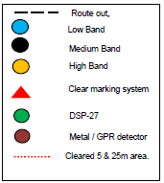
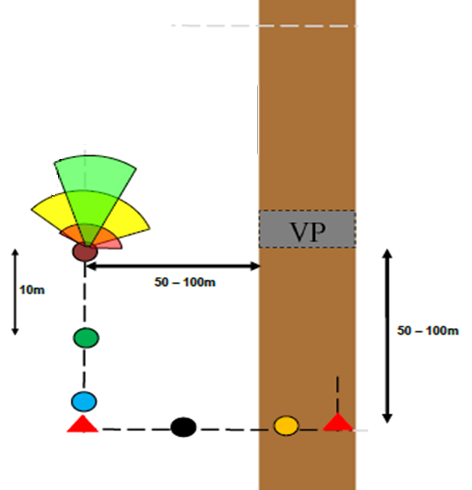
VP 360 (cont.)
Detector sweep and visual search for ground sign
High Threat Side
If IED is found,
conduct 5Cs
Front man marks searched route. Rear man removes / destroys marked lane
Secondary Search Area
Primary Search Area
Detector Sweep
Notes:
Instructor/Facilitator’s (I/F) Note
Explain the proper employment of the detectors in order to detect IEDs.
Ensure students understand the isolation is conducted 50‐100 meters from the VP and that observation into the VP as the searchers pass.
Ensure to talk about the need to use optics to OBSERVE the inside of the culvert as the VP360 team moves along.
INSTRUCTOR MUST EXPLAIN –
If an IED is found during a VP 360 it should be reported, however, the team should continue to remain focused on mitigating the command wire threat. That IS the purpose of the VP 360!

Slide 21
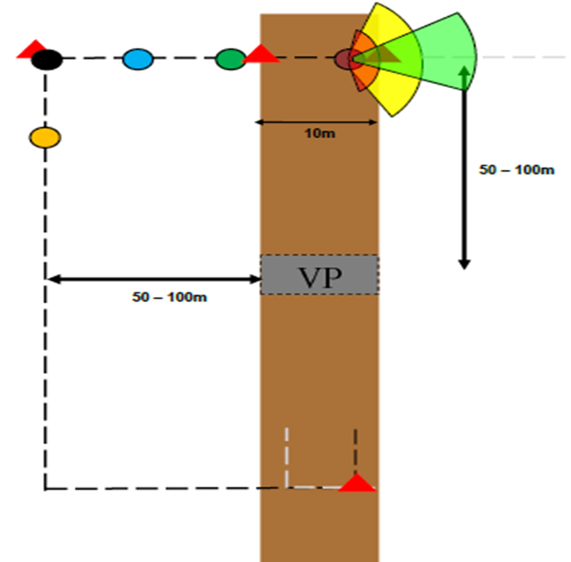
VP 360 (cont.)
High Threat Side
Secondary Search Area
Primary Search Area
Detector Sweep
Notes:
Instructor/Facilitator’s (I/F) Note
1. Discuss marking of the crossing point as it relates to the 4 or 2 man drill.

Slide 22
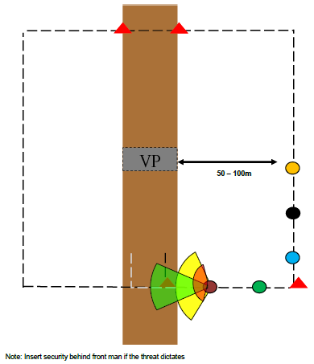
VP 360 (cont.)
High Threat Side
Secondary Search Area
Primary Search Area
Detector Sweep
Notes:
Instructor/Facilitator’s (I/F) Note
Ensure the element returns to its starting point to ensure the isolation is complete.
2. Again: use OPTICS to observe the inside of the culvert as the VP360 team moves past.

Slide 23
VP 360 Route Selection
Adjust Route to
Threat & Terrain
VP
Ground sign or metal reading.
Mark and avoid
High Threat Side
Overlap
Notes:
Instructor/Facilitator’s (I/F) Note
Vulnerable Point 360
Visual search for evidence of buried devices or CW.
Detector sweep and visual search for evidence of buried devices or CW. Lead men are staggered to allow for overlap
Front Soldier places marker, rear Soldier picks up to ensure full isolation.
Marker
Where Intel or history suggests CWIED/CPIED push out towards 100m to reduce the effects of a blast on the VP 360 party. Distances should be varied to reduce the risk of VOIED targeting by pattern setting at the stop short point and on the VP 360. CREW is to be carried, CREW configuration may vary No CREW is to be within 10m of the detector.

Slide 24
VP Search – 4 Man Procedure
Visual search of the route out to 5m in front, looking for ground signs relating to all types of IEDs
Visual search for ground sign, markers, command wires, and RC antenna’s
Lead Detector
ACTIONS ON POSSIBLE IED
STOP All forward movement
Conduct 5Cs
Request EOD Support
Lead Detector
5m
Metal detector/GPR sweep to detect VOIEDs, battery pack, mines, and military ordinance main charges. Detectors must overlap
10m
Road Detector
Secondary Search Area
Primary Search Area
10m
Detector Sweep
Personnel carrying ECM MUST stay within the searched area that is clearly marked by the Lead man
Road Detector
THOR III
(As per theater threat)
Direction of travel
Low Band
10m
Medium Band
High Band
Notes:
Instructor/Facilitator’s (I/F) Note
1. Explain formations proper spacing between HHDs for interoperability and lane coverage procedures.

Slide 25
Lane Coverage
5 m
10 m
Secondary Search Area
Primary Search Area
Detector Sweep
10 m
Notes:
Instructor/Facilitator’s (I/F) Note
1. Emphasis overlapping coverage and control by the element leader.

Slide 26
VP Search – 2 Man Procedure
ACTIONS ON POSSIBLE IED
STOP All forward movement
Conduct 5Cs
Request EOD Support
Road Man
10m
Road Man
THOR III (As per Theater threat)
Low Band
10m
Medium Band
High Band
.
Direction of travel
Personnel carrying ECM MUST stay within the searched area that is clearly marked by the road men
Notes:
Instructor/Facilitator’s (I/F) Note
The 2‐man drill is required.
The spacing and search responsibilities remain the same.
.

Slide 27
V - Sweep
VULNERABLE AREA
Flank Searchers
Visual search for CWIED, culverts, and flush out any trigger man
Sweep Team
Proper dispersion maintained at all times
Flanker dispersion terrain dependent
If NO metal/GPR detectors present, flank searchers can still clear culverts/danger areas with optics
IED Defeat Dogs incorporated into sweep team
10M Spacing is vital, don’t let it reduce
TTPs vary from route to route and is based upon enemy TTP
Ensure flank searchers are provided security from crew served weapons or additional dismounts
Changes to this TTP will always be situational dependent
Notes:
Instructor/Facilitator’s (I/F) Note
DISMOUNTED TECHNIQUES.
There are numerous methods for conducting dismounted clearing of danger areas. Each technique should be selected based on terrain, personnel, and equipment available. The recommended technique for clearing most danger areas is the “V‐Sweep”. These techniques can also be modified to fit the situation, terrain, equipment, or number of personnel available.
V‐Sweep:The V‐Sweep is the currently recommended technique for dismounted investigation of danger areas. It is used at potential danger areas or likely IED emplacement locations in order to flush out trigger‐men or identify indicators before the main body of the patrol enters the effective casualty radius of an IED. This technique can also be used as a reactive measure to search for secondary/tertiary IEDs after an IED detonation.\
Advantages
Since IED indicators can be very subtle, an observer may, unintentionally, be within the effective casualty radius of an IED before detecting its presence.
The “V” formation denies the enemy a target while providing maximum stand‐off and protection while sweeping danger areas.
Dismounts can now be covered at all times by vehicle mounted (crew served) weapons.
The majority of dismounted personnel stay inside the protective coverage of the Electronic Countermeasures (ECM) device. Personnel further away from vehicle mounted systems should employ THOR III to ensure proper coverage.
Even if the trigger man is not identified he might trigger‐identified, abandon his position if he does not think he can detonate the IED and still escape.
Techniques
V‐Formation assembled in front of the lead vehicle.
Personnel furthest from the main body should push out as far as is tactically feasible (recommend 200‐300 meters) and still have good line of sight/line of communication to other members of the patrol.
These individuals will be looking for IED indicators (colors, shapes, and markers) off the road as well as looking for the enemy.
They should also look toward the body of the patrol from time to time to see the terrain from the enemy’s vantage point and possibly see indicators or markers left by the enemy.
The exact distance from the lead vehicle/road will vary depending on terrain and visibility. However, the enemy will try to maximize stand‐off from the device and indicators may be present 200m or more away from the road.
Consider checking the opposite side of any terrain features encountered as well.
Personnel in the middle are looking for IED indicators along the shoulder of the road as well as looking on the road itself.
Personnel closest to/in the road should use a mine/metal detector to sweep for buried components and should be dispersed and staggered forward of the lead vehicle (approximately 50m dispersion).
Vehicles are lined up, ducks in a row, and follow in the lead vehicle’s tire tracks.
Personnel conducting the sweep should have (and employ) optics.

Slide 28
Choke Point - VOIED In Canal
If necessary, sweep from
Back to front and from outside
Inward at choke point.
Power
Source
Circumvent Danger Area
VOIED
Danger Area
Identified
DOT
Notes:
Instructor/Facilitator’s (I/F) Note
1. By approaching the VP from a direction other than the enemy anticipates you will increase your ability to identify IEDs with HHDs.

Slide 29
IED Marking
IEDs may be Marked in two ways:
Detailed marking
Used whenever possible to give both dismounted troops and follow on agencies a clearly marked approach into the area around the possible IED
Minimal marking
In extremes, where there is a shortage of marking material, the marker should be placed 1 meter back from the device
Notes:
Instructor/Facilitator’s (I/F) Note
Detailed Marking should be used whenever possible to give both ground troops and follow up agencies a detailed picture of the area around a possible IED. It should be marked as follows:
Possible IEDs should be marked with mine marking cones or red markers 1m back from the device on a safe path.
Alternatively spray‐paint mark approximately 1m back from possible IED. Straight‐line marking limit of advance followed by arrow pointing at area of device: The safe lane should be marked back to the Incident Command Post (ICP), marked on both sides and approximately 1‐ 2m wide.
Minimal Marking: In extremis, where there is a shortage of kit to mark a device, a marker must be placed 1m back from a device.

Slide 30
IED Marking (cont.)
Marking for IED
A 10 digit grid should be taken, this will help in future operations and assisting EOD
When marking an IED site, markers should be:
Semi-permanent/removable
Identifiable day and night
Lightweight and easily carried
Understood by locals
Notes:
Instructor/Facilitator’s (I/F) Note
Make the safe lane wide enough for patrol or agencies that will use the lane.
Ensure all personnel are aware of your marking SOP so personnel don’t step out of the searched area.
Keep changing your marking system so we don’t set patterns.
Conduct different marking systems on low threat areas so we create deception.

Slide 31
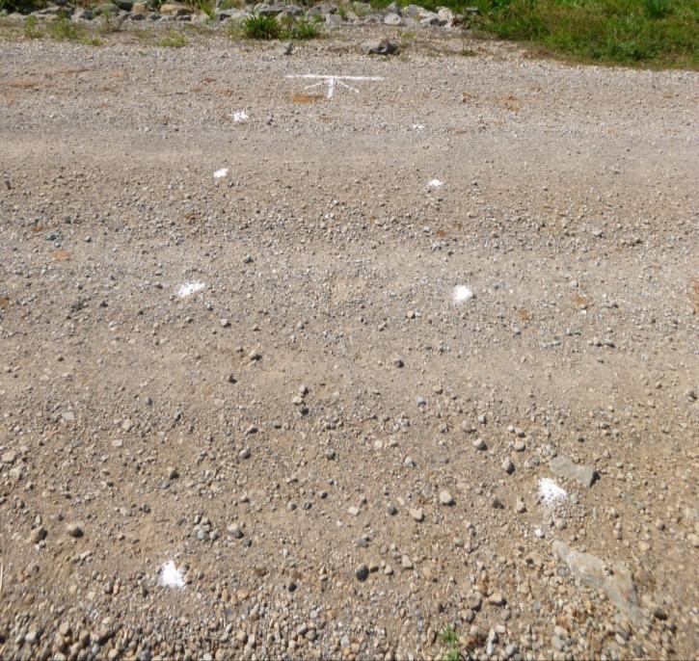
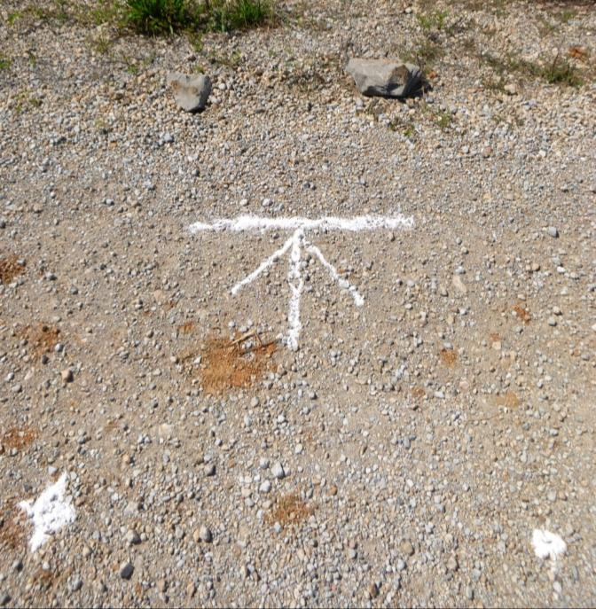
IED Marking (cont.)
The example above is using flour on a hard surface that is easily recognized. The line is placed 1m back with the arrow pointing at the IED. Ensure everyone in the patrol is aware of your marking SOP.
Notes:
Instructor/Facilitator’s (I/F) Note
This example is using flour on a hard surface that is easily recognized. The line is placed 1m back with the arrow pointing at the IED. Ensure everyone in the patrol is aware of your marking SOP.
White plastic markers
Spray paint, including Ultra Violet and Infra Red

Slide 32
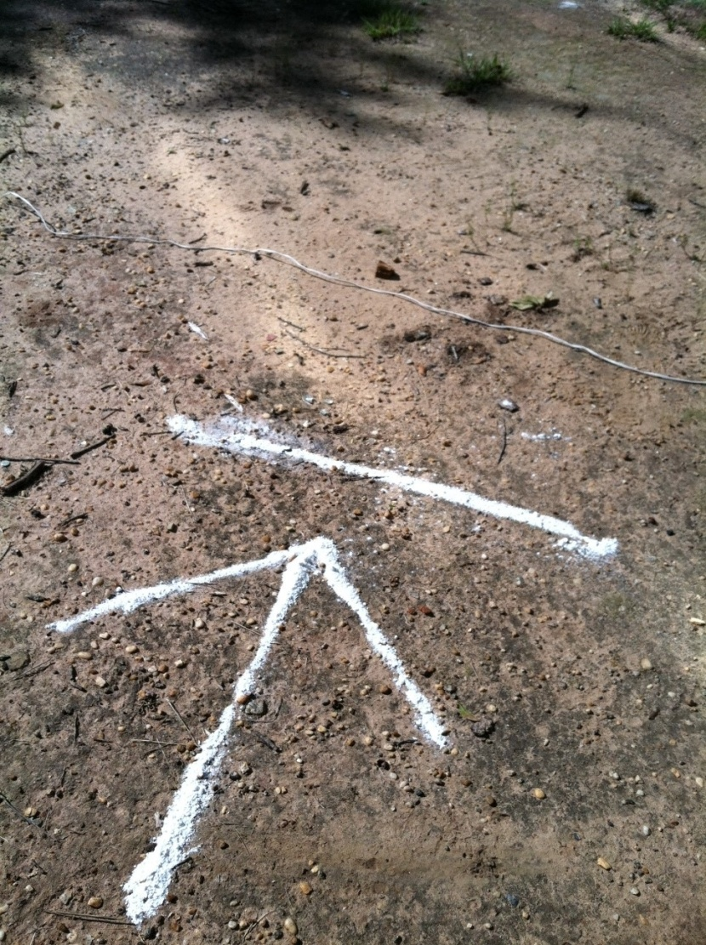
IED Marking (cont.)
Command wire
The line has been placed 1m back and parallel with the command wire. This will help EOD when they approach the target.
Notes:
Instructor/Facilitator’s (I/F) Note
Command Wire
The line has been placed 1m back and parallel with the command wire. This will help Explosive Ordnance Disposal (EOD) when they approach the target.

Slide 33
Additional Equipment
Consider additional equipment and batteries required for each VP and VA
Determine the amount of marking material required to execute a mission
Notes:
Instructor/Facilitator’s (I/F) Note
If additional equipment is carried on top of the basic Soldier load, leaders must plan for additional rest halts.
Ensure that you understand the capabilities and limitations of the additional equipment and any negative impacts from its employment.

Slide 34
Utilize HNSF in the Patrol
Notes:
Instructor/Facilitator’s (I/F) Note
1. Ensure that HNSF in your formation are aware of your SOPs and that if they participate in any clearing activities they are properly trained and vetted.

Slide 35
Local Nationals
Notes:
Instructor/Facilitator’s (I/F) Note
1. We can't force locals to clear any routes that we intend to take, however we can follow in their path if moving in the same direction.

Slide 36
Check on Learning
Name at least four actions required before conducting a VP 360.
Stop short of VP/VA
5/25/200 meter check
Form up VP 360 team
Turn on THOR III
Which dismounted searching technique is used to mitigate Command Wire IEDs (CWIEDs) near a VP?
VP 360 c. 2 man drill
V-Sweep d. All the above
a. VP 360 and b. V-Sweep
VA/VP starts on the low threat side. True or False?
FALSE
Notes:
Instructor/Facilitator’s (I/F) Note
- Answer any questions that students may have.

Slide 37
Summary
Lesson: Danger Areas (VA/VP) Search Techniques
We covered: Demonstrate patrol formations that mitigate the threats in Danger Areas (VP/VA) including:
Identify the fundamentals of danger Areas (VP/VA)
Dismounted operations
Search areas
Safe marking
Conduct dismounted patrol formations search techniques
Actions required before VP 360
VP search – 4 man procedure
VP search – 2 man procedure
V-sweep
Notes:
Instructor/Facilitator’s (I/F) Note
- I/F may ask a student to summarize the material that was covered in this lesson.

Slide 38
Questions
There is a Practical Exercise associated with this lesson
Notes:
Instructor/Facilitator’s (I/F) Note
Ask if anyone has any Questions.
The Practical exercise can be found in the course CD under Appendix C, of Danger Areas (Vulnerable Point/Vulnerable Area) Search Techniques lesson plan.
This PE can be conducted immediately after the formal portion of the class or can be combined with other lessons PE.

